Slide 1
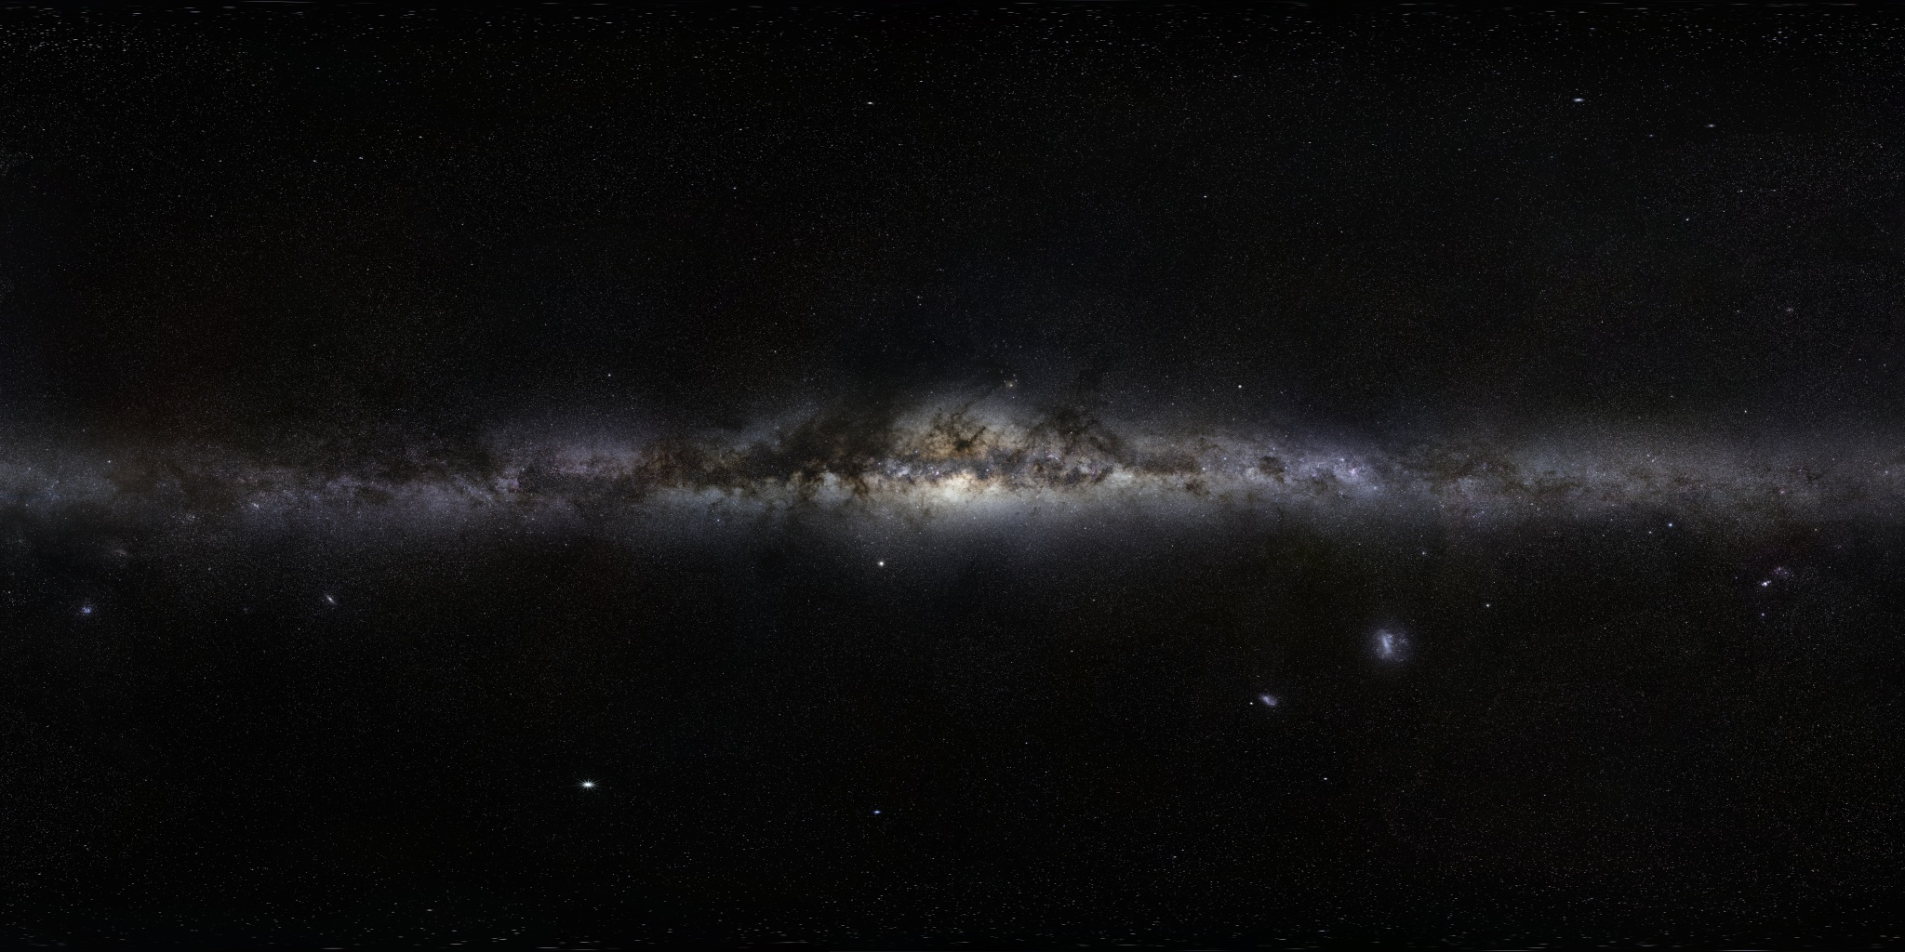
Stellar Birth
Video: https://youtu.be/lI57XIZ17hE

Slide 2
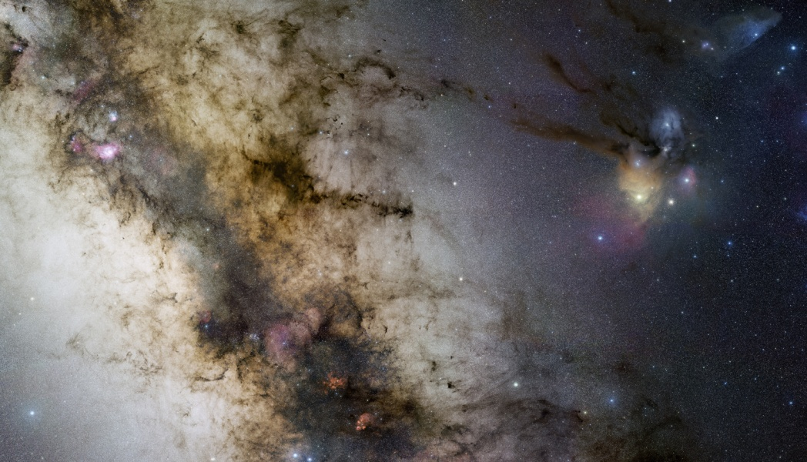

Slide 3
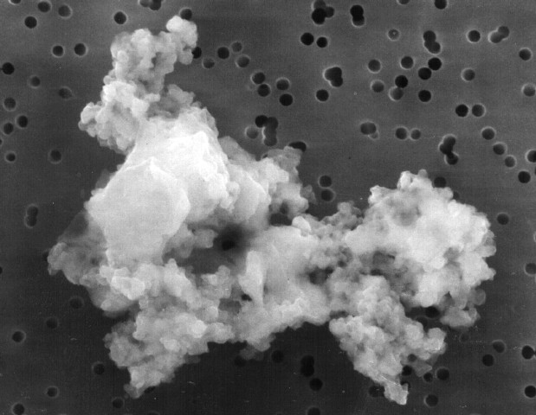

Slide 4
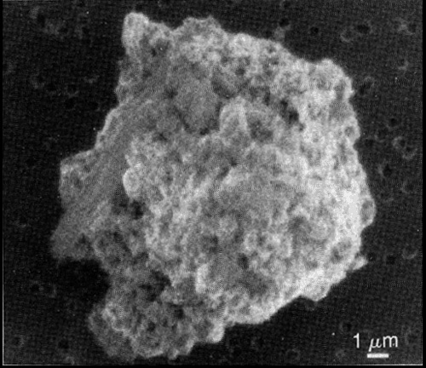

Slide 5
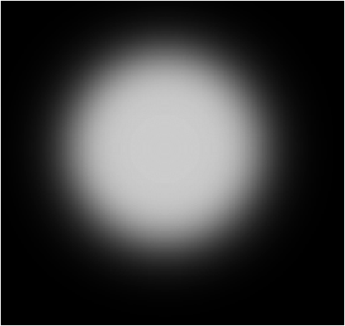
Clouds in space collapse because the force of gravity pulls inward..

Slide 6
Collapse causes the interior to heat up, and then light coming from the center pushes back on gravity

Slide 7
The light pressure pushing out will eventually balance perfectly with gravity pulling in.

Slide 8
When the center is so hot that H's fuse into He, a star is born .

Slide 9
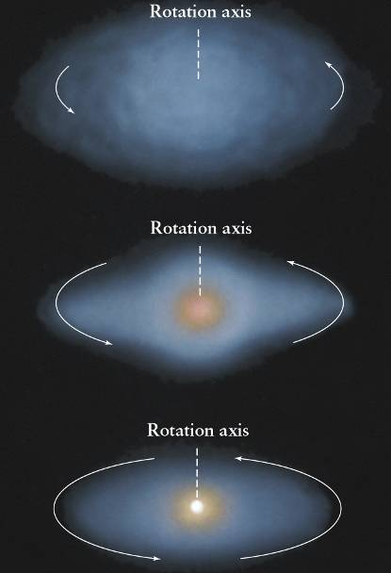
As a cloud collapses, it spins faster
and faster which flattens the gas and dust
into a disk around the star.

Slide 10
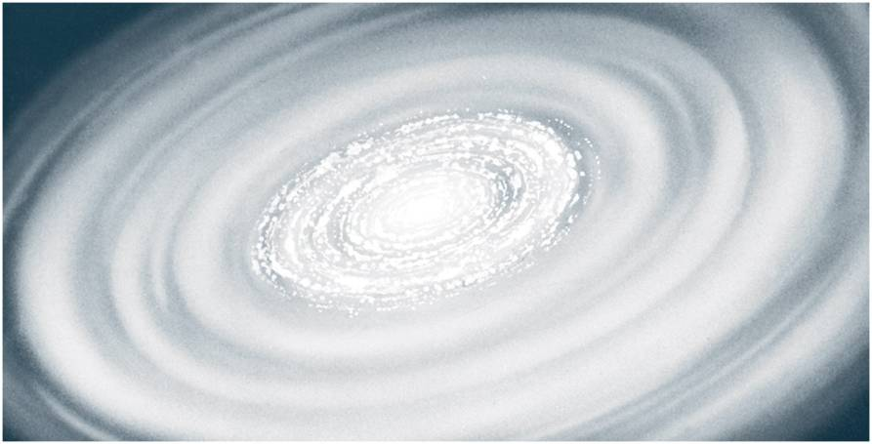
Particles of gas and dust stick together within the disk

Slide 11
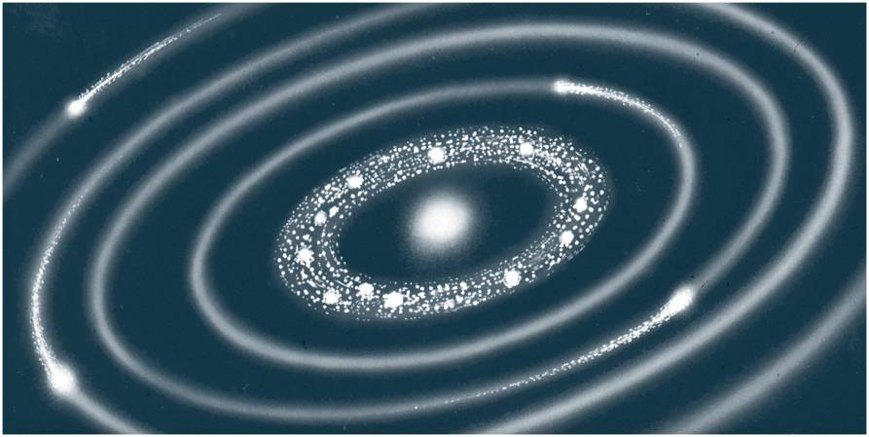
Dust and gas slam into each other and stick. We call this process accretion

Slide 12
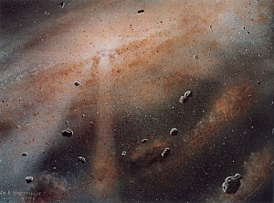

Slide 13
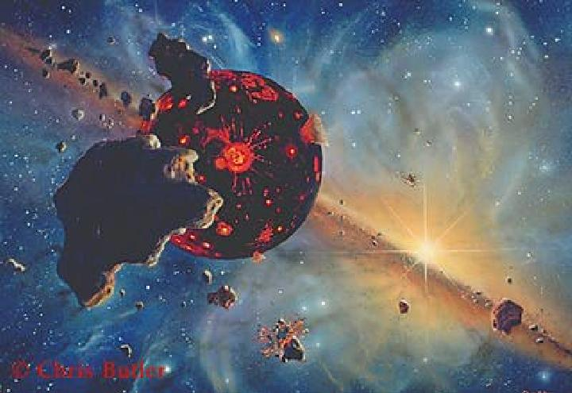
The Earth formed by accretion at the same time as newborn Sun
— about 4.6 billion yrs ago

Slide 14
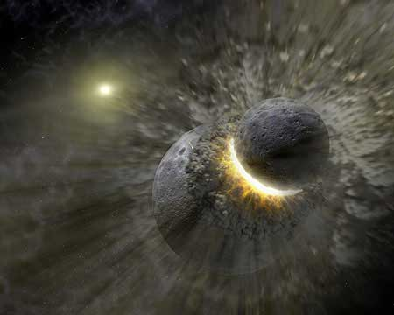
About 150 planets formed, but most were not in stable orbits and duked it out over the first billion years or so.

Slide 15
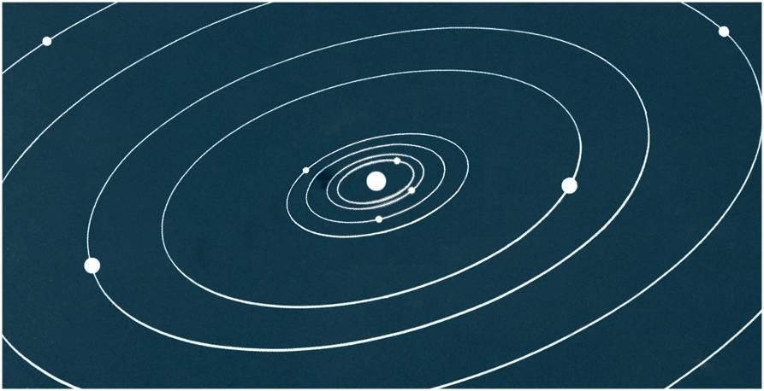
After about 1 billion years, most of the gas and dust was incorporated into the 9 surviving planets, plus a bunch of planetary debris (the asteroid belt)

Slide 16
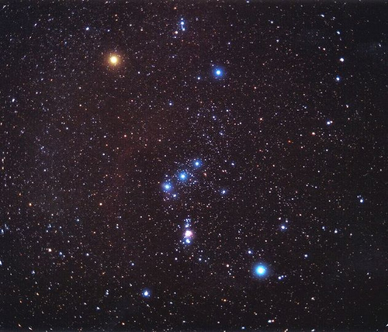
Orion Constellation

Slide 17
Orion’s Belt

Slide 18
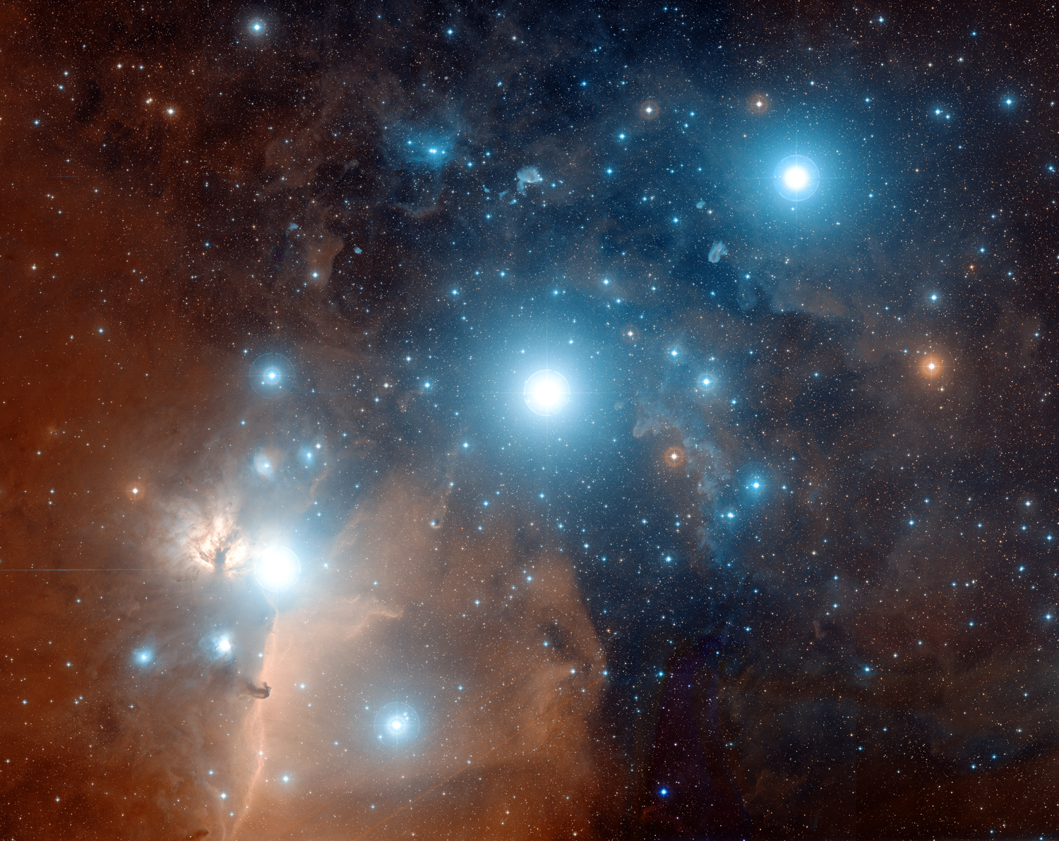
1,500 l-yr from earth — the belt of Orion
Notes:
Alnitak, Alnilam, Mintaka
Credit: Digitized Sky Survey, ESA/ESO/NASA FITS Liberator
Color Composite: Davide De Martin (Skyfactory)
Explanation: Alnitak, Alnilam, and Mintaka, are the bright bluish stars from east to west (left to right) along the diagonal in this gorgeous cosmic vista. Otherwise known as the Belt of Orion, these three blue supergiant stars are hotter and much more massive than the Sun. They lie about 1,500 light-years away, born of Orion's well-studied interstellar clouds. In fact, clouds of gas and dust adrift in this region have intriguing and some surprisingly familiar shapes, including the dark Horsehead Nebula and Flame Nebula near Alnitak at the lower left. The famous Orion Nebula itself lies off the bottom of this star field that covers an impressive 4.4x3.5 degrees on the sky. The color picture was composited from digitized black and white photographic plates recorded through red and blue astronomical filters, with a computer synthesized green channel. The plates were taken using the Samuel Oschin Telescope, a wide-field survey instrument at Palomar Observatory, between 1987 and 1991.

Slide 20
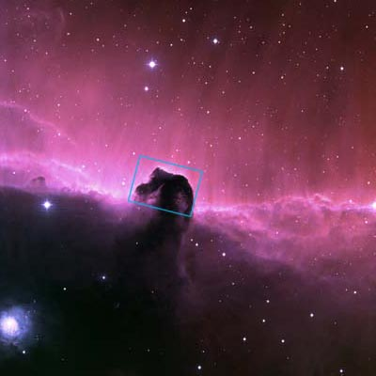

Slide 21
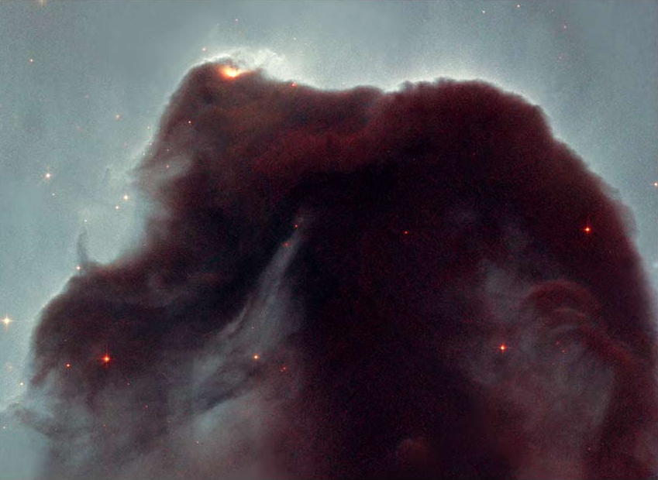

Slide 22
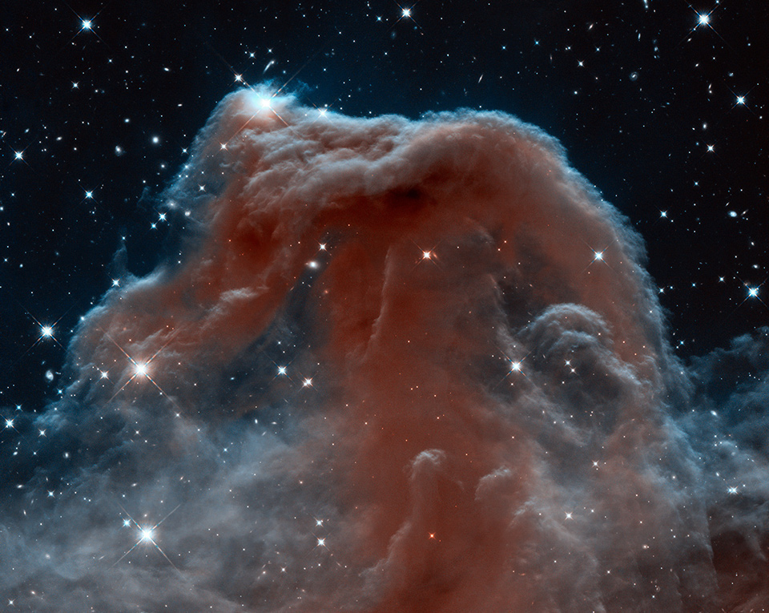

Slide 23
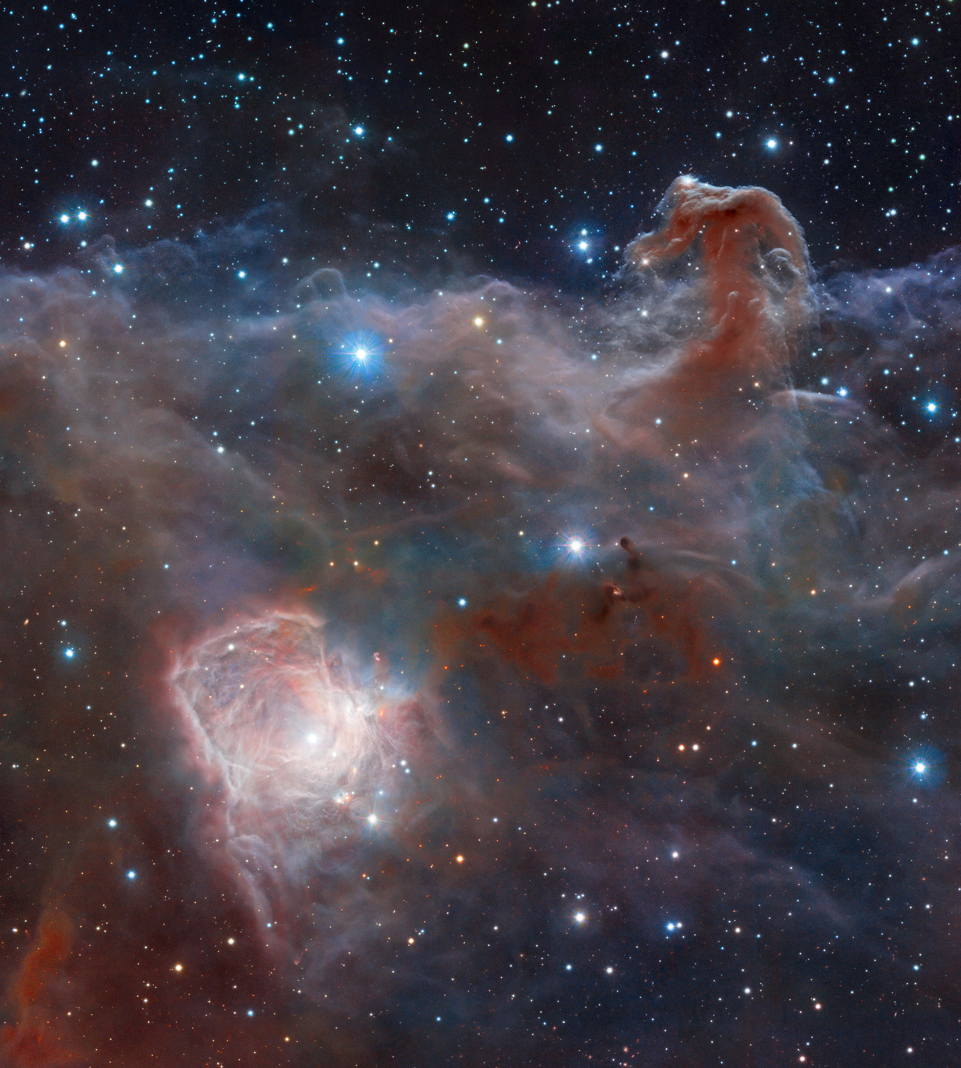

Slide 24
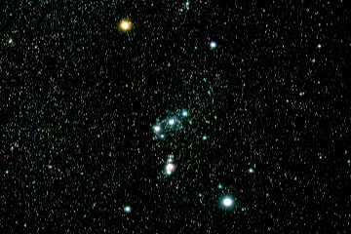

Slide 25
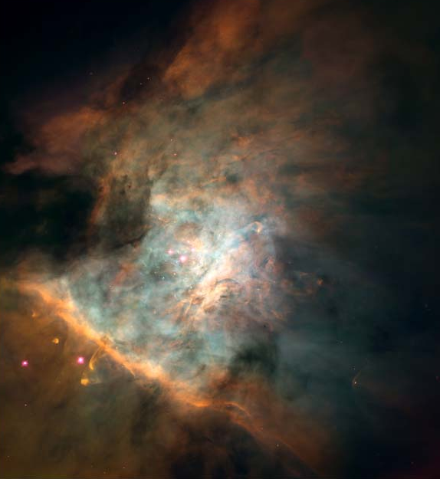

Slide 26
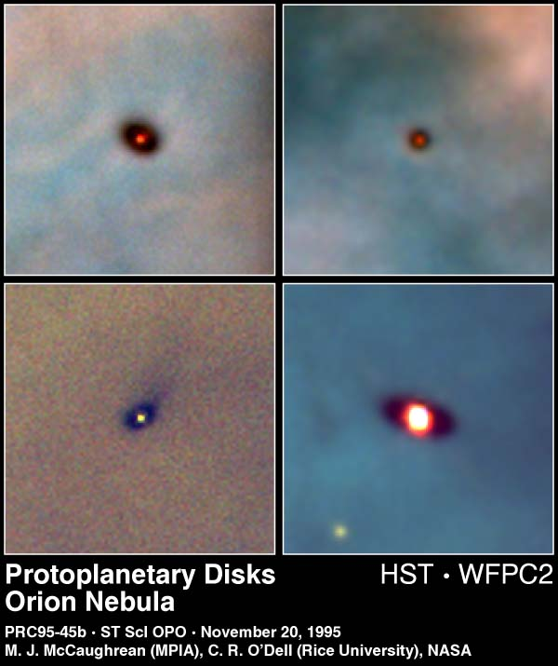

Slide 27
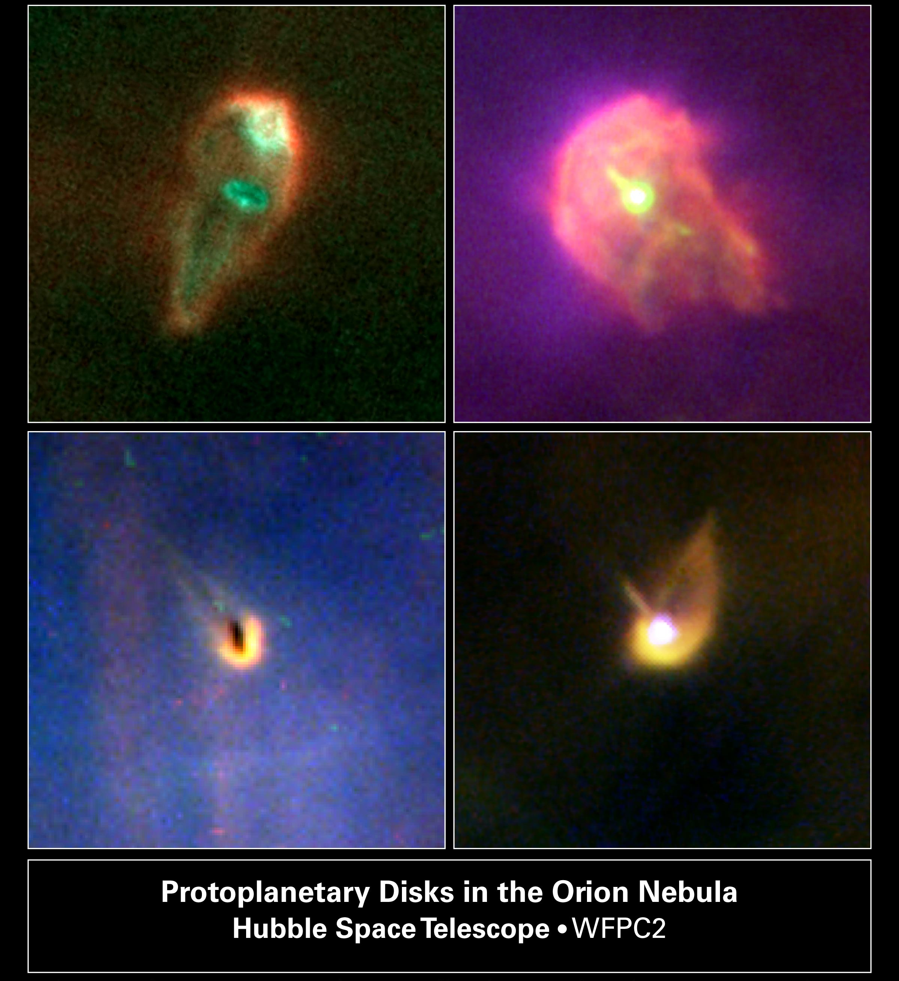

Slide 28
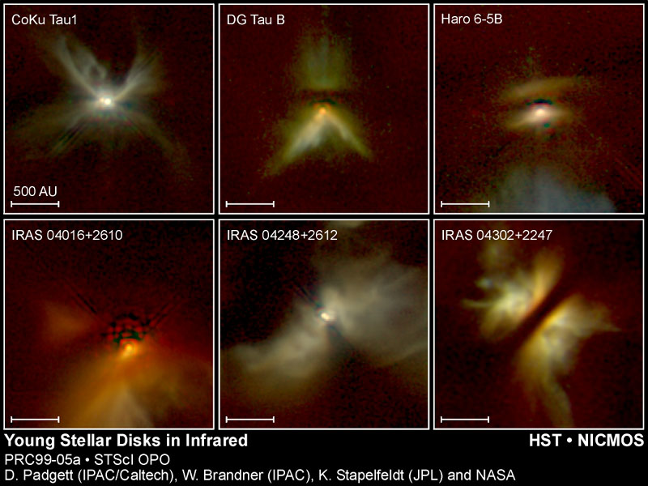

Slide 29
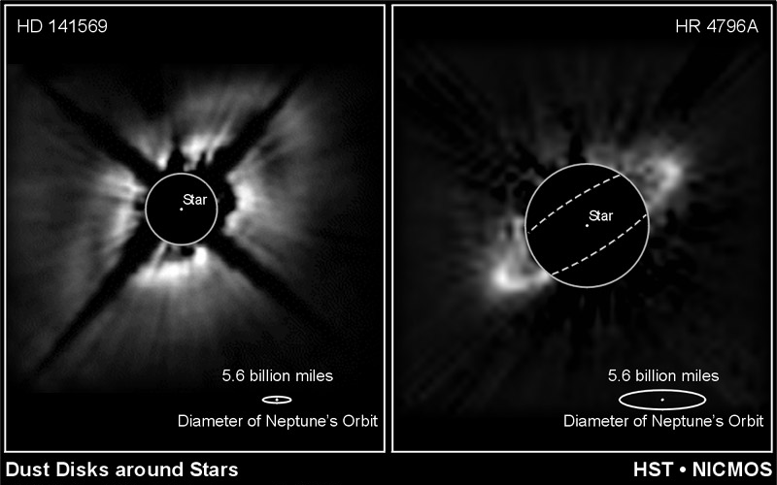

Slide 30
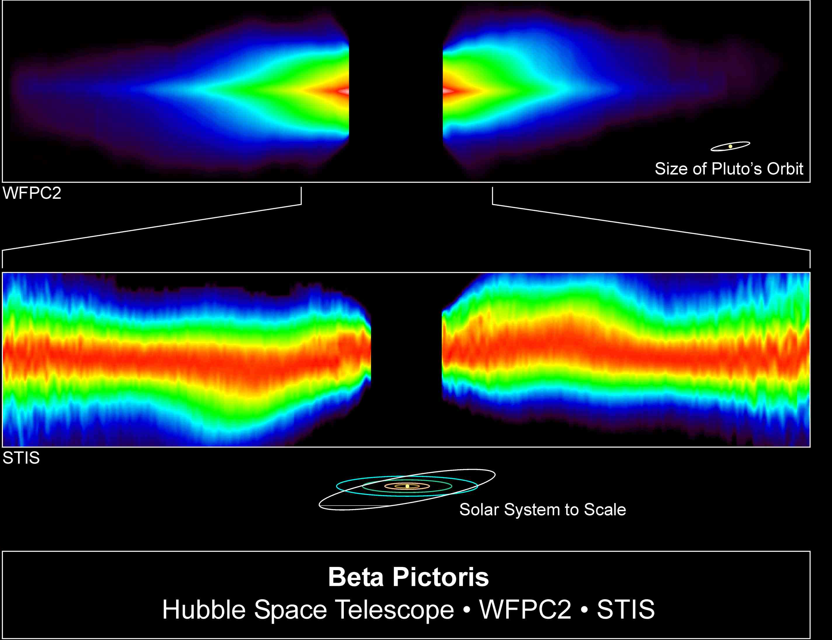

Slide 31
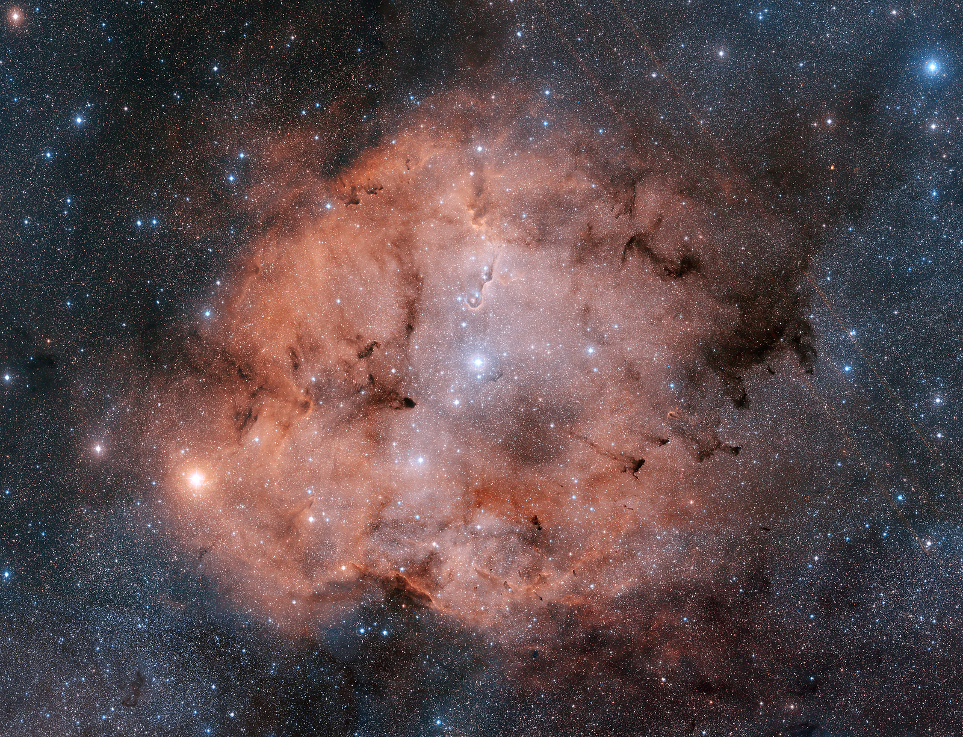
star formation region in constellation Cepheus
3,000 l-yr from earth and hundreds of l-yrs across
Notes:
IC 1396 in Cepheus
Credit: Digitized Sky Survey, ESA/ESO/NASA FITS Liberator
Color Composite: Davide De Martin (Skyfactory),
Explanation: Stunning emission nebula IC 1396 mixes glowing cosmic gas and dark dust clouds in the high and far off constellation of Cepheus. As pictured here, the star forming region sprawls across hundreds of light-years -- spanning over three degrees on the sky while nearly 3,000 light-years from planet Earth. Among the intriguing dark shapes within IC 1396, the winding Elephant's Trunk nebula lies just below center. The gorgeous color view is a composition of digitized black and white photographic plates recorded through red and blue astronomical filters. The plates were taken using the Samuel Oschin Telescope, a wide-field survey instrument at Palomar Observatory, between 1989 and 1993.

Slide 32
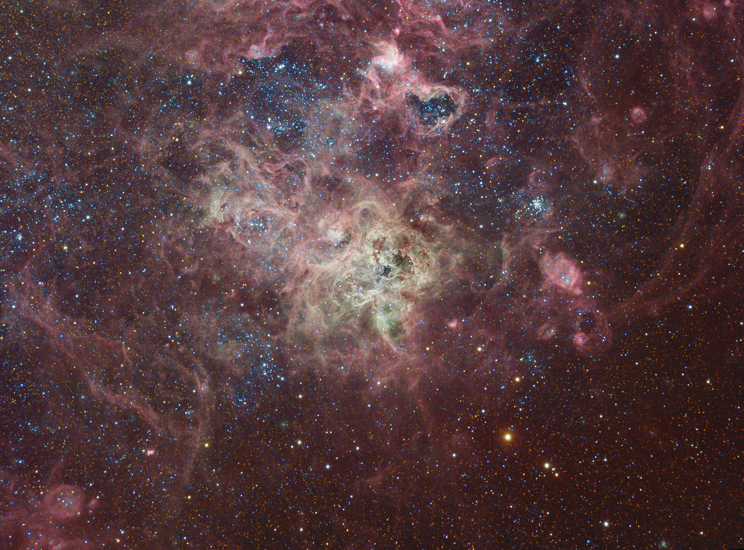

Slide 33
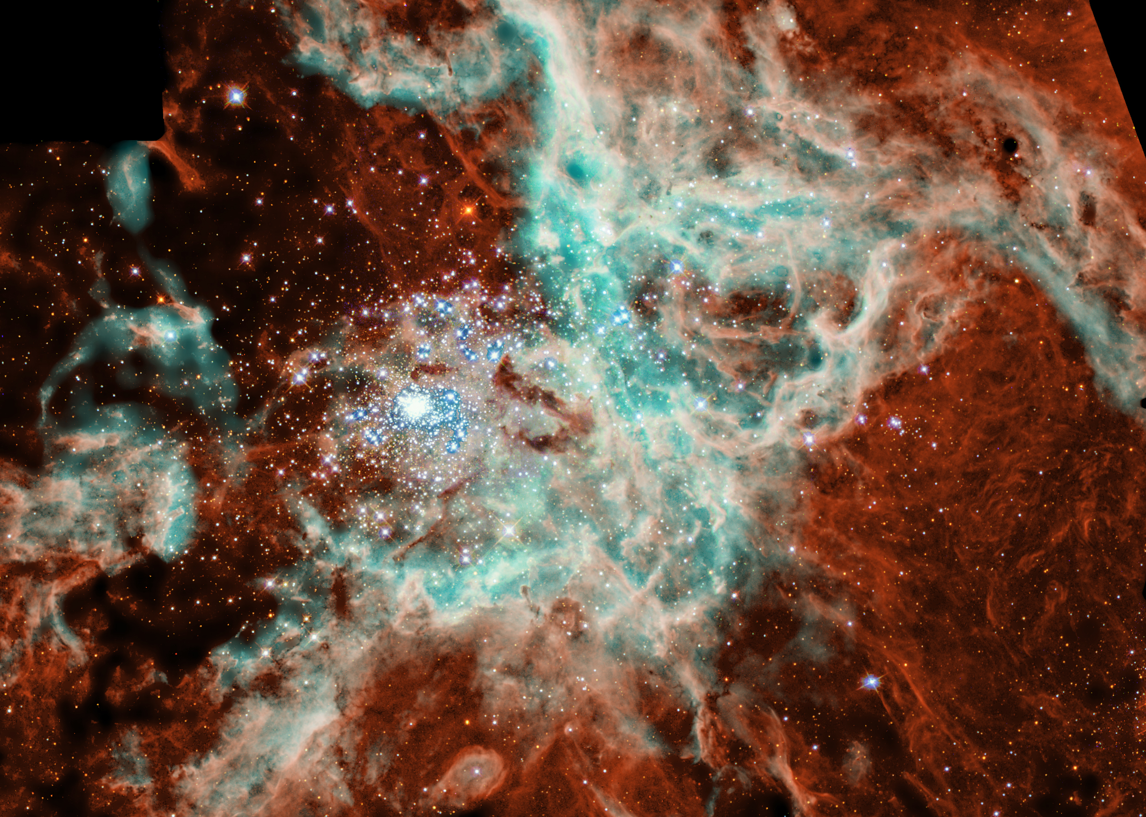

Slide 35
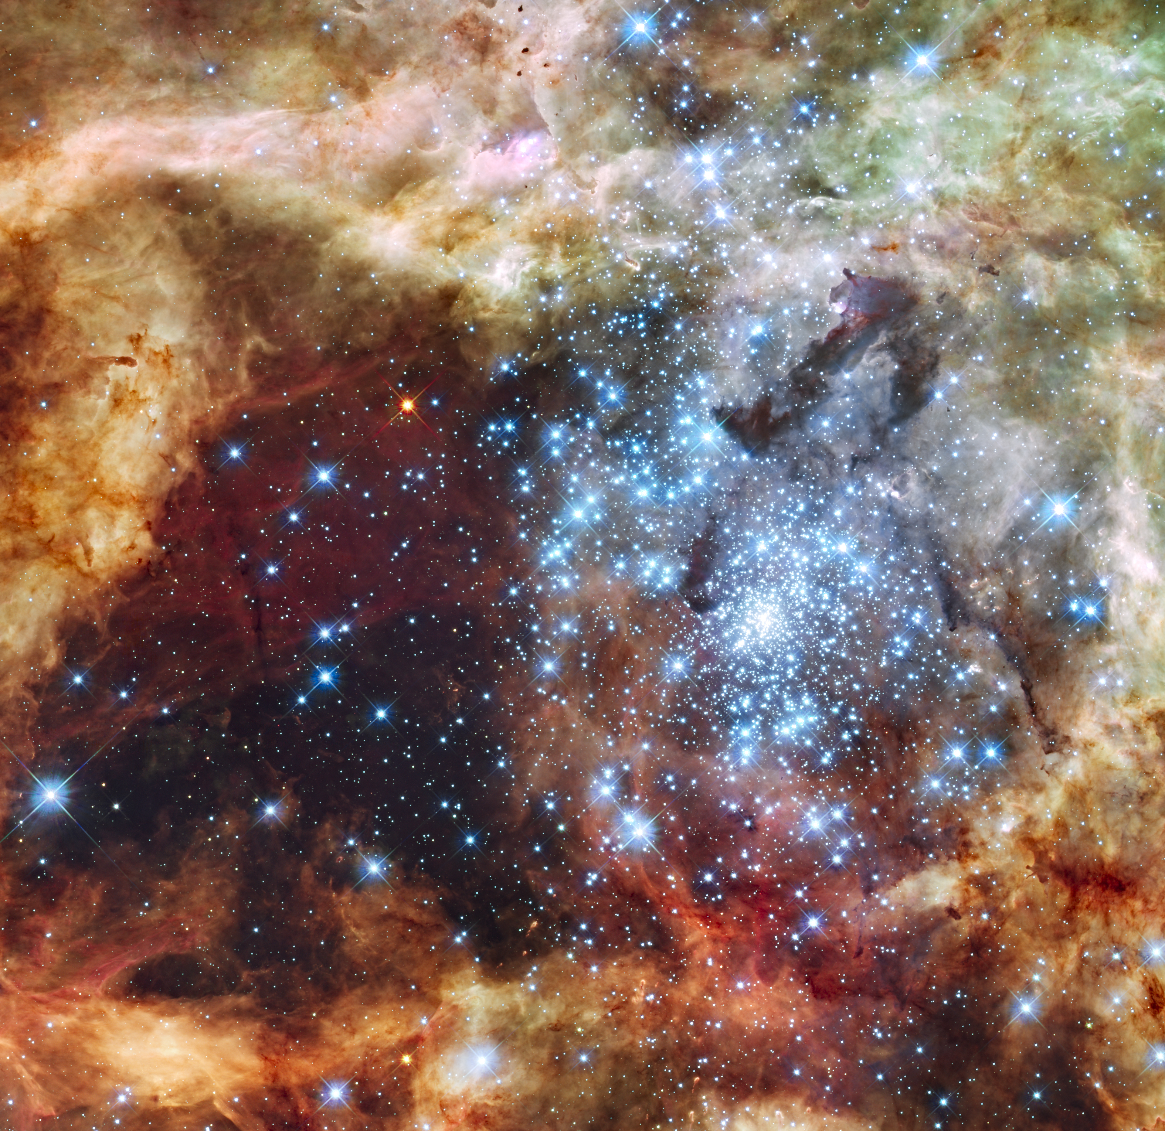
Notes:
30 doradus hst

Slide 36
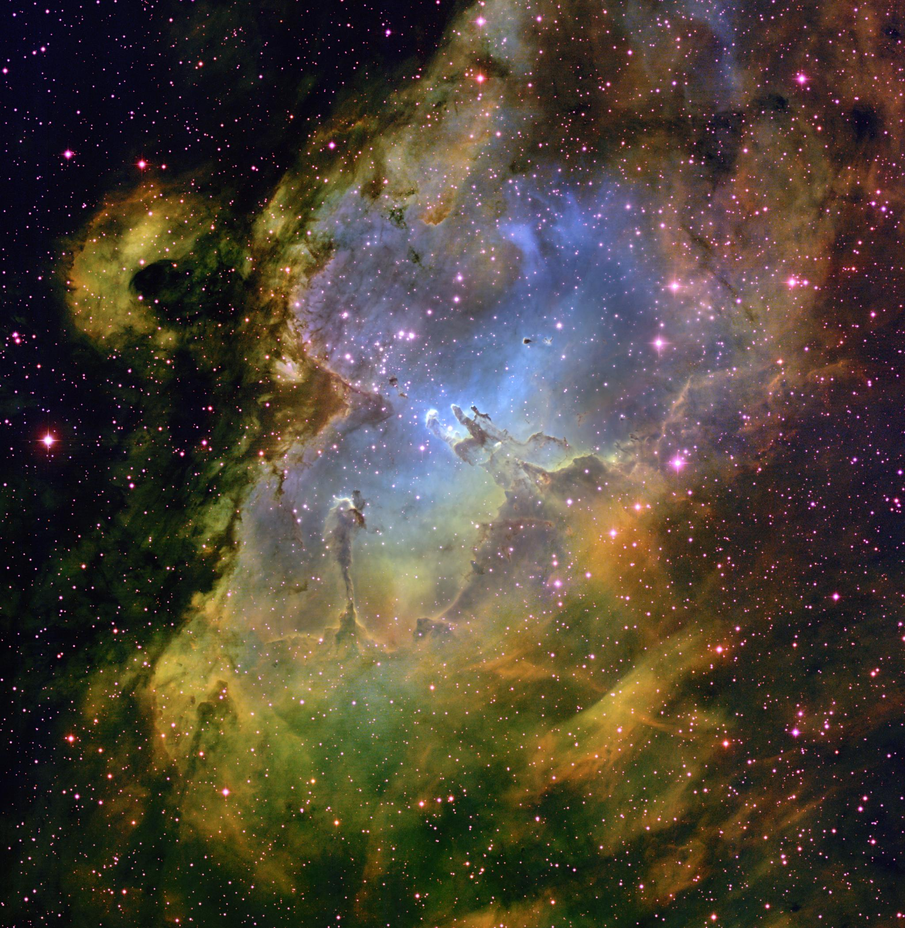

Slide 40
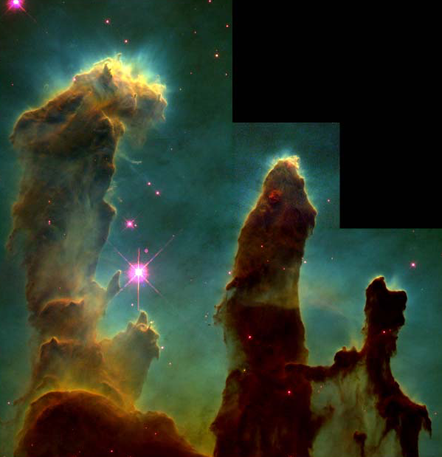

Slide 41
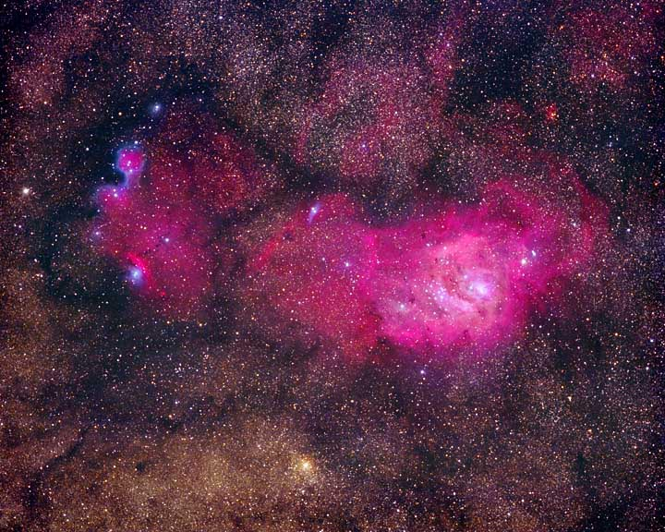
Notes:
m8

Slide 42
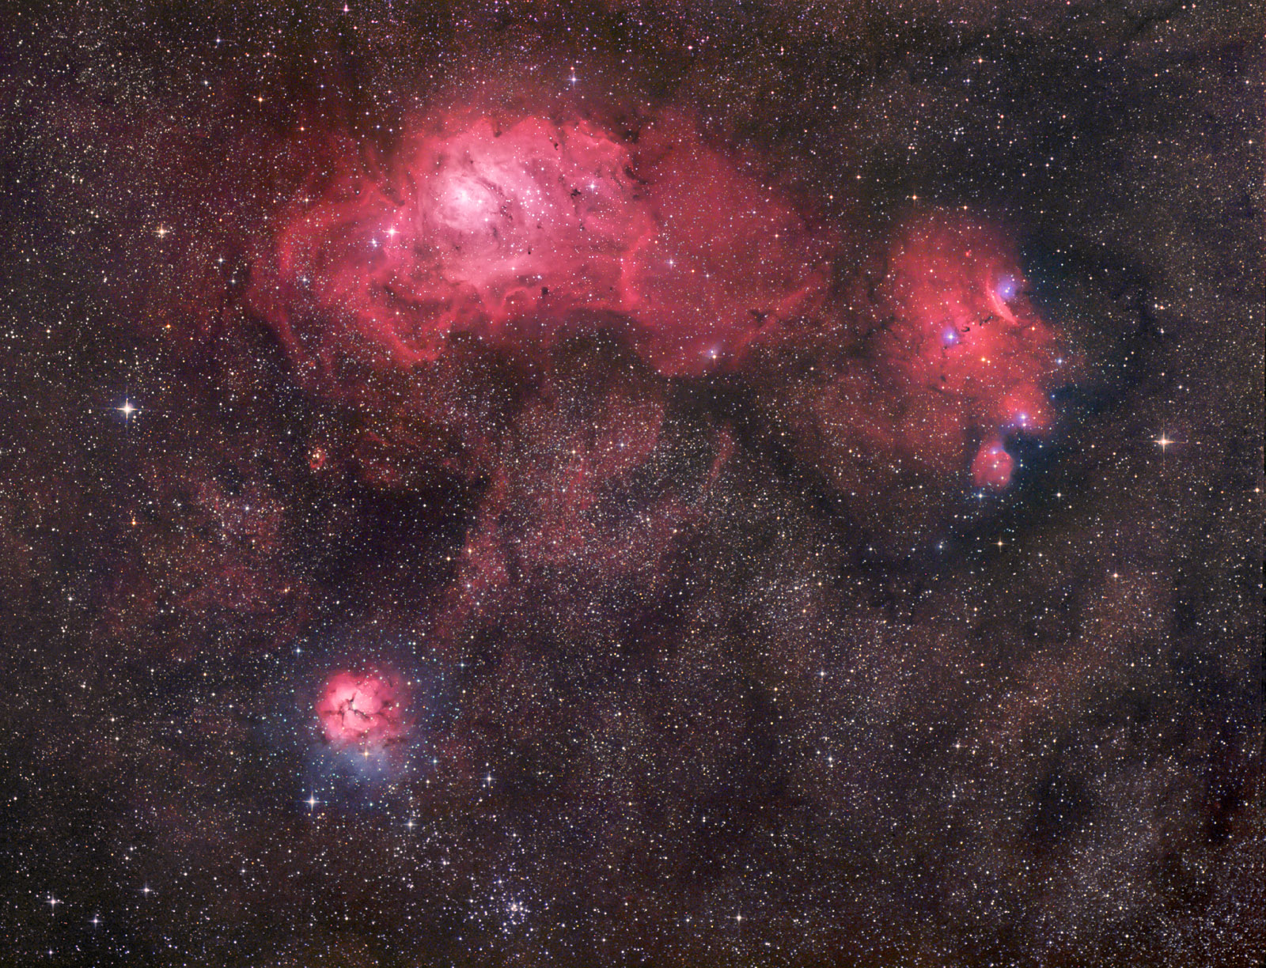
Notes:
Sagittarius Triplet
Credit & Copyright: Robert Gendler
Explanation: These three bright nebulae are often featured in telescopic tours of the constellation Sagittarius and the view toward the center of our Milky Way galaxy. In fact, 18th century cosmic tourist Charles Messier cataloged two of them; M8, the nebula above and left of center, and colorful M20 at the lower left. The third, NGC 6559, is at the right of M8, separated from the the larger nebula by a dark dust lane. All three are stellar nurseries about five thousand light-years or so distant. The expansive M8, over a hundred light-years across, is also known as the Lagoon Nebula while M20's popular moniker is the Trifid. In this gorgeous digital composition, the dominant red color of the emission nebulae is due to glowing hydrogen gas energized by the radiation of hot, young stars. The contrasting blue hues, most striking in the Trifid as well as NGC 6559, are due to dust reflected starlight.

Slide 43
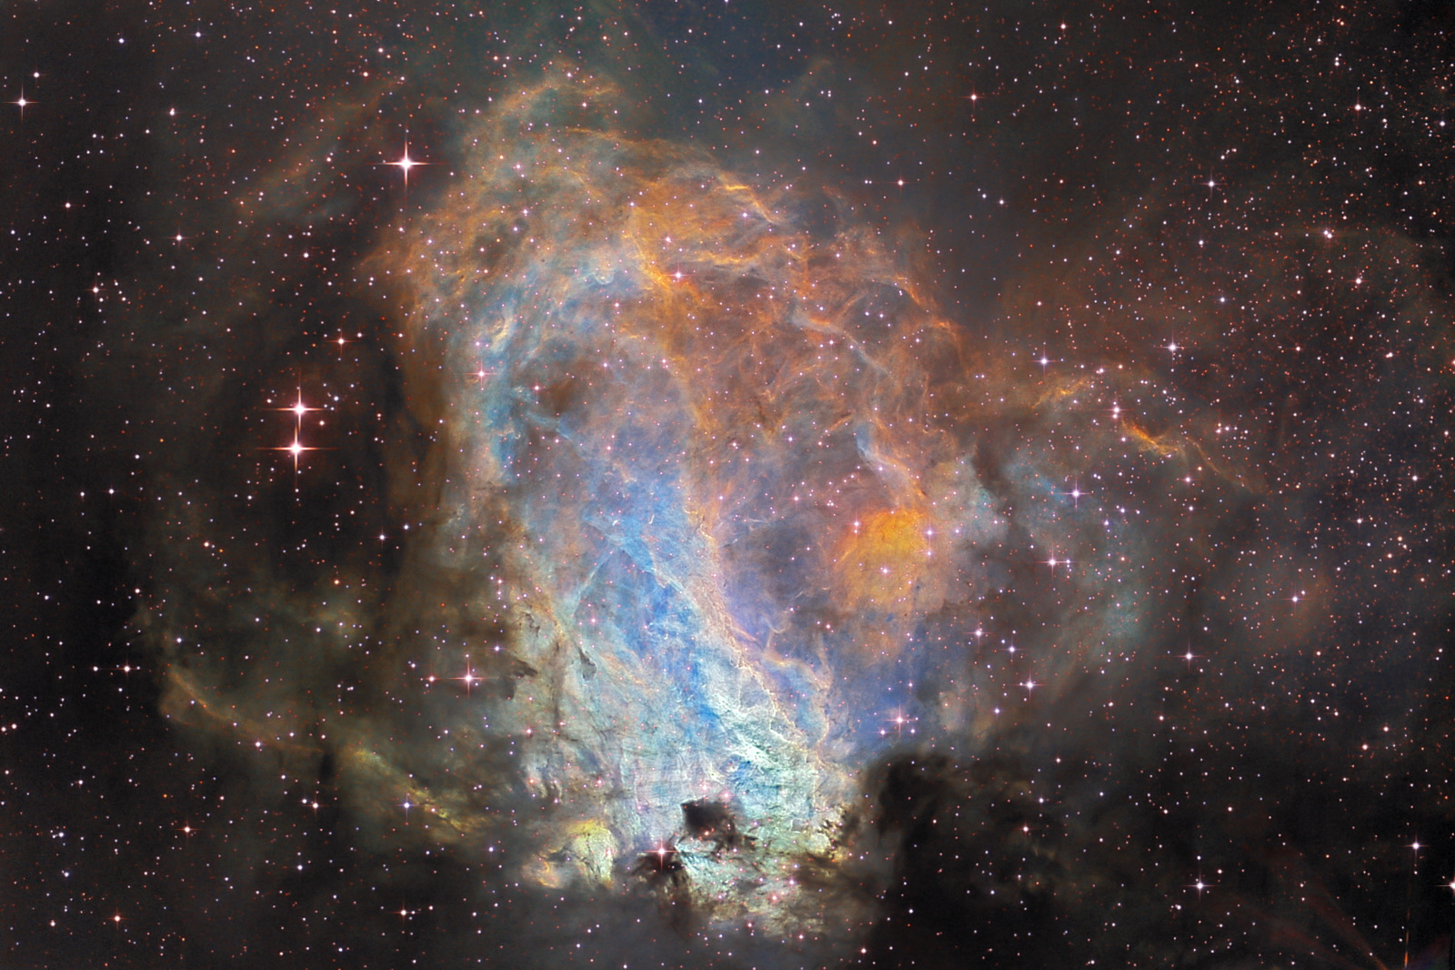

Slide 44
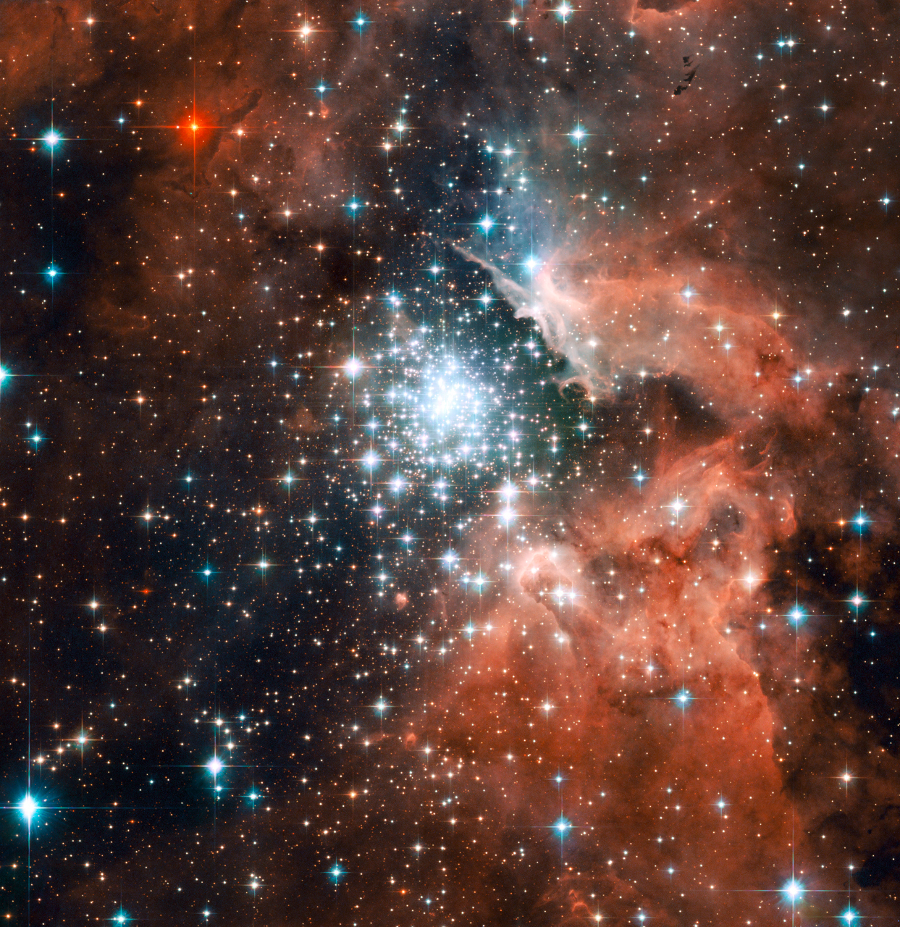
star formation region 20,000 l-yr from Earth
Notes:
ngc 3603 20,000 ly

Slide 45
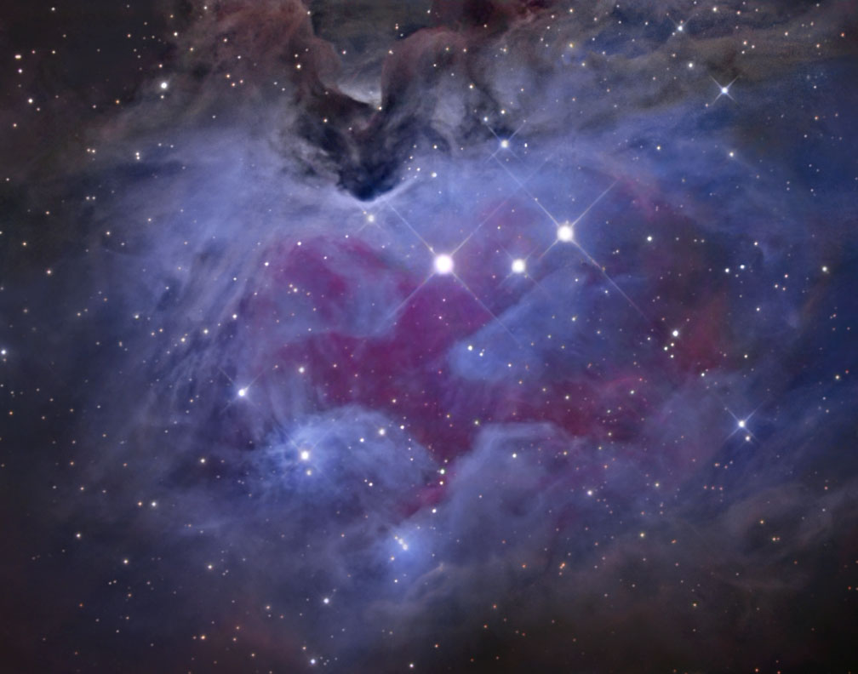
Notes:
ngc1975

Slide 46
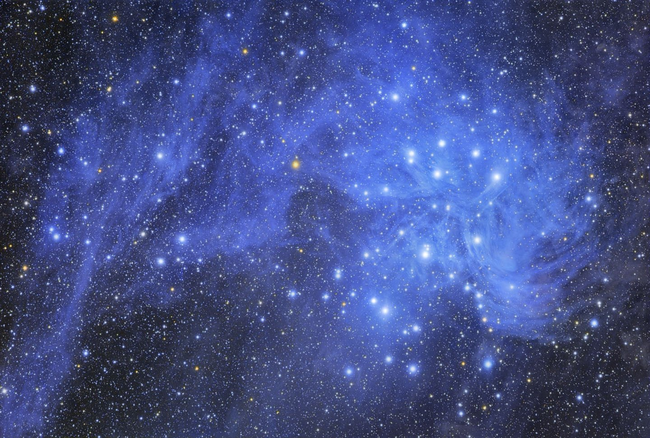

Slide 47
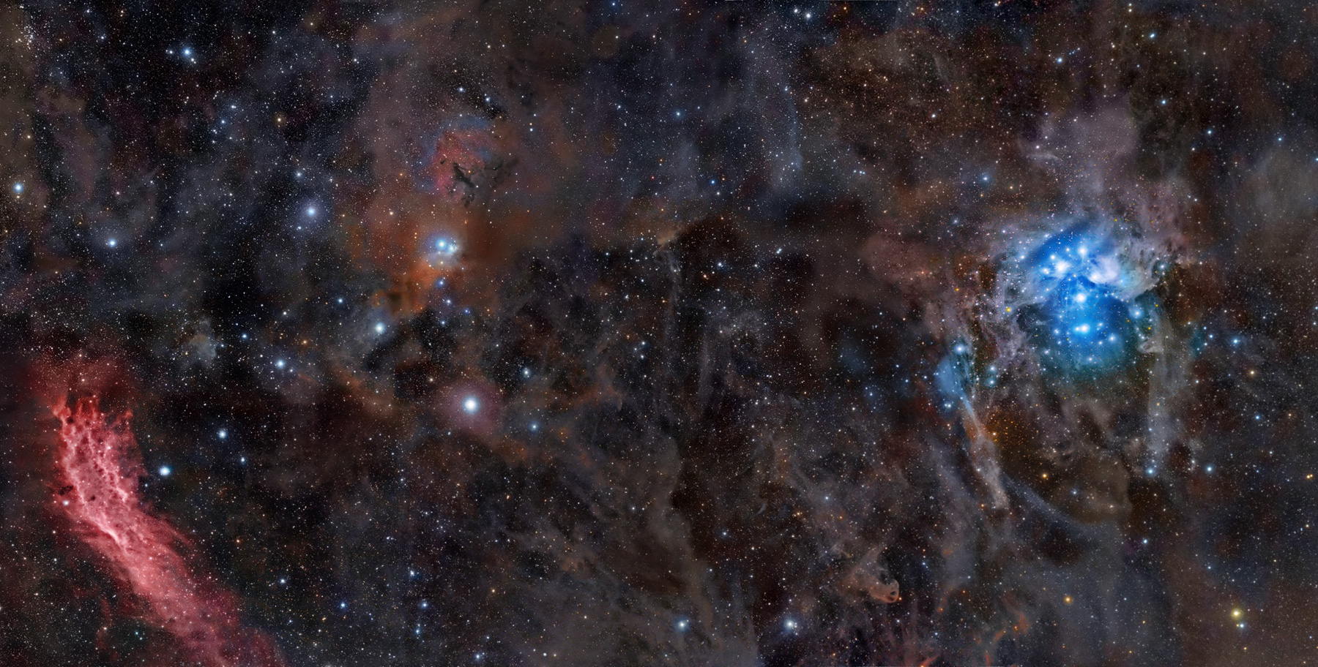
Notes:
pleaides

Slide 48
Notes:
pleaides

Slide 49
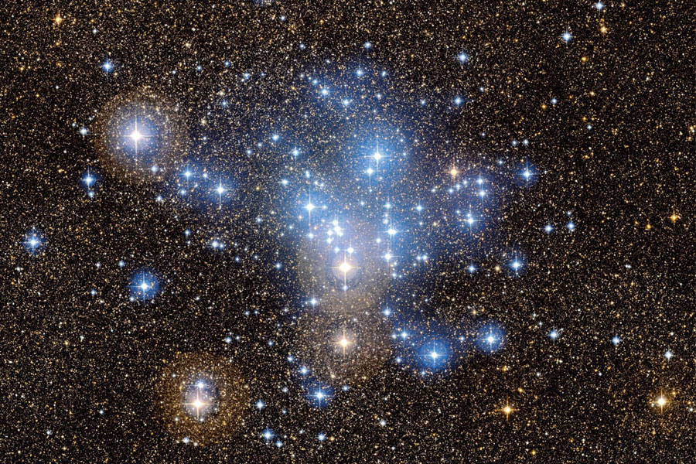

Slide 50
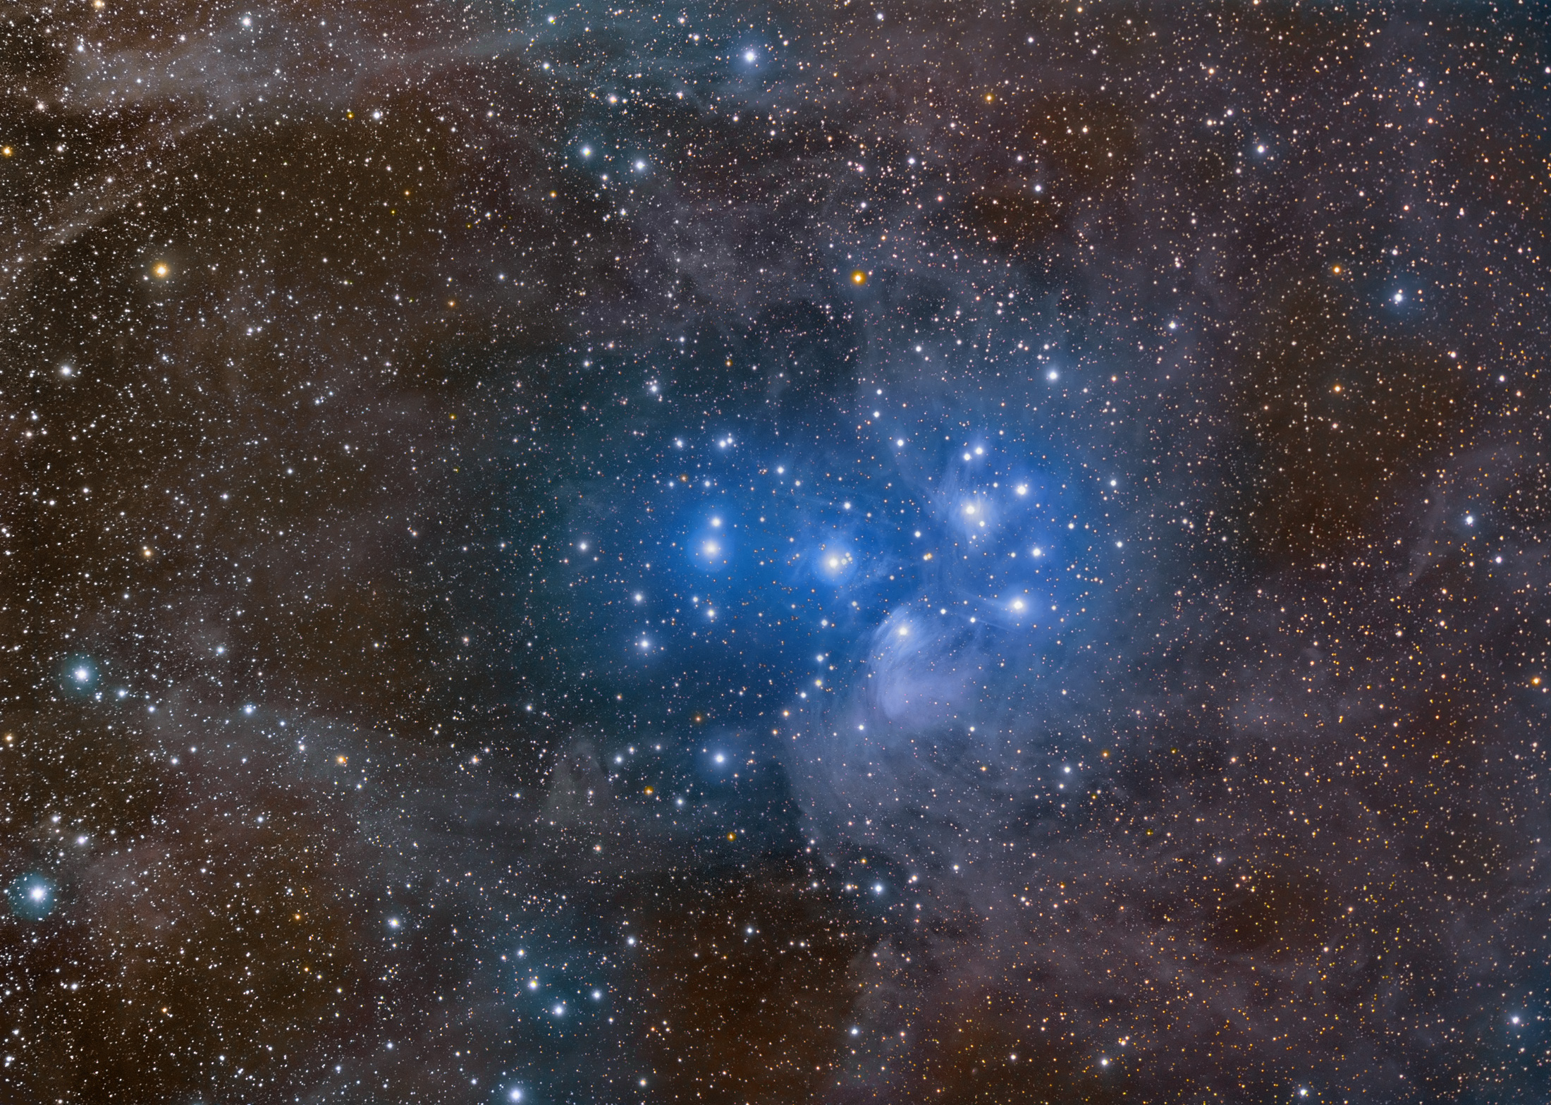
Notes:
pleaides

Slide 51
Notes:
pleaides

Slide 52
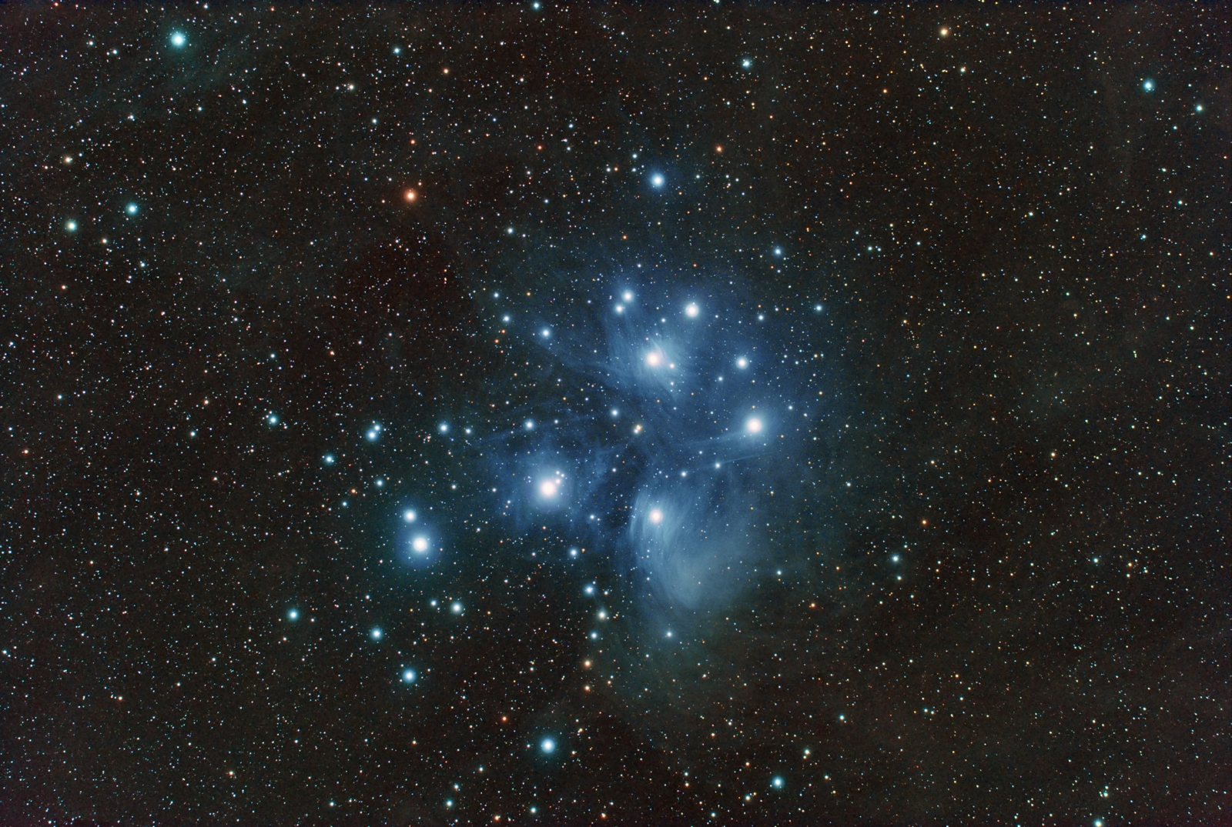

Slide 53
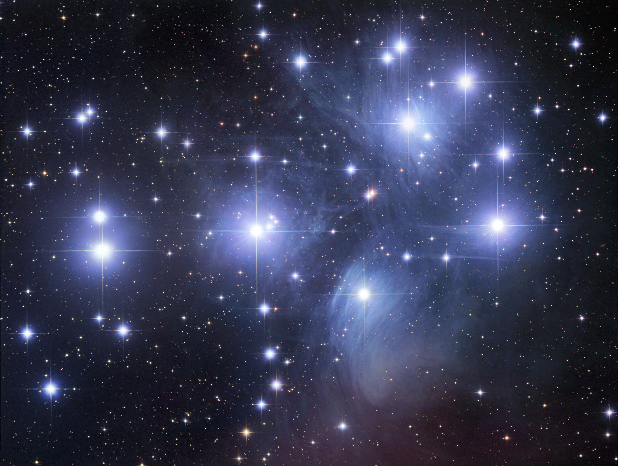

Slide 54
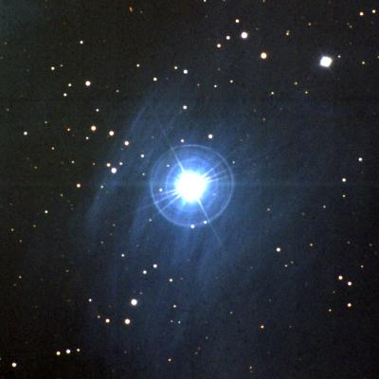

Slide 55
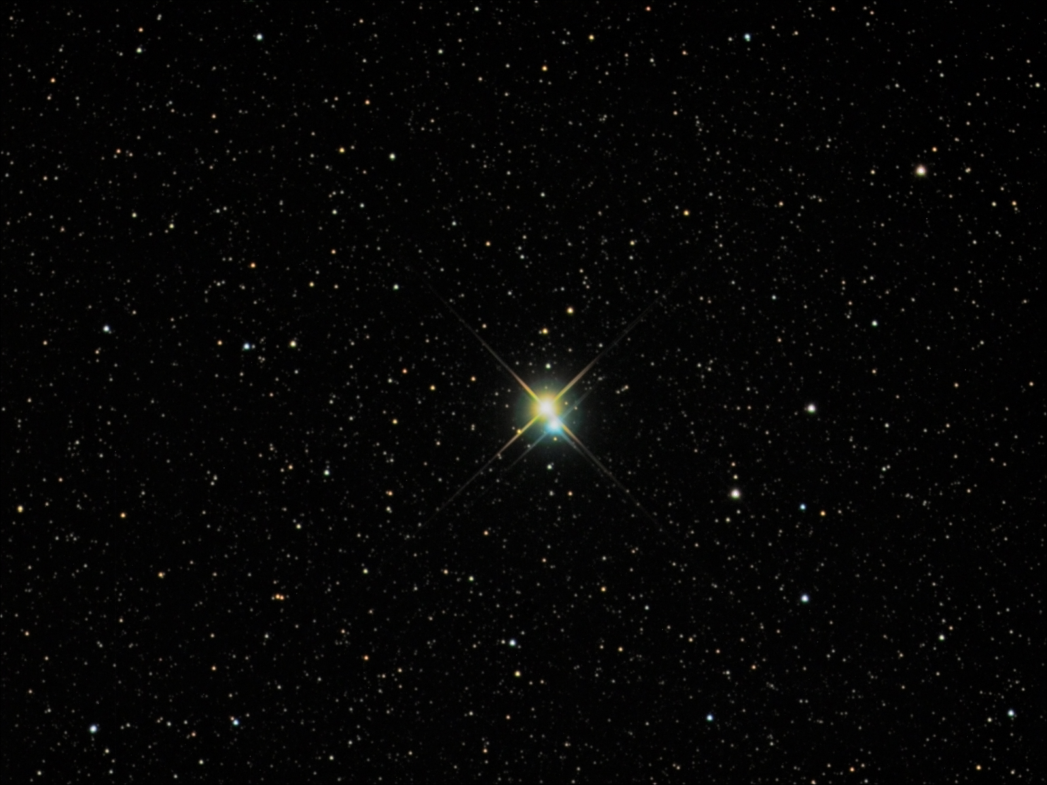
Notes:
Albireo: A Bright and Beautiful Double
Credit & Copyright: Richard Yandrick (Cosmicimage.com)
Explanation: Sometimes, even a small telescope can help unlock a hidden beauty of the heavens. Such is the case of the bright double star Albireo. Seen at even slight magnification, Albireo unfolds from a bright single point into a beautiful double star of strikingly different colors. At 380 light years distant, the two bright stars of Albireo are comparatively far from each other and take about 75,000 years to complete a single orbit. The brighter yellow star is itself a binary star system, but too close together to be resolved even with a telescope. Albireo, pictured above, is the fifth brightest star system toward the constellation of the Swan (Cygnus) and easily visible to the unaided eye.

Slide 56
Review for Test 2
Four fundamental forces
Orbital Speed
Mass versus Weight (Wt_{m} = 1/6 Wt_{E})
Escape speed (v_{m} = 1/5 v_{E})
Tides
Energy, Luminosity
Temperature, Heat
Solar Nebula theory
Stellar Birth

