Slide 1
PHYS 1111K
Lectures 9-10
OpenStax Chapter 4-5
Youtube: https://youtu.be/jeD96A-1uqs

Slide 2
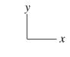

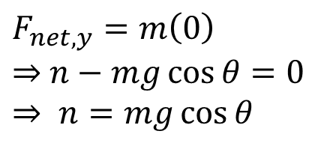



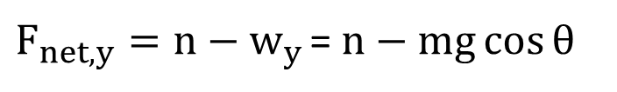
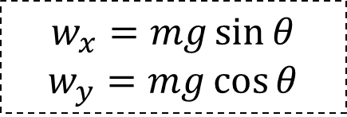
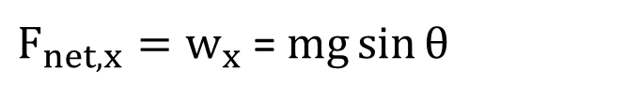

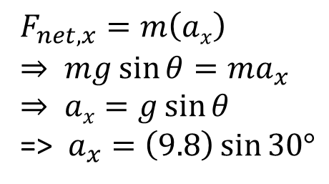
Last Class:
Step 1 : Draw a free body diagram
Step 2 : Find the vector sum of forces
$$\vec{n}$$
$F_{net,x}=w_{x}$ =$mg\sin{θ}$
$F_{net,y}=n−w_{y}$= $n−mg\cos{θ}$
θ
$$\vec{wx}$$
$$\vec{wy}$$
$$\vec{w}$$
θ
Step 3 : Set $\vec{Fnet}=m\vec{a}$
$F_{net,y}=m\left(0\right)$
$⇒$ $n−mg\cos{θ}=0$
$$⇒ n=mg\cos{θ}$$
$F_{net,x}=m\left(ax\right)$
$$⇒ mg\sin{θ}=ma_{x}$$
$$⇒ ax=g\sin{θ}$$
=> $a_{x}=\left(9.8\right)\sin{30°}$
$$w_{x}=mg\sin{θ}$$
$$w_{y}=mg\cos{θ}$$

Slide 3
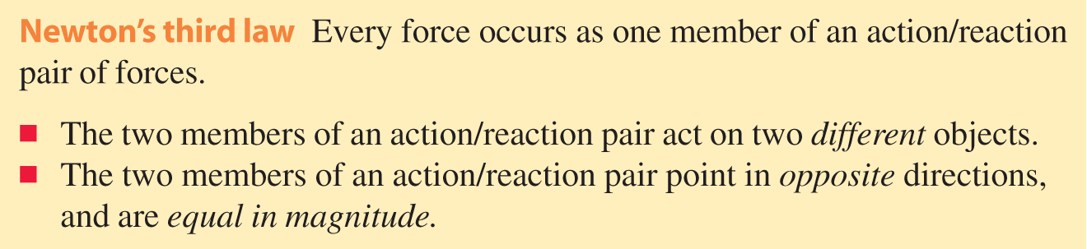
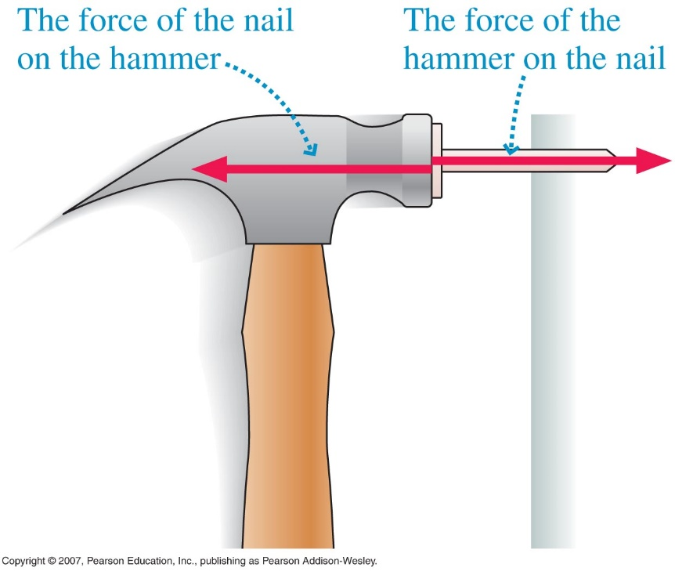
Newton’s third law

Slide 4
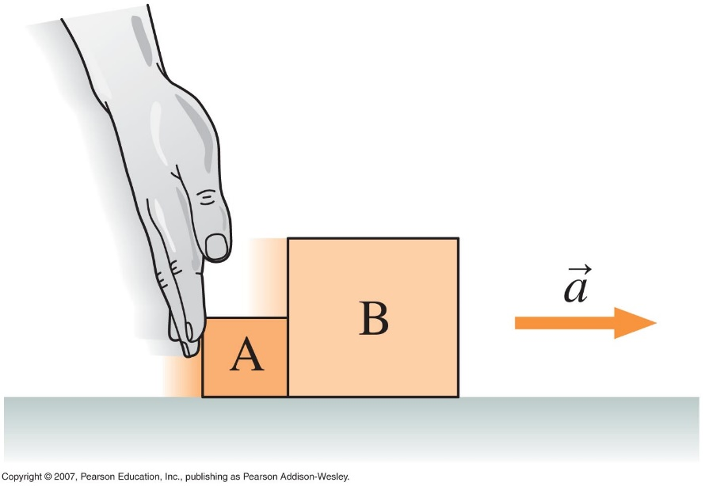

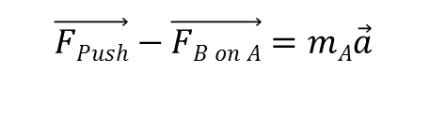




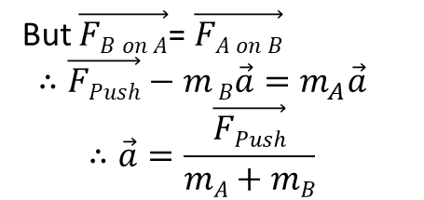


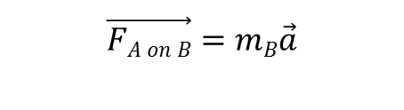
Interacting Objects
Assume that the floor is frictionless and the pushing force is 10 N. Draw Free Body Diagrams of A and B and find the acceleration of each.
Block A
Block B
$$\vec{nA}$$
$$\vec{nB}$$
$$\vec{FPush}$$
$$\vec{FA on B}$$
$$\vec{FB on A}$$
$$\vec{wA}$$
$$\vec{wB}$$
$$\vec{FPush}−\vec{FB on A}=mA\vec{a}$$
$$\vec{FA on B}=mB\vec{a}$$
But $\vec{FB on A}$= $\vec{FA on B}$
$$∴\vec{FPush}−m B\vec{a}=m_{A}\vec{a}$$
$$∴\vec{a}=\frac{\vec{FPush}}{mA+mB}$$

Slide 5
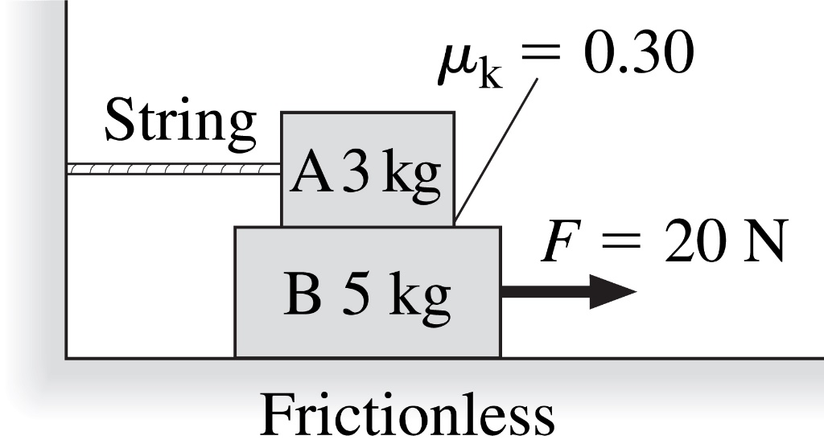
Checking Understanding
Which pair of forces is an action/reaction pair?
The string tension and the friction force acting on A.
The normal force on A due to B and the weight of A.
The normal force on A due to B and the weight of B.
The friction force acting on A and the friction force acting on B.
Notes:
Answer: D

Slide 6
Answer
Which pair of forces is an action/reaction pair?
Not same pair of objects as agents exerting forces
Both forces acting on same object (A)
Not same pair of objects as agents exerting forces
The friction force acting on A and the friction force acting on B.
Notes:
Answer: D

Slide 7
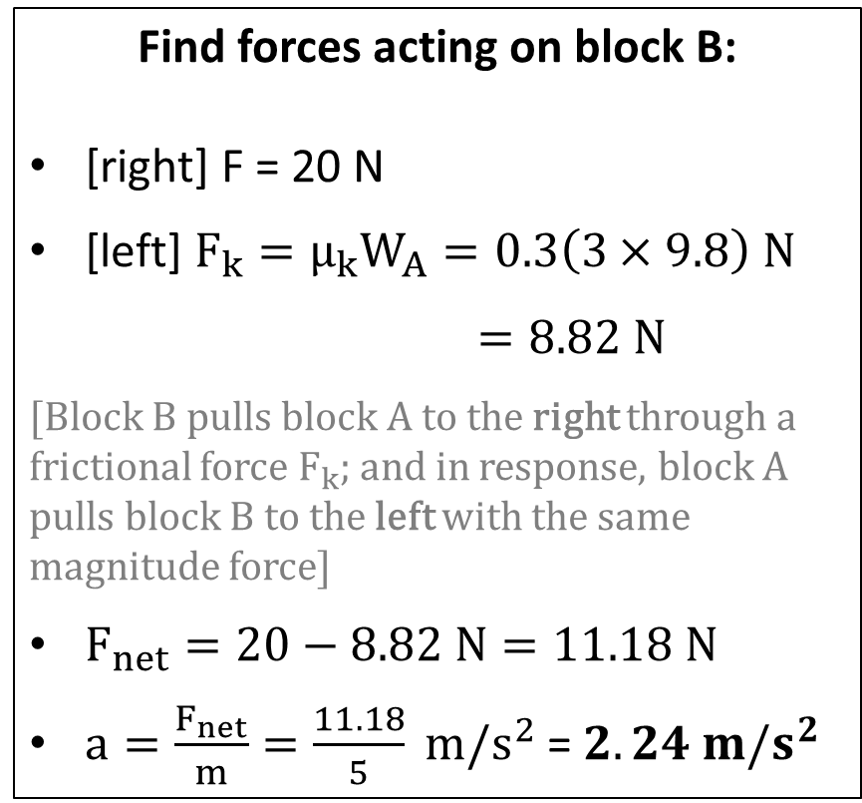
Problem-solving
What is the acceleration of block B?
Find forces acting on block B:
[right] F = 20 N
[left] $F_{k}=μ_{k}W_{A}=0.3\left(3×9.8\right) N$
$=8.82 N$
[Block B pulls block A to the right through a frictional force $F_{k}$; and in response, block A pulls block B to the left with the same magnitude force]
$F_{net}=20−8.82 N=11.18 N$
$a=\frac{F_{net}}{m}=\frac{11.18}{5} m/s^{2}$ = $2.24 m/s^{2}$

Slide 8
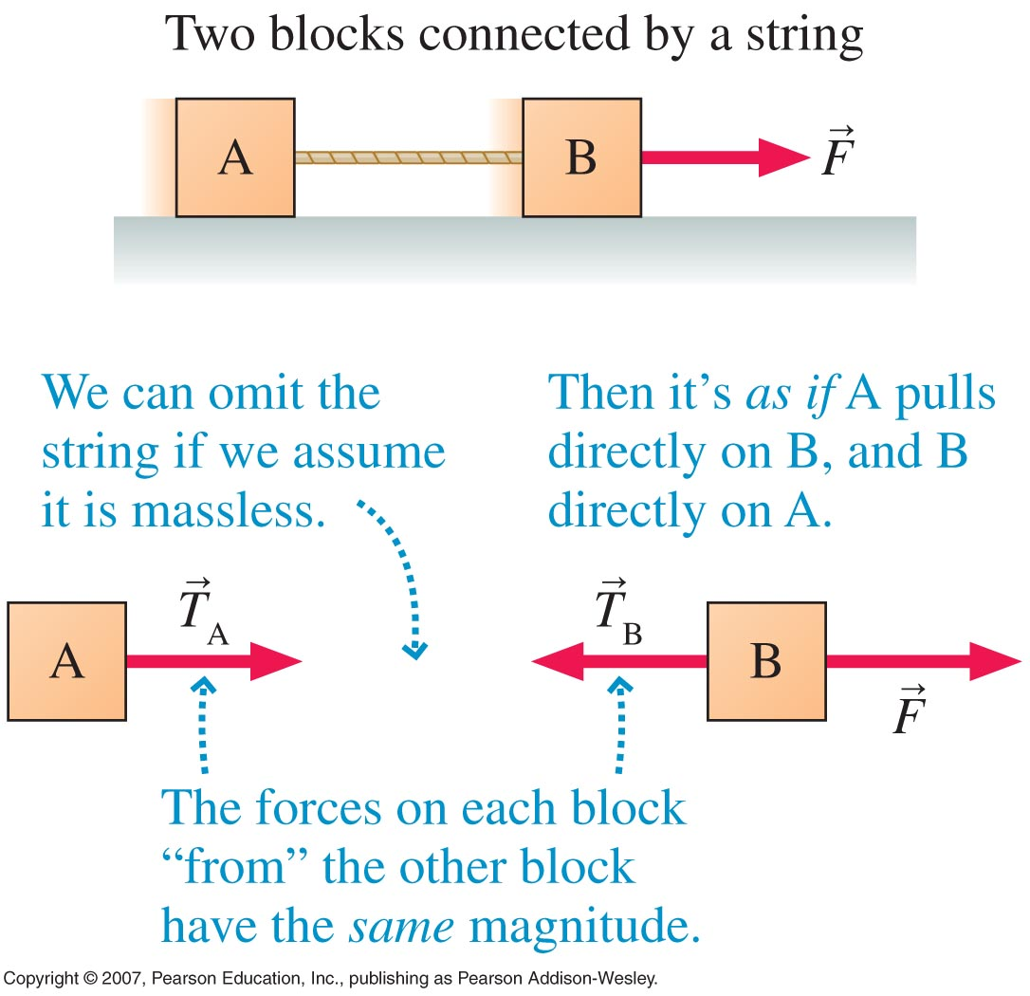
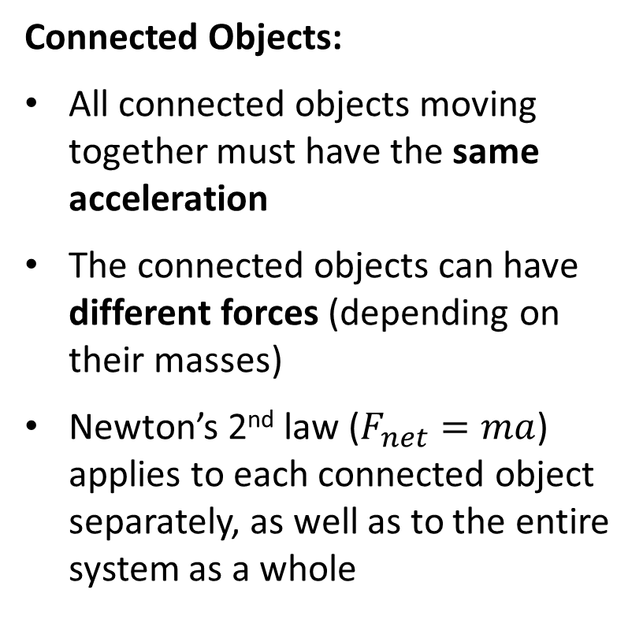
Ropes and Pulleys
Connected Objects:
All connected objects moving together must have the same acceleration
The connected objects can have different forces (depending on their masses)
Newton’s 2nd law ($F_{net}=ma$) applies to each connected object separately, as well as to the entire system as a whole

Slide 9

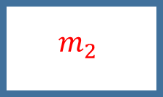

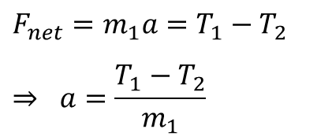

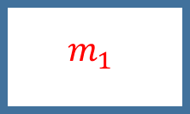


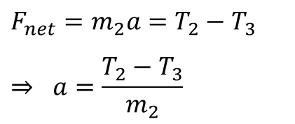
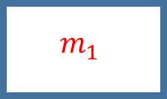



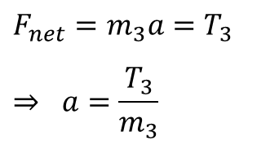


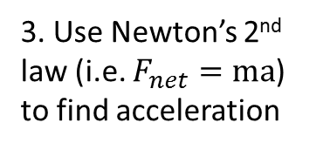

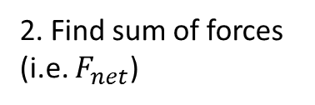



Connected Objects [1]
All connected objects must have the same acceleration
The connected objects can have different forces (depending on their masses)
$$T_{3}$$
$$T_{2}$$
$$m_{3}$$
$$m_{2}$$
$$m_{1}$$
$$T_{1}$$
1. Free-body diagrams of individual masses (assume no forces in y-direction):
$$m_{3}$$
$$T_{3}$$
$$T_{3}$$
$$T_{2}$$
$$T_{2}$$
$$T_{1}$$
$$m_{2}$$
$$m_{1}$$
2. Find sum of forces (i.e. $F_{net}$)
$$F_{net}=T_{3}$$
$$F_{net}=T_{2}−T_{3}$$
$$F_{net}=T_{1}−T_{2}$$
3. Use Newton’s 2nd law (i.e. $F_{net}=ma$) to find acceleration
$$F_{net}=m_{3}a=T_{3}$$
$$⇒ a=\frac{T_{3}}{m_{3}}$$
$$F_{net}=m_{2}a={T_{2}−T}_{3}$$
$$⇒ a=\frac{{T_{2}−T}_{3}}{m_{2}}$$
$$F_{net}=m_{1}a={T_{1}−T}_{2}$$
$$⇒ a=\frac{{T_{1}−T}_{2}}{m_{1}}$$

Slide 10











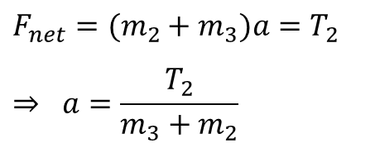


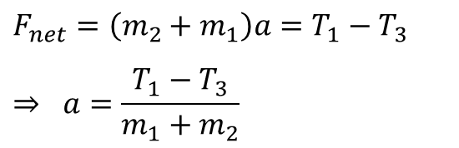
Connected Objects [2]
$$T_{3}$$
$$T_{2}$$
$$m_{3}$$
$$m_{2}$$
$$m_{1}$$
$$T_{1}$$
1. Free-body diagrams of multiple masses (assume no forces in y-direction):
$$m_{3}$$
$$T_{3}$$
$$T_{3}$$
$$m_{2}$$
$$T_{2}$$
$$T_{3}$$
$$T_{2}$$
$$T_{2}$$
$$T_{1}$$
$$m_{2}$$
$$m_{1}$$
2. Find sum of forces (i.e. $F_{net}$)
$$F_{net}=T_{2}+T_{3}−T_{3}=T_{2}$$
$$F_{net}=T_{1}+T_{2}−T_{2}−T_{3}=T_{1}−T_{3}$$
3. Use Newton’s 2nd law (i.e. $F_{net}=ma$) to find acceleration
$$F_{net}=(m_{2}+m_{3})a=T_{2}$$
$$⇒ a=\frac{T_{2}}{m_{3}+m_{2}}$$
$$F_{net}=\left(m_{2}+m_{1}\right)a=T_{1}−T_{3}$$
$$⇒ a=\frac{T_{1}−T_{3}}{m_{1}+m_{2}}$$

Slide 11








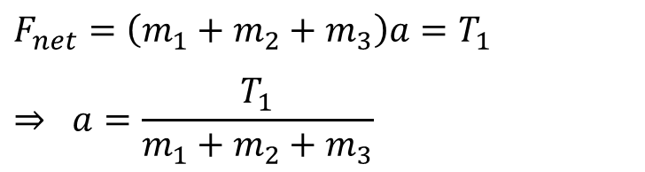
Connected Objects [3]
$$T_{3}$$
$$T_{2}$$
$$m_{3}$$
$$m_{2}$$
$$m_{1}$$
$$T_{1}$$
1. Free-body diagrams of entire system (assume no forces in y-direction):
$$m_{3}$$
$$T_{3}$$
$$T_{3}$$
$$m_{2}$$
$$T_{2}$$
$$T_{2}$$
$$m_{1}$$
$$T_{1}$$
2. Find sum of forces (i.e. $F_{net}$)
$$F_{net}=T_{1}+T_{3}−T_{3}+T_{2}−T_{2}=T_{1}$$
3. Use Newton’s 2nd law (i.e. $F_{net}=ma$) to find acceleration
$$F_{net}=\left(m_{1}+m_{2}+m_{3}\right)a=T_{1}$$
$$⇒ a=\frac{T_{1}}{m_{1}+m_{2}+m_{3}}$$

Slide 12






Ropes and Pulleys (Atwood’s machine)
Two masses hang over a pulley by means of a massless rope. Determine the motion of the system.
$$\vec{T}$$
$$\vec{T}$$
10 kg
20 kg
10 kg
20 kg
$$\vec{w20}$$
$$\vec{w10}$$
$$T−w20=m(−a)$$
$$T−w10=ma$$
(The 20 kg block moves downward)

Slide 13
Atwood’s Machine
Two masses hang over a pulley by means of a massless rope. Determine the motion of the system.
Conceptual approach:
Clearly the 20 kg object is falling and the 10 kg object is rising.
If the 20kg object were only a 10 kg object then the system would be in equilibrium. So the effect is that there is an extra 10 kg hanging on the left side.
This provides a net force of 10(9.8) = 98 N
This 98 N force acts on both masses (they both move due to this extra mass)
10 kg
20 kg

Slide 14
Atwood’s Machine contd.
What is the tension in the rope?
Conceptual approach:
The entire system is accelerating at the rate of 3.26m/s²
On the 10kg object, the tension force provided by the string must be larger than the 10kg object’s weight.
Newton’s 2nd Law says:
10 kg
20 kg
T
10 kg
W

Slide 15
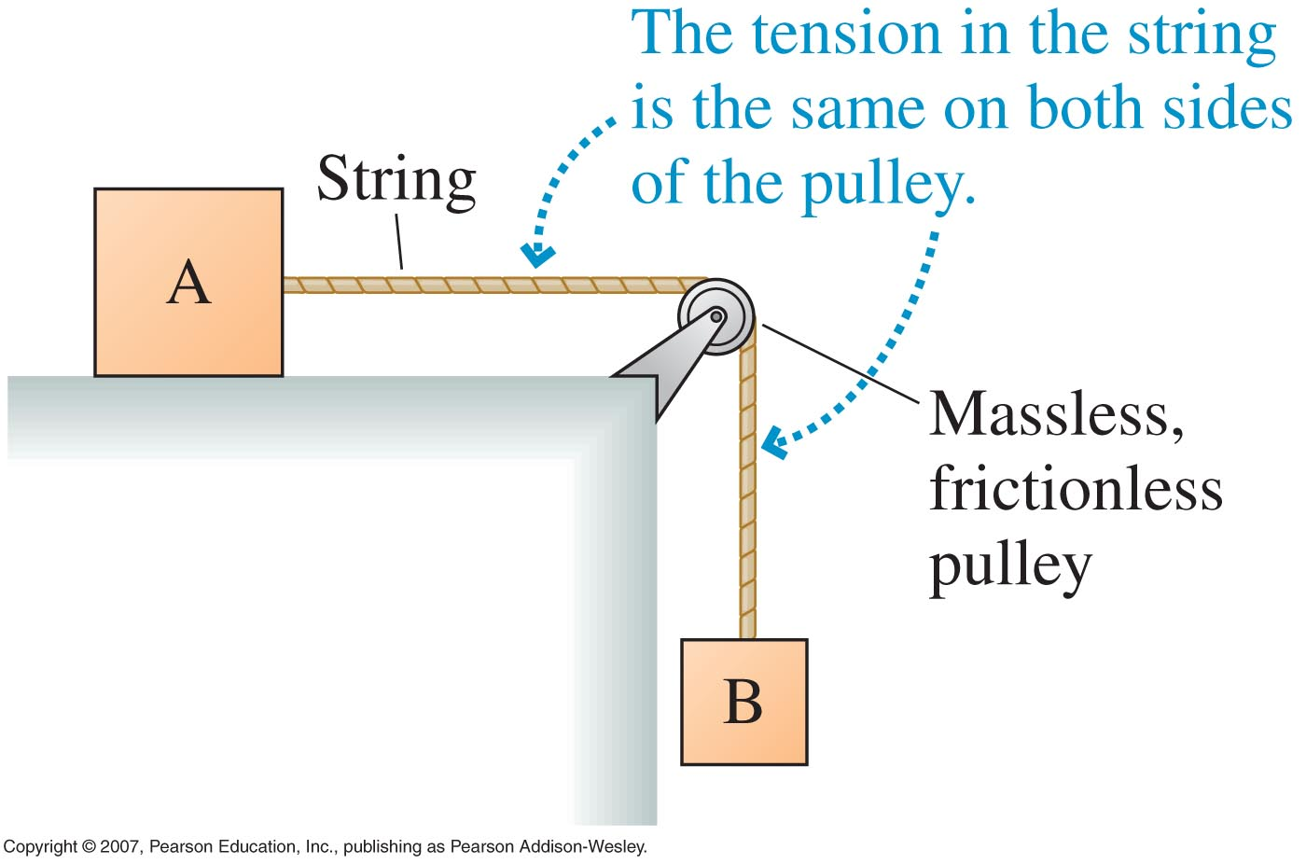
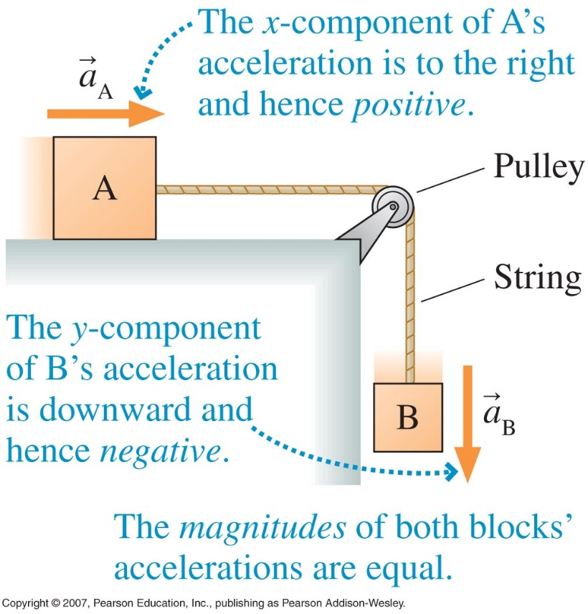
Ropes and Pulleys

Slide 16
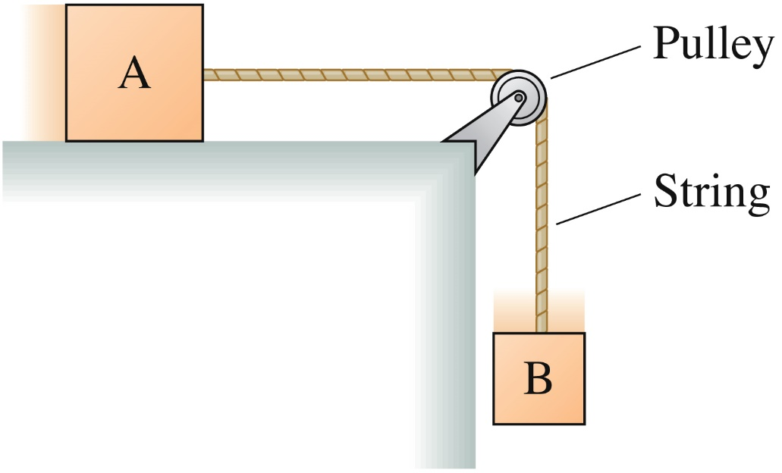





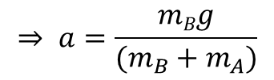





Problem-solving
Block A, with mass 4.0 kg, sits on a frictionless table. Block B, with mass 2.0 kg, hangs from a rope connected through a pulley to block A. What is the acceleration of block A?
Block A
$$n$$
Block B
$$T$$
$$+x$$
$$T$$
$$w_{A}=m_{A}g$$
$$w_{B}=m_{B}g$$
$$F_{net}=T=m_{A}a$$
$$F_{net}=+w_{B}−T=m_{B}a$$
$$⇒ w_{B}−m_{A}a=m_{B}a$$
$⇒m_{B}g−m_{A}a$ $= m_{B}a$
* The direction of the rope is defined as the $+x$-axis
$$⇒ a=\frac{mBg}{(m_{B}+m_{A})}$$

Slide 17
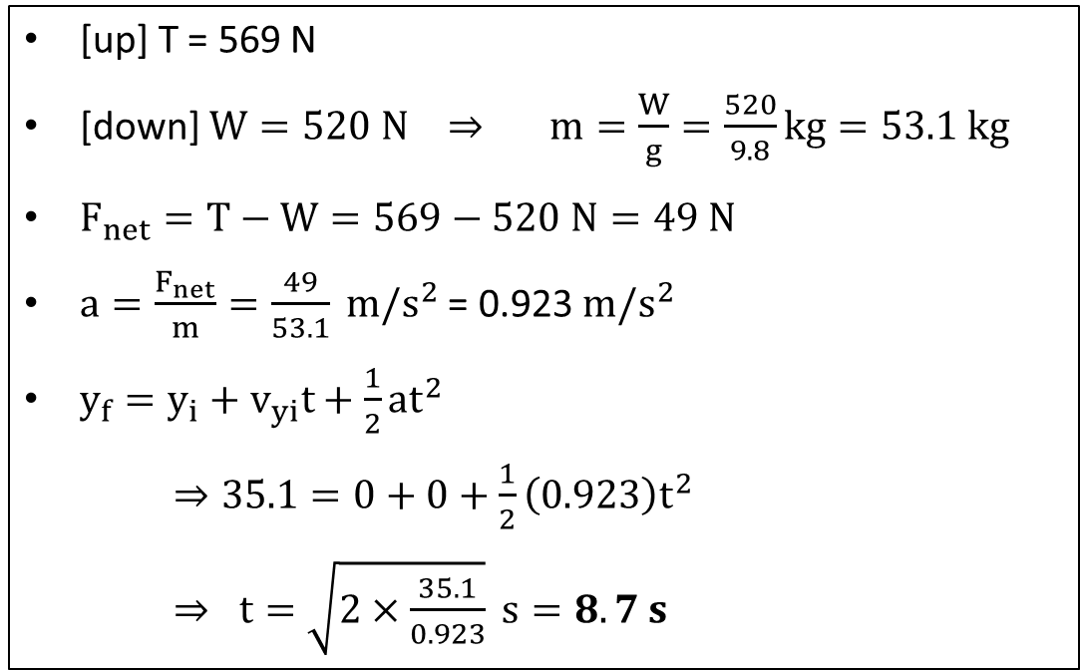


Problem 1
A cave explorer trapped at the bottom of a cavern weighs 520 N. A helicopter is using a rope to pull the explorer out. If the maximum tension of the rope is 569 N, and the cavern is 35.1 m deep, what is the shortest time in which the explorer can be pulled out of the cavern?
[up] T = 569 N
[down] $W=520 N ⇒ m=\frac{W}{g}=\frac{520}{9.8}kg=53.1 kg$
$F_{net}=T−W=569−520 N=49 N$
$a=\frac{F_{net}}{m}=\frac{49}{53.1} m/s^{2}$ = 0.923$m/s^{2}$
$y_{f}=y_{i}+v_{yi}t+\frac{1}{2}at^{2}$
$⇒35.1=0+0+\frac{1}{2}\left(0.923\right)t^{2}$
$⇒ t=\sqrt{2×\frac{35.1}{0.923}} s=8.7 s$
$$\vec{T}$$
$$\vec{w}$$

Slide 18
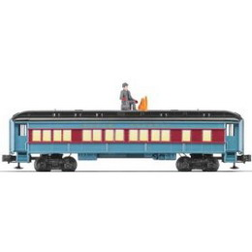


Problem 2
C₃
C₂
C₁
Three railroad cars are being pulled with a force of 12,000 N. Car 1 has a mass of 2000 kg, car 2 has a mass of 3000 kg, and car 3 has a mass of 5000 kg. Neglecting friction, what is the acceleration of the train and what is the force between car 2 and 3?

Slide 19
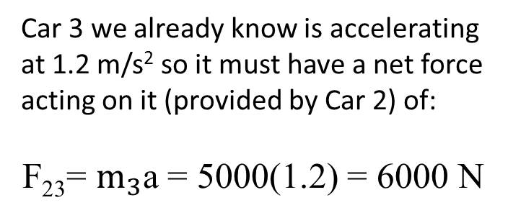


Solution
C₃
C₂
C₁
C₃
C₂
C₁
Think of all three cars as a single object whose mass is equivalent to the total masses of the three cars.
A free body diagram of car 3 would indicate only that car 2 is pulling on it
A free body diagram would indicate only one force if we neglect frictional forces
$$C_{3}$$
F₂₃
$$C_{1}+C_{2}+C_{3}$$
F _{net}
Car 3 we already know is accelerating at 1.2 m/s² so it must have a net force acting on it (provided by Car 2) of:
F₂₃= $m_{3}$a = 5000(1.2) = 6000 N

Slide 20
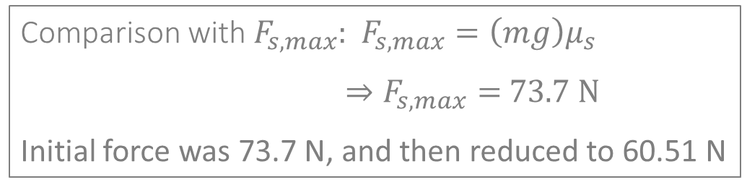
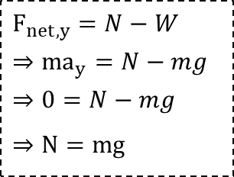
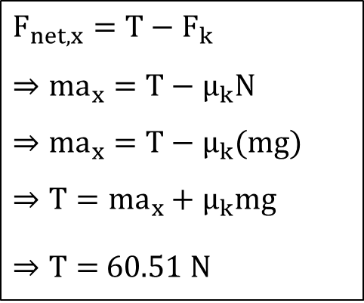

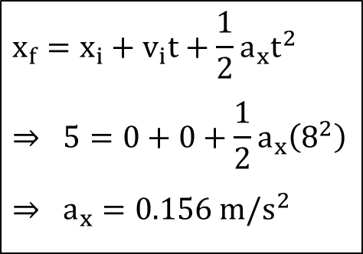



Problem 3
A 16-kg crate sitting on a horizontal floor is attached to a rope that pulls horizontally. The coefficient of static friction between the crate and the floor is 0.47 and the coefficient of kinetic friction is 0.37. If a person starts pulling on the rope and the crate moves 5 m in 8 s, how much force is he pulling with?
$$N$$
$$F_{net,x}=T−F_{k}$$
$$⇒{ma}_{x}=T−μ_{k}N$$
$$⇒{ma}_{x}=T−μ_{k}(mg)$$
$$⇒T=ma_{x}+μ_{k}mg$$
$⇒T=$ 60.51 N
$$x_{f}=x_{i}+v_{i}t+\frac{1}{2}a_{x}t^{2}$$
$$⇒ 5=0+0+\frac{1}{2}a_{x}\left(8^{2}\right)$$
$$⇒ a_{x}=0.156 m/s^{2}$$
$$F_{k}$$
$$T$$
$$W=mg$$
$$F_{net,y}=N−W$$
$$⇒{ma}_{y}=N−mg$$
$$⇒0=N−mg$$
$$⇒N=mg$$
Comparison with $F_{s,max}$: $F_{s,max}=\left(mg\right)μ_{s}$
$⇒F_{s,max}=$ 73.7 N
Initial force was 73.7 N, and then reduced to 60.51 N

Slide 21

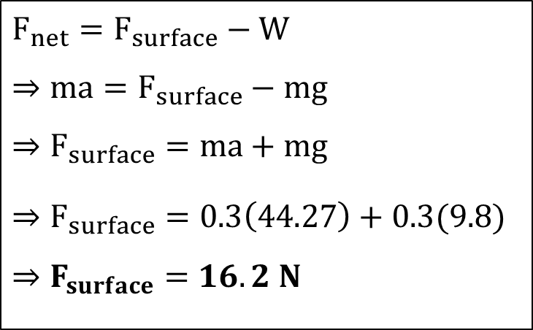
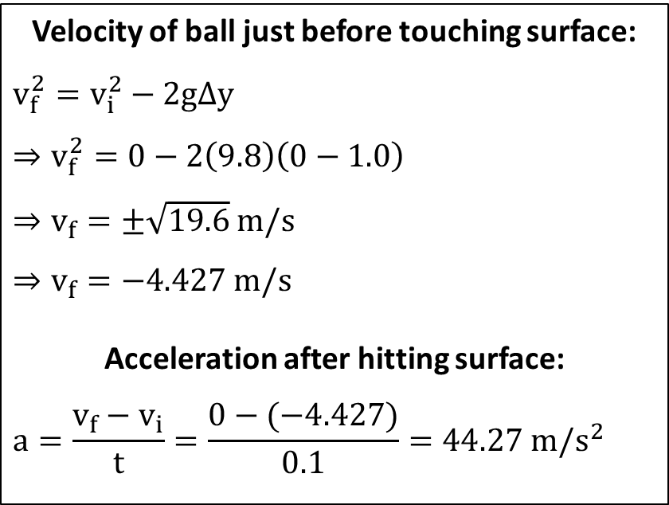

Problem 4
A 0.3 kg metal ball is dropped from a height of 1.0 m to a hard surface. The ball comes to rest 0.1 s after striking the surface. What is the average force exerted by the surface on the ball to bring it to rest?
Velocity of ball just before touching surface:
$$v_{f}^{2}=v_{i}^{2}−2gΔy$$
$$⇒v_{f}^{2}=0−2\left(9.8\right)\left(0−1.0\right)$$
$⇒v_{f}=±\sqrt{19.6}$ m/s
$$⇒v_{f}=−4.427 m/s$$
Acceleration after hitting surface:
$$a=\frac{v_{f}−v_{i}}{t}=\frac{0−(−4.427)}{0.1}=44.27 m/s^{2}$$
$$F_{surface}$$
$$F_{net}=F_{surface}−W$$
$$⇒ma=F_{surface}−mg$$
$$⇒F_{surface}=ma+mg$$
$$⇒F_{surface}=0.3\left(44.27\right)+0.3(9.8)$$
$$⇒F_{surface}=16.2 N$$
$$W$$

