Slide 1
Chemical Energy
Objective: Learning about atoms, molecules and ions. Also, explore the formation of ionic and covalent compounds.
Key concepts:
Metals, Nonmetals and Semimetals
Electronic Structure
Lewis Dot Diagram
Cations and Anions
Ionic Bonds
Covalent Bonds.

Slide 2
Review: Periodic trends
Atomic Radius:
Elements in the same row (periods) show a smooth trend toward smaller diameter (size) as you move from left to right.
Elements in the same column (group) get bigger as you go down, due to additional electron shell.
Chemical properties:
Elements in the same column (group or family) have similar properties, such as how they react (or not) and what kinds of compounds they form.
The original arrangement of the Periodic Table came from organizing elements by their properties, which repeated in a regular pattern with a particular period (frequency). We now understand this to be a result of the organization of electron energy levels given by quantum mechanics.
The highest level is called the valence energy shell.

Slide 3
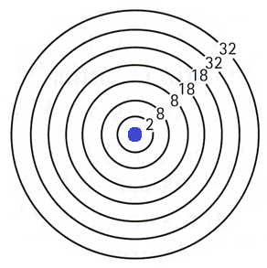
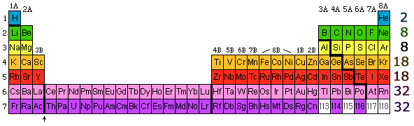
Review: Periodic trends
Electrons fill distinct energy “shells” and each row corresponds to the filling of a shell.
A new period starts when one of these shells is filled.
Counting valence electrons: There are never more than 8 valence electrons. Octet Rule!
We do not count the 10 extra electrons in rows 4 and 5 or the 24 extra electrons in rows 6 and 7. They are not active in bonding because they have a slightly lower energy level than the 8 electrons associated with groups 1, 2, 13, 14, 15, 16, 17, and 18.
Groups 3A, 4A, 5A, 6A, 7A, and 8A identify the number of valence electrons for all elements in those columns. Groups with a “B” label have either 2 or 3 valence electrons.

Slide 4
Atoms and Molecules
ATOM: the basic particle of matter. Example: Ne = one atom of neon.
ELEMENT: simplest pure substance, only one type of atom present. Examples: Fe = one atom of iron, O₂ = two atoms of oxygen.
COMPOUND: pure substance formed from the chemical combination of two or more elements in a definite ratio. Examples: H₂O = water, H₂SO₄ = sulfuric acid, C₆H₁₂O₆ = sugar.
MOLECULE: neutral particle composed of two of more atoms chemically combined that act as an independent unit. Examples: H₂O = water (a compound), O₂ = oxygen (an element).
Formulas | Element or Compound | Atom or Molecule
He
Br₂
HCl
CO
Co
Xe₂

Slide 5
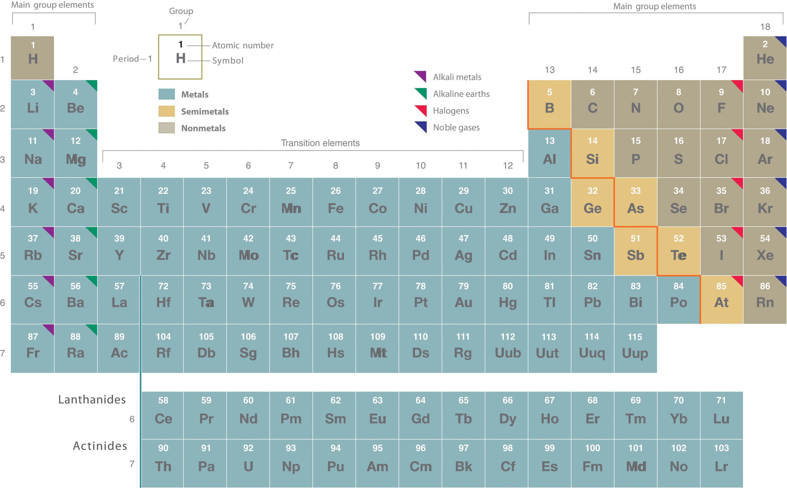
Metals, Nonmetals and Semimetals

Slide 6
Metals, Nonmetals and Semimetals
Metals
Located to left of zigzag line
At room temperature, all except Hg are solid
Lustrous, malleable & ductile
Good conductors of heat & electric
Tend to donate electrons (oxidation) to form cations (acquire positive charge)
Nonmetals
Located to right of zigzag line
At room temperature, 11 gases, 1 liquid, 5 solids
Poor conductors of heat & electricity
Tend to gain electrons (reduction) to form anions (acquire negative charge)
Semimetals (Metalloids)
Located along zigzag line
All are solids: B, Si, As, Te, At, Ge, Sb
Most of their physical properties resemble nonmetals.
Several of the metalloids are semiconductors, which conduct electricity under special circumstances (Si, Ge).

Slide 7
Electron Energy Levels & Valence Electrons
Na
1 valence
electron
2 valence
electrons
1 valence
electron
H
He
Electrons in inner shells are not that important.
5 valence
electrons
6 valence
electrons
7 valence
electrons
N
8 valence
electrons
F
O
Ne
For each element, provide number of occupied electron energy levels and number of valence electrons
Elements | Number of energy levels (shells) | Valence electrons in outermost shell
Na
Ne
F

Slide 8
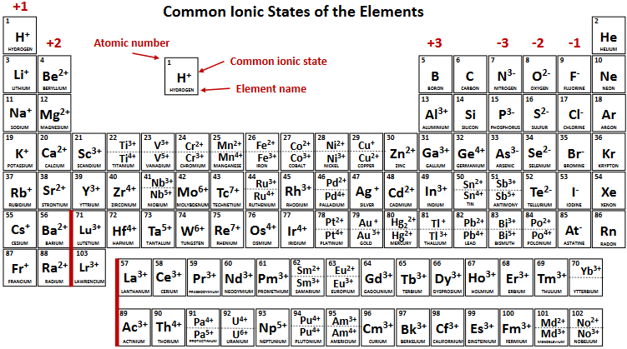
Metals and Nonmetals
Metals lose electrons (cations)
Non-metals gain electrons (anions)
To get the stability of an inert gas,
metals tend to _________ electrons to empty the valence shell
nonmetals tend to ________ electrons to fill the valence shell.

Slide 9
Formation of Ions
Positive ion or cation
Negative ion or anion
lose the electron
vacant valance shell
gain an electron
Na atom
Na ion
net charge +1
F atom
F ion
net charge -1
Na – 11 protons
11 electrons
Na¹⁺ - 11 protons
10 electrons
F – 9 protons
9 electrons
F ¹⁻ – 9 protons
10 electrons

Slide 10
Lewis “dot” diagram
Chemists use simple diagrams to show an atom’s valence electrons and how they transfer. These diagrams have two advantages over the electron shell diagrams.
First, they show only valence electrons.
Second, instead of having a circle around the chemical symbol to represent the electron shell, they have up to eight dots around the symbol; each dot represents a valence electron.
For example, the representation for sodium:
And the representation for chlorine:
The transfer of electrons can be illustrated easily with Lewis diagrams:
***In the final formula, the dots are omitted.
unpaired
electron
paired
electrons

Slide 11
IONIC BONDING
The metal atoms give up their valence electrons and become positive ions (cations) with all inner energy levels filled.
The non-metal atoms gain extra valence electrons and become negative ions (anions) with all energy levels filled.
The ions stay distinct and are electrically attracted (bonded) to form Ionic compounds.
**By convention, the lowest whole-number ratio of the ions is used in ionic formulas. There are
exceptions for certain ions, such as Hg22+
Example: A metal atom has valence electrons stolen by a non-metal. The positive and negative ions are then attracted to each other by the coulomb force to form an ionic compound.

Slide 12
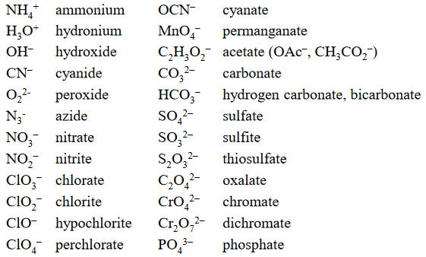
IONIC BONDING
Additionally, some ions consist of groups of atoms bonded together and have an overall electric charge. Because these ions contain more than one atom, they are called polyatomic ions. Polyatomic ions have characteristic formulas, names, and charges. Some examples of polyatomic ions with their charges are shown below:

Slide 13
IONIC BONDING
Practice: Identify each compound as ionic or not ionic.
Compound | Ionic or not ionic
Na₂O
PCl₃
NH₄Cl
OF₂
N₂O
Show the “Lewis dot diagram” and electron transfer with an arrow.
Mg F
Formula: ________

Slide 14
A Guide to Naming Simple Ionic Compounds

Slide 15
COVALENT BONDING
An unpaired electron in one atom is shared with an unpaired electron in another atom. Each atom is happy when it thinks it has a full set of 8 valence electrons even though some electrons actually belong to a different atom and are just being shared with it.
Specific formula resulting in molecules. The formula is determined by the number of unpaired valence electrons.
This is where the Lewis dot diagrams, which show us how the valence electrons are organized, are most useful. We put atoms with unpaired electrons next to each other and then put a line between the electrons to show the bonded pair.

Slide 16
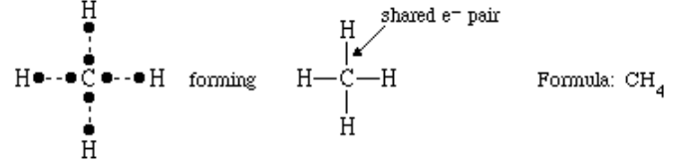
COVALENT BONDING
Covalent Bonds between Different Atoms: Consider a molecule composed of one hydrogen atom and one fluorine atom.
Each atom needs one additional electron to complete its valence shell. By each contributing one electron, they make the following molecule:
Larger molecules are constructed in a similar fashion, with some atoms participating in more than one covalent bond. For example, methane (CH₄), with one carbon atom and four hydrogen atoms, can be represented as follows:

Slide 17
How Many Covalent Bonds Are Formed?
In molecules, there is a pattern to the number of covalent bonds that different atoms can form. Each block with a number indicates the number of covalent bonds formed by that atom in neutral compounds.

Slide 18

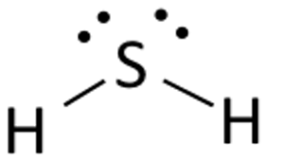
COVALENT BONDING
Always start by drawing the dot diagram for the atom at the center of the group. (We tell you what that is)
The formula tells you how many of the other atoms need to be added to find a partner for every unpaired atom.
A dash connects paired electron dots to show the bond.
Example: C F₄ H₂ S
________________ ________________

Slide 19
Multiple Covalent Bonds
  Two pairs of electrons shared between two atoms make a double bond between the atoms, which is represented by a double dash:
  Some molecules contain triple bonds, covalent bonds in which three pairs of electrons are shared by two atoms. A simple compound that has a triple bond is acetylene (C₂H₂), whose Lewis diagram is as follows:

Slide 20
Molecular Shape: VSEPR Theory
Unlike ionic compounds, covalent molecules are discrete units with specific 3-D shapes. The shape of a molecule is determined by the fact that covalent bonds, which are composed of negatively charged electrons, tend to repel one another. This concept is called the Valence Shell Electron Pair Repulsion (VSEPR) theory.
For example, the two covalent bonds in BeCl₂ stay as far from each other as possible, ending up 180° apart from each other. The result is a linear molecule:
The three covalent bonds in BF3 repel each other to form 120° angles in a plane, in a shape called trigonal planar:

