Slide 1
From Truth Tables to
Rules of Inference
Using the first four Rules of Inference
Modus Ponens, Modus Tollens, Hypothetical Syllogism and Disjunctive Syllogism

Slide 2
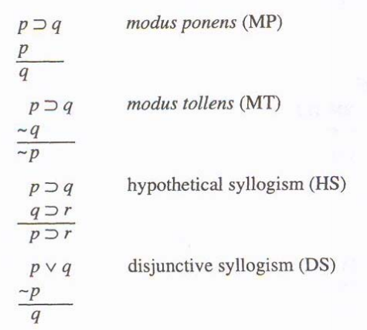
The First Four Rules of Inference
These rules have lines that proceed from what is true, what appears in a “proof” or “derivation”, to what is new under the line.
The first two lines in each of these are “given”, already assumed to be true, already appearing in a proof or derivation.

Slide 3
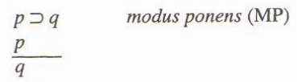
In each rule:
Think of the p and q as placeholders for a “part” of a sentence.
For example, the p is the first part of a horseshoe sentence, the q is the second part.
This Modus Ponens (MP) rule can be applied to sentences with complex parts:
                (A v B) ⊃ (C v D)
                A v B
                C v D
Always remember that the P is the whole first part of the horseshoe, and the Q is the whole second part of the horseshoe.

Slide 4
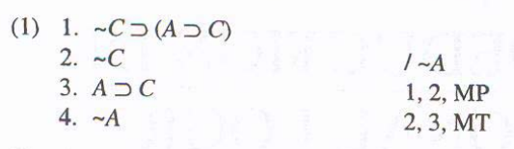
Example:
In this proof, the MP rule is being used on a horseshoe that has a complex second part.
Always start by seeing what you have in your givens (the first lines you see) and then work your way into the problem by asking which Rule of Inference you can use on that particular problem.
Let’s take it step by step:

Slide 5
When you first see a problem, it will look like this:
You’ll see the numbered lines, which are the “givens”, and a slash /
Your goal is to have what is behind the slash on a new line of its own, after applying Rules of Inference.
So the first thing you should note is that the first line is a horseshoe, and the second line is repeating the first part of the horseshoe: The ~C.

Slide 6

Looking for types of sentences and their parts in the lines you have:
Whenever you have a line in the proof that has a horseshoe, and another line that is the first part of the horseshoe repeated all by itself, you can do a Modus Ponens!
To do this Modus Ponens (MP) correctly, be sure to write the whole second part of the horseshoe on line 1 on a new line of its own, noting that it came from lines 1 and 2 by MP. That’s
3. A ⊃ C 1,2 MP

Slide 7
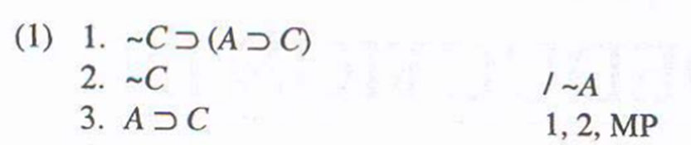
Remember, the final goal…
The final goal is what is behind the slash, the
/ ~A
So to finish the proof, evaluate what you have in your lines again, including the new line 3:
You’ll notice that lines 2 and 3 can be used to make a Modus Tollens (MT), the second Rule of Inference in 7.1!

Slide 8

Modus Tollens (MT)
In Modus Tollens, we have a horseshoe sentence on a line, and on some other line, we have a negation in front of the second half of the horseshoe. We can then write on a new line a negation in front of the first half of the horseshoe!

Slide 9
What should we write next?

Slide 10
~A
With the line number 4,
followed by lines 2,3 MT
4. ~A 2,3 MT

Slide 11
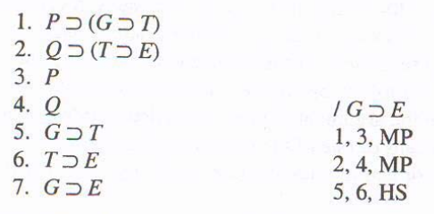
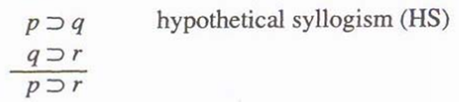
Here’s an example of Hypothetical Syllogism, HS:
HS is used when you have a pair of horseshoe sentences, and one ends the way the other one begins. In this case, notice that the T is in common between lines 5 and 6.

Slide 12
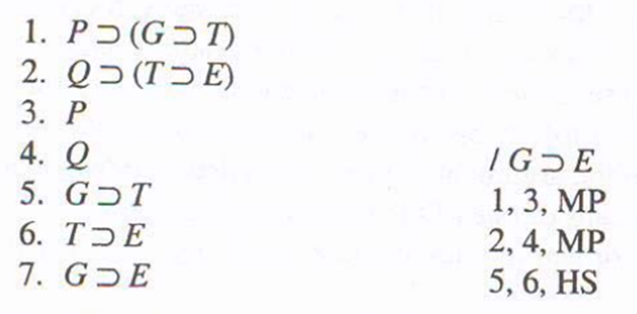
First, you’ll have the givens and what you need to prove, in this case, G⊃E
Notice that lines 1 and 2 are horseshoes, and these lines begin with a P and with a Q.
That P and Q match lines 3 and 4, so you can do a simple set of Modus Ponens first. Once you do the Modus Ponens, you can definitely see the Hypothetical Syllogism HS:

Slide 13
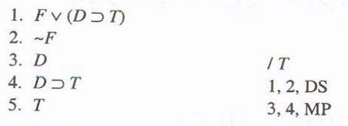
Now let’s look at a sample of Disjunctive Syllogism DS

Slide 14
In this problem, the first line is a wedge (disjunction), and the second part of it is a complex horseshoe:
p= F and q= (D⊃T)
In order to work out way toward the T after the slash, we will need to separate out the T from line 1 by first breaking up the wedge, and then breaking up the horseshoe.

Slide 15
Break up the wedge first, by using a Disjunctive Syllogism (DS).
This rule says that if you have a wedge sentence, and on some other line you have an added negation on the front of the wedge sentence, you are able to write the second half of the wedge on a line by itself.
Here we have F v (D⊃T), and ~F, so we can write D⊃T on a line by itself.

Slide 16
The last step to solve the problem is to do a Modus Ponens MP,
to break out the T from D ⊃ T
Then simply write the result:
5. T 3,4 MP

Slide 17
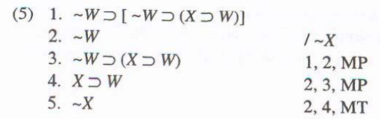

Slide 19
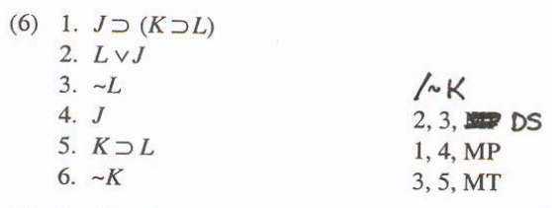

Slide 21
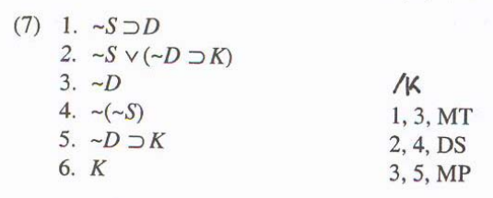

Slide 23
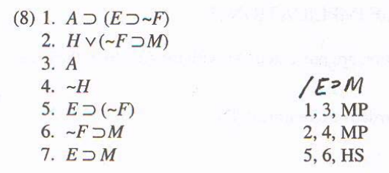

Slide 25
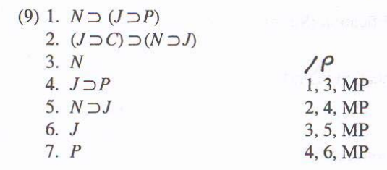

Slide 27
