Slide 1

Atomic Energy

Slide 2
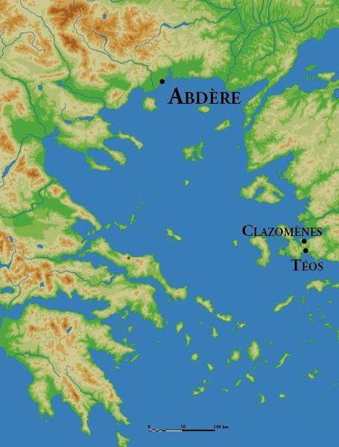
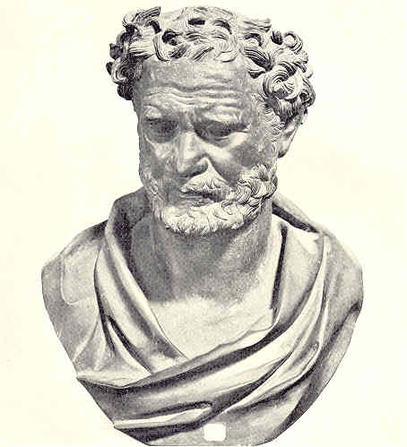
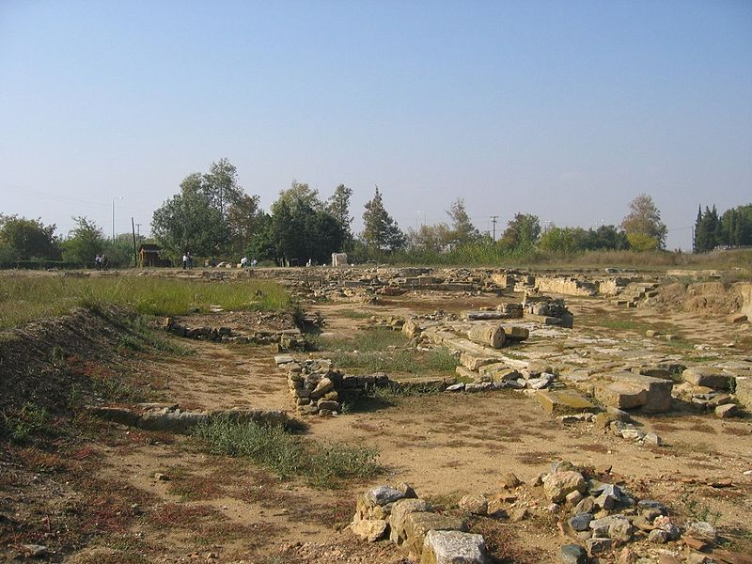
Greece (c. 400 BC)
Notes:
Democritus of Abdère, Thrace (460 BC – 370 BC)
Proposed an experiment: break in half a piece of wood, then break it in half again, and again; Indivisible – ‘atomos’ (atom)

Slide 3
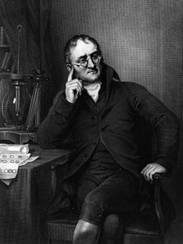
John Dalton
(1766 - 1844)
Discoverer of color blindness
Stoichiometry – math of how elements combined to form other elements
Dalton found that oxygen & carbon combined to make 2 compounds (1803)
  Each had its own particular weight ratio of oxygen to carbon (1.33:1 and 2.66:1)
  Same amount of carbon, one had exactly twice as much oxygen as the other
Law of simple multiple proportions

Slide 4
Dalton’s Elementary Atomic Theory
  Elements are made of extremely small particles called atoms
  Atoms of a given element are identical in size, mass, and other properties
  Atoms of different elements differ in size, mass, and other properties
  Atoms cannot be subdivided, created, or destroyed
  Atoms of different elements combine in simple whole-number ratios to form chemical compounds
  In chemical reactions, atoms are combined, separated, or rearranged

Slide 5
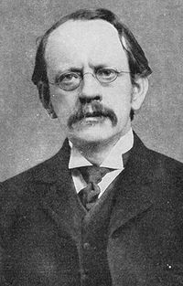
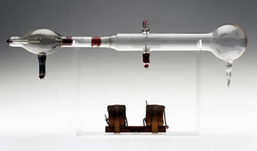
J.J. Thomson (1856 - 1940)
What are cathode rays? (1897)
Notes:
What are cathode rays? (1897)
Measure heat generated when rays hit thermal junction
Compare with magnetic deflection of rays
Cathode rays were
1000 times lighter then hydrogen atom
Same mass no matter what atom is used
Negatively charge particles
Discovered the Electron!

Slide 6
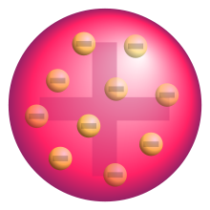
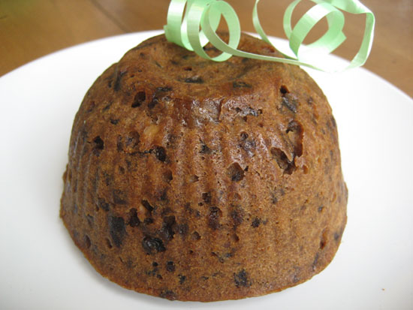
Thomson’s Atomic Model
Notes:
Atoms were made of electrons
However, atoms have an overall neutral charge
Electrons distributed in a uniform sea of positive charge
‘Plum pudding’ model

Slide 7
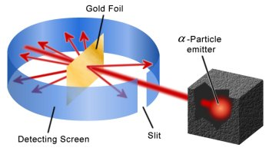
Geiger-Marsden Experiment (1909)
Goal: To measure distribution of charge in atom
Notes:
Beam of positively charged alpha particles directed normally to a sheet of very thin gold foil
Gold foil is surrounded by Zinc Sulfide sheet; ZnS lights up when alpha particles impact
Particles should only be deflected a few degrees

Slide 8
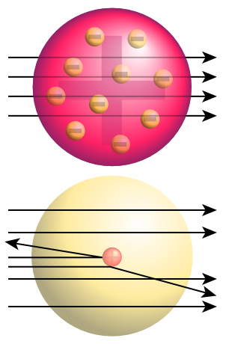
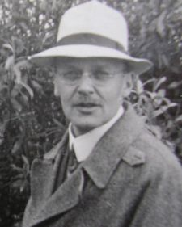
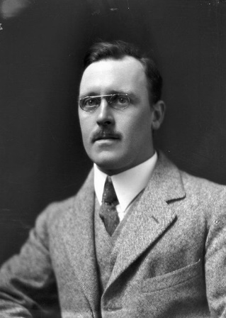
Geiger-Marsden Experiment (1909)
Most particles did as expected
Observed a few percentage of α-particles were deflected through angle > 90°
How can this be true?
Hans Geiger Ernest Marsden

Slide 9
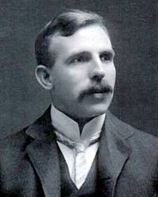
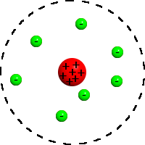
Rutherford Model (1911)
“Plum pudding” model incorrect
Some α-particles were deflected or reflected
Many α-particles passed through
Rutherford’s planetary model
Notes:
Some α-particles were deflected or reflected
Concentrated center of positive charge
Center has relatively large mass
Since many α-particles passed through
Center must be small size
Most of the atom must be open space

Slide 10
Rutherford Model (1911)
Problems with Rutherford’s planetary model
  Electron would lose energy (EM radiation)
  As electron spirals inward, emission would gradually increase in frequency as orbit got smaller and faster
  Produce continuous smear, in frequency, of EM radiation
  Atom has extremely short lifetime (unstable)
Notes:
According to this model, nothing should not exist!

Slide 11
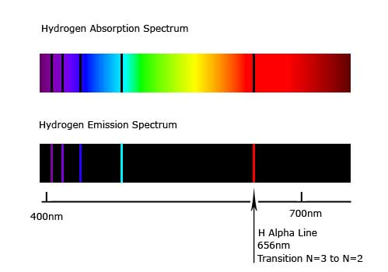
Rutherford Model (1911)
Problems with Rutherford’s planetary model
  Emission spectra of hydrogen is well known by 1908
  Only discreet lines are seen in the hydrogen spectra

Slide 12
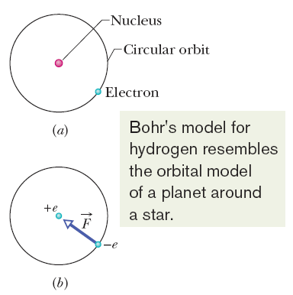
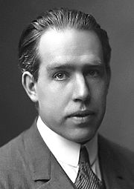
Bohr Model (1913)
Electrons can only be in certain stable orbits around the nucleus
Each orbit has an energy associated with it
Explained why atom is stable!
Only a certain number of electrons can exist in each orbital shell

Slide 13
Bohr Model (1913)
Light emitted/absorbed
  Emitted when electron jumps from higher orbit to lower orbit
  Absorbed when it jumps from a lower to higher orbit
  Energy & frequency of light emitted/absorbed is given by difference between the two orbit energies
Explained why only certain lines
are observed in H-spectra!

Slide 14

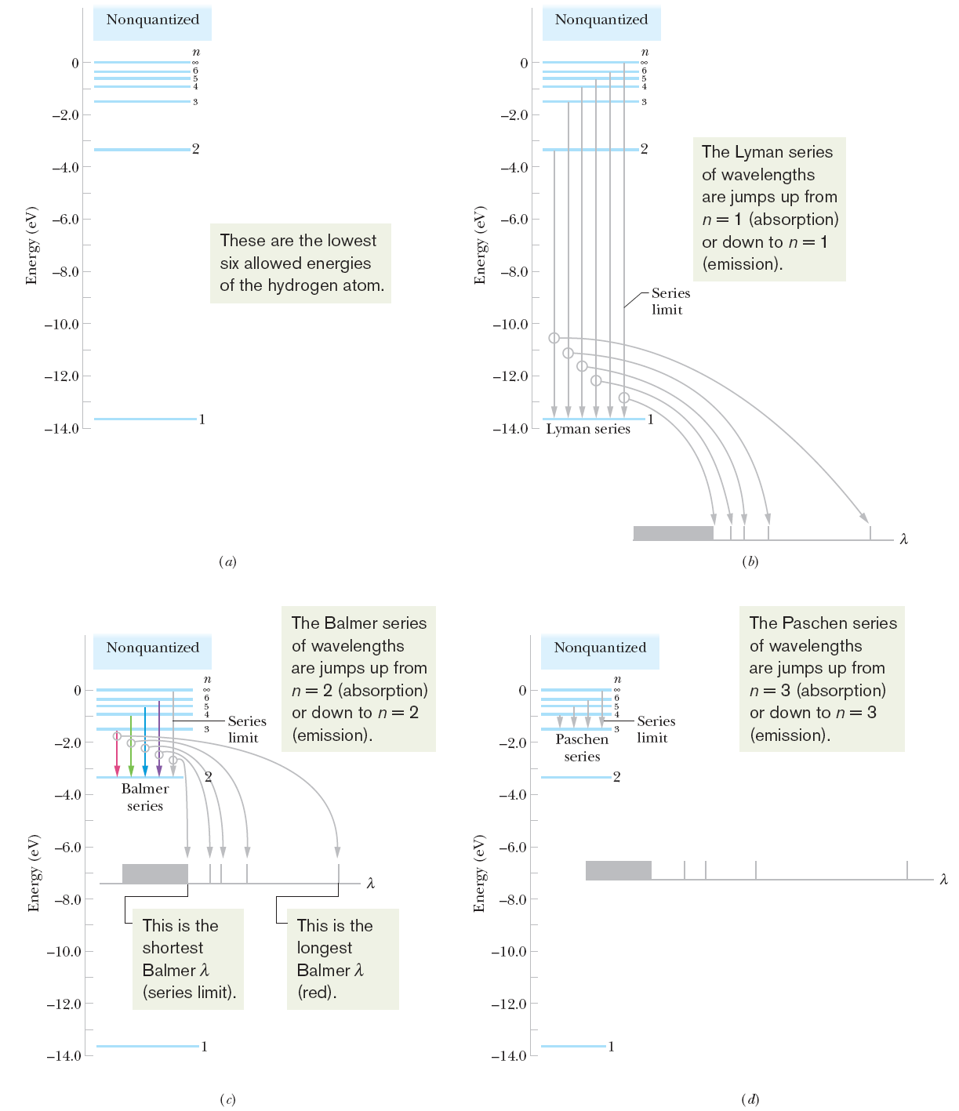
The Hydrogen Atom
Notes:
(a) An energy-level diagram for the hydrogen atom. Some of the transitions for (b) the Lyman series. For each, the longest four wavelengths and the series-limit wavelength are plotted on a wavelength axis. Any wavelength shorter than the series-limit wavelength is allowed.

Slide 15
Example Problem
For the Lyman series, what is energy for the 1, 2, and 3 transitions?
Remember that
So for n = 1
E₁ = - 2.180 × 10⁻¹⁸ J /(1)²
E₁ = - 2.180 × 10⁻¹⁸ J
So for n = 2
E₁ = - 2.180 × 10⁻¹⁸ J /(2)²
E₁ = - 5.45 × 10⁻¹⁷ J
So for n = 3
E₁ = - 2.180 × 10⁻¹⁸ J /(3)²
E₁ = - 2.422 × 10⁻¹⁷ J

Slide 16
Example Problem
For the Lyman series, what is energy for the 1, 2, and 3 transitions?
Remember that
So for n = 1
E₁ = - 2.180 × 10⁻¹⁸ J /(1)²
E₁ = - 2.180 × 10⁻¹⁸ J
So for n = 2
E₁ = - 2.180 × 10⁻¹⁸ J /(2)²
E₁ = - 5.45 × 10⁻¹⁷ J
So for n = 3
E₁ = - 2.180 × 10⁻¹⁸ J /(3)²
E₁ = - 2.422 × 10⁻¹⁷ J

Slide 17
Example Problem
For the Lyman series, what is energy for the 1, 2, and 3 transitions?
Remember that
So for n = 1
E₁ = - 2.180 × 10⁻¹⁸ J /(1)²
E₁ = - 2.180 × 10⁻¹⁸ J
So for n = 2
E₁ = - 2.180 × 10⁻¹⁸ J /(2)²
E₁ = - 5.45 × 10⁻¹⁷ J
So for n = 3
E₁ = - 2.180 × 10⁻¹⁸ J /(3)²
E₁ = - 2.422 × 10⁻¹⁷ J

Slide 18
The Hydrogen Atom
Notes:
Some of the transitions for (c) the Balmer series, and (d) the Paschen series. For each, the longest four wavelengths and the series-limit wavelength are plotted on a wavelength axis. Any wavelength shorter than the series-limit wavelength is allowed.

Slide 19
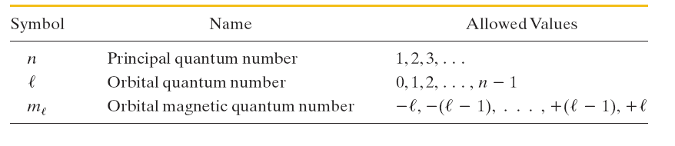
Quantum numbers and the Hydrogen Atom
Each set of quantum numbers (n, l, m_{l}) identifies the wave function of a particular quantum state. The quantum number n, is called the principal quantum number. The orbital quantum number l is a measure of the magnitude of the angular momentum associated with the quantum state. The orbital magnetic quantum number m_{l} is related to the orientation in space of this angular momentum vector.
The restrictions on the values of the quantum numbers for the hydrogen atom, as listed in the table, are not arbitrary but come out of the solution to Schrödinger’s equation.

Slide 20

Photons
But notice here we are talking about light that is emitted or absorbed by an atom. In 1905, Einstein proposed that electromagnetic radiation (or simply light) is quantized and exists in elementary amounts (quanta) that we now call photons.
According to that proposal, the quantum of a light wave of frequency f has the energy
Here h is the Planck constant, which has the value

Slide 21
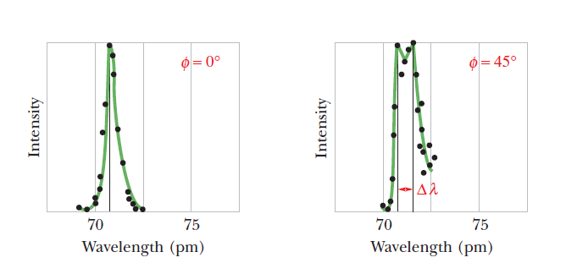
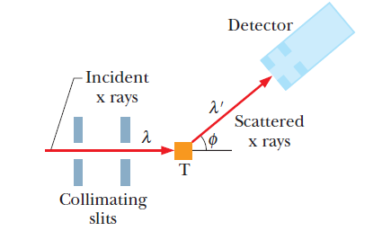
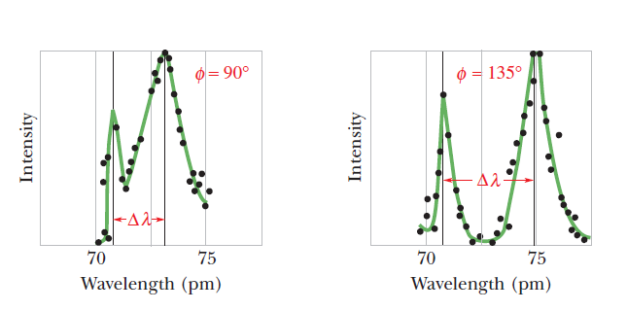

Photon Have Momentum
The Compton Effect
Notes:
Compton’s results for four values of the scattering angle φ. Note that the Compton shift Δλ increases as the scattering angle increases.

Slide 22
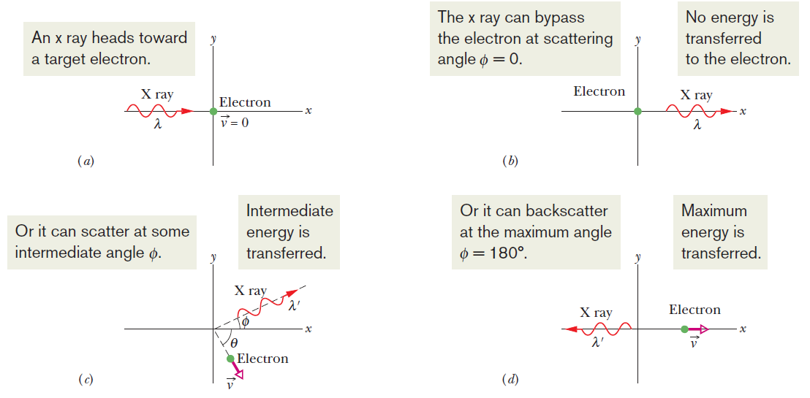


Photon Have Momentum
The Compton Effect
As a result of the collision, an x ray of wavelength λ’ moves off at an angle φ and the electron moves off at an angle θ, as shown. Conservation of energy then gives us
Here hf is the energy of the incident x-ray photon, hf’ is the energy of the scattered x-ray photon, and K is the kinetic energy of the recoiling electron. Since the electron may recoil with a speed comparable to that of light, then the Compton shift is defined as:
Notes:
The quantity h/mc is a constant called the Compton wavelength.

Slide 23
Example Problem
A sodium vapor lamp emits light at a wavelength of 590 nm. What is the momentum of the photons produced by the light and their frequency? Assume that the speed of light is c = 3 × 10⁸ m/s.
Remember that
Converting the wavelength
λ = 590 nm = 590 × 10⁻⁹ m
So, p = (6.63 × 10⁻³⁴ J · s)/ (590 × 10⁻⁹ m) = 1.12 × 10⁻²⁷ kg·m/s
Based on the equation:
f/c = 1/λ
Rearranging this equation we see that f = c/λ
f = (3 × 10⁸ m/s) /(590 × 10⁻⁹ m) = 5.08 × 10¹⁴ Hz

Slide 24
Example Problem
A sodium vapor lamp emits light at a wavelength of 590 nm. What is the momentum of the photons produced by the light and their frequency? Assume that the speed of light is c = 3 × 10⁸ m/s.
Remember that
Converting the wavelength
λ = 590 nm = 590 × 10⁻⁹ m
So, p = (6.63 × 10⁻³⁴ J · s)/ (590 × 10⁻⁹ m) = 1.12 × 10⁻²⁷ kg·m/s
Based on the equation:
f/c = 1/λ
Rearranging this equation we see that f = c/λ
f = (3 × 10⁸ m/s) /(590 × 10⁻⁹ m) = 5.08 × 10¹⁴ Hz

Slide 25
Example Problem
A sodium vapor lamp emits light at a wavelength of 590 nm. What is the momentum of the photons produced by the light and their frequency? Assume that the speed of light is c = 3 × 10⁸ m/s.
Remember that
Converting the wavelength
λ = 590 nm = 590 × 10⁻⁹ m
So, p = (6.63 × 10⁻³⁴ J · s)/ (590 × 10⁻⁹ m) = 1.12 × 10⁻²⁷ kg·m/s
Based on the equation:
f/c = 1/λ
Rearranging this equation we see that f = c/λ
f = (3 × 10⁸ m/s) /(590 × 10⁻⁹ m) = 5.08 × 10¹⁴ Hz

Slide 26
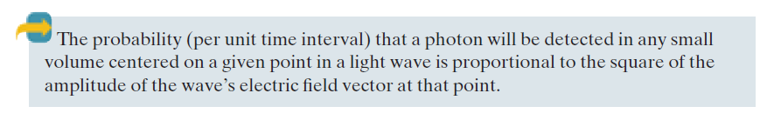
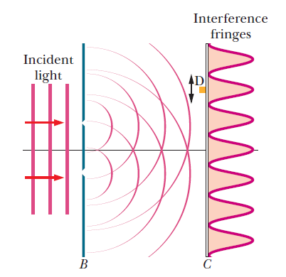
Light as a Probability Wave
Notes:
The probabilistic description of a light wave is another way to view light. It is not only an electromagnetic wave but also a probability wave. That is, to every point in a light wave we can attach a numerical probability (per unit time interval) that a photon can be detected in any small volume centered on that point.

Slide 27
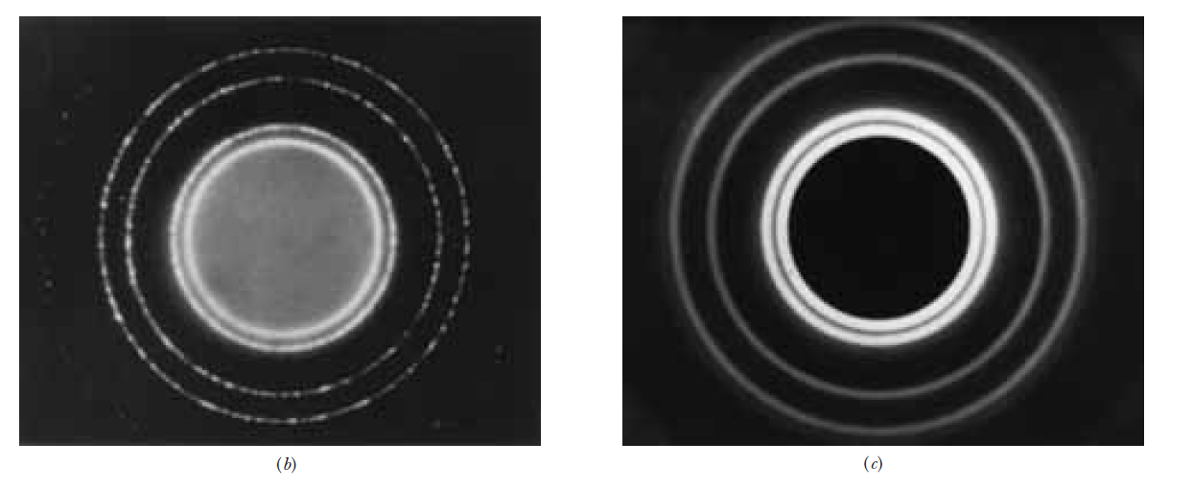

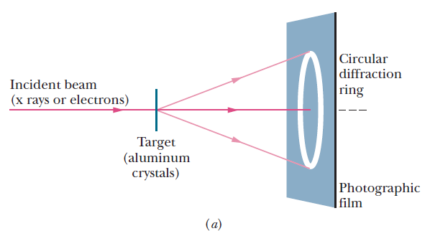
de Broglie Wavelength
Electrons & Matter Waves
de Broglie suggested that p =h/λ might apply not only
to photons but also to electrons

Slide 28
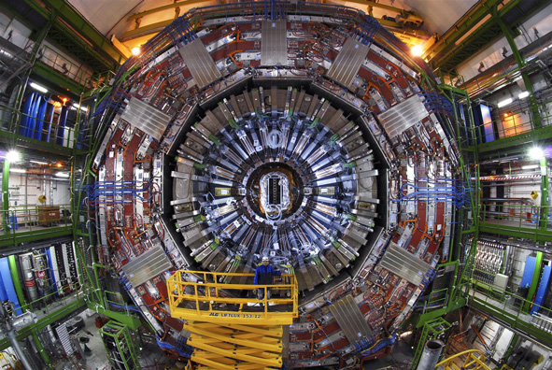
Particles
One of the large particle detectors that comprise the Large Hadron Collider at CERN in Geneva, Switzerland. SOURCE: © CERN

Slide 29
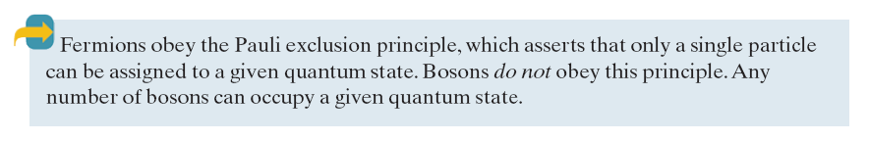

Particles: Fermions and Bosons
All particles have an intrinsic angular momentum called spin. The component of spin in any direction (assume the component to be along a z axis) is:
Fermions: particles with half-integer spin quantum numbers
Bosons: Particles with zero or integer spin quantum numbers
Leptons: Particles on which the strong force does not act, leaving the weak force as the dominant force
Hadrons: Particles on which the strong force acts
  Mesons: hadrons which are also bosons
  Baryons: hadrons which are also fermions
Notes:
All particles have an intrinsic angular momentum called spin. The component of spin in any direction (assume the component to be along a z axis) is:
Particles with half-integer spin quantum numbers (like electrons) are called fermions, after Enrico Fermi. Like electrons, protons and neutrons also have and are fermions.
Particles with zero or integer spin quantum numbers are called bosons, after Indian physicist Satyendra Nath Bose. Photons, which have s=1.
Particles on which the strong force acts are called hadrons. Protons, neutrons, and pions are hadrons.
Particles on which the strong force does not act, leaving the weak force as the dominant force, are called leptons. Electrons and neutrinos are leptons.
One can make a further distinction among the hadrons because some of them are bosons (called mesons); the pion is an example.
The other hadrons are fermions (we call them baryons); the proton is an example.

Slide 30

Particles
In 1928 Dirac predicted that the electron e⁻ should have a positively charged counterpart of the same mass and spin
Every particle has a corresponding antiparticle. The members of such pairs have the same mass and spin but opposite signs of electric charge (if they are charged) and opposite signs of quantum numbers.
When a particle meets its antiparticle, the two can annihilate each other. The particle and antiparticle disappear, and their combined energies reappear in other forms.
Antimatter: An assembly of antiparticles, such as an antihydrogen atom
Notes:
In 1928 Dirac predicted that the electron e⁻ should have a positively charged counterpart of the same mass and spin. The counterpart, the positron e⁺, was discovered in cosmic radiation in 1932 by Carl Anderson.
Physicists then gradually realized that every particle has a corresponding antiparticle. The members of such pairs have the same mass and spin but opposite signs of electric charge (if they are charged) and opposite signs of quantum numbers.
When a particle meets its antiparticle, the two can annihilate each other. The particle and antiparticle disappear and their combined energies reappear in other forms. For an electron annihilating with a positron, this energy reappears as two gamma-ray photons:
An assembly of antiparticles, such as an antihydrogen atom, is often called antimatter to distinguish it from an assembly of common particles (matter).

Slide 31
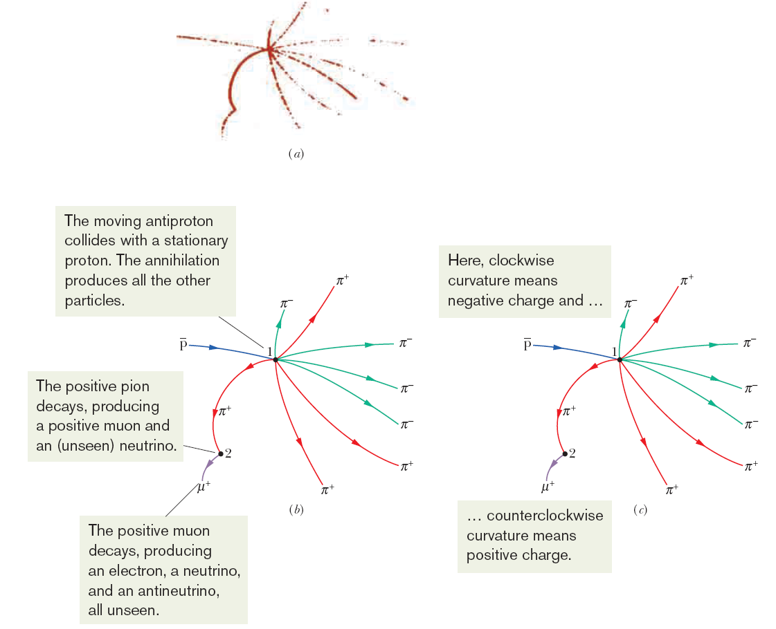



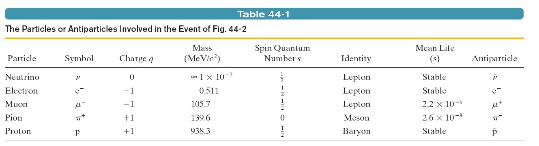
Particles in a Bubble Chamber
Decay Process:
Proton – Antiproton Annihilation
Pion Decay
Muon Decay

Slide 32

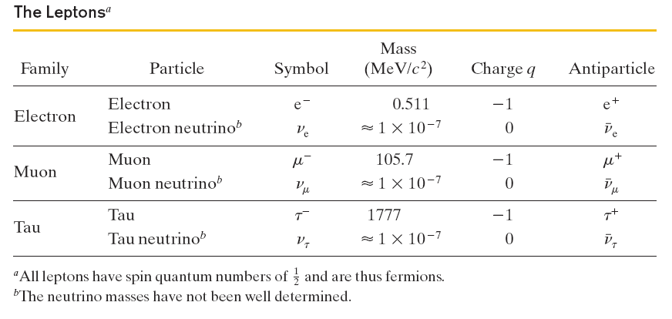
Particles: Leptons
Notes:
Particle interactions involving leptons obey a conservation law for a quantum number called the lepton number L. Each (normal) particle is assigned L=1, and each antiparticle is assigned L=-1. All other particles, which are not leptons, are assigned L=0.
There are actually three lepton numbers L_{e}, L_{μ}, L_{τ}, and the net of each must remain unchanged during any particle interaction.

Slide 33
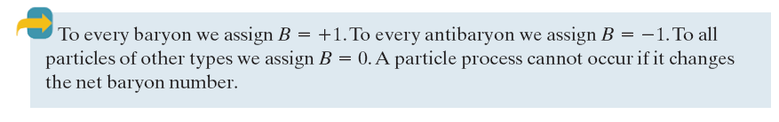
Particles: Hadrons
Baryons and mesons are hadrons, whose interaction are governed by the strong force. A new quantum can be introduced, called the baryon number, B. The conservation law of B is given as:

Slide 34
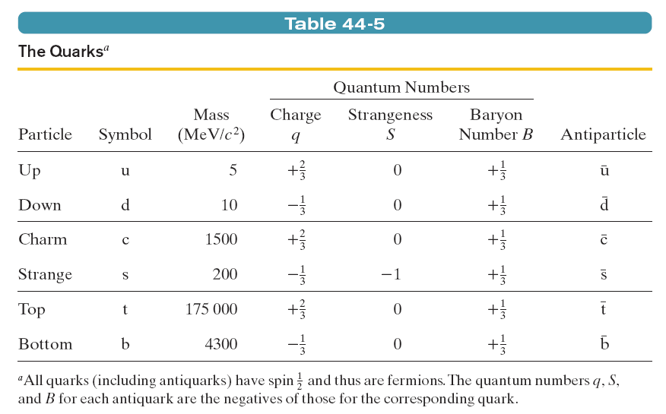
Quark Model
Notes:
In 1964 Gell-Mann and George Zweig independently pointed out that the eightfold way patterns can be understood in a simple way if the mesons and the baryons are built up out of subunits that Gell-Mann called quarks.
Quarks and Mesons:
Mesons are quark–antiquark pairs; this is consistent with the fact that mesons are not baryons, and have a baryon number B =0. The baryon number for a quark is +⅓ and for an antiquark is -⅓; thus, the combination of baryon numbers in a meson is zero.
The meson π⁺, consists of an up quark and an antidown quark; the charge quantum number of the up quark is +⅔ and that of the antidown quark is +⅓. This adds to a charge quantum number +1 for the π⁺ meson.
Still More Quarks:
There are three more quarks: the charm quark c, the top quark t, and the bottom quark b. These quarks are exceptionally massive, the most massive of them (top) being almost 190 times more massive than a proton. To generate particles that contain such quarks, with such large mass energies, one must go to higher and higher energies.

Slide 35

Electromagnetic Forces:
At the atomic level, Coulomb’s Law explains the electromagnetic force that two electrons exert on each other.
At a deeper level, this interaction is described by quantum electrodynamics (QED). It is assumed that each electron senses the presence of the other by exchanging photons with it.
These photons, called virtual photons, cannot be detected since they are emitted by one electron and absorbed by the other a very short time later. These are also called messenger particles.
If a stationary electron emits a photon and remains itself unchanged, energy is not conserved. The principle of conservation of energy is saved, by the uncertainty principle, written in the form
When electron A emits a virtual photon, the overdraw in energy is quickly set right when that electron receives a virtual photon from electron B, within a time frame given by the above relation.
Basic Forces and Messenger Particles

Slide 36
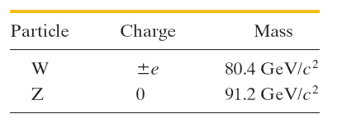
Basic Forces and Messenger Particles
The Weak Force:
A theory of the weak force, which acts on all particles, was developed by analogy with the theory of the electromagnetic force.
The messenger particles that transmit the weak force between particles, however, are not (massless) photons but massive particles, identified by the symbols W and Z.
The theory was so successful that it revealed the electromagnetic force and the weak force as being different aspects of a single electroweak force.

Slide 37
Basic Forces and Messenger Particles
The Strong Force:
The messenger particles in this case are massless, and are called gluons.
The theory assumes that each “flavor” of quark comes in three varieties, labeled red, yellow, and blue. Thus, there are three up quarks, one of each color, and so on. The antiquarks also come in three colors, which we call antired, antiyellow, and antiblue.
The force acting between quarks is called a color force and the underlying theory is called quantum chromodynamics (QCD).
Apparently, quarks can be assembled only in combinations that are color-neutral.
The color force not only acts to bind together quarks as baryons and mesons, but it also acts between such particles, in which case it has traditionally been called the strong force. Hence, not only does the color force bind together quarks to form protons and neutrons, but it also binds together the protons and neutrons to form nuclei.

Slide 38
Einstein’s Dream:
The unification of the fundamental forces of nature into a single force occupied Einstein’s attention for much of his later life.
The weak force has been successfully combined with electromagnetism so that they may be jointly viewed as aspects of a single electroweak force.
The grand unification theories (GUTs) attempt to add the strong force to this combination, and are being pursued actively.
Theories that seek to add gravity, sometimes called theories of everything (TOE), are at an encouraging but speculative stage at this time.
Basic Forces and Messenger Particles

Slide 39
