Slide 1
Introduction
Objective:
Relate and link the knowledge gained from the
course to your everyday life experiences
You will be learning some basic laws of Physics
and few simple topics in Chemistry
Very little mathematics will be used
Conceptual understanding will be emphasized.
Text: Concepts of Physics and Concepts of Chemistry
by Bobby Bailey and Openstax College

Slide 2
Science had its origins in thinking about nature: “Natural Philosophy”
580 BCE – Pythagoras (founded a school of philosophy)
350 BCE – Aristotle (first attempt at physics)
250 BCE – Archimedes (engineering)
150 BCE – Ptolemy (astronomy)
Science in Renaissance
1543 – Copernicus publishes “de Revolutionibus orbium coelestium” This book was revolutionary”, replacing the ideas of Ptolemy.
Around 1589 – Galileo creates the idea of modern experimental science. Galileo’s reliance on experiment led to Newton’s theories that replaced those of Aristotle.

Slide 3
1687 – Newton publishes “Principia Mathematica Naturalis Philosophiae”
We start with Newton’s mathematical ideas on Physics and Gravity.
1865 – Maxwell gives Electromagnetism and a molecular model for gases
Making tele-communication and cell phones possible!
Don’t forget to put your phone in “Airplane Mode” during class!
1905 – Einstein proposes the idea of Relativity and the Photon
We start with the era of “Modern physics”.
1913 – Niels Bohr presents Rutherford-Bohr model
We start with the rise of “Atomic physics”.

Slide 4
The Scientific Method (Formal method of doing science)
Recognize a question or problem
Make an hypothesis which is an educated guess to solve the problem that has not been thoroughly tested.
Predict consequences that can be observed and do experiments to see if predicted consequences are present.
Formulate the simplest general rule that organizes hypothesis, predicted effects and experimental findings.
A theory is a synthesis of many well-tested hypotheses that provide reliable predictions of what will happen in an experiment. Theories are not fixed, but evolve with time as new found knowledge refines theories.
A law is a statement of universally consistent natural phenomena and measured events. Things that we observe and agree to be true!

Slide 5
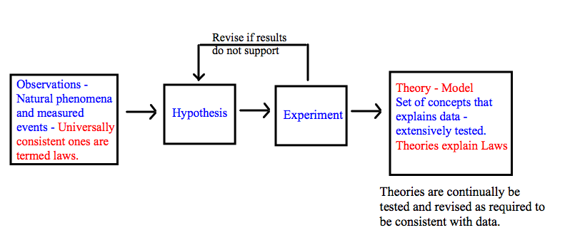
Hypothesis, Law and Theory
Both theories and laws have extensive experimental evidence to support them.
A theory is not a wild guess!
\

Slide 6
Which is a theory and which is a law?
I. GASES
___ As temperature rises, the pressure in a gas in a closed container increases.
___ The motion of molecules, which is the average kinetic energy of molecules, is related to temperature. Molecules move faster at higher temperature and thus collide with more force so that a higher pressure is generated.
II. GRAVITY
____ According to Einstein, gravity is due to the warping of the structure of space by the presence of mass. The larger the mass, which is a form of energy, the greater the warping of space around it and the greater the force of gravity.
____ As mass of object increases or mass of planet increases, so does the strength of gravitational attraction between the two. The strength is inversely proportional to square of the distance.

Slide 7
The Physical Sciences – Physics, Chemistry, Geology, Astronomy
Physics – study of basic concepts e.g. Motion, force, energy, matter etc.
Chemistry – builds on physics; how matter is put together to make molecules and material
Geology – Apply physics and chemistry to earth science (learn about earth and its processes)
Astronomy – Apply physics, chemistry and geology to other planets and stars
Basic Measurements
- Length, Mass, Time
CGS – Centimeter-Gram-Second
MKS – Meter- Kilogram – Second (SI units widely used in physics and other sciences)

Slide 8
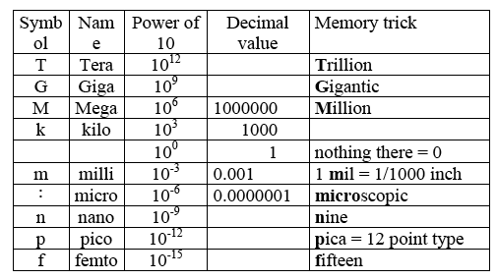
Metric Prefixes
μ
micro (μ) - one millionth 1 μs = 1 x 10⁻⁶ s
milli (m) - one thousandth 1 mm = 1 x 10^{–3} m
centi (c) - one hundredth 1 cm = 1 x 10⁻² m
kilo (k) - one thousand 1 kg = 1000 g
mega (M) - one million 1 MHz = 1 x 10⁶ Hz

Slide 9
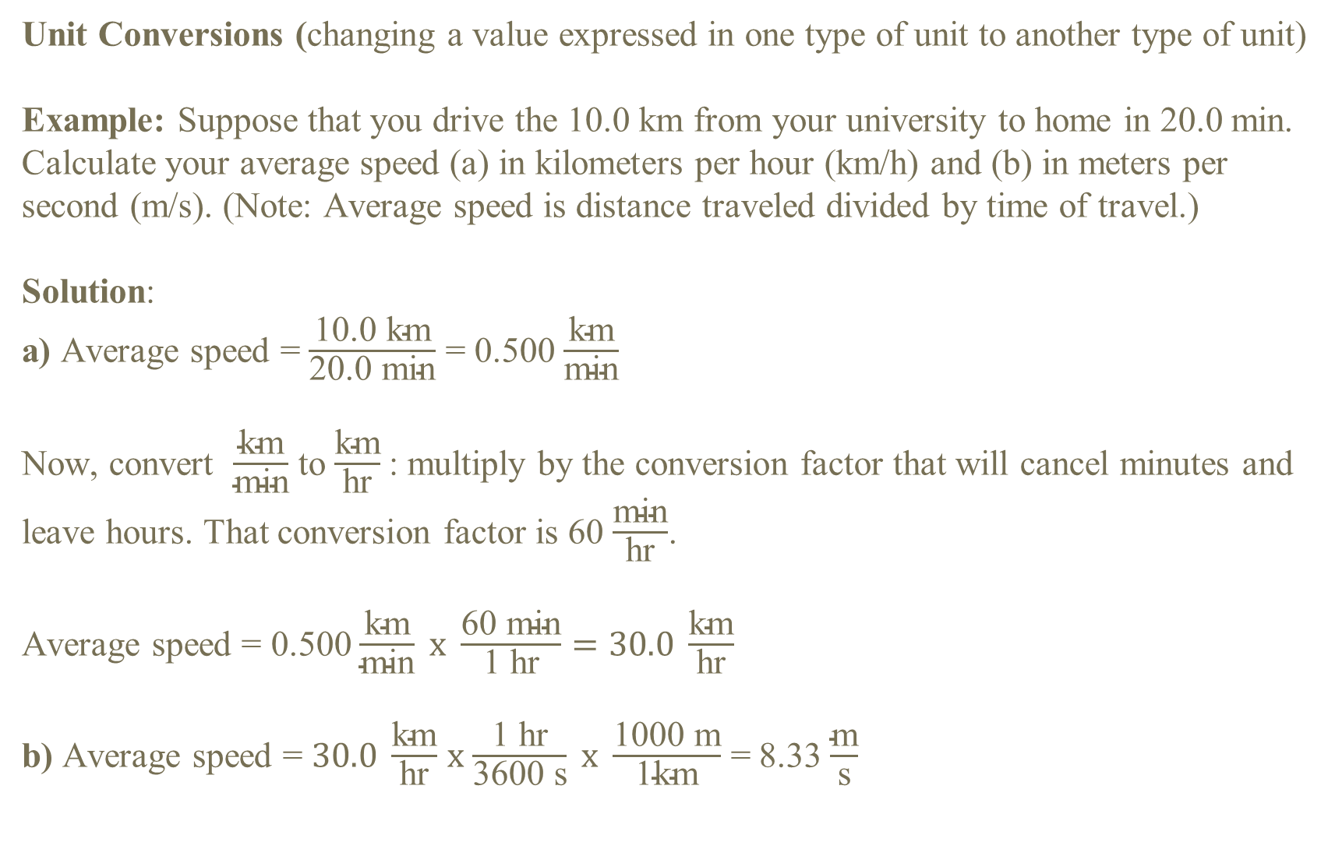
Unit Conversions (changing a value expressed in one type of unit to another type of unit)
Example: Suppose that you drive the 10.0 km from your university to home in 20.0 min. Calculate your average speed (a) in kilometers per hour (km/h) and (b) in meters per second (m/s). (Note: Average speed is distance traveled divided by time of travel.)
Solution:
a) Average speed = $\frac{\text{10.0 }\text{km}}{\text{20.0 }\text{min}}$ = 0.500 $\frac{\text{km}}{\text{min}}$
Now, convert $\frac{\text{km}}{\text{min}}$ to $\frac{\text{km}}{\text{hr}}$: multiply by the conversion factor that will cancel minutes and leave hours. That conversion factor is 60 $\frac{\text{m}\text{in}}{\text{hr}}$.
Average speed = 0.500 $\frac{\text{km}}{\text{min}} x \frac{\text{60 }\text{m}\text{in}}{\text{1 }\text{hr}}=30.0 \frac{\text{km}}{\text{hr}}$
b) Average speed = $30.0 \frac{\text{km}}{\text{hr}}$ $x$ $\frac{\text{1 }\text{hr}}{\text{3600 }\text{s}} x \frac{\text{100}\text{0 }\text{m}}{\text{1}\text{km}}$ = 8.33 $\frac{\text{m}}{\text{s}}$

