Slide 1
What is Matter made from?
Protons, p⁺
Neutrons, n
Electrons, e–

Slide 2
What is Matter made from?
Protons, p⁺
Neutrons, n
Electrons, e–
Neutrinos, ν

Slide 3
What is Matter made from?
Protons, p⁺
Neutrons, n
Are Constructed from smaller Particles:
Quarks

Slide 4
What is Matter made from?
strong force
quark
Protons, p⁺ Neutrons, n
quarks
up down

Slide 5
What is Matter made from?
strong force
strong force
In an atom, the strong force keeps
protons (and neutrons) inside the atomic nucleus

Slide 6
Electrons, e–
Neutrinos, ν
Are Fundamental Particles

Slide 7
Normal Matter
Protons, p⁺
Neutrons, n
Electrons, e–
Neutrinos, ν

Slide 8
Normal Matter Anti-Matter
Protons, p⁺ anti-Protons, p–
Neutrons, n anti-Neutrons, n
Electrons, e– anti-Electrons, e+
Neutrinos, ν anti-Neutrinos, ν

Slide 9
When an anti-proton meets a proton….
They annihilate each other and turn into pure light

Slide 10

IF an anti-nickel and a nickel met up
They would put out 9 x 10¹⁶ J — at 10 cents a J, those two nickels would be worth $ 90 trillion

Slide 11
Elements are DEFINED by their number of PROTONS
Protons, p⁺
Neutrons, n
Hydrogen:
Helium:
Carbon:
smallest piece
of an element is
an ATOM

Slide 12
Model of the Atom
Hydrogen Atom: 1 P⁺ and 1 e–

Slide 13
Model of the Atom

Slide 14
Model of the Atom

Slide 15

Very few hit solid material!

Slide 16
Model of the Atom
Mostly empty space!
empty space to solid mass =
a hundred trillion to 1!
or, 99.9999999999999% empty space!

Slide 17
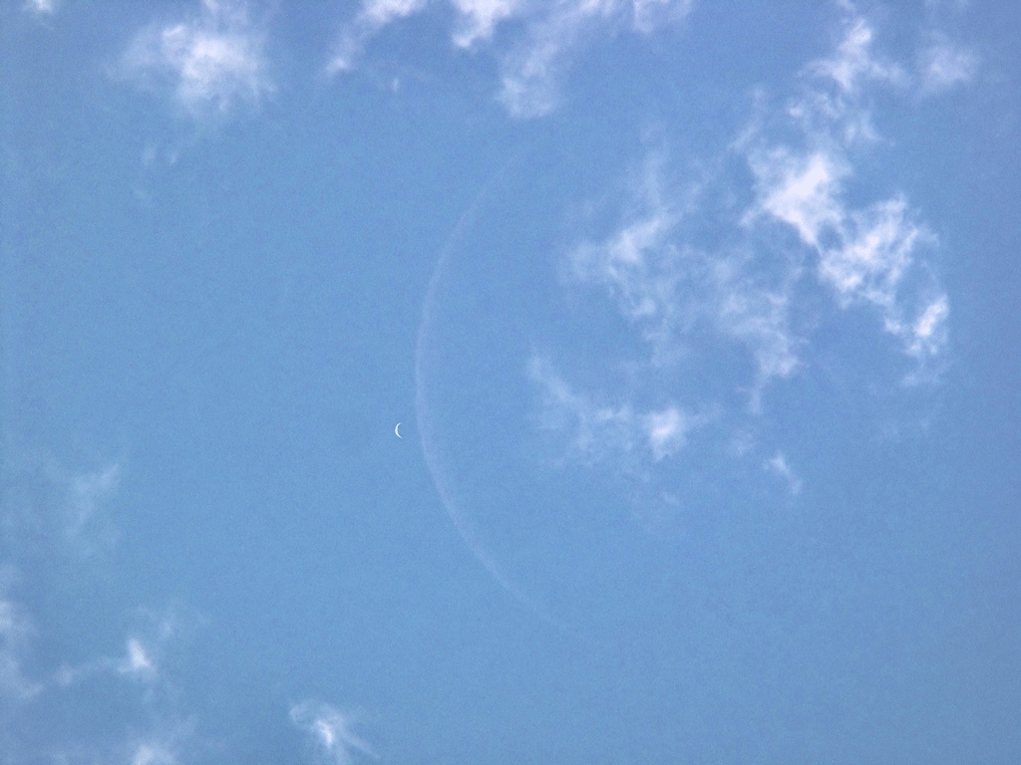
Bohr Model of the Atom
electrons exist as solid particles
-
electron proton

Slide 18
Bohr Model of the Atom
electrons exist as solid particles
e in low energy state
-
e cannot exist inbetween these energy levels
e in high energy state
-

Slide 19
Bohr Model of the Atom
If this model were correct, the e would lose energy and an atom would last only a billionth of a second!!
electrons exist as solid particles
-

Slide 20
Bohr Model of the Atom
if the atom is mostly empty space, why can’t we walk through walls?
electrons exist as solid particles
-

Slide 21
Bohr Model of the Atom
electrons exist as solid particles
-
-
– The atom is mostly space…. So we should be able to push one atom through another.
– the Bohr model is WRONG!

Slide 22

Electron Cloud Model of the Atom
e exists as a probability distribution around the atom

Slide 23
Electron Cloud Model of the Atom
So why can’t we walk through walls?

Slide 24
Electron Cloud Model of the Atom
Because the e charge (and mass) is spread out all over the atom
—
—
—
—
—
—
—
—
—
—
—
—
—
—
—
—
—
—
—
—
—
—
—
—
—
—

Slide 25
Electron Cloud Model of the Atom
So the Electromagnetic Force prevents one atom moving through another.
—
—
—
—
—
—
—
—
—
—
—
—
—
—
—
—
—
—
—
—
—
—
—
—
—
—
—
—
—
—
—
—
—
—
—
—
—
—
—
—
—
—
—
—
—
—
—
—
—
—
—
—

Slide 26

e Cloud with e in the lowest Energy level
n = 1

Slide 27

e Cloud with e in the next higher Energy level
n = 2

Slide 28
It is easier to imagine an Energy Ladder:
with an electron on one of the "rungs"
Energy
n = 5
n = 4
n = 3
n = 2
n = 1

Slide 29
Energy Ladder
electrons can jump to different energy
levels IF they can find exactly the right energy
Energy
n = 5
n = 4
n = 3
n = 2
n = 1

Slide 30
VIDEO: Energy Ladder of Hydrogen
https://youtu.be/QI50GBUJ48s

Slide 31
Elements are DEFINED by their number of PROTONS
Protons, p⁺
Neutrons, n
Hydrogen:
Helium
Carbon

Slide 32
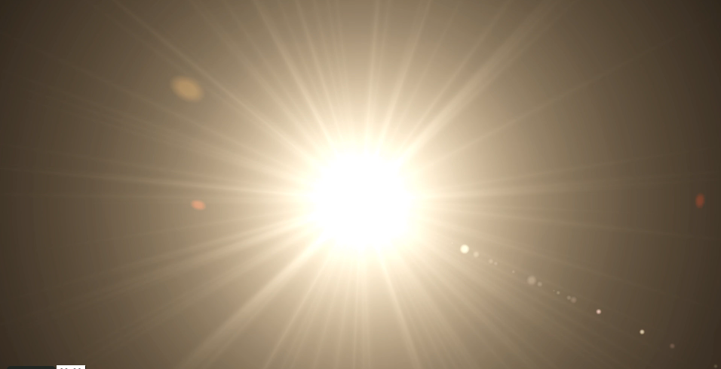

Slide 33
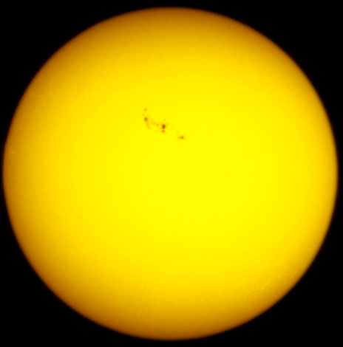
Sun as you see it in visible light with a filter —
the "photosphere"

Slide 34
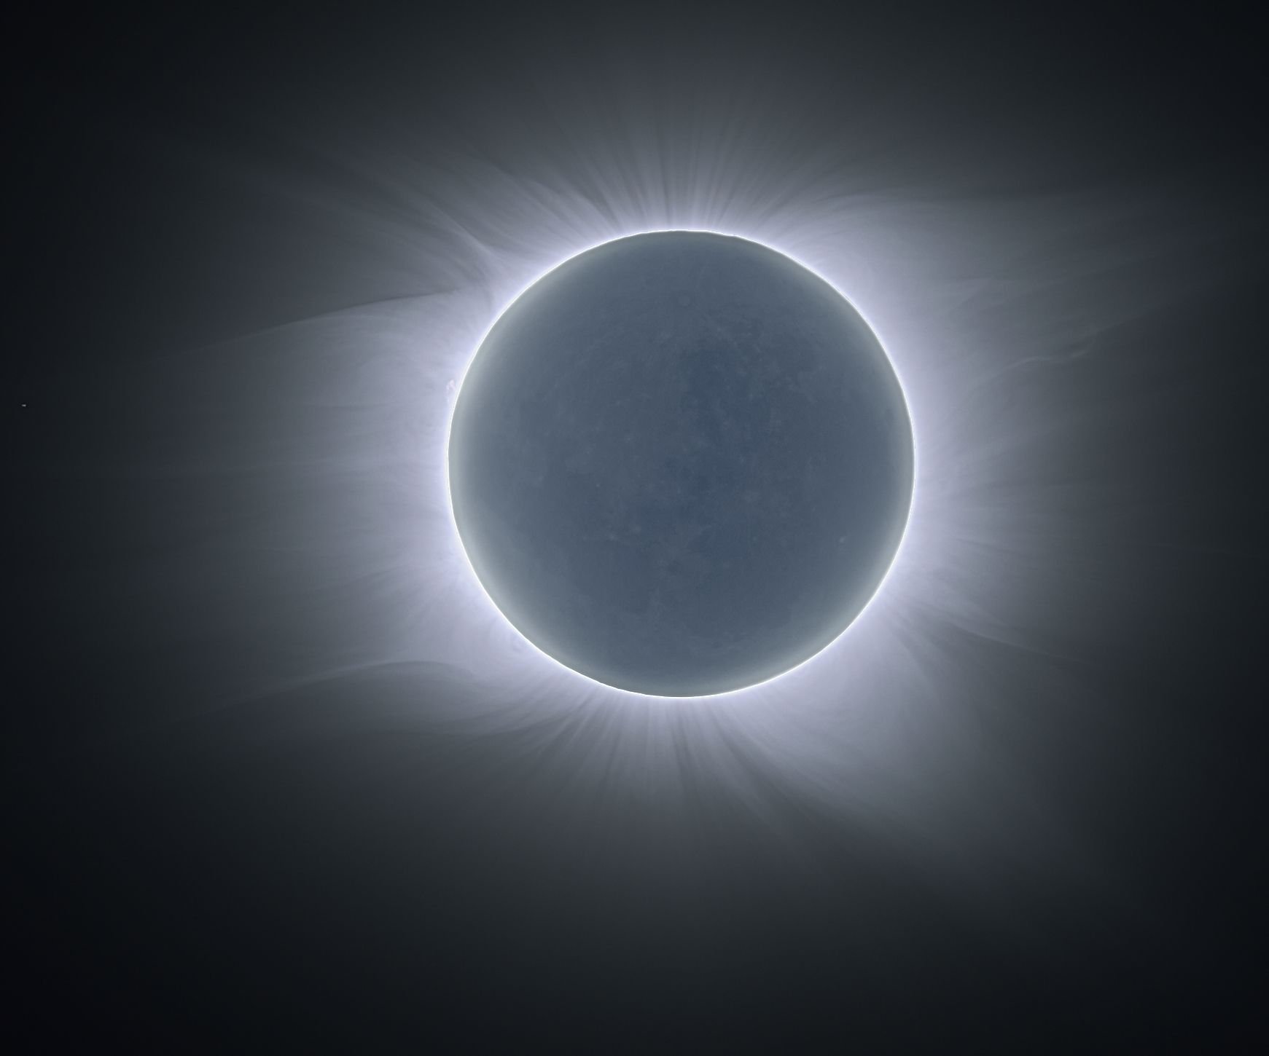

Sun as you see don’t see it —
the photosphere and corona

Slide 35
Corona seen during total solar eclipse

Slide 37
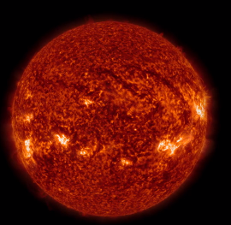
Sun filtered to see somewhat cooler H gas

Slide 38
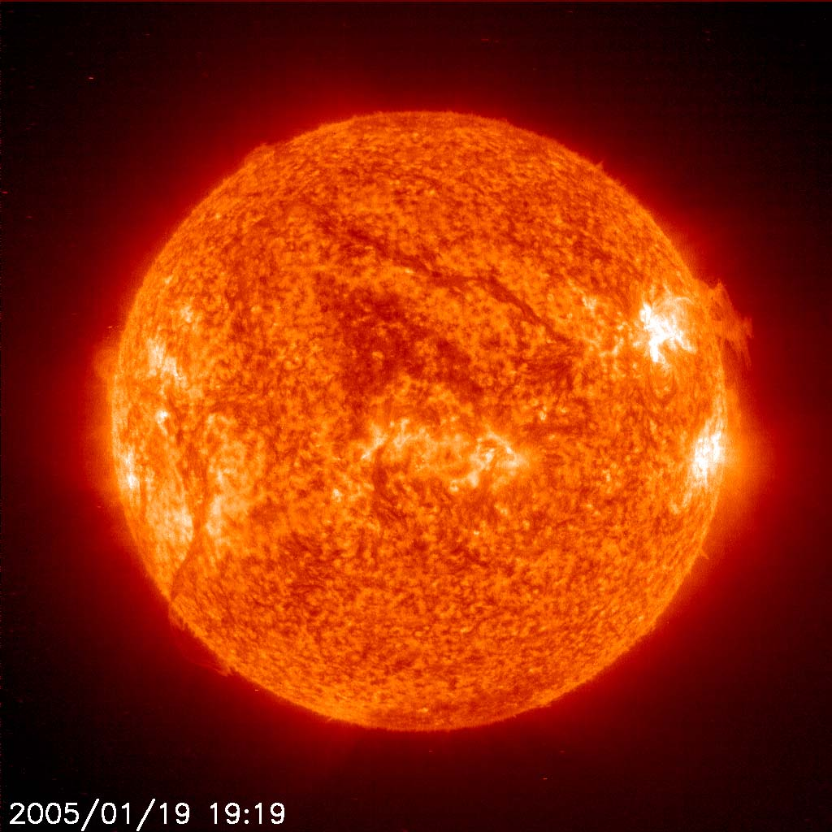
Sun with very narrow Hydrogen filter

Slide 39
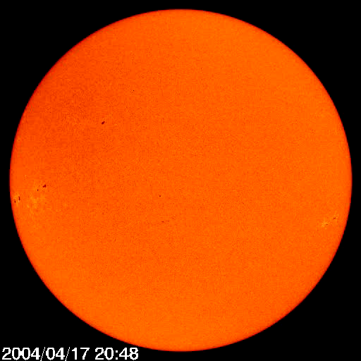
Sun with red light filter — rotates about once a month
Notes:
Current_mdi_igr.mpg

Slide 40
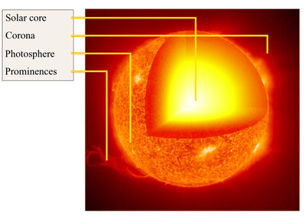
Corona
Photosphere
Prominence
Outside
the Sun

Slide 41
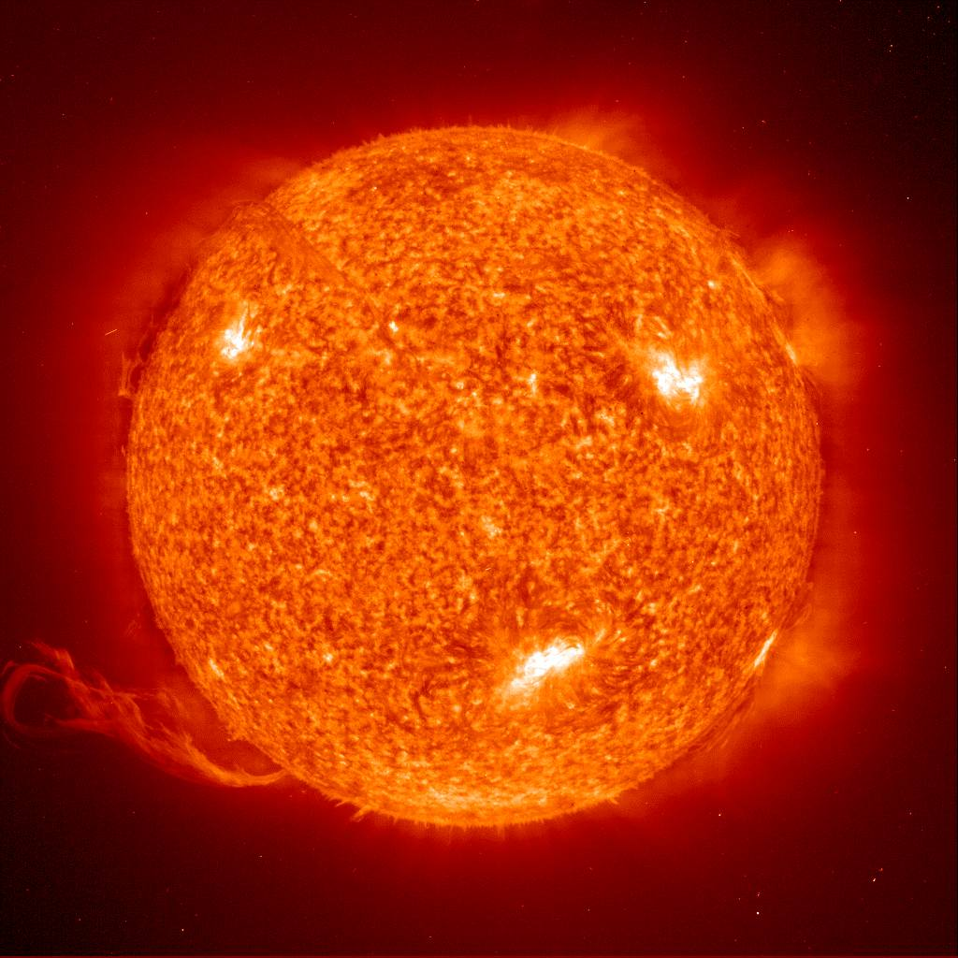
Prominence

Slide 42
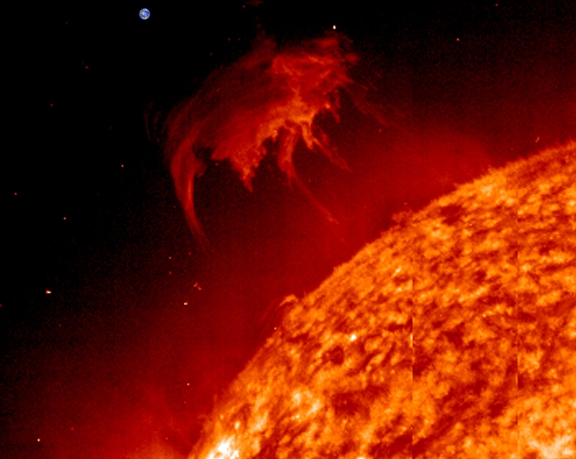

Slide 43
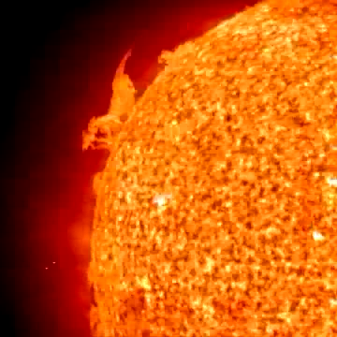
solar prominence
Notes:
Eitquad.mpg or EITmainS.mov

Slide 44
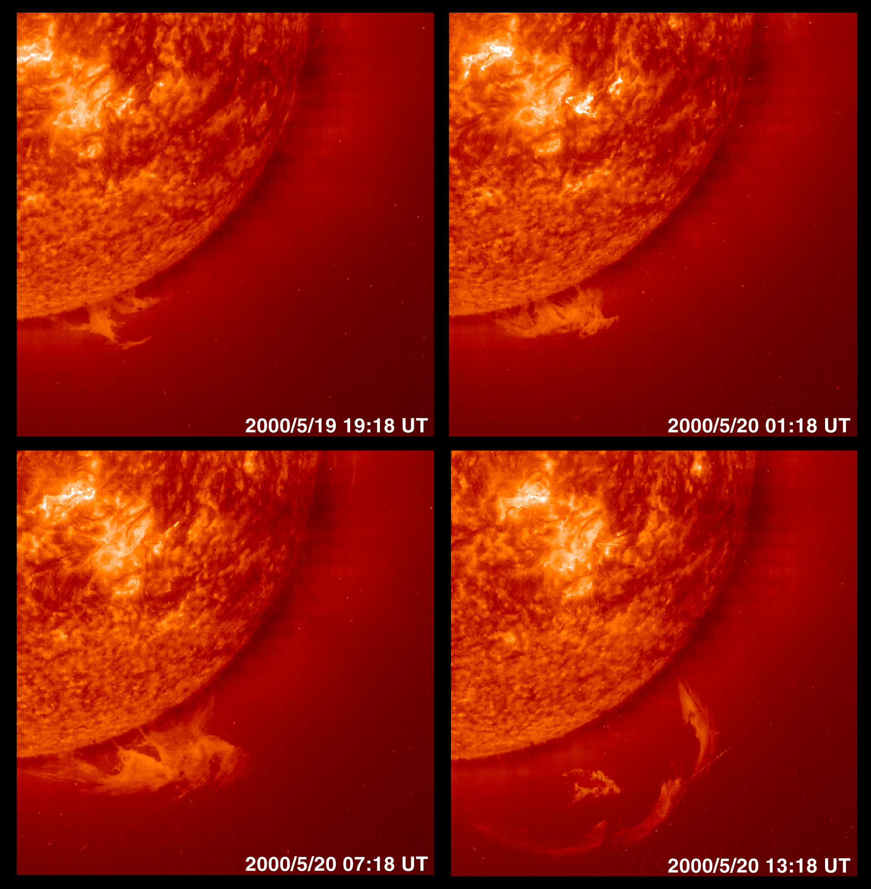

Slide 45
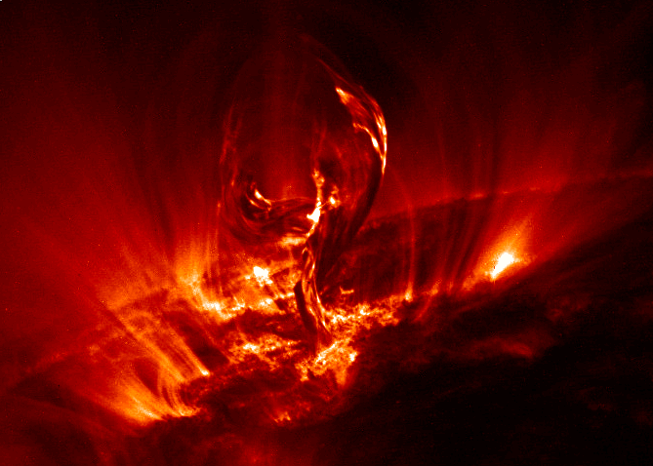
magnetic structure breaking as flare punches through
(x-ray light)
Notes:
From TRACE sat. near sun. X ray?

Slide 46
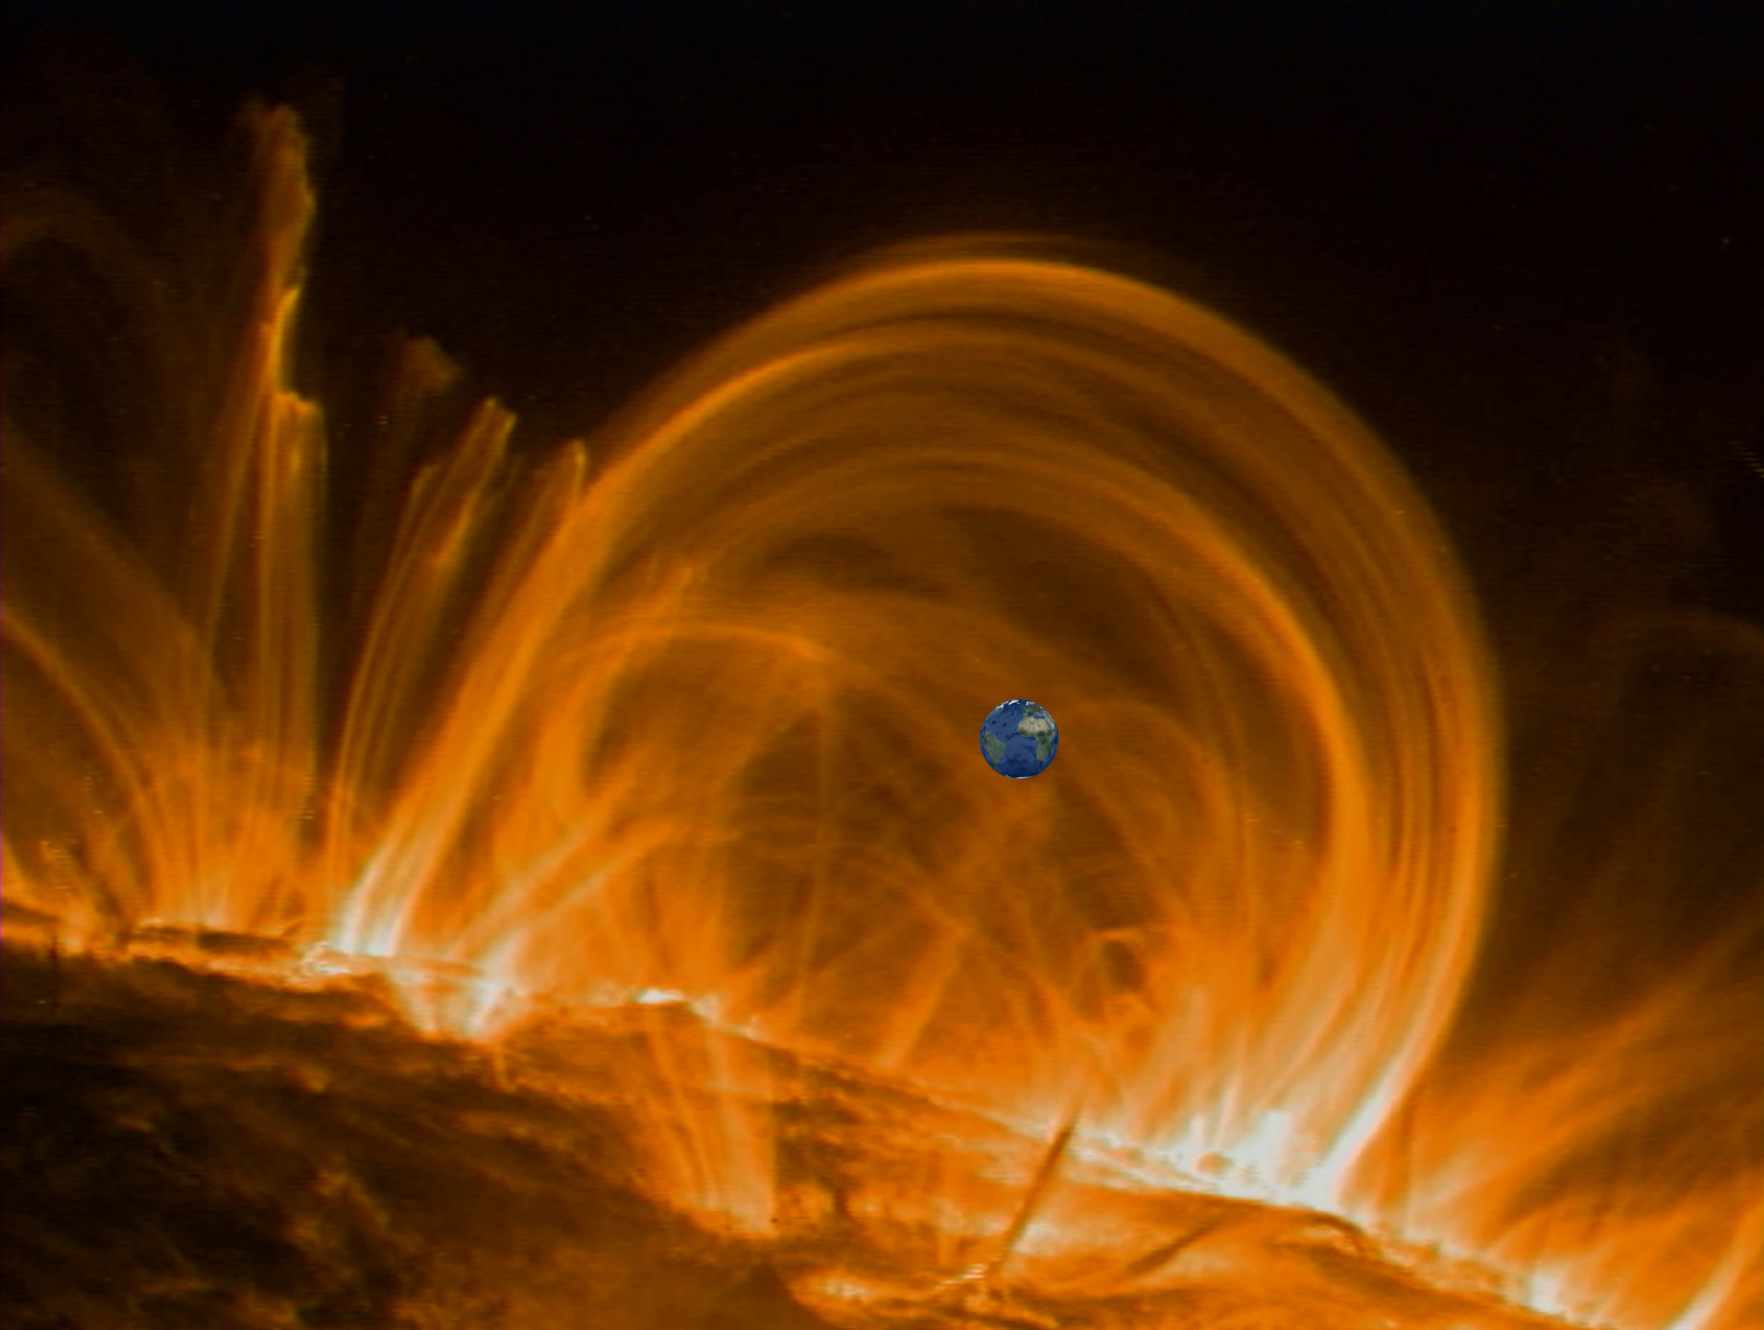

Slide 47
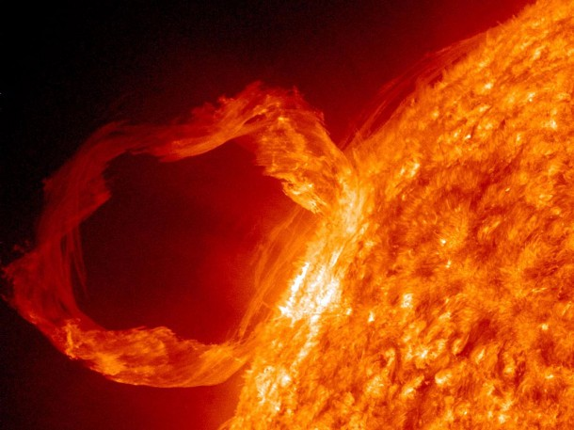

Slide 48
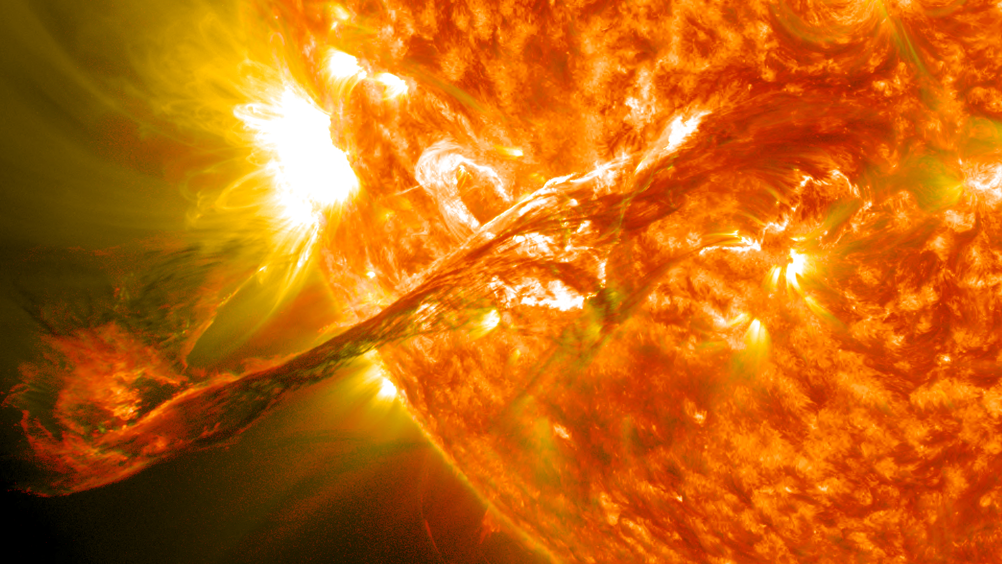

Slide 49
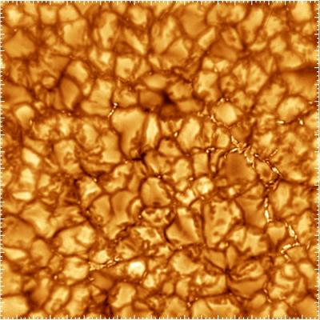
The photosphere is caldron of convective cells

Slide 50
Size of the United States
Convective cells break at the photosphere. Hot H gas rises to the photosphere in cells, cools and then gas descends.

Slide 51
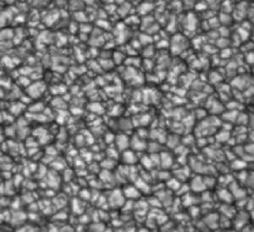
Size of the United States
Convective cells in motion (time lapse)
Notes:
Gran_mov27M_99_crea.mpg

Slide 52
Size of Earth
Sunspots are cooler than the surrounding photosphere

Slide 53
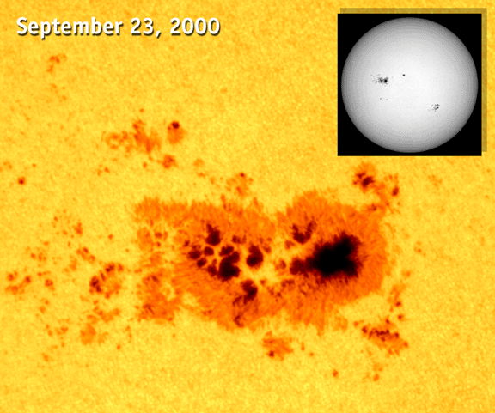

Slide 54
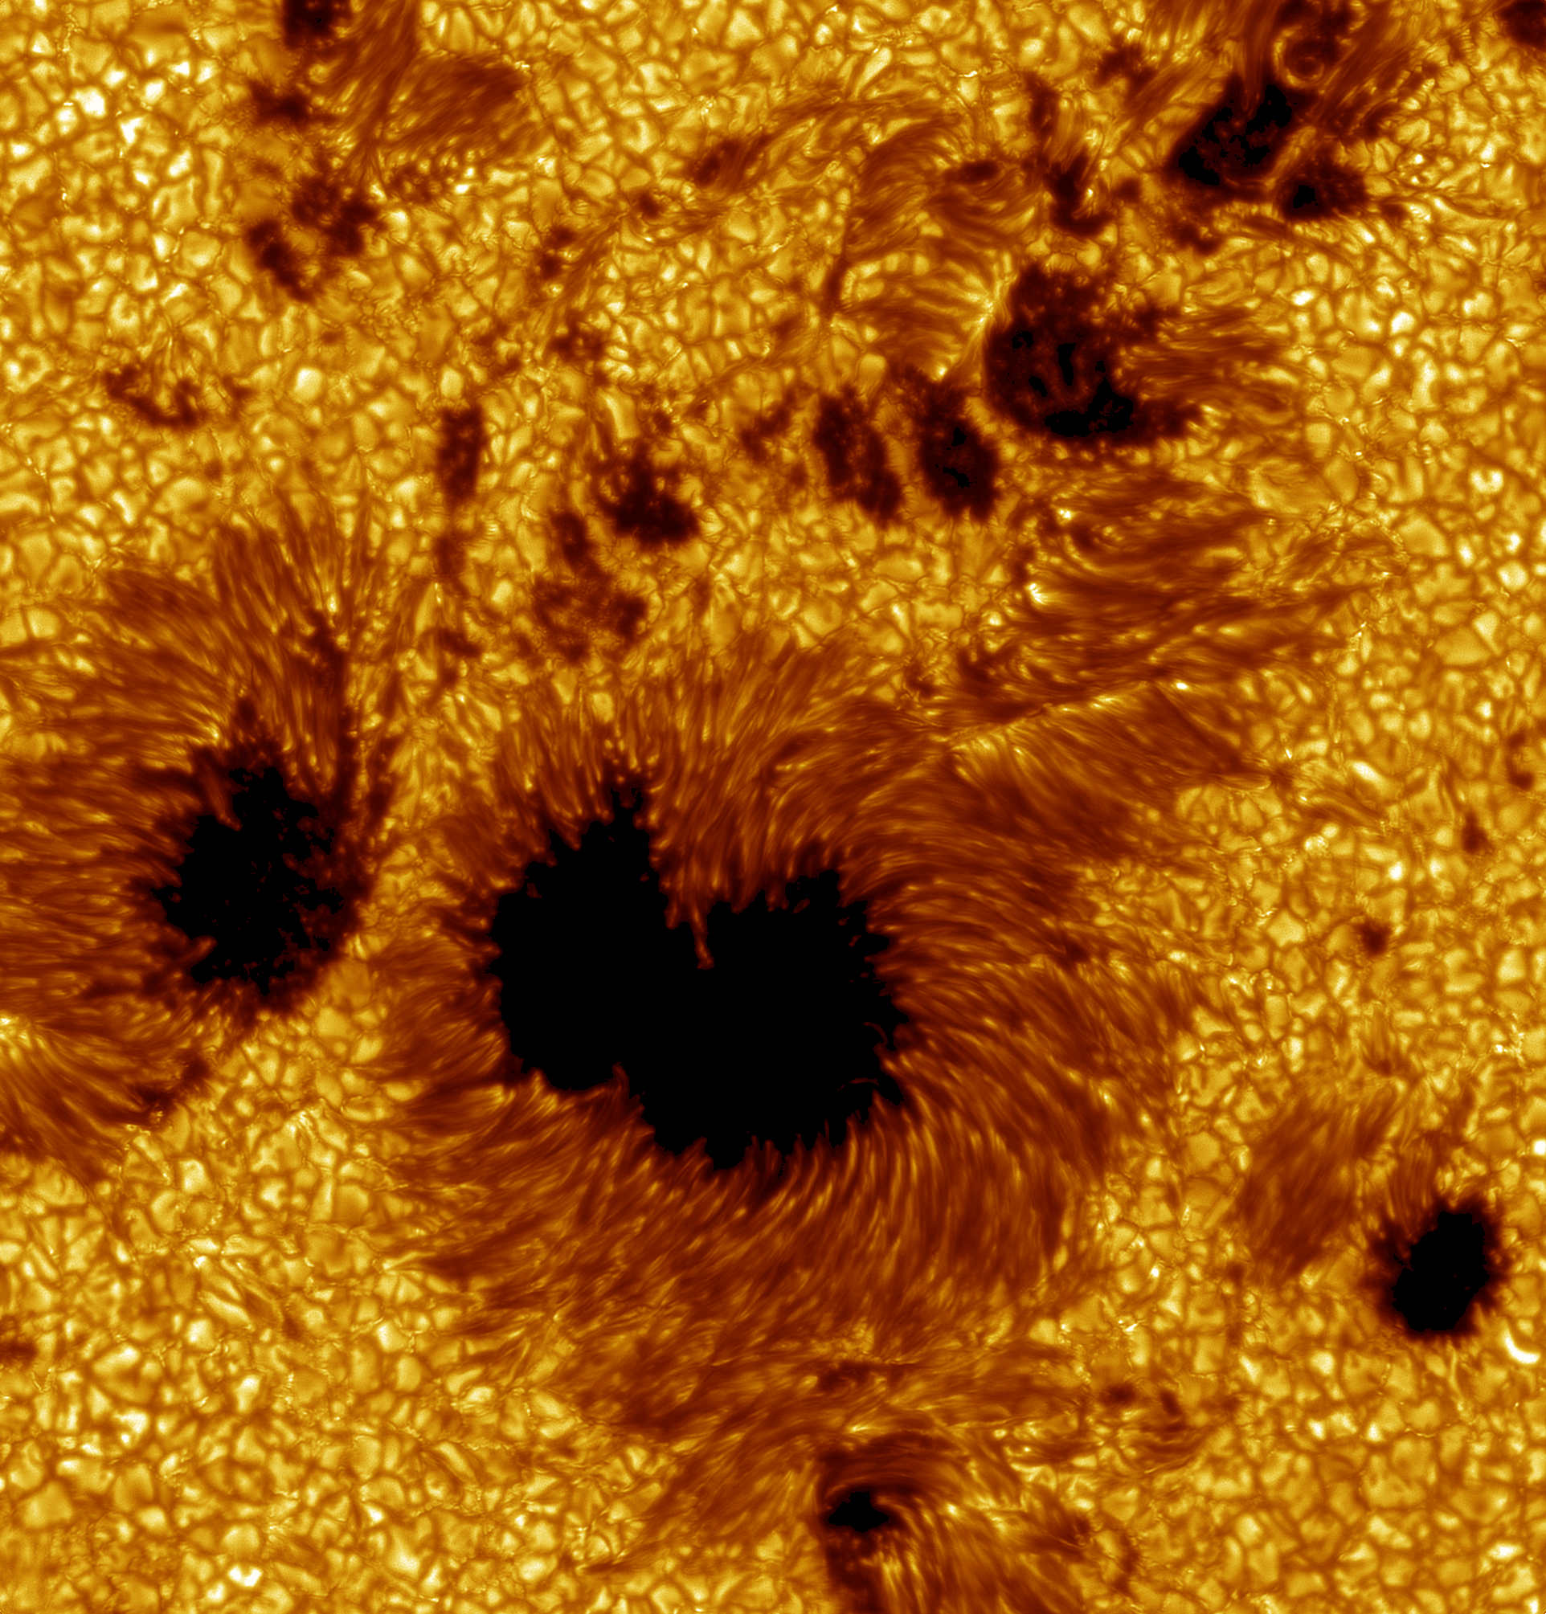
Sunspots

Slide 55
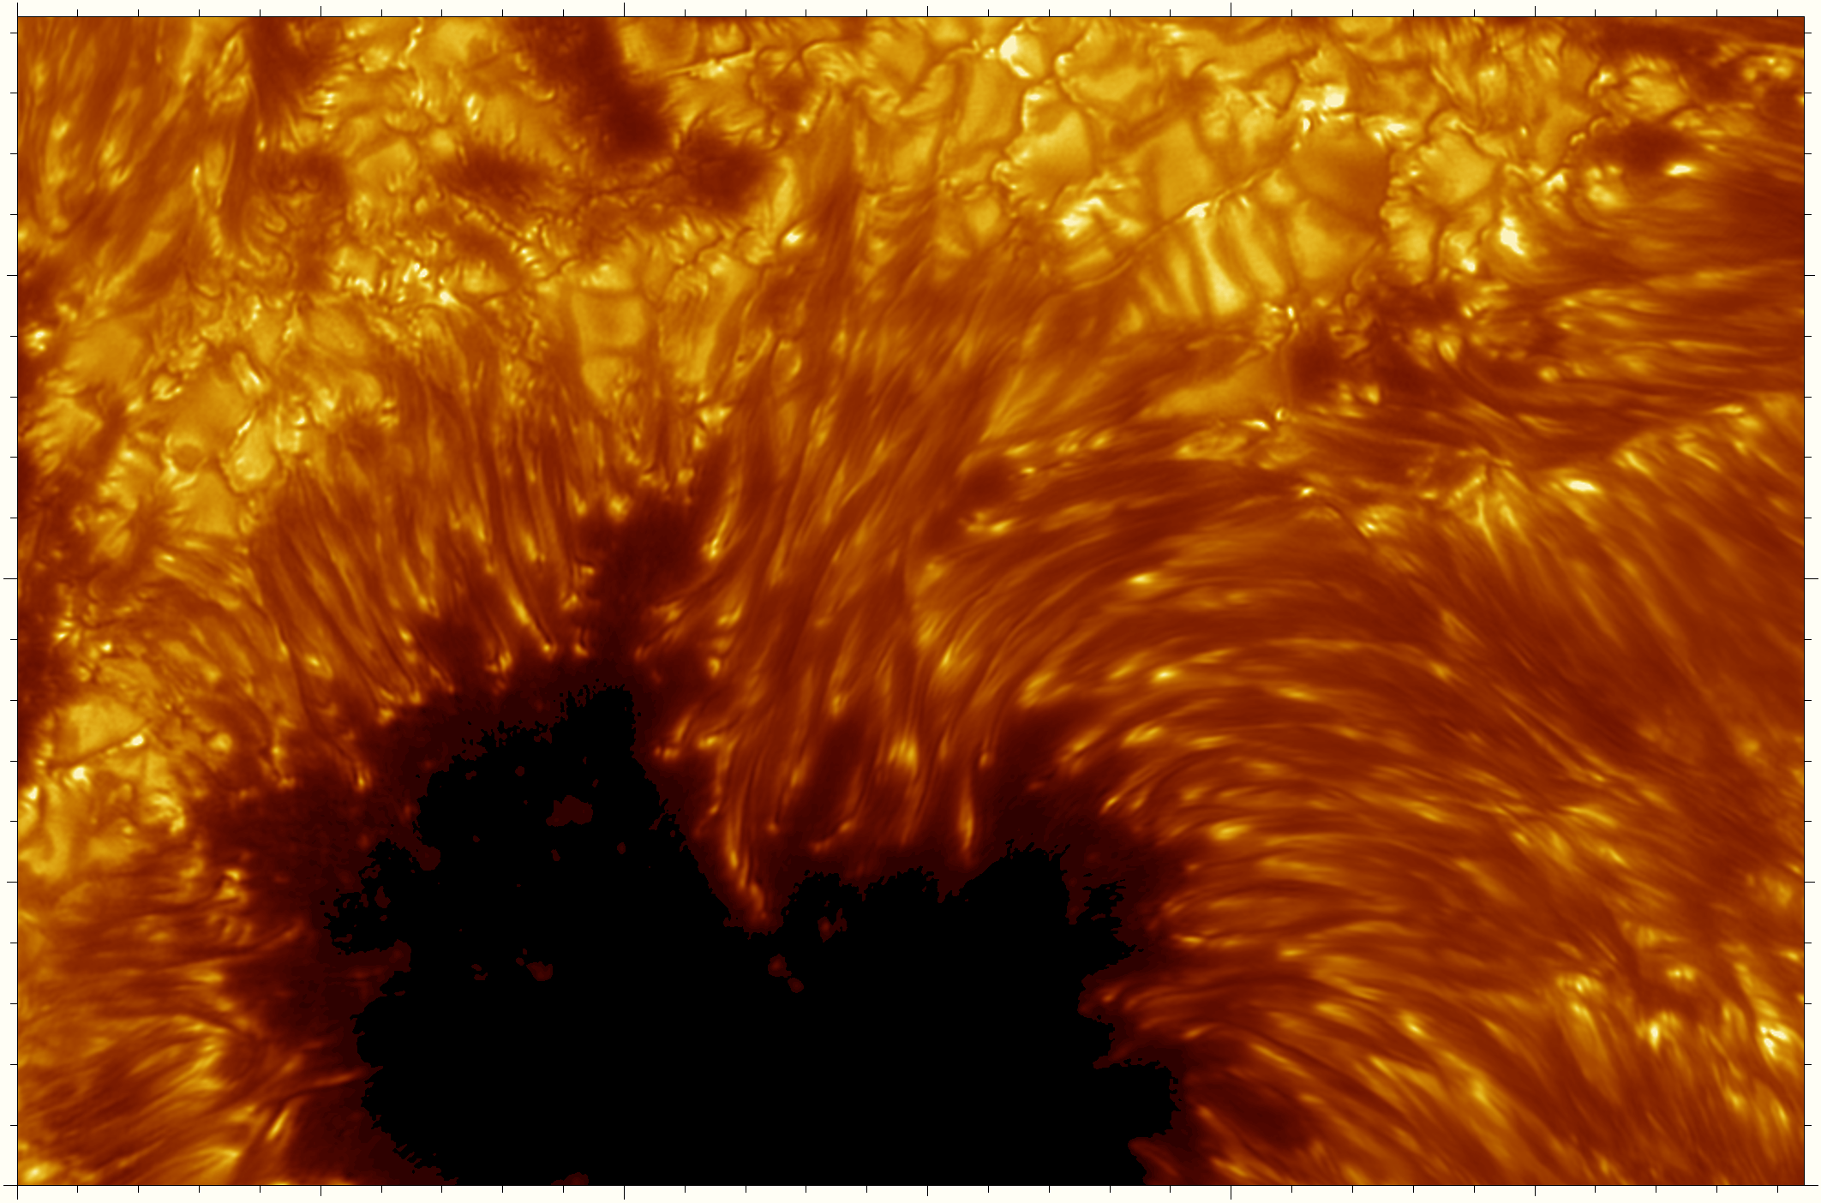

Slide 56
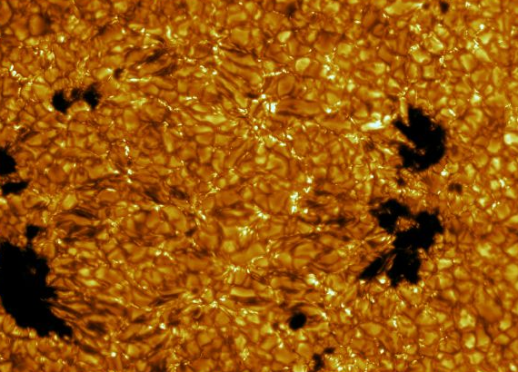

Slide 57
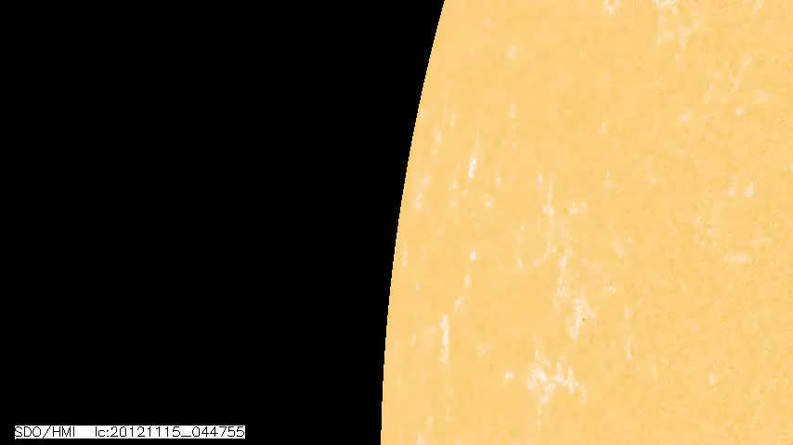

Slide 58
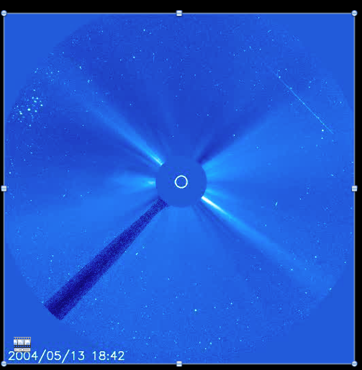

solar wind
corona
photosphere
background stars
arm to hold occulting disk
occulting disk to block brightest part of Sun
Notes:
Currenr_c3.mpg

Slide 59
view of Sun and sky though SOHO space telescope with occulting disk
view of telescope

Slide 60
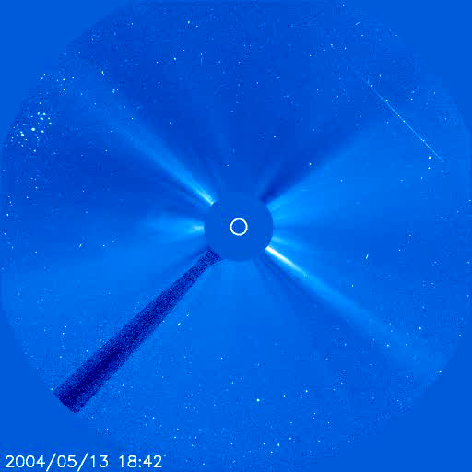
solar wind particles have speeds about 400 km/s
(75 million mph)
Notes:
Currenr_c3.mpg

Slide 61
Flares
and
Coronal Mass Ejections
(CME)

Slide 62
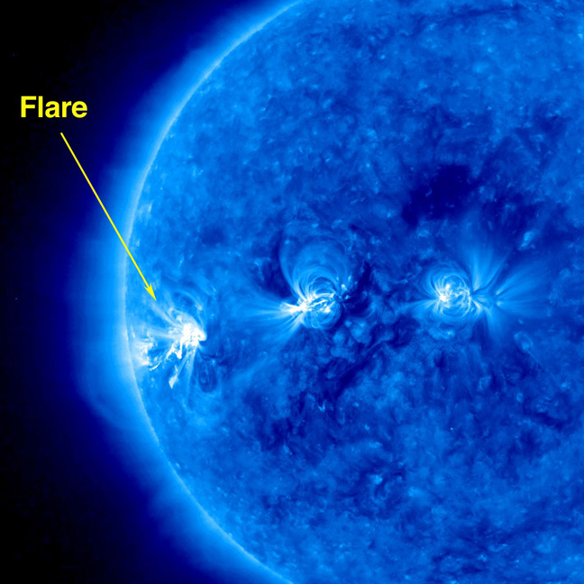
Flares punch through the photosphere, corona, and particles can reach up to 20% of the speed of light

Slide 63
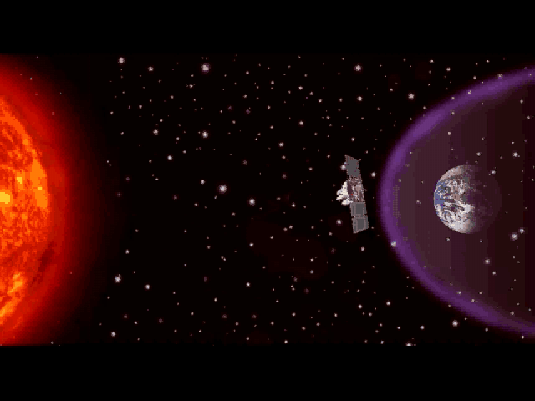
Coronal Mass Ejections (CME)
160 x 10⁹ MTons TNT
atomic bomb: 0.015 MTon TNT

Slide 64
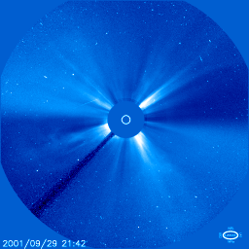
particles have speeds to 3200 km/s for Flare for
Coronal Mass Ejection (CME) (7 million mph)
Notes:
cme.gif

Slide 65
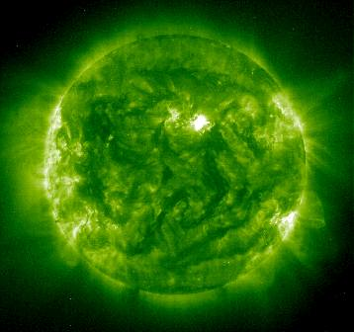
Sun in x-ray light — light emitted by the hottest material hovering above the Sun in the CORONA

Slide 66
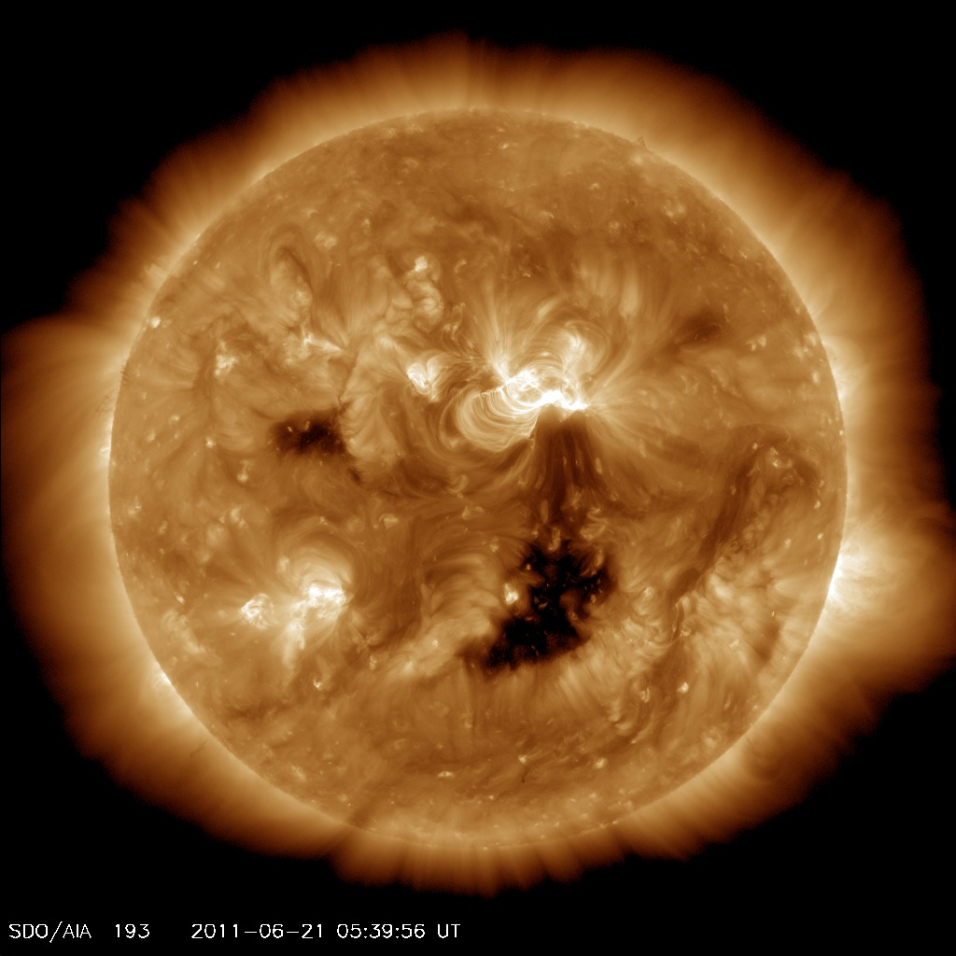
CORONAL HOLE
Sun in x-ray light — CORONA

Slide 67
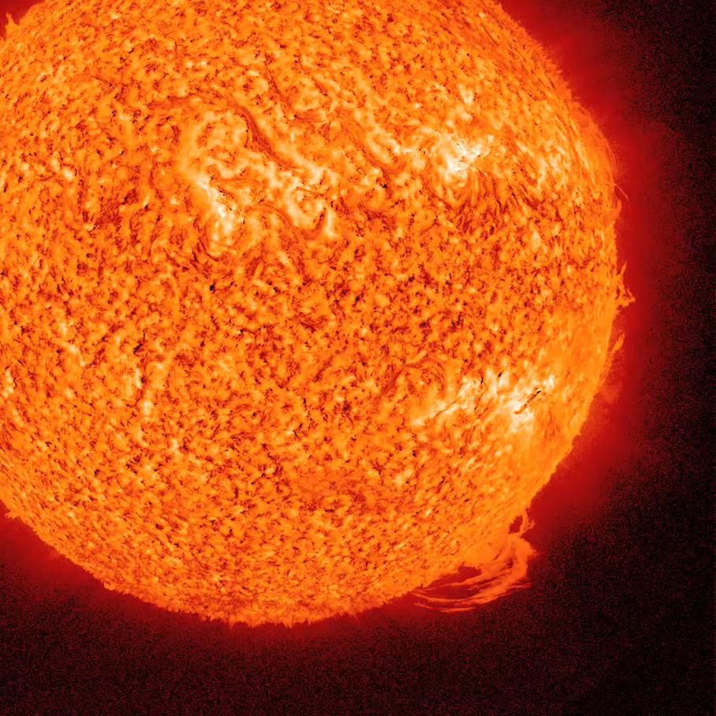
Notes:
sunflare.mov

Slide 68
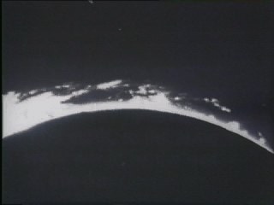
Notes:
Sun_errup.mov
prominences followed by large CME

Slide 69
Notes:
LASCO20011001.gif

Slide 70
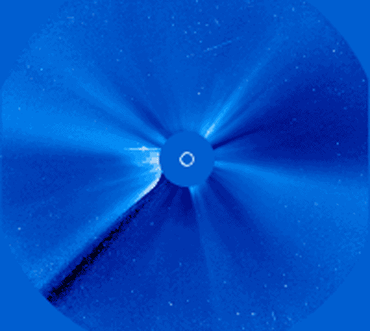
This Flare was aimed directly at Earth. The spots are hits from protons and electrons on the telescope’s detector.
Notes:
xflare_soho_big.gif

Slide 71
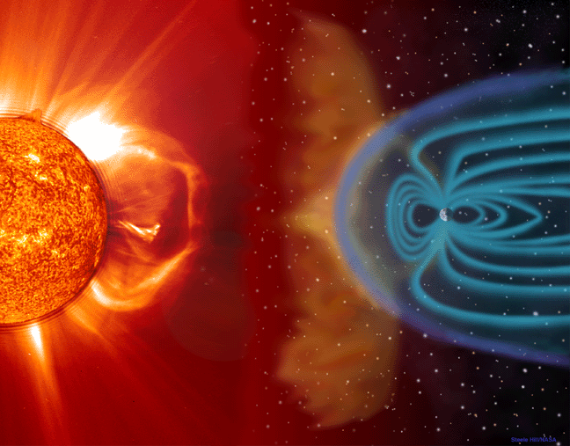
magnetic field of Earth
How does this affect us on Earth?

Slide 72
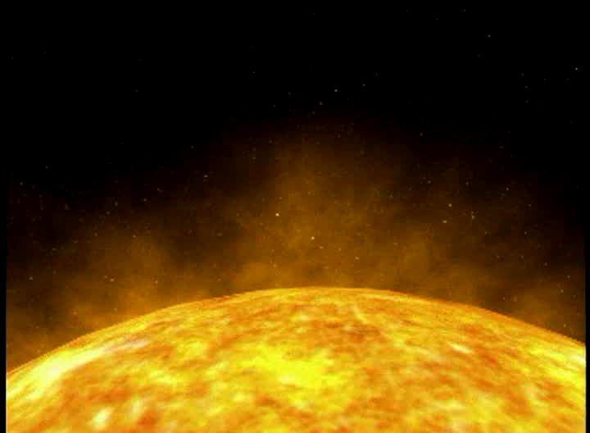
Notes:
Recon.mpg

Slide 73
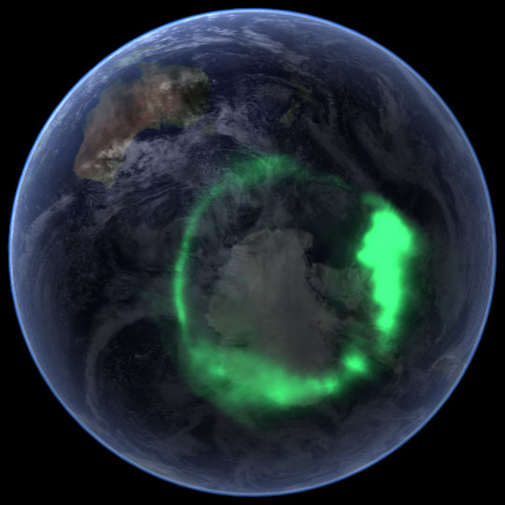
Notes:
from NASA mosaic satellites

Slide 74
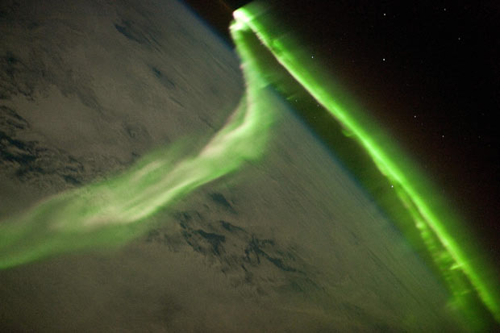
Notes:
from ISS

Slide 75
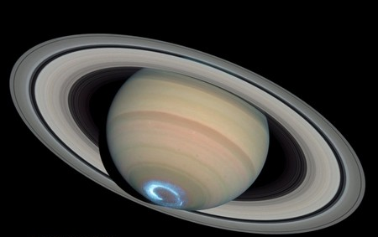

Slide 76
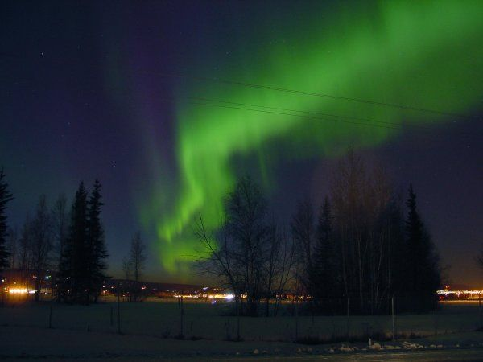

Slide 77
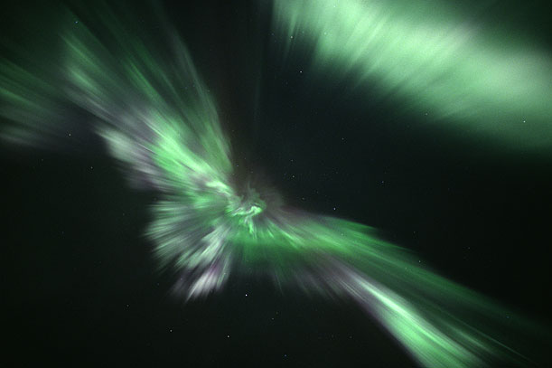

Slide 78
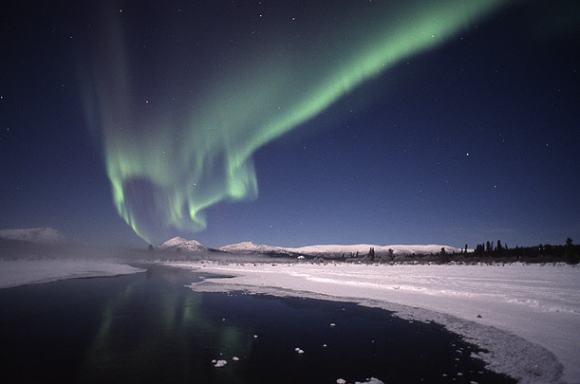

Slide 79
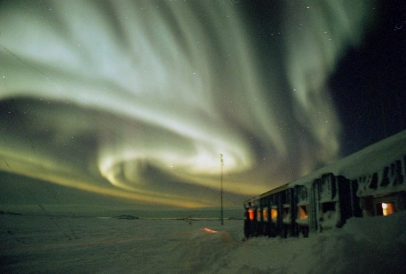

Slide 80
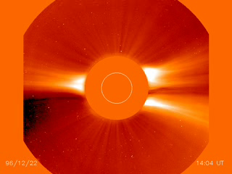
A comet crashes into the Sun on 22 Dec 2006
Notes:
xmas_c2.mpg

Slide 81
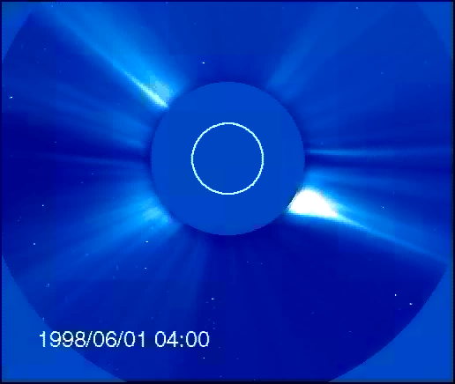
Two comets crash into the Sun on 6 Jan 1998!!
Notes:
C2cometsS.mov

Slide 82
Corona
Photosphere
Prominence
Outside
the Sun

Slide 83
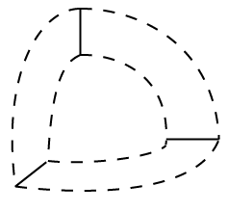

Core
Corona
Photosphere
Prominence
Convective zone
Radiative zone
Outside and Inside
the Sun

Slide 84
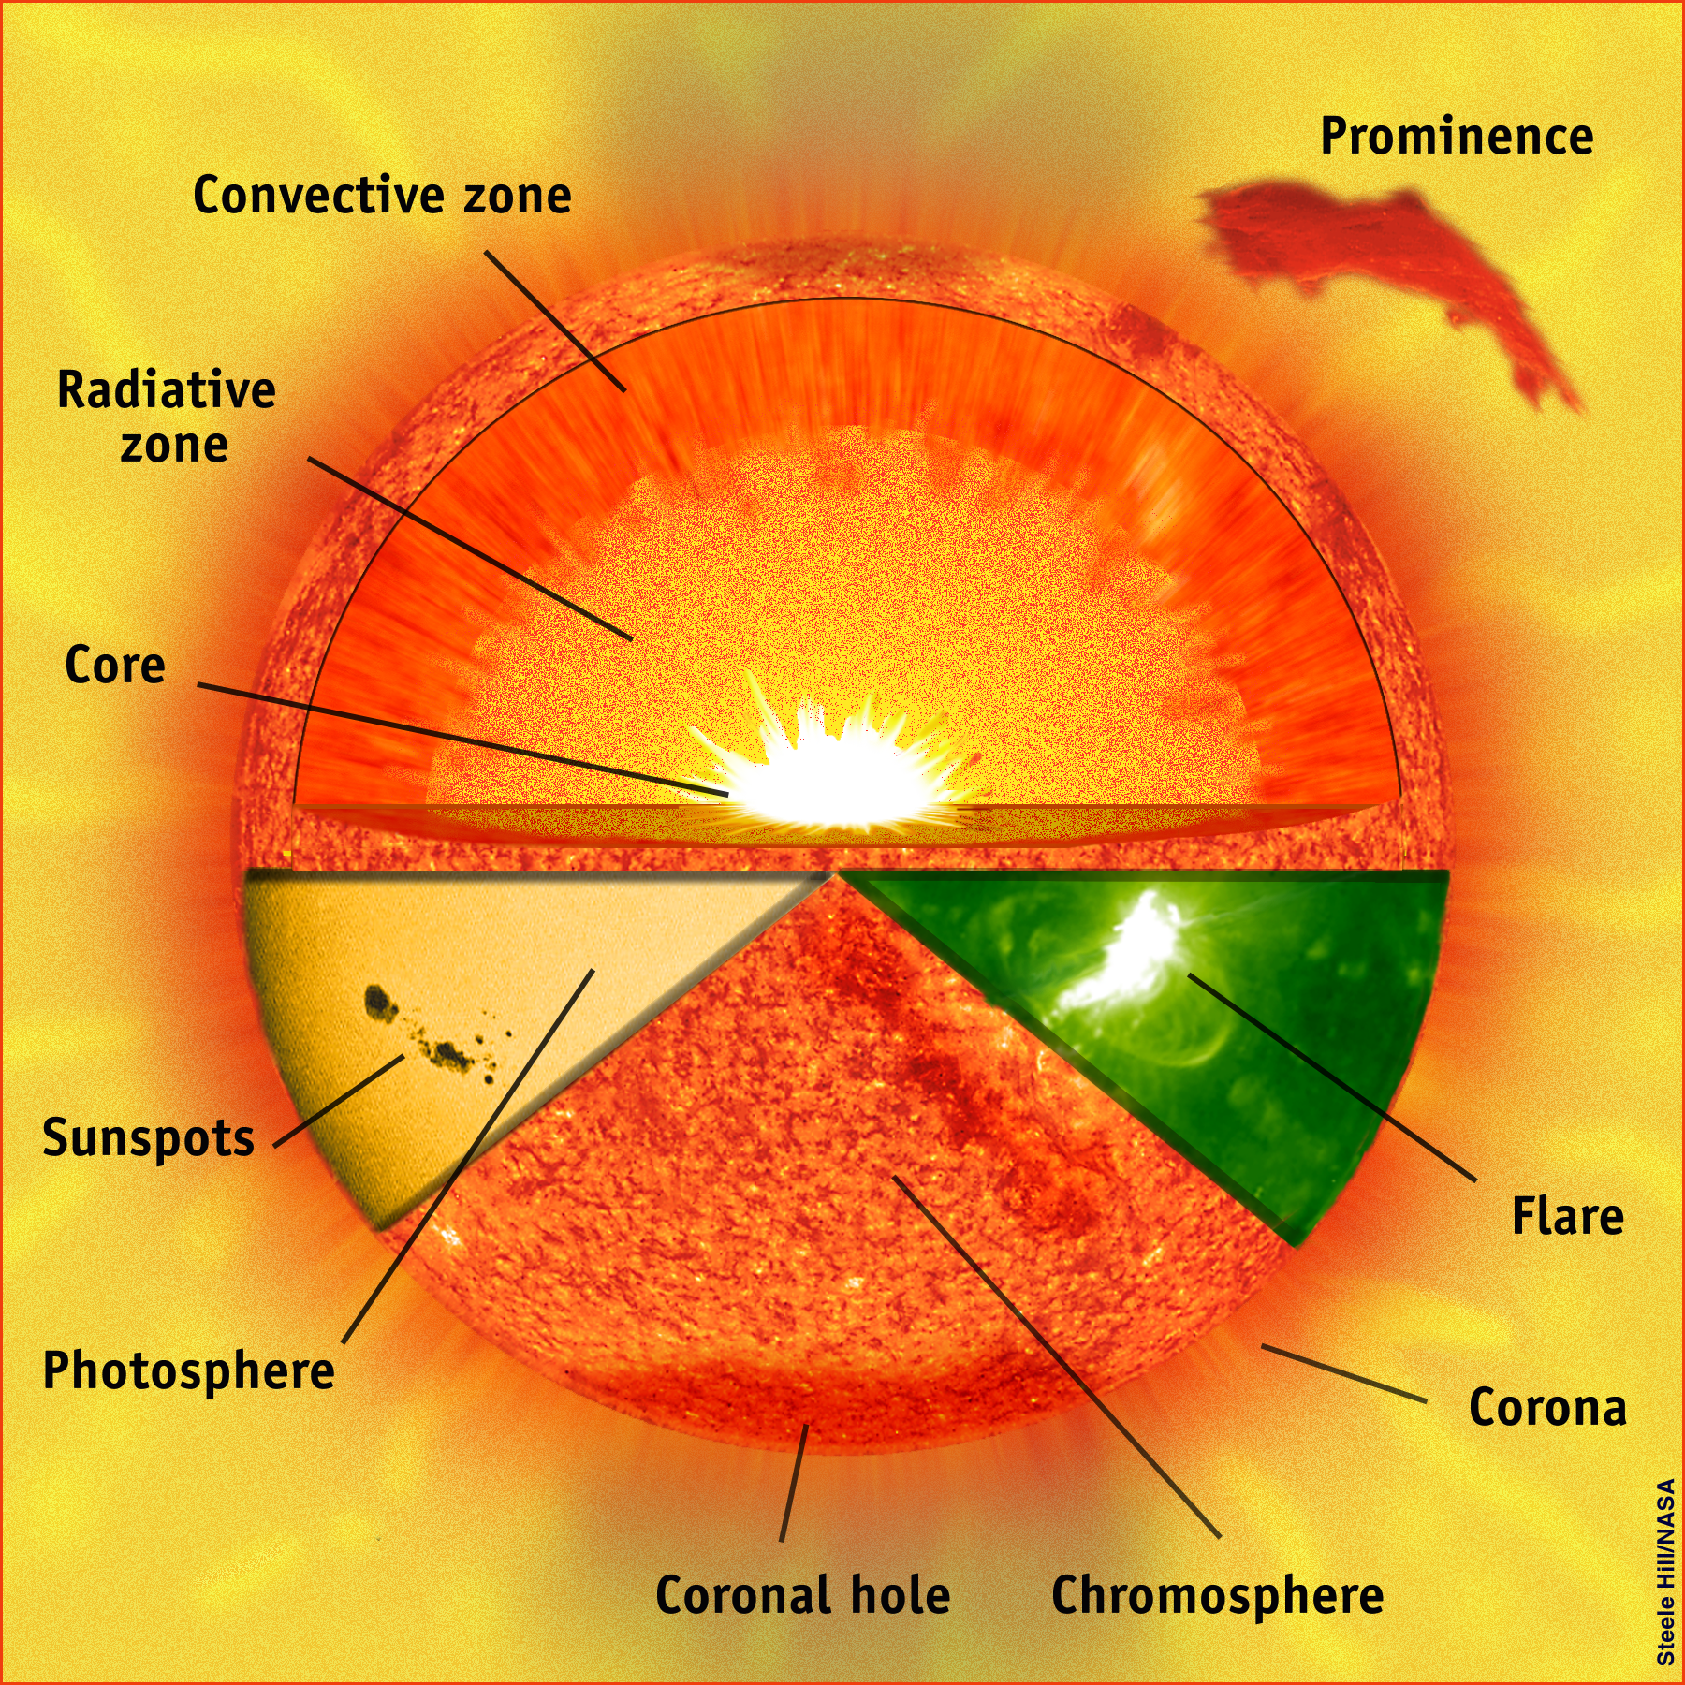



(with narrow red filter)
Corona
(visible light)
(x-ray light)
(visible light)
Photosphere
(with narrow red filter)

Slide 85
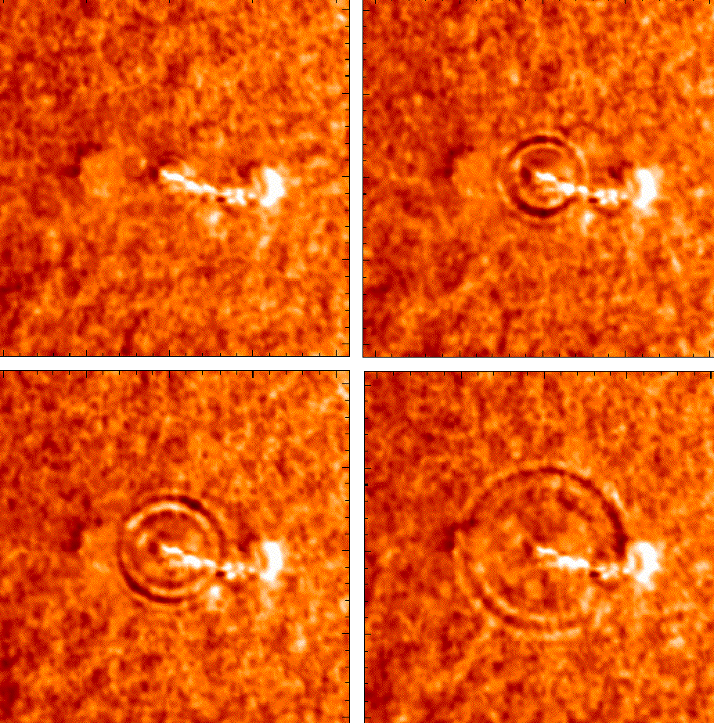
sun-quake = helioseismology
Flares originate just under the photosphere

Slide 86
The outer layers squeeze the core due to Gravity

Slide 87
Light due to Fusion pushes back

Slide 88
There are two kinds of nuclear reactions
Fission tears large atoms apart
Fusion brings light atoms together
is what happens in the Sun's core

Slide 89
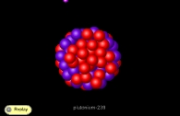
Fission
Massive nuclei (like U with 235 protons and netrons in its nucleus) spit out a fast moving neutron and splits the nucleus into "daughter" nuclei which are, in turn, radioactive (Weak force)
U²³⁵
Barium141 Krypton92
^{3 neutrons}

Slide 90
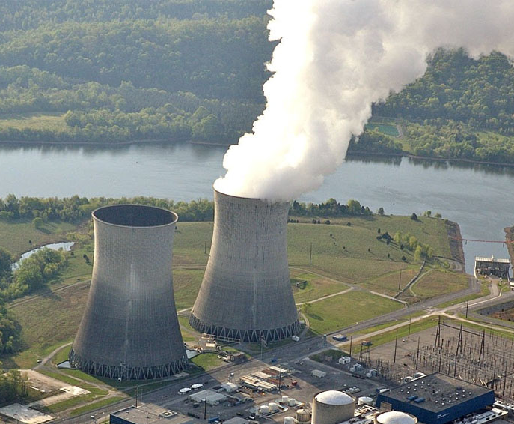
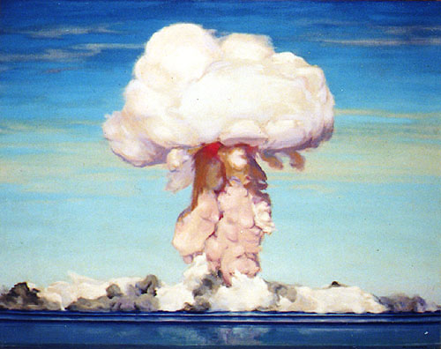
Fission
Fission takes heavy elements and makes lighter ones
Power plants atomic (uranium) bomb

Slide 91


Fusion
Fusion takes light elements and makes heavier ones
In one second our Sun processes 600 MTons H and puts out 10⁶ more energy than the sum of all earth's nuclear bombs
hydrogen bomb—100,000 times more powerful than an atomic bomb

Slide 92
Fusion
The basic fusion reaction:
4 Protons 1 Helium atom + Energy (γ-ray)
+ E

Slide 93
Fusion
The basic reaction:
4 Protons 1 Helium atom + Energy (γ-ray)
+ E
Mass of 4 P's > Mass of He !!!
meaning: 0.7% of the mass of 4 p's is turned into energy via E = mc²

Slide 95
Hydrogen Fusion Reaction
heavy hydrogen
Step 1: two protons collide (Strong force), one turns into a neutron (Weak force), and an anti-electron, and a neutrino

Slide 96
Hydrogen Fusion Reaction
Light Helium
Step 2: one proton collides with heavy hydrogen to make light He

Slide 97
Hydrogen Fusion Reaction
Helium
Step 3: two light He nuclei collide to make stable He and two protons are ejected.

Slide 98
Hydrogen Fusion Reaction
Step 1: + + + E
anti-
Neutrino electron
Step 2: + + E
light He
Step 3: + + + + E
Helium

Slide 99
20 x 10⁶ K in core
5800 K photosphere
γ
Why the great difference in Temperature?

Slide 100
20 x 10⁶ K in core
5800 K photosphere
λ_{peak}=0.5 µ
γ
10^{–9} µ
The photons (γ-ray-energy) lose energy pushing
back on matter on their journey to the surface.

Slide 101
γ
10^{–9} µ
λ_{peak}=0.5 µ
lower E
Energy lost went into pushing back on GRAVITY

Slide 102
γ
10^{–9} µ
λ_{peak}=0.5 µ
lower E
The photons ricochet around the interior of the sun
and take at least 150,000 yrs to get out.

