Slide 1
Critical Thinking and Source Material
Researching and Writing in Different Disciplines

Slide 2
Selecting a topic:
It should interest you
It should meet course requirements
It should be specific enough that you can complete a solid research paper and presentation on the topic within a semester
Don’t worry if the topic seems too controversial or too popular, the research will show you where the best academic debate is on the topic
You may find yourself interested in a topic with two different possible focuses (or foci), use the debate in the literature to guide you

Slide 3
Developing the “research question”
Consider writing on educational equipment
General topic of “Whiteboards” or “Smartboards” can be subdivided into many different specific questions
Ideally, having a research question will help you to narrow down your topic. It is alright if the question changes
Your “hypothesis” should be tentative

Slide 4
Using Tools from Different Disciplines and finding sources from different disciplines
Consider how the paper on volunteer motivation included research from:
  Sociology
  Psychology, Organizational Psychology
  Communication
  Philosophy/Ethics
  Political Science
        It is good to include interdisciplinary research methods, qualitative text-analysis and quantitative numbers and statistics

Slide 5
Finding Sources
Begin with a broad search and see what is out there
Focus in on the most useful, most relevant
See who is cited at the end of those sources (see who each author is in debate with, to whom each article is responding)
What is the landscape of different views and schools of thought
What are the frameworks
The concept of “gateways” is what we mean by specific databases like Galileo, Academic Search Complete, Jstor, Ulrichs
Online texts (ie., websites) are a good area to start with, but remember you should be using peer reviewed works

Slide 6
Opening questions:
What are the objects of study
  Humanities studies products, things, artifacts, texts, works of art, etc.
  Document analysis
  Literature research (this is one of the main reasons to begin with a literature review)

Slide 7
What will you find within that literature search?
Creative responses to problems and case studies
Concepts and theories that are described and compared with each other
Criticism of literature that was published previously, criticism of works of art

Slide 8
In Humanities and Arts, research can mean a combination of:
Information gathering, questioning and documenting
Critique, analysis, explanation
Conceptual work, theorizing the work by relating it to a theory proposed by someone else
Interpreting works
Personal narrative, personal argument, personal point of view

Slide 9
You might start by:
Doing a quick Google search to see what people are already saying
Be aware that much of what you find in this kind of search is not peer-reviewed, and therefore it should not be used in a college level paper

Slide 10
Sample 1:
Topic: How do students of design use museum collections to inspire their own work?
  Consider looking at an academic journal on arts education
  Interviewing art students
  Interviewing museum curators, community liaisons, docents
  Personal narratives of design professionals about their own past experiences in museums

Slide 11
Sample 2:
Topic: Crime
Explore causes for changes in crime rates over time
Consider looking at academic journals in Sociology, Criminal Justice, Political Science
  School support, meals plans
  Abortion/Roe v. Wade
  Statistics over time compared with theories and explanations

Slide 12
Sample 3:
Topic: Non-profit work
Academic Journals in Sociology and Social Work
Career Services Professionals
  Interviews with people who are currently working in non-profit contexts
  Interviews with professional social workers for comparison
  Challenges of fund raising in difficult economic times
  Challenges of perception, political and social connotations of working in human services

Slide 13
Sample 4:
Topic: Alternative/Holistic Medicine
Choice 1: Structure of Experiments, are alternative treatments studied through proper experiment structures and protocols
Choice 2: Political Issue, government funding for alternative therapies and insurance company decisions about funding for patients who choose alternative therapies

Slide 14
Sample 5:
Topic: Kawasaki Syndrome and/or Medical Controversies
Check the literature to see what the major debates are: http://www.galileo.usg.edu/express?link=zbac
  Kawasaki comparative research in various populations and geographic regions (Japan, Jordan, Texas, Ontario)
  Coronary Artery Disease and aneurysms linked to Kawasaki
  Genealogy and Kawasaki, parent studies

Slide 15
Sample 6
Public Education
  Assessment Controversies, AYP, “Teaching to the Test”
  Compared with Charter Schools and/or Magnet Schools
  Political Support and Funding of Public Education
    Recent controversy about Philadelphia Schools in the news

Slide 16
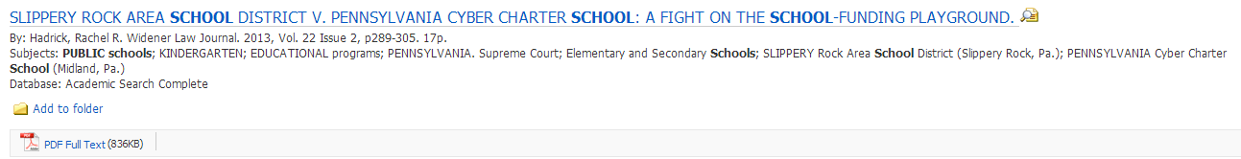
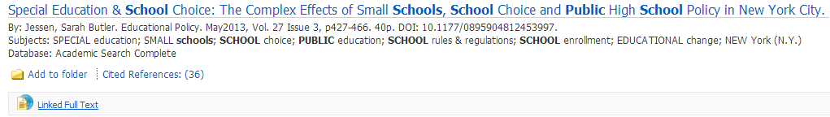

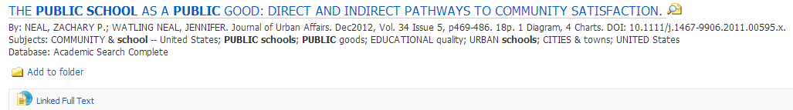

Slide 17
Sample 7
Religious Studies and Comedy?
Google search for “theology and Dante's inferno”
Here’s what you might see:

Slide 18
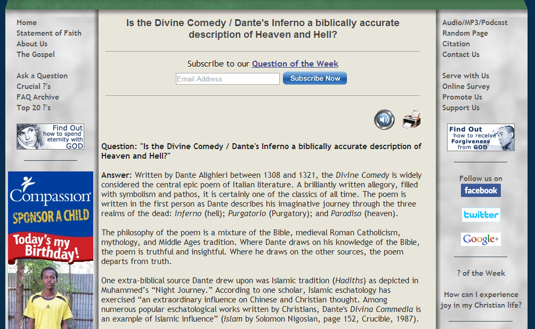
http://www.gotquestions.org/Divine-Comedy-Dantes-Inferno.html
Not peer reviewed, not academic:

Slide 19
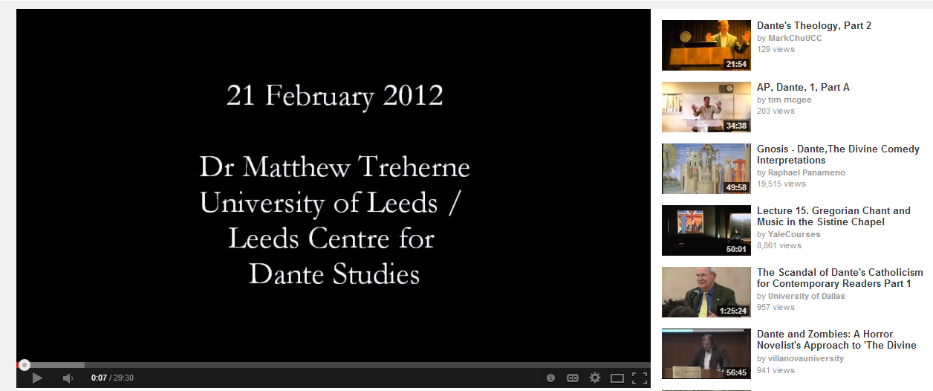
Youtube: Academic Lectures https://www.youtube.com/watch?v=vk9z94jyPtM
Dante Public Lecture Series 2012, Department of Italian, University College Cork, Ireland.
The final lecture in this annual series was given by Dr Matthew Treherne of the University of Leeds / Leeds Centre for Dante Studies, GB. The topic of Matthew's lecture was "Dante's Theology in Poetry, Practice and Society"

Slide 20
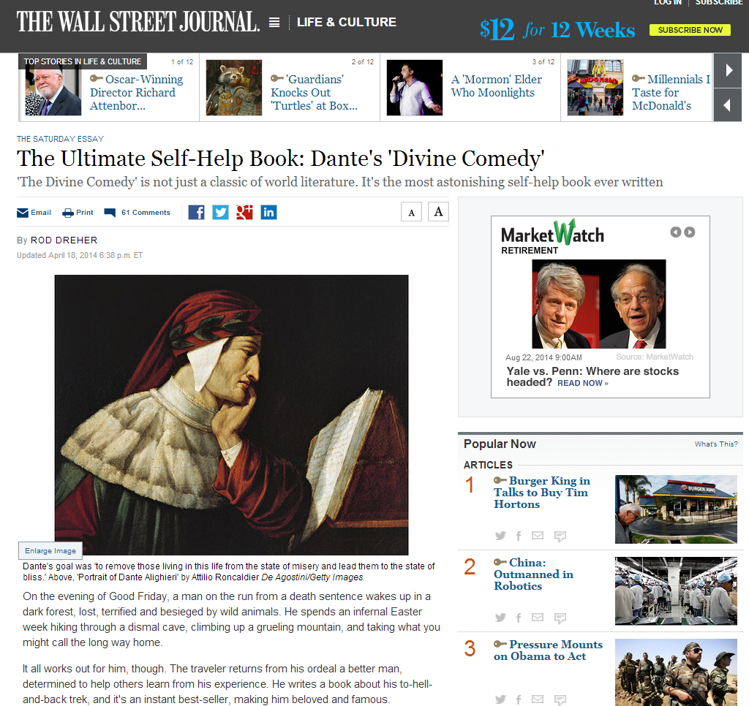
Popular Press material which may be used if it is well researched
http://online.wsj.com/news/articles/SB10001424052702303663604579503700159096702

Slide 21


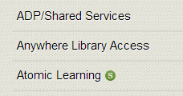
Your best source material will always be peer-reviewed articles through:
Galileo
Academic Search Complete
JStor

Slide 22
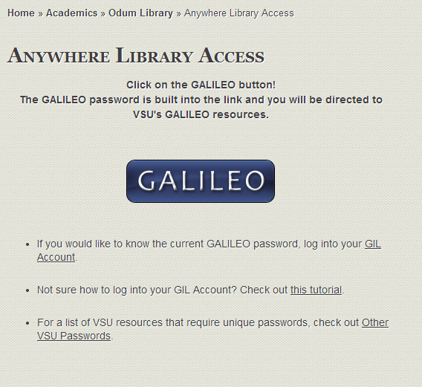
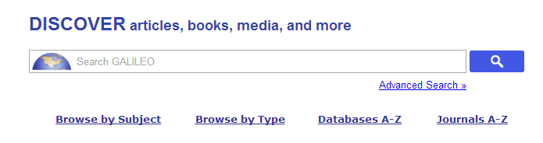
Use “Databases” A-Z for Academic Search Complete and Jstor under A and J
Ulrichs under U when you aren’t sure if a source is peer-reviewed

Slide 23
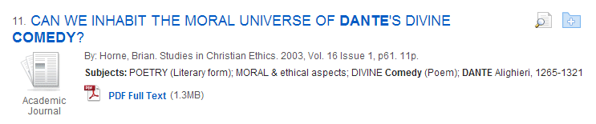
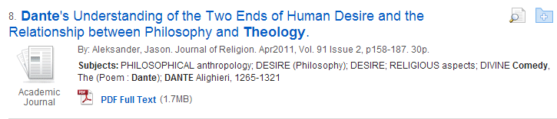
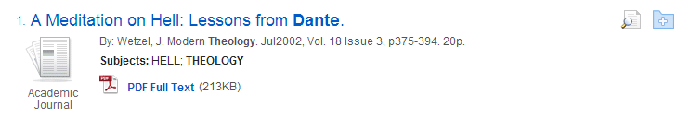

Slide 24
