Slide 1
PHIL 2020 ALG
Tips about finding your way in the course materials

Slide 2
Affordable Learning Georgia
Textbook Transformation grants
Program to decrease or eliminate the high costs of textbooks in Core classes
http://www.affordablelearninggeorgia.org/about/textbook_transformation_grants

Slide 3
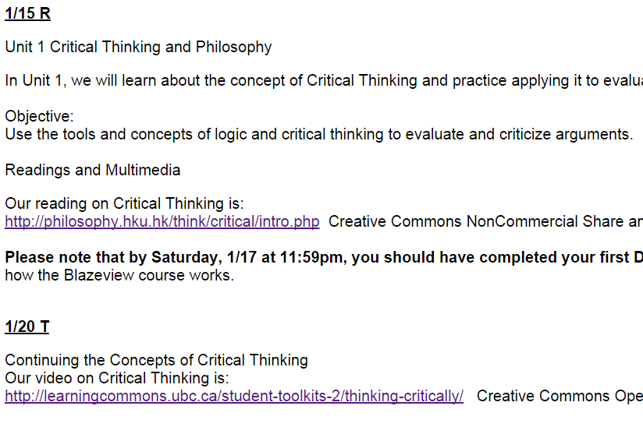
Remember that there are two ways to access the course material:
1) Links in the Syllabus
Just click on the purple links…

Slide 4

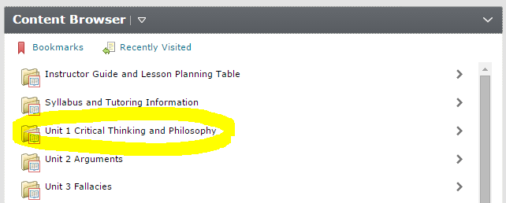

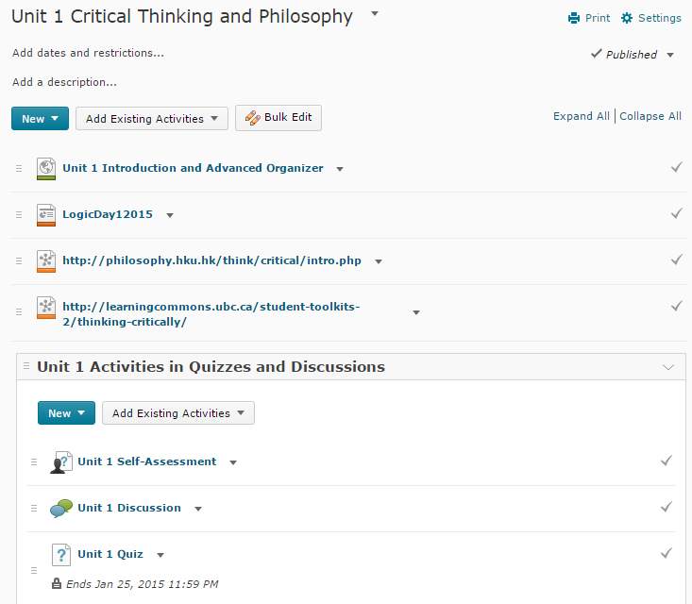
2) Links inside the Blazeview Content
Click on “Content” in the top bar, and choose the Unit you need to work in. This will open the full Table of Contents, where you can see linked readings, podcasts, and the activities (Self-Assessments, Discussions, and Quizzes.

Slide 5
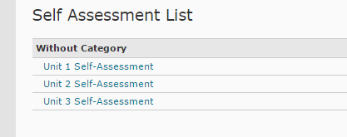
Self Assessments
Practice quiz-style questions in each unit
Hints are given
Grades are never kept
You can retake them to practice and review
You can find them through Content, or Assessments

Slide 6
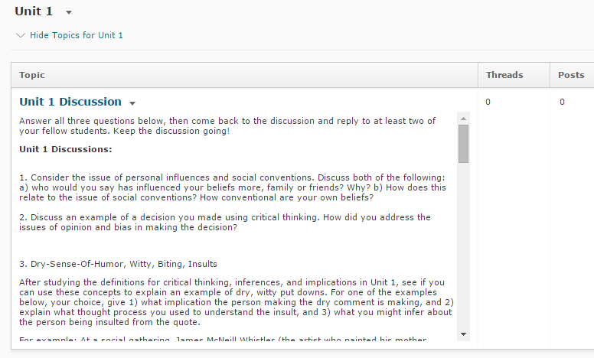
Discussions
Discussions for you to post your own response, and then reply to some of your fellow students
Usually these are specific situations or examples of the concepts we covered in the Unit
You can find them through Content, or Communication

Slide 7
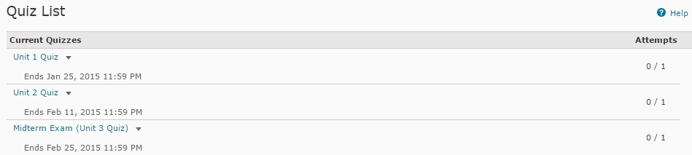
Quizzes
Questions will be similar to the Self-Assessments, but not exactly the same
Only one opportunity to take them
Timed once you click on them, usually 60 minutes
You can find them linked in Content or under Assessments

Slide 8
Midterm and Final
Think of these as expanded Quizzes in certain Units as marked on the Syllabus
You can find them under Content in those Units, or under Assessments>Quizzes

Slide 9
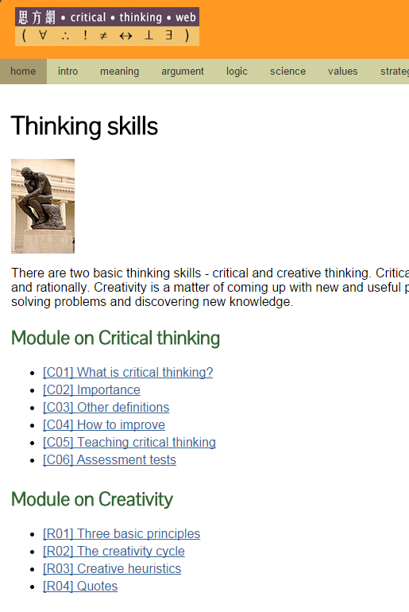
How to click through items linked in each unit:
Some items will be webpages under Creative Commons license:
In a page like this one from Unit 1, be sure to click on each blue line. Those blue underlined links will open up the pages of content.

Slide 10
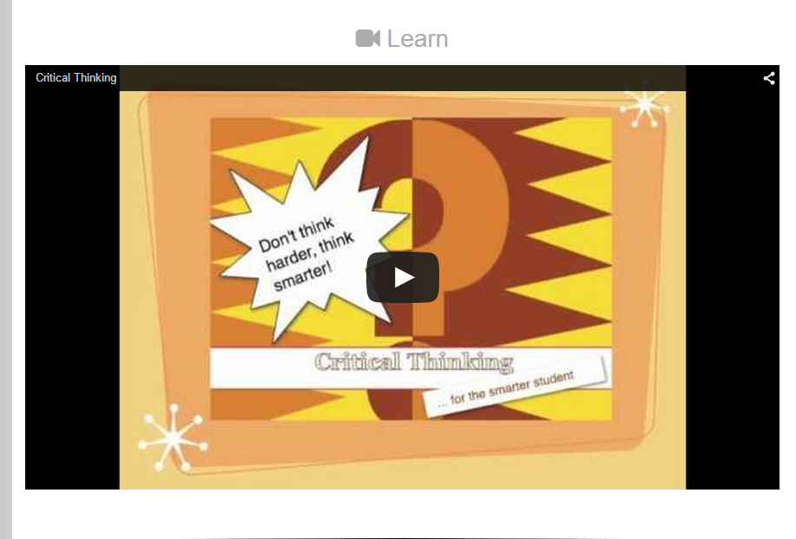
Podcasts
Some items in the course will be podcasts (like Youtube videos)
Be sure to play them and listen carefully and take notes

Slide 11
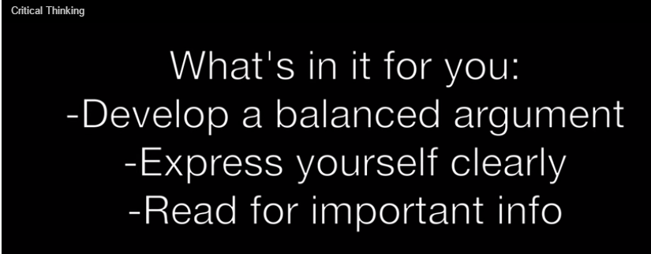
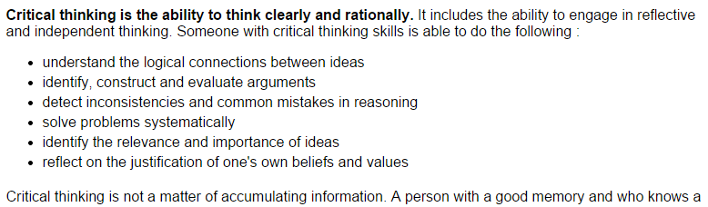
Take notes on:
Definitions
  May be “what it is” and “what it is not”
Lists
Comparisons between two different items
Examples that illustrate definitions
From video:
From reading:

