Slide 1
Dynamics
Objective: Learning about the affect of forces on motion – “Dynamics”
Kinematics –'How’
Dynamics –'Why' (Forces)
Key concepts:
Mass and inertia
Force
Free-body diagram
Newton’s laws of motion
Newton’s laws of gravitation

Slide 2
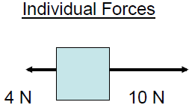
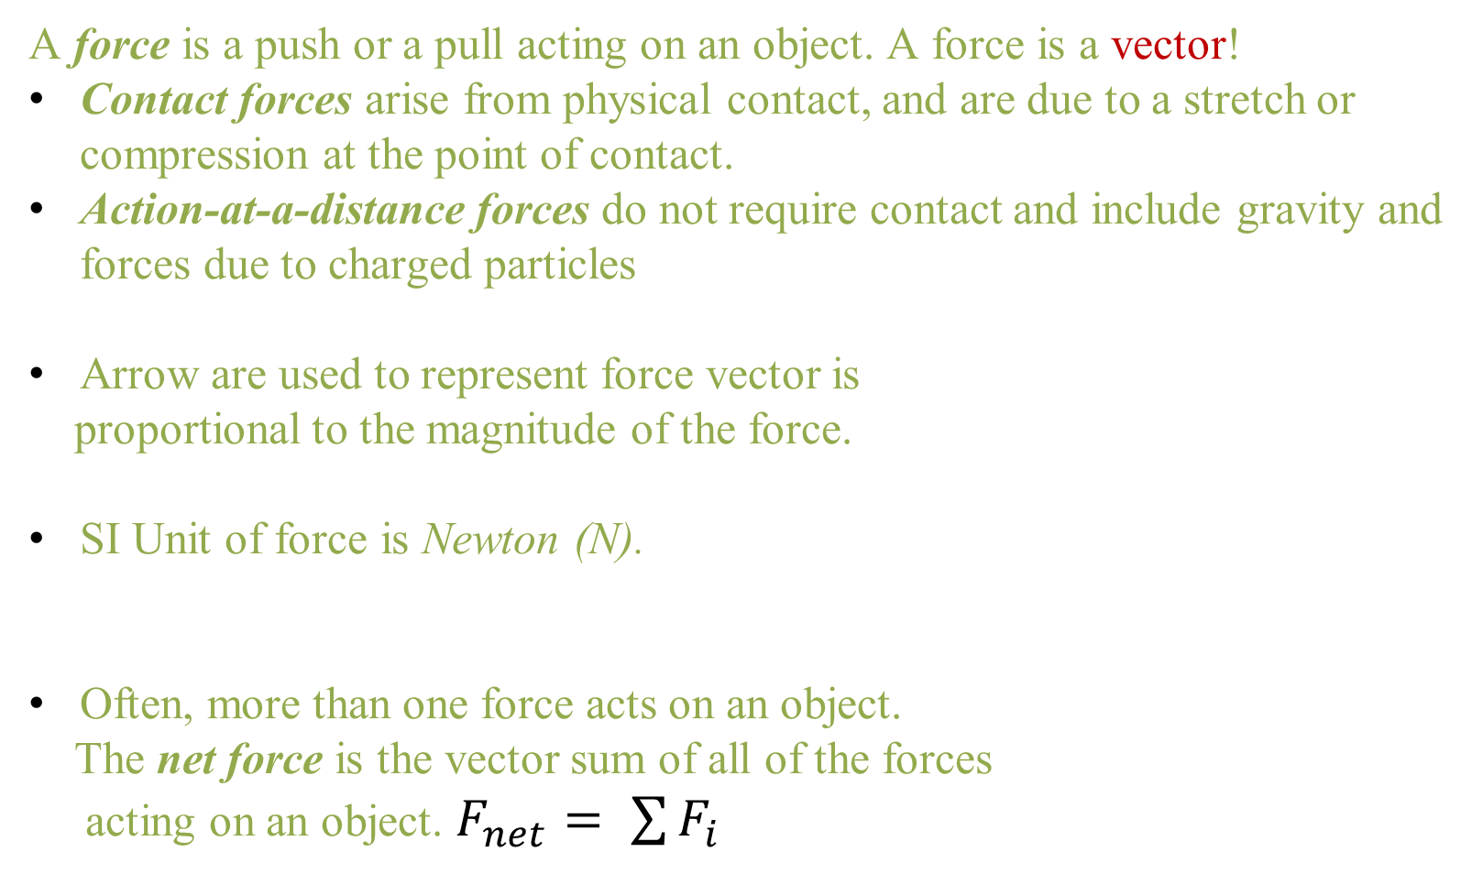
Concept of Force
A force is a push or a pull acting on an object. A force is a vector!
Contact forces arise from physical contact, and are due to a stretch or compression at the point of contact.
Action-at-a-distance forces do not require contact and include gravity and forces due to charged particles
Arrow are used to represent force vector is
proportional to the magnitude of the force.
SI Unit of force is Newton (N).
Often, more than one force acts on an object.
  The net force is the vector sum of all of the forces
  acting on an object. $F_{net}= \sum{F_{i}}$

Slide 3
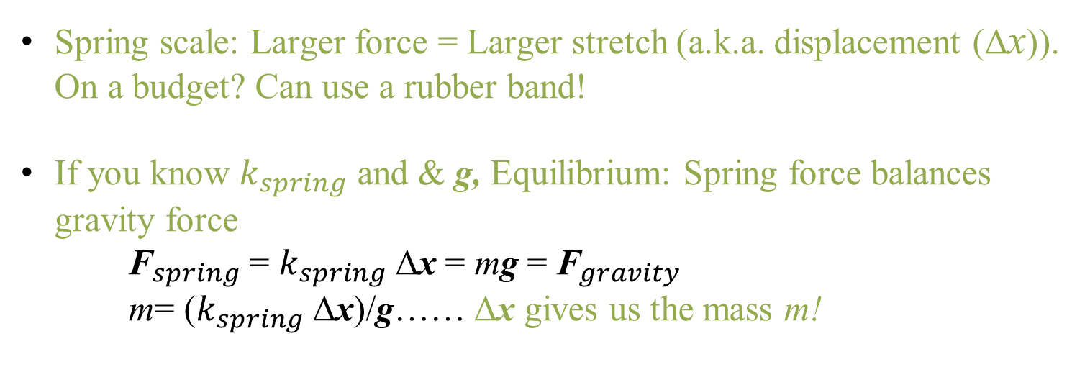
How to measure Force
Spring scale: Larger force = Larger stretch (a.k.a. displacement (Δx)). On a budget? Can use a rubber band!
If you know $k_{spring}$ and & g, Equilibrium: Spring force balances gravity force
${\text{F}}_{spring}$= $k_{spring}$Δx = mg = ${\text{F}}_{gravity}$
m= ($k_{spring}$Δx)/g…… Δx gives us the mass m!

Slide 4
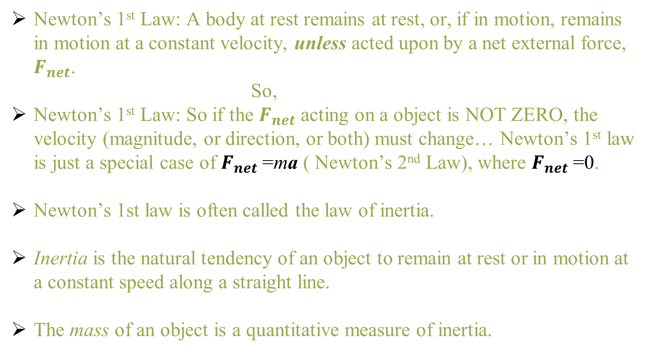
Newton’s First Law of motion
The Law of Inertia
Newton’s 1st Law: A body at rest remains at rest, or, if in motion, remains in motion at a constant velocity, unless acted upon by a net external force, $F_{net}$.
So,
Newton’s 1st Law: So if the $F_{net}$ acting on a object is NOT ZERO, the velocity (magnitude, or direction, or both) must change… Newton’s 1st law is just a special case of $F_{net}$=ma ( Newton’s 2nd Law), where $F_{net}$=0.
    Newton’s 1st law is often called the law of inertia.
    Inertia is the natural tendency of an object to remain at rest or in motion at a constant speed along a straight line.
    The mass of an object is a quantitative measure of inertia.

Slide 5
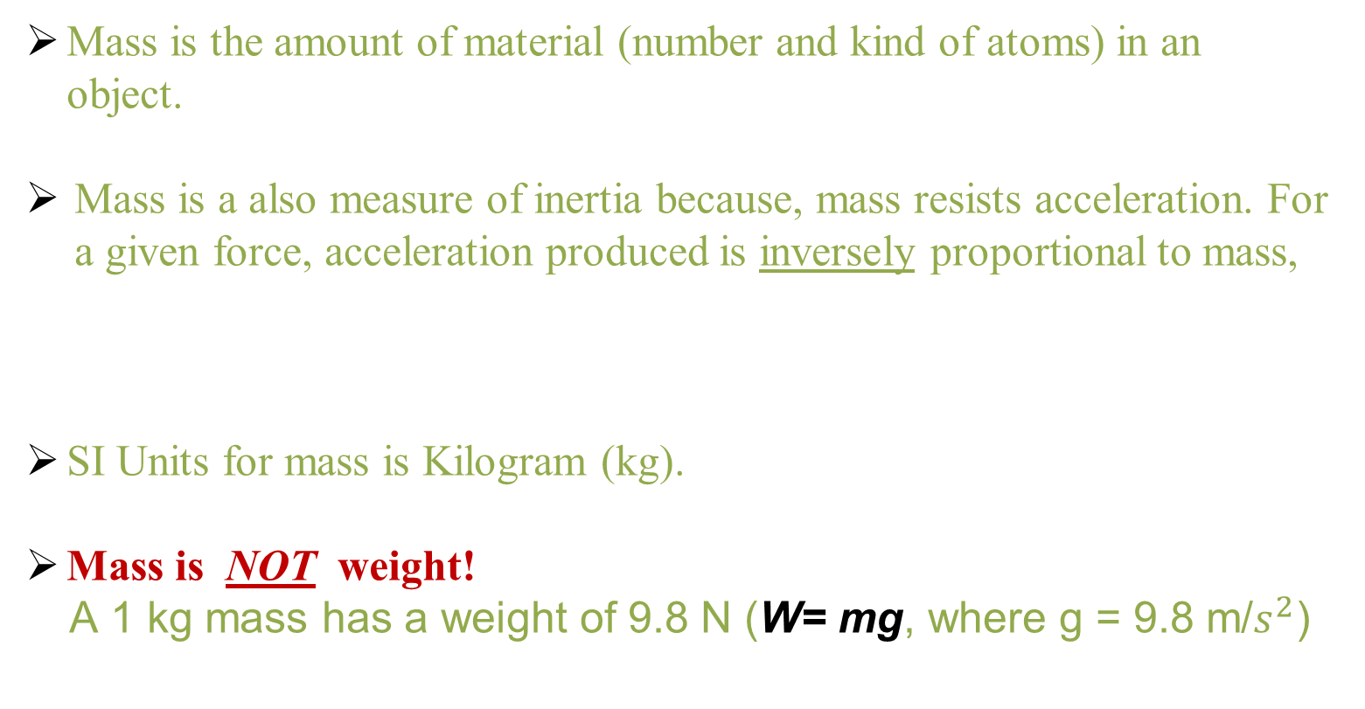
Mass and Inertia
Mass is the amount of material (number and kind of atoms) in an object.
Mass is a also measure of inertia because, mass resists acceleration. For a given force, acceleration produced is inversely proportional to mass,
SI Units for mass is Kilogram (kg).
Mass is NOT weight!
A 1 kg mass has a weight of 9.8 N (W= mg, where g = 9.8 m/$s^{2}$)

Slide 6
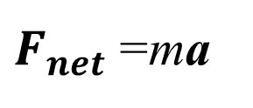
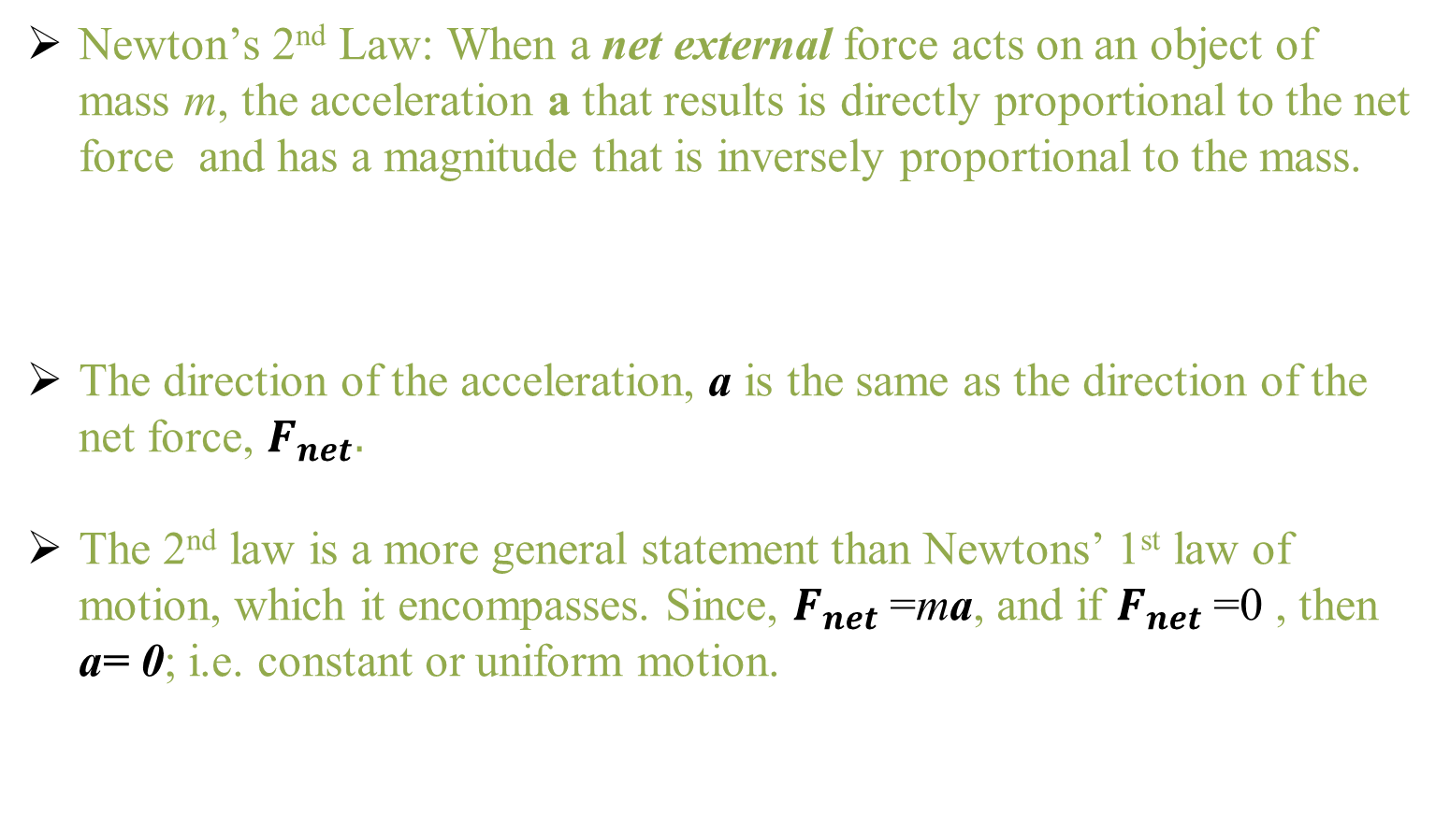

Newton’s Second Law of motion
The Law of Inertia
  Newton’s 2nd Law: When a net external force acts on an object of mass m, the acceleration a that results is directly proportional to the net force and has a magnitude that is inversely proportional to the mass.
  The direction of the acceleration, a is the same as the direction of the net force, $F_{net}.$
  The 2nd law is a more general statement than Newtons’ 1st law of motion, which it encompasses. Since, $F_{net}$=ma, and if $F_{net}$=0 , then a= 0; i.e. constant or uniform motion.
a = $\frac{F_{net}}{m}$
or
$F_{net}$=ma

Slide 7
Newton’s Second Law of motion
The Law of Inertia
Concept questions:
Suppose you push with the same force on two wagons. What is the acceleration of wagon B compared to that of wagon A? Justify your answer.
Wagon A has a mass of 10 kg
and wagon B has a mass of 40 kg.
Does the mass of an object affect the force of gravity on it?
Does the mass of an object affect the rate of acceleration caused by gravity?

Slide 8
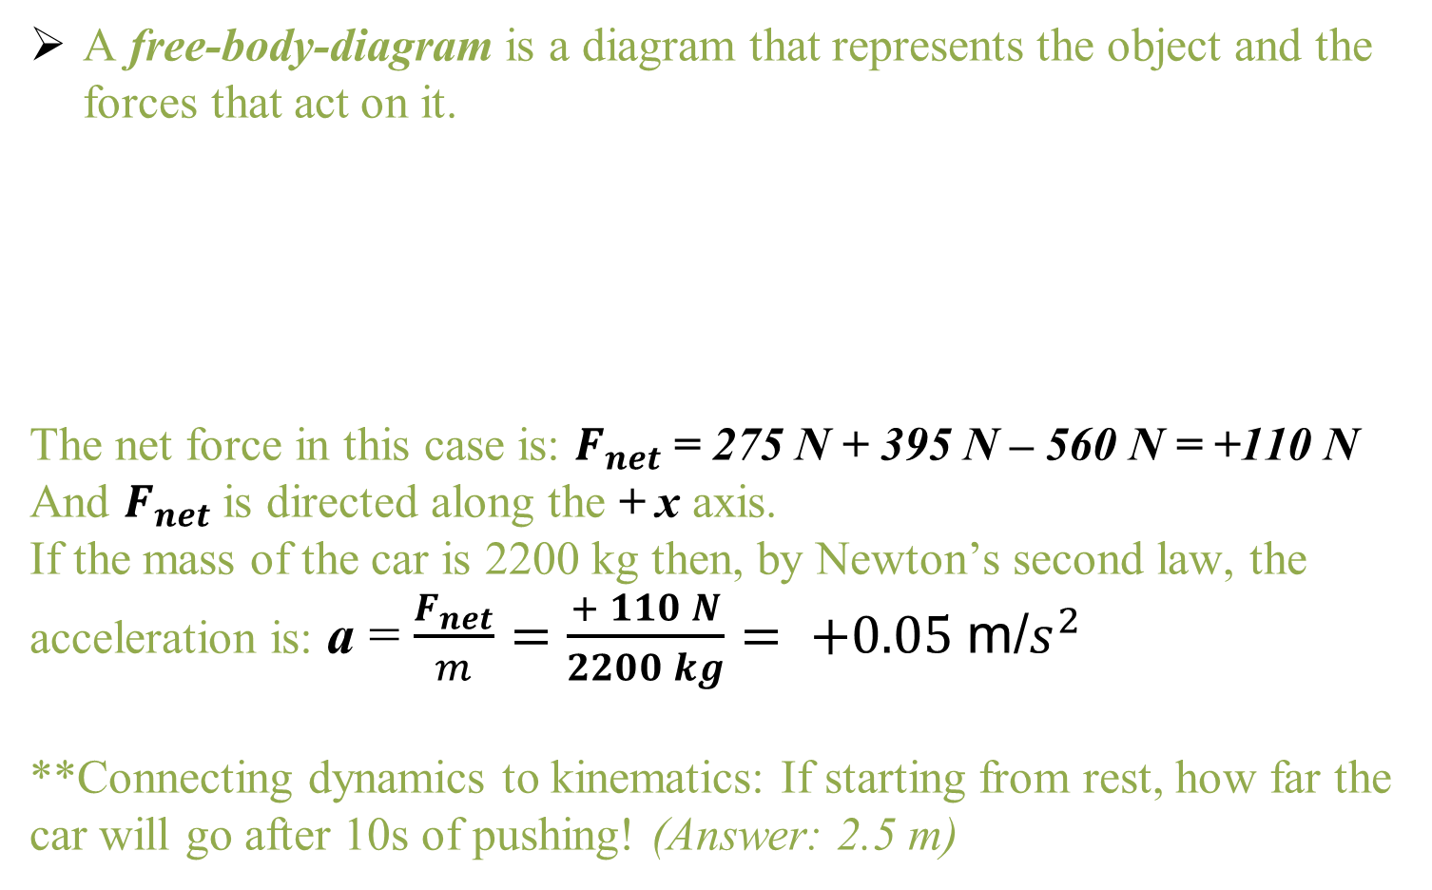
Free-body diagram
A free-body-diagram is a diagram that represents the object and the forces that act on it.
The net force in this case is: $F_{net}$= 275 N + 395 N – 560 N = +110 N
And $F_{net}$is directed along the + x axis.
If the mass of the car is 2200 kg then, by Newton’s second law, the acceleration is: a = $\frac{F_{net}}{m}=\frac{+ 110 N}{2200 kg}= +0.05 \text{m}\text{/}s^{2}$
**Connecting dynamics to kinematics: If starting from rest, how far the car will go after 10s of pushing! (Answer: 2.5 m)

Slide 9
System of interest
Choosing the correct system:
The system of interest is the stuff we care about
Need to define “the system” before solving problem
It’s possible to have systems within a system

Slide 10
Frictional forces
Friction affects Motion
F
M
F_{friction}
Friction always act
to oppose motion
F
M
F_{friction}
To Move M
Pull force F must be greater than
F_{friction}
To maintain motion
F need to be only equal to
F_{friction}
i.e Net force is zero
Constant velocity

Slide 11
Frictional forces and Drag
Terminal velocity :When air drag is not negligible the acceleration of fall is less than g
air drag
Downward Net Force = weight – air drag
When falling high distances the air drag
builds up to equal weight
Net force = 0
weight
Object reaches its terminal velocity

Slide 12
Frictional forces and Drag
Force | Frictional Force | Net Force | Acceleration
50 N | 0 N
 | 0 N |  | 5 m/s²
60 N | 30 N
60 N | 60 N
Use F= ma with m = 15 kg

Slide 13
Newton’s Third Law of motion
Newton’s 3rd Law: Whenever one body exerts a force on a second body, the second body exerts an oppositely directed force of equal magnitude on the first body.
Forces always come in action-reaction pairs!
Since the action force & reaction force are acting on different objects, you will never have both the action force & its reaction force on the same free-body diagram.
***Newton’s 3st law can appear to be violated if you can’t see the resulting movement of a massive object.

Slide 14
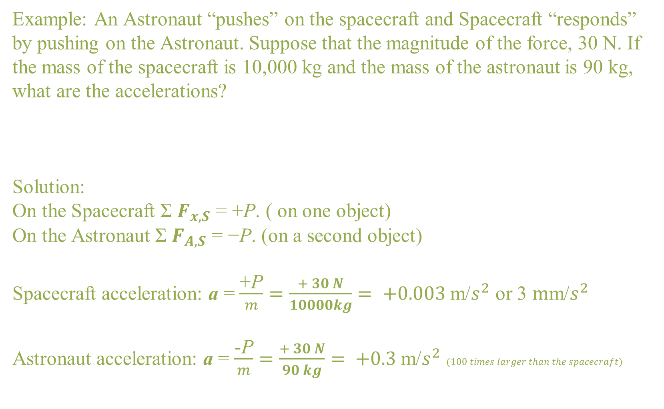
Newton’s Third Law of motion
Example: An Astronaut “pushes” on the spacecraft and Spacecraft “responds” by pushing on the Astronaut. Suppose that the magnitude of the force, 30 N. If the mass of the spacecraft is 10,000 kg and the mass of the astronaut is 90 kg, what are the accelerations?
Solution:
On the Spacecraft Σ $F_{x,S}$ = +P. ( on one object)
On the Astronaut Σ $F_{A,S}$ = −P. (on a second object)
Spacecraft acceleration: a = $\frac{\text{+}\text{P}}{m}=\frac{+ 30 N}{10000kg}= +0.003 \text{m}\text{/}s^{2}$ or 3 $m\text{m}\text{/}s^{2}$
Astronaut acceleration: a = $\frac{\text{-}\text{P}}{m}=\frac{+ 30 N}{90 kg}= +0.3 \text{m}\text{/}s^{2}$ $(100 times larger than the spacecraft)$

Slide 15
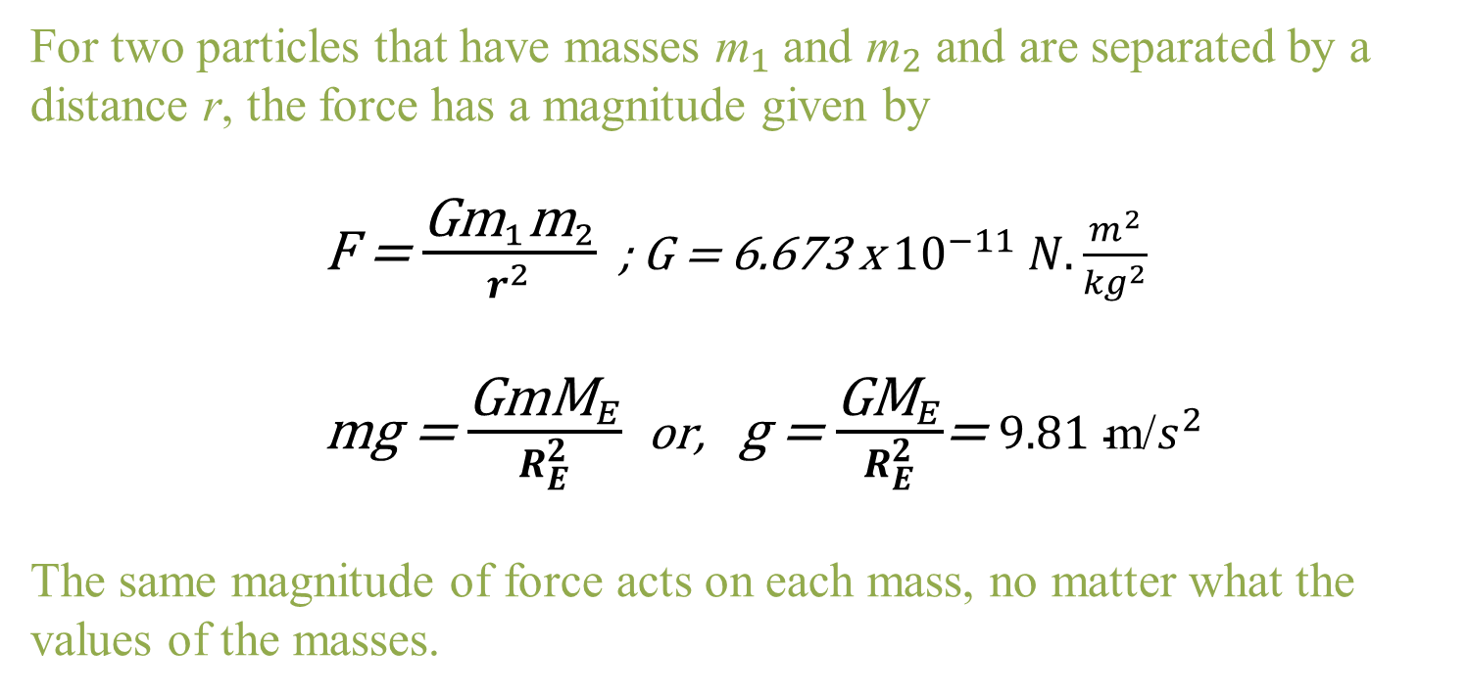
Newton’s Law of Gravitation
For two particles that have masses ${\text{m}}_{1}$and ${\text{m}}_{2}$ and are separated by a distance r, the force has a magnitude given by
F = $\frac{{\text{G}\text{m}}_{1}{\text{m}}_{2}}{r^{2}}$ ; G = 6.673 x ${10}^{−11} N.\frac{m^{2}}{{kg}^{2}}$
mg = $\frac{{\text{GmM}}_{E}}{R_{E}^{2}}$ or, g = $\frac{{\text{GM}}_{E}}{R_{E}^{2}}$= 9.81 $\text{m}\text{/}s^{2}$
The same magnitude of force acts on each mass, no matter what the values of the masses.

Slide 16
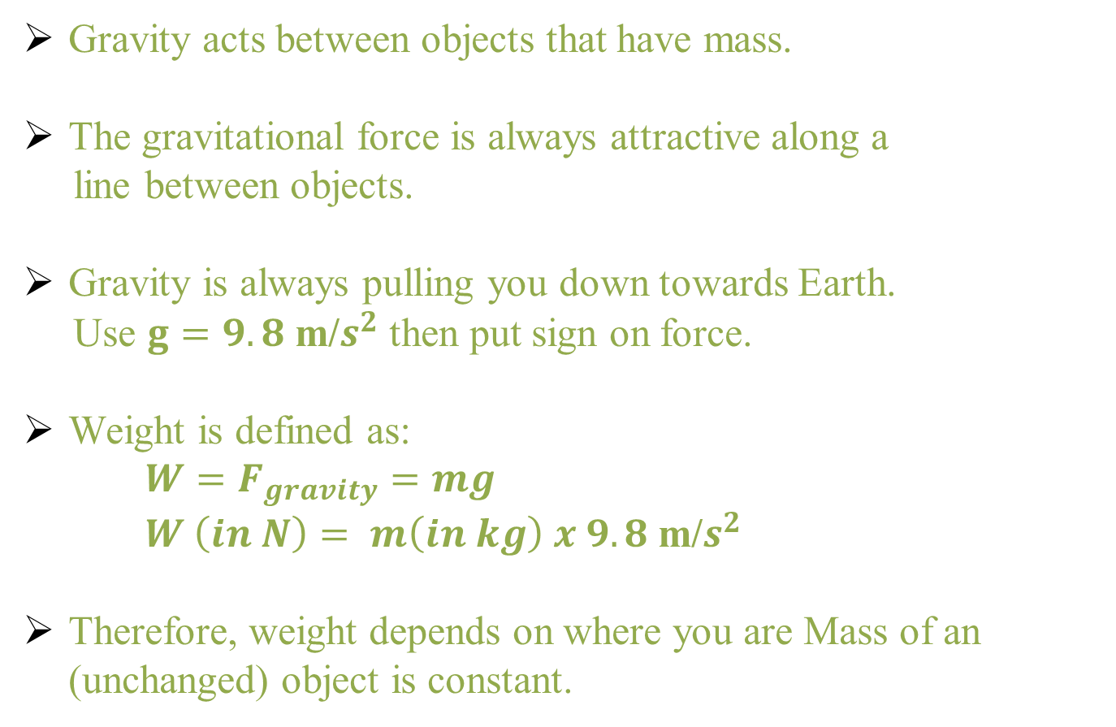
Newton’s Law of Gravitation
Relation Between Mass and Weight
Gravity acts between objects that have mass.
The gravitational force is always attractive along a
line between objects.
Gravity is always pulling you down towards Earth.
Use $g=9.8 \text{m}\text{/}s^{2}$ then put sign on force.
Weight is defined as:
${W=F}_{gravity}=mg$
$W \left(in N\right)= m\left(in kg\right) x 9.8 \text{m}\text{/}s^{2}$
Therefore, weight depends on where you are Mass of an (unchanged) object is constant.

