Slide 1
Kinematics
Objective: Learning about the fundamental concepts used to describe motion – “Kinematics”
Kinematics –'How’
Dynamics –'Why' (Forces)
Key concepts:
1-d Motion/Kinematics
Displacement
Velocity
Acceleration
Graphing Motion

Slide 2

Position, Displacement and Distance
Need coordinate system:
•Axes (we’ve chosen +x to right & +y up)
•Origin defined as (x,y) = (0,0)
“Position”: Location relative to origin
Initial position: $x_{0}$= +1.5m
Final position: $x_{f}$= +3.5m
For both, $y_{f}$ = $y_{f}$= 0
“Displacement”: Change in Position
Δx = $x_{f}$- $x_{0}$
Displacement would be 2.0m to the right
(Greek letter delta, Δ= change = final –initial)
“Distance”: Ignore direction and add up distance traveled
*** Displacement rarely equals Distance Traveled (only when traveling in the exact same direction the whole time)
Origin
x=0, y=0 or,
(x,y) = (0,0)

Slide 3
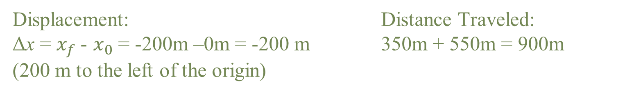
Displacement vs. Distance
A cyclist rides 350 m due East, then turns around and rides again 550 m due West. Find the displacement and the distance traveled by the cyclist?
Displacement: Distance Traveled:
Δx = $x_{f}$- $x_{0}$ = -200m –0m = -200 m 350m + 550m = 900m
(200 m to the left of the origin)

Slide 4
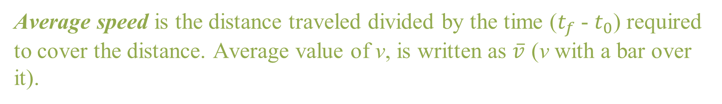
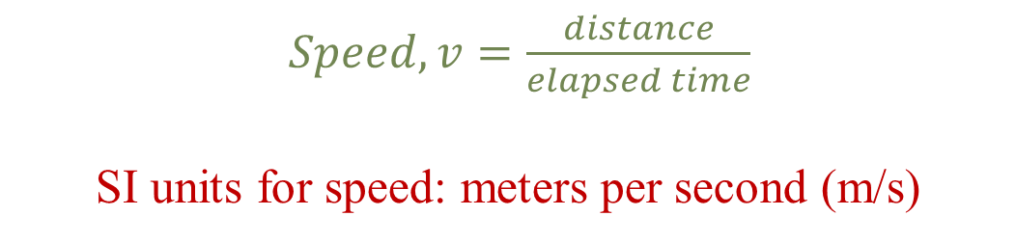
Speed
Average speed is the distance traveled divided by the time ($t_{f}$- $t_{0}$) required to cover the distance. Average value of v, is written as $\overline{v}$ (v with a bar over it).
$Speed, v=\frac{distance}{elapsed time}$
SI units for speed: meters per second (m/s)
If the cyclist rides 900 meters in 5 mins his speed is 3 m/s (this is the average speed).
**Speed at any instant in time is termed instantaneous speed

Slide 5
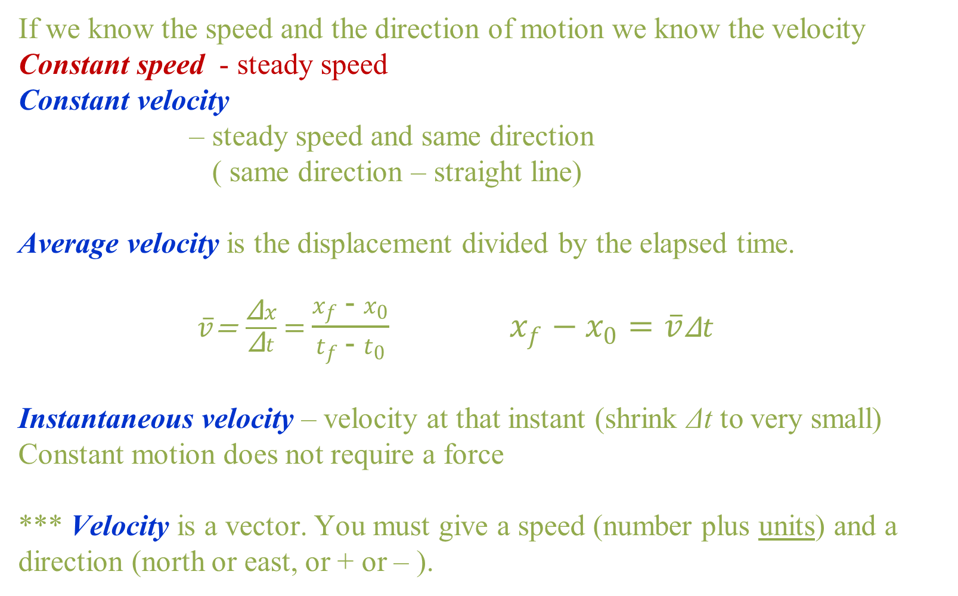
Velocity
If we know the speed and the direction of motion we know the velocity
Constant speed - steady speed
Constant velocity
– steady speed and same direction
( same direction – straight line)
Average velocity is the displacement divided by the elapsed time.
$\overline{v}\text{=} \frac{\text{Δ}x}{\text{Δ}t}$ = $\frac{x_{f} \text{−} x_{0}}{t_{f} \text{− }t_{0}} x_{f} \text{−} x_{0}=\overline{v}\text{Δ}t$
Instantaneous velocity – velocity at that instant (shrink Δt to very small)
Constant motion does not require a force
*** Velocity is a vector. You must give a speed (number plus units) and a direction (north or east, or + or – ).

Slide 6
Scalars and Vectors
A scalar quantity specifies magnitude only; that is, value. Speed is one example of a scalar quantity.
List another scalar quantity and explain.
A vector quantity has magnitude + direction. Velocity is one example of a vector quantity.
List another scalar quantity and explain.
An arrow is used to designate a vector with length indicating relative magnitude.
If = 5 m/s N
Then = 10 m/s N
And = -5 m/s or 5 m/s S

Slide 7
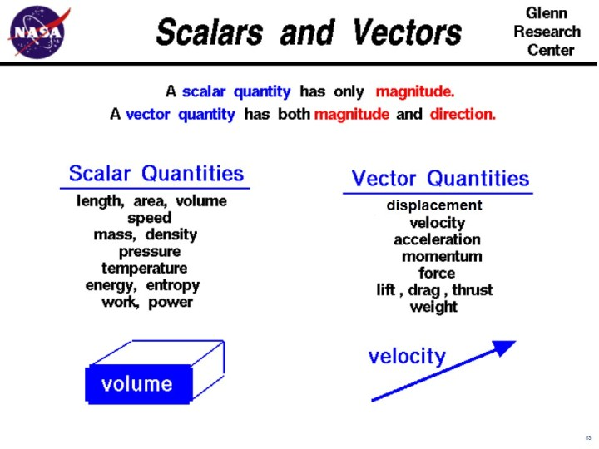

Slide 8
Graphical representation of motion
Slope of a function on a graph Graph of position vs. time.
Slope = rise/run = Δy/Δx
Up to the right is a positive slope.
Down to the right is negative slope.
Velocity = slope of line
(units read from the axis labels)
straight line = uniform motion

Slide 9
Graphical representation of motion
This position versus time graph represents the position of a person as a function of time. At what point or points is the person standing still?
A
B
C
D
A and D
B and E
Try to replicate this graph using the following PhET: Moving Man

Slide 10
Graphical representation of motion
  This position versus time graph represents the position of a cyclist as a function of time. What is the slope (velocity) of each of these lines?

Slide 11
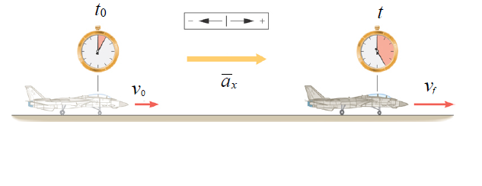
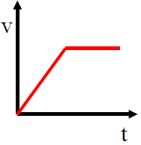
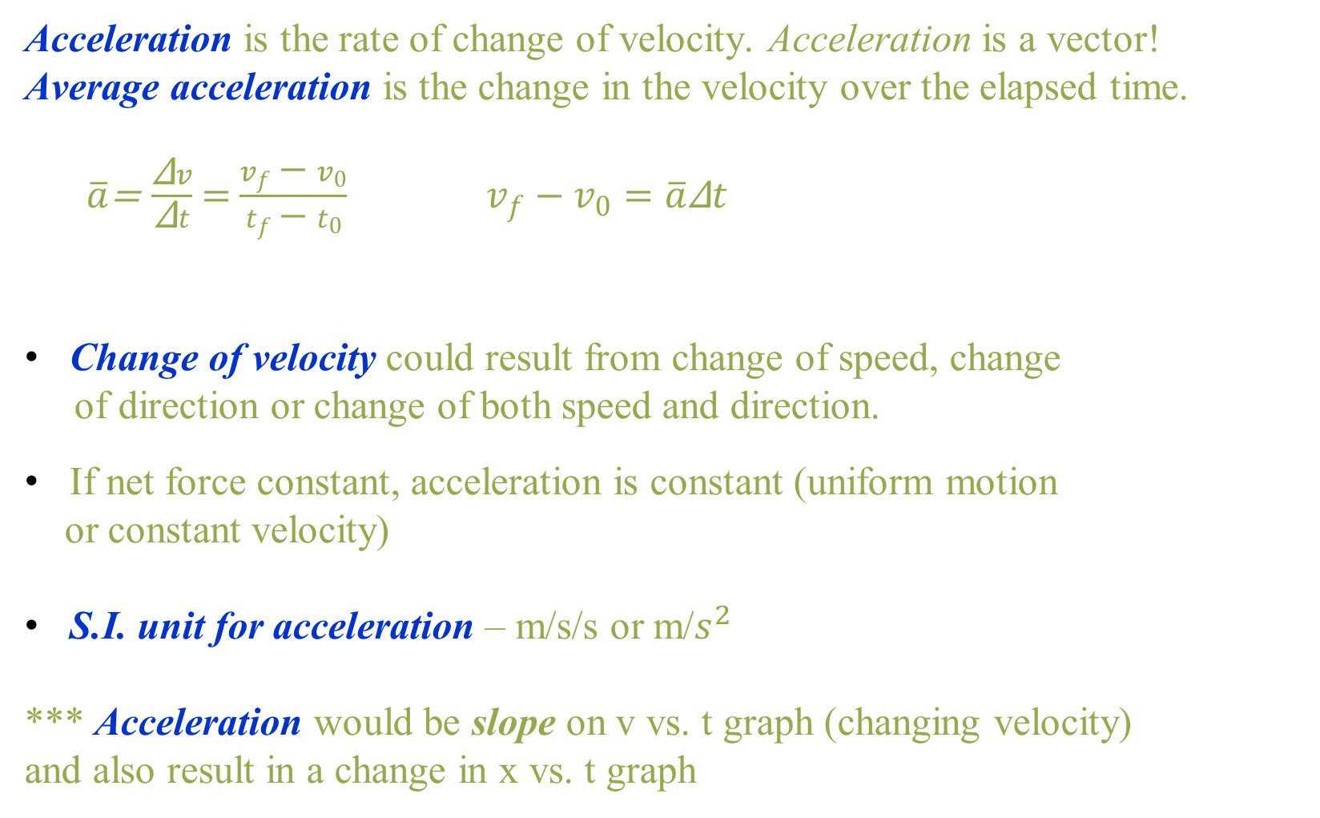
Acceleration
Acceleration is the rate of change of velocity. Acceleration is a vector!
Average acceleration is the change in the velocity over the elapsed time.
$\overline{a}\text{=} \frac{\text{Δ}v}{\text{Δ}t}$ = $\frac{v_{f} \text{−} v_{0}}{t_{f} \text{− }t_{0}} v_{f} \text{−} v_{0}=\overline{a}\text{Δ}t$
Change of velocity could result from change of speed, change
of direction or change of both speed and direction.
If net force constant, acceleration is constant (uniform motion
or constant velocity)
S.I. unit for acceleration – m/s/s or m/$s^{2}$
*** Acceleration would be slope on v vs. t graph (changing velocity)
and also result in a change in x vs. t graph

Slide 12
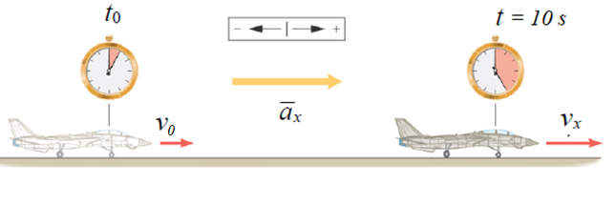
Acceleration
Example: Suppose you are taking off and you change the velocity steadily from 40 km/h to 45 km/h in 10 seconds. In next 10 seconds you increase it to 50km/h, and soon.
You change velocity by 5km/h in every 10 seconds.
Acceleration
*This calculation of the average acceleration works even if the acceleration is not constant throughout the motion.

Slide 13
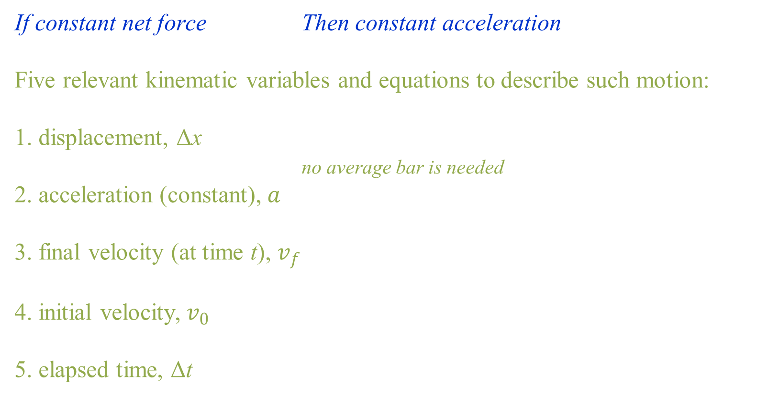
Equations of Kinematics for Constant Acceleration
If constant net force Then constant acceleration
Five relevant kinematic variables and equations to describe such motion:
1. displacement, Δx
no average bar is needed
2. acceleration (constant), $a$
3. final velocity (at time t), $v_{f}$
4. initial velocity,$v_{0}$
5. elapsed time, Δt

Slide 14
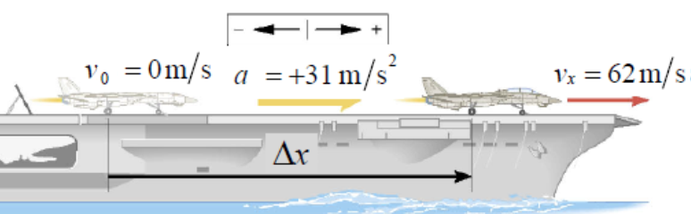
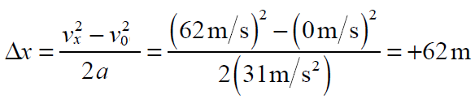
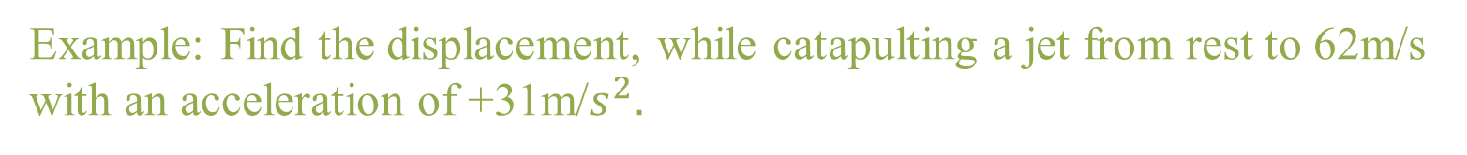
Kinematics of Constant Acceleration
Example: Find the displacement, while catapulting a jet from rest to 62m/s with an acceleration of +31m/$s^{2}.$

Slide 15
Freely Falling Bodies
For vertical motion, we will replace the x label with y in all kinematic equations, and use upward as positive.
    It is found that, when objects are in free fall and thus not affected by air resistance (drag), all bodies at the same location above the Earth fall vertically with the same acceleration. Also, if the distance of the fall is small
compared to the radius of the Earth, then the acceleration remains essentially constant throughout the descent.
Such idealized motion is called free-fall and the acceleration of a freely falling body is called the acceleration due to gravity, and the acceleration is downward or negative.

Slide 16
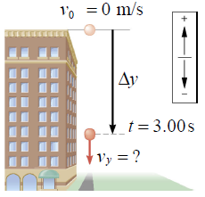
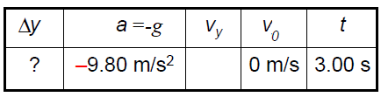
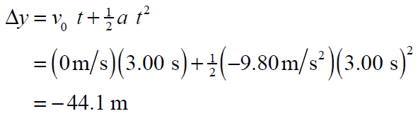
Freely Falling Bodies
Example: A coin from the top of a tall building is dropped from rest. After 3.00s of free fall, what is the vertical displacement, Δ y of the coin?

Slide 17
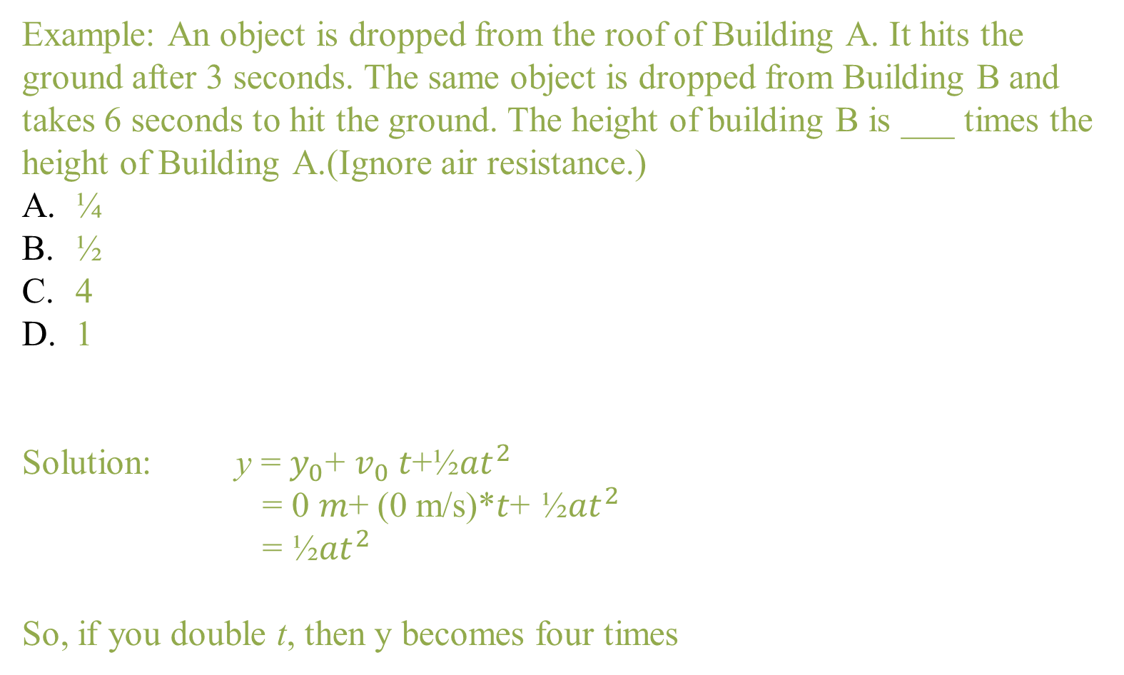
Freely Falling Bodies
Example: An object is dropped from the roof of Building A. It hits the ground after 3 seconds. The same object is dropped from Building B and takes 6 seconds to hit the ground. The height of building B is ___ times the height of Building A.(Ignore air resistance.)
¼
½
4
1
Solution: y = $y_{0}$+ $v_{0}$𝑡+½𝑎$t^{2}$
= 0 𝑚+ (0 m/s)*𝑡+ ½𝑎$t^{2}$
= ½𝑎$t^{2}$
So, if you double t, then y becomes four times

