Slide 1
PHYS 1111K
Lectures 17-18
OpenStax Chapter 7
Youtube: https://youtu.be/1-TW4arw0-c

Slide 2
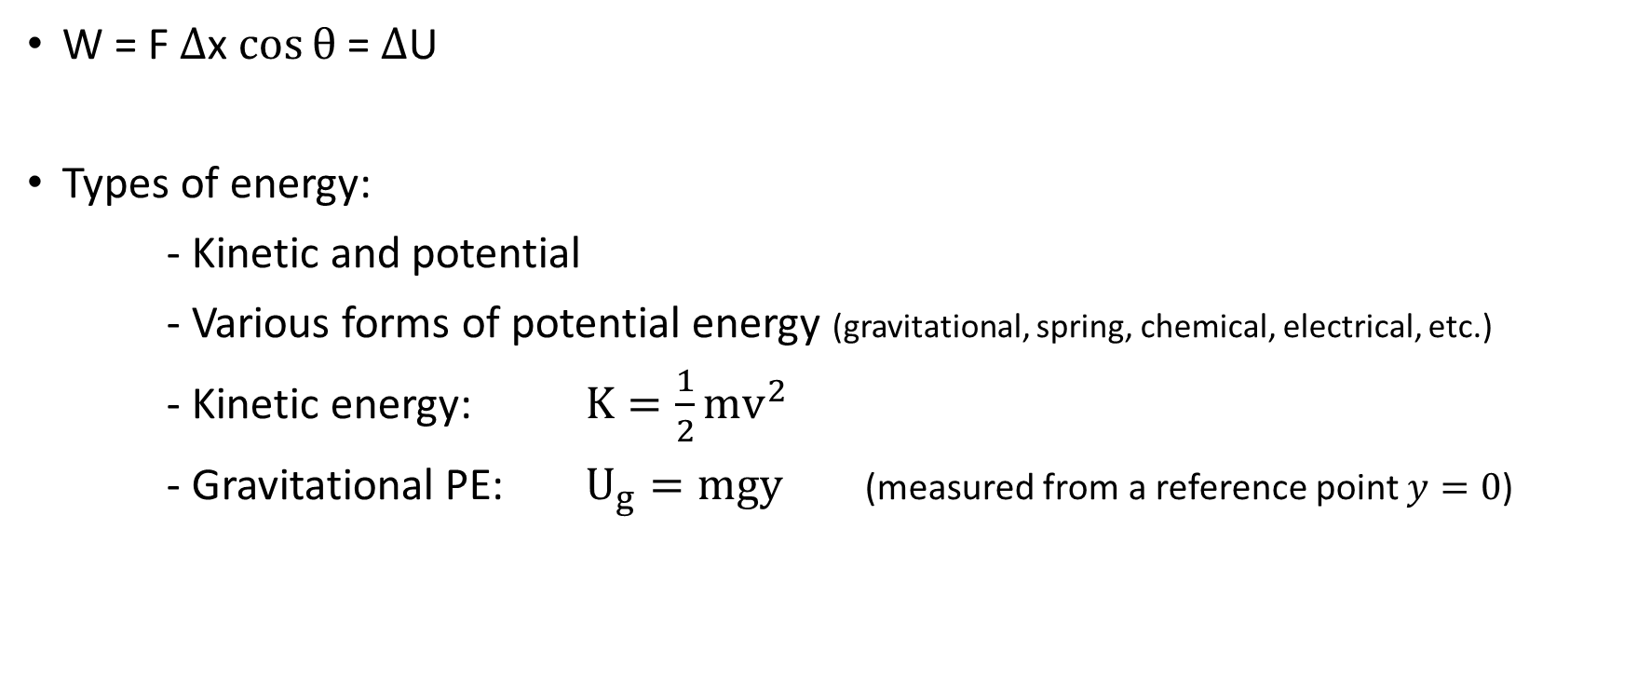
Last Class
W = F $Δ$x $\cos{θ}$ = $Δ$U
Types of energy:
- Kinetic and potential
- Various forms of potential energy (gravitational, spring, chemical, electrical, etc.)
- Kinetic energy: $K=\frac{1}{2}mv^{2}$
- Gravitational PE: $U_{g}=mgy$ (measured from a reference point $y=0$)

Slide 3
Conservation of energy
If the system is isolated – i.e., no external forces or torques, the total energy of the system is conserved
Initial energy of the system = Final energy of the system

Slide 4
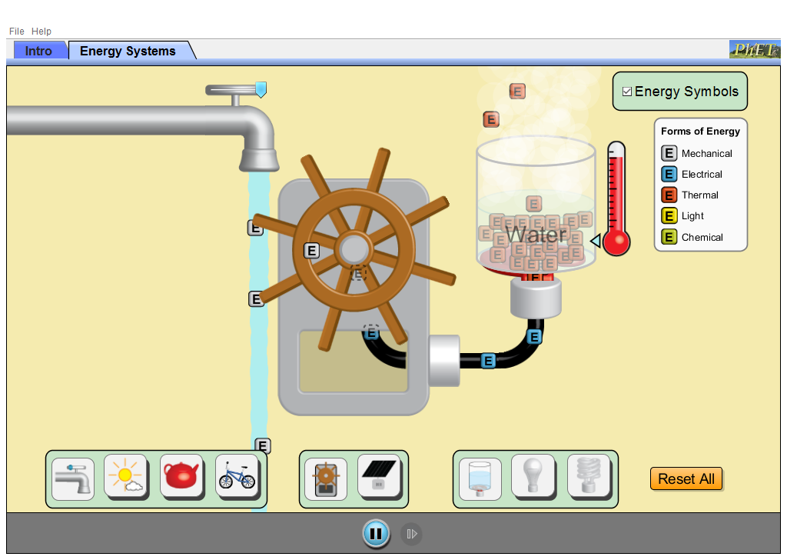
Energy Conversions
https://phet.colorado.edu/en/simulation/legacy/energy-forms-and-changes

Slide 5
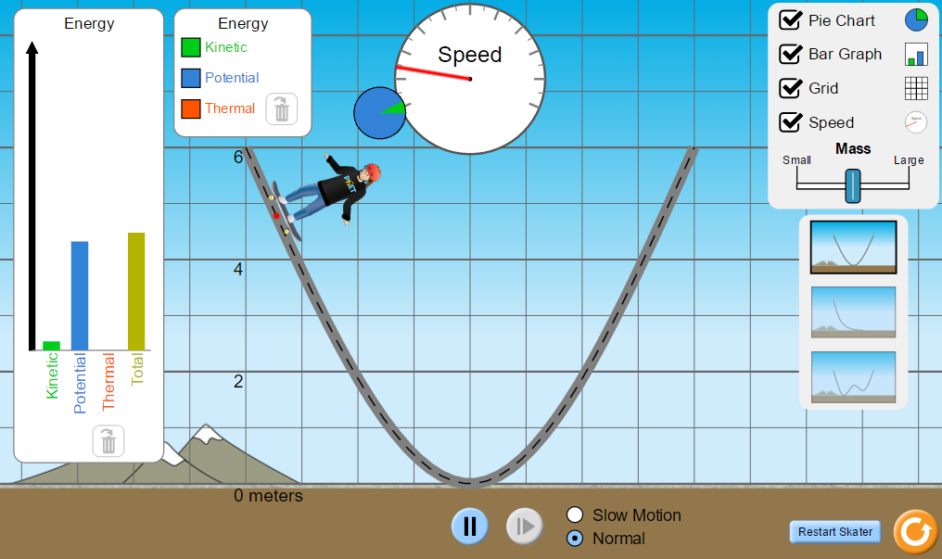
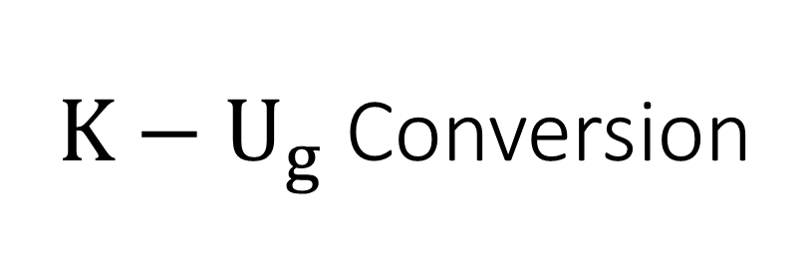
$K−U_{g}$ Conversion
https://phet.colorado.edu/en/simulation/energy-skate-park-basics

Slide 6
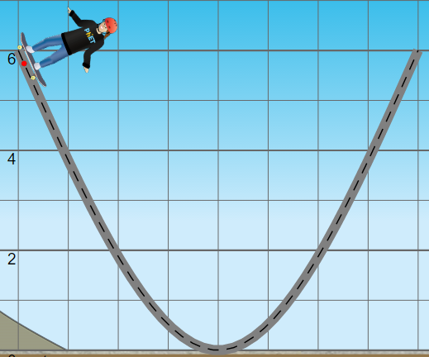
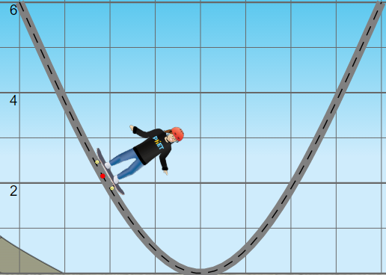
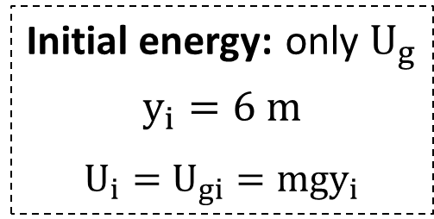

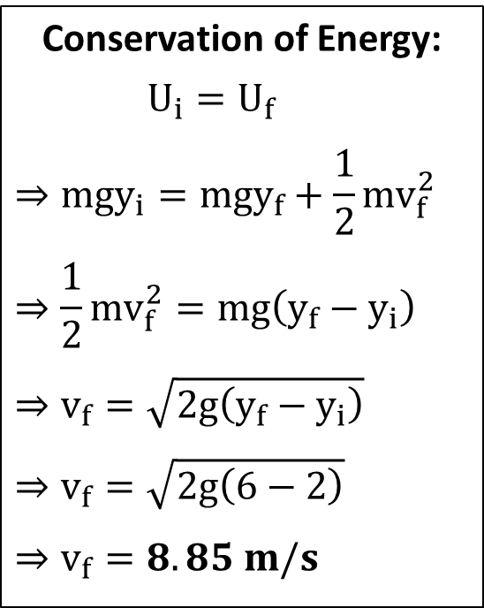
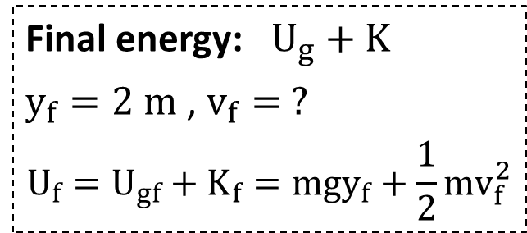
$K−U_{g}$ Conversion [1]
Conservation of Energy:
$U_{i}=U_{f}$
$$⇒mgy_{i}=mgy_{f}+\frac{1}{2}{mv}_{f}^{2}$$
$$⇒\frac{1}{2}{mv}_{f}^{2}=mg\left(y_{f}−y_{i}\right)$$
$$⇒v_{f}=\sqrt{2g\left(y_{f}−y_{i}\right)}$$
$$⇒v_{f}=\sqrt{2g\left(6−2\right)}$$
$$⇒v_{f}=8.85 m/s$$
Initial energy: only $U_{g}$
$$y_{i}=6 m$$
$$U_{i}=U_{gi}=mgy_{i}$$
Final energy: $U_{g}+K$
$y_{f}=2 m$ , $v_{f}= ?$
$$U_{f}=U_{gf}+K_{f}=mgy_{f}+\frac{1}{2}{mv}_{f}^{2}$$

Slide 7
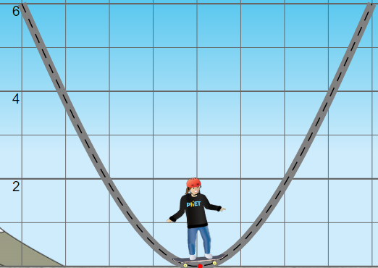
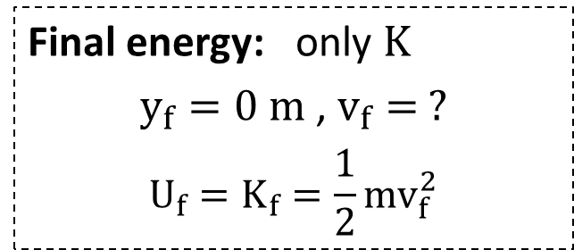
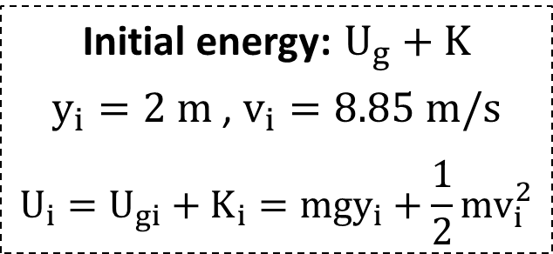

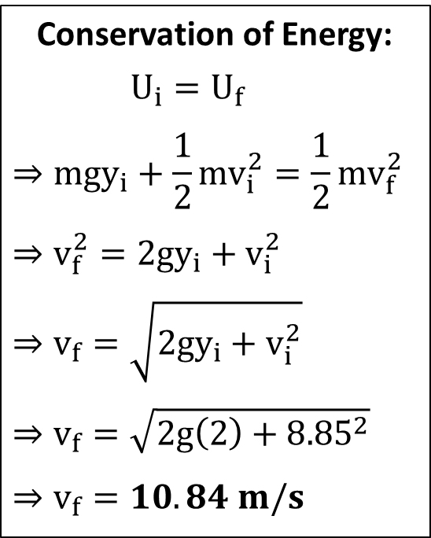
$K−U_{g}$ Conversion [2]
Conservation of Energy:
$U_{i}=U_{f}$
$$⇒mgy_{i}+\frac{1}{2}{mv}_{i}^{2}=\frac{1}{2}{mv}_{f}^{2}$$
$$⇒v_{f}^{2}=2gy_{i}+v_{i}^{2}$$
$$⇒v_{f}=\sqrt{2gy_{i}+v_{i}^{2}}$$
$$⇒v_{f}=\sqrt{2g\left(2\right)+{8.85}^{2}}$$
$$⇒v_{f}=10.84 m/s$$
Initial energy: $U_{g}+K$
$y_{i}=2 m$ , $v_{i}=8.85 m/s$
$$U_{i}=U_{gi}+K_{i}=mgy_{i}+\frac{1}{2}{mv}_{i}^{2}$$
Final energy: only $K$
$$y_{f}=0 m\text{ , }v_{f}= ?$$
$$U_{f}=K_{f}=\frac{1}{2}{mv}_{f}^{2}$$

Slide 8

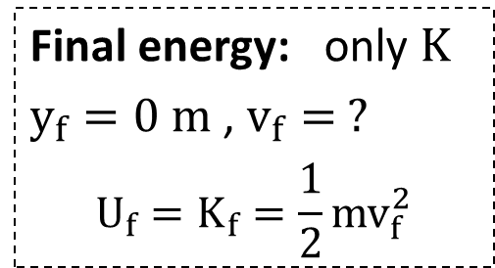
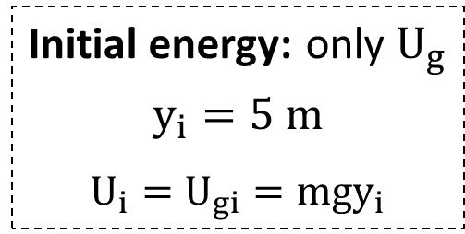
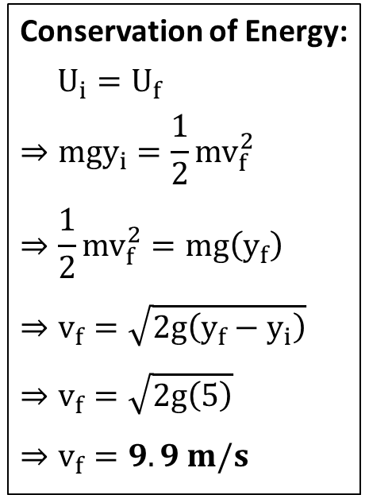
Check Your Understanding
A car sits at rest at the top of a hill. A small push sends it rolling down a hill. After its height has dropped by 5.0 m, it is moving at a good speed. Write down the equation for conservation of energy, noting the choice of system, the initial and final states, and what energy transformation has taken place.
Conservation of Energy:
$$U_{i}=U_{f}$$
$$⇒mgy_{i}=\frac{1}{2}{mv}_{f}^{2}$$
$$⇒\frac{1}{2}{mv}_{f}^{2}=mg\left(y_{f}\right)$$
$$⇒v_{f}=\sqrt{2g\left(y_{f}−y_{i}\right)}$$
$$⇒v_{f}=\sqrt{2g\left(5\right)}$$
$$⇒v_{f}=9.9 m/s$$
Initial energy: only $U_{g}$
$$y_{i}=5 m$$
$$U_{i}=U_{gi}=mgy_{i}$$
y = 5 m
car
Final energy: only $K$
$y_{f}=0 m$ , $v_{f}= ?$
$$U_{f}=K_{f}=\frac{1}{2}{mv}_{f}^{2}$$
y = 0

Slide 9
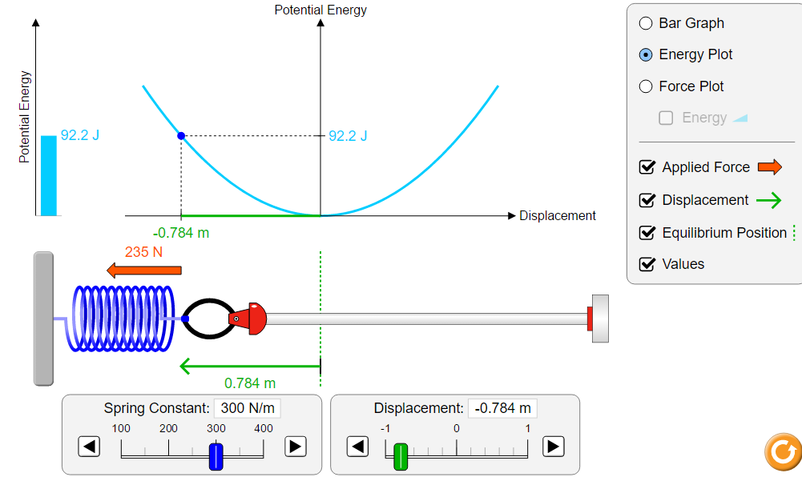
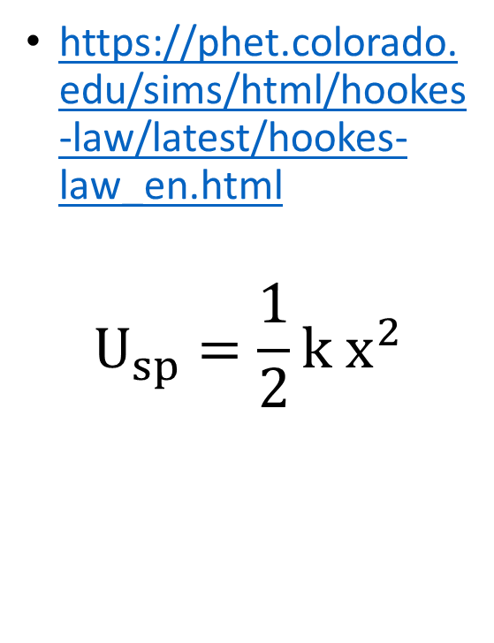

Spring energy ($U_{sp}$)
https://phet.colorado.edu/sims/html/hookes-law/latest/hookes-law_en.html
$$U_{sp}=\frac{1}{2}k x^{2}$$

Slide 10
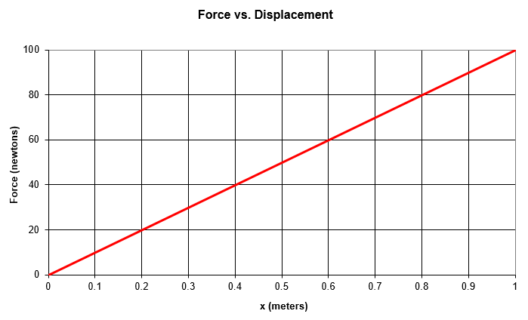
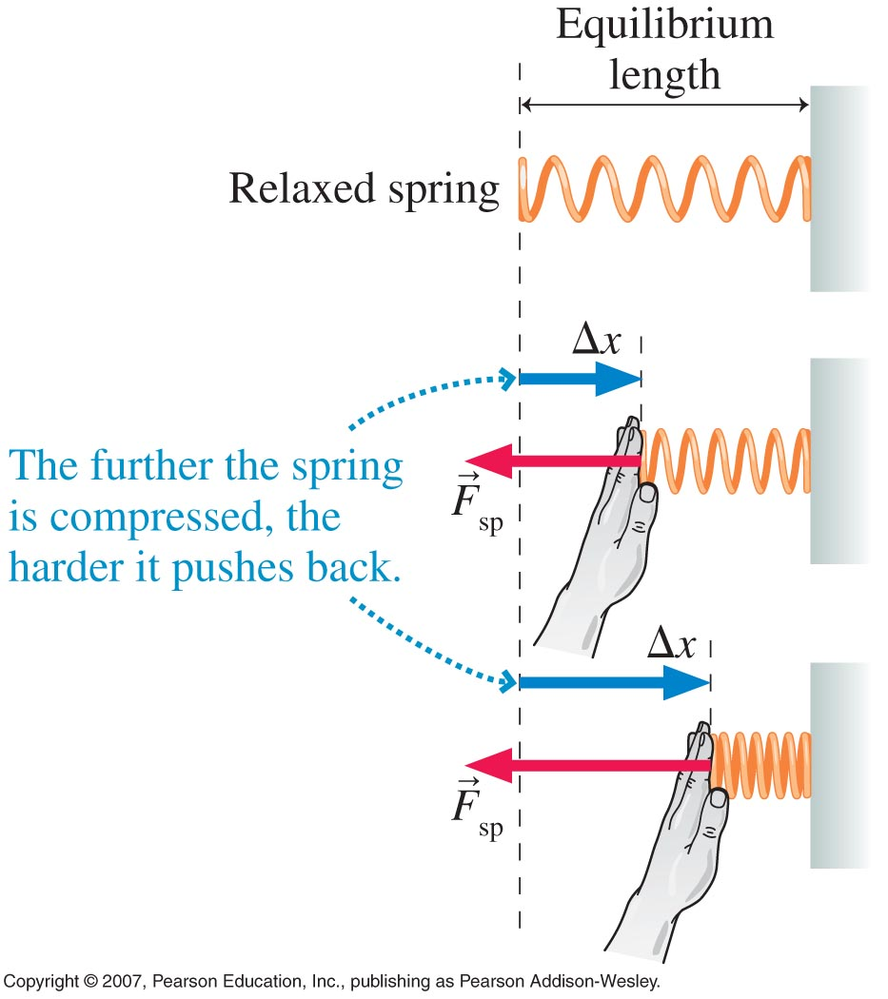
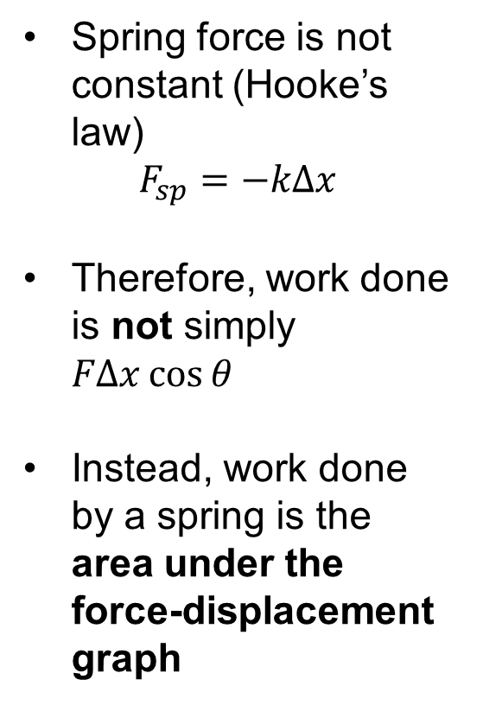
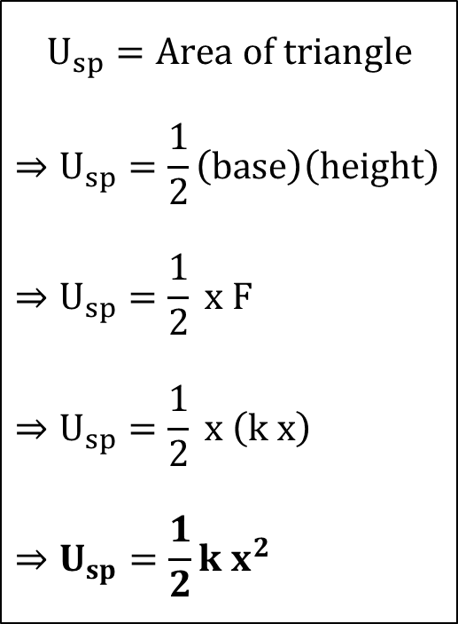
Calculating Spring Energy from Work Done
Spring force is not constant (Hooke’s law)
$$F_{sp}=−kΔx$$
Therefore, work done is not simply $FΔx\cos{θ}$
Instead, work done by a spring is the area under the force-displacement graph
$$U_{sp}=Area of triangle$$
$$⇒U_{sp}=\frac{1}{2}\left(base\right)\left(height\right)$$
$$⇒U_{sp}=\frac{1}{2} x F$$
$$⇒U_{sp}=\frac{1}{2} x \left(k x\right)$$
$$⇒U_{sp}=\frac{1}{2}k x^{2}$$

Slide 11
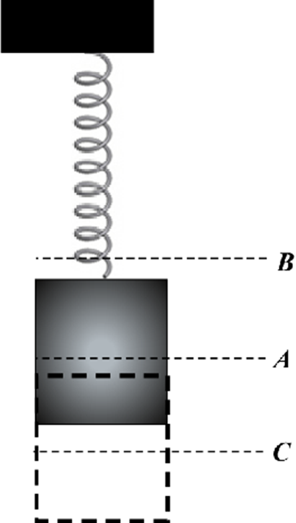
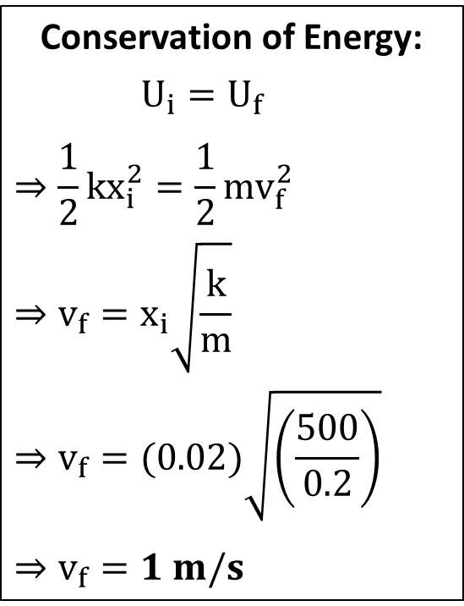
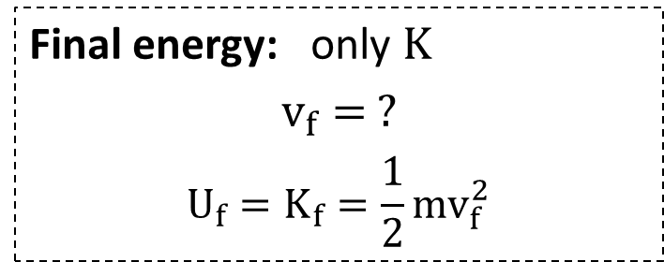
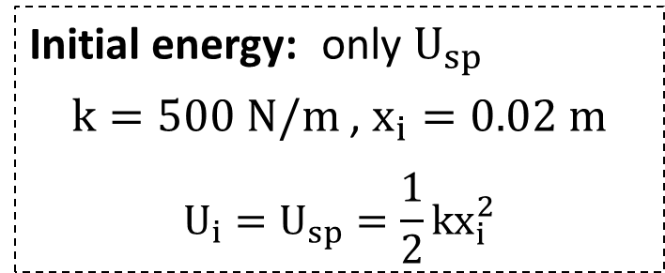
Problem 1
A 200 g block on a frictionless surface is pushed against a spring with spring constant 500 N/m, compressing the spring by 2.0 cm. When the block is released, at what speed does it shoot away from the spring?
Conservation of Energy:
$U_{i}=U_{f}$
$$⇒\frac{1}{2}kx_{i}^{2}=\frac{1}{2}{mv}_{f}^{2}$$
$$⇒v_{f}=x_{i}\sqrt{\frac{k}{m}}$$
$$⇒v_{f}=(0.02)\sqrt{\left(\frac{500}{0.2}\right)}$$
$$⇒v_{f}=1 m/s$$
Initial energy: only $U_{sp}$
$k=500 N/m$ , $x_{i}=0.02 m$
$$U_{i}=U_{sp}=\frac{1}{2}kx_{i}^{2}$$
Final energy: only $K$
$$v_{f}= ?$$
$$U_{f}=K_{f}=\frac{1}{2}{mv}_{f}^{2}$$

Slide 12
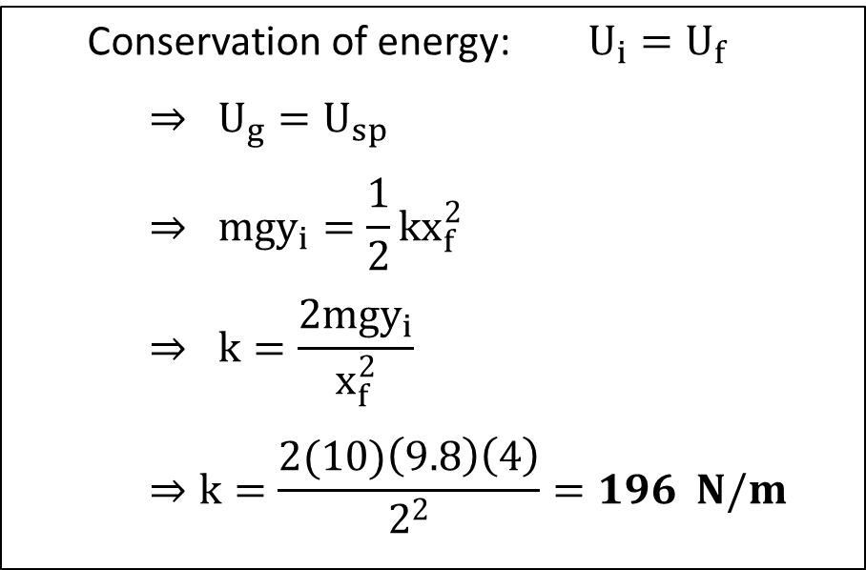
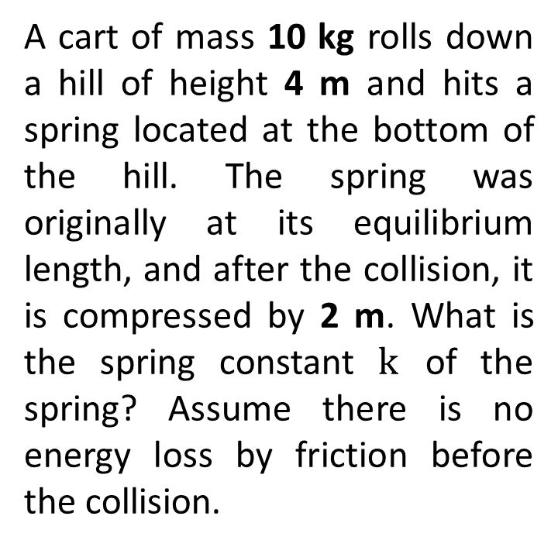
Problem 2
A cart of mass 10 kg rolls down a hill of height 4 m and hits a spring located at the bottom of the hill. The spring was originally at its equilibrium length, and after the collision, it is compressed by 2 m. What is the spring constant $k$ of the spring? Assume there is no energy loss by friction before the collision.
Conservation of energy: $U_{i}=U_{f}$
$$⇒ U_{g}=U_{sp}$$
$$⇒ {mgy}_{i}=\frac{1}{2}kx_{f}^{2}$$
$$⇒ k=\frac{2{mgy}_{i}}{x_{f}^{2}}$$
$$⇒k=\frac{2(10)\left(9.8\right)\left(4\right)}{2^{2}}=196 N/m$$

Slide 13
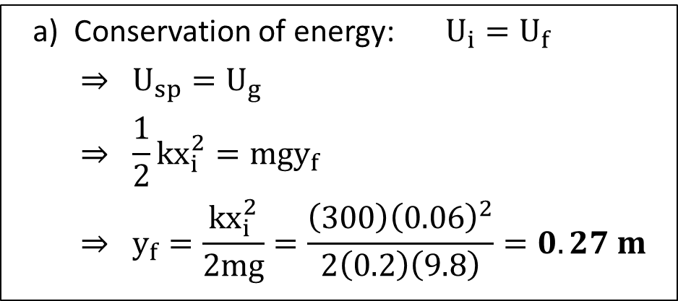
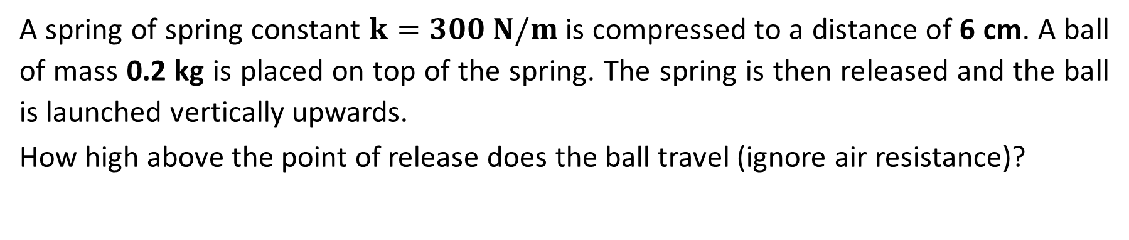
Problem 3
A spring of spring constant $k=300 N/m$ is compressed to a distance of 6 cm. A ball of mass 0.2 kg is placed on top of the spring. The spring is then released and the ball is launched vertically upwards.
How high above the point of release does the ball travel (ignore air resistance)?
a) Conservation of energy: $U_{i}=U_{f}$
$$⇒ U_{sp}=U_{g}$$
$$⇒ {\frac{1}{2}kx_{i}^{2}=mgy}_{f}$$
$$⇒ y_{f}=\frac{kx_{i}^{2}}{2mg}=\frac{\left(300\right){\left(0.06\right)}^{2}}{2\left(0.2\right)\left(9.8\right)}=0.27 m$$

Slide 14
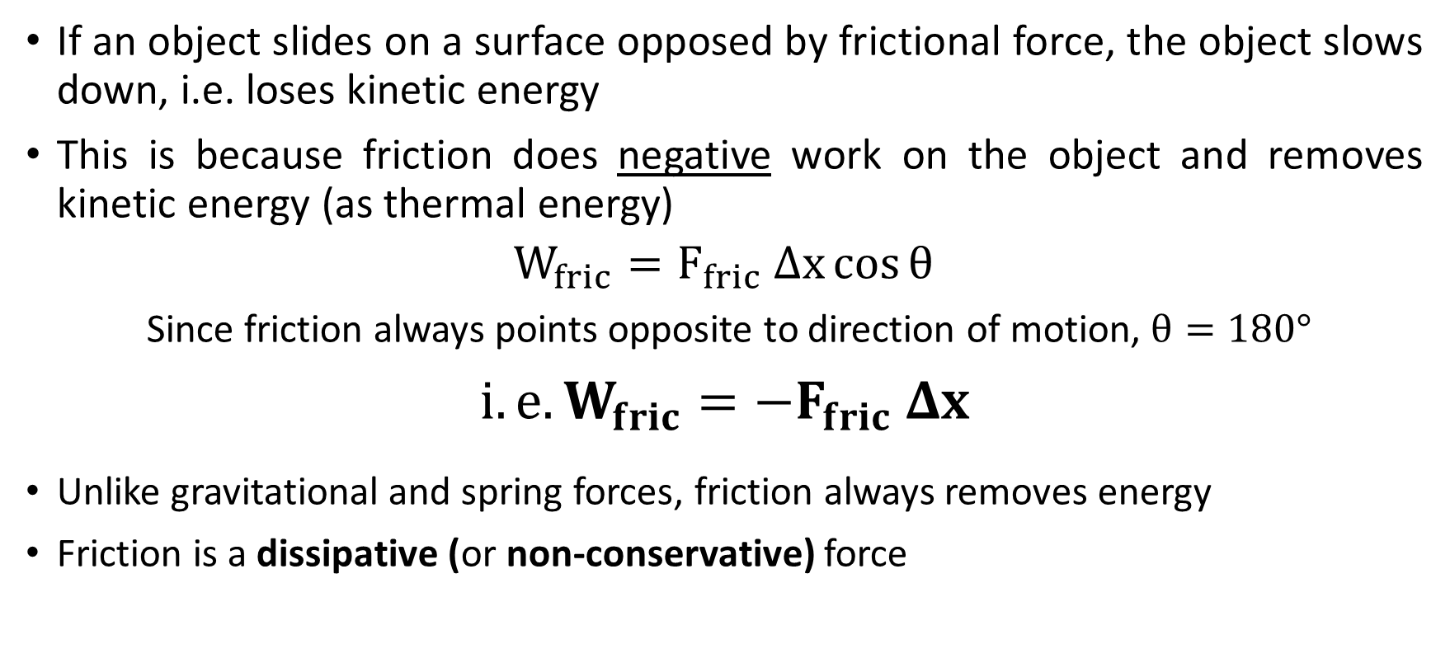
Work done by Friction
If an object slides on a surface opposed by frictional force, the object slows down, i.e. loses kinetic energy
This is because friction does negative work on the object and removes kinetic energy (as thermal energy)
$$W_{fric}=F_{fric} Δx\cos{θ}$$
Since friction always points opposite to direction of motion, $θ=180°$
$$i.e. W_{fric}=−F_{fric} Δx$$
Unlike gravitational and spring forces, friction always removes energy
Friction is a dissipative (or non-conservative) force

Slide 15
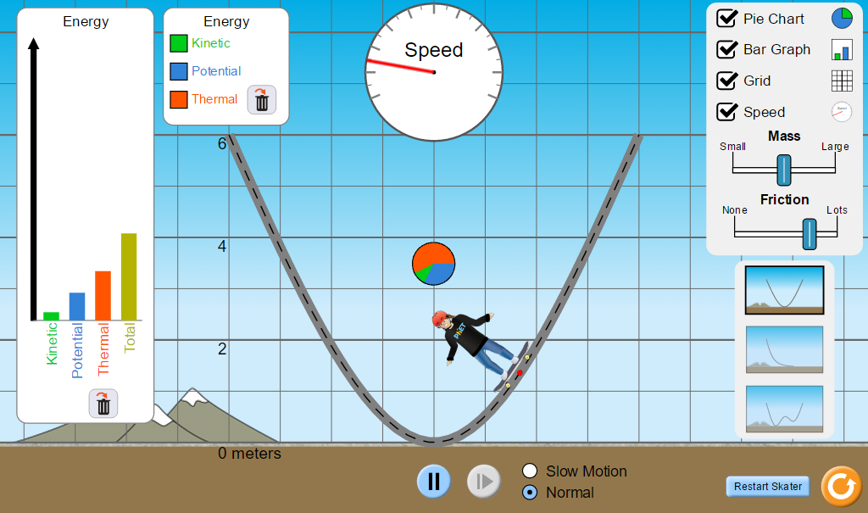
Energy Loss by Friction
https://phet.colorado.edu/sims/html/energy-skate-park-basics/latest/energy-skate-park-basics_en.html

Slide 16
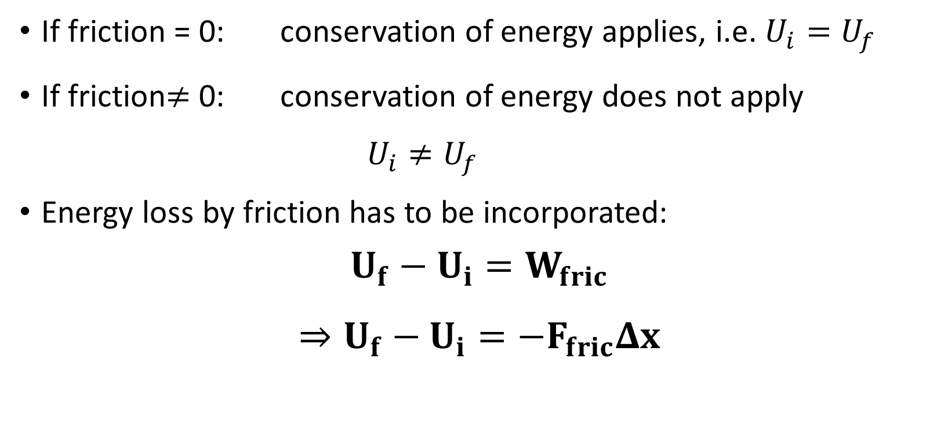
Conservation of Energy
If friction = 0: conservation of energy applies, i.e. $U_{i}=U_{f}$
If friction$≠$ 0: conservation of energy does not apply
  $U_{i}≠U_{f}$
  Energy loss by friction has to be incorporated:
  $$U_{f}−U_{i}=W_{fric}$$
  $$⇒U_{f}−U_{i}={−F}_{fric}Δx$$

Slide 17
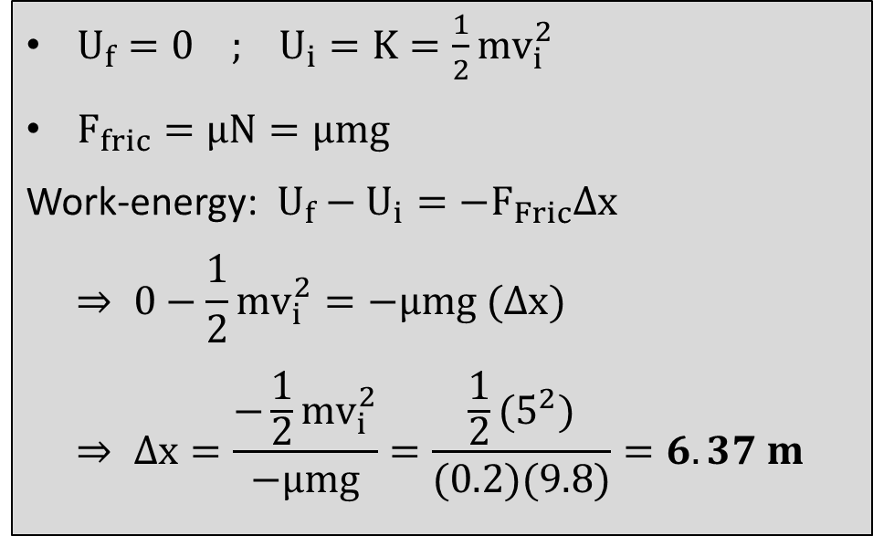


Problem 1
A 10-kg desk is being pulled by a person at 5 m/s along a flat wooden surface (µ=0.20) when suddenly the rope breaks. After the rope has broken, how far will the desk slide before stopping?
$U_{f}=0$ ; $U_{i}=K=\frac{1}{2}{mv}_{i}^{2}$
$F_{fric}=μN=μmg$
Work-energy: $U_{f}−U_{i}={−F}_{Fric}Δx$
$$⇒ 0−\frac{1}{2}mv_{i}^{2}=−μmg (Δx)$$
$$⇒ Δx=\frac{−\frac{1}{2}mv_{i}^{2}}{−μmg}=\frac{\frac{1}{2}(5^{2})}{(0.2)(9.8)}=6.37 m$$
$v_{i}$ = 5 m/s
$Δ$x=?
10 kg

Slide 18



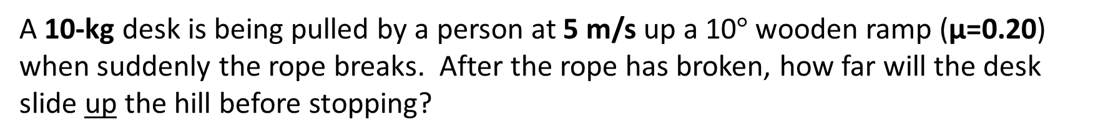
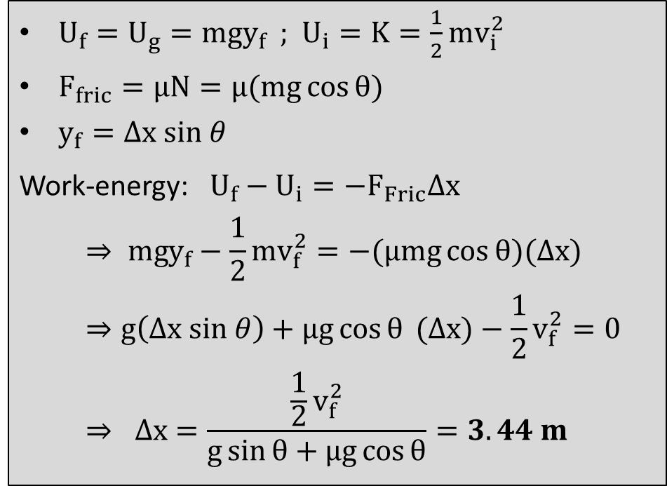
Problem 2
A 10-kg desk is being pulled by a person at 5 m/s up a 10$°$ wooden ramp (µ=0.20) when suddenly the rope breaks. After the rope has broken, how far will the desk slide up the hill before stopping?
$U_{f}=U_{g}={mgy}_{f}$ ; $U_{i}=K=\frac{1}{2}{mv}_{i}^{2}$
$F_{fric}=μN=μ(mg\cos{θ})$
$y_{f}=Δx sin θ$
Work-energy: $U_{f}−U_{i}={−F}_{Fric}Δx$
$$⇒ mgy_{f}−\frac{1}{2}mv_{f}^{2}=−(μmg\cos{θ})(Δx)$$
$$⇒g\left(Δx sin θ\right)+μg\cos{θ} (Δx)−\frac{1}{2}v_{f}^{2}=0$$
$$⇒ Δx=\frac{\frac{1}{2}v_{f}^{2}}{g\sin{θ}+μg\cos{θ}}=3.44 m$$
$v_{i}$ = 5 m/s
$Δ$x=?
10 kg
$$θ=10°$$

Slide 19

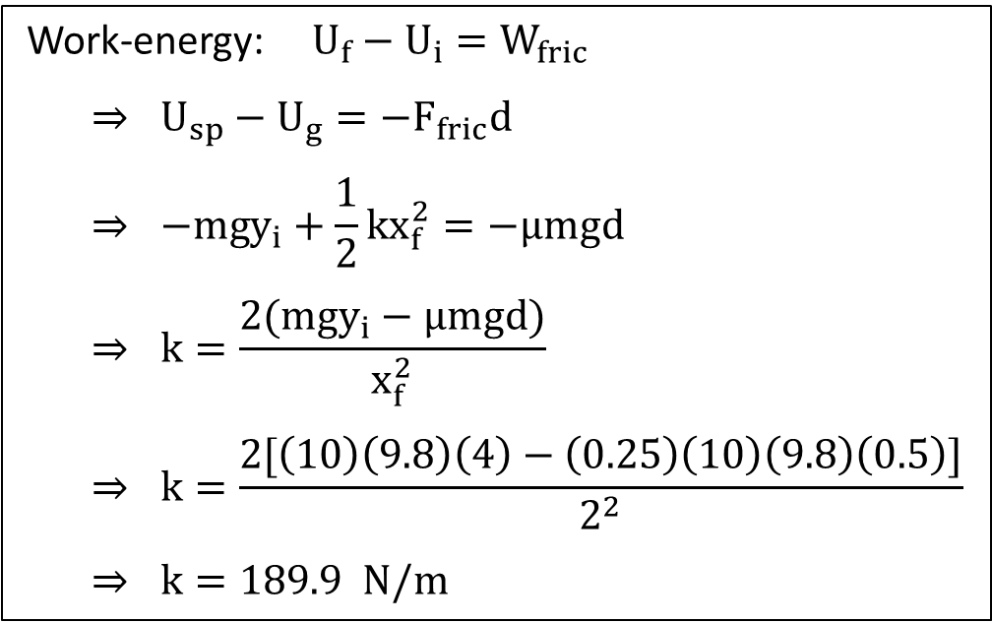
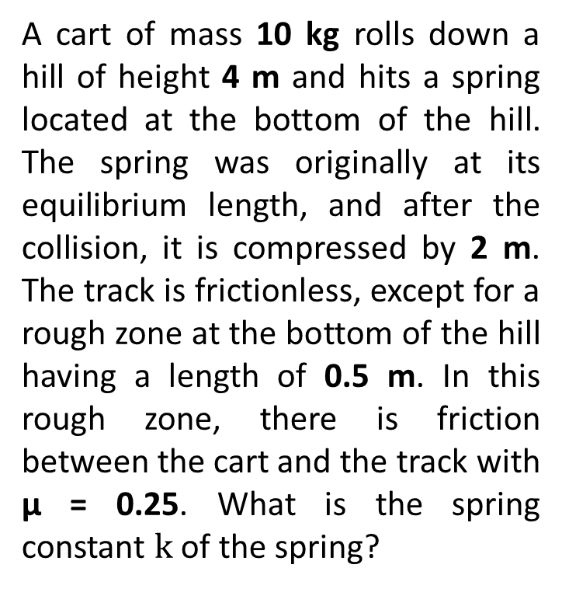
Problem 3
A cart of mass 10 kg rolls down a hill of height 4 m and hits a spring located at the bottom of the hill. The spring was originally at its equilibrium length, and after the collision, it is compressed by 2 m. The track is frictionless, except for a rough zone at the bottom of the hill having a length of 0.5 m. In this rough zone, there is friction between the cart and the track with µ = 0.25. What is the spring constant $k$ of the spring?
$d$ = 0.5 m
Work-energy: $U_{f}−U_{i}=W_{fric}$
$$⇒ U_{sp}−U_{g}=−F_{fric}d$$
$$⇒ −{mgy}_{i}+\frac{1}{2}kx_{f}^{2}=−μmgd$$
$$⇒ k=\frac{2({mgy}_{i}−μmgd)}{x_{f}^{2}}$$
$$⇒ k=\frac{2[\left(10\right)\left(9.8\right)\left(4\right)−\left(0.25\right)\left(10\right)\left(9.8\right)\left(0.5\right)]}{2^{2}}$$
$$⇒ k=189.9 N/m$$

Slide 20
Related topics that will not be covered in class:
Rotational kinetic energy
Conservation of angular momentum
Elastic and inelastic collisions

Slide 21
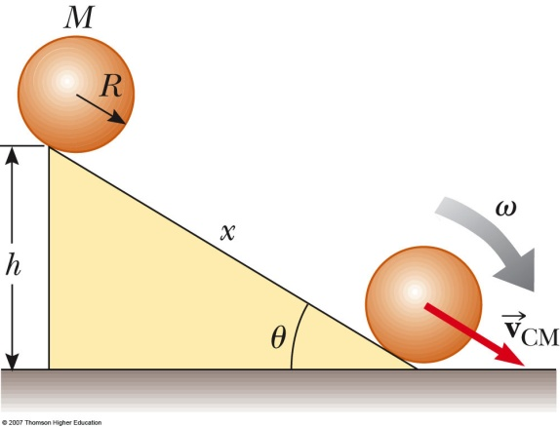
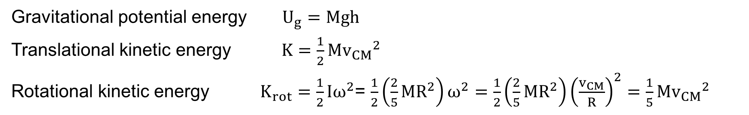
Conservation of Energy
A ball (solid sphere) of mass M and radius R is rolling down a ramp of height h. Describe the kinds of energy present in the system.
Gravitational potential energy $U_{g}=Mgh$
Translational kinetic energy $K=\frac{1}{2}M{v_{CM}}^{2}$
Rotational kinetic energy $K_{rot}=\frac{1}{2}Iω^{2}$= $\frac{1}{2}\left(\frac{2}{5}MR^{2}\right)ω^{2}=\frac{1}{2}\left(\frac{2}{5}MR^{2}\right){\left(\frac{v_{CM}}{R}\right)}^{2}=\frac{1}{5}M{v_{CM}}^{2}$

Slide 22
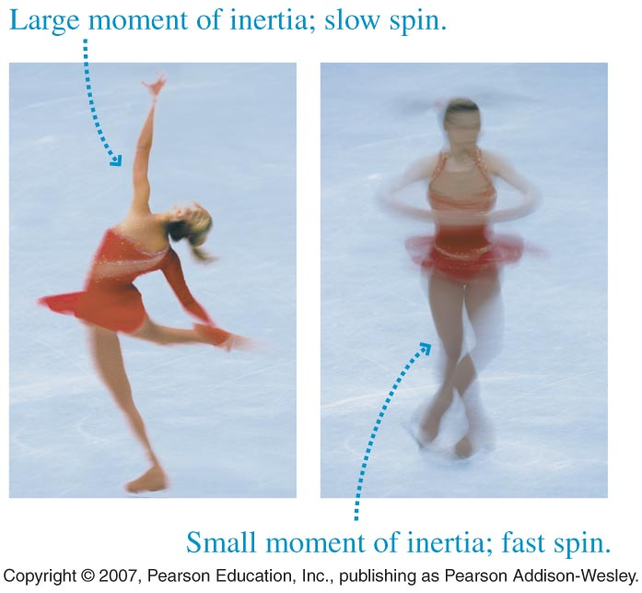
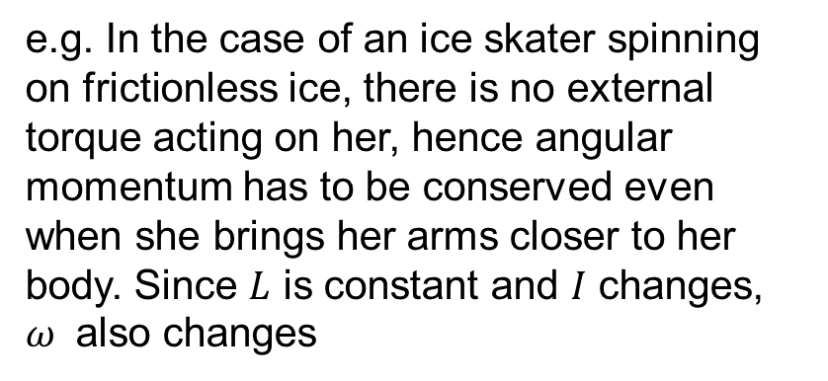

Conservation of Angular Momentum
Angular Momentum $L=Iω$
e.g. In the case of an ice skater spinning on frictionless ice, there is no external torque acting on her, hence angular momentum has to be conserved even when she brings her arms closer to her body. Since $L$ is constant and $I$ changes, $ω$ also changes

Slide 23
Conservation of Angular Momentum
A 2.0 kg, 20 cm diameter turntable rotates at 100 rpm on frictionless bearings. Two 500 g blocks fall from above, hit the turntable simultaneously at opposite ends of a diagonal, and stick. What is the turntable’s angular speed just after this event?

Slide 24
Collisions

