Slide 1
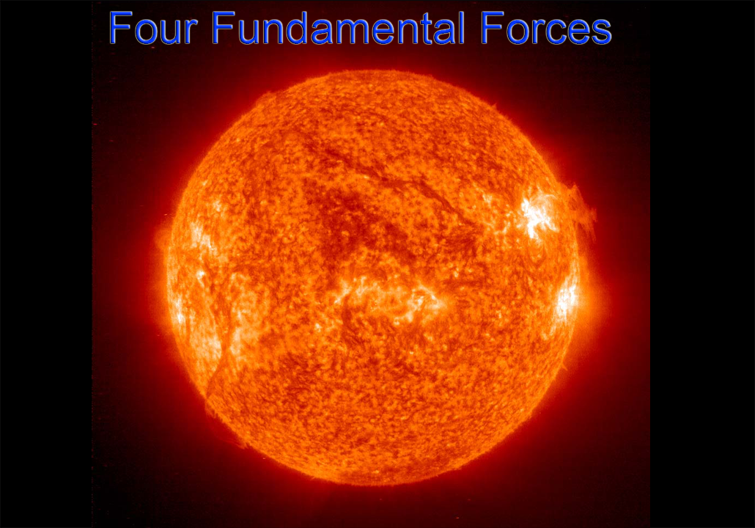

Slide 2
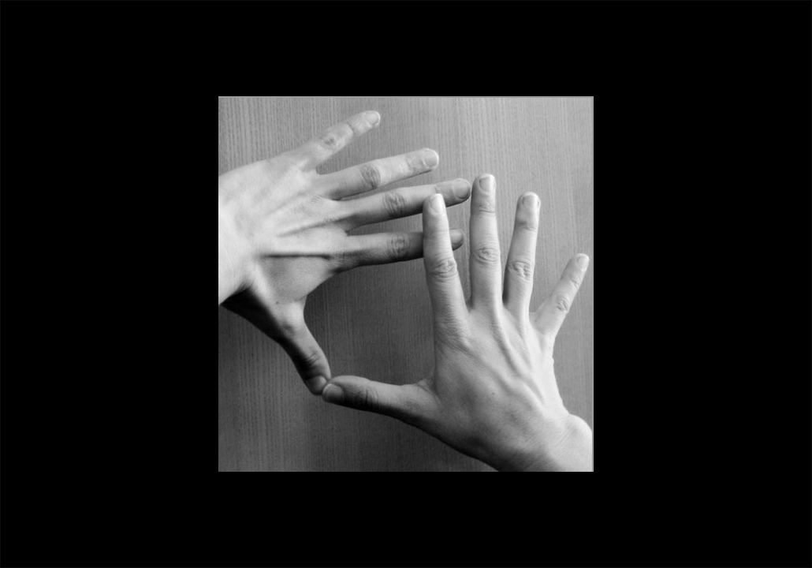

Slide 3
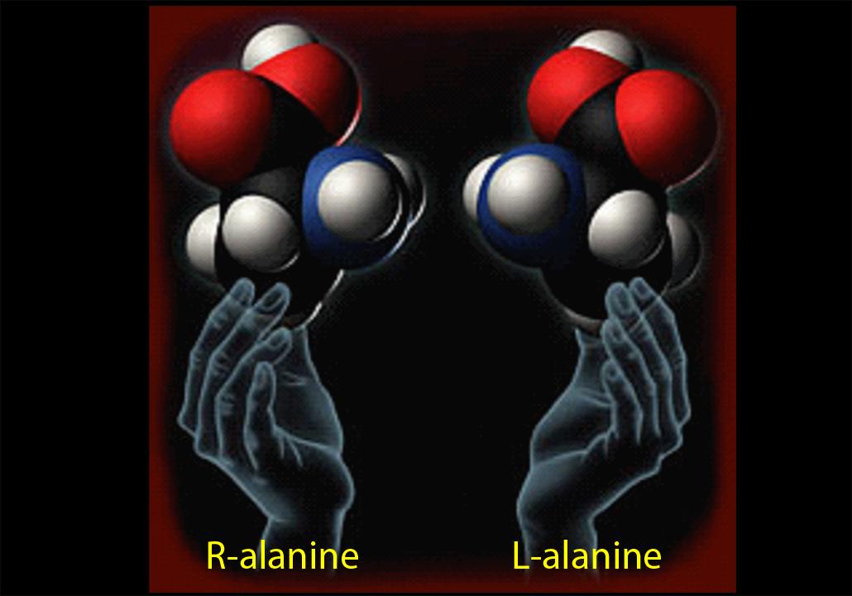

Slide 4


Slide 5
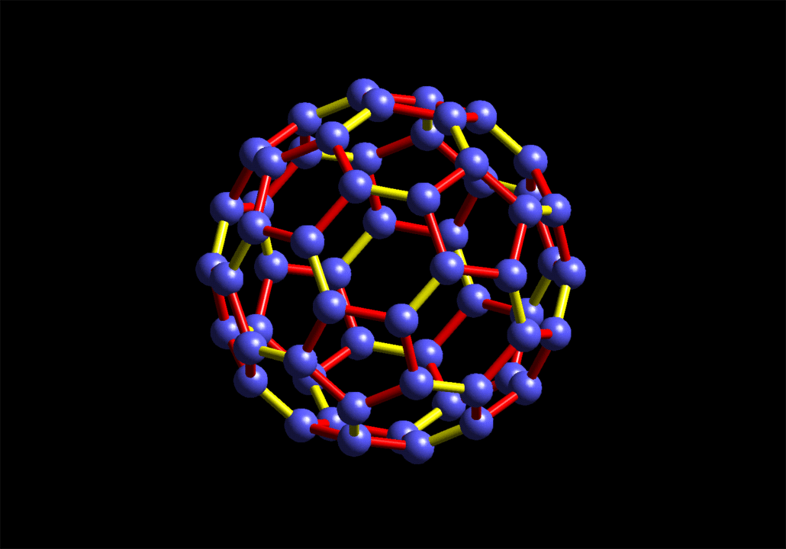
C₆₀

Slide 6
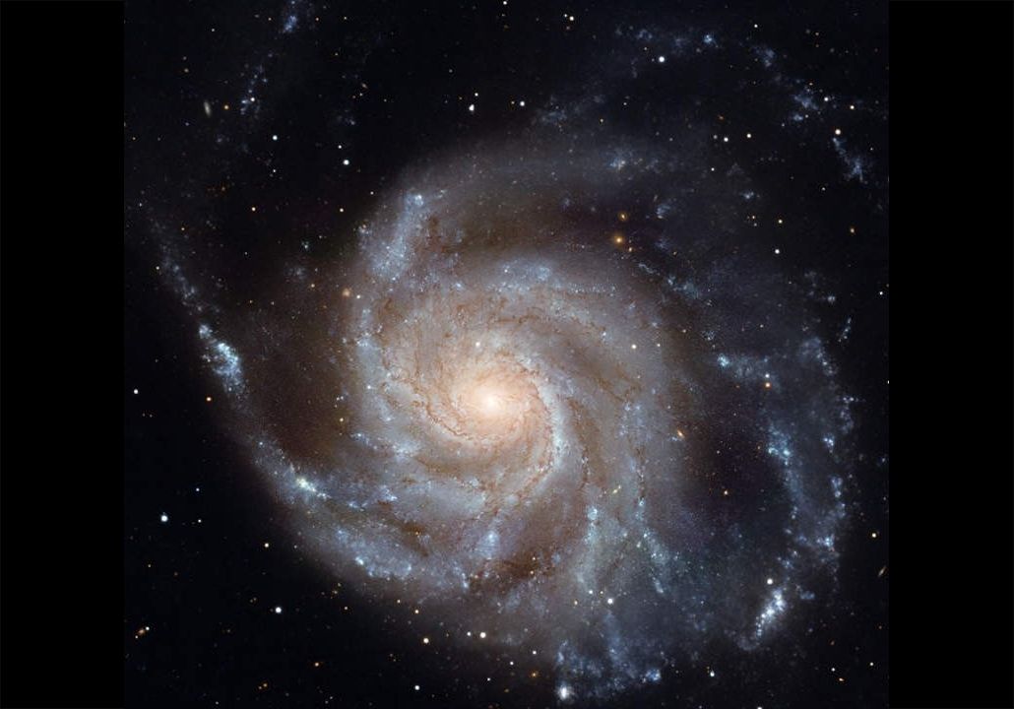

Slide 7
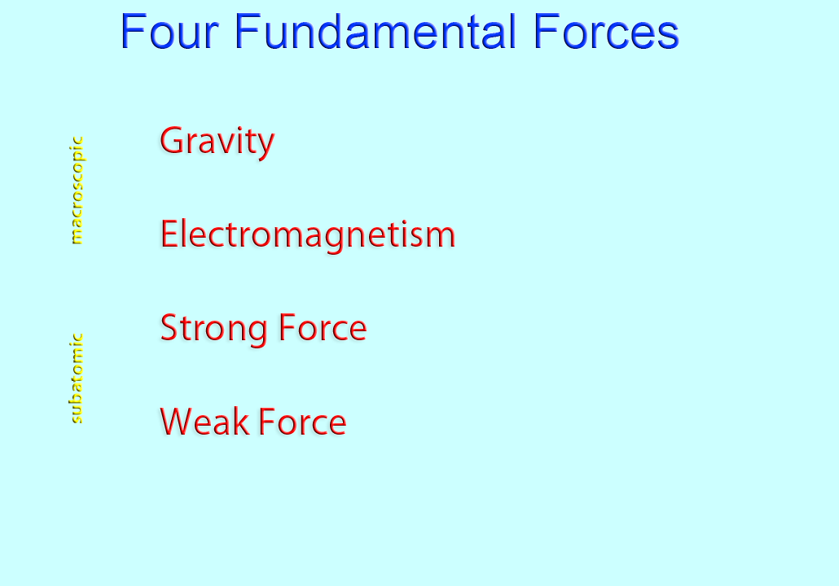
range over space
∞
∞
10⁻¹² cm
10⁻¹⁴ cm

Slide 8
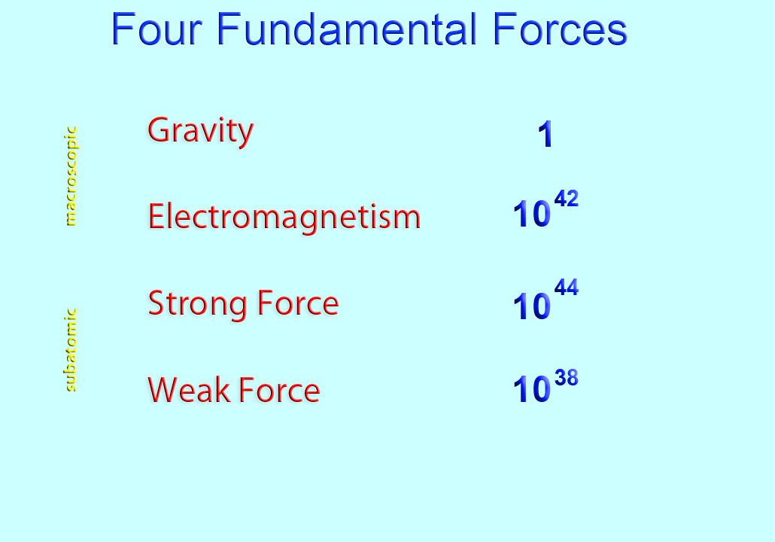
strength

Slide 9
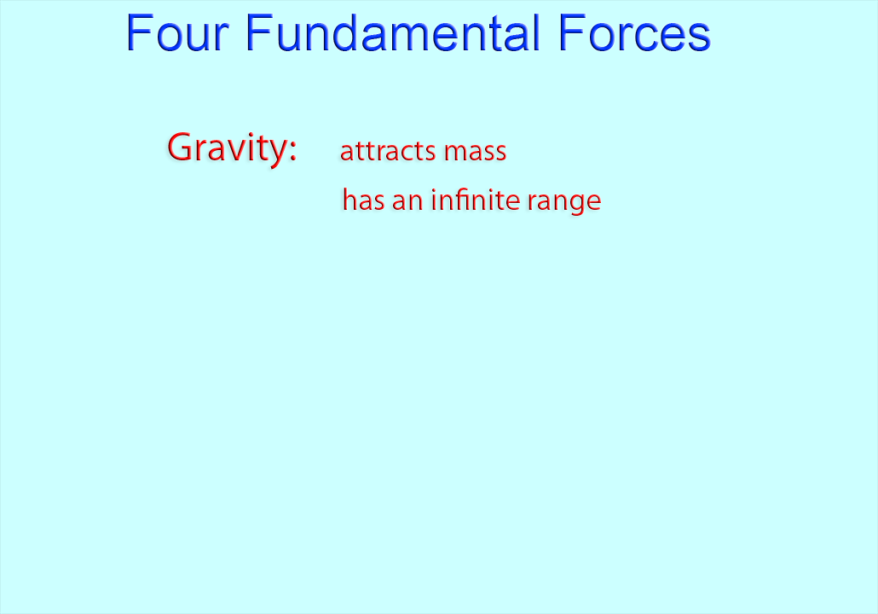

Slide 10
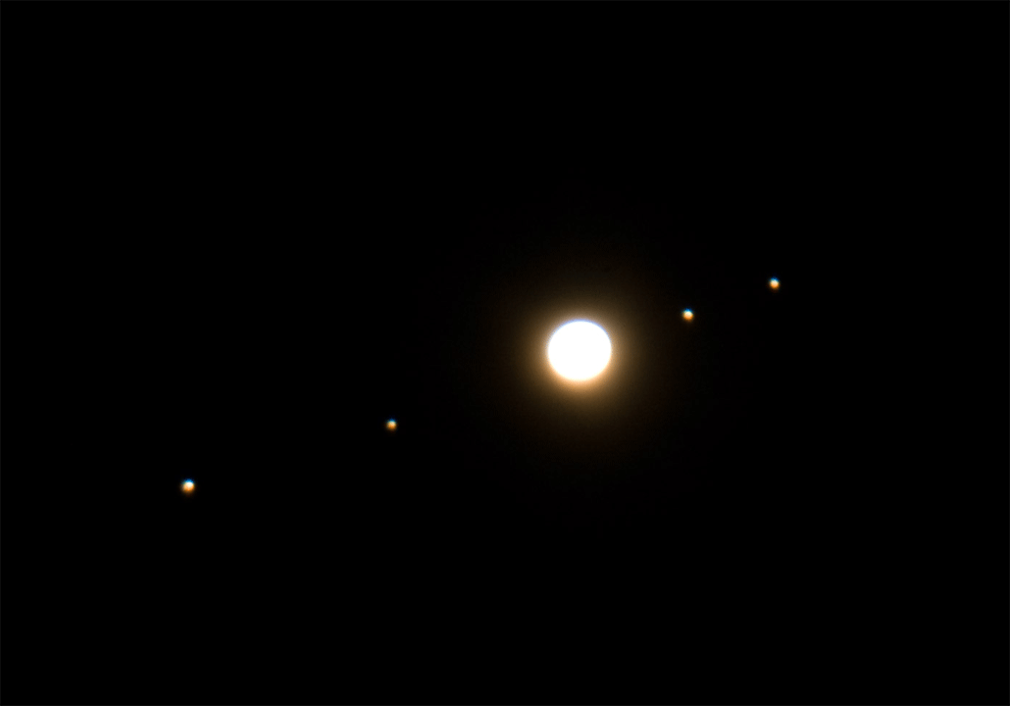

Slide 11
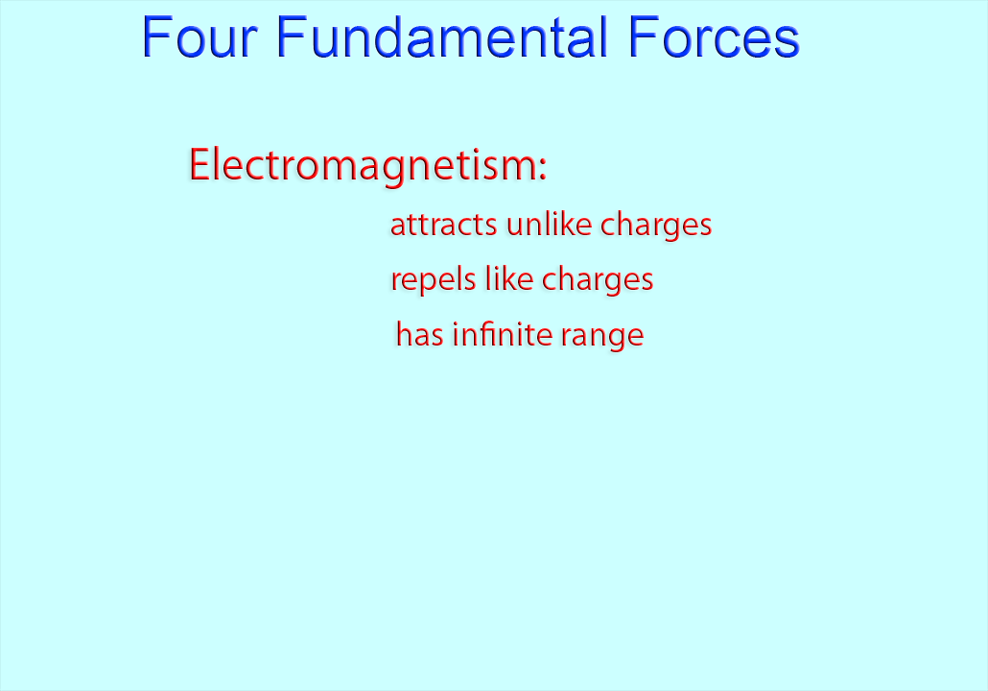
+ –
– –

Slide 12
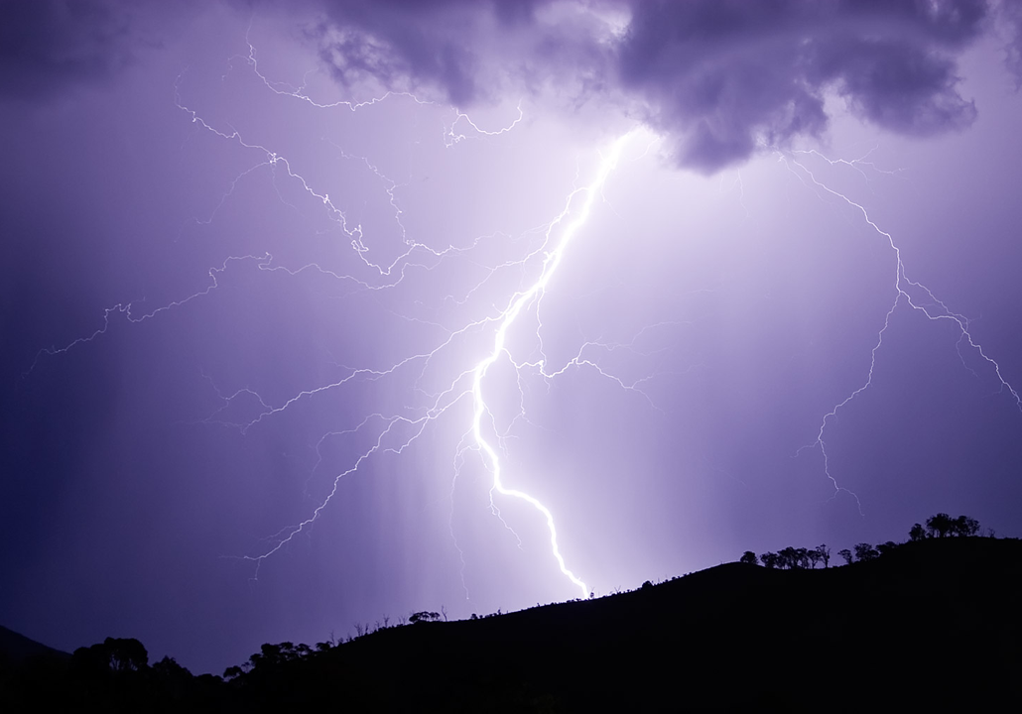

Slide 13
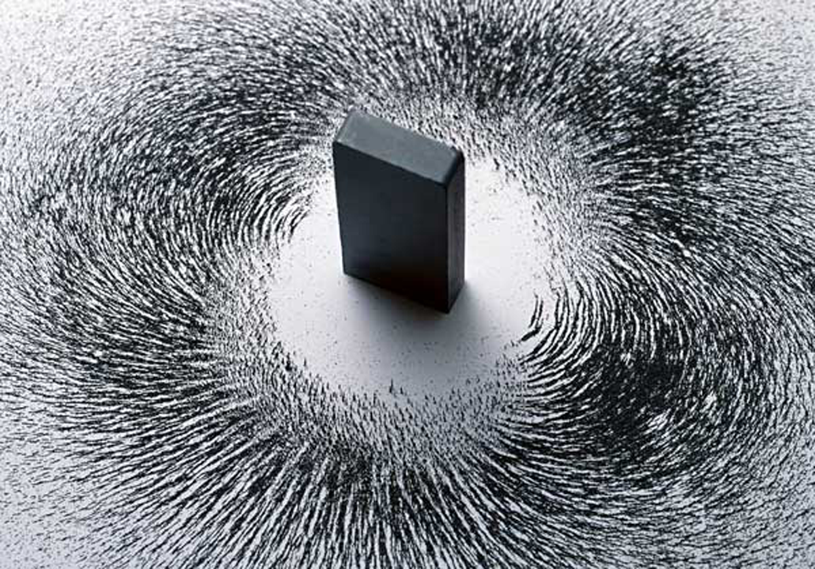

Slide 14
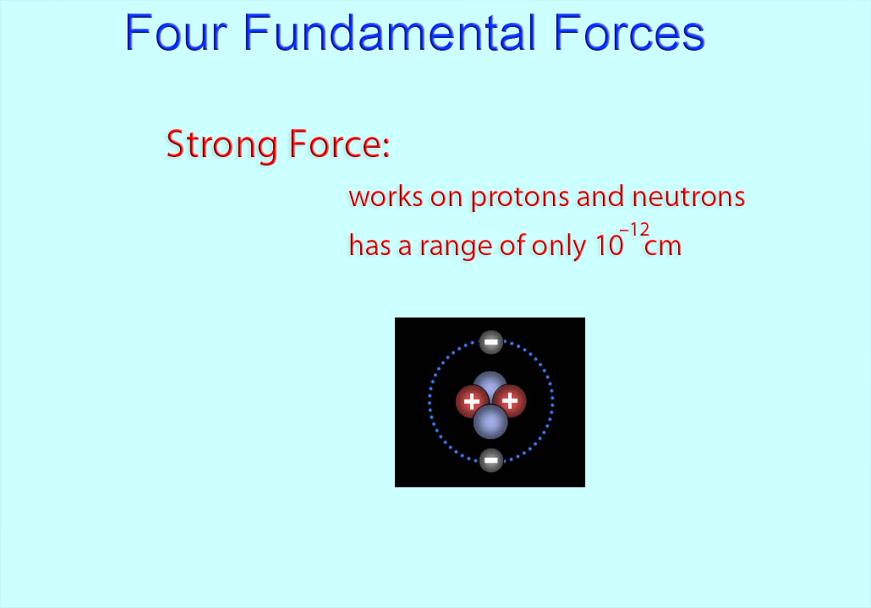
1
it keeps protons and neutrons inside the atom . . .

Slide 15
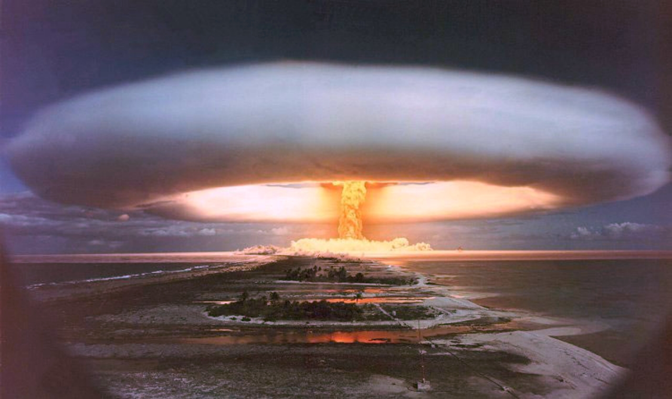
Hydrogen fusion bomb

Slide 16
2
And it keeps quarks inside protons and inside neutrons

Slide 17
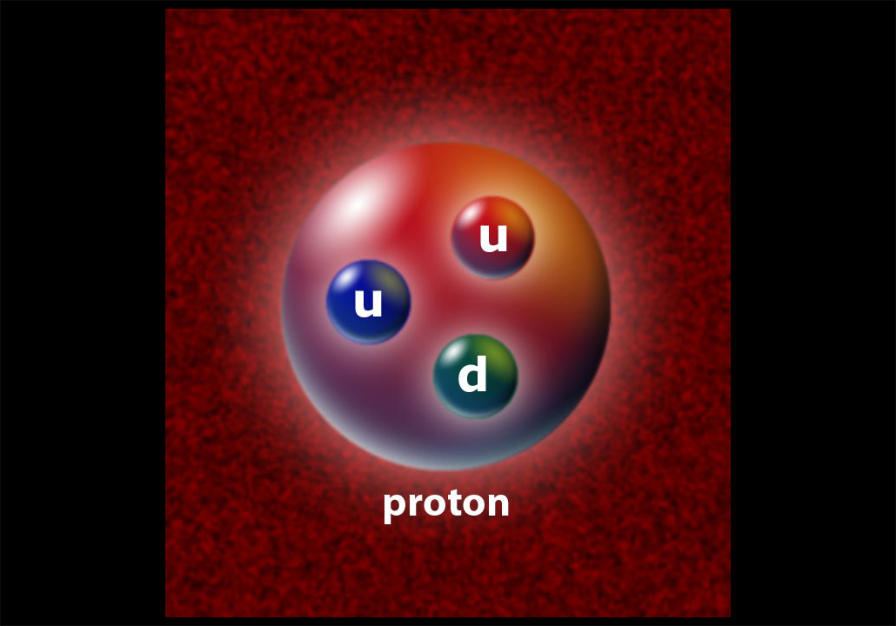
quarks

Slide 18
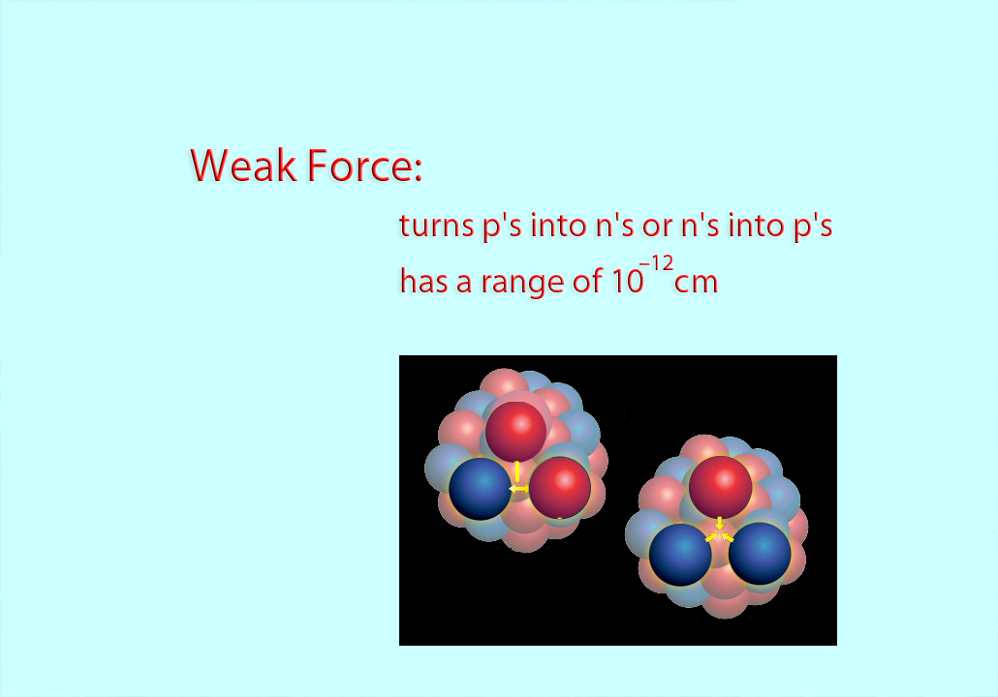
neutron
proton
radioactivity

Slide 19
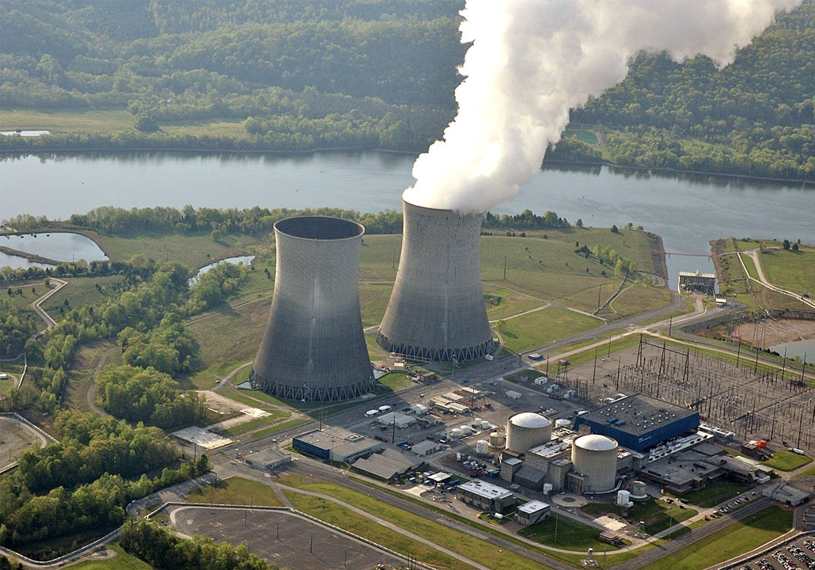
Nuclear Fission Plant

Slide 20
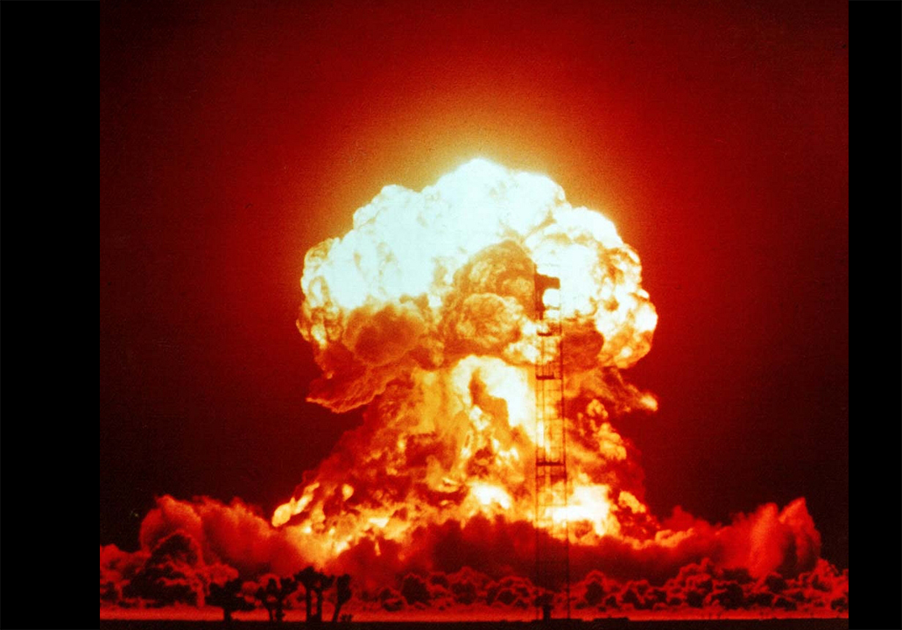
Atomic bomb

Slide 21
Force of Gravity

Slide 22
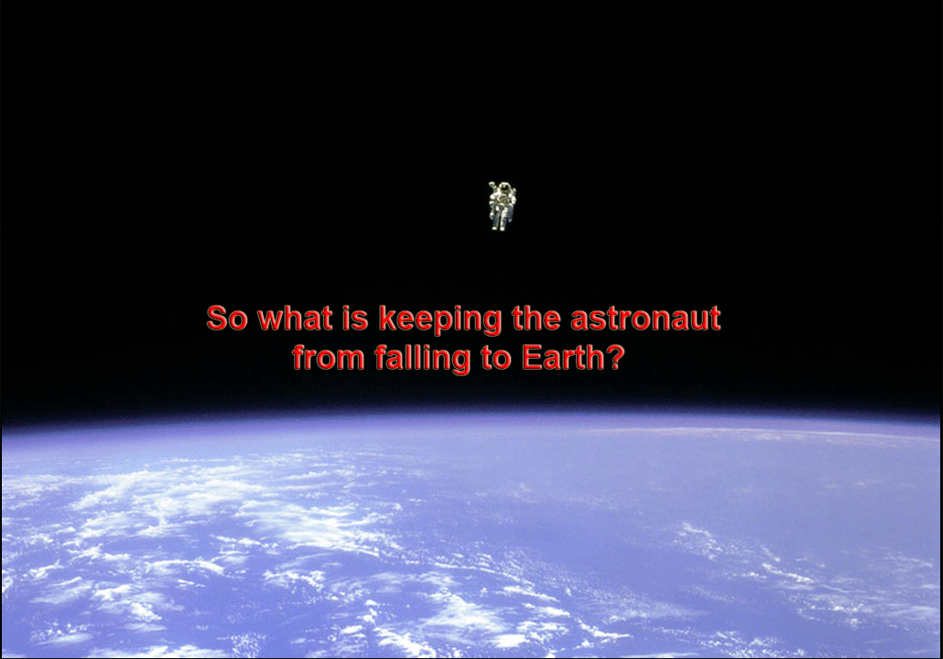

Slide 23


Slide 24
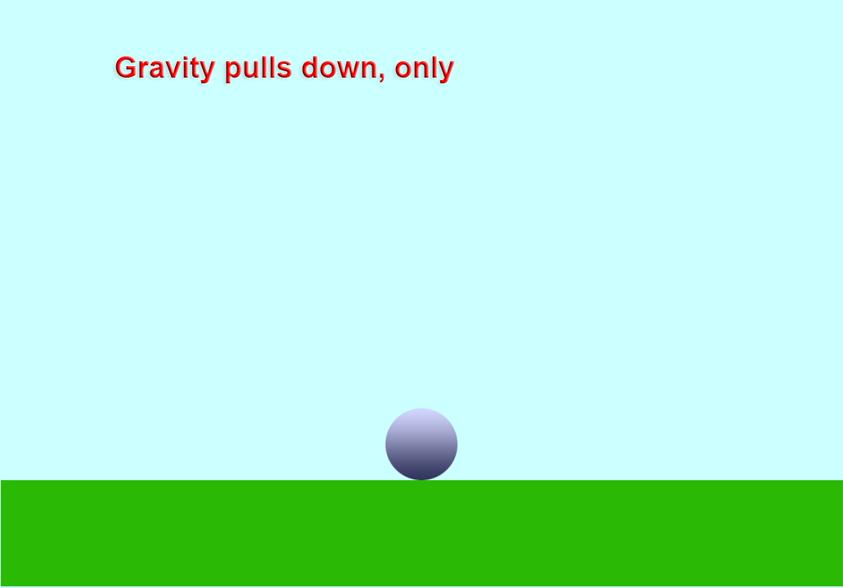

Slide 25
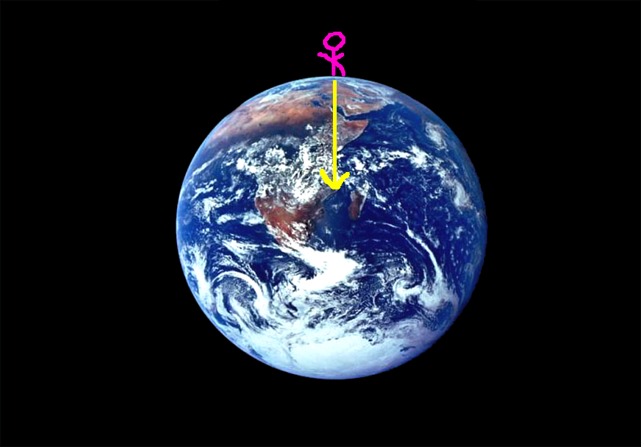

Slide 26
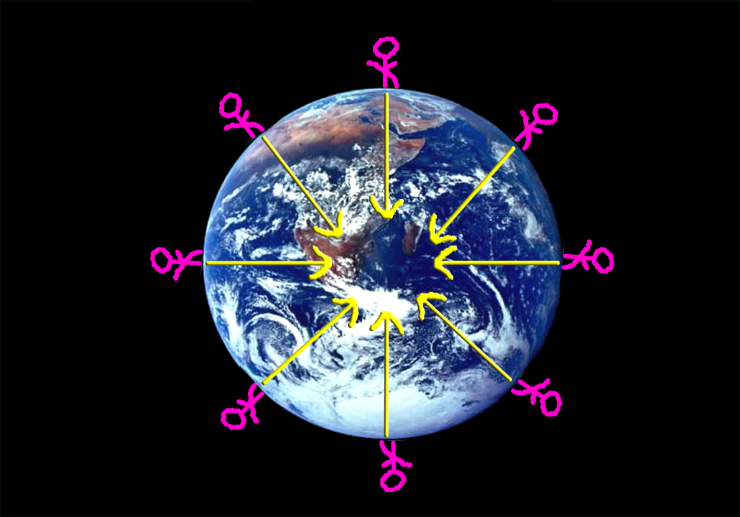

Slide 27
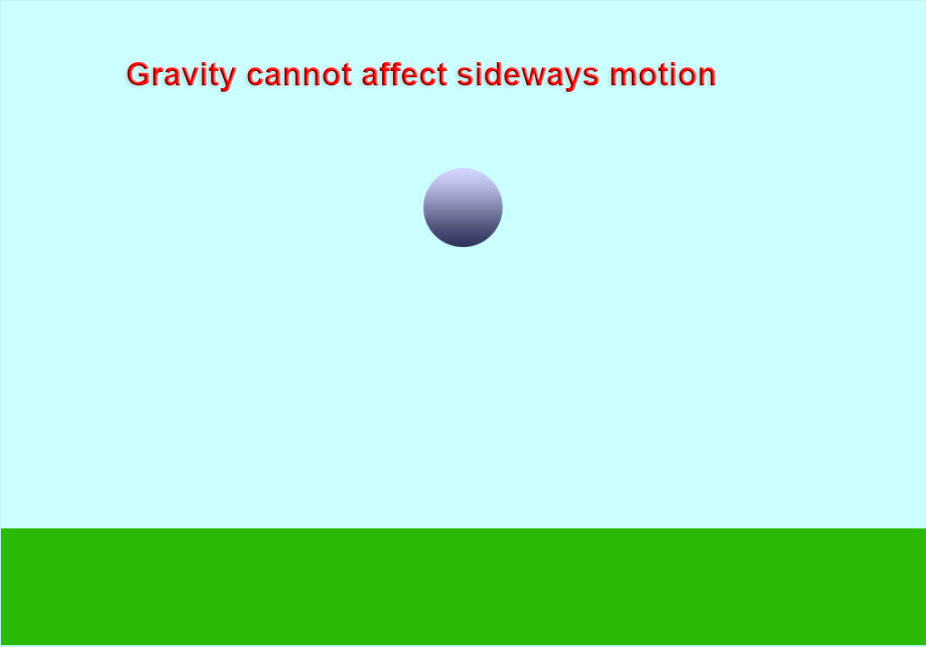

Slide 28
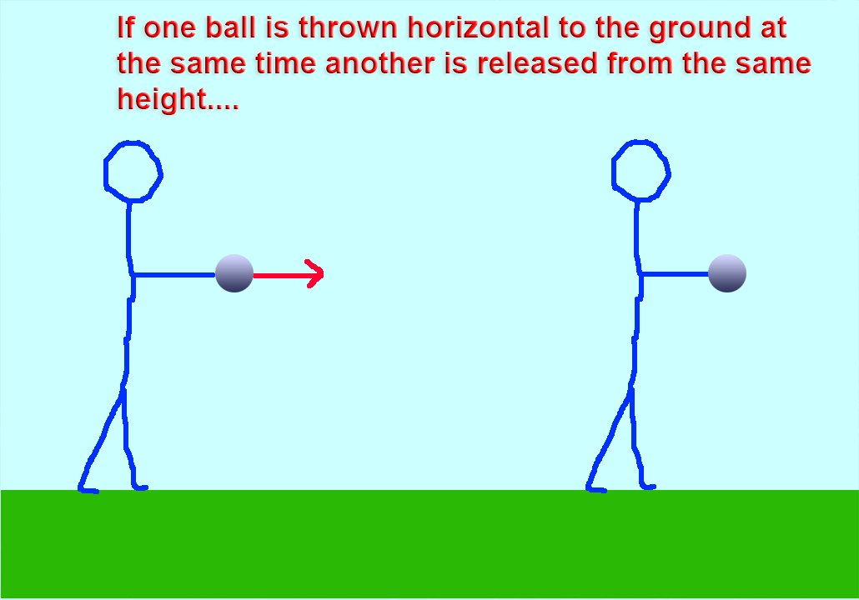

Slide 29
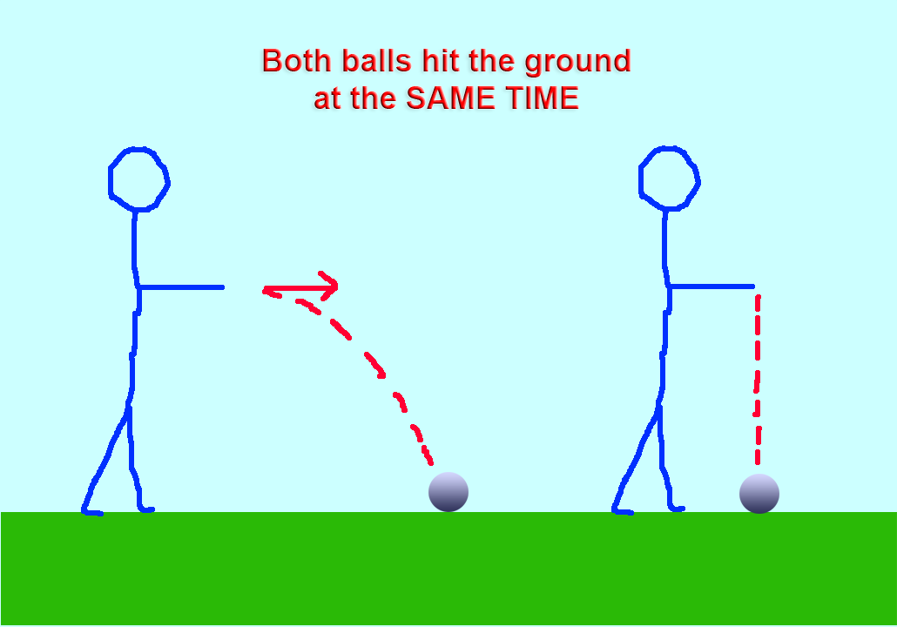

Slide 30
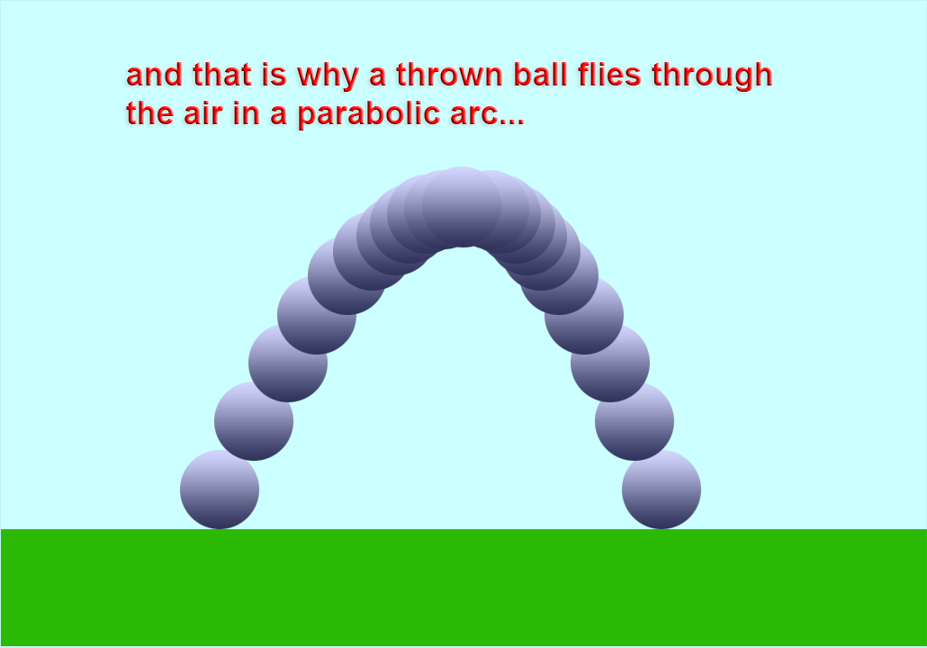

Slide 31
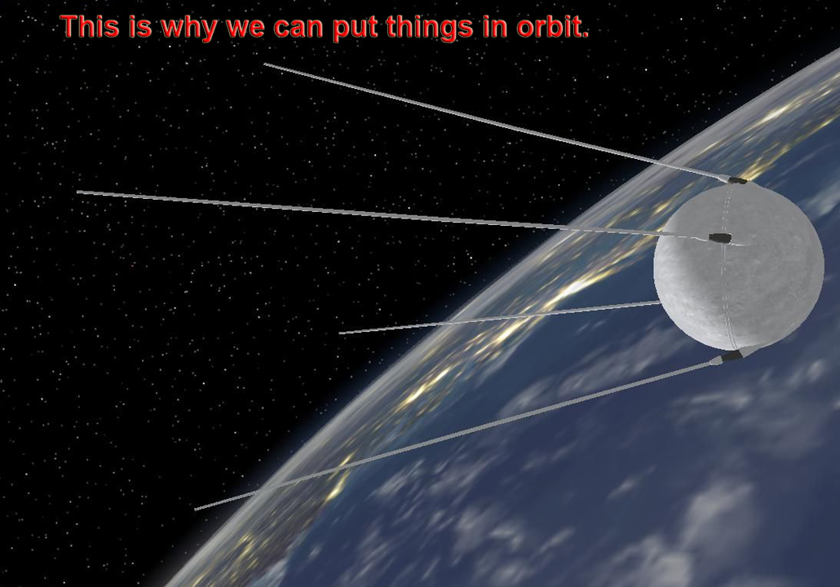

Slide 32
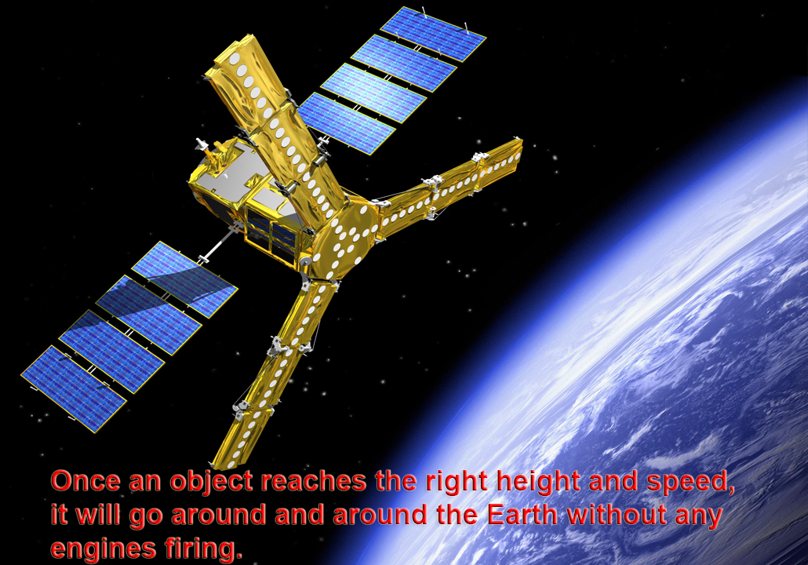

Slide 33
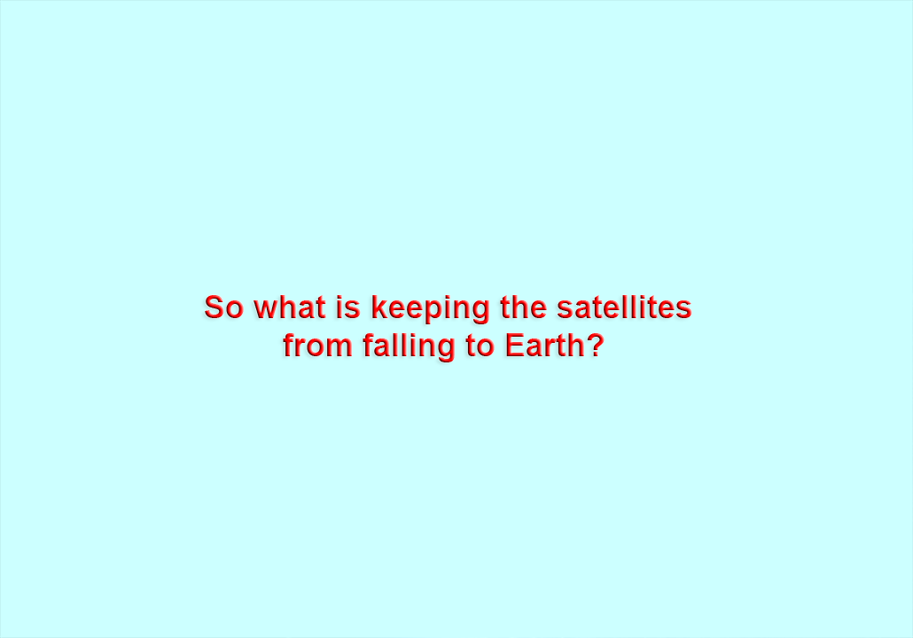

Slide 34
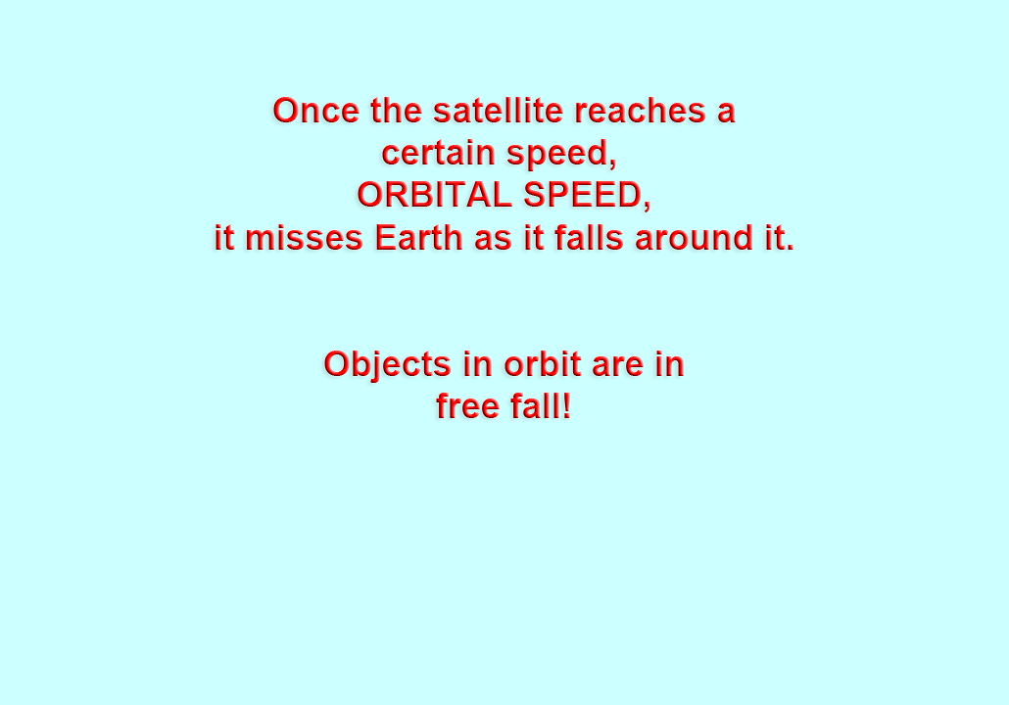

Slide 35
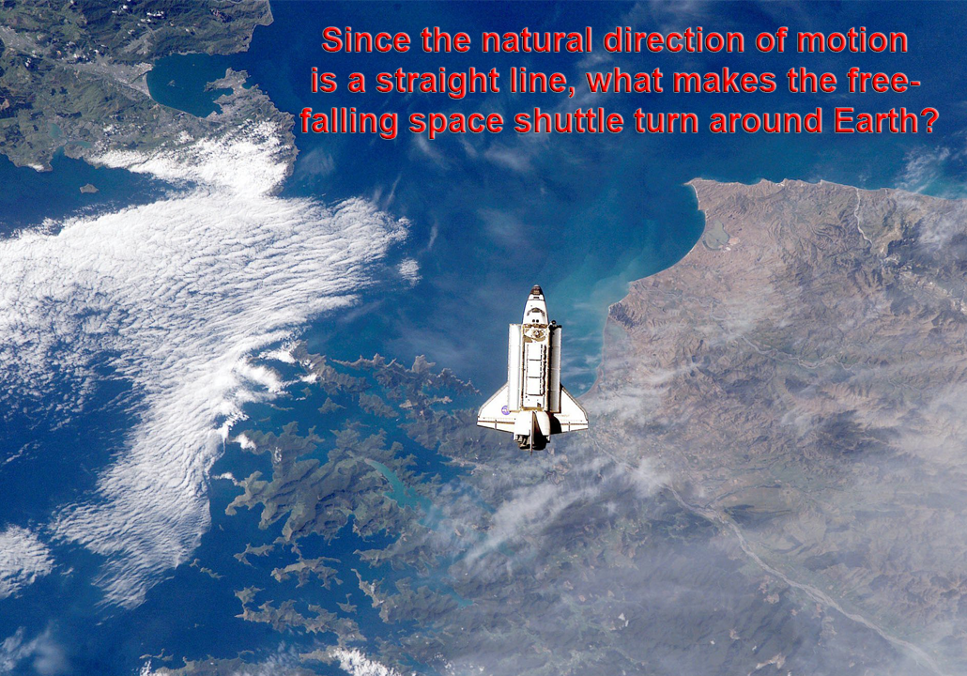
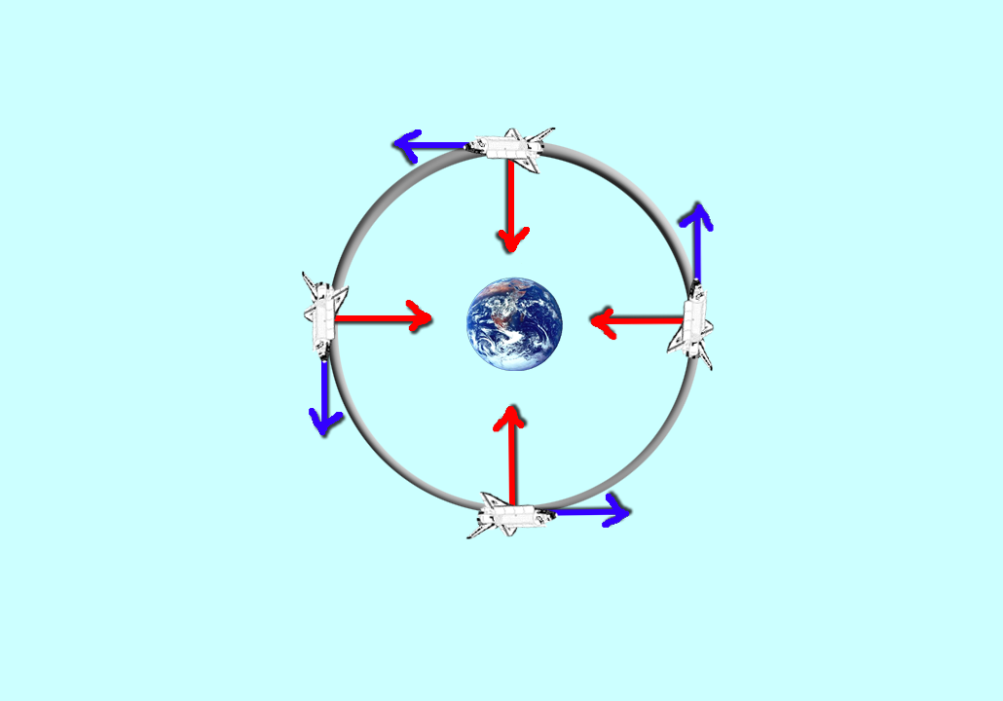
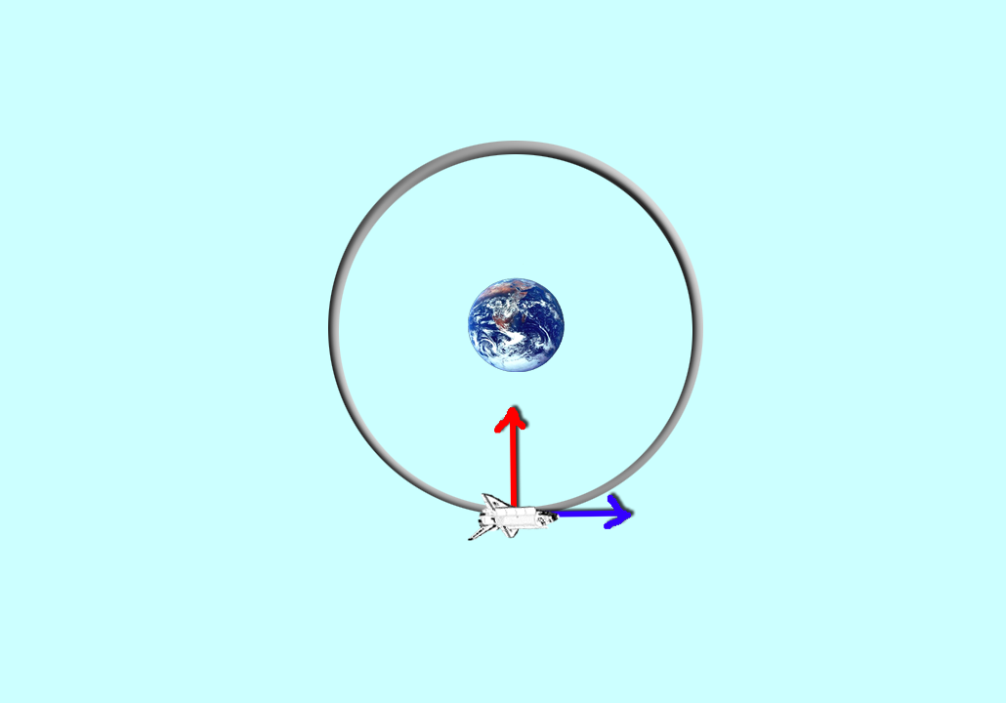
versus

Slide 36
Remember that in order to move in other than a straight line, something must be accelerating you

Slide 37
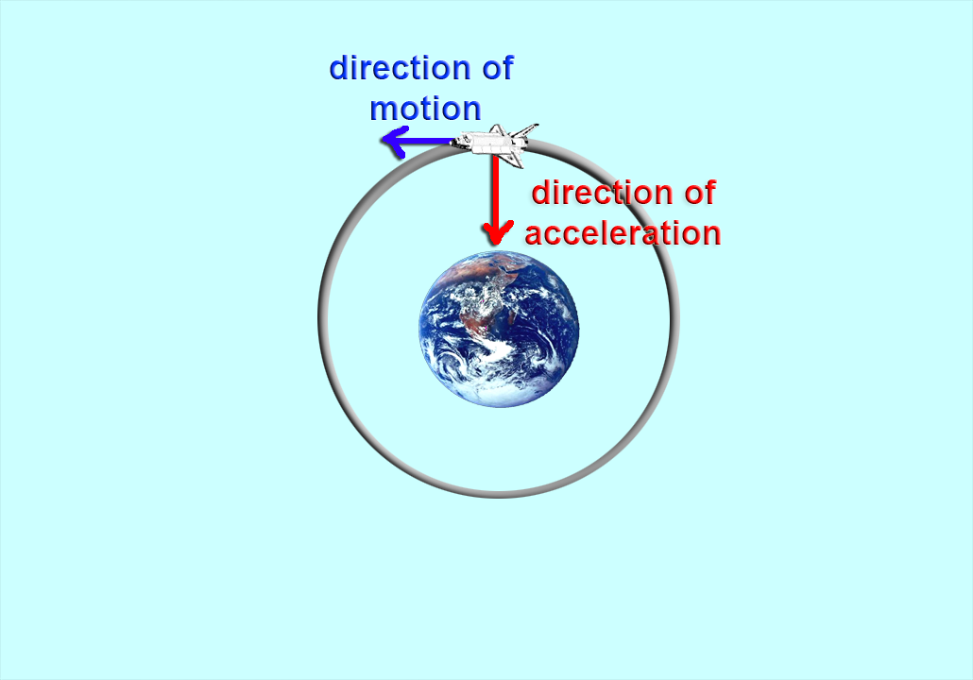
The spacecraft is travelling straight to the left,
but it is accelerating downwards,
i.e. the velocity is trying to change to a downward direction
The net result is that the spacecraft does not keep travelling straight to the left, but curves downwards and is displaced downwards and leftwards

Slide 38
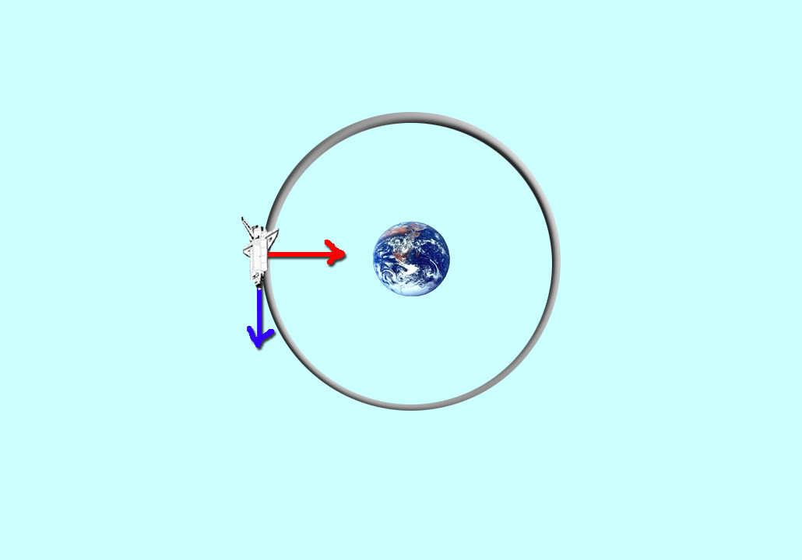
The spacecraft is travelling straight to downwards,
but it is accelerating to the right,
i.e. the velocity is trying to change to a rightward direction
The net result is that the spacecraft does not keep travelling straight downwards, but curves to the right and is displaced downwards and rightwards

Slide 39
The spacecraft is travelling straight to right,
but it is accelerating upwards,
i.e. the velocity is trying to change to a upward direction
The net result is that the spacecraft does not keep travelling straight to the right, but curves upward and is displaced upward and rightwards

Slide 40
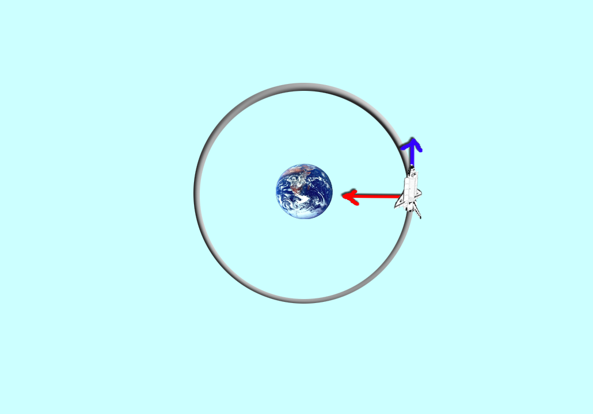
The spacecraft is travelling straight to upwards,
but it is accelerating to the left,
i.e. the velocity is trying to change to a leftward direction
The net result is that the spacecraft does not keep travelling straight upwards, but curves to the left and is displaced diagonally upwards and leftwards

Slide 41
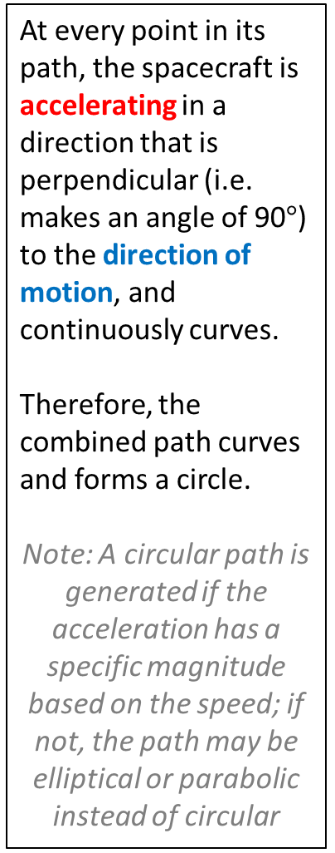
At every point in its path, the spacecraft is accelerating in a direction that is perpendicular (i.e. makes an angle of 90$°$) to the direction of motion, and continuously curves.
Therefore, the combined path curves and forms a circle.
Note: A circular path is generated if the acceleration has a specific magnitude based on the speed; if not, the path may be elliptical or parabolic instead of circular

Slide 42
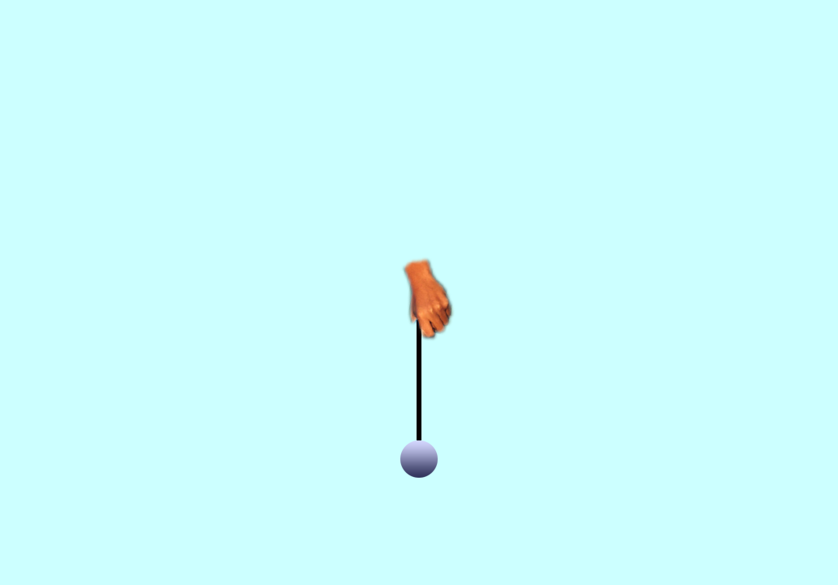
looking down from the ceiling

Slide 43
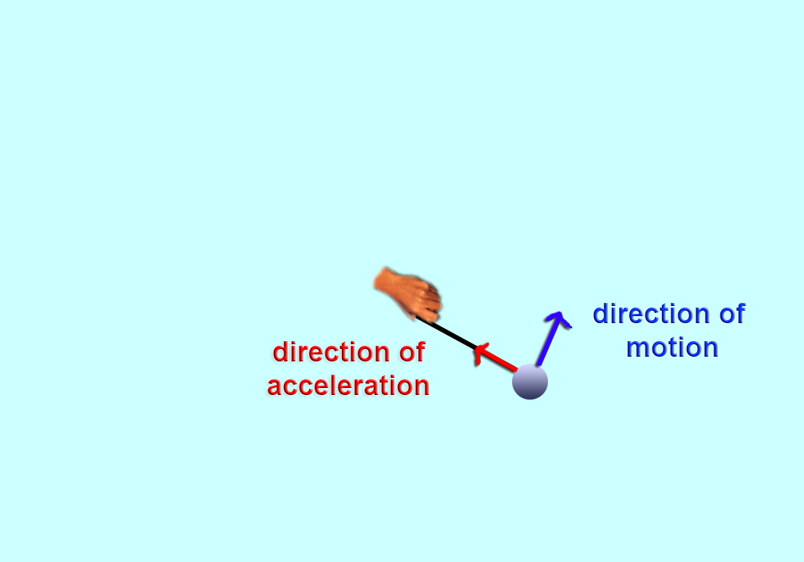
looking down from the ceiling

Slide 44
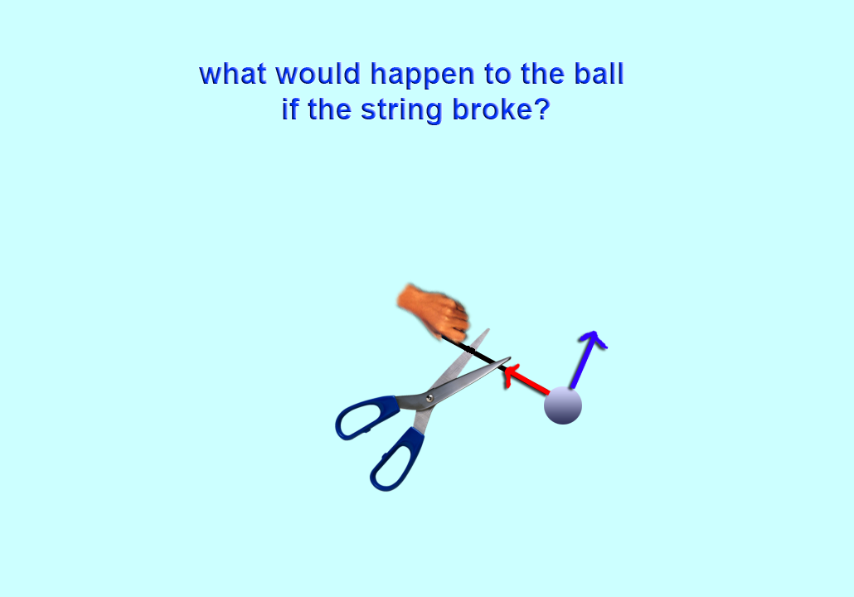
looking down from the ceiling

Slide 45
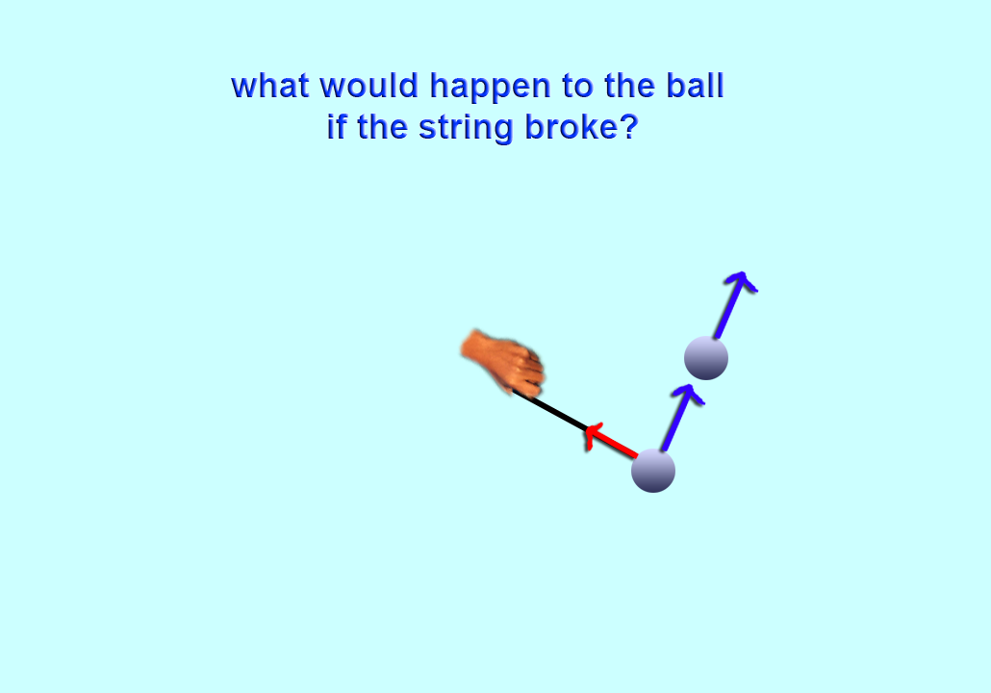
looking down from the ceiling

Slide 46
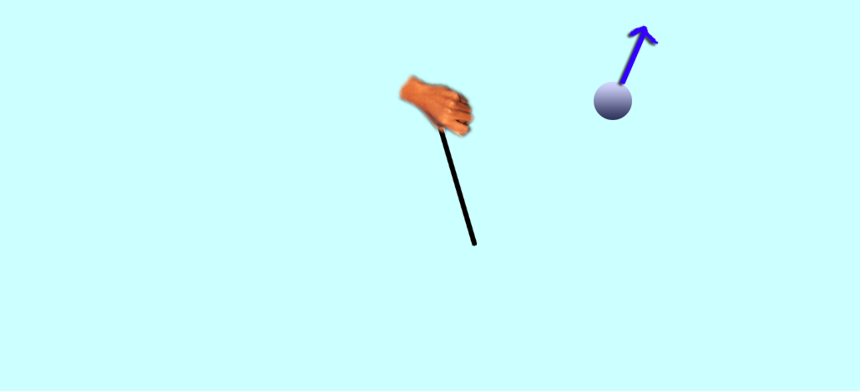
If we are looking from above so gravity is pulling the ball downward, our view of the ball would see it going straight. If our view is from the side, then the ball would make a parabolic descent to the ground
looking down from the ceiling

Slide 47
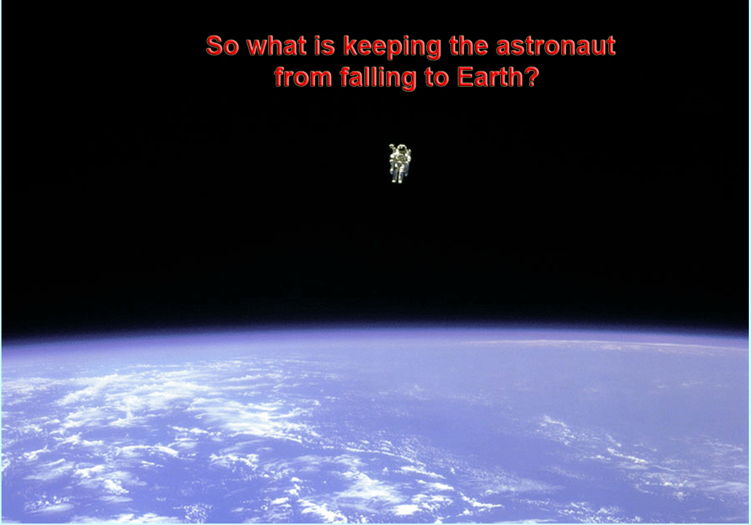

Slide 48
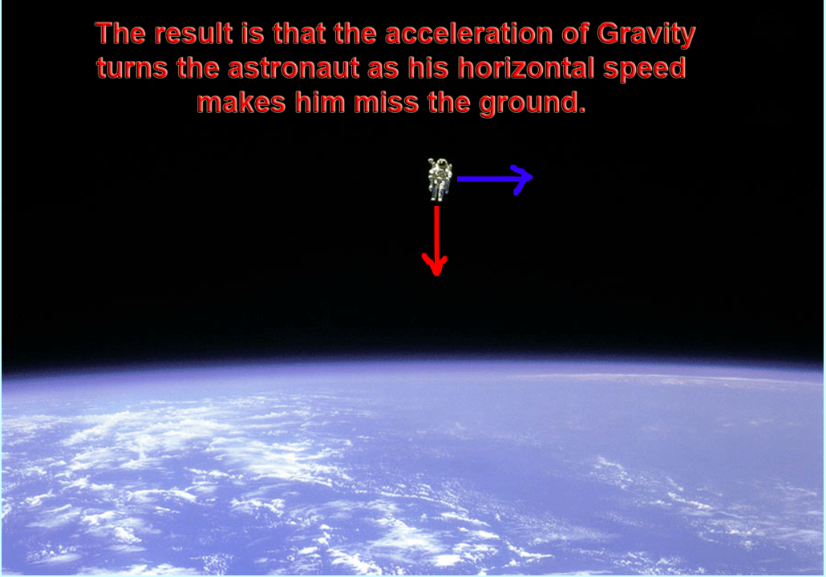

Slide 49
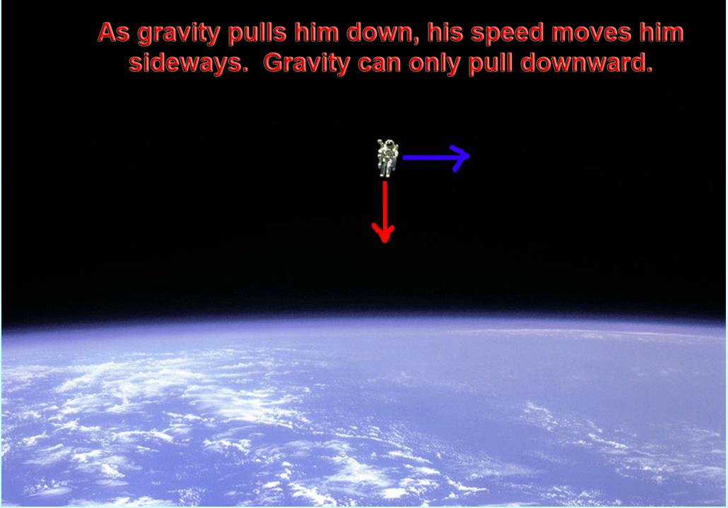
So the astronaut is in free fall around the Earth

Slide 50
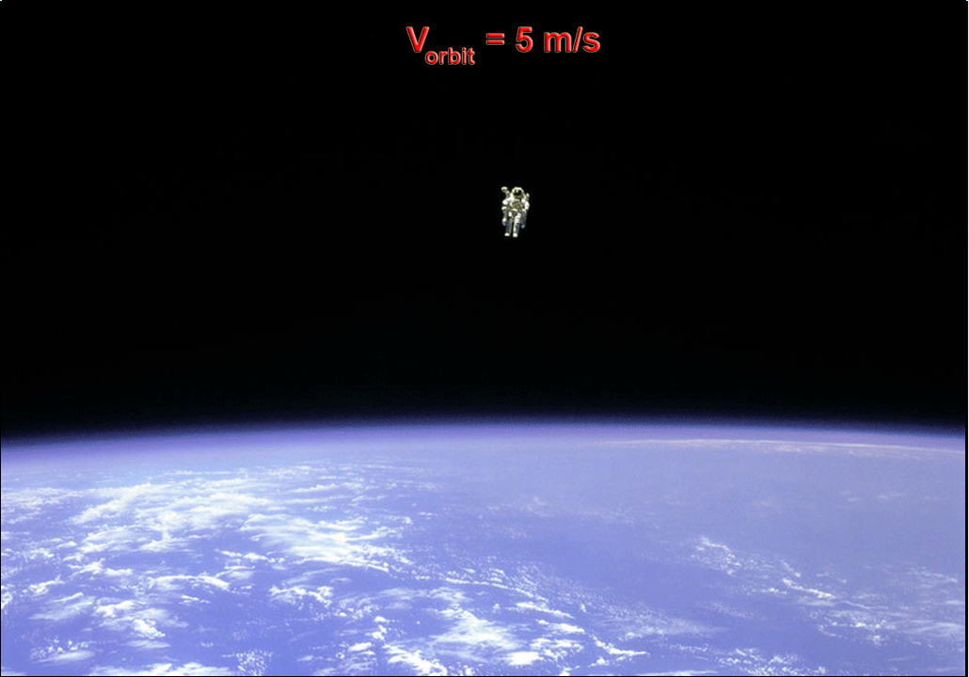
i

Slide 51
mass depends only on the total amount of stuff that makes you up
weight depends on the MASS and SIZE of the planet you're standing on

Slide 52
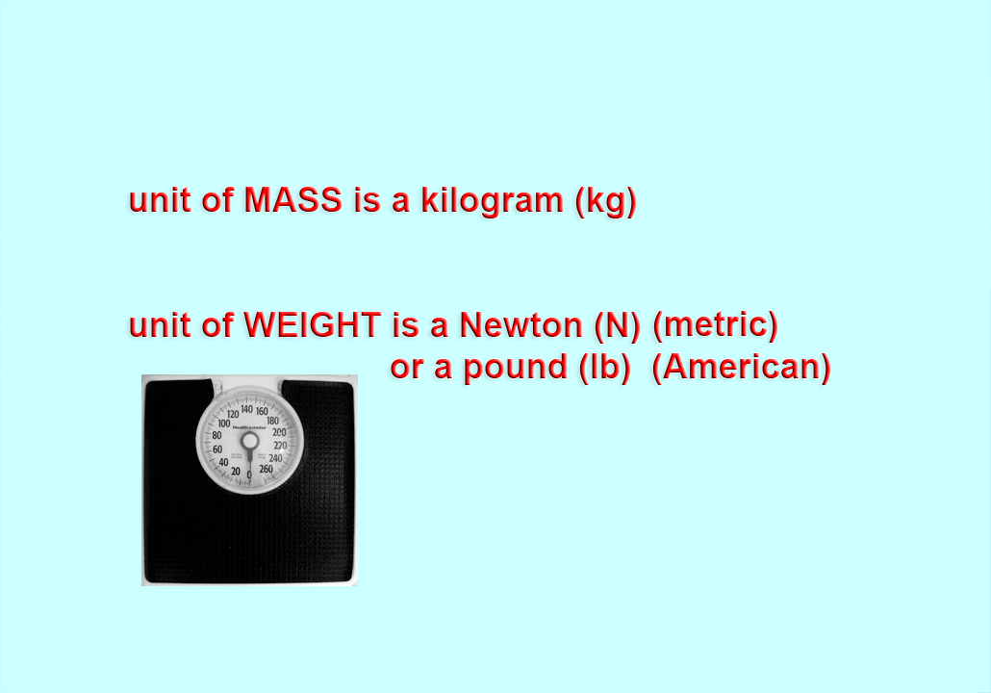

Slide 53
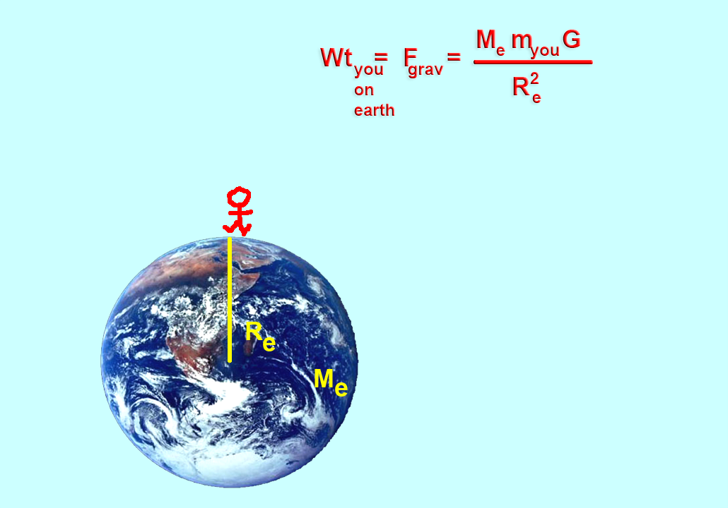
M
e
R
e
the more COMPACT the planet, the more you weigh
R
e

Slide 54
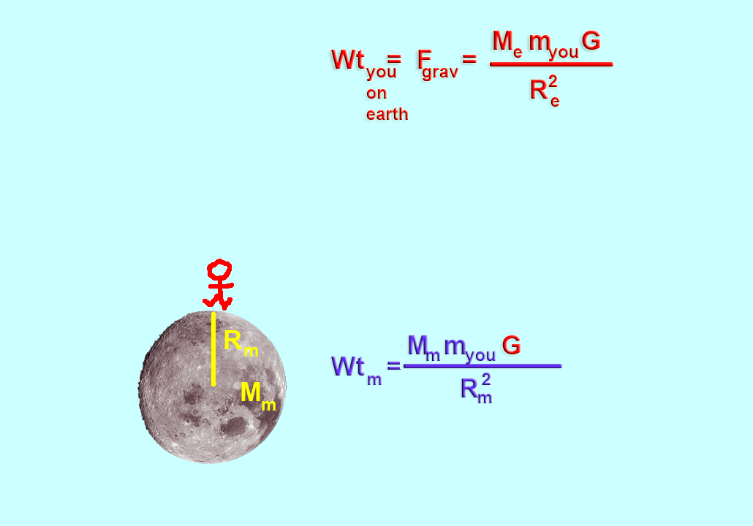
m_{you}

Slide 55
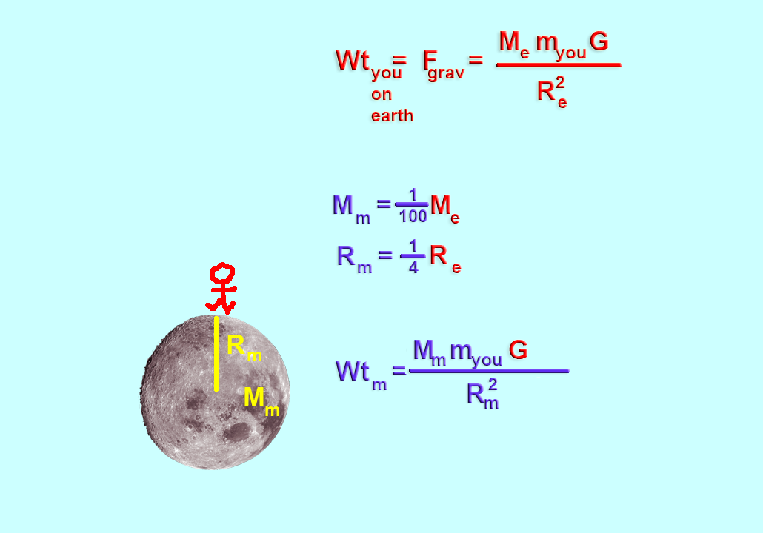
m_{you}
²

Slide 56
m_{you}
²

Slide 57


Slide 58


Slide 59


Slide 60
x

Slide 61
x

Slide 62

x

Slide 63
16
100
×

Slide 65

If you weigh 120 lbs on Earth, what would you weigh on the Moon?

Slide 66

Let's consider the acceleration of gravity near Earth's surface
a = 32 (ft per sec) per sec
As you fall, your speed will increase by 32 ft/s every second you're in flight toward
the ground

Slide 67
Let's consider the acceleration of gravity near Earth's surface
a = 32 (ft per sec) per sec
So the higher you fall, the faster you'll be going when you hit the ground

Slide 68
Let's consider the acceleration of gravity near Earth's surface
a = 32 (ft per sec) per sec
after 1 sec, v = 32 ft/s
16 ft

Slide 69
Let's consider the acceleration of gravity near Earth's surface
a = 32 (ft per sec) per sec
after 1 sec, v = 32 ft/s
after 2 sec, v = 64 ft/s
after 3 sec, v = 96 ft/s
after 4 sec, v = 128 ft/s — SPLAT
266 ft

Slide 70
Let's consider the acceleration of gravity near Earth's surface
a = 32 (ft per sec) per sec
If the building had been taller, you would have hit the ground going even faster —> BIGGER SPLAT

Slide 71
Let's say you weigh 120 lbs.
If you and a ball of iron weighing 500 lbs fell off at the same time,
You'd both hit the ground at the same time! Everything falls at the same rate.

Slide 72
Let's say you weigh 120 lbs.
If you and a ball of iron weighing 500 lbs fell off at the same time,
You'd both hit the ground at the same time! Everything falls at the same rate.
The speed at impact would be
v = 128 ft/s for both

Slide 73
Let's say you weigh 120 lbs.
If you and a ball of iron weighing 500 lbs fell off at the same time,
Who would hit the ground with the greater force?
The speed at impact would be
v = 128 ft/s for both

Slide 74


fall rate =
a = 32 ft/s²

Slide 75


Slide 76


Slide 80
fall rate is independent of mass, m!

Slide 81
= g

Slide 82
Let's calculate the value of a
= g
(6 x 10²⁴ kg) x (6.67 x 10⁻¹¹ m³/kg/ s²)
(6.374 x 10⁶ m)²
= g
= g
9.8 m/s² 32 ft/s²
acceleration due to gravity near Earth's surface

Slide 83

So, the acceleration of an object falling to Earth is independent of its mass! From a given height above Earth, all things fall at the same rate!!

Slide 84

We live in an Air Force community and pilots talk about pulling so many g's in their planes.
What are they talking about?
When you are standing on the ground, you feel your weight — 1 g

Slide 85

We live in an Air Force community and pilots talk about pulling so many g's in their planes.
What are they talking about?
When you take off, you feel the acceleration of the engines against Earth's gravity — 2.5 g or larger
This pilot feels 2.5 times his weight

Slide 86

In Free-Fall you do not feel your weight
In free fall (ex., in orbit or falling from a building) you experience 0 g

Slide 87



A car accelerating from 0 to 100 mph in 10 seconds is
0.28 g
(get shoved back in your seat by about ¼ your weight)
Taking off in an airplane
1.5 g
(get shoved back in your seat by 1.5 times your weight)

Slide 88

Wicked Roller Coaster
4.3 g

Slide 89

Apollo re-entry to Earth
7.19 g
Human Body can take about 13 g, but not for long.
This puts a strict limit on how fast we can accelerate space ships for interstellar travel.

Slide 90
Let's go back to the big SPLAT.
Would you and the 500 lb iron ball hit the ground with the same FORCE?
Your speeds at impact would both be v = 128 ft/s

Slide 91
Let's calculate.
F _{of you} = m_{you} a
F _{of ball} = M_{ball} a
_{on} _{earth}
_{on} _{earth}
change in velocity when you hit the ground
how long it takes to stop
acceleration =

Slide 92
Let's calculate.
F _{of you} = m_{you} (128 ft/s – 0 ft/s)
F _{of ball} = M_{ball} (128 ft/s – 0 ft/s)
_{on} _{earth}
1/10 s
_{on} _{earth}
1/10 s
change in velocity when you hit the ground

Slide 93
Let's calculate.
F _{of you} = m_{you} (128 ft/s – 0 ft/s)
F _{of ball} = M_{ball} (128 ft/s – 0 ft/s)
_{on} _{earth}
1/10 s
_{on} _{earth}
1/10 s
how long it takes you
to come to a stop

Slide 94
Let's calculate.
F _{of you} = m_{you} (128 ft/s – 0 ft/s)
F _{of ball} = M_{ball} (128 ft/s – 0 ft/s)
_{on} _{earth}
1/10 s
_{on} _{earth}
1/10 s
F _{of you} = 5,060 lb
F _{of ball} = 21,120 lb

Slide 95
Why do stuntmen survive?

Slide 96
F _{of you} = m_{you} (128 ft/s – 0 ft/s)
_{on} _{earth}
2 s
F _{of you} = 253 lb
this slows the stop — acceleration smaller

Slide 97
If you toss a ball up…
It will come back down.

Slide 98
If you toss it faster it will go higher…
but it will come back down.

Slide 99
If you throw it at the ESCAPE SPEED
of Earth….
it will NEVER come back down.

Slide 100

This is escape speed. It depends on the mass and size of the planet you want to escape, in this case, Earth.

Slide 101
The escape speed of Earth is 7 mi/s = 25,200 mph.

Slide 102
P
P
What is the fundamental difference between this and the gravity equation?

Slide 103
P
P
Note that the mass of the object trying to leave the planet is not in the V_{esc} equation!
m

Slide 104

earth
earth
earth
A rocket or a baseball both need to reach 7 mi/s in order to escape Earth.
25,200 mph !!

Slide 105
moon
esc moon
moon
What about escaping the Moon?

Slide 106
moon
esc moon
moon
moon
moon

Slide 107
moon
esc moon
moon
put those numbers into the equation and:
( )
1
100
esc moon
( )
1
4

Slide 108
compare with escape speed from earth:
1
100
esc moon
1
4

Slide 109
compare with escape speed from earth:
1
100
esc moon
1
4

Slide 110
which is:
4
100
esc moon

Slide 111
which is:
4
100
× v_{esc earth}
esc moon

Slide 112
which is:
1
25
× v_{esc earth}
esc moon

Slide 113
which is:
1
5
v_{esc earth}
esc moon

Slide 114

v_{esc earth}
esc moon

Slide 115

The more compact the planet, the more you weigh and the faster you must go to escape. The fluffier the planet, the less you weigh and the slower you can go to escape.

