Slide 1
Nuclear Energy
Objective: Learning about Nuclear decay, Radioactivity and Nuclear Reactions. Also, explore the structure and the trends of periodic table.
Key concepts:
Radioactivity
Nuclear Forces and Stability
Nuclear decay
Nuclear Reactions
Half-life and Activity
Fusion and Fission Reactions

Slide 2
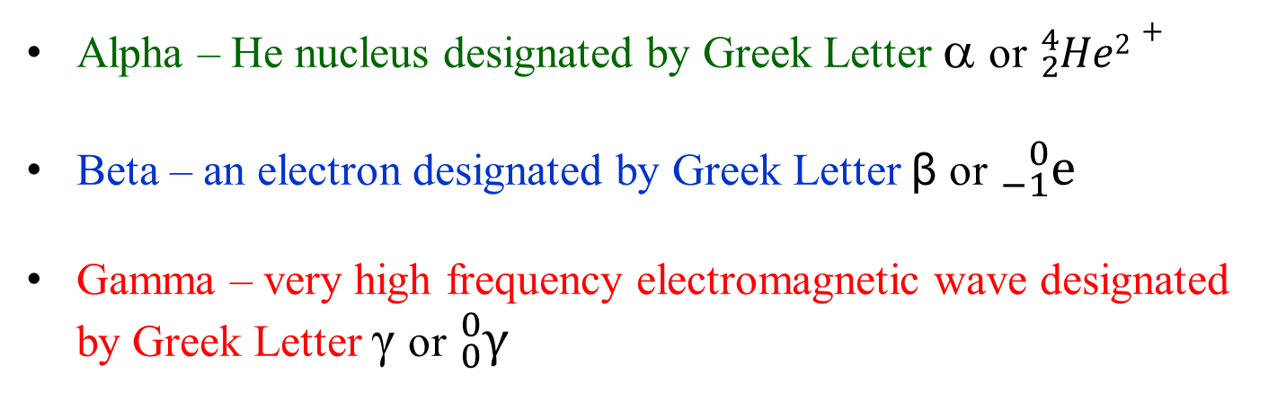
Radioactivity
Radioactivity is a natural phenomenon. Certain elements emit particular forms of radiation.
such elements are called radioactive materials
Three major forms of radiation (Alpha, Beta and Gamma)
Alpha – He nucleus designated by Greek Letter α or ${}_{2}^{4}{He2+}$
Beta – an electron designated by Greek Letter β or ${}_{−1}^{0}{\text{e}}$
Gamma – very high frequency electromagnetic wave designated by Greek Letter γ or ${}_{0}^{0}{\text{γ}}$
Radioactivity naturally results from instability of the nucleus
- related to the neutron/proton ratio
- instability of the forces in the nucleus

Slide 3
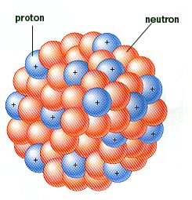
Nuclear Forces and Stability
How does the instability of forces occur?
Two types of forces found in an Atom.
(1) Electrical forces
- attractive electrical force between unlike charges (electrons and protons)
- repulsive electrical force between like charges
protons and protons
(2) Nuclear forces
- particles in the nucleus are bound together by these forces
- they act within extremely short distances
- strong nuclear force binds p⁺ to p⁺, n⁰ to n⁰,
and p⁺ to n⁰ when next to each other
- weak nuclear force converts proton to
neutron or neutron to proton
**There are stable Nuclei with certain number of protons and neutrons known as magic numbers.

Slide 4
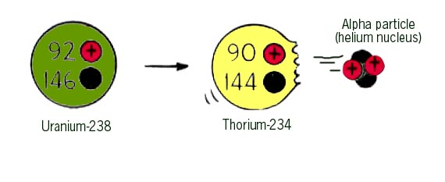
Alpha Decay and Radioactivity
Radioactive elements Transmute to different element.
Transmutation - Changing of one element to another
Uranium-238 Decay
Mass number is
decreased by 4
He-4 (no electrons)
alpha (α) decay equation
This Thorium–234
is not stable either
alpha (α) particle

Slide 5
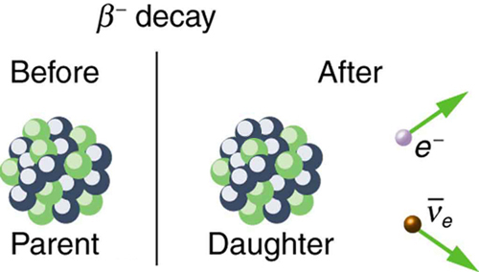
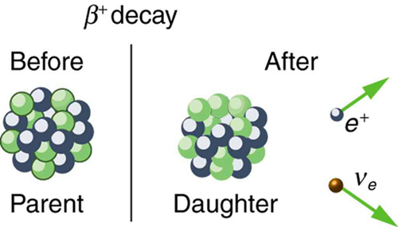
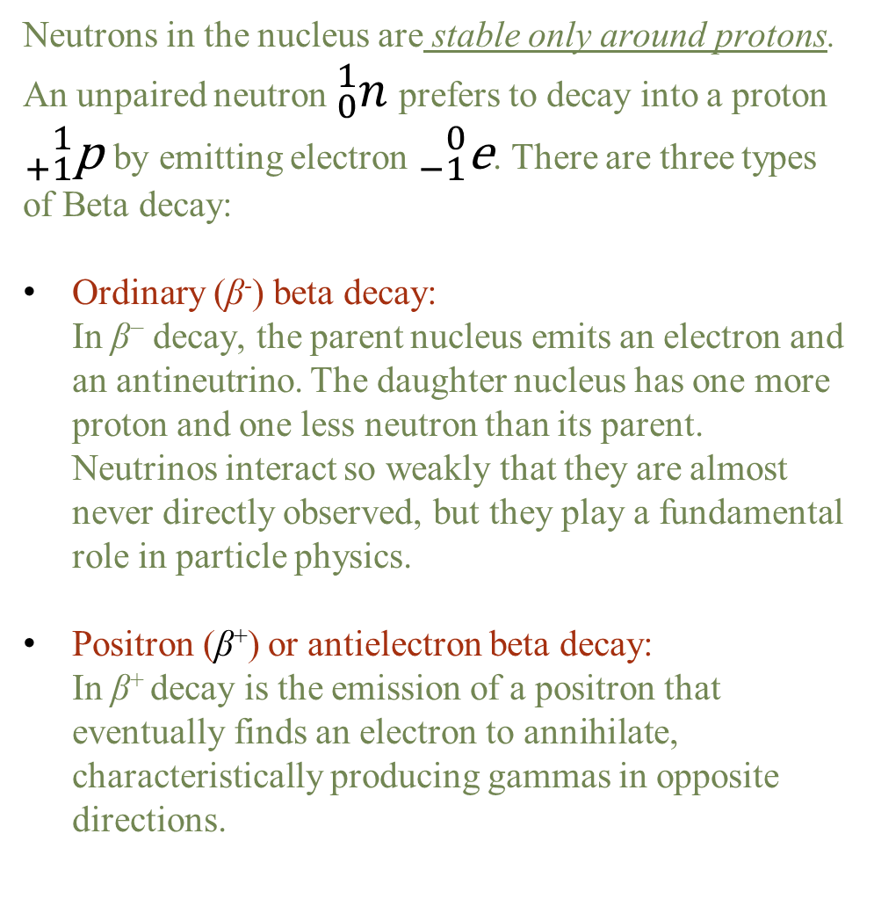
Beta Decay and Radioactivity
Neutrons in the nucleus are stable only around protons. An unpaired neutron ${}_{0}^{1}n$ prefers to decay into a proton ${}_{+1}^{1}{\text{p}}$by emitting electron ${}_{−1}^{0}{\text{e}}$. There are three types of Beta decay:
Ordinary (β⁻) beta decay:
In β⁻ decay, the parent nucleus emits an electron and an antineutrino. The daughter nucleus has one more proton and one less neutron than its parent. Neutrinos interact so weakly that they are almost never directly observed, but they play a fundamental role in particle physics.
Positron (β⁺) or antielectron beta decay:
In β⁺ decay is the emission of a positron that eventually finds an electron to annihilate, characteristically producing gammas in opposite directions.

Slide 6
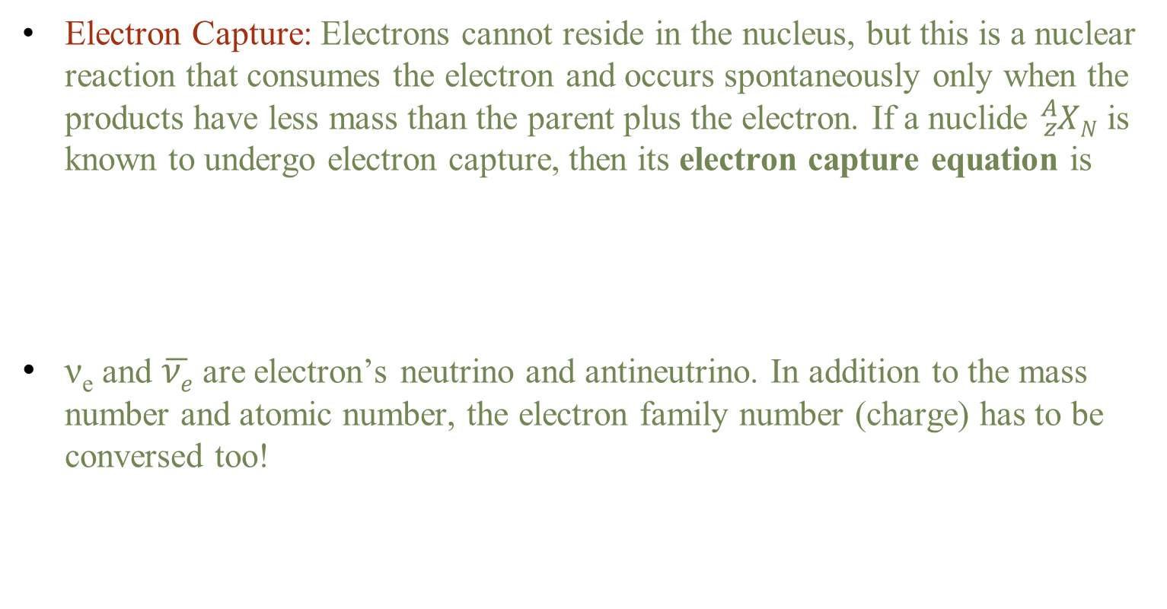
Beta Decay and Radioactivity
Electron Capture: Electrons cannot reside in the nucleus, but this is a nuclear reaction that consumes the electron and occurs spontaneously only when the products have less mass than the parent plus the electron. If a nuclide ${}_{z}^{A}{XN}$ is known to undergo electron capture, then its electron capture equation is
ν_{e} and $\overline{νe}$ are electron’s neutrino and antineutrino. In addition to the mass number and atomic number, the electron family number (charge) has to be conversed too!

Slide 7
Balancing Nuclear Reactions
All you have to do is make sure that
(1) the total of the atomic numbers [lower left corner]
on the left and right are the same,
and
(2) the total of the mass numbers [upper left corner]
on the left and right are the same,
then
(3) fill in any missing element symbols. [lookup the periodic table]

Slide 8
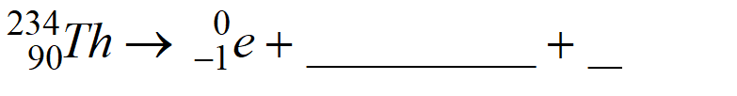
Balancing Nuclear Reactions
Examples:
1. (beta decay)
2. (alpha and gamma decay)

Slide 9
Balancing Nuclear Reactions
Examples:
3. (d-t fusion)
4. (fission)

Slide 10
Half-Life
Radioactive elements decay at different rates!
Half-life: time needed for half of a radioactive sample to decay, t_{1/2}
Example: The half-life for I-131 (¹³¹I) is 8 days. If the original sample of I-131
was 10 g,
then in 8 days (1 half-life)
only 5 g would be left.
After 16 days (2 half-lives),
2.5 g would be left;
After 24 days (3 half-lives),
1.25 g of I-131 remains.
The amount is cut in half every 8 day or t_{1/2} .

Slide 11
Half-Life
Sample Problem:
How much of 200. mg of Carbon-11 isotope would be left after 2 hours? The half-life of ¹¹C is 20 min.
Solution: 2 hours = 120 minutes,
120 min / 20 min per half-life = 6 half-lives
Half-life: 1 2 3
200 mg → 100 mg → 50 mg → 25 mg
Half-life: 4 5 6
25 mg → 12.5 mg → 6.25 mg → 3.13 mg
You count out half lives and divide by 2 each time.

Slide 12
Half-Life and Activity
We define activity R to be the rate of decay expressed in decays per unit time.
The SI unit for activity is one decay per second and is given the name becquerel (Bq) in honor of the discoverer of radioactivity.
1 Bq = 1 decay/s.
One of the most common units for activity is the curie (Ci), in honor of Marie Curie’s work with radium. The definition of curie is
1 Ci = 3.70×10¹⁰ Bq= 3.7 x 10¹⁰ decays/s
The shorter the t_{1/2}, the more decays per unit time, for a given number of nuclei. So activity R should be proportional to the number of radioactive nuclei, N and inversely proportional to their half-life, t_{1/2} . Therefore, we define R as,

Slide 13
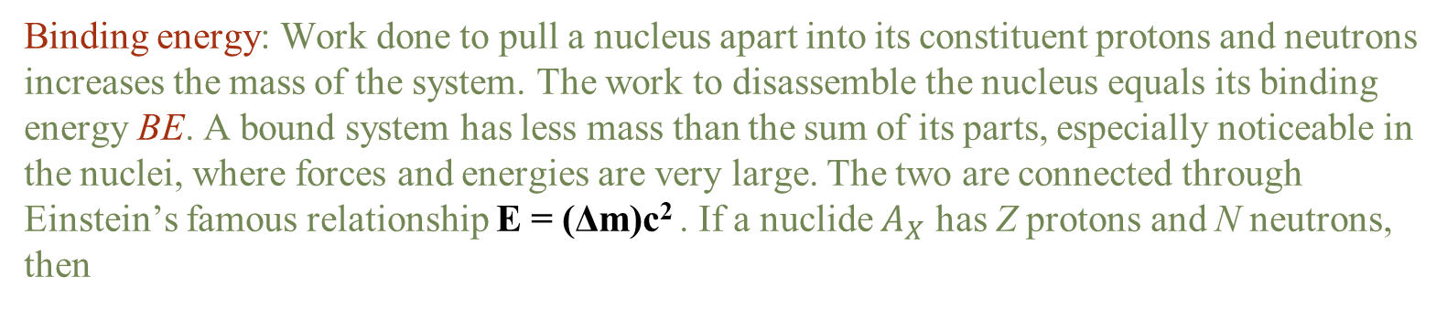
Binding Energy
Binding energy: Work done to pull a nucleus apart into its constituent protons and neutrons increases the mass of the system. The work to disassemble the nucleus equals its binding energy BE. A bound system has less mass than the sum of its parts, especially noticeable in the nuclei, where forces and energies are very large. The two are connected through Einstein’s famous relationship E = (Δm)c² . If a nuclide $A_{X}$ has Z protons and N neutrons, then

Slide 14
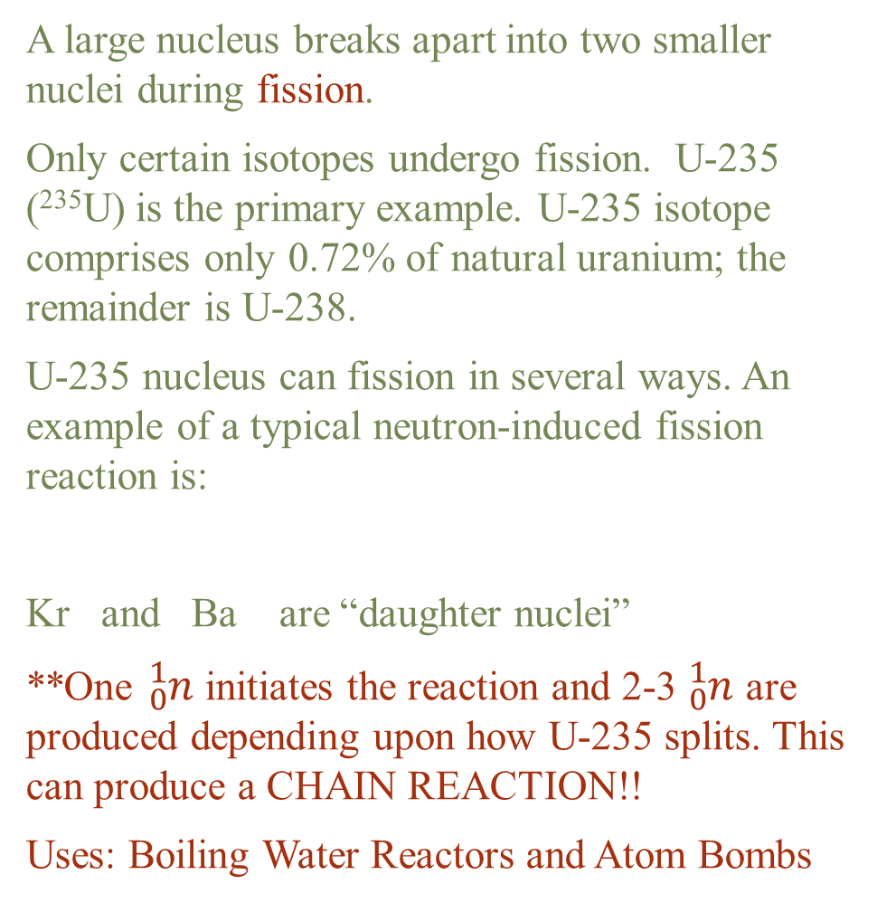
Fission
A large nucleus breaks apart into two smaller nuclei during fission.
Only certain isotopes undergo fission. U-235 (²³⁵U) is the primary example. U-235 isotope comprises only 0.72% of natural uranium; the remainder is U-238.
U-235 nucleus can fission in several ways. An example of a typical neutron-induced fission reaction is:
Kr and Ba are “daughter nuclei”
**One ${}_{0}^{1}n$ initiates the reaction and 2-3 ${}_{0}^{1}n$ are produced depending upon how U-235 splits. This can produce a CHAIN REACTION!!
Uses: Boiling Water Reactors and Atom Bombs

Slide 15
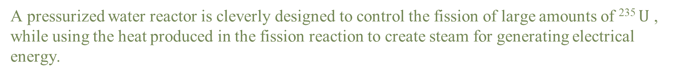
Schematic of a pressurized water reactor
A pressurized water reactor is cleverly designed to control the fission of large amounts of ²³⁵ $U$ , while using the heat produced in the fission reaction to create steam for generating electrical energy.

Slide 16
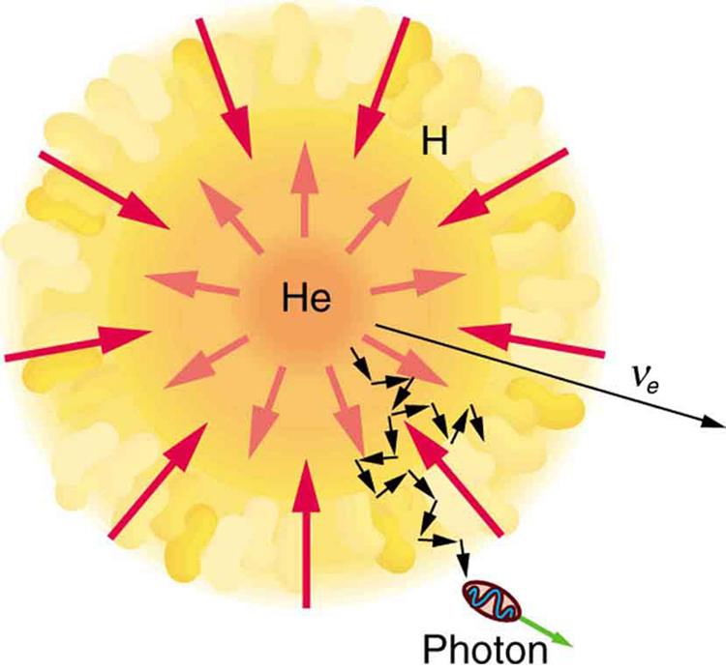
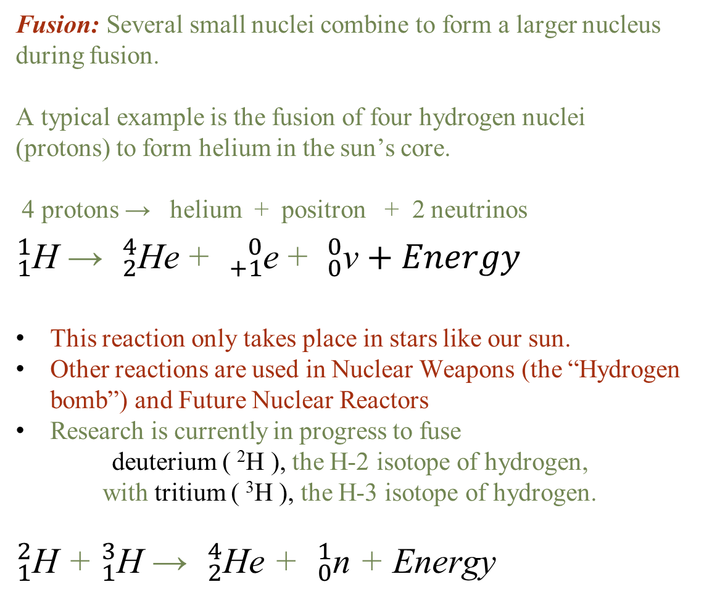
Fusion
Fusion: Several small nuclei combine to form a larger nucleus during fusion.
A typical example is the fusion of four hydrogen nuclei (protons) to form helium in the sun’s core.
4 protons → helium + positron + 2 neutrinos
${}_{1}^{1}{\text{H}}$ → ${}_{2}^{4}{\text{H}\text{e}}$ + ${}_{+1}^{0}{\text{e}}$ + ${}_{0}^{0}{\text{ν}}+Energy$
This reaction only takes place in stars like our sun.
Other reactions are used in Nuclear Weapons (the “Hydrogen bomb”) and Future Nuclear Reactors
Research is currently in progress to fuse
deuterium ( ²H ), the H-2 isotope of hydrogen,
with tritium ( ³H ), the H-3 isotope of hydrogen.
${}_{1}^{2}{\text{H}}$ + ${}_{1}^{3}{\text{H}}$ → ${}_{2}^{4}{\text{H}\text{e}}$ + ${}_{0}^{1}{\text{n}}$ + Energy

Slide 17
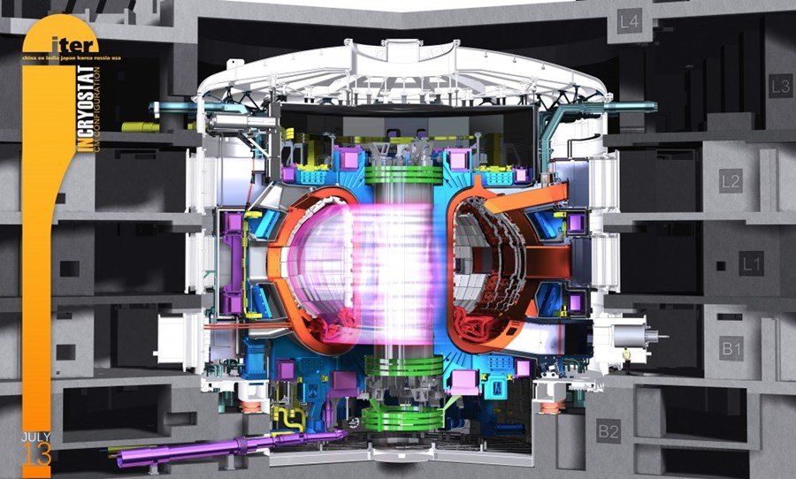
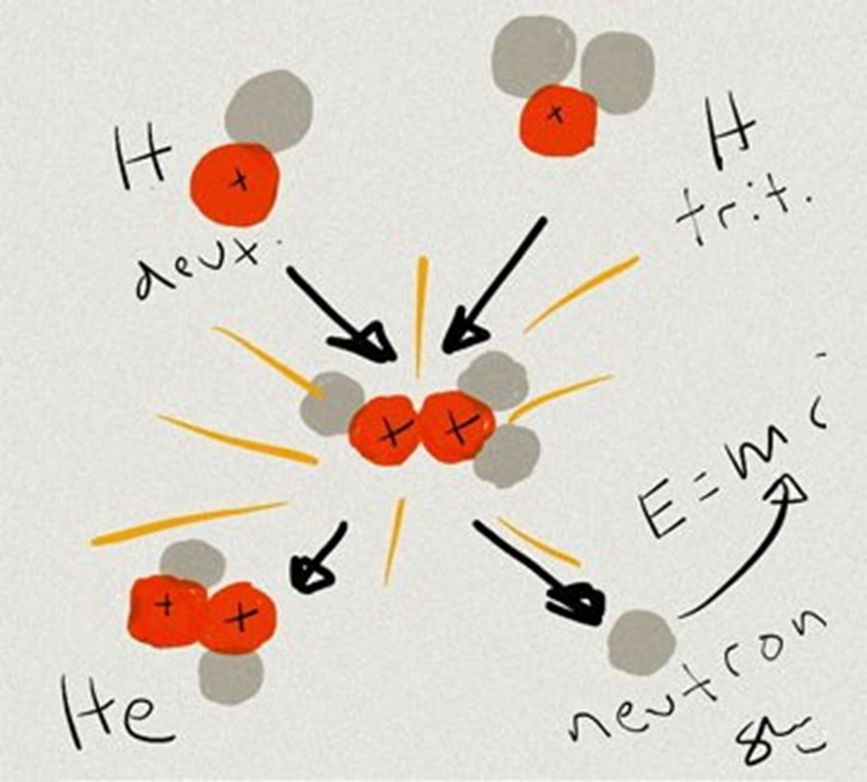
Fusion Reactor
ADVANTAGE over Fission reactors: Minimal problem with radioactive waste.
PROBLEMS:
Tremendously high temperatures and pressures are required to do this. The energy that is required to generate the magnetic fields, lasers, etc. to produce the fusion reaction is more than you get out from the conversion of mass into energy via E = mc². No net energy output!
**Currently ITER’s Tokamak reactor is
scheduled to be completed in Dec 2025!

