Slide 1



DIVISION OF INFORMATION TECHNOLOGY
How to Stay TRU to ITSM
Presented by
Quinncy Thomas & Sterlin Sanders

Slide 2
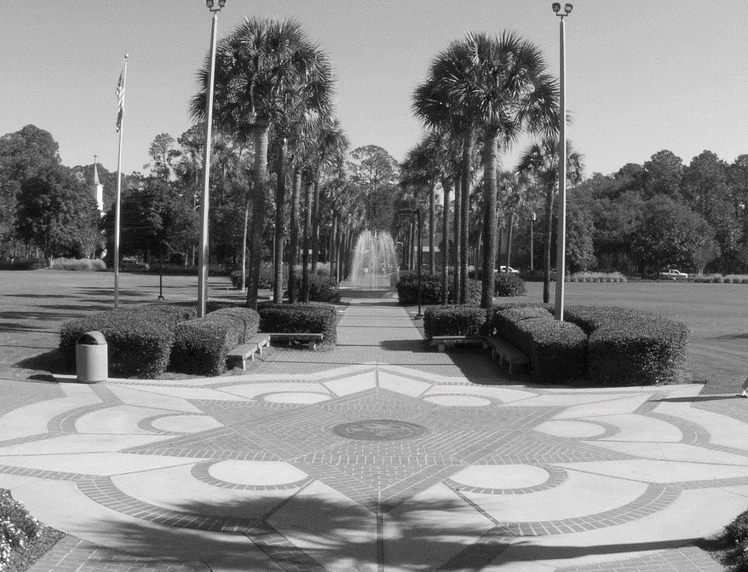
2
Items of Discussion
1
About VSU/Development of TRU
2
What is ITSM?
3
ITSM Audience Poll
4
Implementation of ITSM
5
Helpdesk Transformation to SC
6
Responsibilities of TRU
7
Pros and Cons of ITSM
8
Future Implementation and Questions

Slide 3
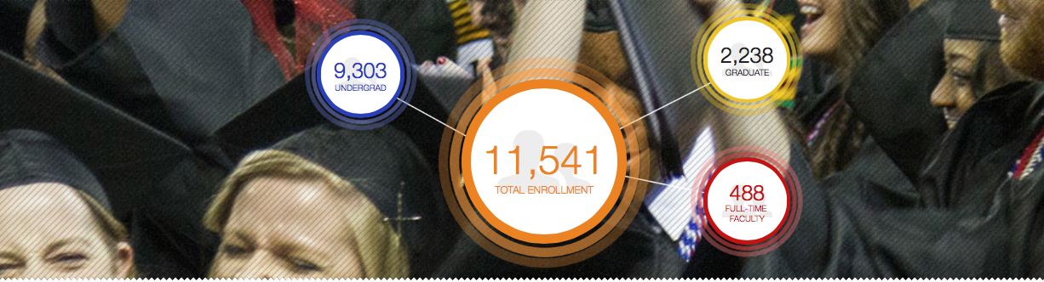

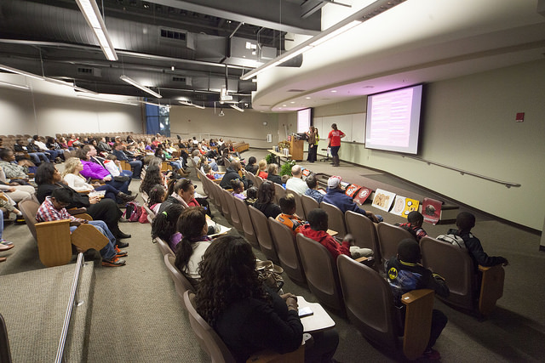
Information Technology at VSU
900
Faculty &
Staff
4,000 + PCs
HP 90%
Apple 5%
Other 5%
Who We Represent
More than 11,500 Students, 1400 Faculty and Staff
4000 + PCs, 90% HP 5 % Apple 5% Other
iVanti Service Desk 7.8
235 Smart Classrooms with 90 Labs
MS Office 365 Campus
Resolve 25,000+ incidents Annually
15 Full-time TSS Staff, 50+ Student Assistants
235 Smart Classrooms with 90 labs
40 Managed
Student Xerox
MFP

Slide 4
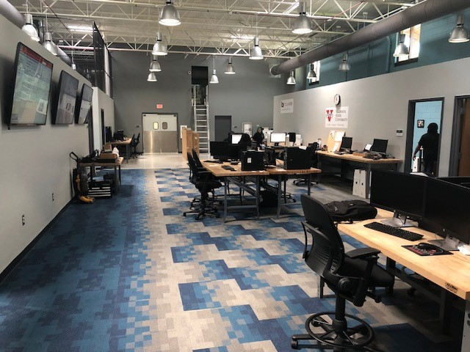
Development of the Technical Response Unit (TRU)

Slide 5
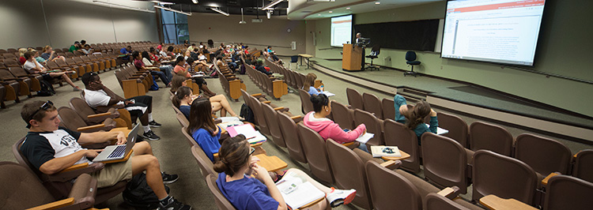
Status Quo – 2012
Managing:
  56 computer labs
  101 technology-enhanced classrooms
  1,600 computers
With:
  3 FTEs
  On average, 2–4 student assistants per lab with limited duties

Slide 6
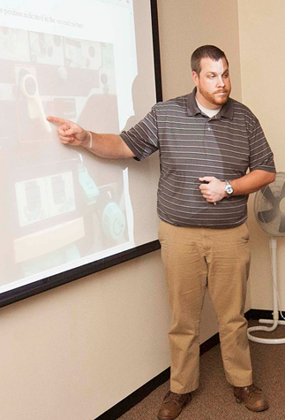
TLC Program – 2013
TLC Maintenance Program
Better leverage student staffing
  Hybrid training
  Appropriate resourcing
  Team building
  Regular lab evaluations
Pilot in library and business school

Slide 7
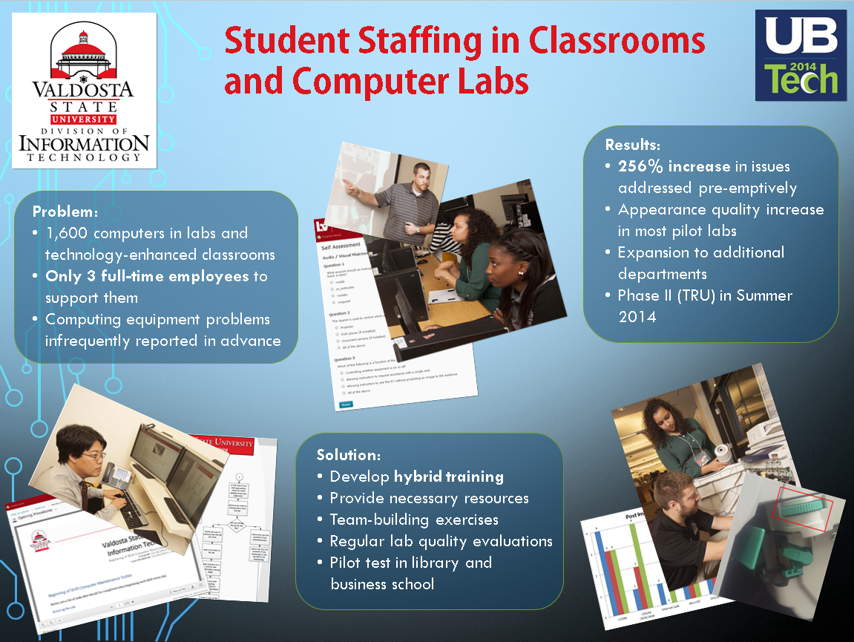
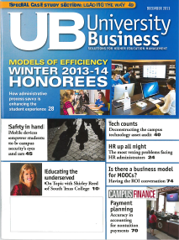
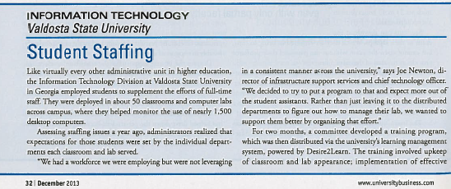
TLC Pilot Results
Quality increase in most locations
256% issues addressed
preemptively
Recognition:
  University Business Magazine
  (December 2013)
  2014 UBTech Conference

Slide 8
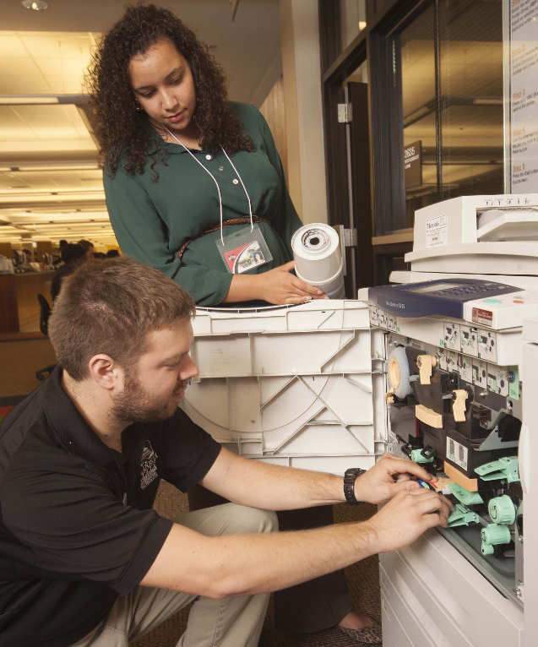
TRU Initiative – 2014
Technical Response Unit
Evolution of TLC
Goals:
  Further increase preemptive support
  Establish 15 minute incident response time
  Enhance customer service
  Identify departmental needs
  Provide cost savings

Slide 9
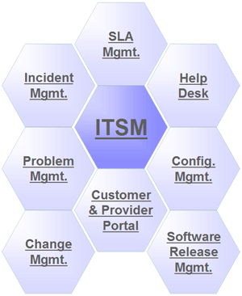
What is ITSM?
ITSM (or IT Service Management) refers to the implementation of quality IT services that meet the needs of the business.
Ensures people, processes, and technology provide value to a business.
Improves business performance through better IT delivery.
Bridges communication between IT and the customer.
26 Process disciplines

Slide 10
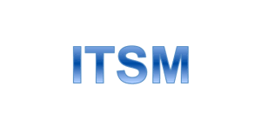

VSU IT Implementation ITSM
ITSM processes used at VSU
    Incident Management
    Problem Management
    Change Management
    Request Fulfilment

Slide 11
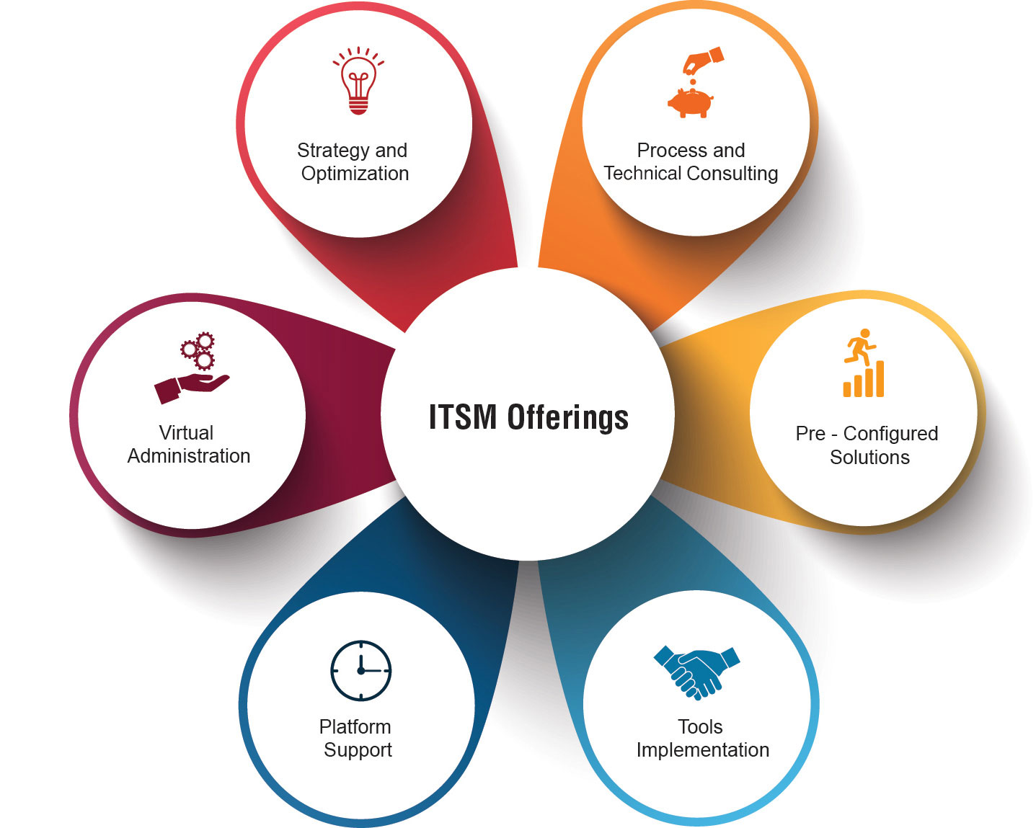
Why Use ITSM
Reduce IT costs
Improve quality of service
Improve customer satisfaction
Improve governance and reduce risk
Increase competitive advantage
Improve flexibility
Increase agility for new IT services

Slide 12

Lets Vote! – ITSM Use
Step 1: Send a text to cell# 22333
Step 2: Enter following text contents STERLINSANDE734
Step 3: Prepare to text your choice of A,B, or C
Step 4: Be sure to text LEAVE to exit the poll after voting

Slide 13
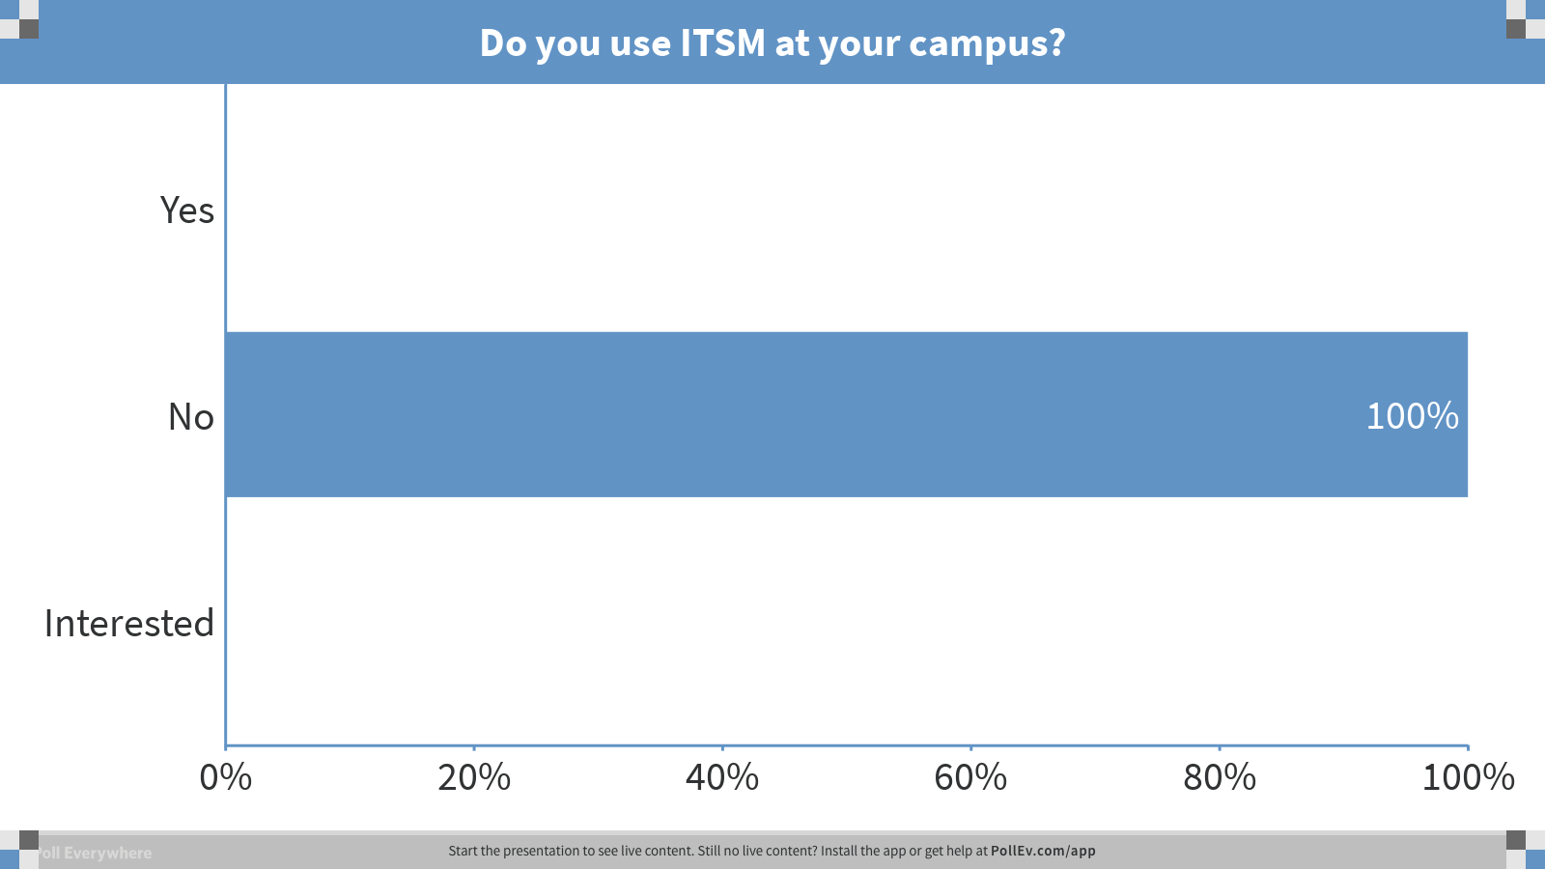
Notes:
Poll Title: Do you use ITSM at your campus?
https://www.polleverywhere.com/multiple_choice_polls/FEOFOZt3dC9Ob6H

Slide 14
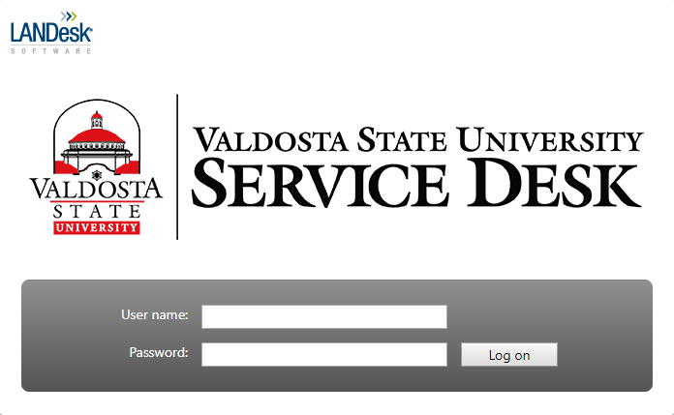
TRU Incident Management
ITIL incident management (IM) is the practice of restoring services as quickly as possible after an incident.
Ex: Creating a service request wireless issue
Incident Management via Ivanti LANDesk Servidesk 7.8

Slide 15
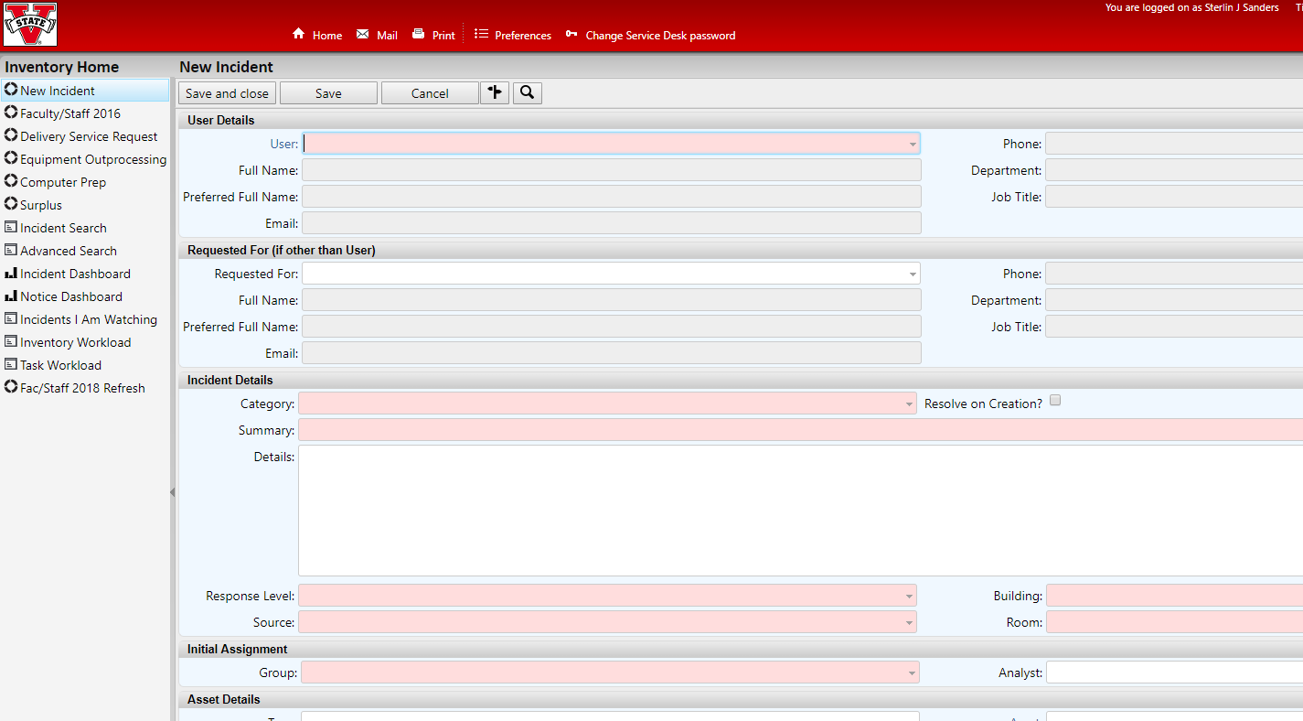
TRU Problem Management
The primary objectives of problem management are to prevent problems and resulting incidents from happening, to eliminate recurring incidents, and to minimize the impact of incidents that cannot be prevented.
Ex: Multiple Incidents experiencing wireless issues

Slide 16
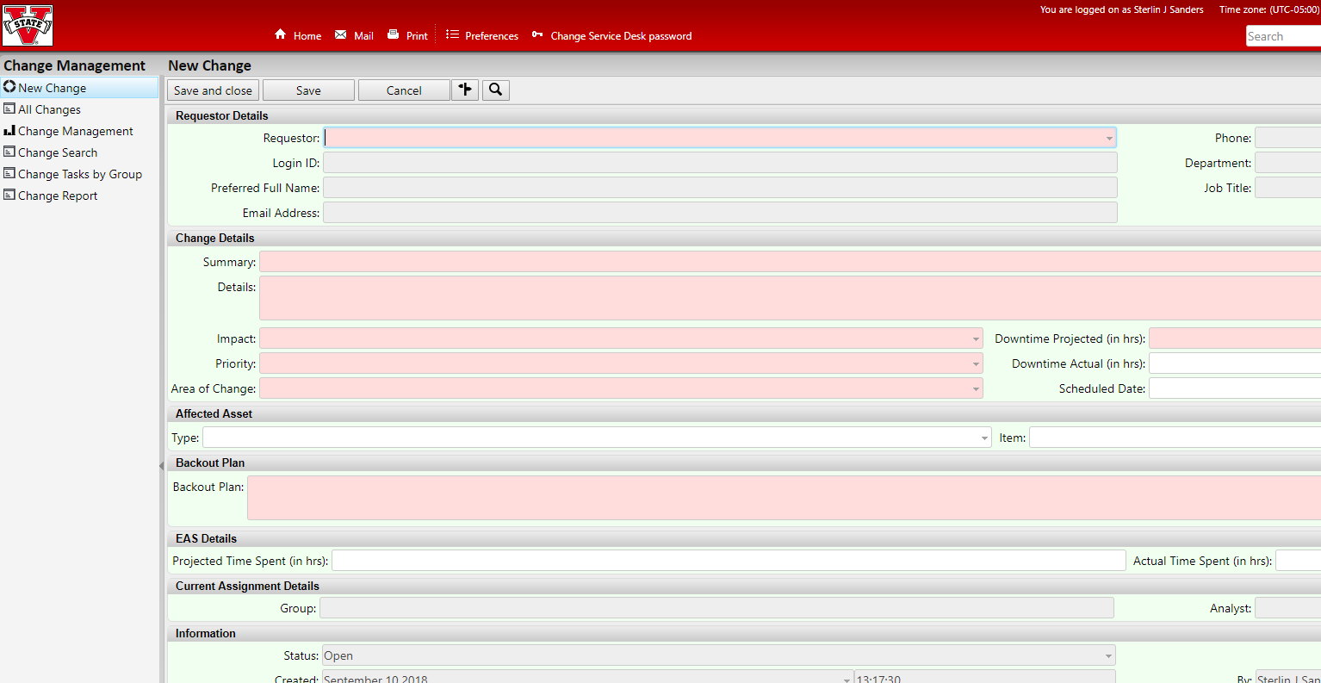
TRU Change Management
To ensure that standardized methods and procedures are used for efficient and prompt handling of all changes to control IT infrastructure, in order to minimize the number and impact of any related incidents upon service.
Ex: Applying network patch or hardware change

Slide 17

Pros/Cons of ITSM
PROs
+
Improved process organization
Time Efficient
Cost Savings
-
CONs
IT Department Buy-In
Time Investment for initial startup

Slide 18
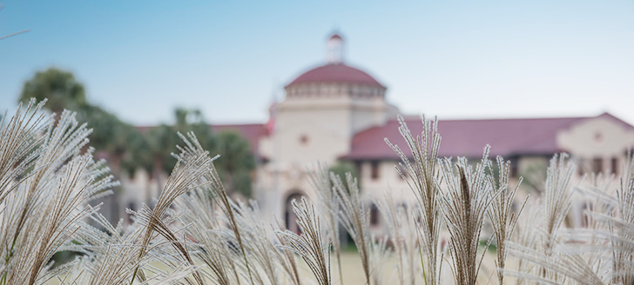
The Solutions Center is the first of its kind at Valdosta State University and the entire University System of Georgia!

Slide 19
Purpose and Background
  Created to improve student experience by reducing queue wait times and implementing end-to-end case management.
  Improvements and new designs in automation, analytics, and telecommunications provide a data-driven environment to improve service to students.
  Callers will now be able to speak with one representative that can answer many common questions and only get transferred for issues requiring specialized expertise, which reduces campus runaround and end-user frustration.

Slide 20
Impacts On Admissions
Before the Solutions Center
After the Solutions Center
Total Calls: 40,437
Average Wait: 0:39
Max Wait: 1:26:34
Calls Handled: 22,648
Average Call Time: 2:05
Abandon Rate: 43.99%
07/15/2015 - 02/28/2016
Admissions Only
Total Calls: 37,647
Average Wait: 0:15
Max Wait: 29:46
Calls Handled: 36,267
Average Call Time: 3:47
Abandon Rate: 3.67%
07/15/2016 - 02/28/2017
Admissions, IT, and Welcome Center

Slide 21
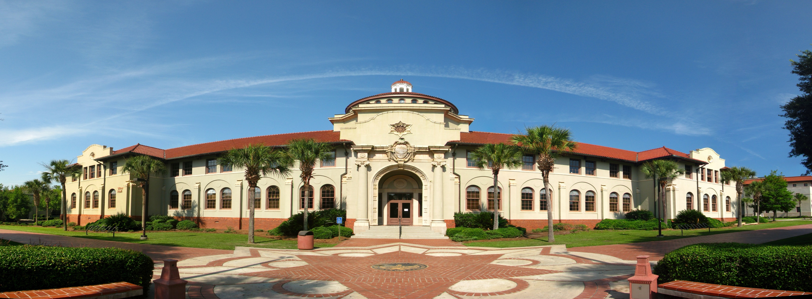
“By partnering with the Solutions Center, our time has been re-allocated from answering general phone questions, and we are able to focus on higher level projects that impact the university.”
- Ryan Hogan, Director of Admissions

Slide 22
Staffing Model
 | IT | Admissions | Housing | Solutions Center
Annual Calls | 17,734 | 43,465 | 10,475 | 71,674
Full-Time Staff | 1 | 1 | 1 | 3
Student Assistants | 8 | 8 | 1 | 17
Total Employees | 9 | 9 | 2 | 20
Annual Calls Per Agent | 1,970 | 4,829 | 4,829 | 3,584

Slide 23
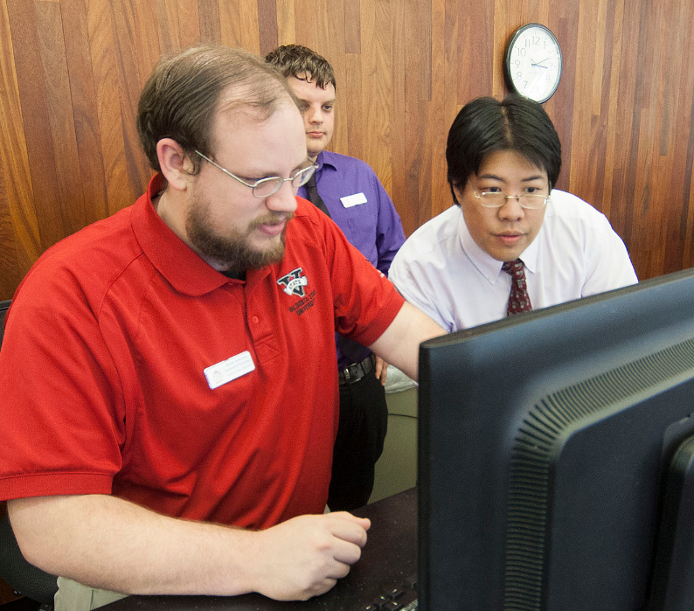
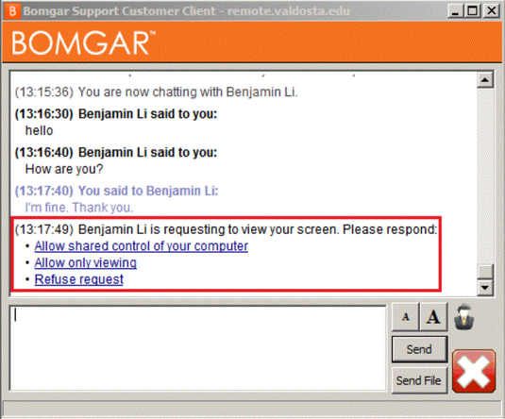
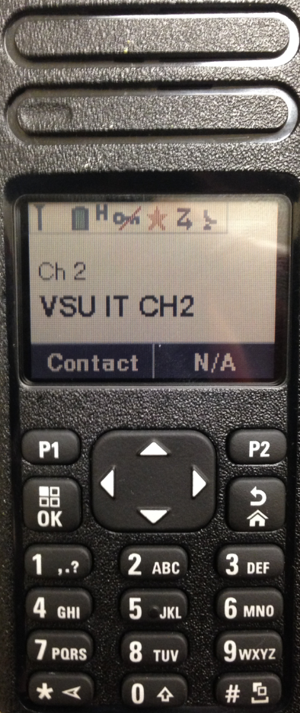
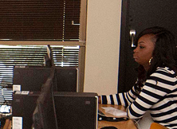
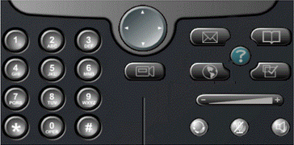
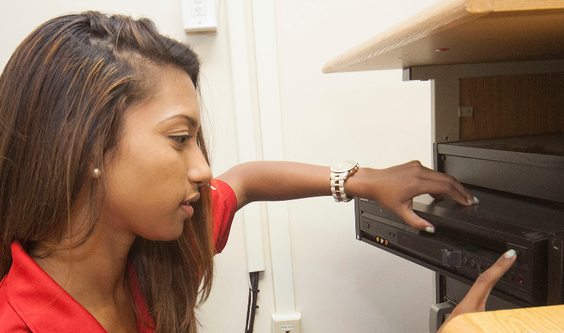
TRU Responsibilities
  Tier1/Tier2 Support
  15min first responder to designated calls
  Wireless Support in Residence Halls
  Lab/Classroom routine maintenance/zoning
  Tutoring
  Campus Event Support

Slide 24
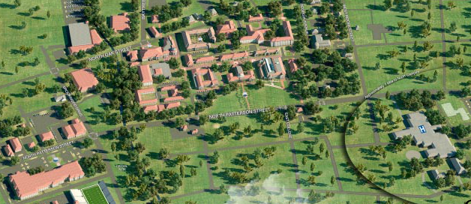

Key Strategic Locations
1 FTE
7 strategically placed offices with 3-5 student assistants each

Slide 25
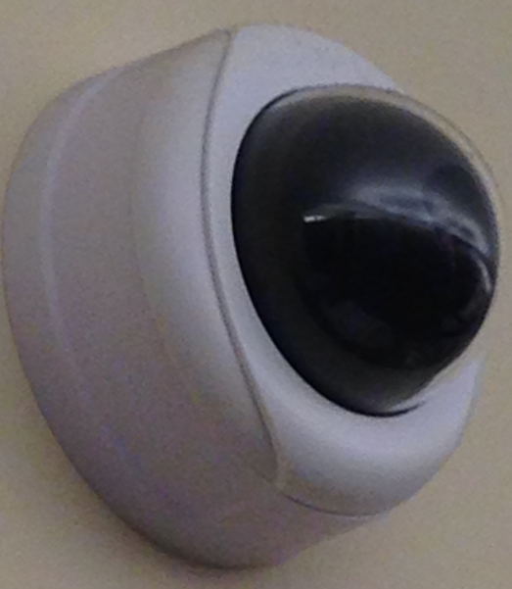
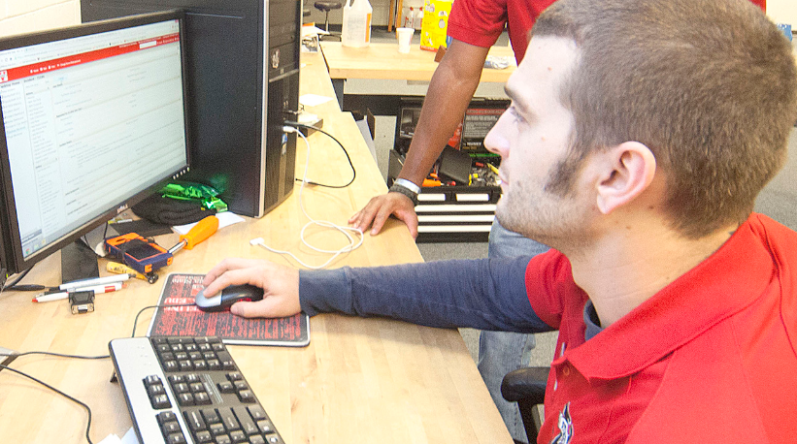
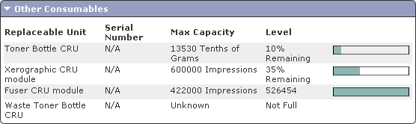
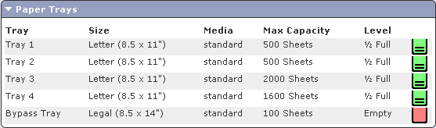
Preemptive Support
Routine on-site maintenance
Pelco Endura camera system
Xerox CentreWare Web
Reduction in workload for other IT areas

Slide 26
Bridging the Tiers
Incident Response
Service Requests
First Tier
IT Helpdesk
Training and
Communication
Intermediary Tier
Technical Response Unit
Second Tier
Desktop Support
Classroom Support
Asset Management
Initial Contact
Preventative Maintenance

Slide 27

Looking Ahead
ITSM Training
TRU and ITSM Expansion
ITIL/ITSM Certifications
ITSM Training
TRU and ITSM Expansion
ITIL/ITSM Certifications

Slide 28
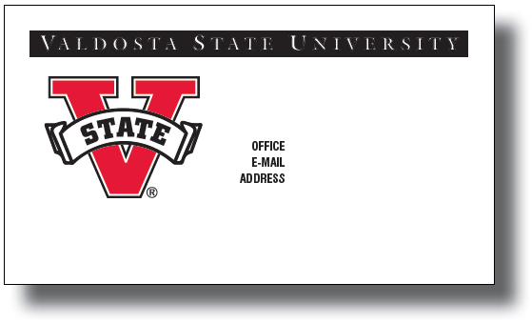
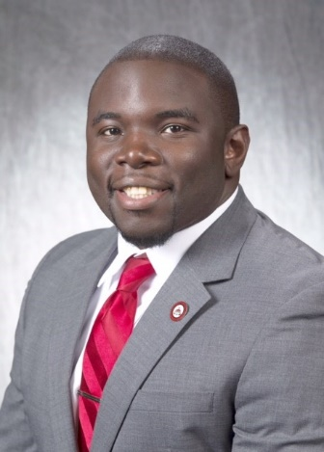
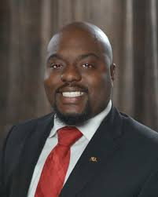
Thank You!
Sterlin Sanders
Director for Technical Support Services
229-245-4357
ssanders@valdosta.edu
Valdosta State University
1500 N. Patterson St.
Valdosta, GA 31698-0000
Pine Hall 160
Division of
Information Technology
Quinncy Thomas
TRU Coordinator
229-245-4357
bkli@valdosta.edu
Valdosta State University
1500 N. Patterson St.
Valdosta, GA 31698-0000
Odum Library 2639
Division of
Information Technology
© 2018 Board of Regents of the University System of Georgia by and on behalf of Valdosta State University.

