Slide 1
Logic and Legal Reasoning
http://lawreview.law.pitt.edu/ojs/index.php/lawreview/article/view/117
(Click on “Full Text PDF”)
http://www.granberglaw.com/wp-content/uploads/2012/07/legal_reasoning.pdf

Slide 2
Inductive Generalization (Particular-To-General Reasoning)
Creates Appellate Case Legal Principles
Here is an example of legal reasoning by inductive generalization:
1. Premise One: Appellate Case 1 held that a contract
with a vague term was void.
2. Premise Two: Appellate Case 2 held that a contract
with a vague term was void.
3. Premise Three: Appellate Case 3 held that a contract
with a vague term was void.
4. Premises Four+:
Conclusion: Therefore, all contracts with vague terms are void

Slide 3
Inductive Analogy (Particular-To-Particular Reasoning)
Selects Relevant Legal Principles To Be Used
Plaintiff sues Defendant to rescind a contract. Here is an example of Plaintiff’s reasoning by inductive analogy:
1. Premise One: The present case deals with [Vague Term A], [Fact B] and [Fact C].
2. Premise Two: Appellate Case I dealt with [Vague Term A], [Fact B and Fact C]. and held that the contract was void.
Conclusion: Therefore, the contract in the present case is void.

Slide 4
Real World Example:
The California Supreme Court stated in Haruis v. Capital Growth Investors XIV (1991) 52 Cal.3d l\42.ll57:
“. . . prior decisions are controlling only as to cases presenting the same factual situation....”

Slide 5
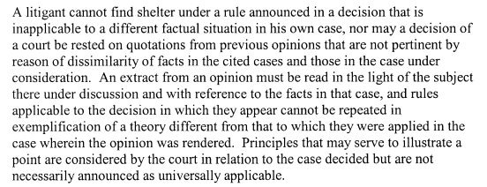
Southern Cal. Enterprises v. Walter & Co. (1947) 78 Cal.App.2d
'7 \0 -7 \'7 '

Slide 6
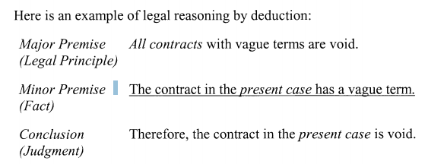
Deduction (General-To-Particular Reasoning)
Applies Legal Principles To A Particular Case

Slide 7
Inductive Generalizations and Legal Reasoning
How would you construct an inductive generalization about these particular statutes? What kinds of examples might these statutes be generalized from?
1. No county may pass any ordinance that restricts possession, transportation, sale, transfer, ownership, manufacture or repair of firearms or ammunition or their components. Any ordinances prohibited by this section are null and void. (South Dakota firearms statute)
(Answer: County A makes an ordinance that does not restrict possession of firearms, while neighboring County B makes an ordinance that does restrict possession of firearms. In general the law will be more coherent across the state if all the county ordinances agree. So it is probably wise to make a statute that will prohibit any restriction on gun possession, and make any previous ordinances that did such restrictions null and void.)
2. Any fence or other structure in the nature of a fence that unnecessarily exceeds ten feet in height and is maliciously erected or maintained for the purpose of annoying the owner of an adjoining property constitutes a private nuisance. The spite fence law expresses the judgment of our legislature that a fence, which includes any structure, trees, shrubs, or traditional fences, built to separate the boundary between two adjoining parcels does not need to be more than ten feet high to serve that purpose. (California's spite fence law)

Slide 8
3. A person who drives a commercial motor vehicle may not receive a driver license unless and until he or she surrenders to the department all driver licenses in his or her possession issued to him or her by any other jurisdiction or makes an affidavit that he or she does not possess a driver license. (Florida driver’s license statutes)
4. If a voter has written the name of an individual in the proper place on a general or special election ballot a vote shall be counted for that individual whether or not the voter makes a mark (X) in the square opposite the blank. (Minnesota voter statutes)
5. Under the Appropriation Doctrine, a State water resource agency may find that a water right has been abandoned or forfeited. Abandonment requires an intent to give up the water right permanently. Forfeiture results from failure to use the water in the manner described in State statutes. Reserved water rights are not subject to State rules on abandonment or forfeiture. (Federal Water Rights as interpreted in most states with various water resource agencies)

Slide 9
Law school teaches the deductive syllogism as "IRAC" ("Issue, Rule, Analysis,
Conclusion"), where:
"Issue" defines the syllogism's subject matter;
"Rule" is the syllogism's major premise;
"Analysis" is the syllogism's minor premise;
"Conclusion" is the syllogism's conclusion.

Slide 10
Video with a law professor discussing logic and reasoning
Vern Walker
Hofstra University
Speaking at the Logic and Reasoning Institute at James Madison University
https://www.youtube.com/watch?v=oxticw1C9uo

Slide 11
Discussion Work:
Consider the legal situations described on the next few slides. Can you rewrite them as formal, standard form Categorical Syllogisms if they are not already?
Use the Logic App to construct symbolic statements and derivations for the Categorical Syllogisms involved in legal reasoning. Do screen captures and post them (like in our previous unit).
Discuss the validity of the Categorical Syllogism using mood and figure.
Examples on the next slide and in Discussion.

Slide 12
There are legal limits on all gamefish, but carp are not gamefish. So there are no legal limits on carp.
There are legal limits only on gamefish. There are no legal limits on carp, since carp are not gamefish.
There are legal limits on carp or carp are not gamefish. There are no legal limits on carp, so carp are not gamefish.

Slide 13
All military actions that are essential to national security are exemptions to the National Environmental Policy Act.
The Navy’s use of sonar is essential to national security.
Therefore, the Navy’s use of sonar is an exemption to the National Environmental Policy Act.
The National Environmental Policy Act requires Environmental Impact Statements.
Environmental Impact Statements are not completed for activities during which marine mammals are not detected.
The Navy did not detect marine mammals during their activities, so no Environmental Impact Statements were completed.
Some takings of marine mammals are military takings.
Under military deference, No military takings do have to be reported.
Some takings of marine mammals do not have to be reported.

Slide 14
All those who are arrested must be informed of their Fifth Amendment and Sixth Amendment rights.
Police officers are those who are in a position to inform those who are arrested.
Police officers must inform all who are arrested of their Fifth and Sixth Amendment rights.
Anyone not informed of their Fifth Amendment and Sixth Amendment rights, and who confesses to a crime, should have their confession excluded from trial.
Ernesto Miranda was not informed of his Fifth Amendment and Sixth Amendment rights, and confessed to a crime.
Ernesto Miranda’s confession should have been excluded from trial.

