Slide 1
Light!

Slide 2

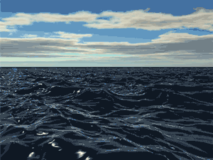
We experience WAVE PHENOMENA every day.
Ocean Waves
Most WAVE PHENOMENA are a disturbance

Slide 3
We experience WAVE PHENOMENA every day.
Ocean Waves
Sound Waves

Slide 4
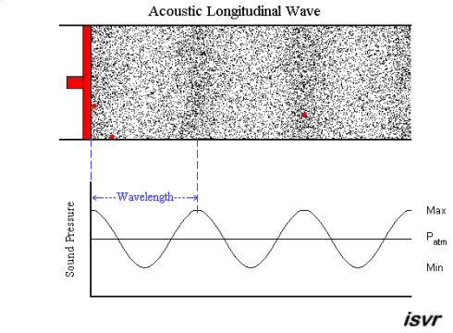
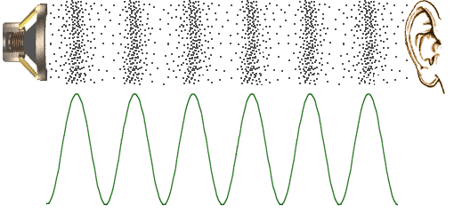

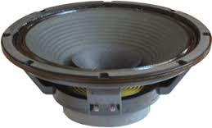
SOUND needs something to travel in: air or water
Sound is a disturbance
Energy is
transferred
to the ear
air pressure
The compression can be represented as a wavelength

Slide 5
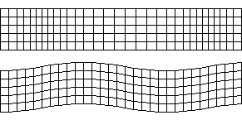
We experience WAVE PHENOMENA every day.
Ocean Waves
Sound Waves
Earthquakes
EARTHQUAKES are a disturbance

Slide 6
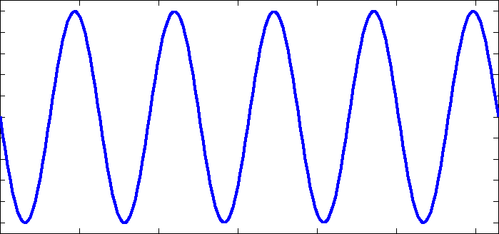
We experience WAVE PHENOMENA every day.
Ocean Waves
Sound Waves
Earthquakes
Light Waves
but LIGHT needs NOTHING to travel in

Slide 7
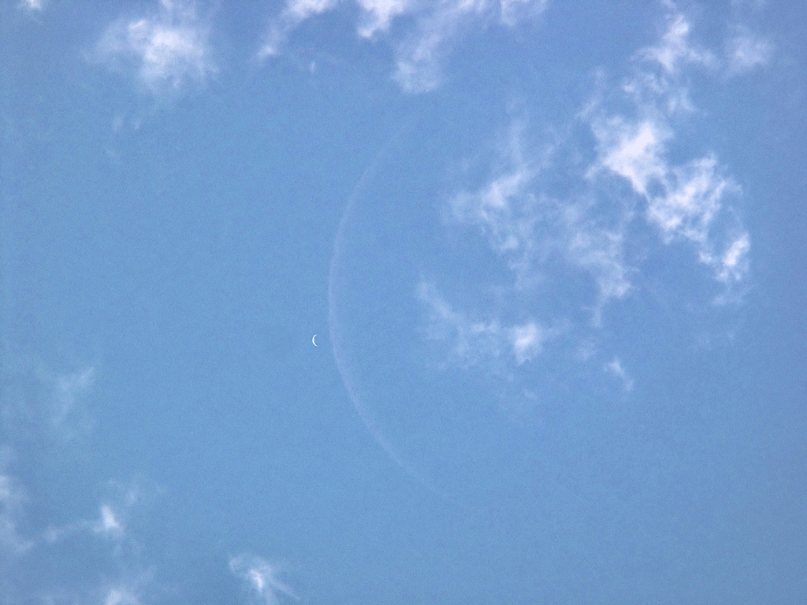
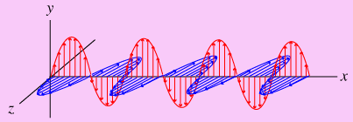
Light is made of electric and magnetic waves.
Electric wave
Magnetic wave

Slide 8
But sometimes, it behaves as if it were a compact particle,
like a billiard ball.
But sometimes, it behaves as if it were a WAVE.

Slide 9
This is called the WAVE-PARTICLE DUALITY of light
Here is how we know……..

Slide 10
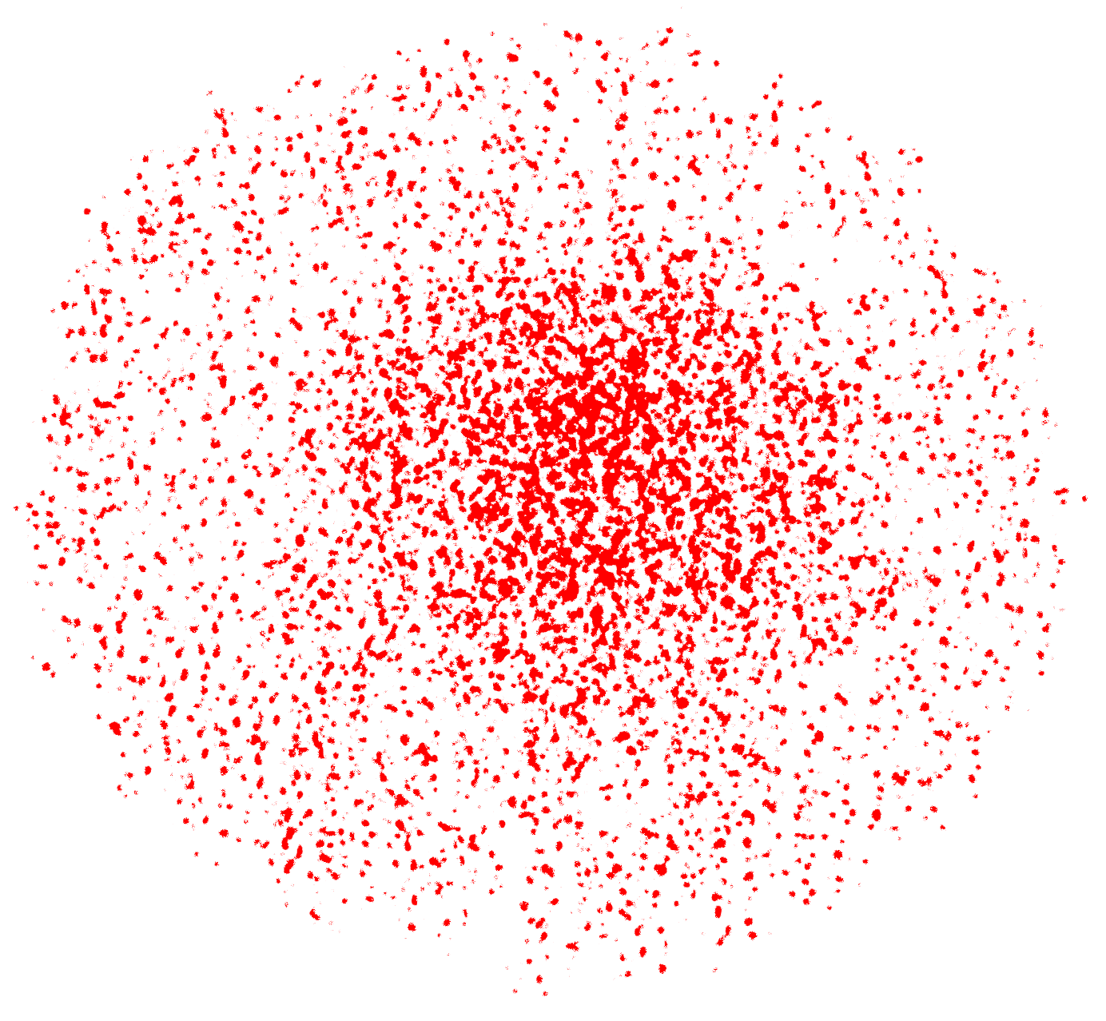
We know this because particles act differently than waves.
particles act like this when going through a hole

Slide 11
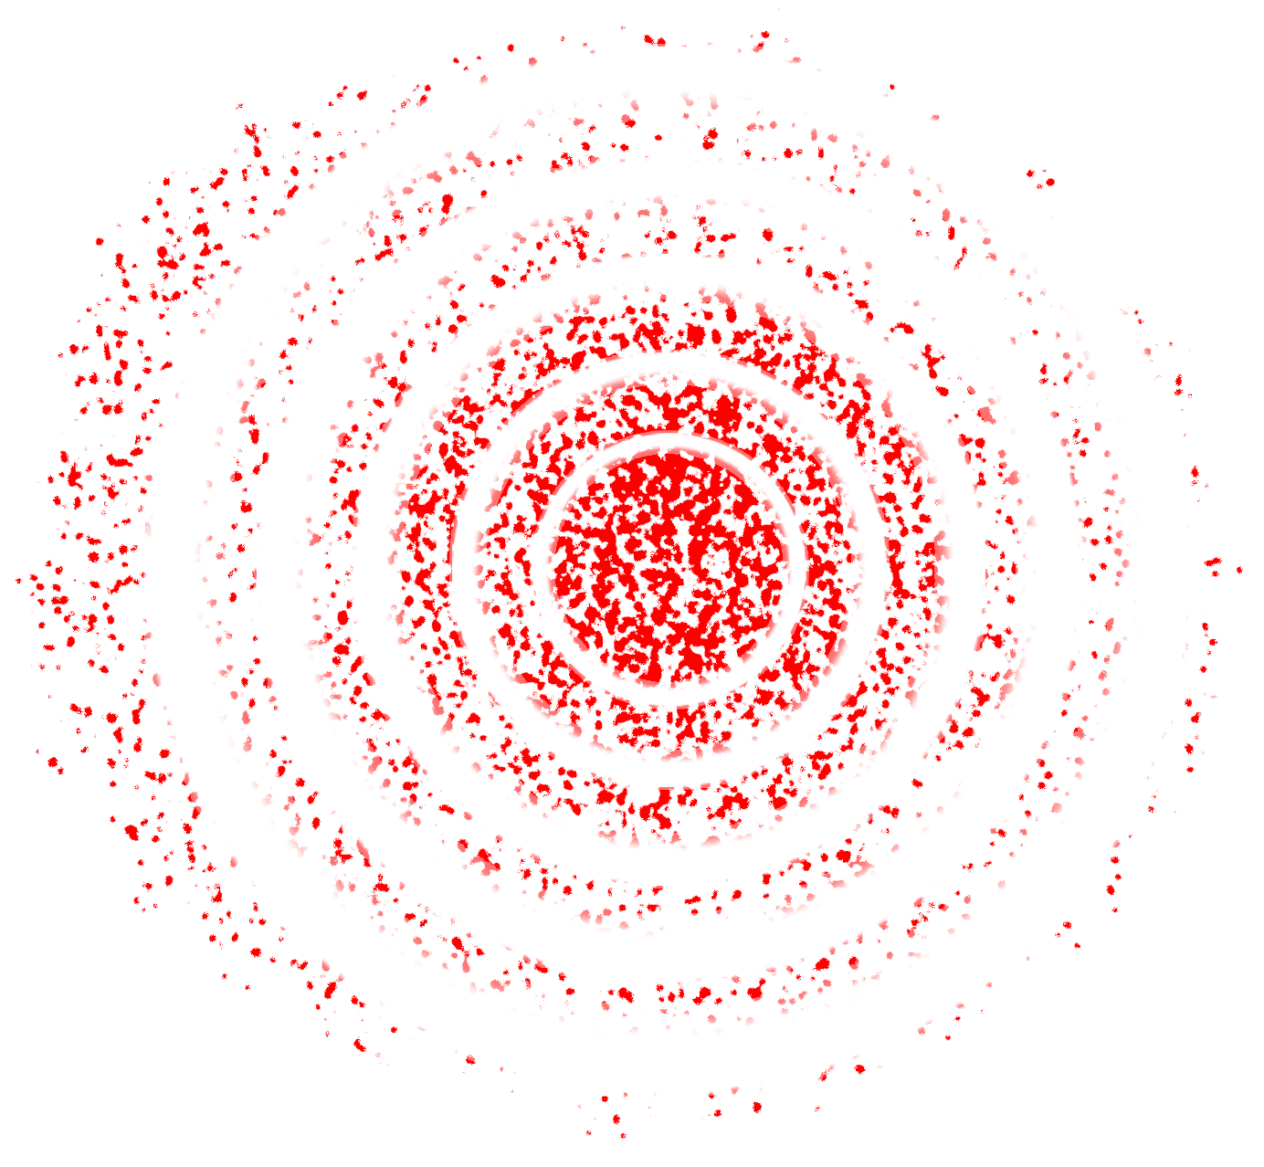
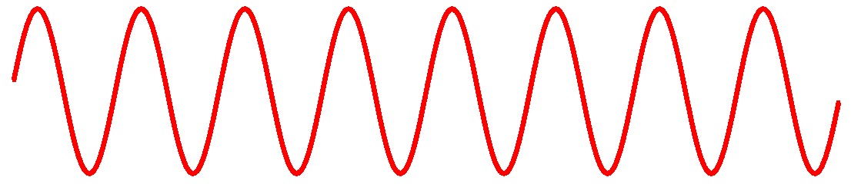
We know this because particles act differently than waves.
PARTICLES act like this when going through a hole
WAVES act like this when going through a hole

Slide 12
Light acts always as ONE or the OTHER, not both at a time.
PARTICLES act like this when going through a hole
WAVES act like this when going through a hole

Slide 13
When we refer to a “piece” of light, we call it a PHOTON.
LIGHT does not need anything to travel through.
LIGHT can travel through empty space. And although we understand how light works, we don’t know why Nature works this way!

Slide 14
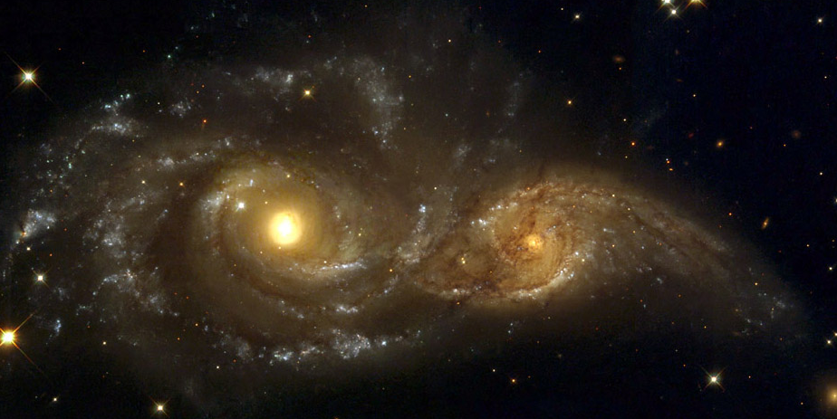
We know the WHAT, and we know the HOW
But we don’t know the WHY.

Slide 15
Light has the basic characteristics and properties of all waves.
Characteristics:
wavelength
frequency
speed

Slide 16
Light has the basic characteristics and properties of all waves.
Characteristics:
wavelength
frequency
speed
λ
λ
λ
λ

Slide 17
Light has the basic characteristics and properties of all waves.
Characteristics:
wavelength
frequency f
speed
λ
8 wavelengths in 2 seconds make a frequency:
f = 4 per sec

Slide 18
Light has the basic characteristics and properties of all waves.
Characteristics:
wavelength
frequency f
speed c
λ
λ x f = c
c = 3 x 10⁵ km/s

Slide 19
Light has the basic characteristics and properties of all waves.
Properties:
reflection
refraction
interference
diffraction

Slide 20

Light has the basic characteristics and properties of all waves.
Properties:
reflection
Light travelling from the mountains bounces off the surface of water (i.e. reflects) and creates an image of the mountain on the water

Slide 21
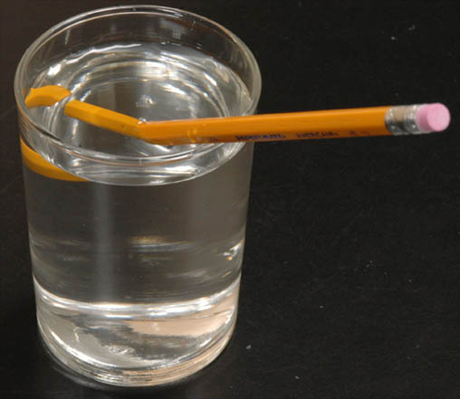
Light has the basic characteristics and properties of all waves.
Properties:
reflection
refraction
Light travelling from the part of the pencil under water refracts (i.e. changes direction) when passing from water to air (i.e. changes medium), producing an image of a bent pencil to an observer located outside the water
Notes:
Refraction: change in direction of a wave due to a change in its medium

Slide 22
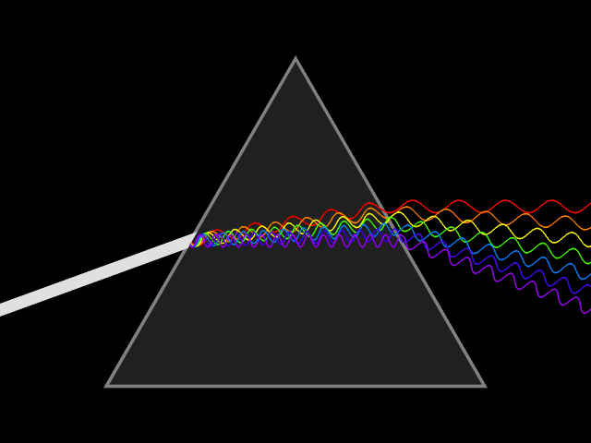
Light has the basic characteristics and properties of all waves.
Properties:
reflection
refraction
White light travelling through air from the left enters a glass prism, and refracts because it is changing medium. The different constituent colors of white light bend by different angles, and separate into distinguishable colors.

Slide 23
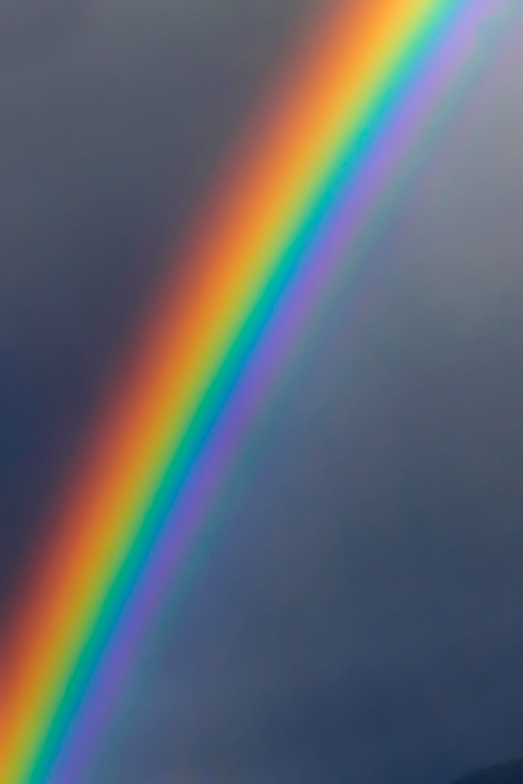
Light has the basic characteristics and properties of all waves.
Properties:
reflection
refraction
White sunlight is refracted by water particles in air and separated into colors of the rainbow

Slide 24
Light has the basic characteristics and properties of all waves.
Properties:
reflection
refraction
interference
diffraction
Two waves superimposed (i.e. placed on top of each other) can interfere to form a resultant wave. If the peaks and troughs of both waves are aligned, the resultant wave exhibits constructive interference.

Slide 25
Light has the basic characteristics and properties of all waves.
Properties:
reflection
refraction
interference
No wave, i.e. cancels out completely!
If the peaks of one wave are aligned with the troughs of the other wave, then the resultant wave exhibits destructive interference; in case of completely destructive interference, the two original waves completely cancel each other and there is no resultant wave.

Slide 26
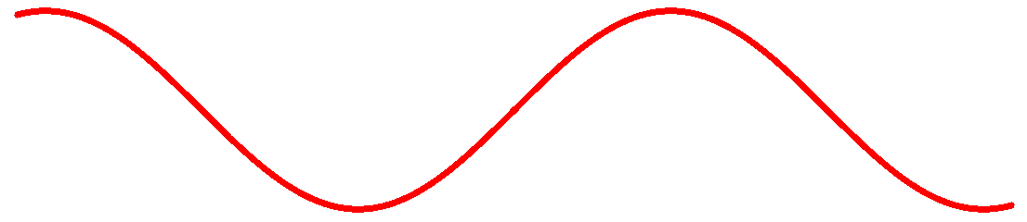

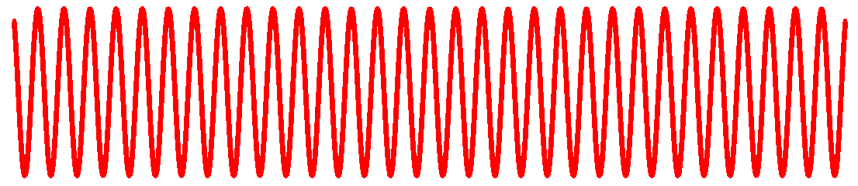
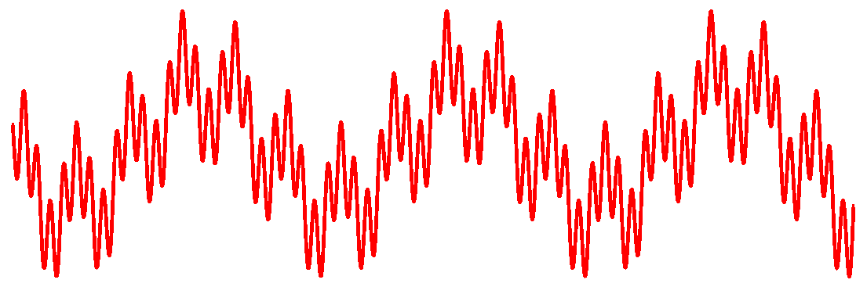
or if you have a complicated addition:
+
+
+

Slide 27
Light has the basic characteristics and properties of all waves.
Properties:
reflection
refraction
interference
e.g. Radio waves transmitted from a station tower

Slide 28
Light has the basic characteristics and properties of all waves.
Properties:
reflection
refraction
interference
e.g. Radio waves transmitted from a station tower

Slide 29
Light has the basic characteristics and properties of all waves.
Properties:
reflection
refraction
interference
e.g. Radio waves transmitted from a station tower

Slide 30
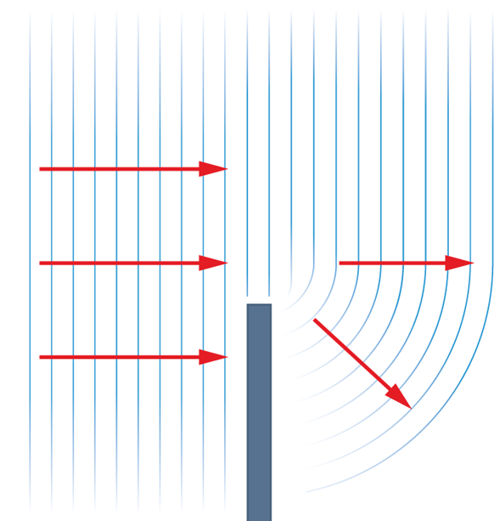
Light has the basic characteristics and properties of all waves.
Properties:
reflection
refraction
interference
difraction
waves bend around barriers

Slide 31
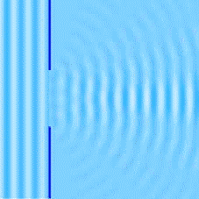
Light has the basic characteristics and properties of all waves.
Properties:
reflection
refraction
interference
difraction
waves bend around barriers

Slide 32
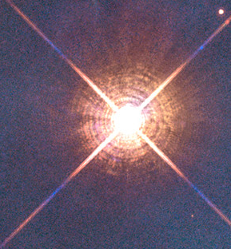
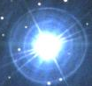

Light has the basic characteristics and properties of all waves.
Properties:
reflection
refraction
interference
difraction
a diffraction pattern
Light passing through a telescope lens diffracts and produces an image with diffused rings

Slide 33
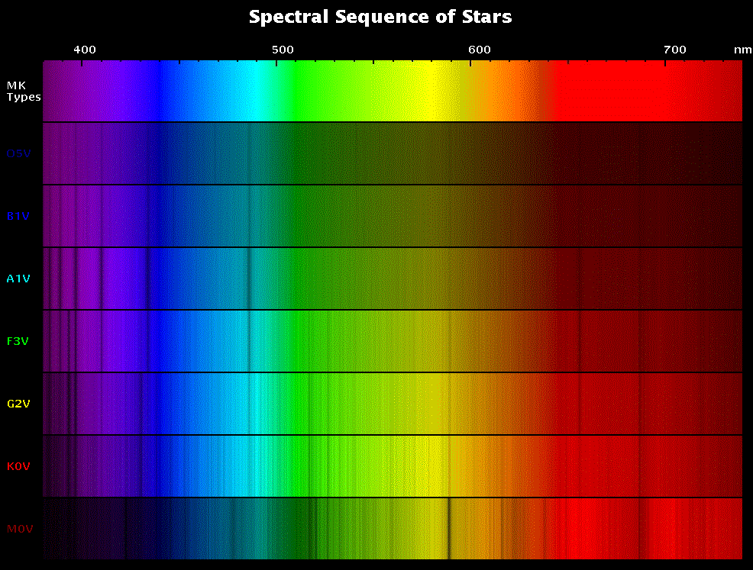
Electromagnetic Spectrum = RAINBOW

Slide 34
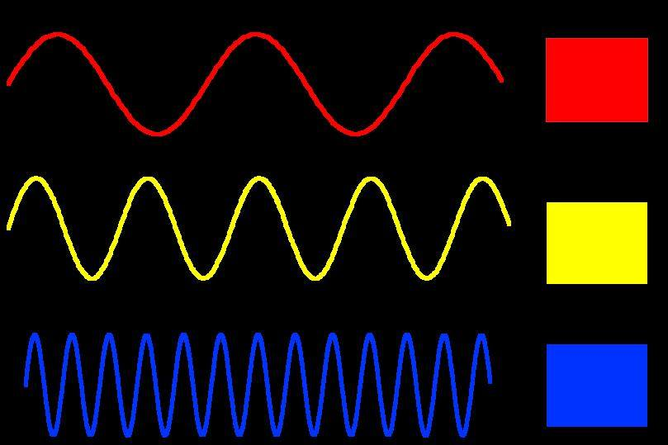

Slide 35
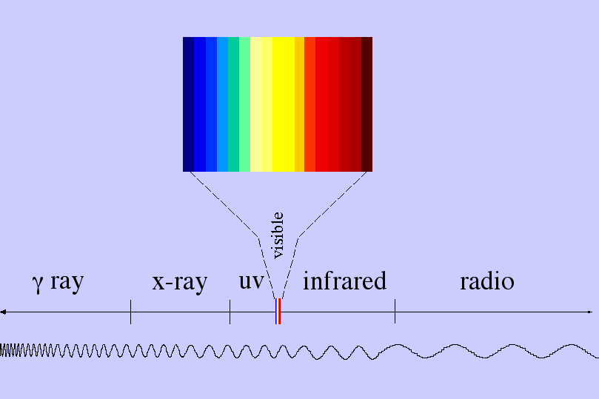

1 µ = 1/60 width of a hair
0.4 µ 0.7 µ
< 0.01 nm 0.0001 µ 0.01 µ
1 cm >1 cm
Electromagnetic Spectrum = LIGHT

Slide 36
LIGHT WAVES HAVE ENERGY!
0.4 µ 0.7 µ
HIGH ENERGY
SHORT wavelength
Electromagnetic Spectrum = LIGHT

Slide 37
LIGHT WAVES HAVE ENERGY!
0.4 µ 0.7 µ
HIGH ENERGY LOW ENERGY
SHORT wavelength LONG wavelength
Electromagnetic Spectrum = LIGHT

Slide 38
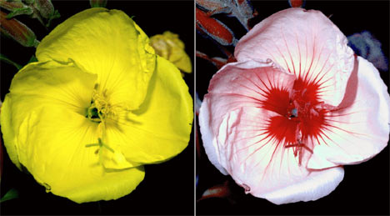
visible light uv light

Slide 39
how bees see the world:
visible light uv light

Slide 40
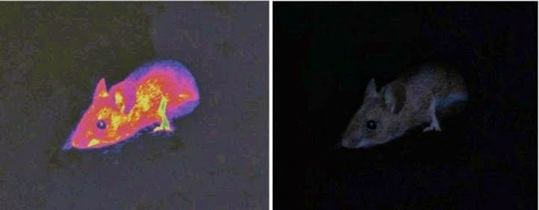
visible light infrared light
how bees snakes see the world

Slide 41
how snakes see the world:
visible light infrared light

Slide 42
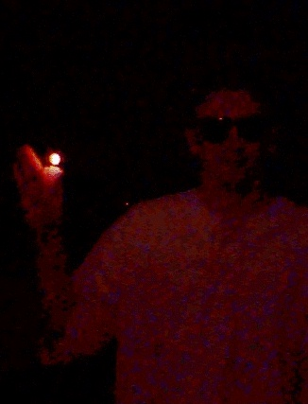
A human in dim visible light

Slide 43
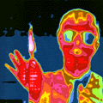
A human in INFRARED light

Slide 44
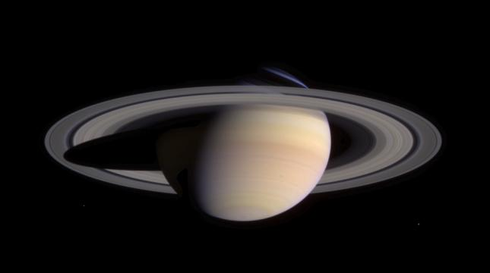
Saturn in visible light
Notes:
From cassini

Slide 45
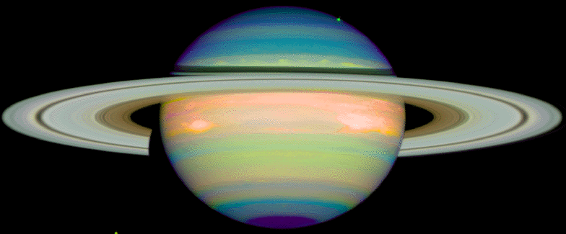
Saturn in INFRARED light

Slide 46
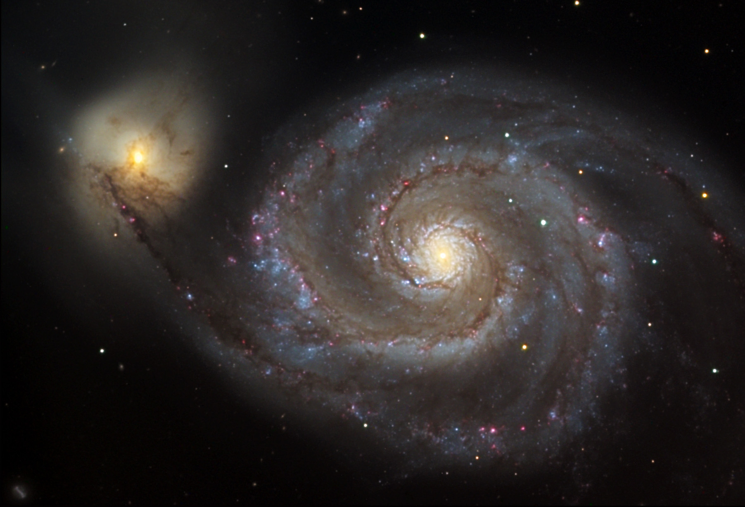
M51 galaxy in VISIBLE light

Slide 47
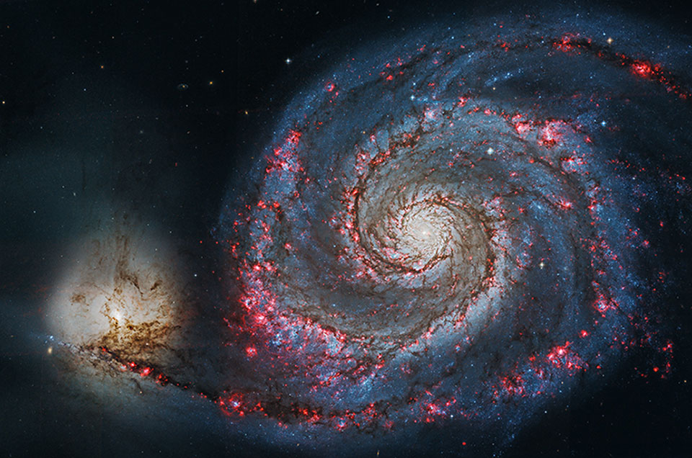
M51 galaxy in UV light

Slide 48
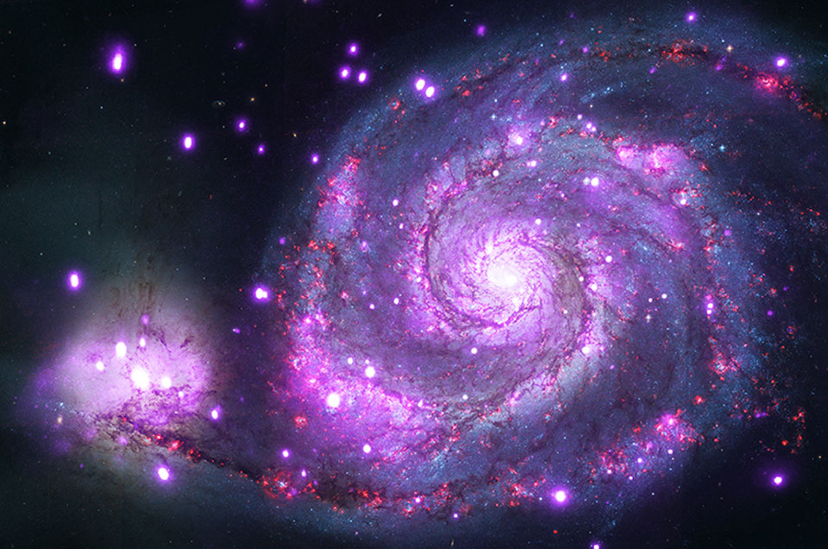
M51 galaxy in X-RAY light

Slide 49
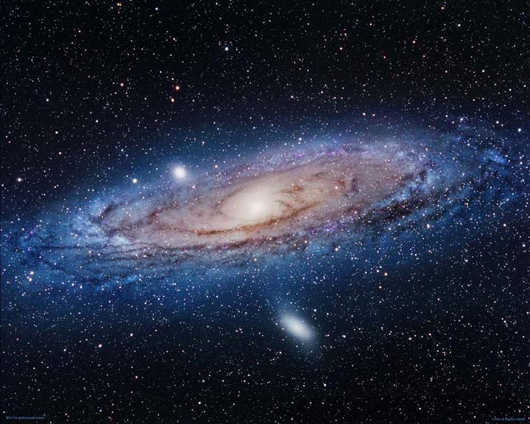
Andromdea Galaxy in visible light (color)
Notes:
M31

Slide 50
Andromdea Galaxy in visible light (color)
Notes:
M31

Slide 51
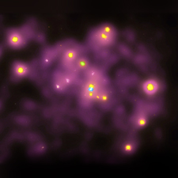
Andromdea Galaxy in X-RAY light

Slide 52
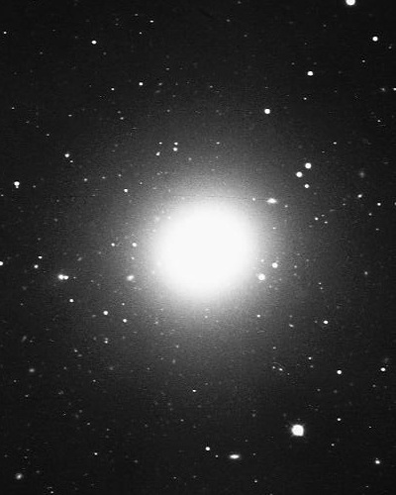
Galaxy M84 in visible light (b&w)
Notes:
m84

Slide 53
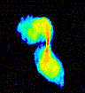
Galaxy M84 in RADIO light

Slide 54
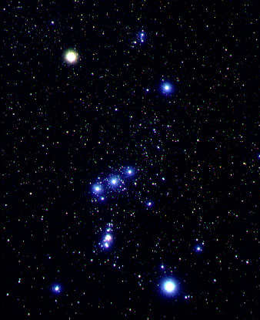
Great Nebula in Orion in visible light (true color)

Slide 55
Great Nebula in Orion in visible light (true color)

Slide 56
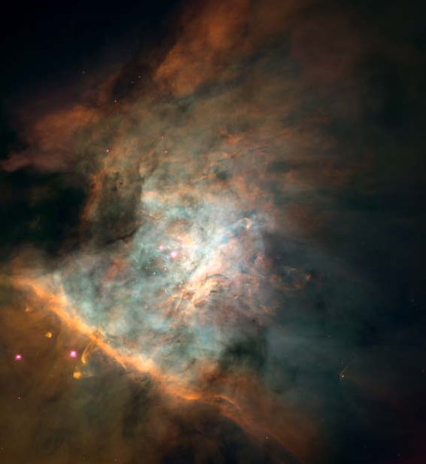
Great Nebula in Orion in visible light (true color)

Slide 57
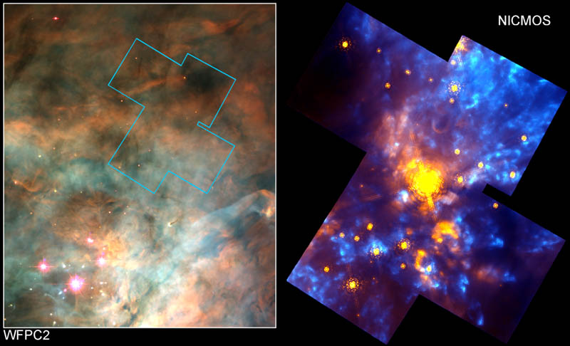
Great Nebula in Orion in visible
light (color) from HST
Great Nebula in Orion in INFRARED light rom HST

Slide 58
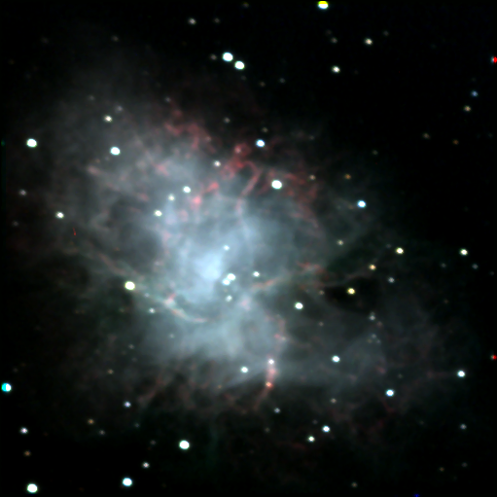
Crab Nebula in visible light

Slide 59
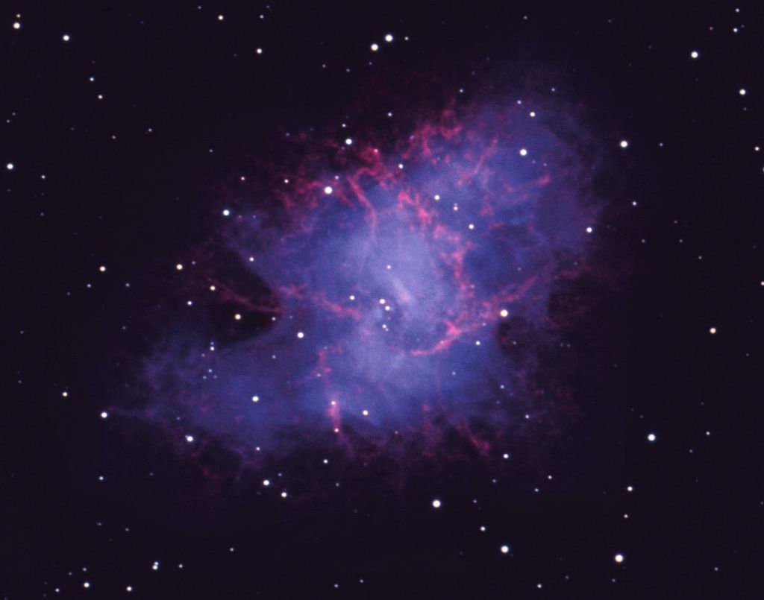
Crab Nebula in visible light

Slide 60
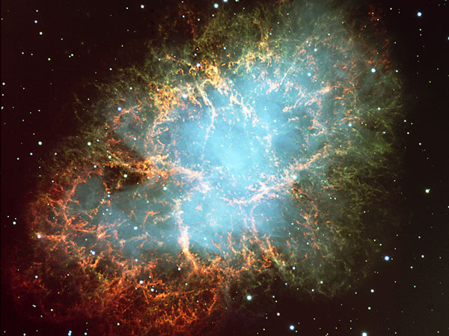
Crab Nebula in visible light

Slide 61
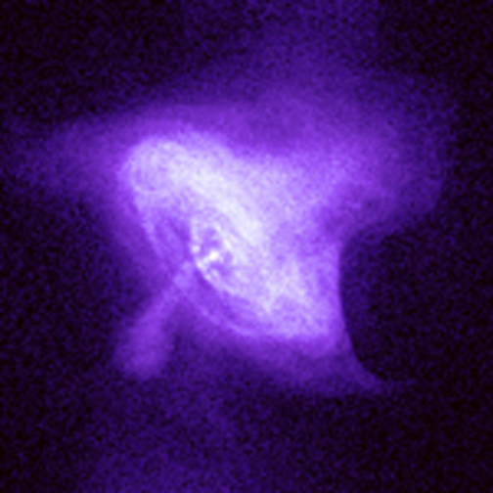
Crab Nebula in very short x-rays

Slide 62
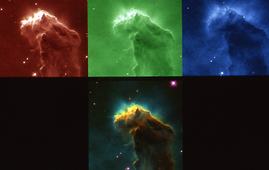
Untitled-36.jpg

