Slide 1
What is Energy
Objective: Learning about the different forms of energy. Explore mechanical energies and associated conservation principle.
Key concepts:
Work and Energy
Kinetic energy
Gravitational potential energy
Conservation of energy
Power and Efficiency

Slide 2
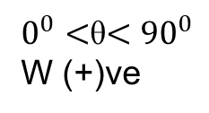
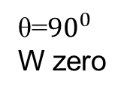
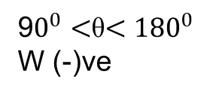
Concept of Work
Work tells you how much energy it takes to push something and make it move.
Work is done on an object (a mass) by the force components acting on the object that are parallel to the displacement of the object.
Work, W = Force x Distance x cosθ = Fd cosθ
SI Units of Work and Energy: Joules (J)
Work is a scalar! (no direction - but it can have a sign)
  The work is positive if F and d point in the same direction.
  The work is negative if F and d point in opposite directions.
F
$0^{0}<$θ$<{90}^{0}$
W (+)ve
d
F
θ=${90}^{0}$
W zero
d
9$0^{0}<$θ$<{180}^{0}$
W (-)ve
F
θ
d

Slide 3
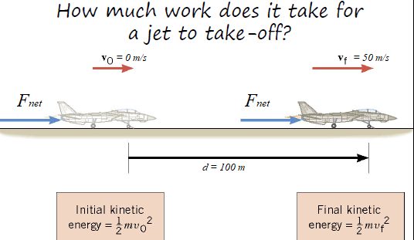
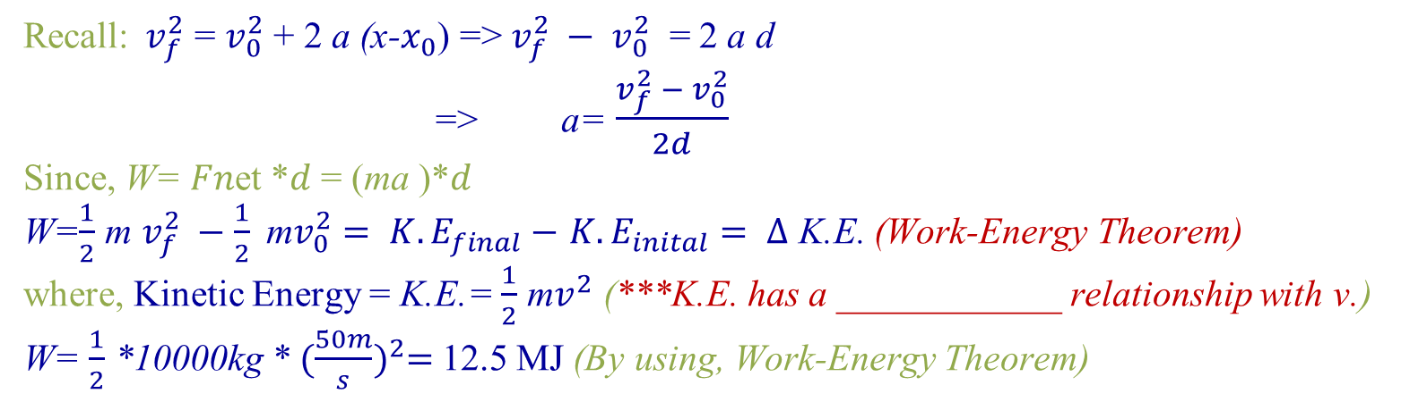
Work-Energy Theorem
  Example: Suppose you are taking off in a jet of 10000 kg. If the 125 kN force acts on the probe through a displacement of 100 m, what is the work done.
Solution:
𝑊=𝐹𝑛et *𝑑= (125000 N)*(100m)
  𝑊= 12.5 MJ
  From Kinematics,
  Recall:$v_{f}^{2}$ = $v_{0}^{2}$+ 2 a (x-$x_{0}$) => $v_{f}^{2} − v_{0}^{2}$ = 2 a d
  => a= $\frac{v_{f}^{2} − v_{0}^{2}}{2d}$
  Since, W= 𝐹𝑛et *𝑑 = (ma )*𝑑
  W=$\frac{1}{2}$ m $v_{f}^{2} −\frac{1}{2} \text{m}v_{0}^{2}= {K.E}_{final}−$ ${K.E}_{inital}= Δ$ K.E. (Work-Energy Theorem)
  where, Kinetic Energy = K.E.= $\frac{1}{2}$ m$v^{2}$ (***K.E. has a ____________ relationship with v.)
  W= $\frac{1}{2}$ *10000kg * ${(\frac{50m}{s})}^{2}=$12.5 MJ (By using, Work-Energy Theorem)

Slide 4
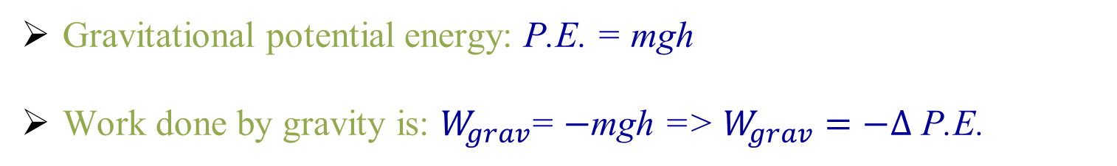
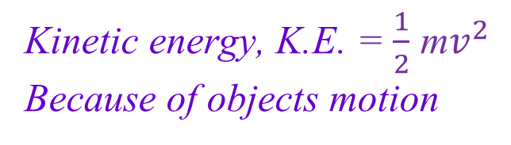
Mechanical Energy
    Potential energy, P.E. =mgh
    Because of objects position
Kinetic energy, K.E. = $\frac{1}{2}$ m$v^{2}$
Because of objects motion
Gravitational potential energy: P.E. = mgh
Work done by gravity is: $W_{grav}$= $−$mgh => $W_{grav}=−Δ$ P.E.
There are various kinds of potential energy.
Most important kind - gravitational potential energy.
M
PE = mgh
Lift the object a distance h
mg
h
Here work is done against gravity
ground
PE = 0
*If speed doubles K.E. increases by times
*If mass doubles P.E. increases by times

Slide 5
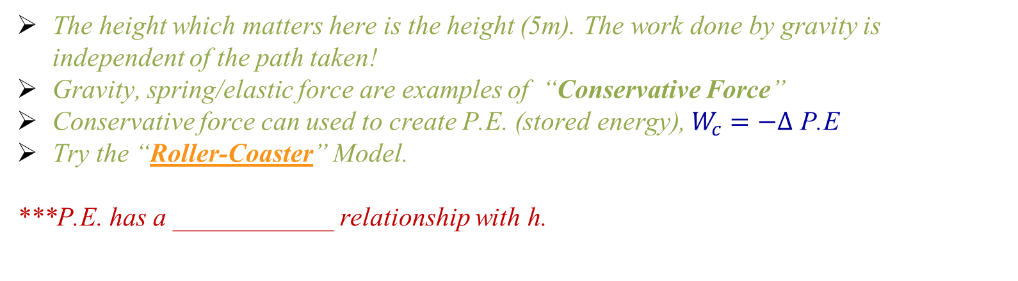
Conservative Forces and Gravitational Potential Energy
PE = 49J
PE = 49J
PE = 49J
For a mass of 1 kg lifted to 5m
PE=1kg x 9.8 m/s² x 5m = 49 J
5 m
5 m
5 m
The height which matters here is the height (5m). The work done by gravity is independent of the path taken!
Gravity, spring/elastic force are examples of “Conservative Force”
Conservative force can used to create P.E. (stored energy), $W_{c}=−Δ$ P.E
Try the “Roller-Coaster” Model.
***P.E. has a ____________ relationship with h.

Slide 6
Different forms of Energy &
Conservation of Energy
Kinetic Energy = Energy of motion
Potential Energy = Energy of position
Thermal Energy = Kinetic Energy of the random motion of molecules
Chemical Energy = Potential Energy of the bonds between atoms
Nuclear Energy = Potential Energy of the particles inside the atomic nucleus
Conservation of Energy: Energy cannot be created or destroyed. It may be transformed from one form into another or transferred from one object to another, but the total amount of energy never changes.

Slide 7
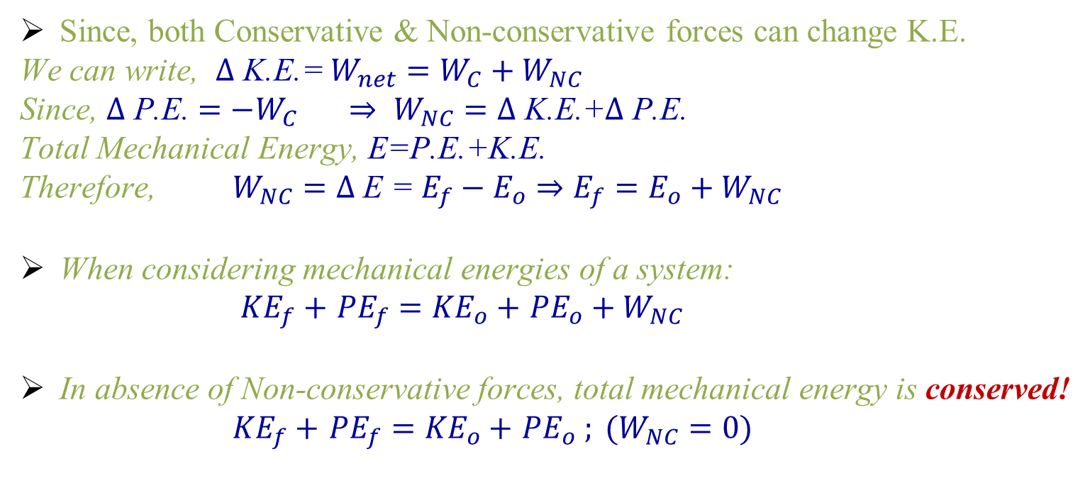
Conservation of Mechanical Energy
A Non-conservative force is one for which the work depends on the path taken. Friction, air-resistance, viscosity, tension… etc adds or removes energy from the system.
Since, both Conservative & Non-conservative forces can change K.E.
We can write, $Δ$ K.E.= $W_{net}=W_{C}+W_{NC}$
Since, $Δ$ P.E. $={−W}_{C} ⇒$ $W_{NC}=Δ \text{K}\text{.}\text{E}\text{.+}Δ \text{P}\text{.}\text{E}\text{.}$
Total Mechanical Energy, $\text{E}\text{=}\text{P}\text{.}\text{E}\text{.+}\text{K}\text{.}\text{E}\text{.}$
Therefore, $W_{NC}=$ $Δ$ E = $E_{f}−E_{o}⇒E_{f}=E_{o}+W_{NC}$
When considering mechanical energies of a system:
${KE}_{f}+$ ${PE}_{f}={KE}_{o}+$ ${PE}_{o}+W_{NC}$
In absence of Non-conservative forces, total mechanical energy is conserved!
${KE}_{f}+$ ${PE}_{f}={KE}_{o}+$ ${PE}_{o} ; (W_{NC}=0)$

Slide 8
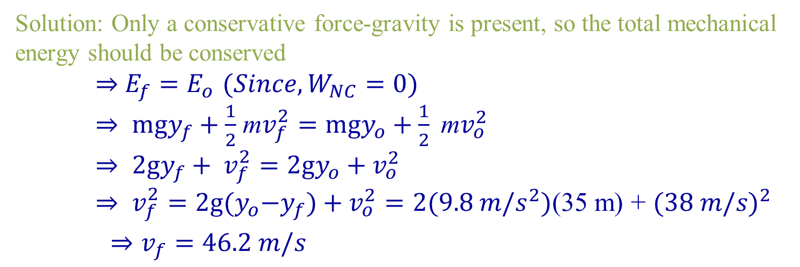
Conservation of Mechanical Energy
Example: A motorcyclist leaps across the canyon by driving horizontally off a cliff with 38.0 m/s. Ignoring air resistance, find the speed with which the cycle strikes the ground on the other side.
Solution: Only a conservative force-gravity is present, so the total mechanical energy should be conserved
$⇒$ $E_{f}=E_{o}$ $({Since, W}_{NC}=0)$
$⇒$ $mgy_{f}+\frac{1}{2}$ m$v_{f}^{2}=mgy_{o}+\frac{1}{2} \text{m}v_{o}^{2}$
$⇒$ $2gy_{f}+ v_{f}^{2}=2gy_{o}+v_{o}^{2}$
$⇒ v_{f}^{2}=2g{(y}_{o}−y_{f})+v_{o}^{2}=2(9.8 m/s^{2})$(35 m) + ${(38 m/s)}^{2}$
${ ⇒v}_{f}=46.2 m/s$

Slide 9
Machines - devices to multiply forces
(Force x Distance)input = (Force x Distance)output
Work Input = Work Output
Levers:
Energy is conserved: A machine can multiply force but cannot increase energy!
Output F x D
Input F x D
Output F x d
Input F x D
Equal distance means equal force
Smaller distance means bigger force

Slide 10
POWER
Power is the RATE at which energy is changed from one form to another.
Power tells you how quickly work gets done.
1000 W = 1 kW
1000 kW = 1 MW
746 W = 1 Mechanical Horsepower

Slide 11
Efficiency
Efficiency is how much work gets done for the amount of energy used. Machines that do more work given the same energy input are more efficient.
80% efficient
100% efficient systems are not practical

Slide 12

Efficiency
Example:100 J of energy input for a machine, 98 J of work done.
Where did the other 2J or energy go?
The lower the efficiency, the more energy is “wasted” as heat.
The “graveyard” (or final form of energy) is “heat”.

Slide 13
Energy Sources
Sun - the most powerful energy source
All natural power sources we have today originated from sun
e.g. wind, hydro, thermal etc.
Solar power – sunlight is directly transformed into electricity
Wind power - turn into electricity using wind turbines
Hydro power – water is used to turn turbines and
produce electricity
Nuclear power – stored energy in plutonium and uranium
can be used to produce electricity
Energy is needed for all living things

