Slide 1
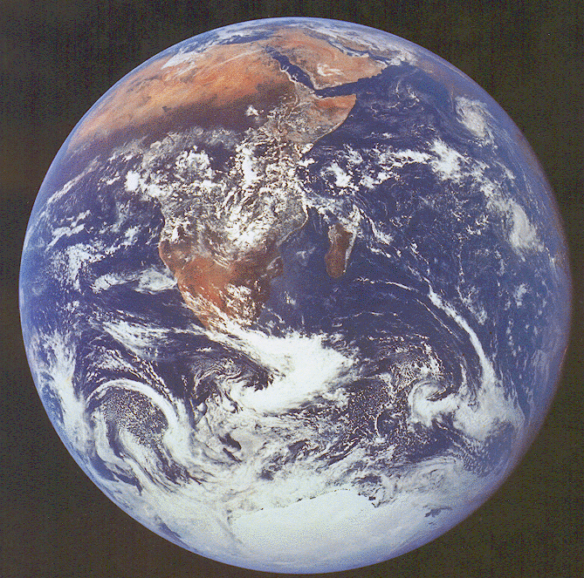

Slide 2
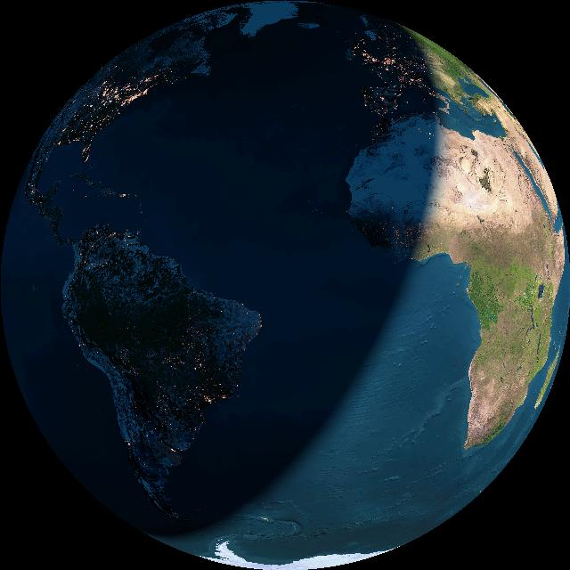
Dec 21

Slide 3
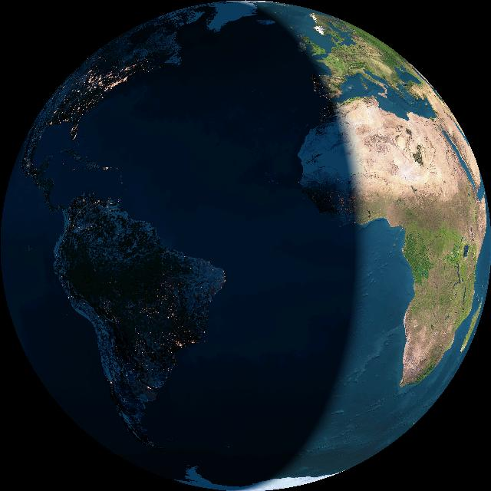
Mar 21

Slide 4
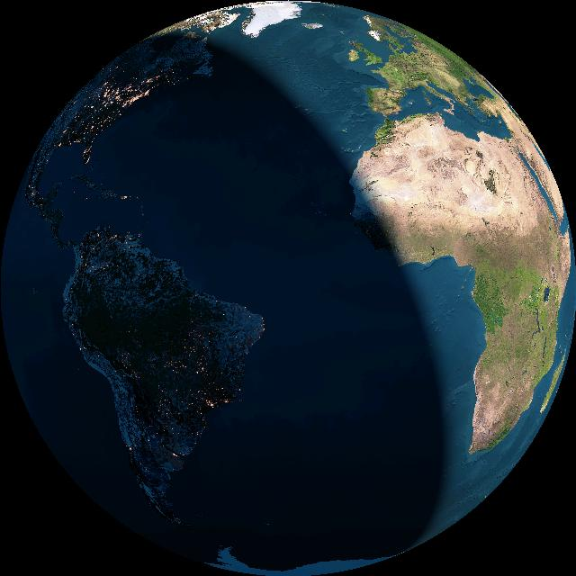
Jun 21

Slide 5
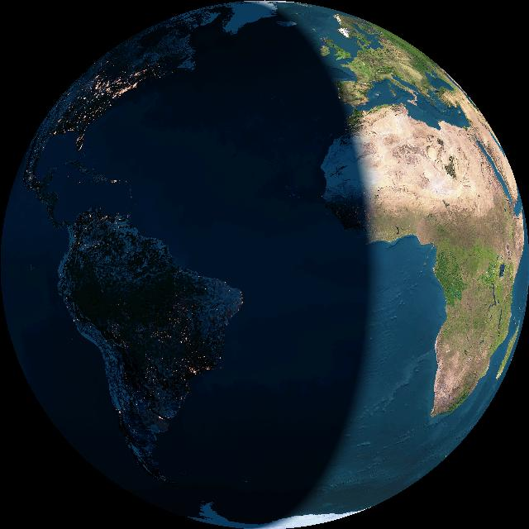
Sep 21

Slide 6
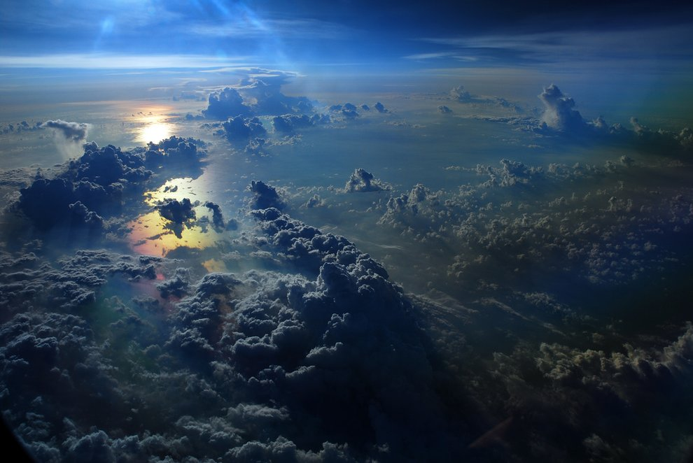

Slide 7
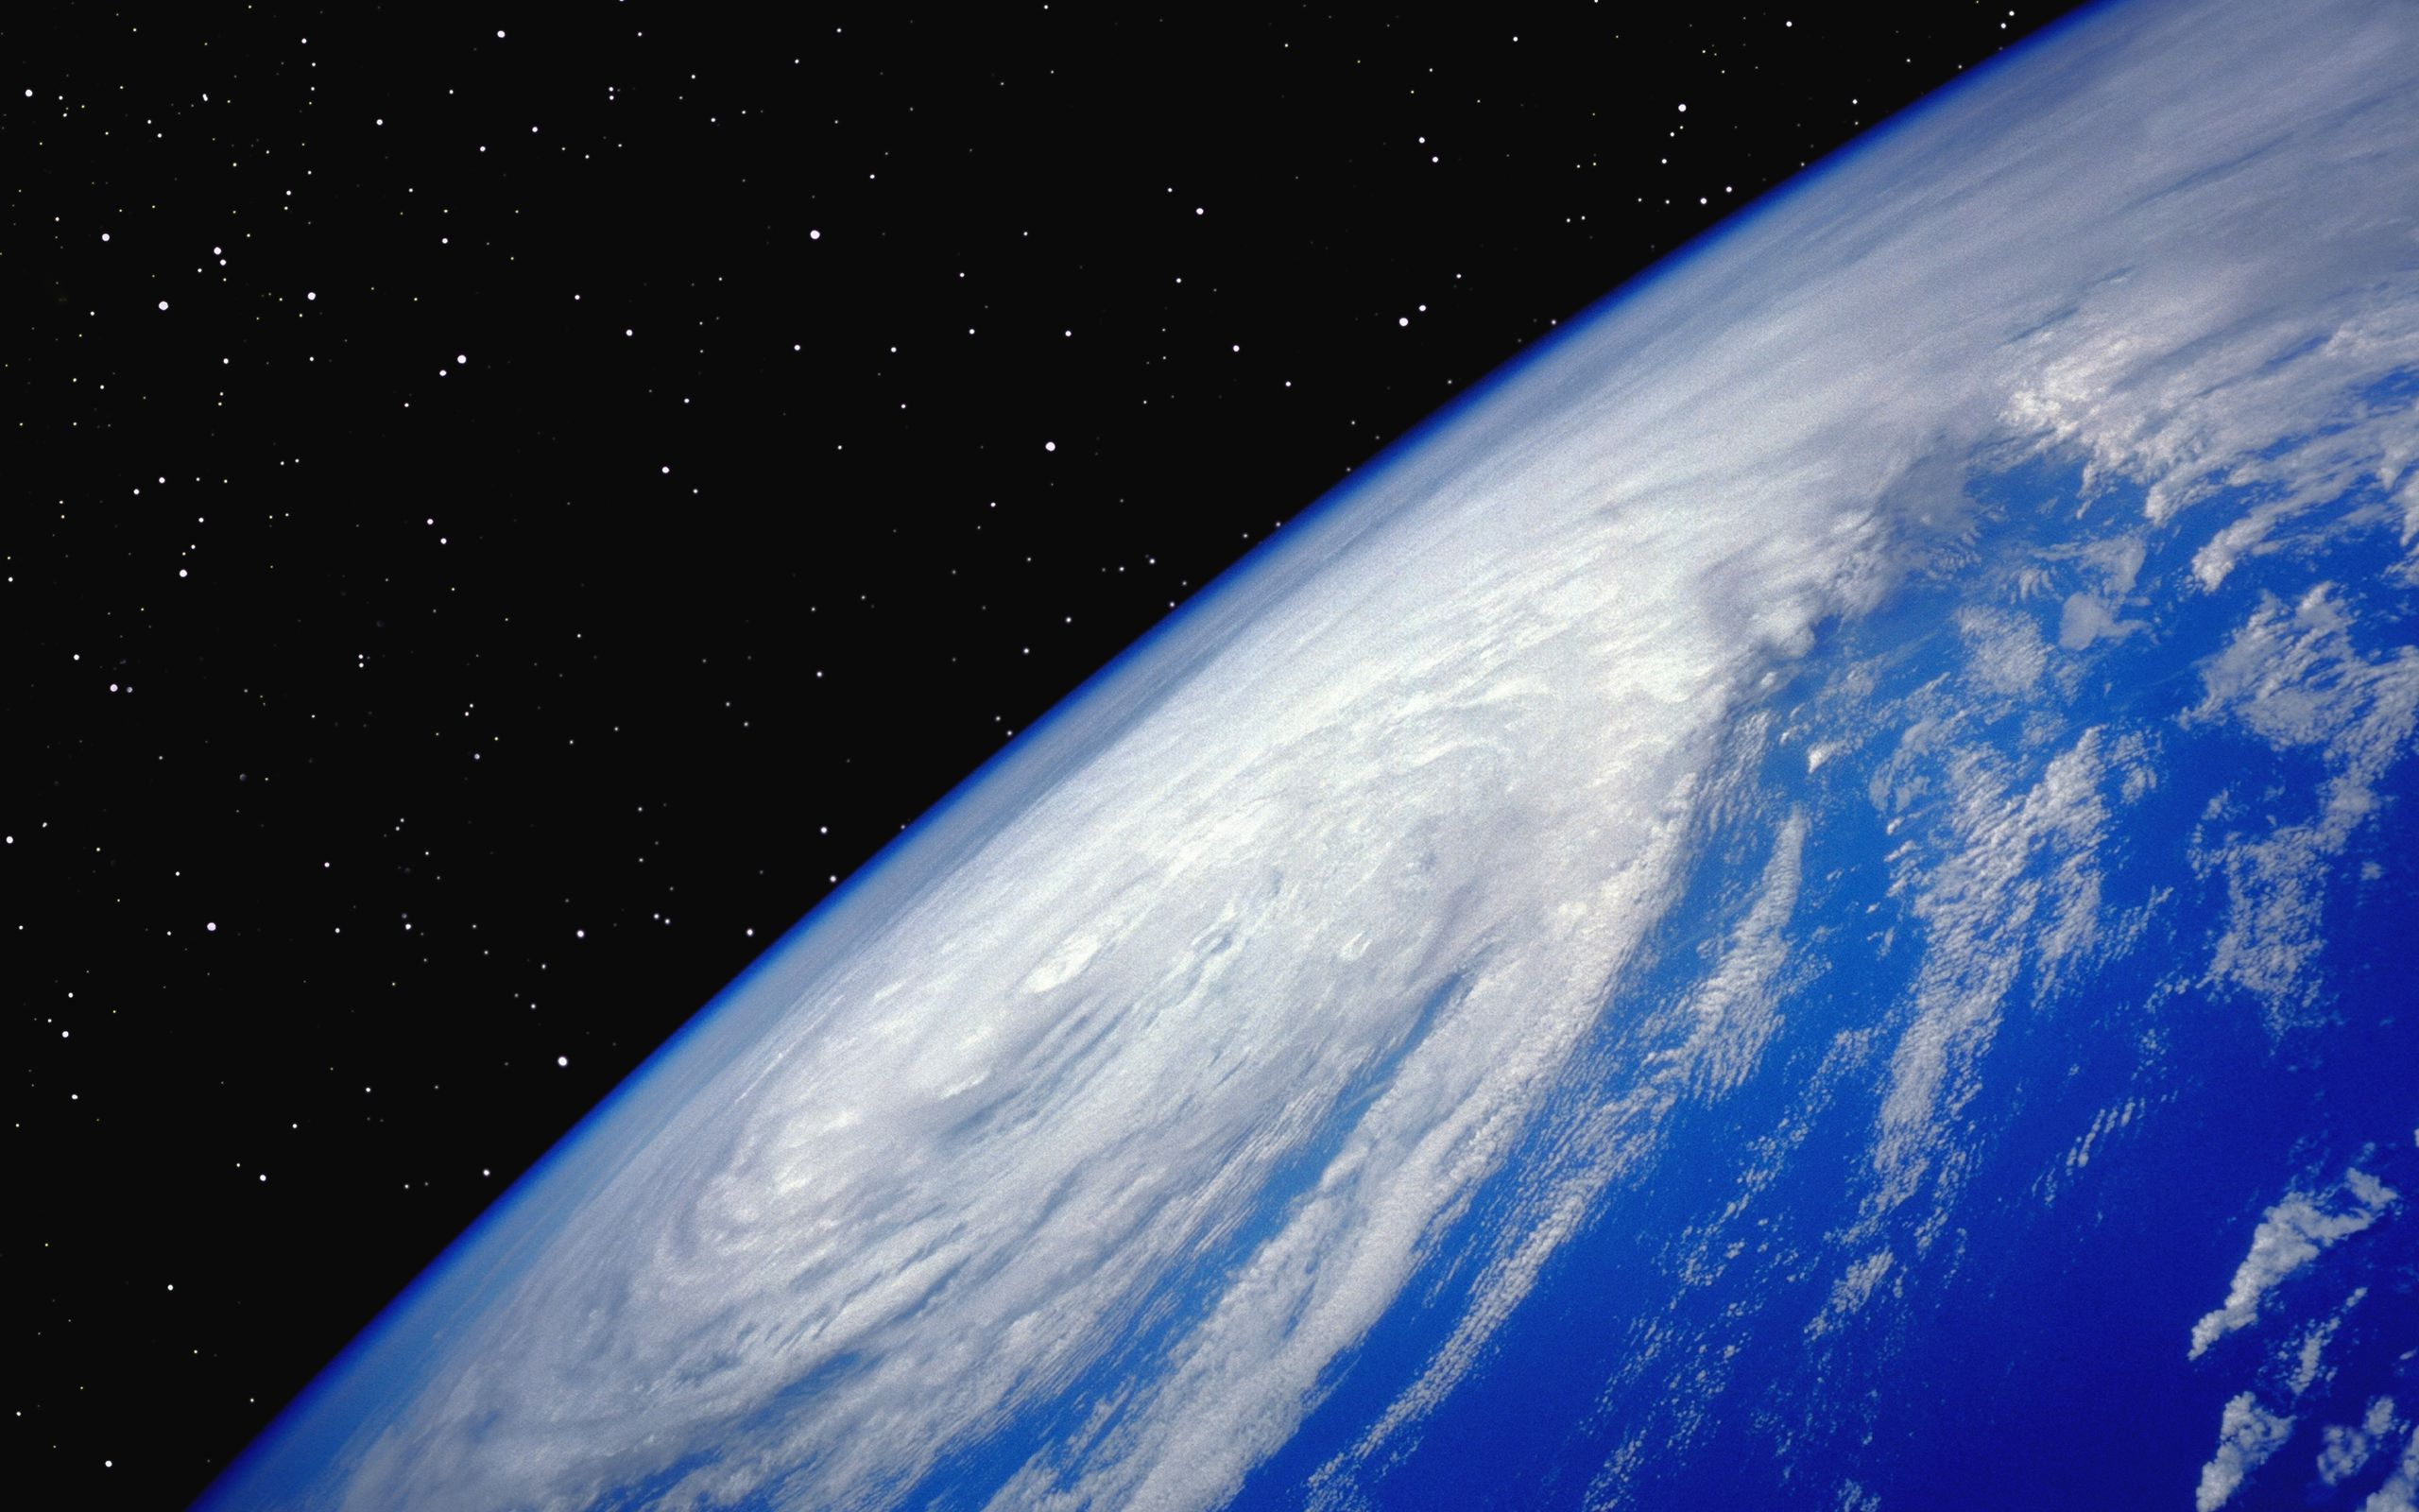

Slide 8
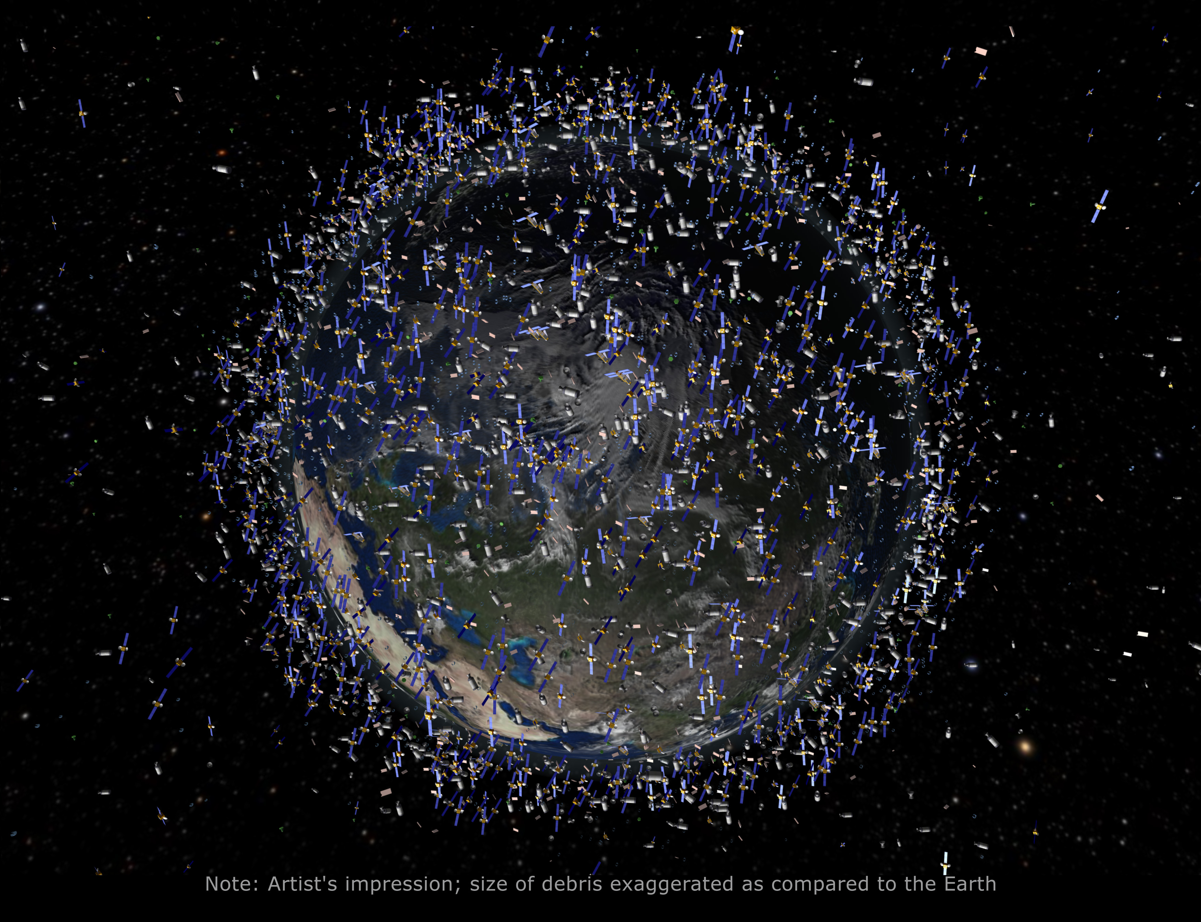

Slide 9
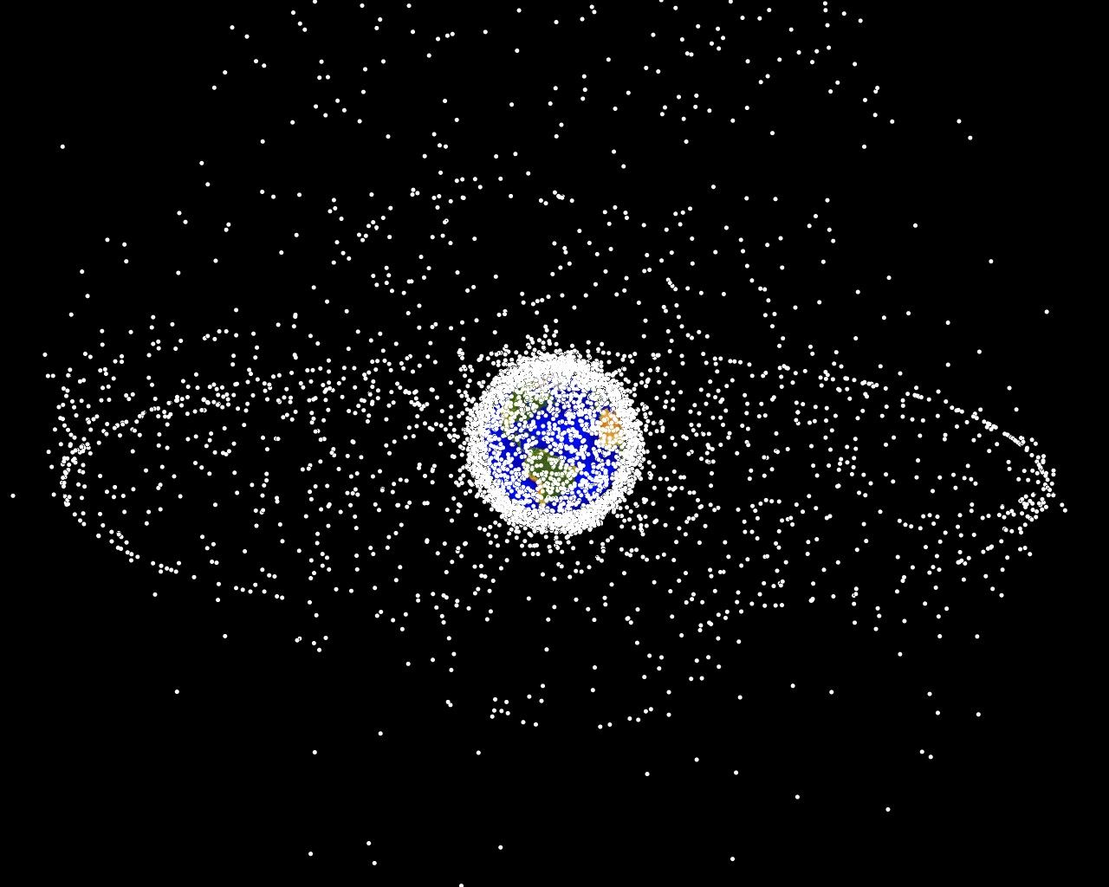

Slide 10
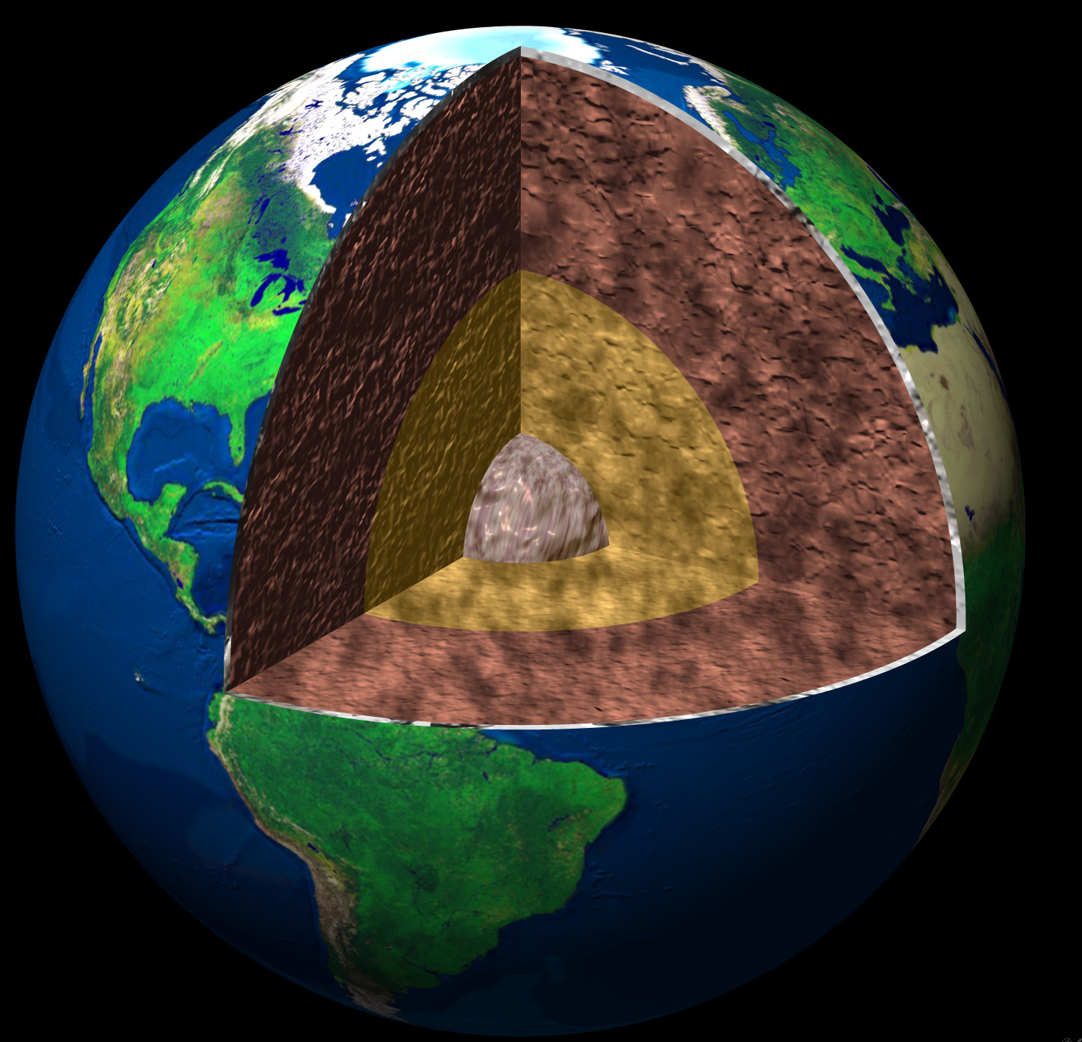

Slide 11
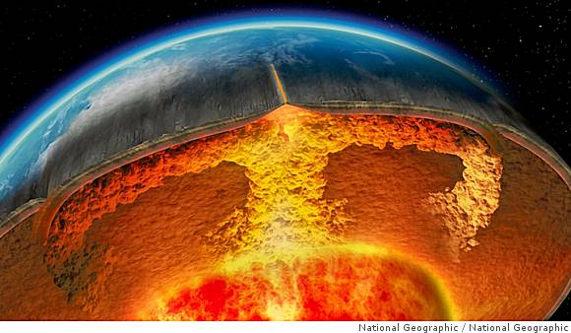

Slide 12
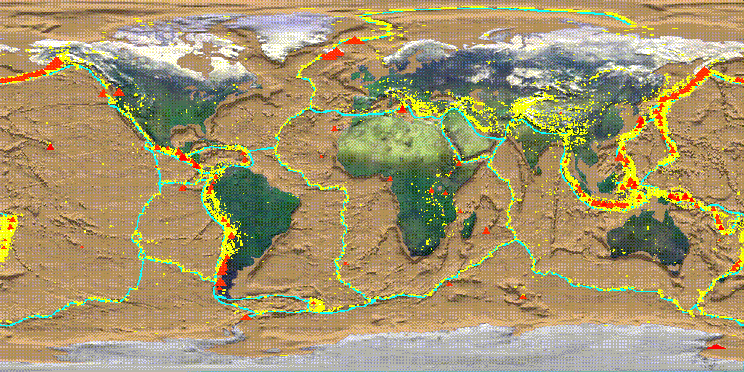

Slide 13
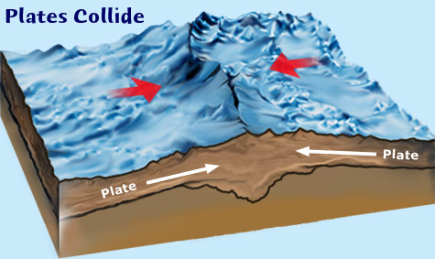

Slide 14
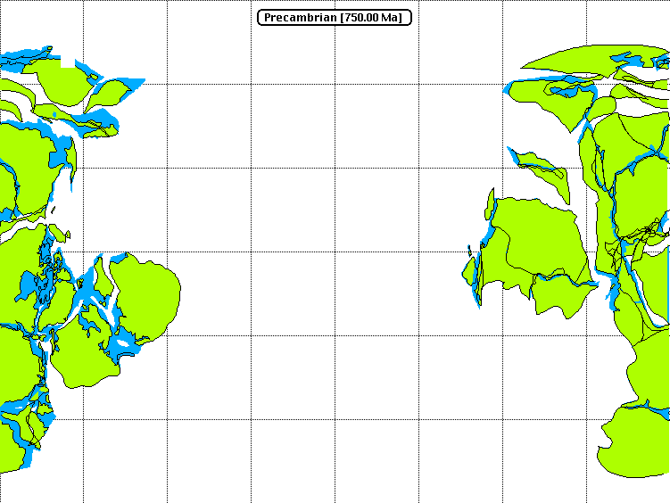

Slide 15
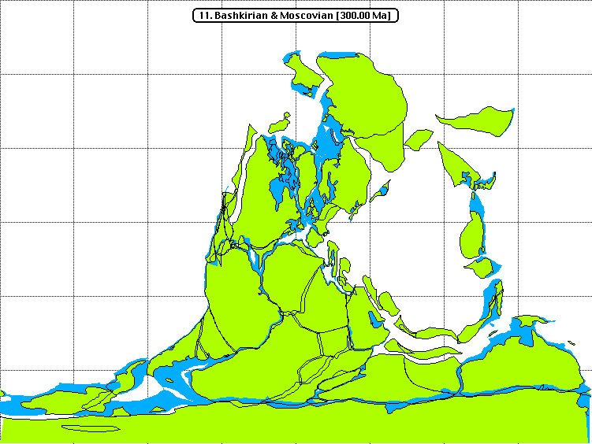

Slide 16
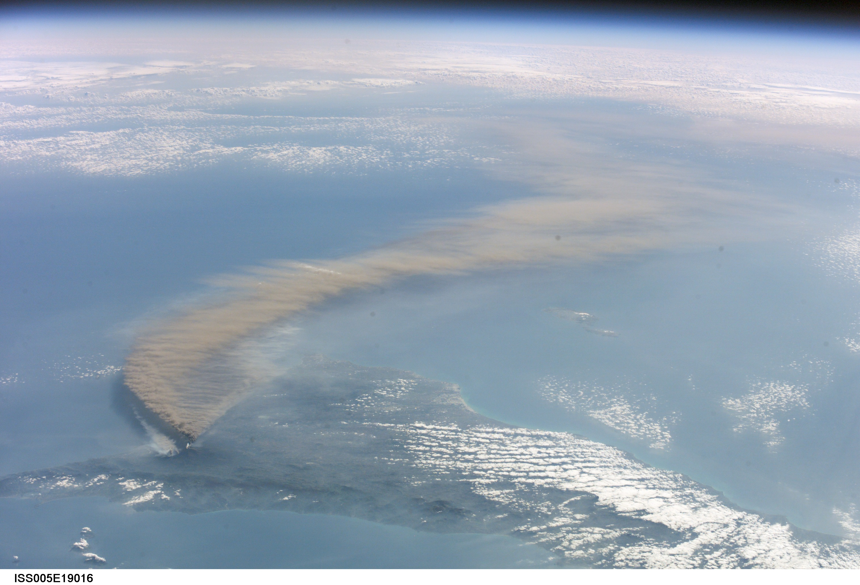
Mt Etna explodes

Slide 17
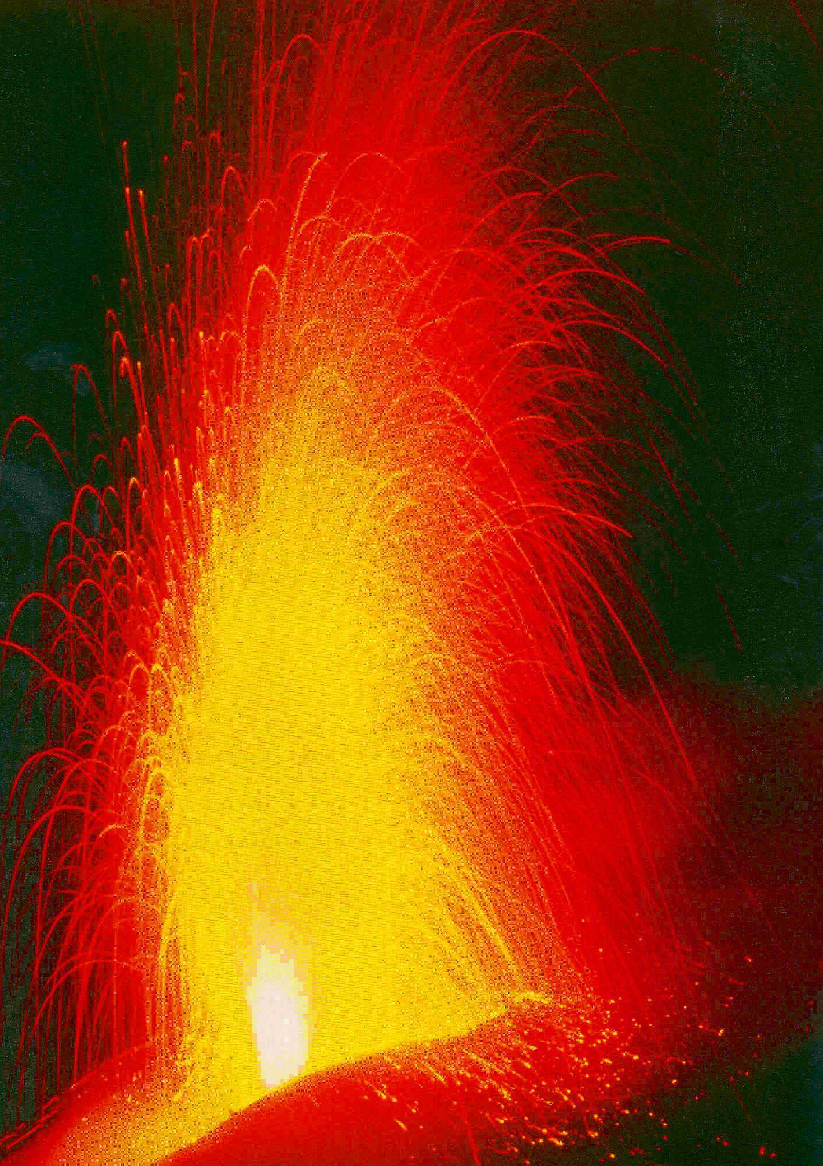

Slide 18
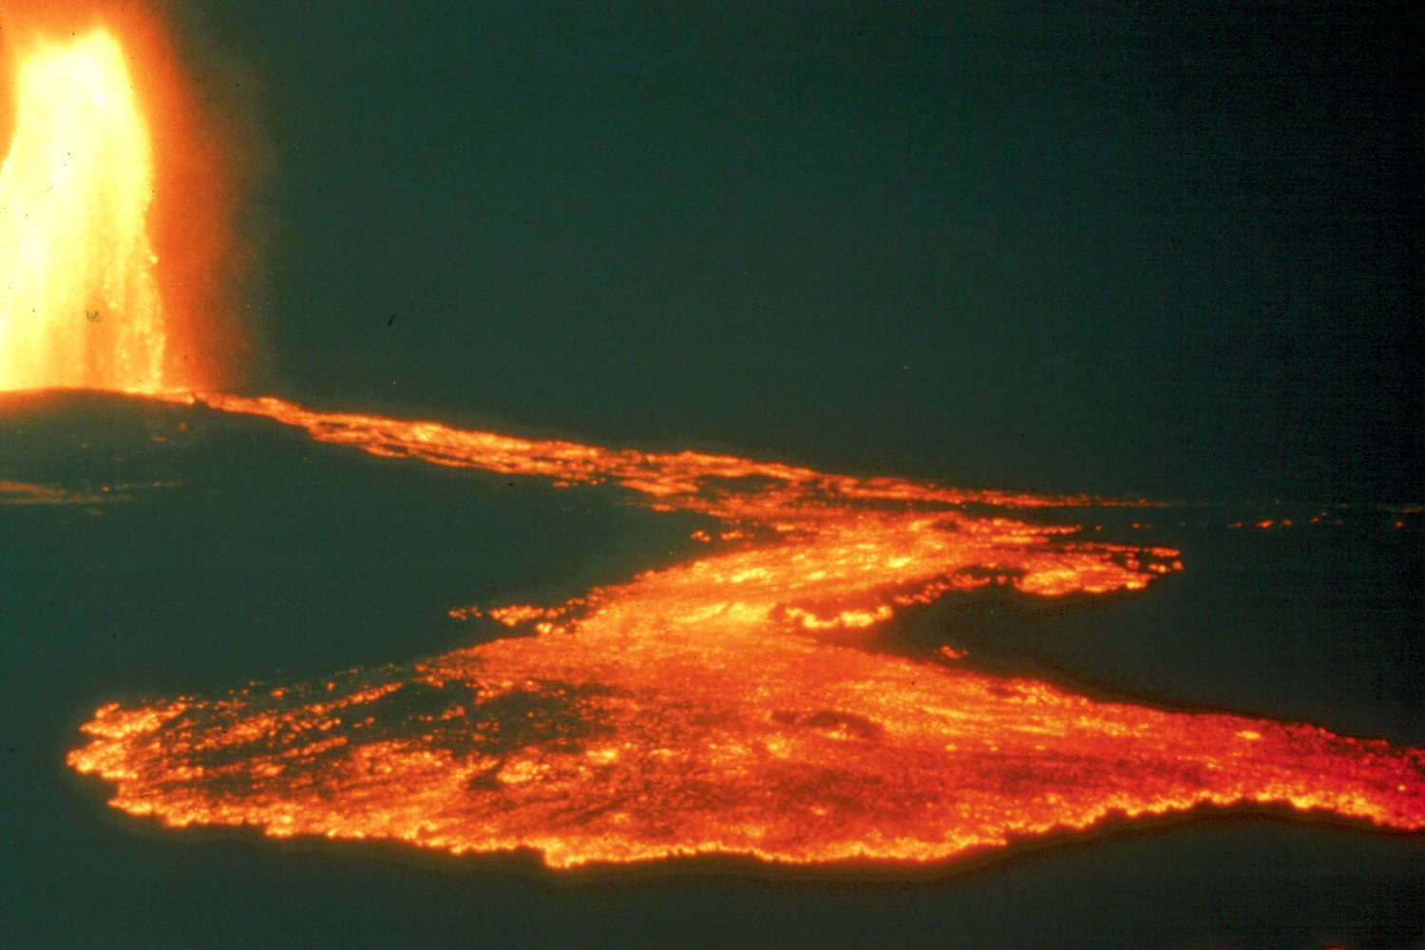

Slide 19
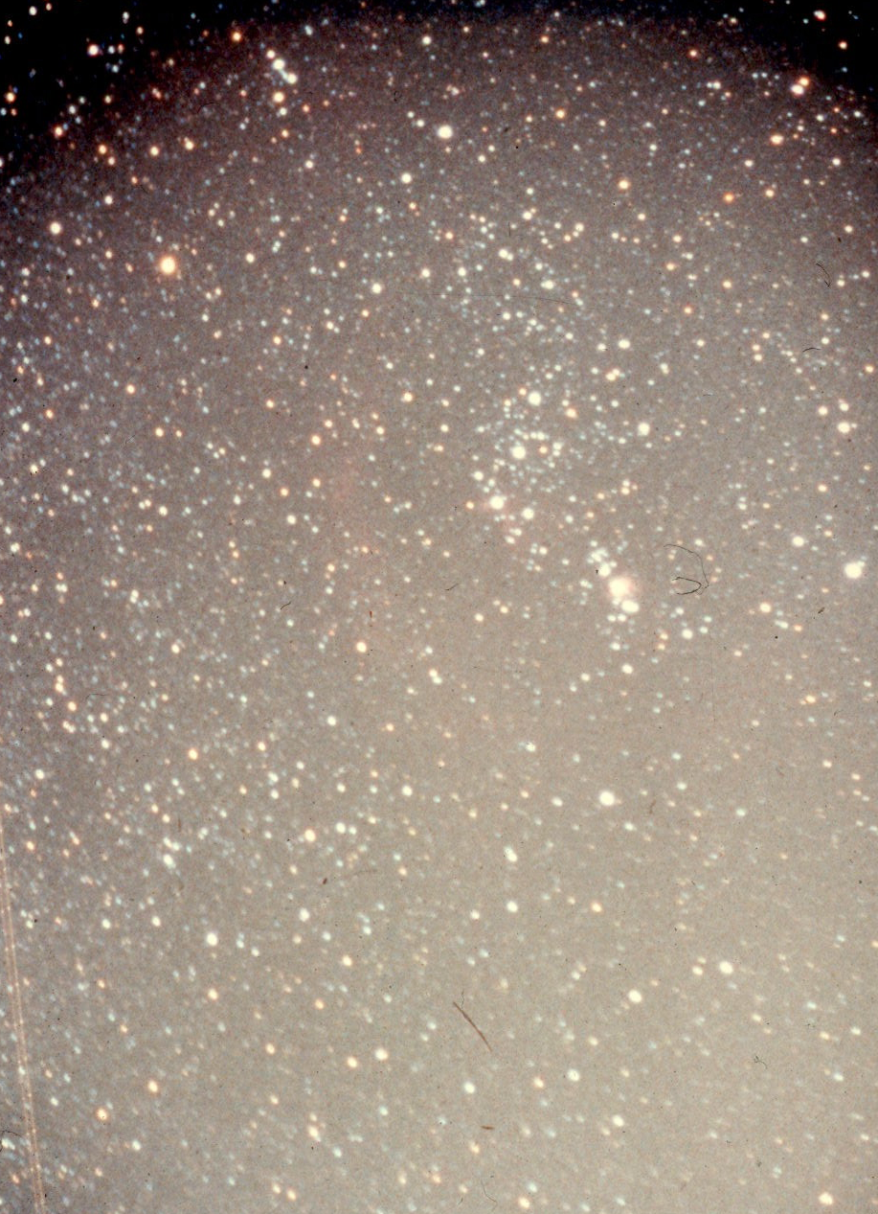
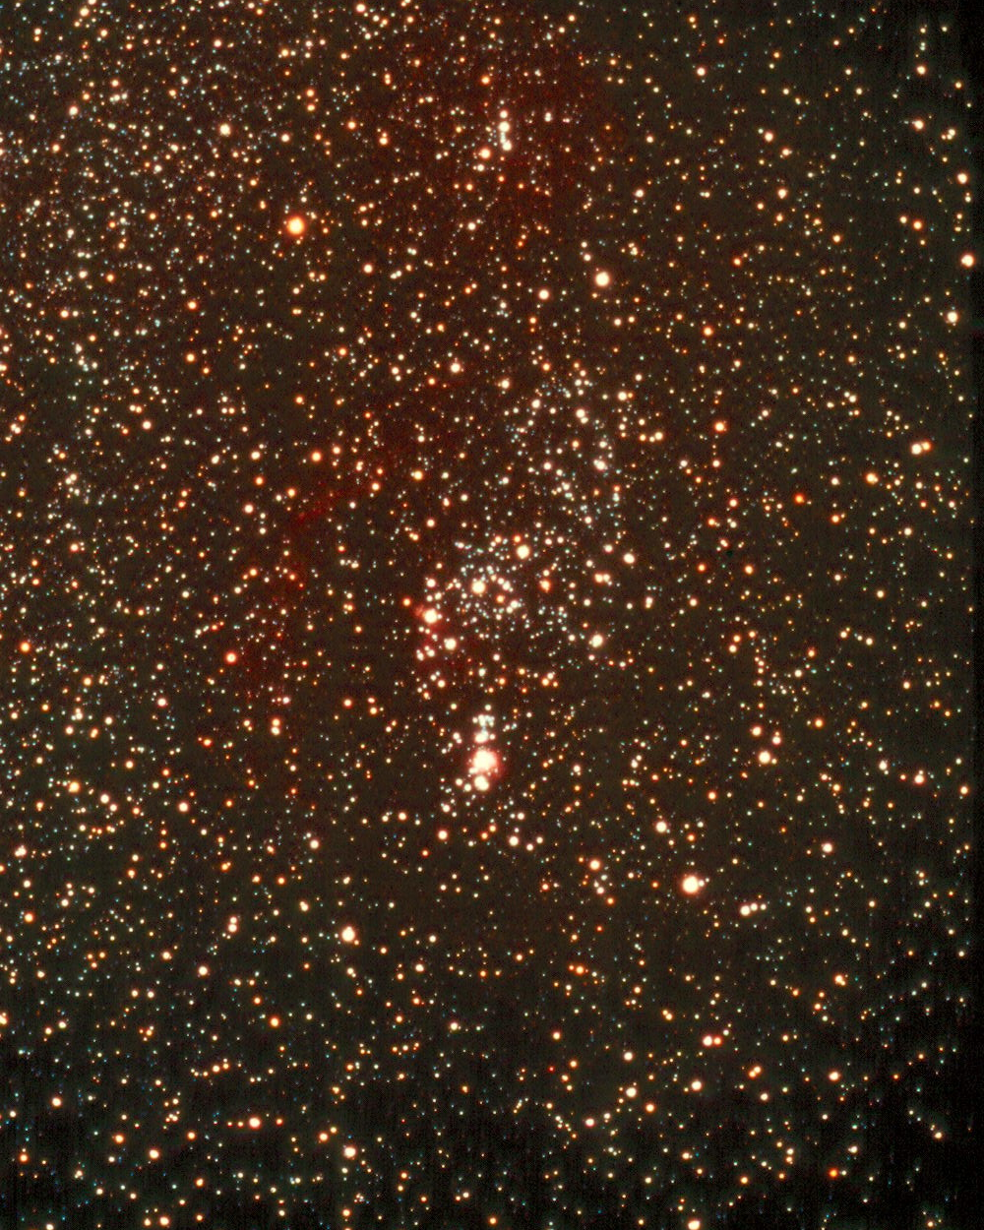

Slide 20
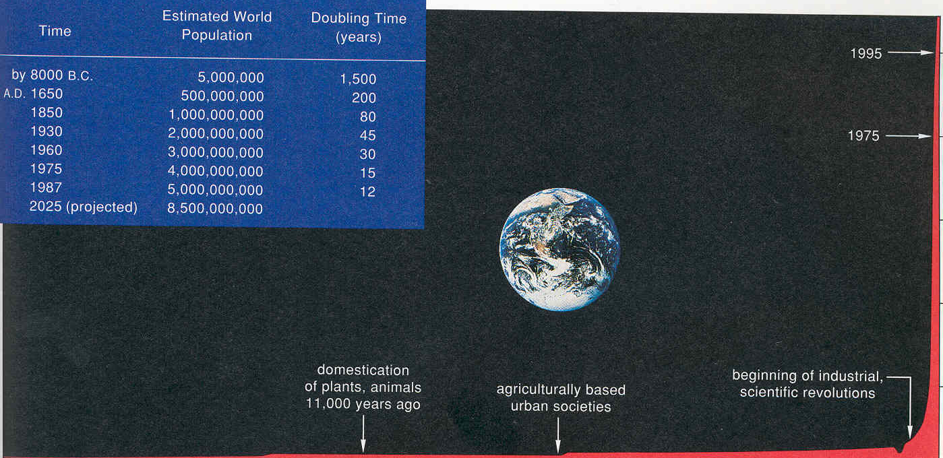
5.7
4
3
2
1
Billions of People
14,000 12,000 10,000 8,000 6,000 4,000 2,000 BC AD 2000
year
Black Death

Slide 21
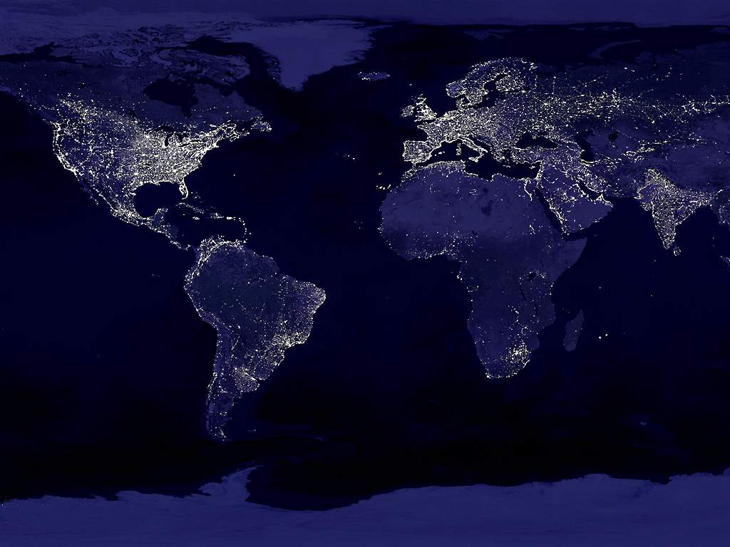

Slide 22
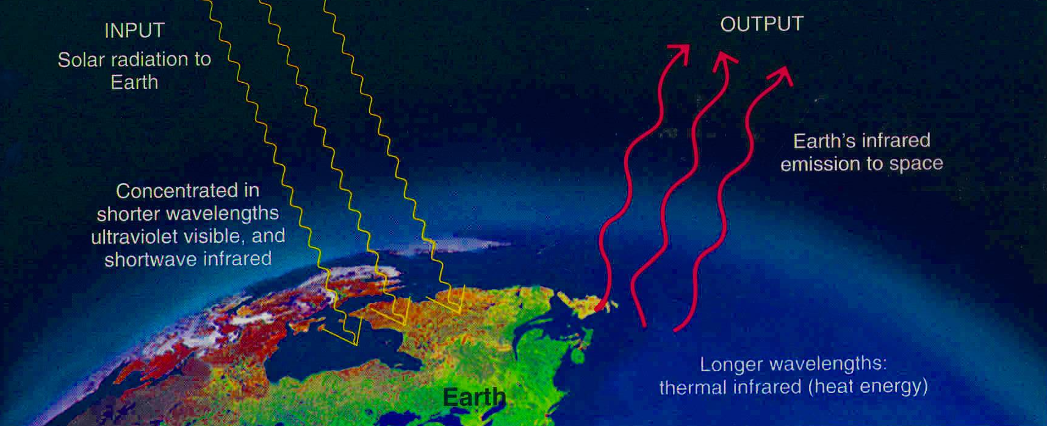

Slide 23
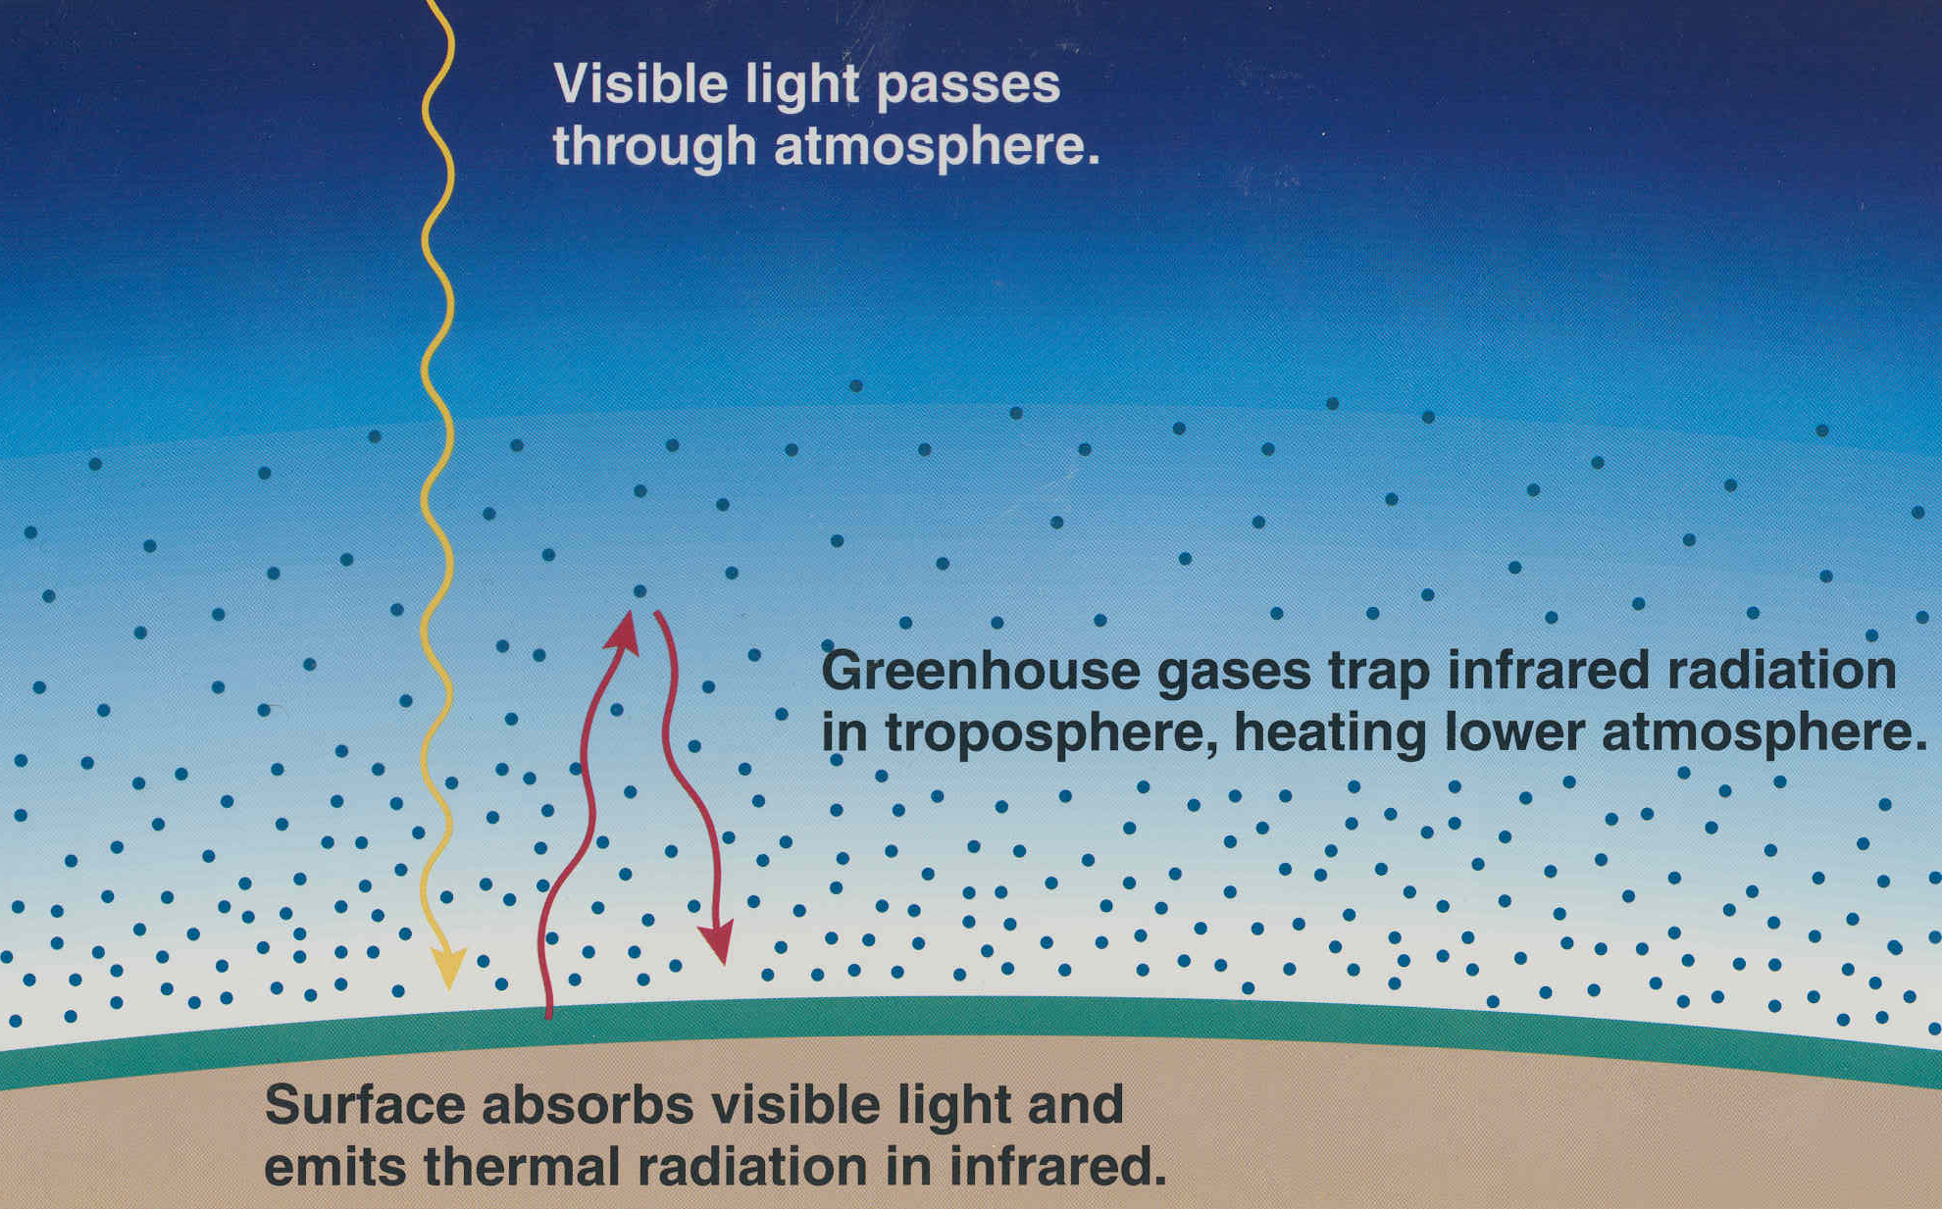
Surface absorbs visible light and emits infrared light.

Slide 24
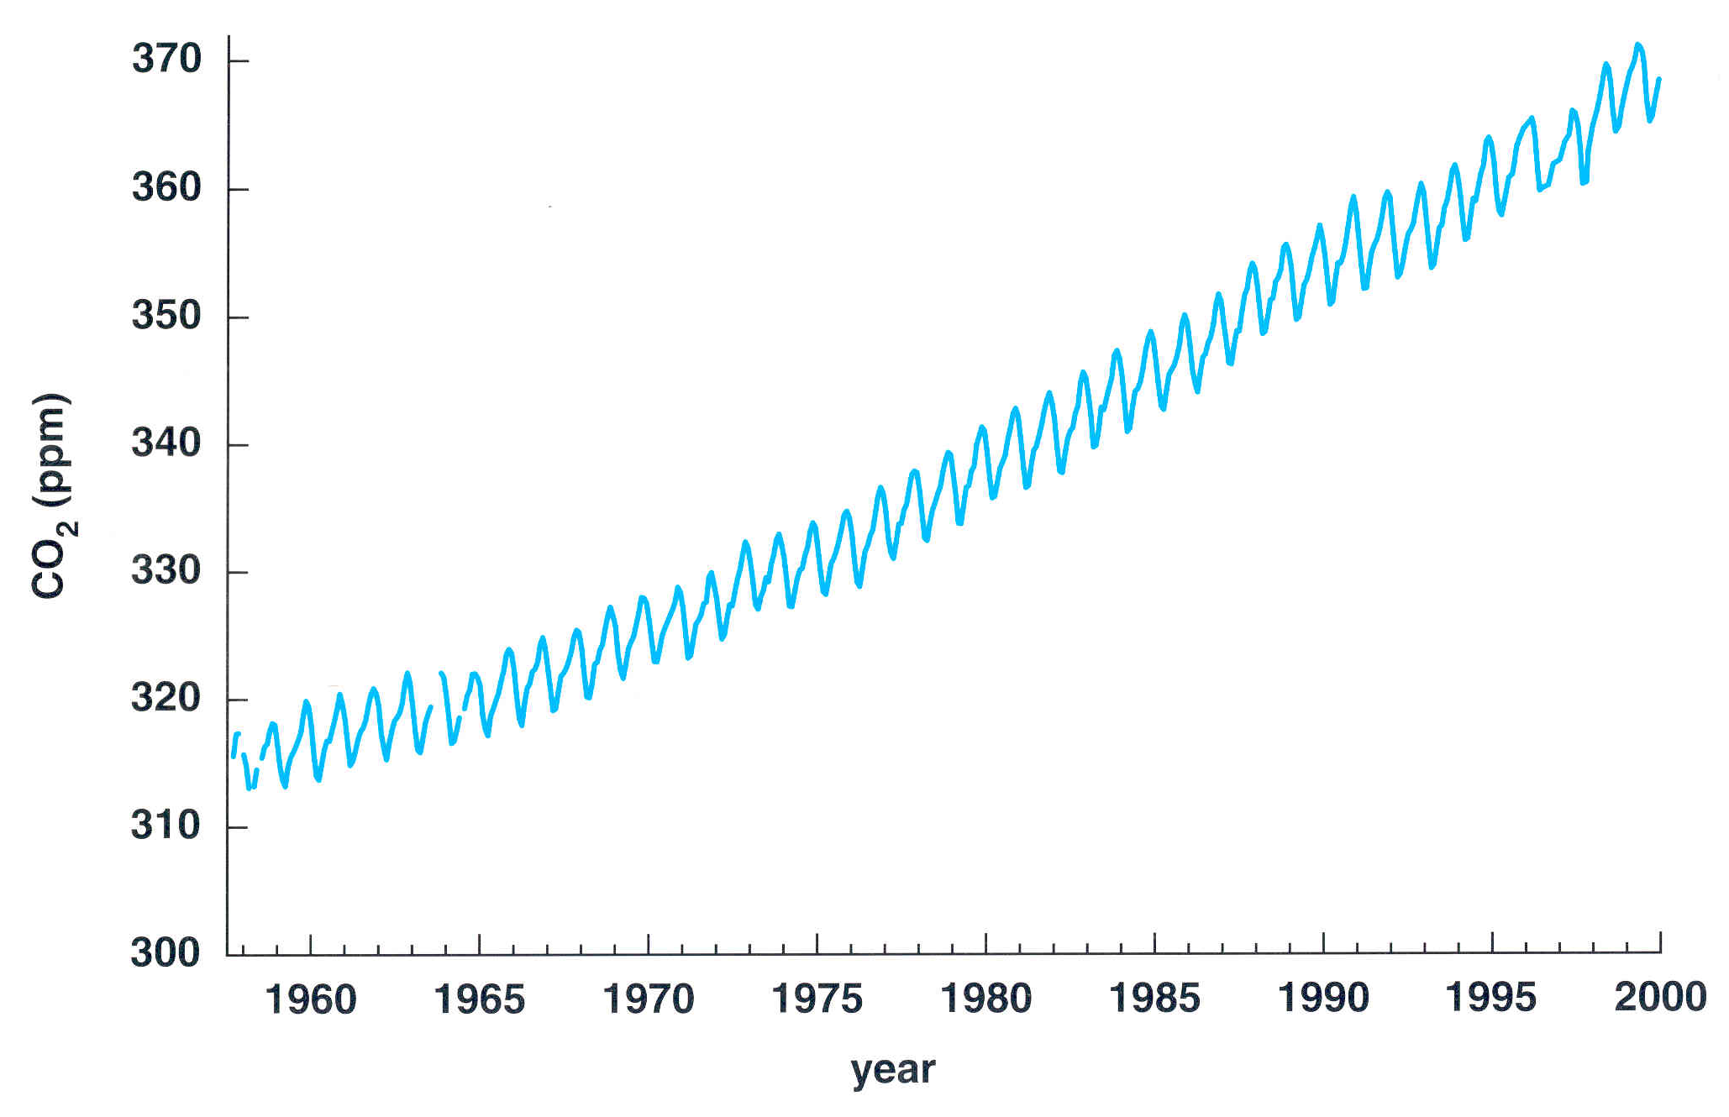
CO₂
CO₂ (ppm)

Slide 25
CO₂
60 (ppm) increase
CO₂ (ppm)

Slide 26
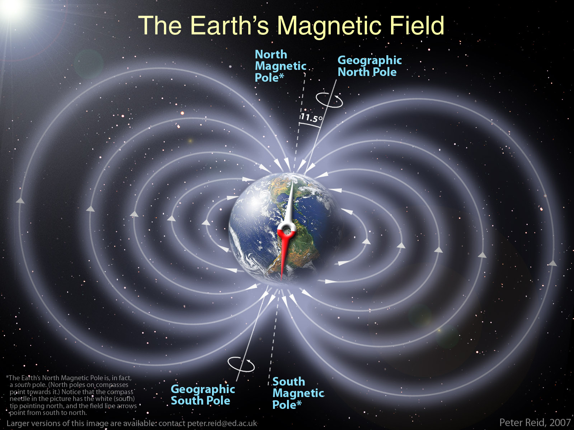

Slide 27
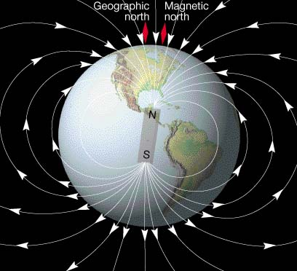

Slide 28
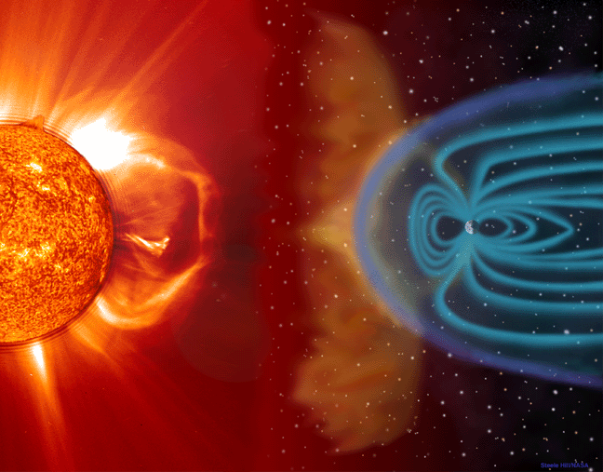

Slide 29
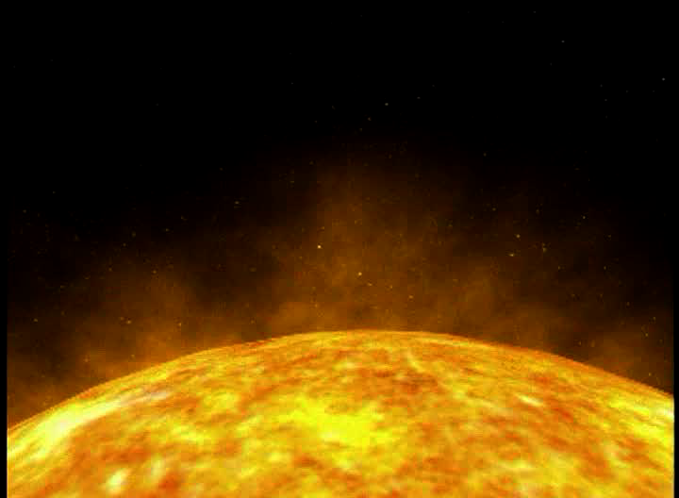
Notes:
recon.mpg

Slide 30
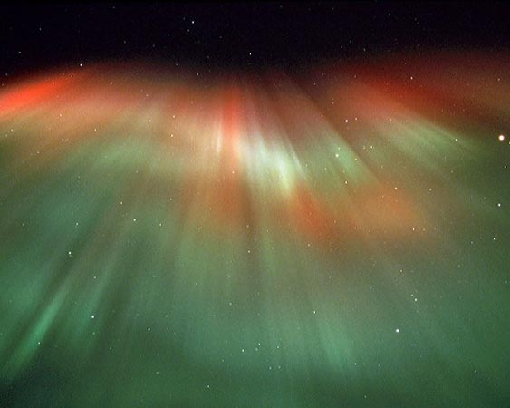

Slide 31
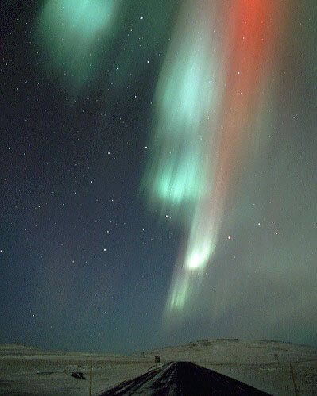

Slide 32
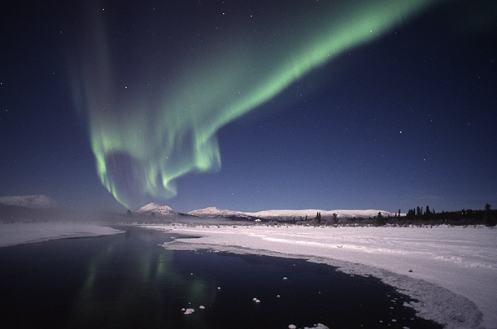

Slide 33
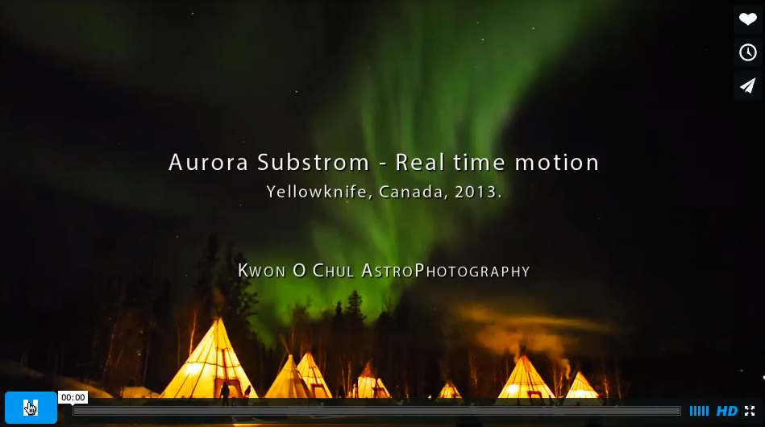

Slide 34
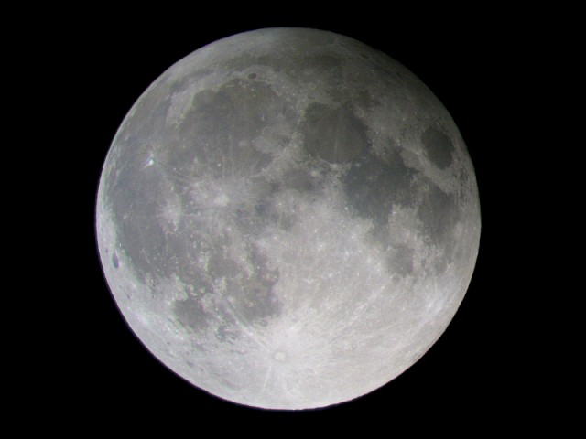
Earth's view of the Moon — only one side

Slide 35
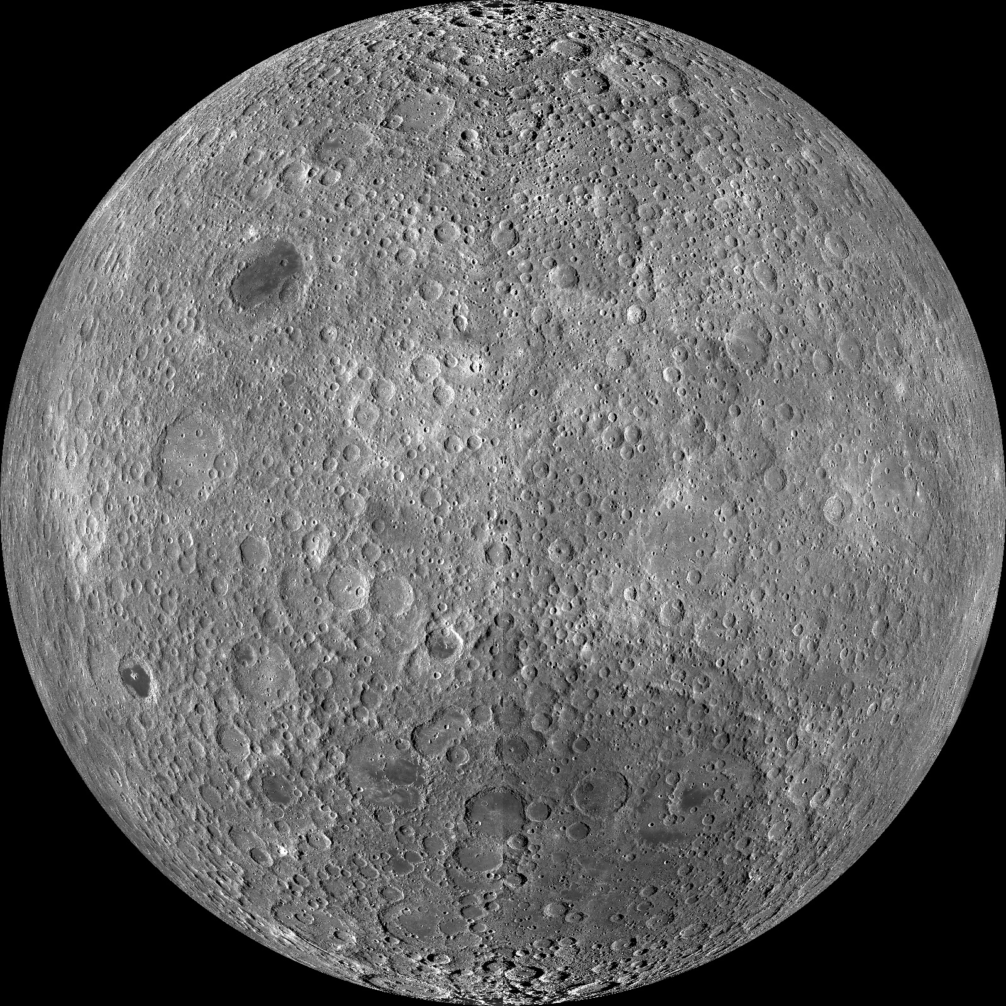
Farside of the Moon —not seen from Earth

Slide 36
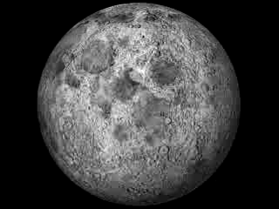
Moon

Slide 37
thick
thin
Earth Moon in tidal lock

Slide 38
thick
thin
Earth Moon in tidal lock

Slide 39
thick
thin
Earth Moon in tidal lock

Slide 40
thick
thin
Maria
Earth Moon in tidal lock

Slide 41
thick
thin
Maria
Earth view from Earth

Slide 42
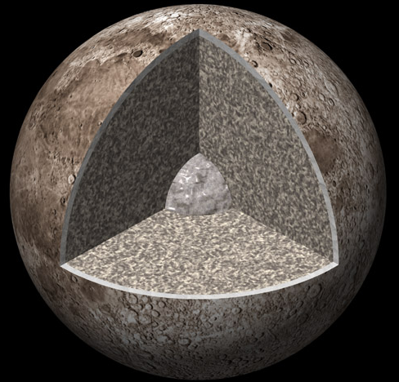

Slide 43
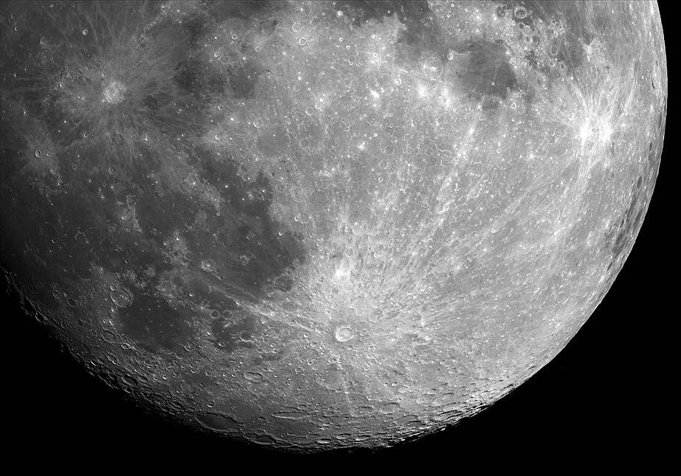

Slide 44
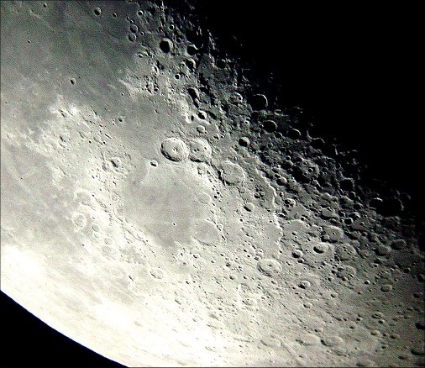

Slide 45
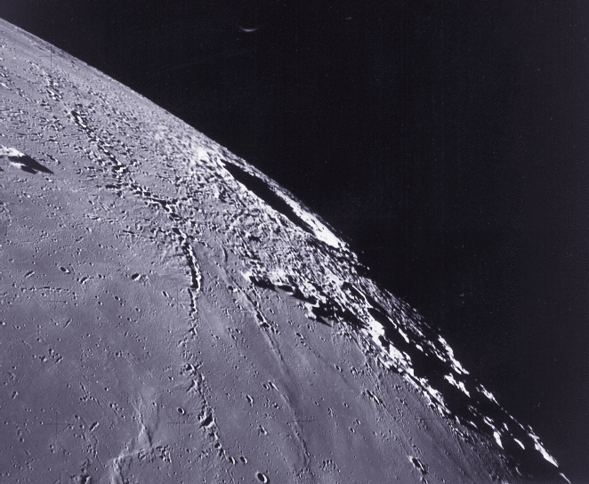
Copernicus Crater
75 mi wide
Notes:
copernicus

Slide 46
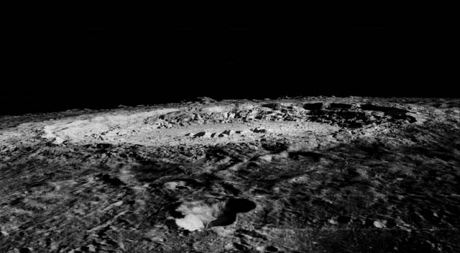
Copernicus Crater

Slide 47
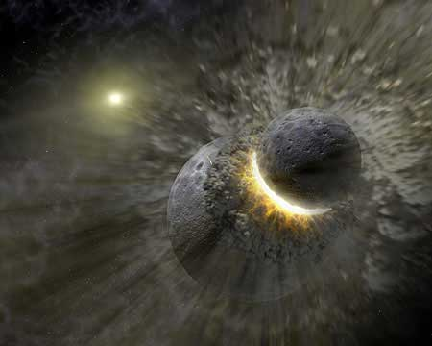
Abour 1 billion years after the solar system started to form

Slide 48
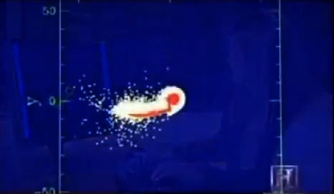
Earth's surface melted from the collision and Moon formed

Slide 49
Moon's formation:
➔ caused strong tides on Earth
➔ stabilized Earth's rotational tilt

Slide 50
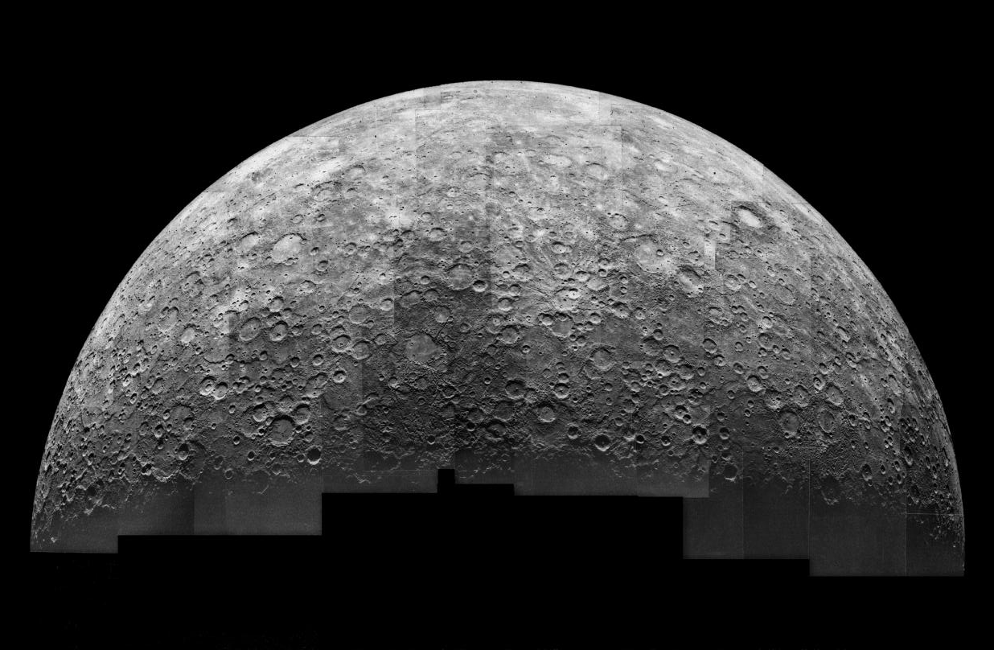
Mercury

Slide 51
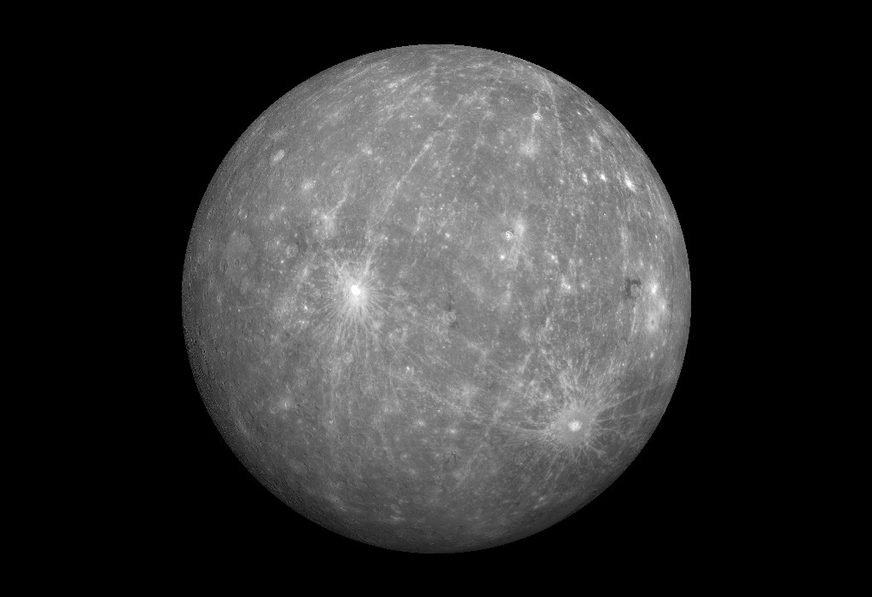

Slide 52
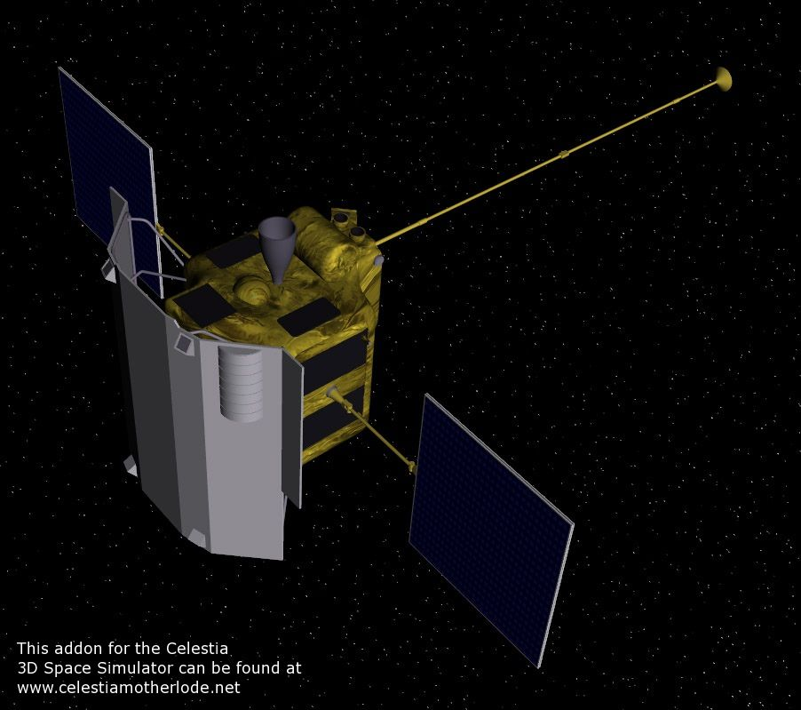
Messenger spacecraft

Slide 53
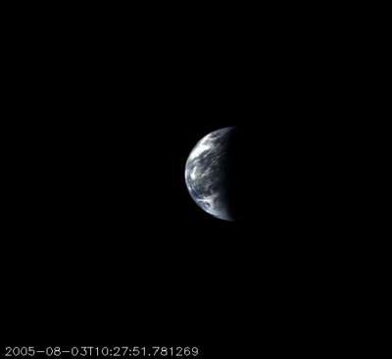

Slide 54
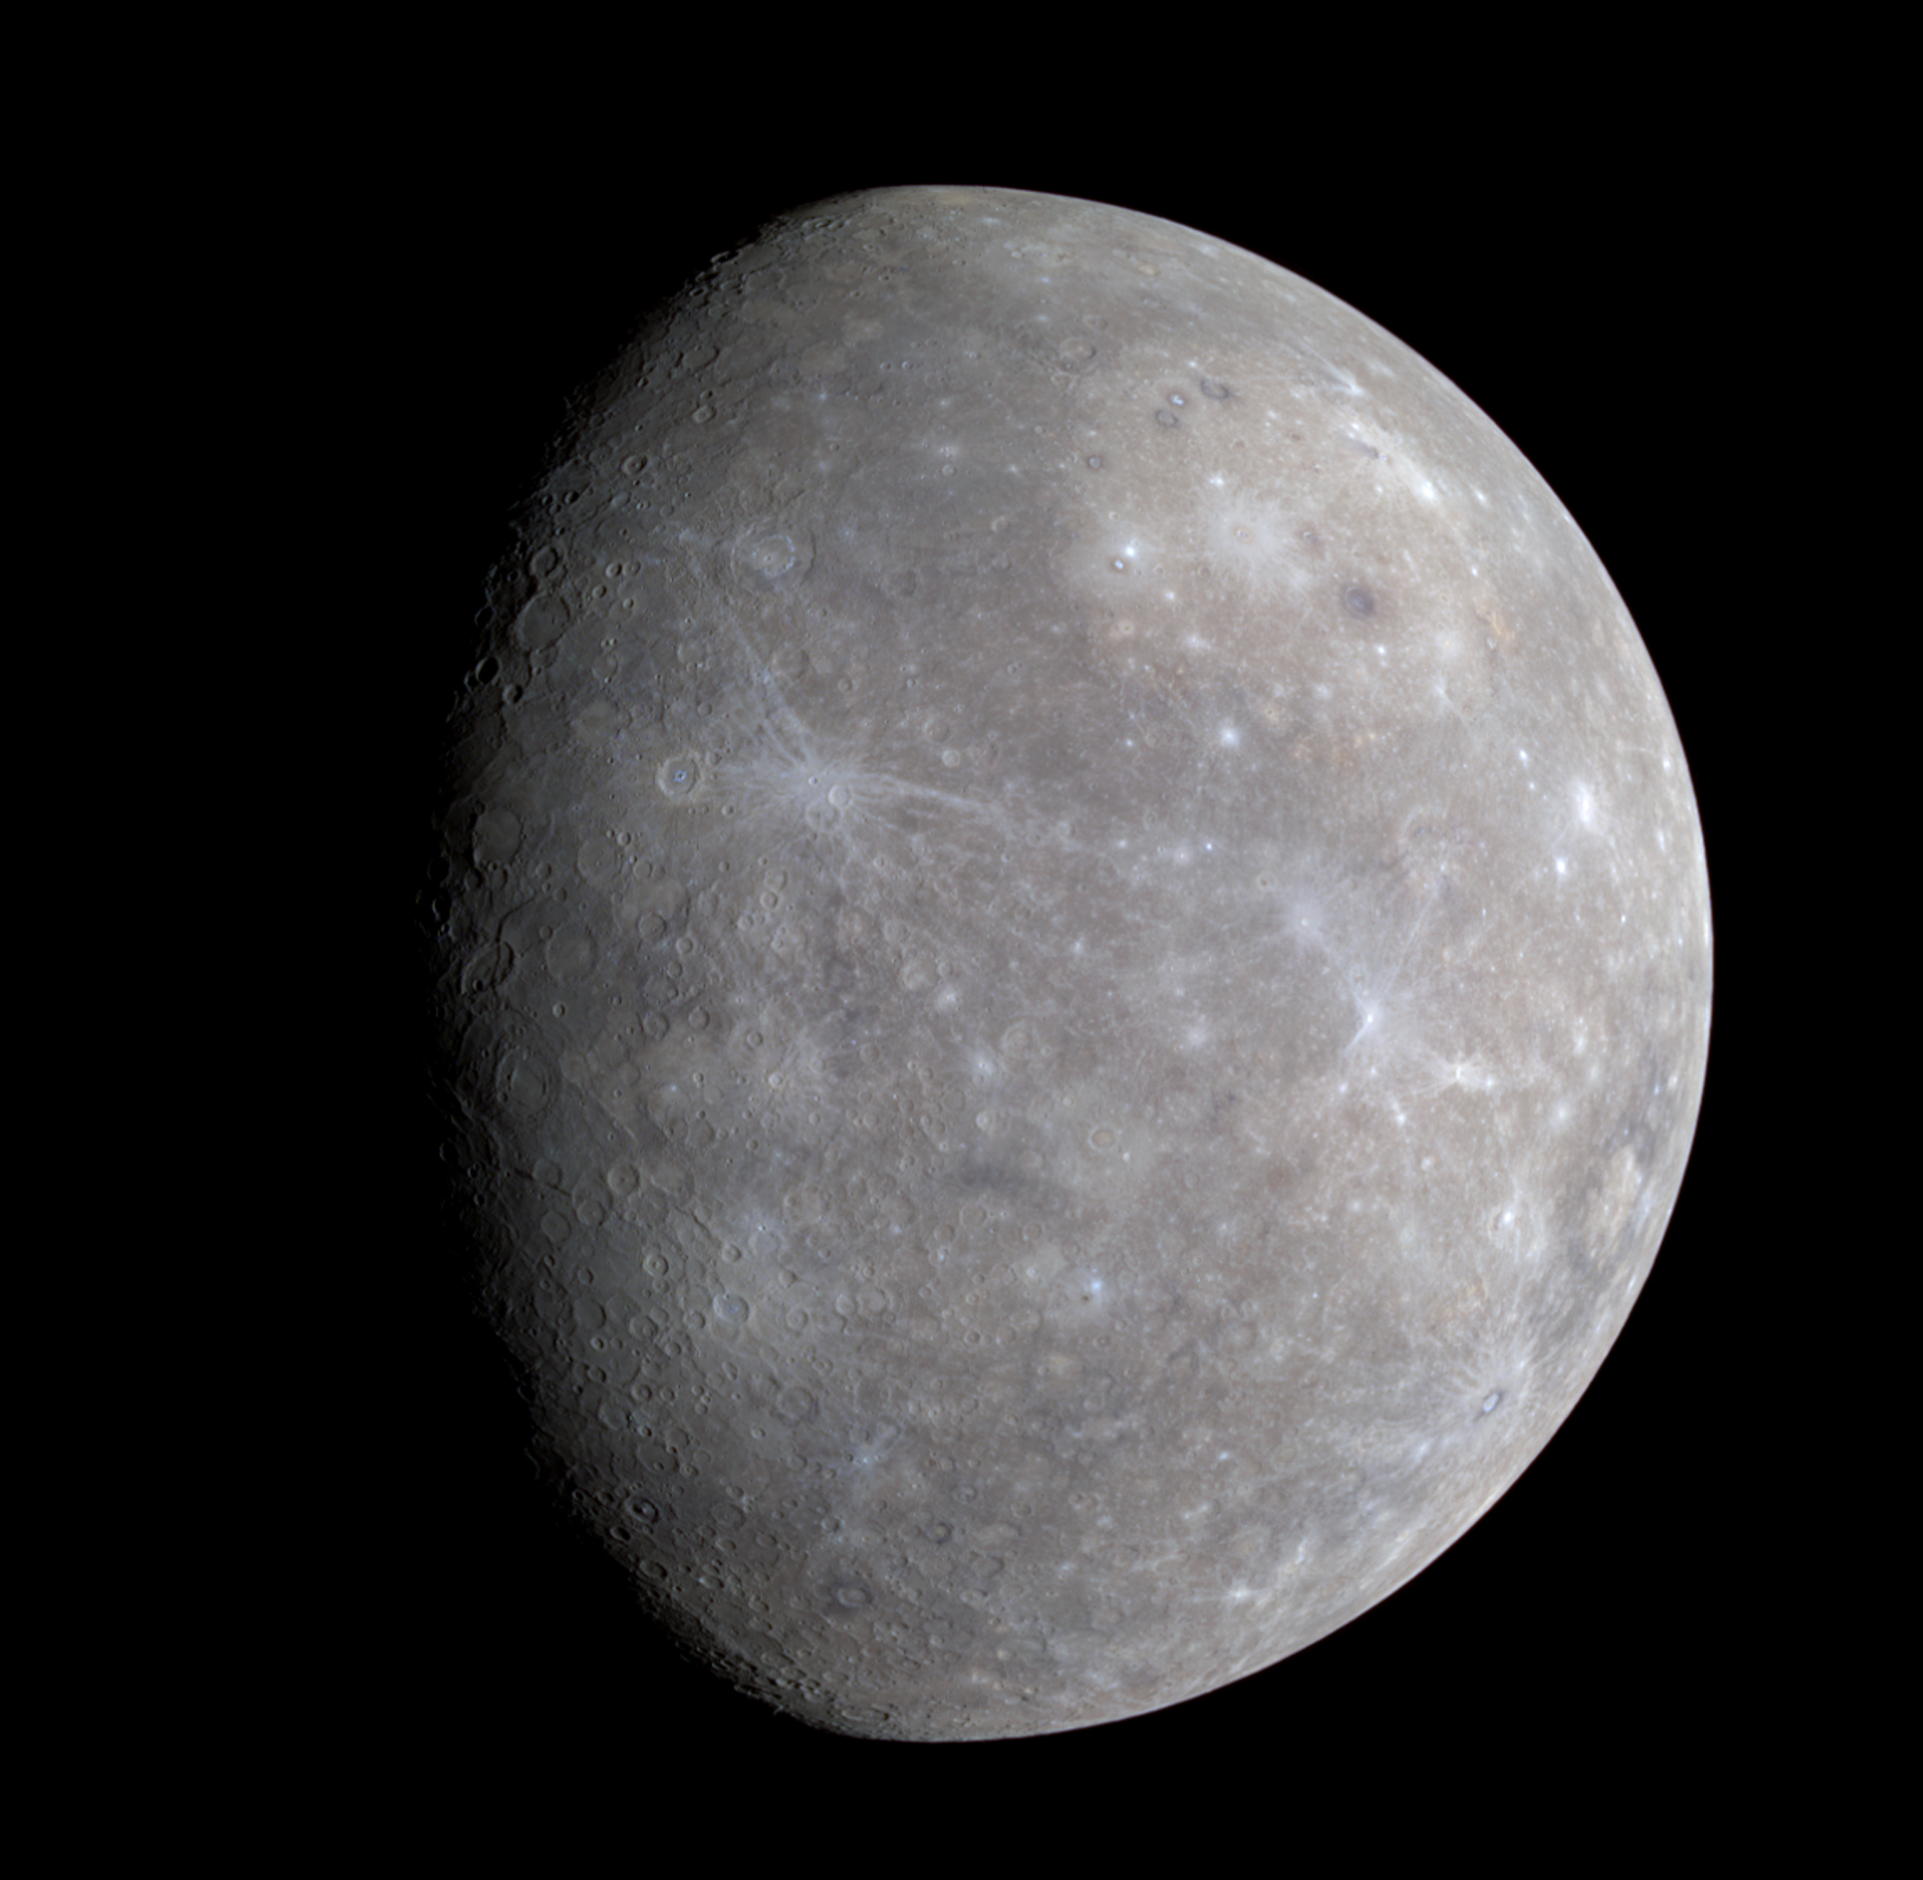
Notes:
messenger in color

Slide 55
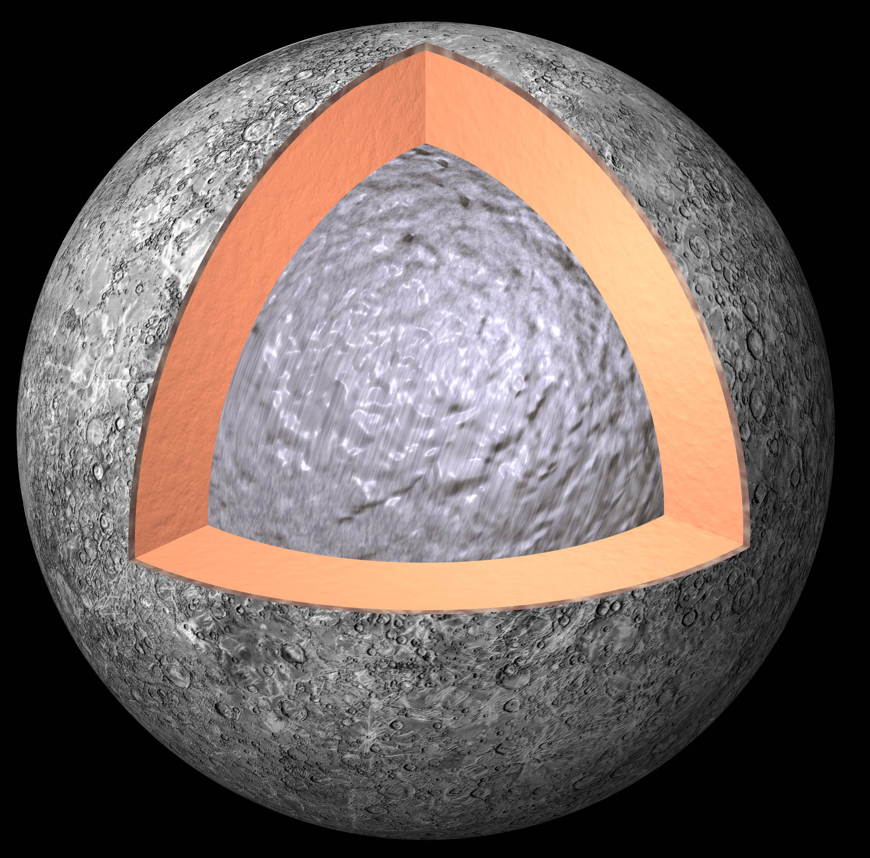
Earth’s Moon Mercury

Slide 56
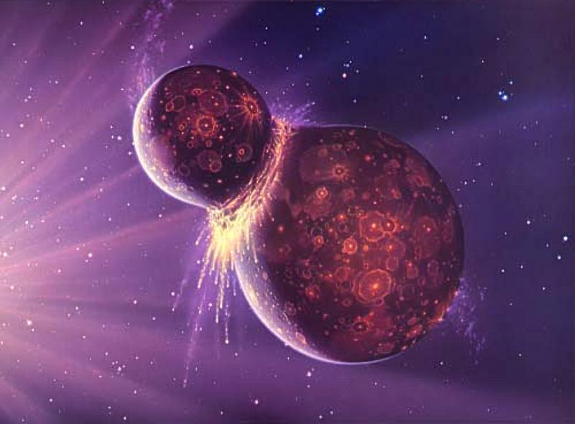
glancing blow

Slide 57


Slide 61
Mercury's huge core

Slide 62
Mercury's huge core

Slide 63

Caloris
Basin

Slide 64

Caloris
Basin

Slide 65
Caloris
Basin

Slide 66


Slide 67


Slide 68


Slide 69
Caloris Basin Impact Site
Weird
Terrain

Slide 70

Weird
Terrain

