Slide 1
Youtube: Lecture 24 [1]: https://youtu.be/n-ZItXiZWXA
Lecture 24 [2]: https://youtu.be/q2aL-ccjmOU
Lecture 24 [3]: https://youtu.be/Dz_kRbj8KtI

Slide 2
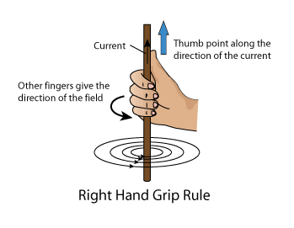
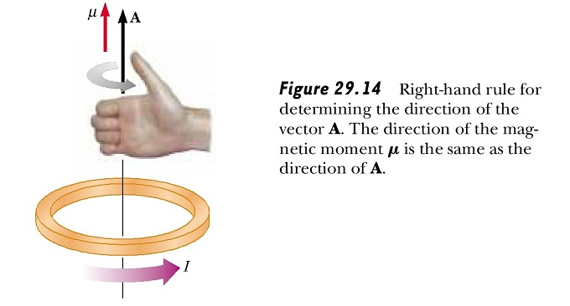
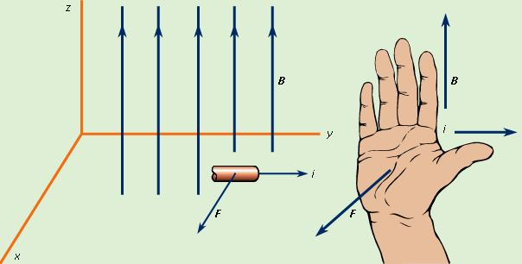
Reminder: Right-hand Rules
Grip Rule
2. Loop Rule
3. Cross Product
B
v
+q
F
Point thumb in the direction of v or I
Point fingers in the direction of B
Palm faces in the direction of F for +ve q (opposite for –ve q)
Grip wire with right hand
Point thumb in direction of current
Fingers represent direction of field
Curl fingers in direction of current
Direction of thumb is the direction of field

Slide 3
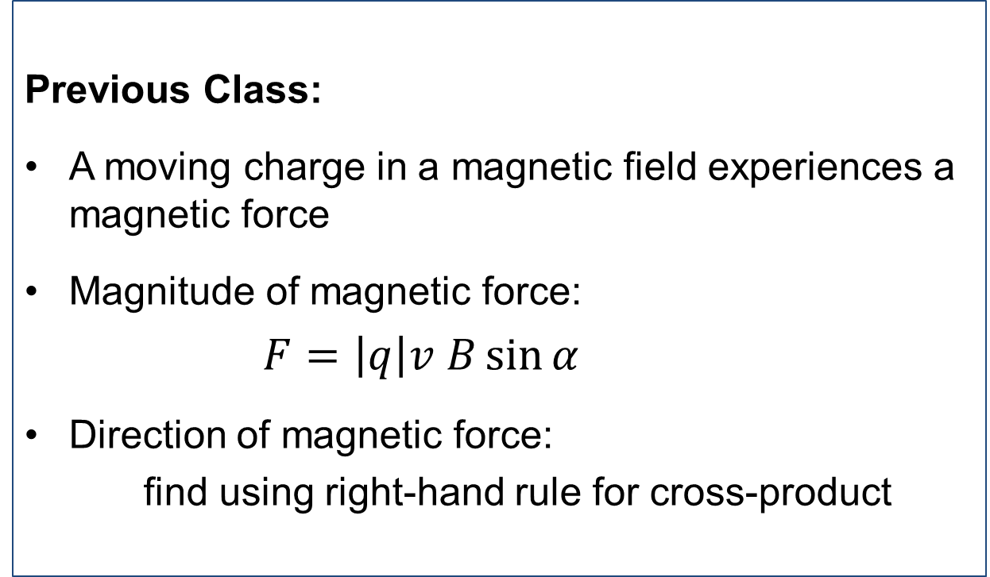
Magnetic Force
Previous Class:
A moving charge in a magnetic field experiences a magnetic force
Magnitude of magnetic force:
$F=\left|q\right|v B\sin{α}$
Direction of magnetic force:
find using right-hand rule for cross-product

Slide 4
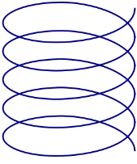
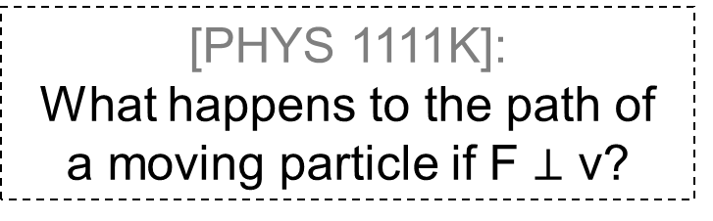
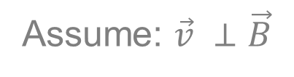
What Magnetic Field Does to Direction
Assume: $\vec{v} ⊥\vec{B}$
Force is always perpendicular to velocity
[PHYS 1111K]:
What happens to the path of a moving particle if F $⊥$ v?
Circular motion
If ,
motion is
For other arrangement
motion is
Straight line
(F = 0)
helix

Slide 5
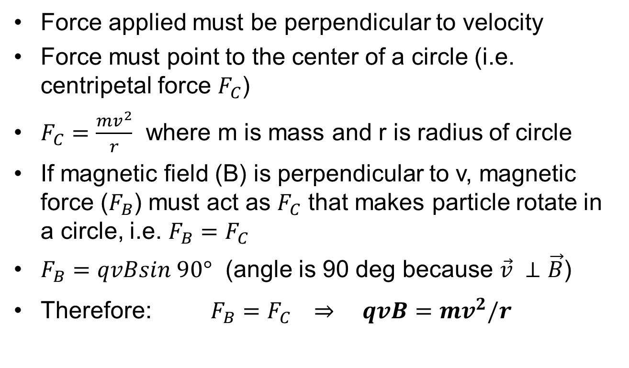
Circular Motion in Magnetic Field
Force applied must be perpendicular to velocity
Force must point to the center of a circle (i.e. centripetal force $F_{C}$)
$F_{C}=\frac{mv^{2}}{r}$ where m is mass and r is radius of circle
If magnetic field (B) is perpendicular to v, magnetic force ($F_{B}$) must act as $F_{C}$ that makes particle rotate in a circle, i.e. $F_{B}=F_{C}$
$F_{B}=qvBsin 90°$ (angle is 90 deg because $\vec{v} ⊥\vec{B}$)
Therefore: $F_{B}=F_{C} ⇒ qvB=mv^{2}/r$

Slide 6
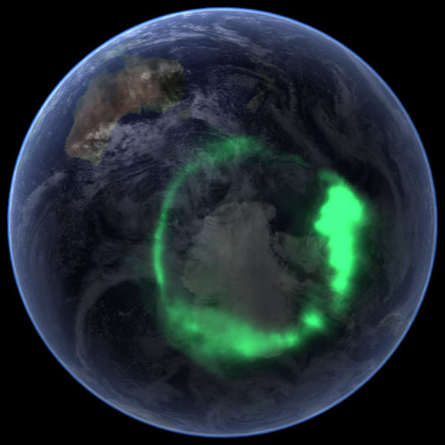
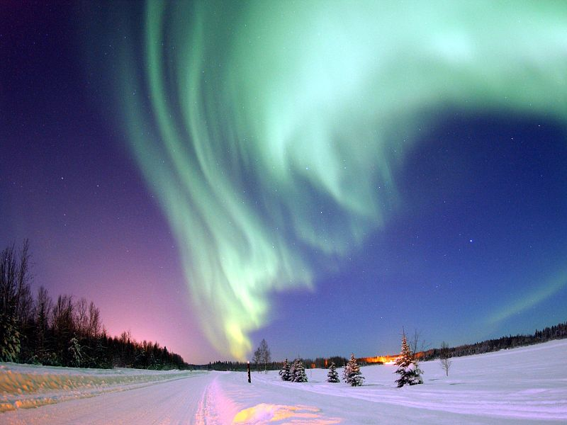
Aurorae
Sun emits charged particles
Can be symmetric around pole:
Particle’s get “trapped” by Earth’s magnetic field
Move toward poles
Excite molecules in atmosphere
http://earthobservatory.nasa.gov/IOTD/view.php?id=6226
http://upload.wikimedia.org/wikipedia/commons/1/16/Polarlicht4.jpg

Slide 7
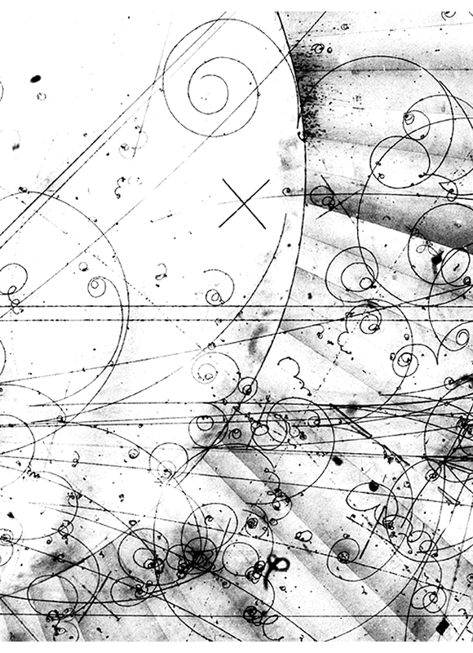
Bubble Chambers
+
–
Charged particles ionize liquid
Bubbles form along track
Apply magnetic field
(here into page)
Identify particles based on path
Mass spectrometers more common now
http://teachers.web.cern.ch/teachers/archiv/HST2005/bubble_chambers/BCwebsite/gallery/gal2_281.gif

Slide 8

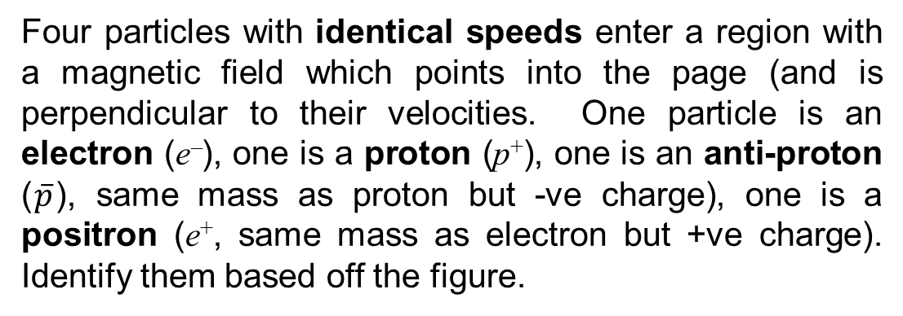
Identifying Particles [1]
B = 0
into page
Four particles with identical speeds enter a region with a magnetic field which points into the page (and is perpendicular to their velocities. One particle is an electron (e–), one is a proton (p⁺), one is an anti-proton ($\overline{p}$), same mass as proton but -ve charge), one is a positron (e⁺, same mass as electron but +ve charge). Identify them based off the figure.
I
II
IV
I II III IV
From right-hand rule:
I, II → +ve (i.e. p⁺ and e⁺)
III, IV → -ve (i.e. $\overline{p}$⁻ and e⁻)
III
a. e– e⁺ p⁺
b. e⁺ p⁺ e–
c. p⁺ e⁺ e–
d. e– p⁺ e⁺
e. More information is needed

Slide 9
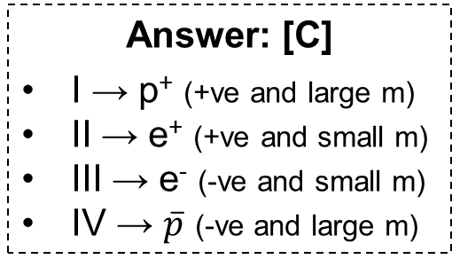

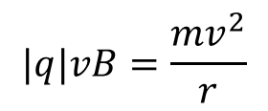
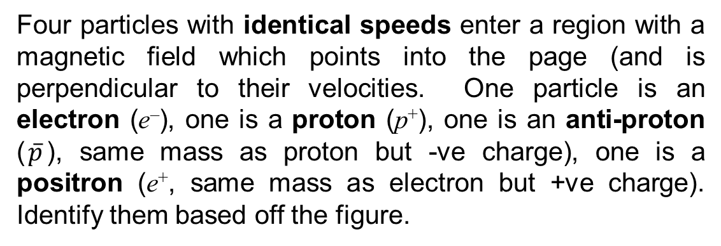
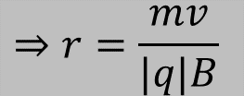
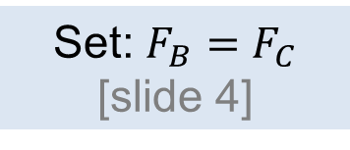
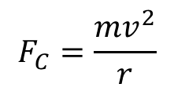
Identifying Particles [2]
Four particles with identical speeds enter a region with a magnetic field which points into the page (and is perpendicular to their velocities. One particle is an electron (e–), one is a proton (p⁺), one is an anti-proton ($\overline{p}$), same mass as proton but -ve charge), one is a positron (e⁺, same mass as electron but +ve charge). Identify them based off the figure.
I
II
III
Magnetic Force:
(same on all particles)
$$F_{B}=|q|vBsin 90°$$
IV
$$F_{C}=\frac{mv^{2}}{r}$$
Centripetal Force:
Set: $F_{B}=F_{C}$ [slide 4]
$$|q|vB=\frac{mv^{2}}{r}$$
$$⇒r=\frac{mv}{|q|B}$$
Answer: [C]
I → p⁺ (+ve and large m)
II → e⁺ (+ve and small m)
III → e⁻ (-ve and small m)
IV → $\overline{p}$ (-ve and large m)
i.e. since the particles have same v, q and B, their r depends on their m

Slide 10
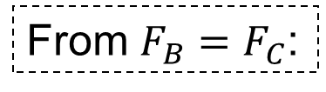
Mass Spectrometer
A beam of doubly charged (each one has two extra 2 e–’s) ions traveling at 3.10 × 10⁵ m/s enters a region with a magnetic field of 3.00 mT pointing out of the page. The beam leaves the magnetic field 4.30 m away from where it entered. What is the mass of each ion (1 u = 1.67 × 10^{–27} kg)?
From $F_{B}=F_{C}$:
3 u
8 u
4 u
2 u
1 u
4.30 m
q = 2(1.6 × 10^{–19}) C = 3.2 × 10^{–19} C
r = 4.30 m / 2 = 2.15 m
m = 6.66 × 10^{–27} kg

Slide 11
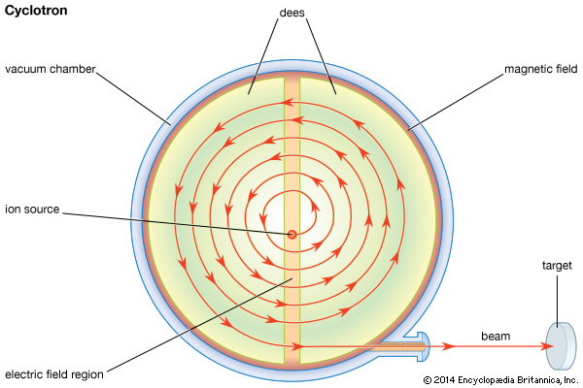
Cyclotron
Used in radiation therapy to accelerate charged particles
Accelerates charges using an electric field
Keeps charges confined to a circular region using a magnetic field; this way, space required is reduced (compared to linear accelerator)

Slide 12
Magnetic Forces on Wires
OpenStax 22.9 - 22.10
Magnetic fields exert forces on wires
Wires exert forces on each other
  Like wires attract
  Opposite wires repel

Slide 13
Magnetic Force Exerted on Current
A current is a flow of charges
Therefore, magnetic force must act on a current
The magnetic force has to be summed over all charges in the current
The magnetic force equation becomes:
Angle between wire and .
Current (A)
Magnetic field (T)
Length of section (m)
(same as force on a charged particle but with |q|v replaced by IL)

Slide 14

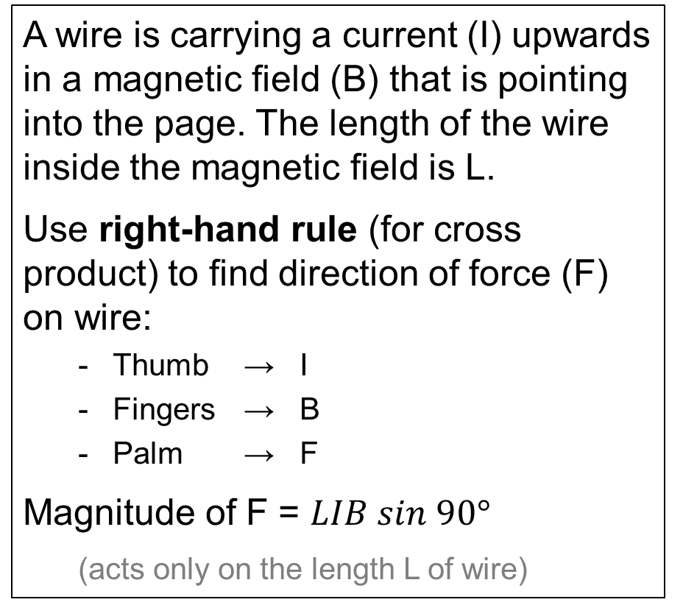
Example
A wire is carrying a current (I) upwards in a magnetic field (B) that is pointing into the page. The length of the wire inside the magnetic field is L.
Use right-hand rule (for cross product) to find direction of force (F) on wire:
  Thumb → I
  Fingers → B
  Palm → F
  Magnitude of F = $LIB sin 90°$
  (acts only on the length L of wire)
B
I
L
F

Slide 15
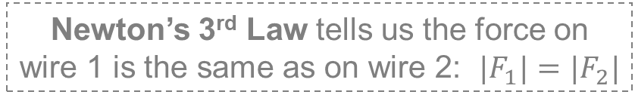
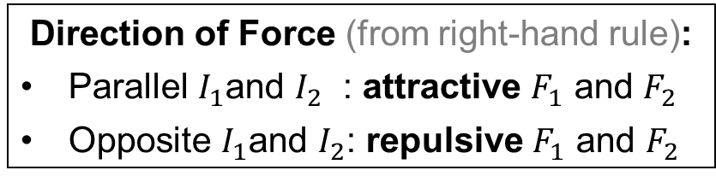
Magnetic Force between Wires
d
I₂
Start with force on one wire (wire 2):
Find magnetic field from wire 1 [lecture 22-23 slide 19]:
F₂
I₁
So force on wire 2 is
Newton’s 3rd Law tells us the force on wire 1 is the same as on wire 2: $|F_{1}|=|F_{2}|$
F₁
Direction of Force (from right-hand rule):
Parallel $I_{1}$and $I_{2}$ : attractive $F_{1}$ and $F_{2}$
Opposite $I_{1}$and $I_{2}$: repulsive $F_{1}$ and $F_{2}$

Slide 16
Finding the Current in a Wire
Two current carrying wires are separated by 3.0 cm. Wire 1 carries a current of 5.0 A from right to left and exerts a repulsive magnetic force of 0.16 mN on a 1.2 m long stretch of Wire 2. What is the current in wire 2?
4.0 A right to left
4.0 A left to right
1.3 A right to left
1.3 A left to right
0.57 MA right to left
Repulsive force → currents are in opposite directions:
Rearrange equation from previous slide:
= 4.0 A

Slide 17
Scaling Problem
When two parallel wires carrying currents I_{A} and I_{B} are a distance l away from each other, they exert a repulsive force with magnitude F on each other. Which of the following would make the force attractive and four times larger than F?
Reverse I_{A}; double both
Reverse I_{B} currents; double one current
Reverse I_{B}; double one current; halve the distance between the wires
Reverse both currents; quarter the distance between the wires
Both a and c work
Doubles I_{B} and B_{from_A}
Only doubles I_{B} or B_{from_A}
Doubles I_{B} and B_{from_A} or Quadruples B_{from_A}
Quadruples B_{from_A}
Looking at:
For direction to reverse, need to reverse only one current
F_{on} _{B} = I_{B} L B_{from_A}
Either double I_{B} and B_{from_A}
Or quadruple I_{B} or B_{from_A}

Slide 18
Motors
OpenStax 23.3

Slide 19
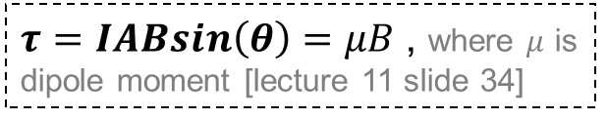
Wire Loop in Magnetic Field
top view (left) and side view (right)
F
Loop’s area is A
θ
I
What’s the net force on this loop?
zero
(forces on the four sides of the loop add up to zero)
Is the net torque zero?
$τ=IABsin\left(θ\right)=μB$ , where $μ$ is dipole moment [lecture 11 slide 34]
no

Slide 20




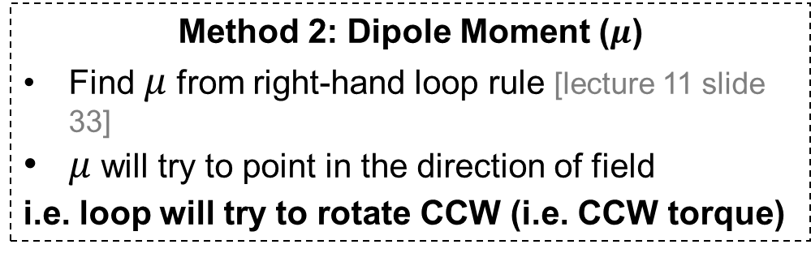
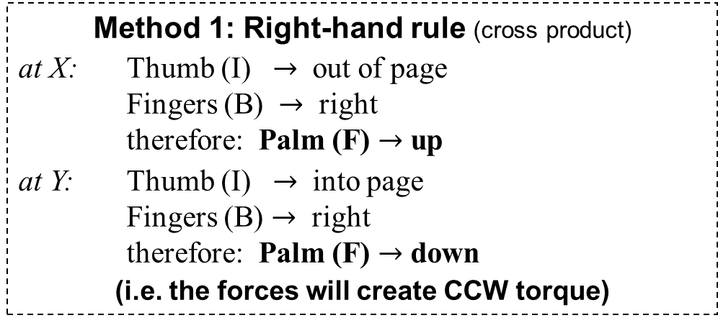

Direction of Rotation of Loop
Finding direction of rotation (i.e. direction of $τ$) of loop
(I out of page on top, into page at bottom)
$$F$$
Method 1: Right-hand rule (cross product)
at X: Thumb (I) $→$ out of page
Fingers (B) $→$ right
therefore: Palm (F) $→$ up
at Y: Thumb (I) $→$ into page
Fingers (B) $→$ right
therefore: Palm (F) $→$ down
(i.e. the forces will create CCW torque)
$$X$$
I
$$Y$$
$$F$$
Method 2: Dipole Moment ($μ$)
Find $μ$from right-hand loop rule [lecture 11 slide 33]
$μ$ will try to point in the direction of field
i.e. loop will try to rotate CCW (i.e. CCW torque)
I
$$μ$$

Slide 21
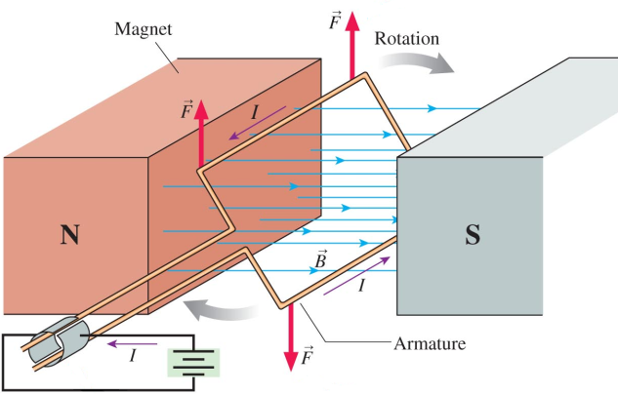
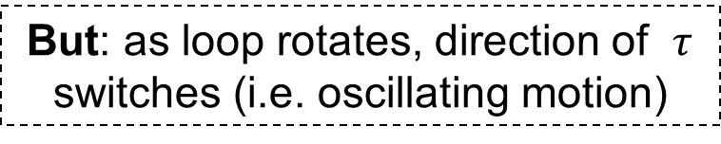
Electric Motors
Uses loop in a magnetic field to generate rotational motion
(I out of page on top, into page at bottom)
I
I
Torque is CCW
Torque is CW
But: as loop rotates, direction of $τ$ switches (i.e. oscillating motion)
To create continuous motion:
Switch direction of current or field
© 2010 Pearson Education, Inc.

Slide 22
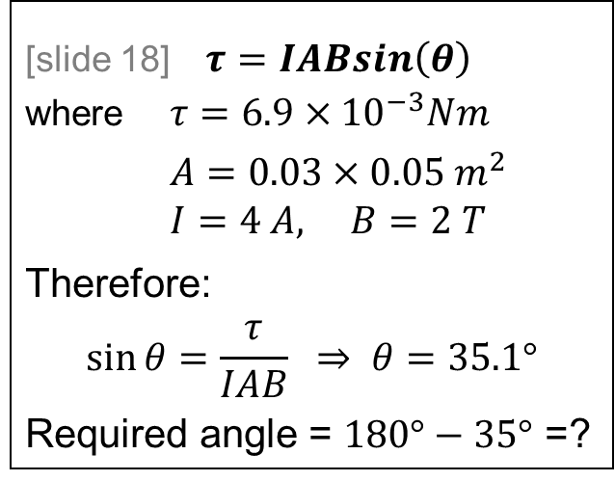
Torque in an Electric Motor
A rectangular loop with sides that are 3 cm and 5 cm carries a 4 A current in while inside a magnetic field of 2 T. If the net torque acting on the loop at one moment is 6.9 × 10^{–3} Nm clockwise, what is the angle θ the loop make with the field?
[slide 18] $τ=IABsin\left(θ\right)$
where $τ=6.9×{10}^{−3}Nm$
$A=0.03×0.05 m^{2}$
$I=4 A, B=2 T$
Therefore:
$$\sin{θ}=\frac{τ}{IAB} ⇒ θ=35.1°$$
Required angle = $180°−35°$ =?
I
90°
35°
145°
55°
125°
θ
(the angle shown in the diagram is larger than 90 deg, so it cannot be 35 deg as solved on the left)

Slide 23
Magnetic Flux
OpenStax 23.1
Flux is a measure of how much field passes through a region

Slide 24
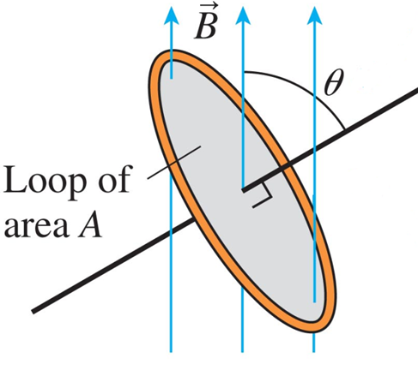
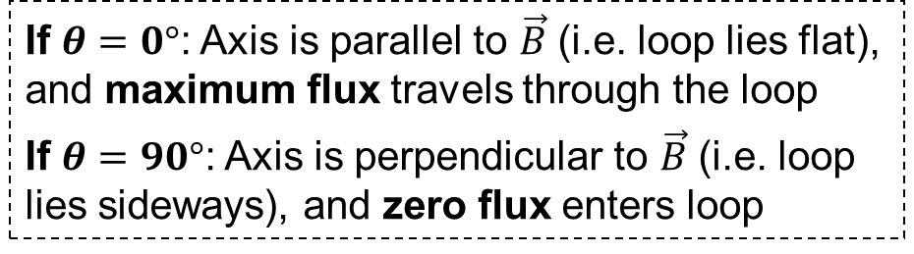
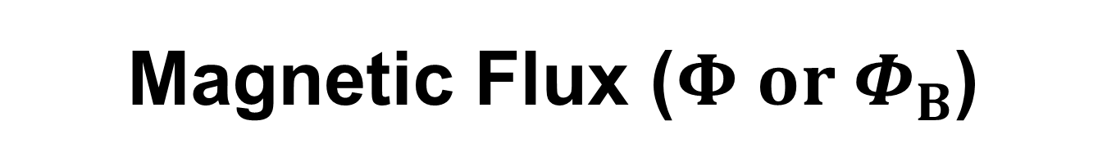
Magnetic Flux ($Φ or Φ_{B}$)
Measure of how much a magnetic field goes through a region
Axis: line perpendicular to region’s area
If $θ=0°$: Axis is parallel to $\vec{B}$ (i.e. loop lies flat), and maximum flux travels through the loop
If $θ=90°$: Axis is perpendicular to $\vec{B}$ (i.e. loop lies sideways), and zero flux enters loop
Magnetic field (T)
Area of region (m²)
Angle between region’s axis and field
SI Unit: weber (Wb); 1 Wb = 1 T m²

Slide 25



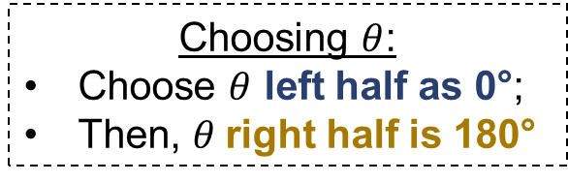
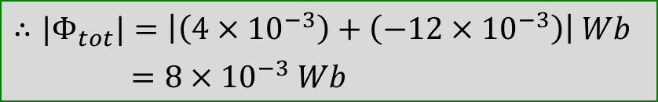
Example: Calculating $Φ$
There are magnetic fields as shown perpendicular to a loop of triangular wire (which is 4 cm wide and 8 cm tall). Each field occupies half of the loop’s area. What is the magnitude of the total flux through the loop?
Choosing $θ$:
Choose $θ$ left half as 0°;
Then, $θ$right half is 180°
5 T
15 T
Area of half of triangle:
8 × 10^{–4} m²
$Φ_{left}=\frac{A}{2}\left(5 T\right) cos 0°=4×{10}^{−3} Wb$
$Φ_{right}=\frac{A}{2}\left(15 T\right) cos 180°=−12×{10}^{−3} Wb$
$$∴{|Φ}_{tot}|=\left|\left(4×{10}^{−3}\right)+\left(−12×{10}^{−3}\right)\right| Wb$$
$=8×{10}^{−3} Wb$

Slide 26
Example: Loop Partially in Field
A square loop of wire (10.0 cm on a side) rests so that half of it is in a region with a uniform magnetic field which has a magnitude of 4.00 T. The figures give side and top views of the set up. What is the magnitude of the flux through the loop?
40.0 mWb
10.0 mWb
17.3 mWb
35.6 mWb
20.0 mWb
θ
60.0°
Flux is given by:
Φ = A B cos(θ)
Region where B field isn’t zero
A = area with non-zero field = (0.10 m)(0.10 m) / 2
θ = angle between field & normal = 30°

Slide 27
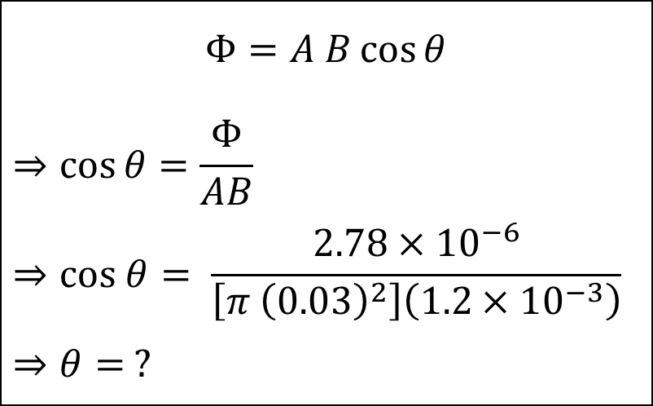
Example
A circular loop with radius 3 cm is in a region where the magnetic field is 1.2 mT. If the magnetic flux through the loop is +2.78 μWb, what angle could the loop make with the field?
$$Φ=A B\cos{θ}$$
$$⇒\cos{θ=\frac{Φ}{AB}}$$
$$⇒cos θ= \frac{2.78×{10}^{−6}}{\left[π {\left(0.03\right)}^{2}\right]\left(1.2×{10}^{−3}\right)}$$
$$⇒θ= ?$$
0°
35°
55°
125°
145°

Slide 28

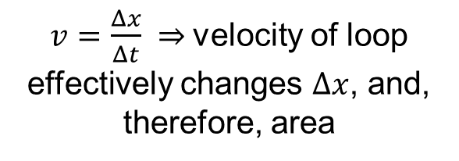

Changing Flux
Some ways to increase or decrease flux:
Changing Area (A)
ΔΦ = (Bcos(θ)) (A_{f} – A_{i})
Changing Field (B)
ΔΦ = (Acos(θ)) (B_{f} – B_{i})
Changing angle $θ$
ΔΦ = AB(cos(θ_{f}) –cos(θ_{i}))
Move loop into / out of field
$v=\frac{Δx}{Δt} ⇒$velocity of loop effectively changes $Δx$, and, therefore, area

Slide 29
Magnetic Induction
OpenStax 23.3
Induction: magnetic fields create electrical responses
Lenz’ Law
  Induced current creates field to oppose a change in flux

Slide 30
Moving Magnet Near Loop
Moving charges (current), make a magnetic field,
what do moving magnets make?
Take a loop of wire
Move a magnet near the loop
Now current flows even without a battery present!
Current depends on how magnet is moved (and resistance of loop)
Process is called “induction”

Slide 31
Magnetic Induction
A changing (increasing or decreasing) magnetic flux [slide 27] through a conductor induces an EMF in the conductor
e.g.
- a moving conductor in the presence of a magnet
- a moving magnet near a conductor
The conductor develops an EMF
If the conductor forms a closed loop (i.e. a complete circuit), then the EMF will produce a current

Slide 32
Conductor in E-Field
[lecture 14-15 slide 37]
What happens when a conductor is in an electric field?
–
–
––
–
+
+
+
+
+
d
ΔV = E d
Charges move to exterior surface of conductor
Therefore, potential difference develops

Slide 33
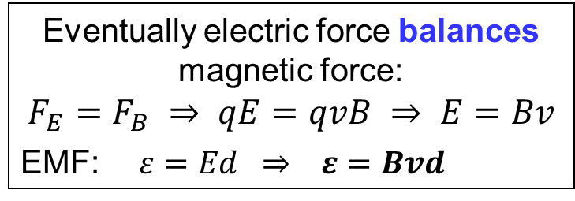
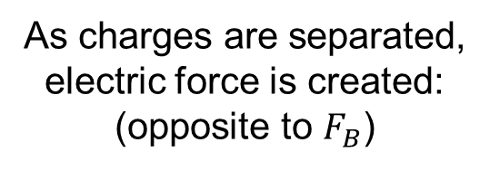

Neutral Conductor in B-field
What happens when a Cu conductor is in a magnetic field?
Not much
Unless it is moved (by external agent)
Magnetic force pushes +ve and –ve charges (according to right-hand rule)
Magnetic force separates moving charges:
d
As charges are separated, electric force is created:
(opposite to $F_{B}$)
–
–
–
+
+
+
Eventually electric force balances magnetic force:
$$F_{E}=F_{B} ⇒ qE=qvB ⇒ E=Bv$$
EMF: $ε=Ed ⇒ ε=Bvd$
Note: $\vec{E}$ is perpendicular to$\vec{v}$

Slide 34




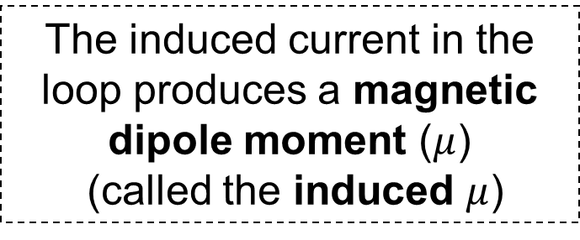
Induced EMF and Current
The EMF does not produce a current unless a circuit is completed (called the induced current)
$$I$$
$$μ$$
$$ε$$
The induced current in the loop produces a magnetic dipole moment ($μ$)
(called the induced $μ$)
–
–
–
+
+
+
For the above circuit, the current is CCW, so according to the right-hand loop rule, induced $μ$ points out of the page
$μ$ (and Lenz’s law) determines the direction of induced current

Slide 35
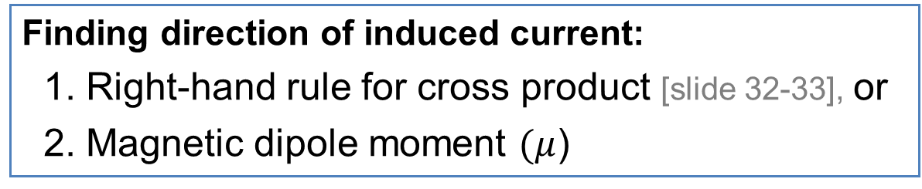
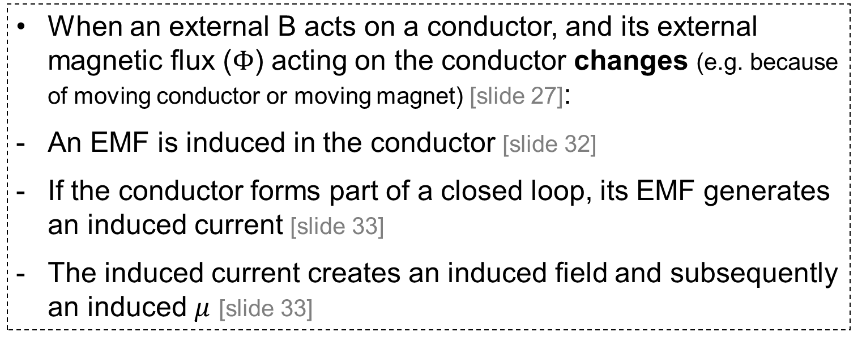
Induced Current by Magnetic Induction
When an external B acts on a conductor, and its external magnetic flux ($Φ$) acting on the conductor changes (e.g. because of moving conductor or moving magnet) [slide 27]:
An EMF is induced in the conductor [slide 32]
If the conductor forms part of a closed loop, its EMF generates an induced current [slide 33]
The induced current creates an induced field and subsequently an induced $μ$ [slide 33]
Finding direction of induced current:
1. Right-hand rule for cross product [slide 32-33], or
2. Magnetic dipole moment $(μ$)

Slide 36

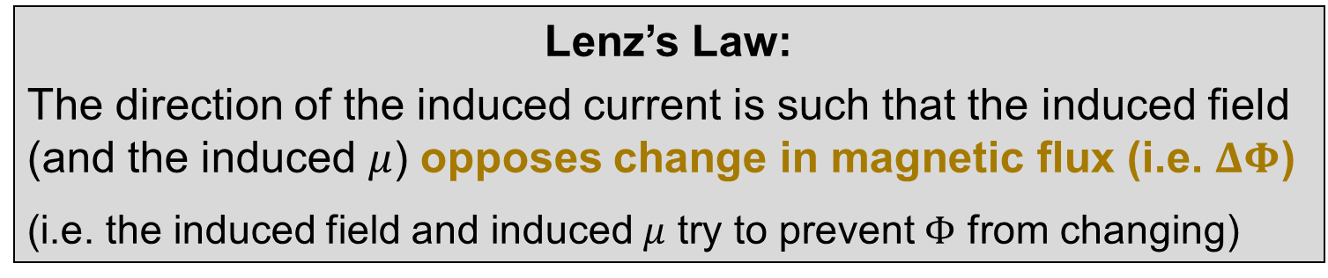
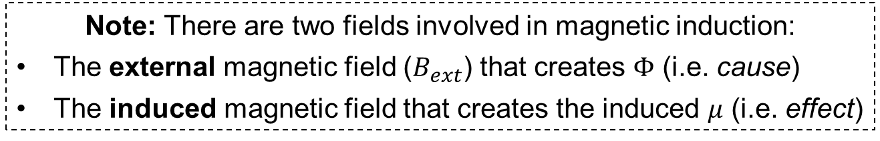
Direction of I and Lenz’s Law
Finding direction of induced current from $μ$:
Use Lenz’s Law
Lenz’s Law:
The direction of the induced current is such that the induced field (and the induced $μ$) opposes change in magnetic flux (i.e. $ΔΦ$)
(i.e. the induced field and induced $μ$ try to prevent $Φ$ from changing)
Note: There are two fields involved in magnetic induction:
The external magnetic field ($B_{ext}$) that creates $Φ$ (i.e. cause)
The induced magnetic field that creates the induced $μ$ (i.e. effect)

Slide 37




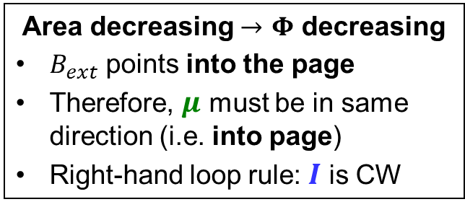
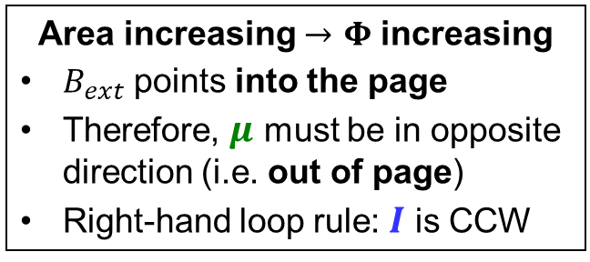
Guideline For Lenz’s Law
Magnetic induction can occur by both increase or decrease of external magnetic flux ($Φ$)
If $Φ$ increases: $μ$ points in the opposite direction of external B
$$I$$
Area increasing $→$ $Φ$ increasing
$B_{ext}$ points into the page
Therefore, $μ$ must be in opposite direction (i.e. out of page)
Right-hand loop rule: $I$ is CCW
$$μ$$
If $Φ$ decreases: $μ$ points in the same direction as external B
Area decreasing $→$ $Φ$ decreasing
$B_{ext}$ points into the page
Therefore, $μ$ must be in same direction (i.e. into page)
Right-hand loop rule: $I$ is CW
$$μ$$
$$I$$
Note: The right-hand rule for cross product gives the same directions

Slide 38
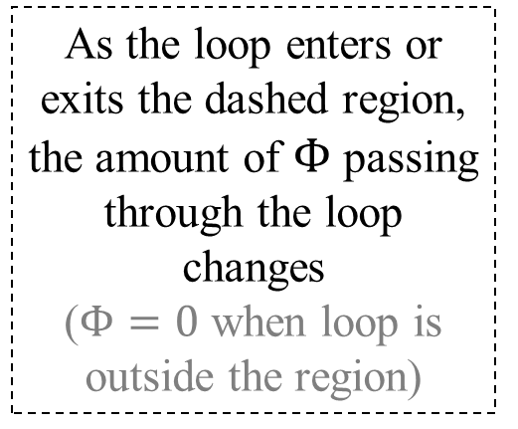
Example with Lenz’s Law:
Moving Loop [1]
A circular loop of copper parallel to the plane of the page is pulled into a region where a uniform magnetic points out of the page (field is zero outside of box) as shown. When viewed from above, what is the direction of the induced current as the loop enters the field and then leaves?
As the loop enters or exits the dashed region, the amount of $Φ$ passing through the loop changes
($Φ=0$ when loop is outside the region)
Direction of motion

Slide 39

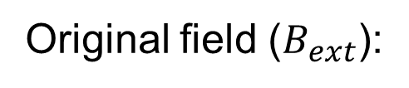


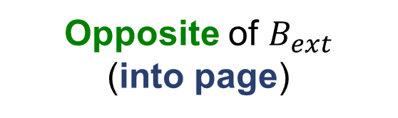
Example with Lenz’s Law: Moving Loop [2]
(entering the region)
Area of the loop located inside the region is increasing
Flux:
Increasing
Original field ($B_{ext}$):
Out of page
$$μ$$
Opposite of $B_{ext}$
(into page)
Induced $μ$:
$$I$$
Induced current:
(from right-hand loop rule)
clockwise
As the loop enters the region, a CW current is induced in it

Slide 40

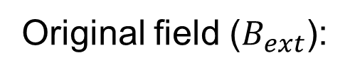



Example with Lenz’s Law: Moving Loop [3]
(leaving the region)
Area of the loop located inside the region is decreasing
Flux:
Decreasing
$$I$$
Original field ($B_{ext}$):
Out of page
$$μ$$
Same as $B_{ext}$
(out of page)
Induced $μ$:
Induced current:
(from right-hand loop rule)
counter-clockwise
As the loop leaves the region, a CCW current is induced in it

Slide 41


Example with Lenz’s Law: Moving Loop [4]
(inside the region)
What happens when the loop is moving inside the region (away from the edges)?
Flux:
Constant
Original field ($B_{ext}$):
Out of page
Zero
(because flux is not changing)
Induced $μ$:
Induced current:
Zero
When the loop is not entering or leaving the region, there is no induced current

Slide 42
Extra Example with Lenz’s Law: Moving Magnet [1]
A magnet is dropped, as shown, through a closed loop of aluminum. What will be the direction of the induced current (when viewed from above) as the magnet falls towards and then away from the loop?
Towards (N pole closer to loop):
Away (S pole closer to loop):
S
N
S
N

Slide 43







Extra Example with Lenz’s Law: Moving Magnet [2]
Towards (N pole closer to loop):
Away (S pole closer to loop):
$$μ$$
$$I$$
$$I$$
$$μ$$
Since magnet is getting closer to loop, $Φ$ is increasing
$B_{ext}$ is pointing down as it enters the loop (field travels from N to S)
Therefore, induced $μ$ points up
Right-hand loop rule: $I$ is CCW
Since magnet is moving away from loop, $Φ$ is decreasing
$B_{ext}$ is still pointing down as it enters the loop
Therefore, induced $μ$ points down
Right-hand loop rule: $I$ is CW

Slide 44



Extra Example with Lenz’s Law: Moving Magnet [3]
What happens to the speed of the magnet as it falls?
$$μ$$
$$μ$$
When the magnet is approaching the loop, $μ$ is opposite to $B_{ext}$
The loop repels the magnet [lecture 11 slide 35]
Therefore, the magnet slows down
When the magnet is moving away from the loop, $μ$ points in the same direction as $B_{ext}$
The loop attracts the magnet
The magnet still slows down
The magnet slows down throughout the process of induction

Slide 45




Falling Magnet vs Falling Iron
https://www.youtube.com/watch?v=N7tIi71-AjA
A non-magnetized iron ball drops through a metal pipe in 0.02 s
A magnet of the same size drops through the same metal pipe in 4 s
The magnet takes longer to fall because it induces a current in the metal pipe and is, therefore, slowed down

Slide 46

Energy Transfer in Induction
As a magnet creates induction, it slows down, i.e. loses kinetic energy
The kinetic energy is transferred to the induced conductor (as electric energy)
Therefore, magnetic induction is a process of energy transfer, converting kinetic energy to electrical energy
(this principle is used in most power plants)
This is why it is necessary for the induced $μ$ to prevent $Φ$ from changing [Lenz’s law, slide 35] – so that kinetic energy is reduced and converted to electric energy, and the principle of energy conservation is not violated.
i.e. Lenz’s law is based on conservation of energy

Slide 47
Faraday’s Law
OpenStax 23.2 – 23.3
Faraday's Law gives the magnitude of the induced EMF

Slide 48
Faraday’s Law
Magnitude of induced EMF ($ε$):
Change of Magnetic Flux
Induced EMF
Rate of Change of Flux
Time taken for flux change
Can use Ohm’s Law to find current magnitude based on resistance
Can use Lenz’s Law to find current direction
(For multiple loops, multiply ε by number of loops)

Slide 49


Rate of Change of Flux $\left(\frac{ΔΦ}{Δt}\right)$
$$ΔΦ=Φ_{final} −Φ_{initial}$$
Also, we know: $Φ=A B\cos{θ}$
If any one of A or B is changing, then:
$ΔΦ=\left(ΔA\right)B\cos{θ}$ $or$ $ΔΦ=\left(ΔB\right)A\cos{θ}$
(depending on whether A or B is changing)
Then, the rate of change of flux becomes:
$$\frac{ΔΦ}{Δt}=\left(\frac{ΔA}{Δt}\right)B\cos{θ} or \frac{ΔΦ}{Δt}=\left(\frac{ΔB}{Δt}\right)A\cos{θ}$$
Note: If $θ$ is changing, then find $ΔΦ$ from $Φ_{final} −Φ_{initial}$

Slide 50


Finding induced $I$: Changing Field [1]
A circular loop of copper with resistance R = 5.0 mΩ and radius r = 0.15 m (A = 0.0707 m²) is in a region where the magnetic field is decreasing. The field is decreasing at a rate of 0.5 mT/s. What is the induced current in the loop if the field is parallel to the loop’s axis?
$$A = 0.0707 m^{2} , R=5 mΩ$$
$θ=0°$ (B is parallel to axis)
$\frac{ΔB}{Δt}=−0.5 mT/s$
(-ve sign because B is decreasing)
As B changes, $Φ$ changes as well, and an EMF is induced in the loop

Slide 51






Finding induced $I$: Changing Field [2]
A circular loop of copper with resistance R = 5.0 mΩ and radius r = 0.15 m (A = 0.0707 m²) is in a region where the magnetic field is decreasing. The field is decreasing at a rate of 0.5 mT/s. What is the induced current in the loop if the field is parallel to the loop’s axis?
$$A = 0.0707 m^{2}$$
$$R=5 mΩ$$
$θ=0°$
$\frac{ΔB}{Δt}=−0.5 mT/s$
$$ε=\left|\frac{ΔΦ}{Δt}\right|$$
$$⇒ ε=\left|\frac{ΔB}{Δt}A\cos{θ}\right|$$
$$⇒ ε=\left|\left(−0.5\right)\left(0.0707\right)\cos{0°}\right|$$
$⇒ ε=$0.0354 mV
Ohm’s law: $I=\frac{ε}{R}=\frac{0.0354}{5}=7.1 mA$
Direction:
$B_{ext}$:
into page
Flux:
decreasing
Induced $μ$:
Same direction as $B_{ext}$ (into page)
Induced current:
clockwise

Slide 52


Finding induced $ε$: Moving Loop [1]
As shown, a square loop of wire with sides that are 1.5 m long moves with constant speed 2.0 m/s from a region where the magnetic field is 3.0 mT to one where the magnetic field is zero (which is parallel to the axis of the loop and perpendicular to the loop’s velocity). What emf is induced in the wire as it leaves the field?
EMF is induced only when the loop is entering or exiting the region [slides 37 – 40]
The induced EMF depends on the velocity, which changes area of loop through which $Φ$ passes,
i.e. $ΔA/Δt$ depends on $v$
Direction of motion

Slide 53






Finding induced $ε$: Moving Loop [2]
As shown, a square loop of wire with sides that are 1.5 m long moves with constant speed 2.0 m/s from a region where the magnetic field is 3.0 mT to one where the magnetic field is zero (which is parallel to the axis of the loop and perpendicular to the loop’s velocity). What emf is induced in the wire as it leaves the field?
At $t=t_{i}$: left edge is at $x=x_{i}$
Finding $ΔA/Δt$
$ΔA$ is the area covered by any point in the loop.
Looking at the left edge of the loop:
The left edge travels $Δx$ in $Δt$, therefore $ΔA$ is the blue rectangle:
$$ΔA=lΔx ⇒ \frac{ΔA}{Δt}=\frac{lΔx}{Δt}$$
$$⇒ \frac{ΔA}{Δt}=vl \left(where v=Δx/Δt\right)$$
At $t=t_{f}$: left edge is at $x=x_{f}$
$$l=1.5 m$$
$$Δx={x_{f}−x}_{i}$$

Slide 54




Finding induced $ε$: Moving Loop [3]
As shown, a square loop of wire with sides that are 1.5 m long moves with constant speed 2.0 m/s from a region where the magnetic field is 3.0 mT to one where the magnetic field is zero (which is parallel to the axis of the loop and perpendicular to the loop’s velocity). What emf is induced in the wire as it leaves the field?
$$\frac{ΔA}{Δt}=vl$$
Finding EMF: $ε=\left|\frac{ΔΦ}{Δt}\right|$
$$⇒ ε=\left|\frac{ΔA}{Δt}B\cos{θ}\right|$$
$$⇒ ε=Bvl\cos{θ}$$
[$θ=0°$ (B is parallel to axis)]
$$∴ ε=Bvl$$
[same result as in slide 32 using right-hand rule]
$$B=3 mT$$
$$l=1.5 m$$
$$v=2 m/s$$
$$ε=Bvl=9 mV$$
Current direction: CCW
[see slide 39]

