Slide 1
Magnetism and Electromagnetic Energy
Objective: Learning about magnetism, magnetic field and electromagnetism.
Key concepts:
Magnetic poles
Magnetic force and fields
Electromagnets
Electromagnetic induction- Faraday’s Law
Electric Motor and Generators
Transformers

Slide 2
Magnetic Forces
Magnetic Force- is similar to electrical force
Cause objects to attract or repel
Strength decreases as distance
increases between two magnets
Magnetic poles produce magnetic
forces (electric charges produce
electric forces)

Slide 3
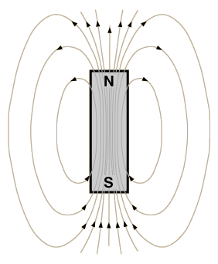
Magnetic Poles
Every magnet has a North and a South pole
Magnetic poles always exist in pairs, though electric charges can be separated
Rule:
Like poles repel each other (N –N) or (S –S)
Opposite poles attract (N – S)
Magnetic Fields - Regions of Magnetic influence
Direction of the magnetic field outside the magnet is from North pole to the South pole
N
S
Inside the magnet

Slide 4
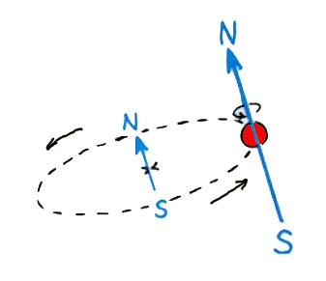
Magnetic Field
A magnetic field is produced by the motion of electric charges
Two kinds of electron motion make magnetism
Electron revolution
Electron spin
Electron spin produces
a stronger magnetic filed
Two electrons spinning in the same direction produce a strong magnetic field -Iron, cobalt nickel make good magnets
Two electrons spinning in the opposite direction produce no magnetic field - magnetic fields cancel each other
***This is why most materials are not magnets

Slide 5
Magnetic Domains
Magnetic Domains- clusters of aligned atoms
-only found in ferro-magnetic materials
Ordinary iron is not magnetized

Slide 6
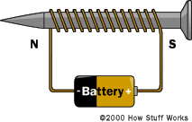
Electromagnet
A current carrying wire produces a magnetic field
If we insert a piece of iron inside a current carrying coil we can make a stronger magnet
The nail becomes an electromagnet
Stays as a magnet as long as current flows through the coil.
If we increase the current through the coil we can increase the strength of the electromagnet.

Slide 7
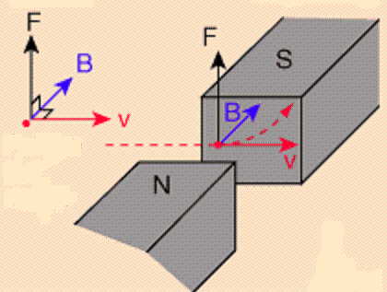
Magnetic forces on moving charges
If a charged particle is moving in a magnetic field it experiences a deflecting force.
For a positive charged particile, you point the thumb of the right hand in the direction of v, the fingers in the direction of B , and a perpendicular to the palm points in the direction of F

Slide 8
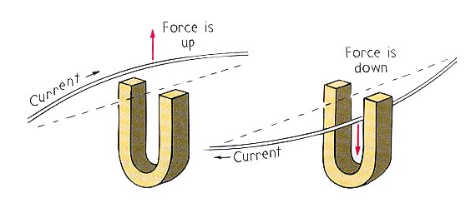
Magnetic forces on a current-carrying wire
Charges ordinarily cannot escape a conductor, the magnetic force on charges moving in a conductor is transmitted to the conductor itself.

Slide 9
Electric Motor
The force on the current carrying
coil makes it to rotate
Rotation can be used
to run clocks, lift
objects, etc.
Input – Electrical energy
Output – Mechanical energy

Slide 10
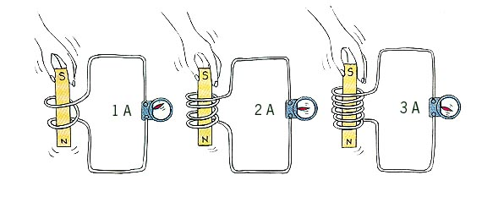
Electromagnetic Induction
Faraday’s Law of induction: (Lenz’s Law)
The induced voltage in a coil is proportional to the number of loops multiplied by the rate at which the magnetic field changes within those loops.
More number of loops induce more voltage or more current
The induced voltage also depend on how fast the magnet is entering or leaving the coil

Slide 11
Connections between Electricity and Magnetism
Complete the relationships. List at least one example of each relationship from everyday applications.
(A) Wire with electric current flowing interacting with a magnetic field generates:
Example:_____________________________
(B) Electric (charge) field in motion generates:
Example:____________________________________

Slide 12
Connections between Electricity and Magnetism
(C) Magnetic field in motion relative to a coil of wire (or coil of wire in motion relative to magnetic field) generates:
Example:________________________________

Slide 13
Electromagnetism
A coherent description of electromagnetism was formulated by James Clerk Maxwell
Maxwell’s Laws:
Law 1: Coulomb's Law - like charges repel, unlike attract;
inverse square force
Law 2: There are no magnetic monopoles in nature.
Law 3: Magnetic phenomena can be produced by electrical effects.
Law 4: Electrical phenomena can be produced by magnetic effects.

Slide 14
Transformers
Transformers are used to increase or decrease
voltage.
What is required for transformers to function?
_______________
The number of windings is __________ related
to the voltage.
The power ( P = V × I ) must remain constant
so the current is ________________ related to the voltage.

Slide 15


Transformers
STEP UP TRANSFORMERS
3 coils 6 coils
20 V 40 V
6 A 3 A
STEP UP TRANSFORMERS
3 windings 9 windings
20 V ____V
6 A ____ A

Slide 16
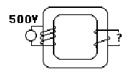
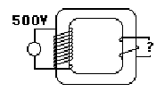
Transformers
STEP DOWN TRANSFORMERS
4 coils 2 coils
500 V 250V
5 A _10_A
STEP DOWN TRANSFORMERS
10 coils 2 coils
240 V ____V
6 A ____ A

