Slide 1
At a Crossroads: Communities of Practice, Learning Styles, and Distance Education
Curtis A. Carver Jr. , PhD
Vice Chancellor and Chief Information Officer
University System of Georgia

Slide 2
Agenda
Communities of Practice
Learning Styles
Distance Education
Implications

Slide 3
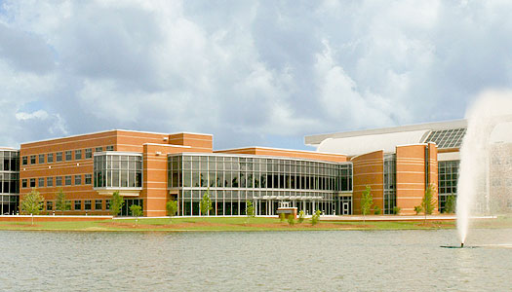
Communities of Practice
Thank You
Enhancing our Communities
  Engagement
  Training
  Communications
  Anticipation
  Innovation

Slide 4
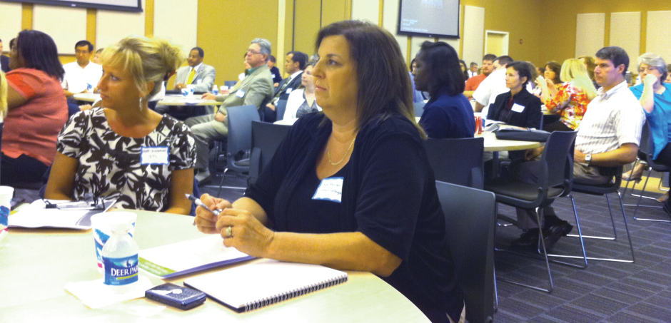
Engagement
Campus Visits
Engagement with Strategic Partners
Consulting Teams
IT Contracts

Slide 5
Training
Joint USO – Campus Initiative
Centralized Training Coordinator
Types of Training
  New User, Periodic, Advanced
  Internal, External, Conference, Affiliation
  Professional Development Consortium
  Lydia.com

Slide 6
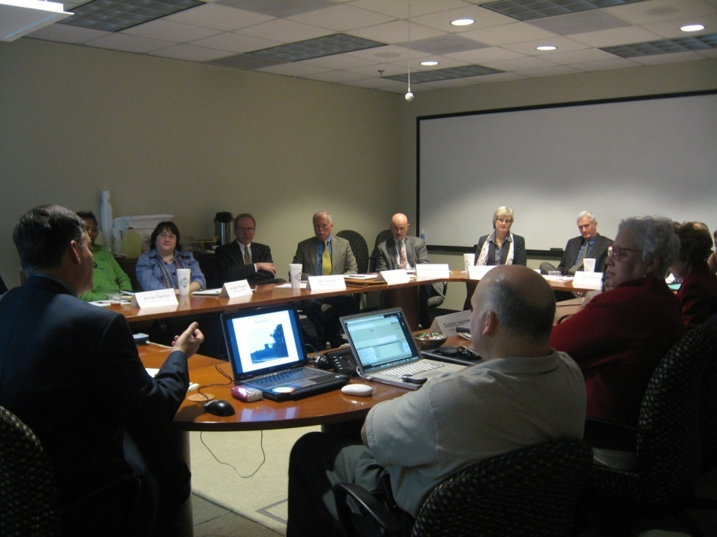
Communications
Dedicated Customer Relations Coordinator
Three Tier Enhanced Model
  Public Brand
  Community of Practice
  Internal Organization

Slide 7
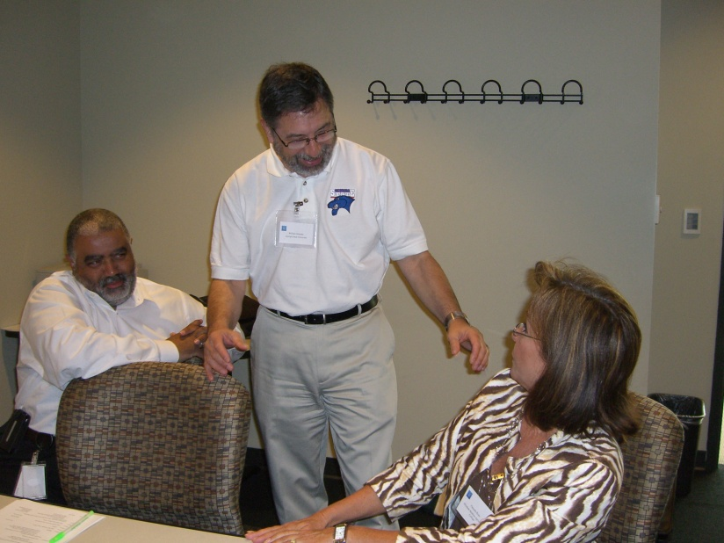
Anticipation
Strategic Plan
Strategic Roadmap
Sensing the Environment
  Georgia Summit
  Rock Eagle
  Strategic Vendor Engagements

Slide 8
Innovation
Customer
Value
ITS
Campus Enterprise
Everyone can must be an agent of innovation

Slide 9

Where We are Now
Rising Enrollments
College as the only path to the middle class
Economic Uncertainty
  Short Term?
  Long Term?
  Stagnation?
Increasing demand for change
Increasing pressure requiring change

Slide 10
Learning Styles and Lessons Learned
Learning to Ski
Making Choices
Study or Die
Geek in a Box

Slide 11
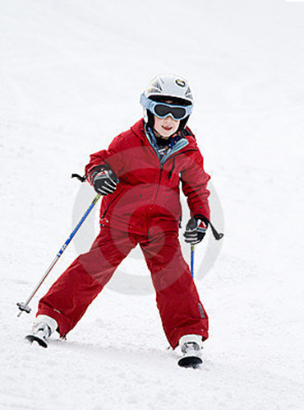
Learning Styles: Learning to Ski
Definitions | Dimensions |  | Definitions
Do it | Active | Reflective | Think about it
Learn Facts | Sensing | Intuitive | Learn Concepts
Require Pictures | Visual | Verbal | Require Reading or Lecture
Infer Principles from Facts | Inductive | Deductive | Deduce outcomes from principles
Step by Step | Sequential | Global | Big Picture
Figure 1. Felder's Learning Dimensions

Slide 12
Making Choices
14 paths through a course with different support for different learning styles.
Given 100 students, which combination did students prefer?
Definitions | Dimensions |  | Definitions
Do it | Active | Reflective | Think about it
Learn Facts | Sensing | Intuitive | Learn Concepts
Require Pictures | Visual | Verbal | Require Reading or Lecture
Infer Principles from Facts | Inductive | Deductive | Deduce outcomes from principles
Step by Step | Sequential | Global | Big Picture
Figure 1. Felder's Learning Dimensions

Slide 13
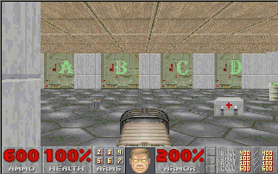
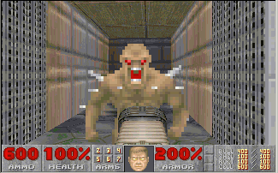
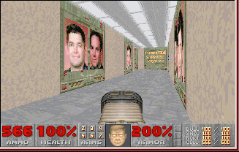
Study or Die
80 Hard Questions
Provided in Advance
Teams of Four Students
Last level is an exact copy of the Department of Electrical Engineering and Computer Science at West Point except the faculty are now monsters
Answer Incorrectly
Answer Correctly – more aid kits, armor, and weapons

Slide 14



Geek in a Box

Slide 15
Where Will We Be in the Future?
Clouds
  Private
  Public
  Cell Phones
Shared Services
Outsourcing
Transactional systems somewhere else?
Enhanced faculty student interaction?
Enhanced informational resources?
Students taught by their learning style?

Slide 16
Implications and Food for Thought
Engage the community and solve problems as a team.
Anticipate the future and react appropriately.
Embrace innovation as change is cyclical.
Events like Online Learning Conference will become increasingly important.

Slide 17
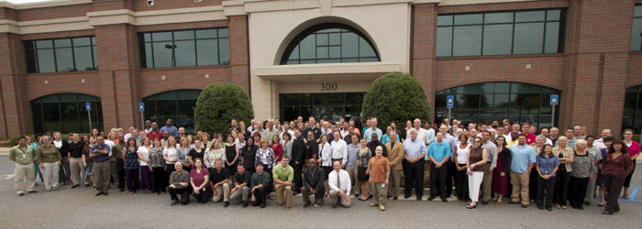
Questions, Comments,
A Conversation?

