Slide 1
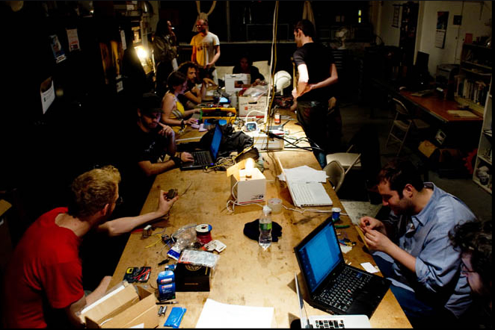
Hacking Reality:
The Hackerspace Project
and the Farming of Innovation

Slide 2
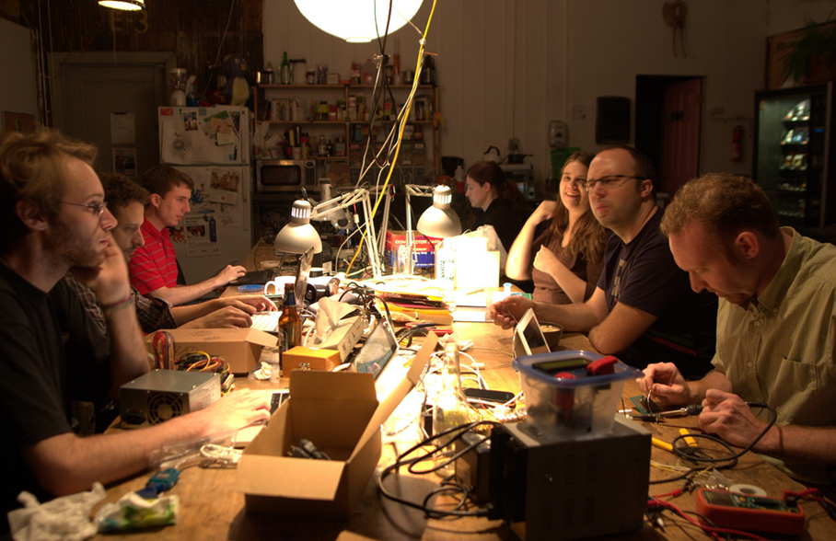
What is a hackerspace?
Community oriented:
  Member contributions
  Self-sustaining
Collaborative
Innovative
  Developing Technologies
Inclusive
  Proprietary to University
Tech/Engineering
focus

Slide 3
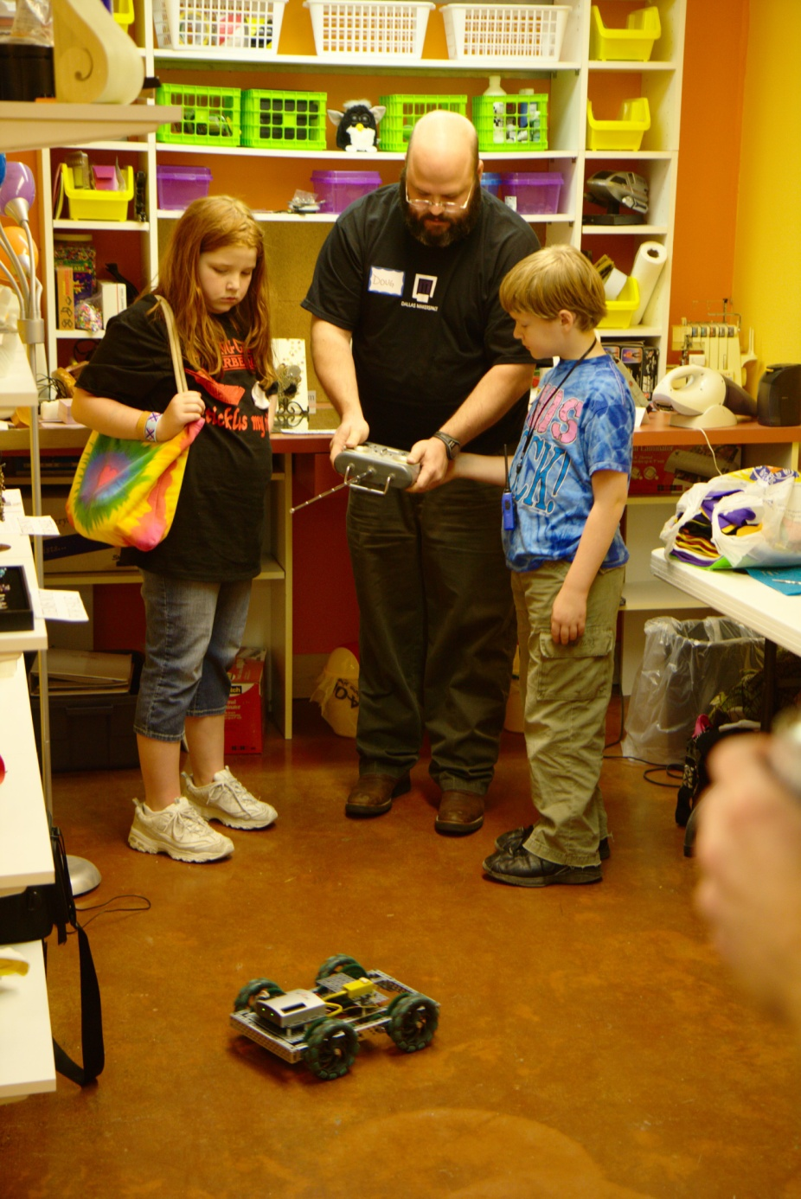
What is a hackerspace?
Teaching, learning,
and inspiring:
  Community outreach
Sharing
Predicting changes
Trending technology
inspire, learn, teach, create, and much more!

Slide 4
What is a hacker?
What is a hacker?

Slide 5
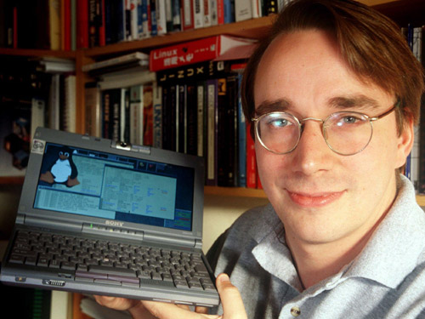
Hackers are:
Scholars, improvers,
and sharers
Linus Torvalds –
Developer of the
Linux kernel

Slide 6
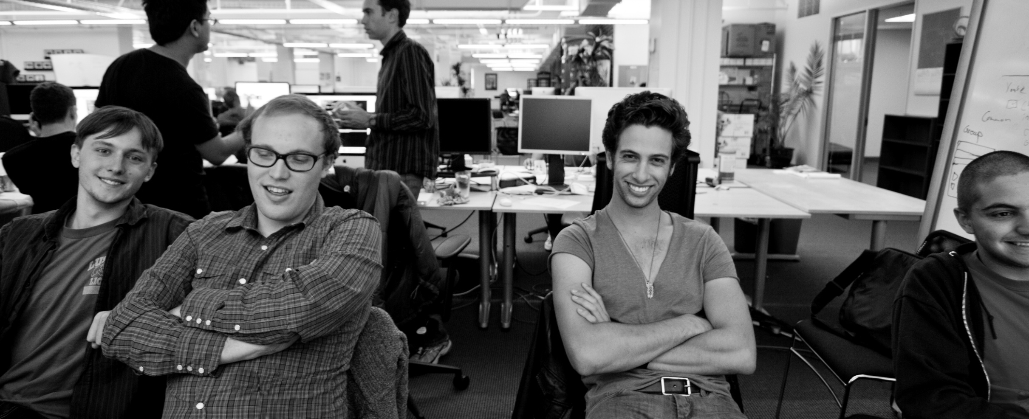
Hackers are:.
Problem Solvers
Ilya Zhitomirskiy, Max Salzberg, Raphael Sofear, and
Dan Grippi – Co-founders of the DIASPORA* distributed
social network
2. An expert or enthusiast of any kind. (i.e. an astronomy hacker)
(RFC1392, The Internet Users Glossary)

Slide 7
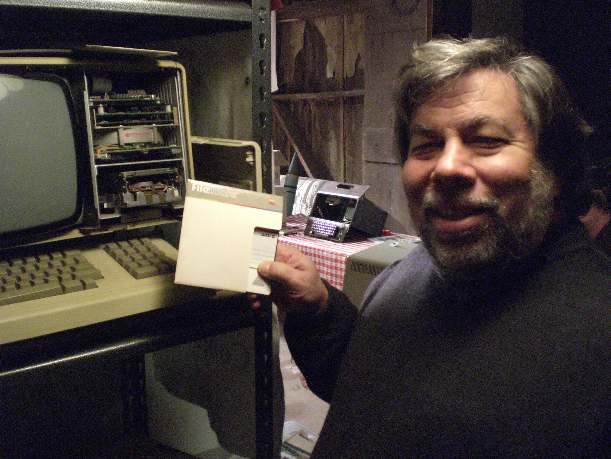
Hackers are:
Passionate,
enthusiastic,
and innovative
Every true hacker makes
a discovery by accident in
the pursuit of the work they love
Steve Wozniak-
Inventor of the Apple
Computer

Slide 8
What hackers are not:

Slide 9
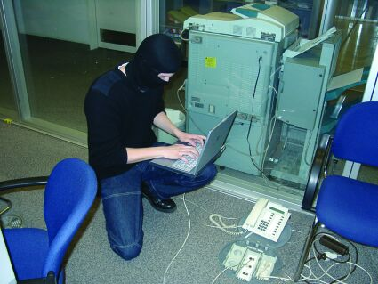
Hackers ≠ Crackers
Hackers do not engage in illicit activity!

Slide 10
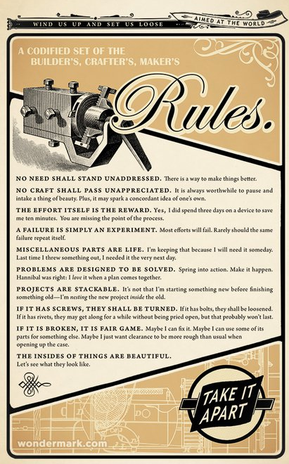
But, using the word “hacker” in hackerspace
still might give some the wrong idea…
So,we suggest calling
it a “makerspace”
instead.
A makerspace with a
focus on developing
Existing technologies

Slide 11
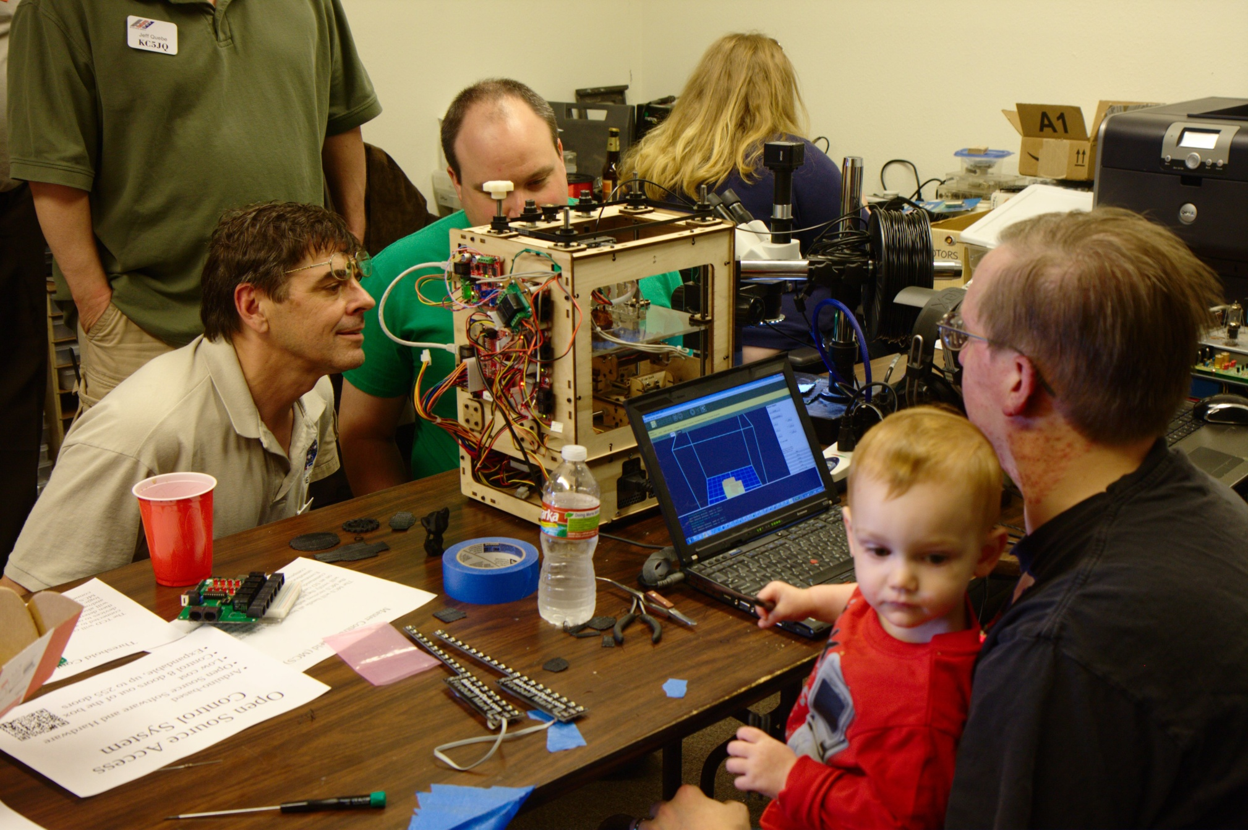
What makerspaces do:
Some examples

Slide 12
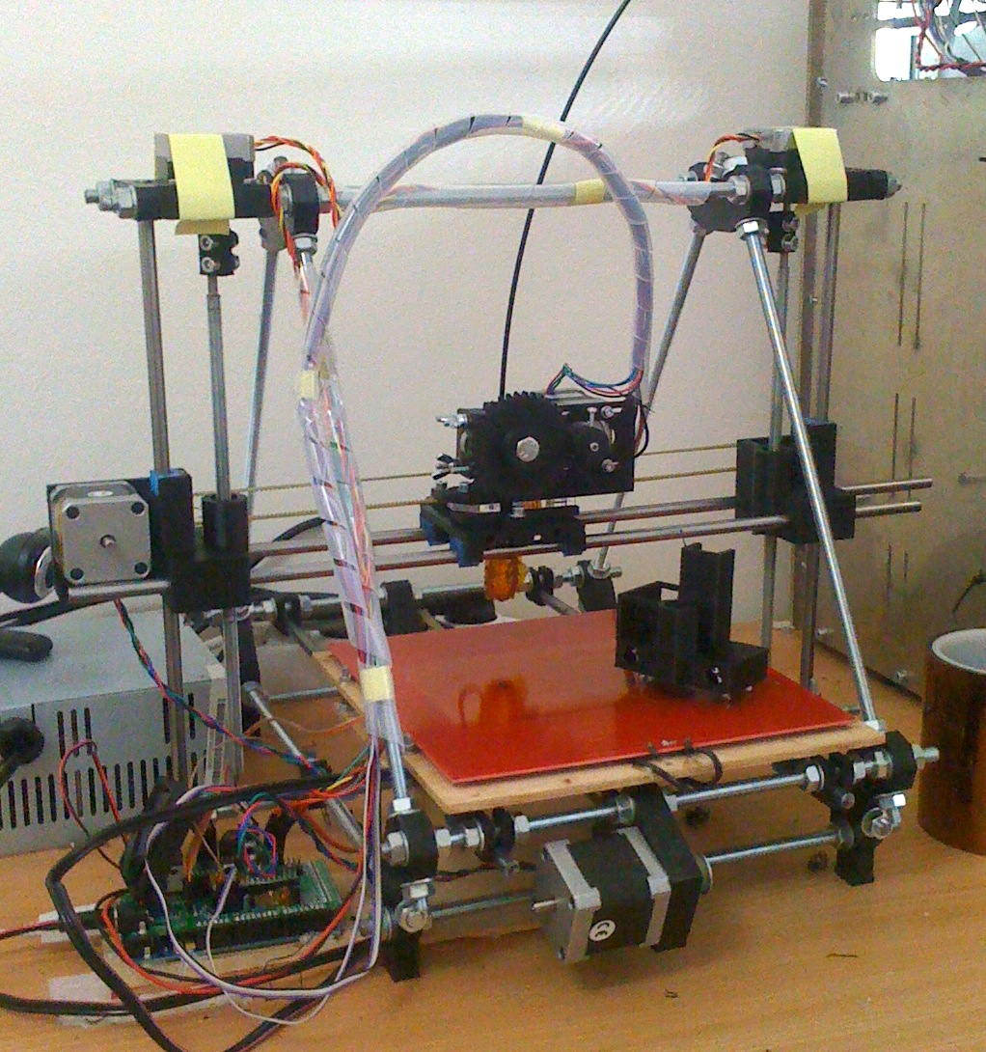
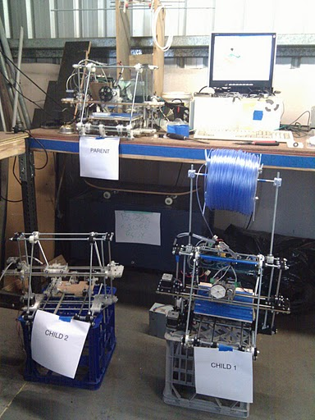
What makerspaces do:
RepRap – Self Replicating 3D Printer

Slide 13
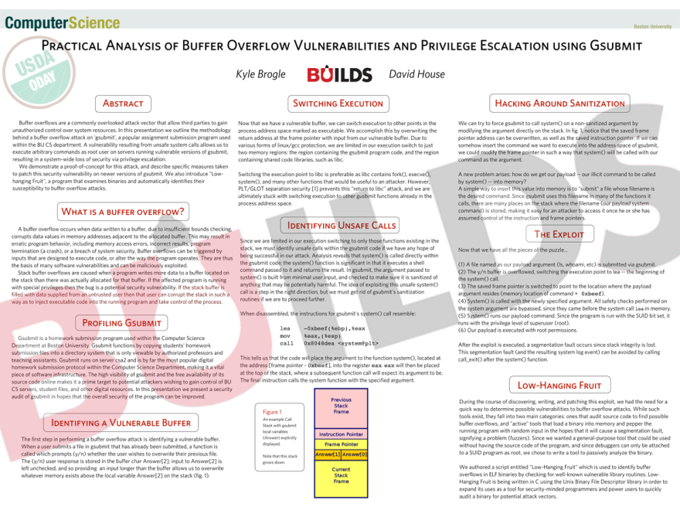
What makerspaces do:
Creative Security Enhancements

Slide 14
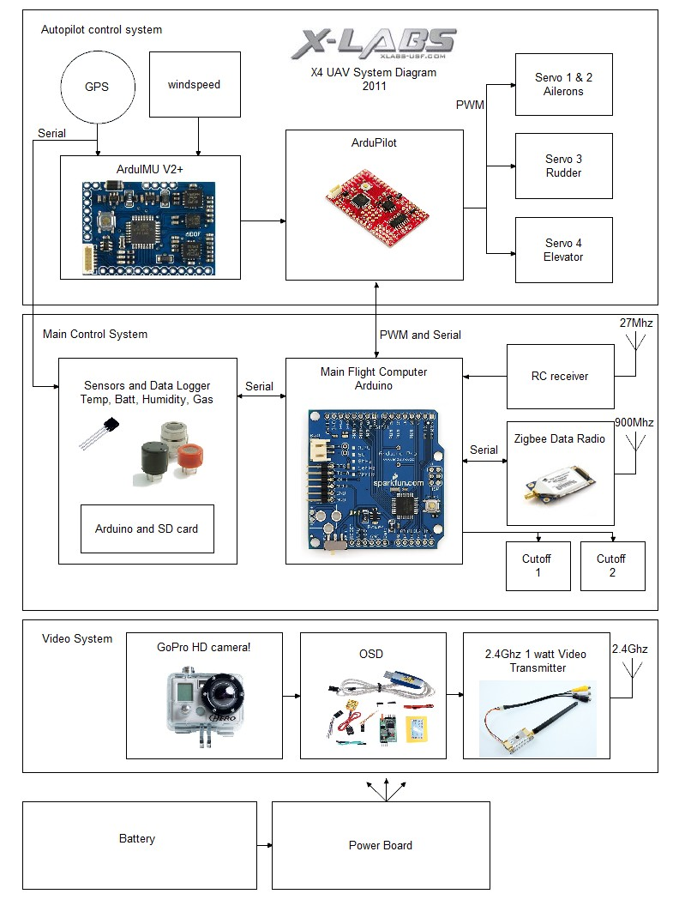
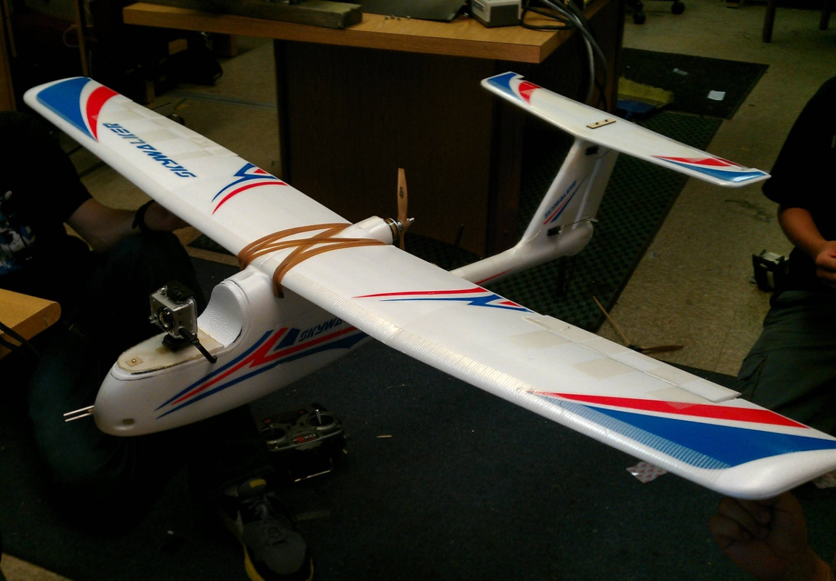
What makerspaces do:
Aerospace Engineering!

Slide 15
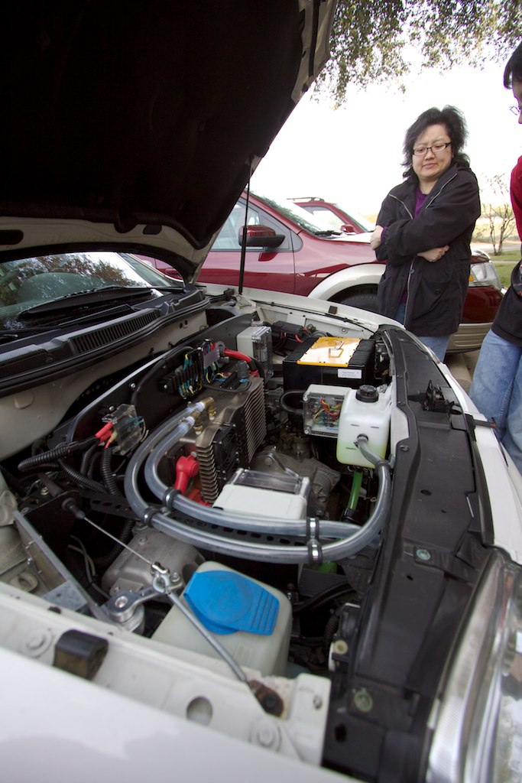
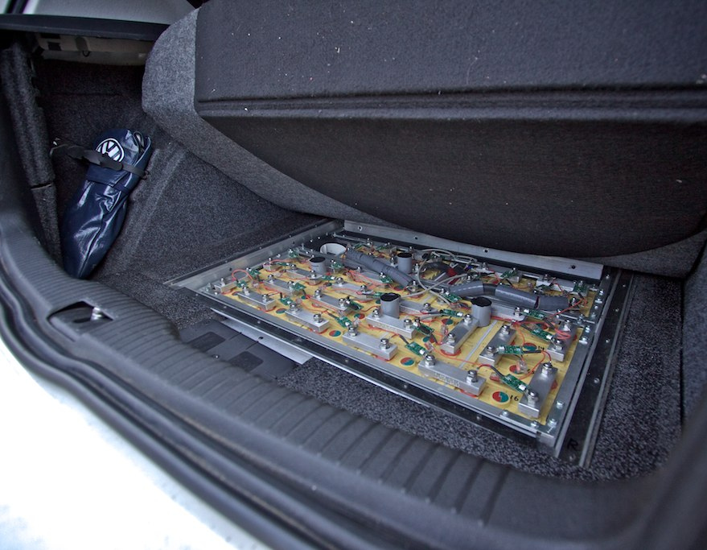
What makerspaces do:
Even Electric Cars!

Slide 16
Can a makerspace work
in a university setting?

Slide 17
Yes!
They are already succeeding in several universities !

Slide 18


Boston University Group
Student Run
(Division of the Association
Of Computing Machinery)
Help develop the school’s
own linux distribution
(BULinux)
Facilitates student-run tech
initiatives

Slide 19

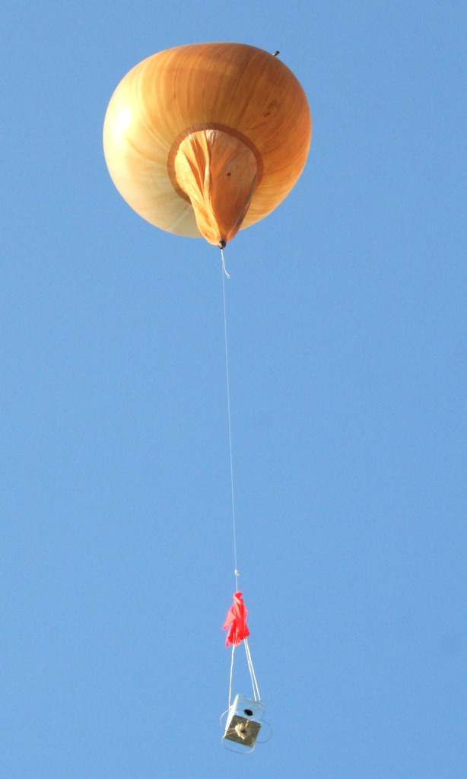
University of South Florida
Student Run
Part of the
Engineering School
Started to showcase the tech skills
of USF students
Promotes innovation
through creative research
High altitude weather balloons and
Unmanned Aerial Vehicle experiments
http://xlabs.eng.usf.edu/

Slide 20
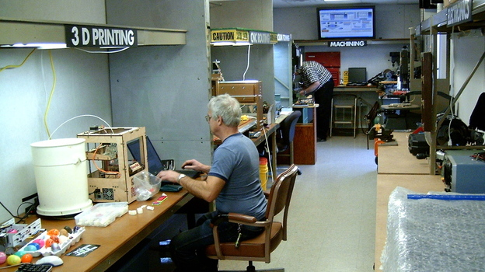
Makerspaces are also appearing in another area:
Libraries!

Slide 21

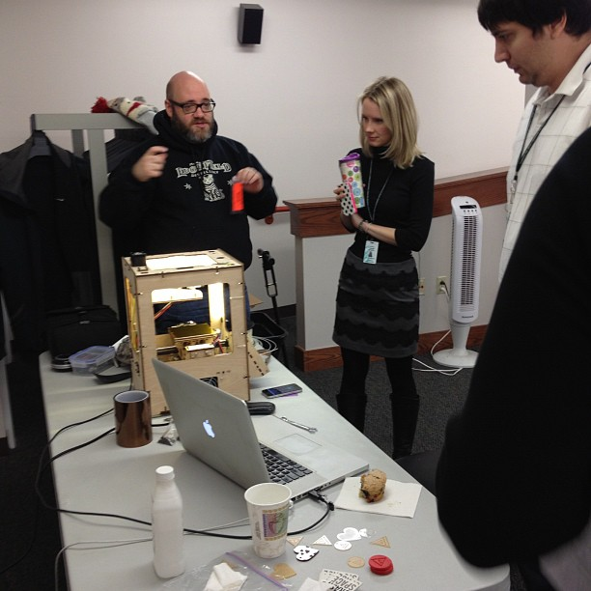
Fayetteville Free Library
in New York
Spurred the movement to put
tinkerspaces in libraries
Offers lots of workshops to the
public on a wide range of
tech/maker technologies

Slide 22
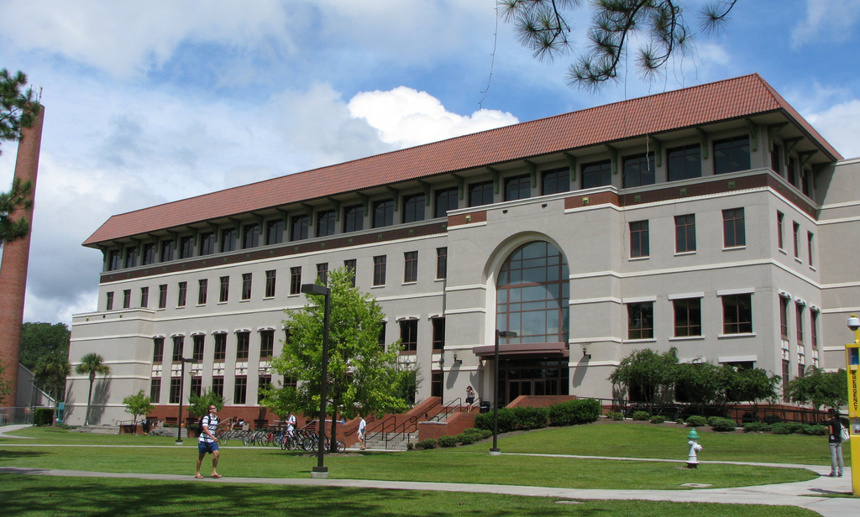
Why not combine these concepts…
and put a makerspace in a university library?

Slide 23
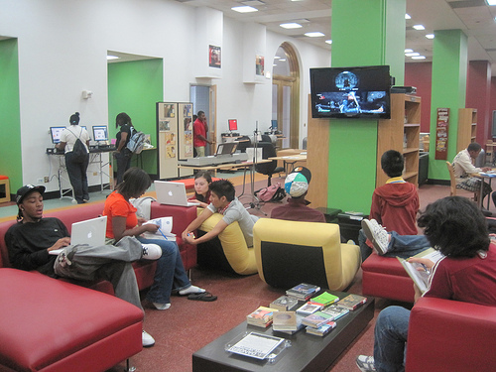
Why put it in a university library?
It makes the space inclusive
University admins recognize the changing state of academic libraries.
Gets science and tech people involved in the library!
Gets people in the library engaged with science and technology!
Helps meet university goals!

Slide 24
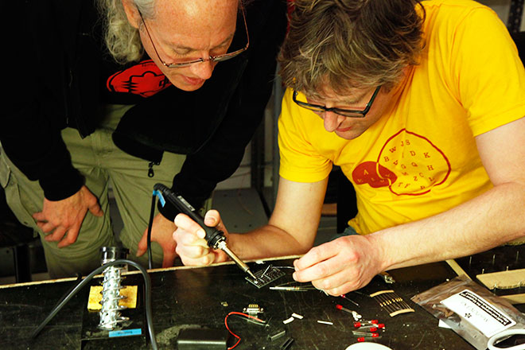
Makerspaces can help meet library and university goals by:
Engaging Students

Slide 25
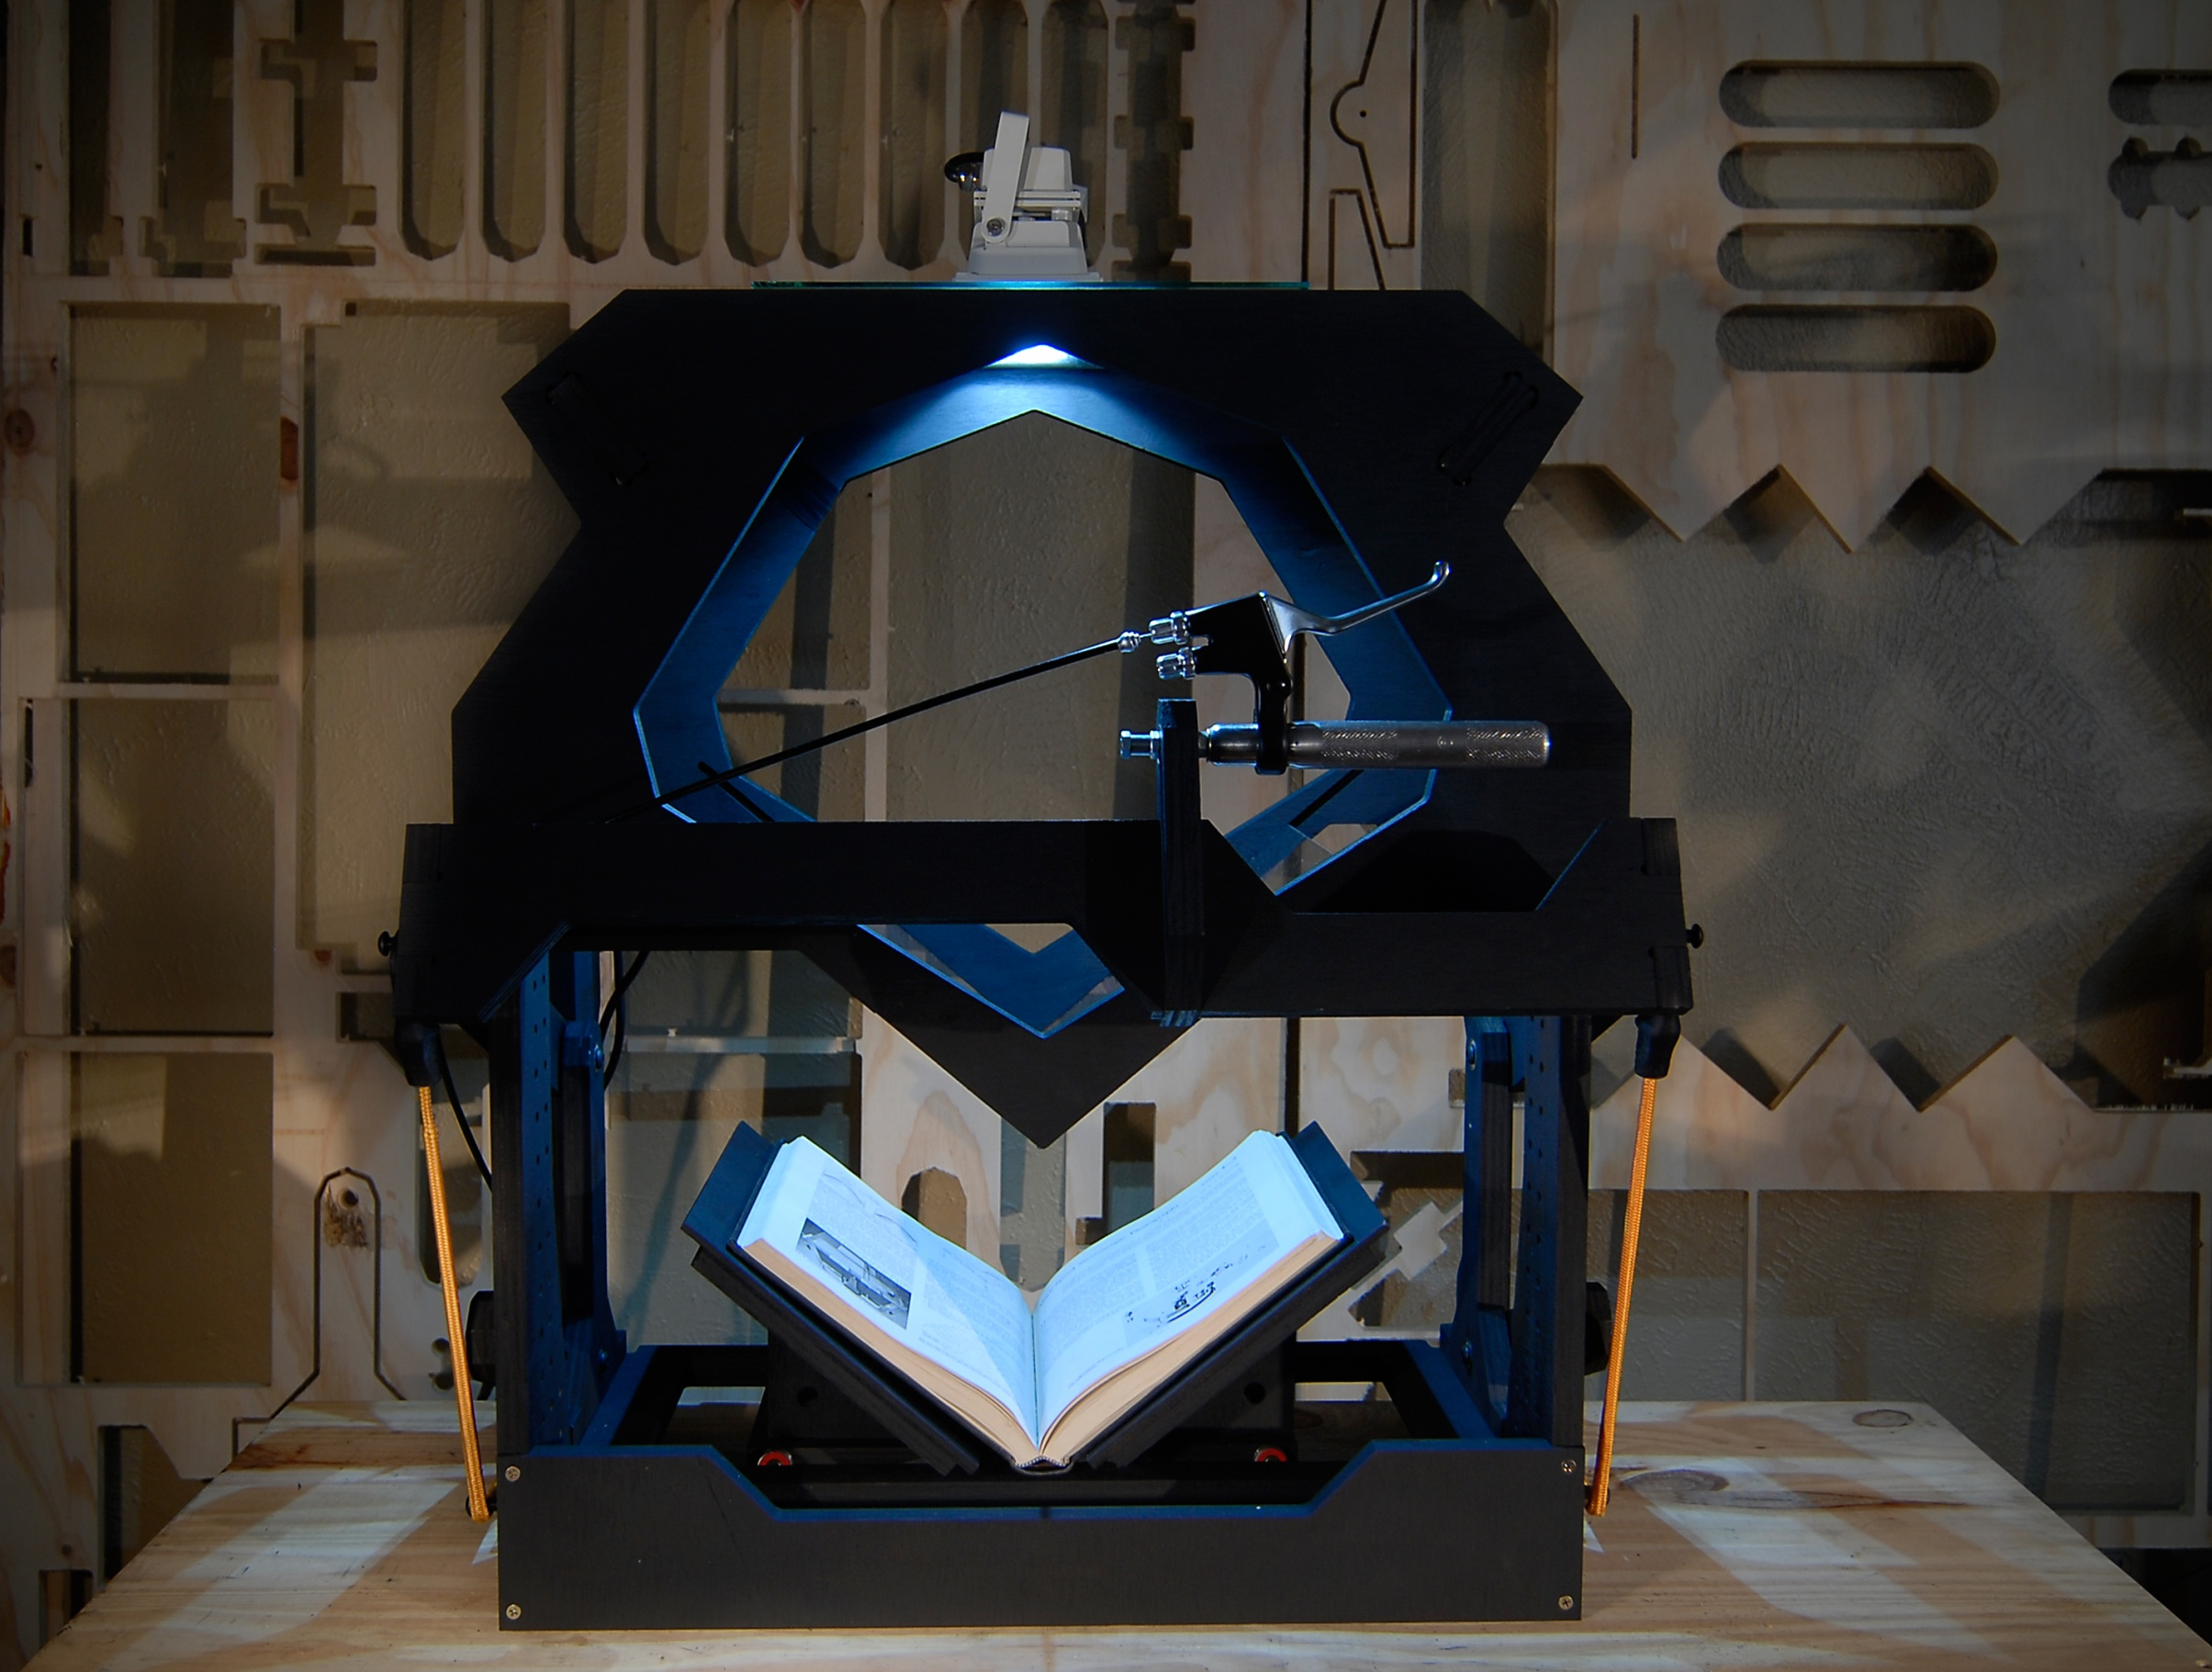
Makerspaces can help meet library and university goals by:
Supporting the Curriculum

Slide 26
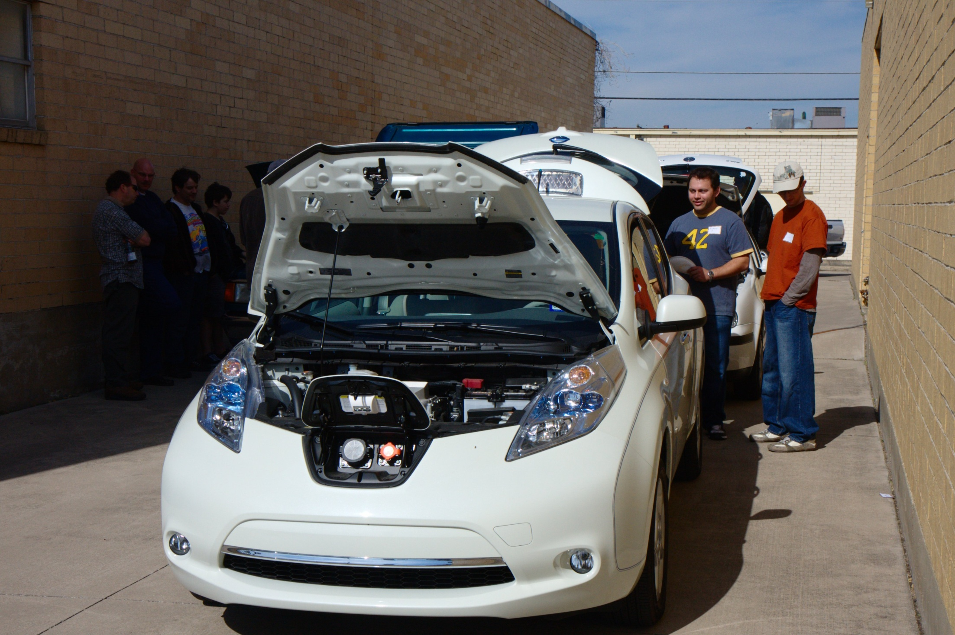
Makerspaces can help meet library and university goals by:
Fostering Innovation

Slide 27
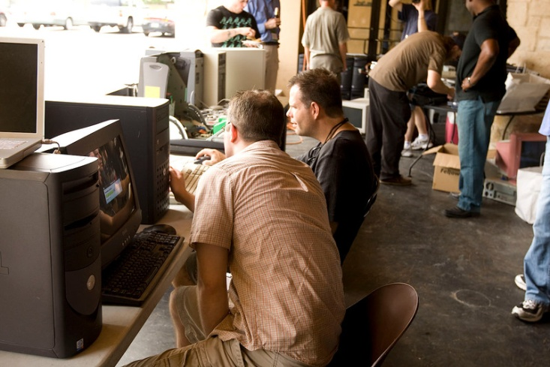
Makerspaces can help meet library and university goals by:
Increasing Technical Awareness

Slide 28
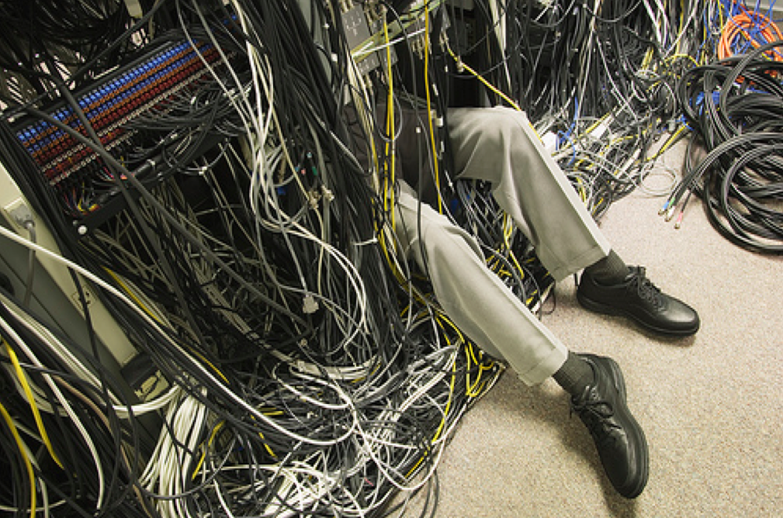
Setting up a makerspace:
It’s not as hard (or expensive)
as you’d think

Slide 29
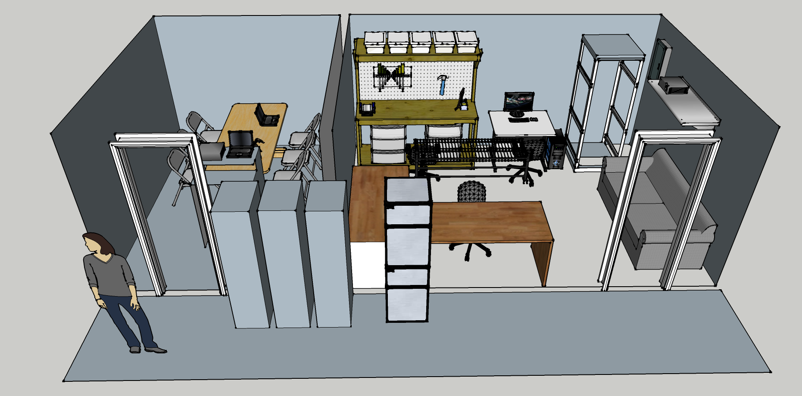
What do you need?
Space
Interested People
Website / Blog
Equipment
A little funding

Slide 30
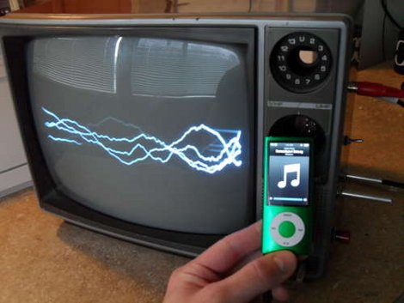
But what about the money?
Hackerspaces are not
expensive
They encourage restoration
of “old” equipment
In addition, there’s lots
of grant funding available

Slide 31
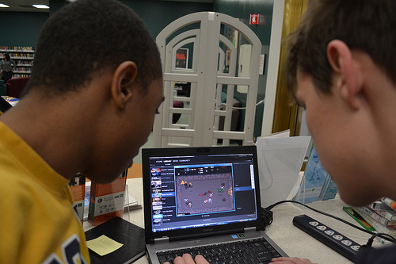
Funding sources for makerspaces
Navy STEM grant
IMLS grant
Kickstarter funding
drive.

Slide 32
Summing it all up
Makerspaces are places that provide the opportunity for people to innovate and learn
They aren’t difficult to start up
They fit naturally into the university world
Including them in academic libraries makes them inclusive and fits where libraries are aiming to go.
Starting one at VSU would help keep the university at the head of the tech curve, where it has been for some time.

Slide 33
Q
Questions?

