Slide 1
Symbolic Logic and Rules of Inference

Slide 2
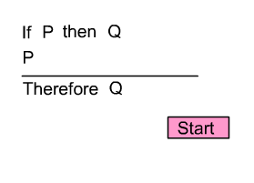
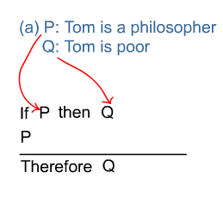
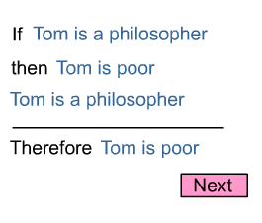
http://philosophy.hku.hk/think/logic/whatislogic.php
If Tom is a philosopher, then Tom is poor.
Tom is a philosopher.
Therefore, Tom is poor.
This is a valid form of argument, or Rule of Inference, called Modus Ponens.

Slide 3
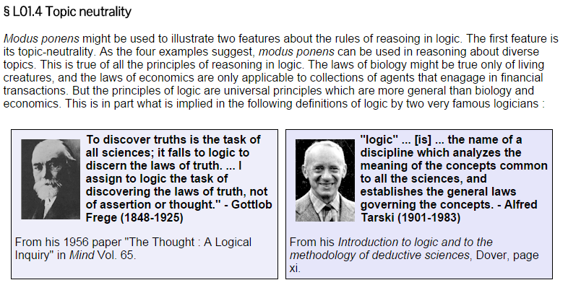
Logic is topic neutral: rules can be used for multiple topics when the form is correct

Slide 4
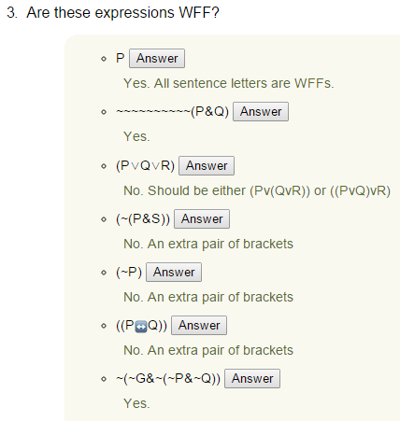
Review of Well Formed Formulas: WFFs http://philosophy.hku.hk/think/sl/wff.php

Slide 5
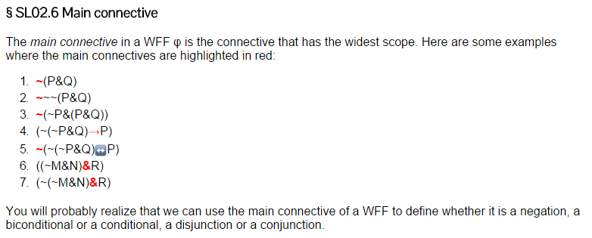
Finding the main connective: http://philosophy.hku.hk/think/sl/wff.php

Slide 6
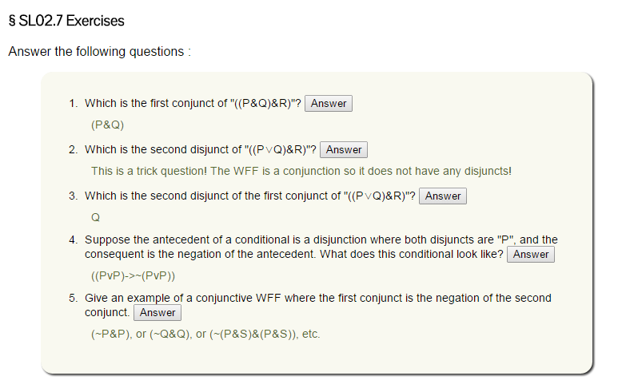
Describing the parts of a well formed formula statement:

Slide 7
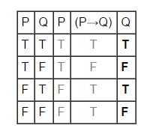
Testing arguments for validity using truth tables:
http://philosophy.hku.hk/think/sl/full.php
P
(P->Q)
Therefore, Q
Valid, no line has all premises true with a false conclusion.

Slide 8
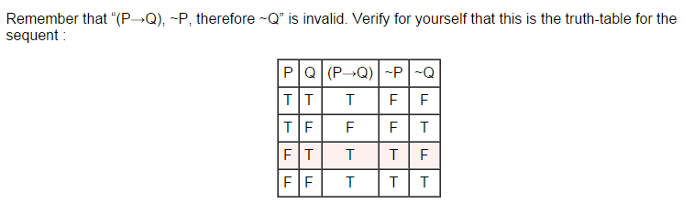
Invalid argument
Has at least one line where all premises are True and the conclusion is False:
P->Q
~P
Therefore ~Q
This is the invalid line, where the premises are both T and the conclusion is False.

Slide 9
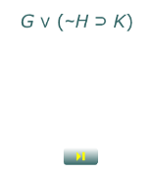
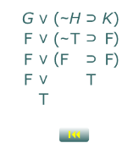
http://www.butte.edu/~wmwu/iLogic/3.2/iLogic_3_2.html
Truth Tables with automatic completion from Butte College in California
On this website, you can click each of the little buttons (they look like Play and Rewind on a remote control) to see how the truth table fills in!

Slide 10
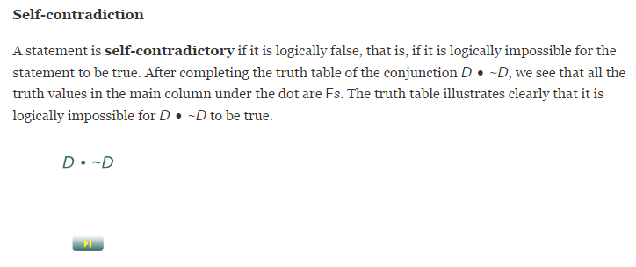
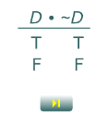
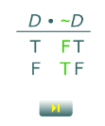
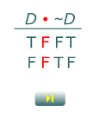
That page also has special sections for single statements and pairs of statements
Single: Tautology, Contradiction, Contingent
Pairs: Logically Equivalent, Logically Contradictory, Consistent and Inconsistent

Slide 11
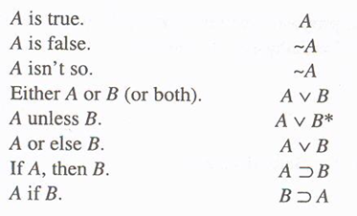
Review: Types of sentences part 1:

Slide 12
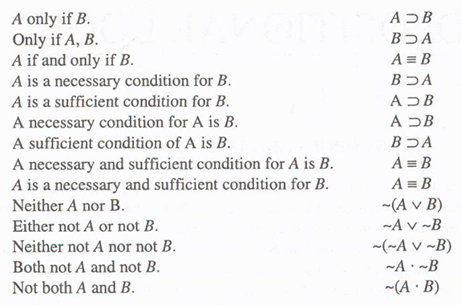
Review: Types of sentences part 2:

Slide 13
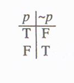
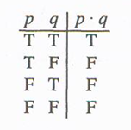
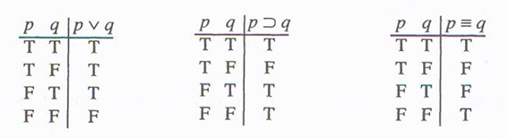
~ • v ⊃ ≡
Truth Functions (how the operators are true or false)

Slide 14
Truth Functions written out in English:
~ changes the truth value of whatever it has “scope” over from T to F and from F to T; note that some ~ are on letters and some are on brackets or parentheses.
• is only True if both sides are True, T•T.
v is only False if both sides are False, FvF. If there is even one T on one side, or T on both sides, the v is true.
⊃ is only false in a line where T⊃F, because that’s like a cause happening without the effect. Any other combination of T⊃T, F⊃T, or F⊃F is T for the ⊃.
≡ is T as long as the sides match, T≡T or F≡F is True for the ≡.

Slide 15
Order of Operations ~ • v ⊃ ≡
1) Tilde ~ on single letters should be done right away, after the letters themselves are already done.
2) Connectors inside parentheses should be done next, after each side in the parentheses is done.
3) Tilde ~ outside of parentheses should be done next. Make sure you are changing the truth value of the connector column, not a side column.
4) Connectors that are in between two sets of parentheses should be done next.
5) Tilde ~ on big brackets, larger brackets [] and {}

