Slide 1

Library Instruction and Ludonarrative Dissonance:
Making Our Rules Fit Our Narrative
Jeffrey Gallant
Assistant Professor and Reference Librarian for Virtual Services
Valdosta State University
Bioshock Infinite, Irrational Games

Slide 2
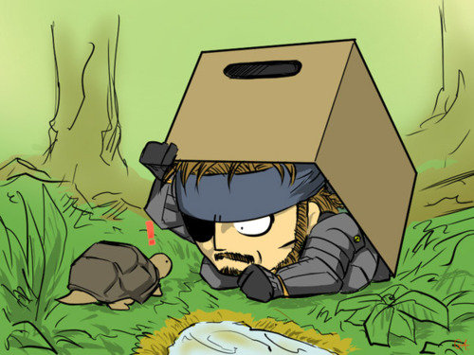
Disclaimer!
The following presentation contains a few quotes with “salty” language.
This presenter believes whole-heartedly that his audience can handle it. ☺

Slide 3

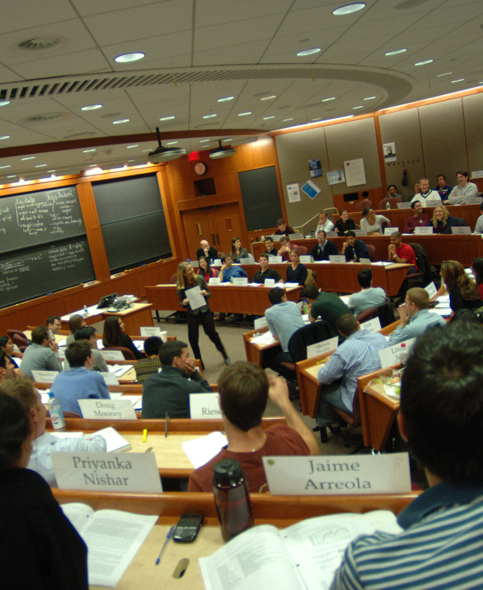
Combining My Professions

Slide 4
Instruction
Music Performance
Clarity and Projection
Engagement
Analysis / Reflection

Slide 5
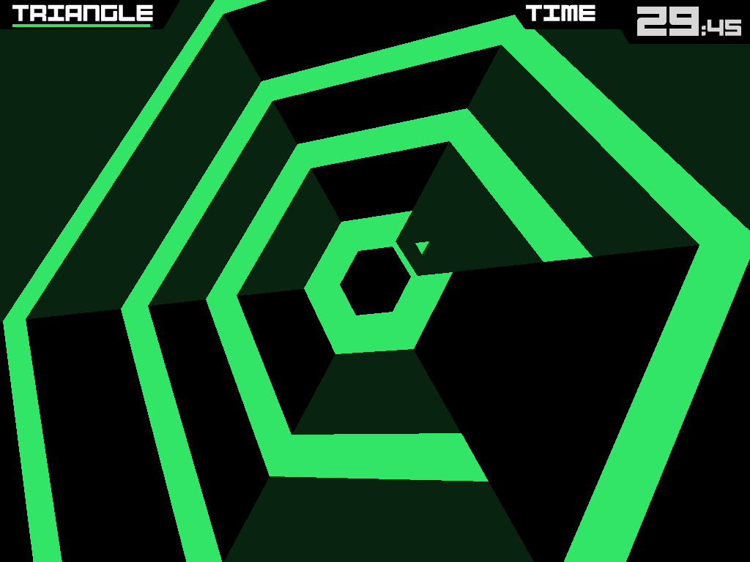
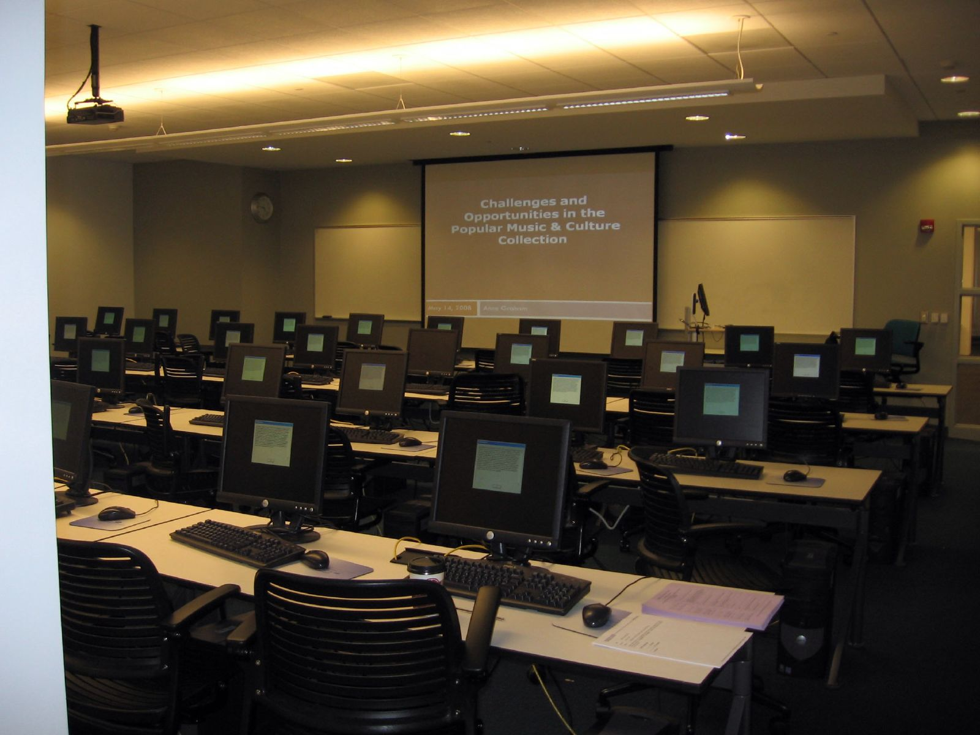
Combining My Interests
Super Hexagon, Terry Cavanagh

Slide 6
Instructional Design
Game Design
?
?
?

Slide 7
Isn’t this just “gamification?”
Ian Bogost, Chair in Media Studies and Professor of Interactive Computing, Georgia Tech:
“Gamification is bullshit.”

Slide 8

“More specifically, gamification is marketing bullshit, invented by consultants as a means to capture the wild, coveted beast that is videogames and to domesticate it for use in the grey, hopeless wasteland of big business, where bullshit already reigns anyway.”
Ian Bogost, “Gamification is Bullshit, http://www.bogost.com/blog/gamification_is_bullshit.shtml

Slide 9
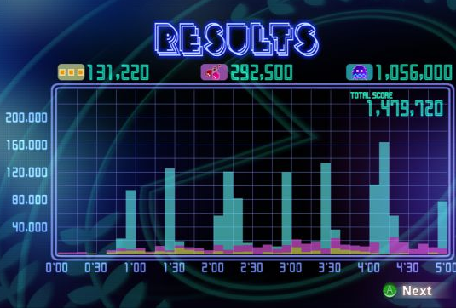
Wait, what?
The “Just add points” mindset isn’t about games. It’s often about framing past practices as something new.
Exploitation in marketing
Buzzwords and masks to justify current practices
Pac-Man CE DX, Namco

Slide 10
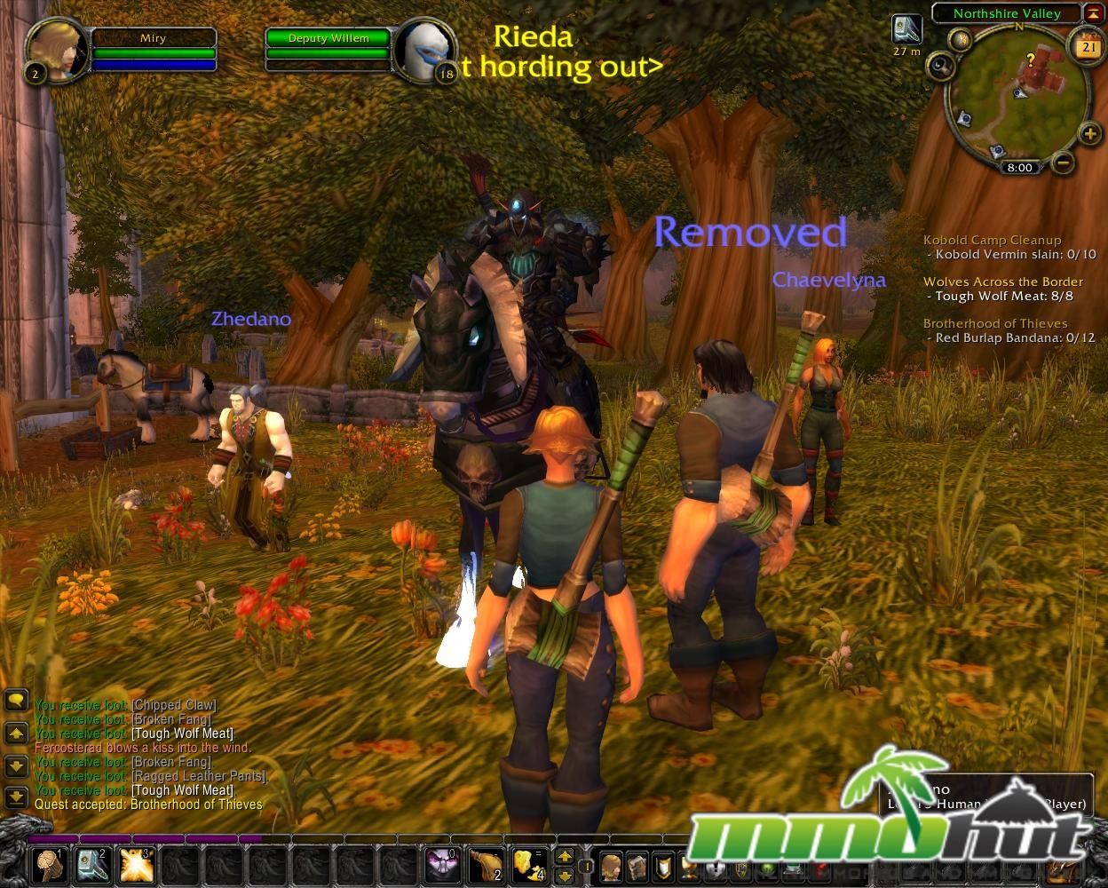
Plenty of scholarly literature on
“role assumption”
For example:
Barab, S., Gresalfi, M., & Ingram-Goble, A. (2010). Transformational play: Using games to position person, content, and context. Educational Researcher, 39
This isn’t really about play, it’s narrative design, only working with the story within a role-playing game. It’s scenario-focused, and not about actions.
World of Warcraft, Blizzard

Slide 11
Game Design
Instructional Design
Play
Learning.
is

Slide 12
If not “gamification” or role literature, then what?
“Ludonarrative Dissonance in Bioshock” by Clint Hocking
The “Ludodeca-hedron” blogs
In-depth, open-access games criticism

Slide 13

Games criticism FTW
Games criticism addresses the “why” of games in the same way that literary criticism addresses the “why” of literature
The gamification and role-playing movement only addressed the “what,” and barely scratched the surface
Looking at game design and instructional design is highly qualitative
Shin Megami Tensei IV, Atlus

Slide 14
Ludonarrative Dissonance
Coined in Clint Hocking, “Ludonarrative Dissonance in Bioshock”,
http://clicknothing.typepad.com/click_nothing/2007/10/ludonarrative-d.html

Slide 15
What’s Ludonarrative Dissonance?
A distance or clash between the two contracts the
game developer has with the player:
Narrative Contract
Ludic Contract
&
The values presented to the player through the game’s story, setting, and characters
The values presented to the player through the rules of play
The “rules” of the game

Slide 16
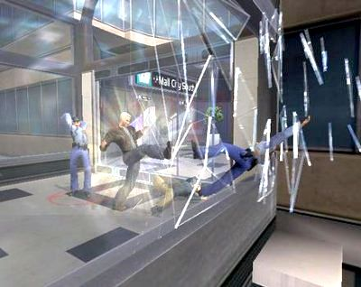
Minority Report: Everybody Runs (2002)
Narrative: You are part of the Precrime Division of the police. You go on missions to prevent murders from happening in the near future. There hasn’t been one murder in six years because of Precrime.
Play: When you enter a mission, you kick people ten feet across the room into hazardous materials or a fryolator, or just throw them off of skyscrapers. These people should all be dead. There is no reaction from the character when this violence happens.

Slide 17
Why did this happen?
Lazy or rushed design (If it’s a movie-licensed game, this is usually the case.)
Lack of collaboration (the programmers, game designers, and story designers probably didn’t talk much)
When the issues are this obvious, there’s a planning problem.

Slide 18
A typical argument…
Not enough money with the staff we have!
(Couldn’t you have done a smaller-scale game?)
Not enough time with the assignment we were given!
(The movie studio may have forced the design and deadline on the team. This happens, but it shouldn’t. The team should manage up if possible.)

Slide 19
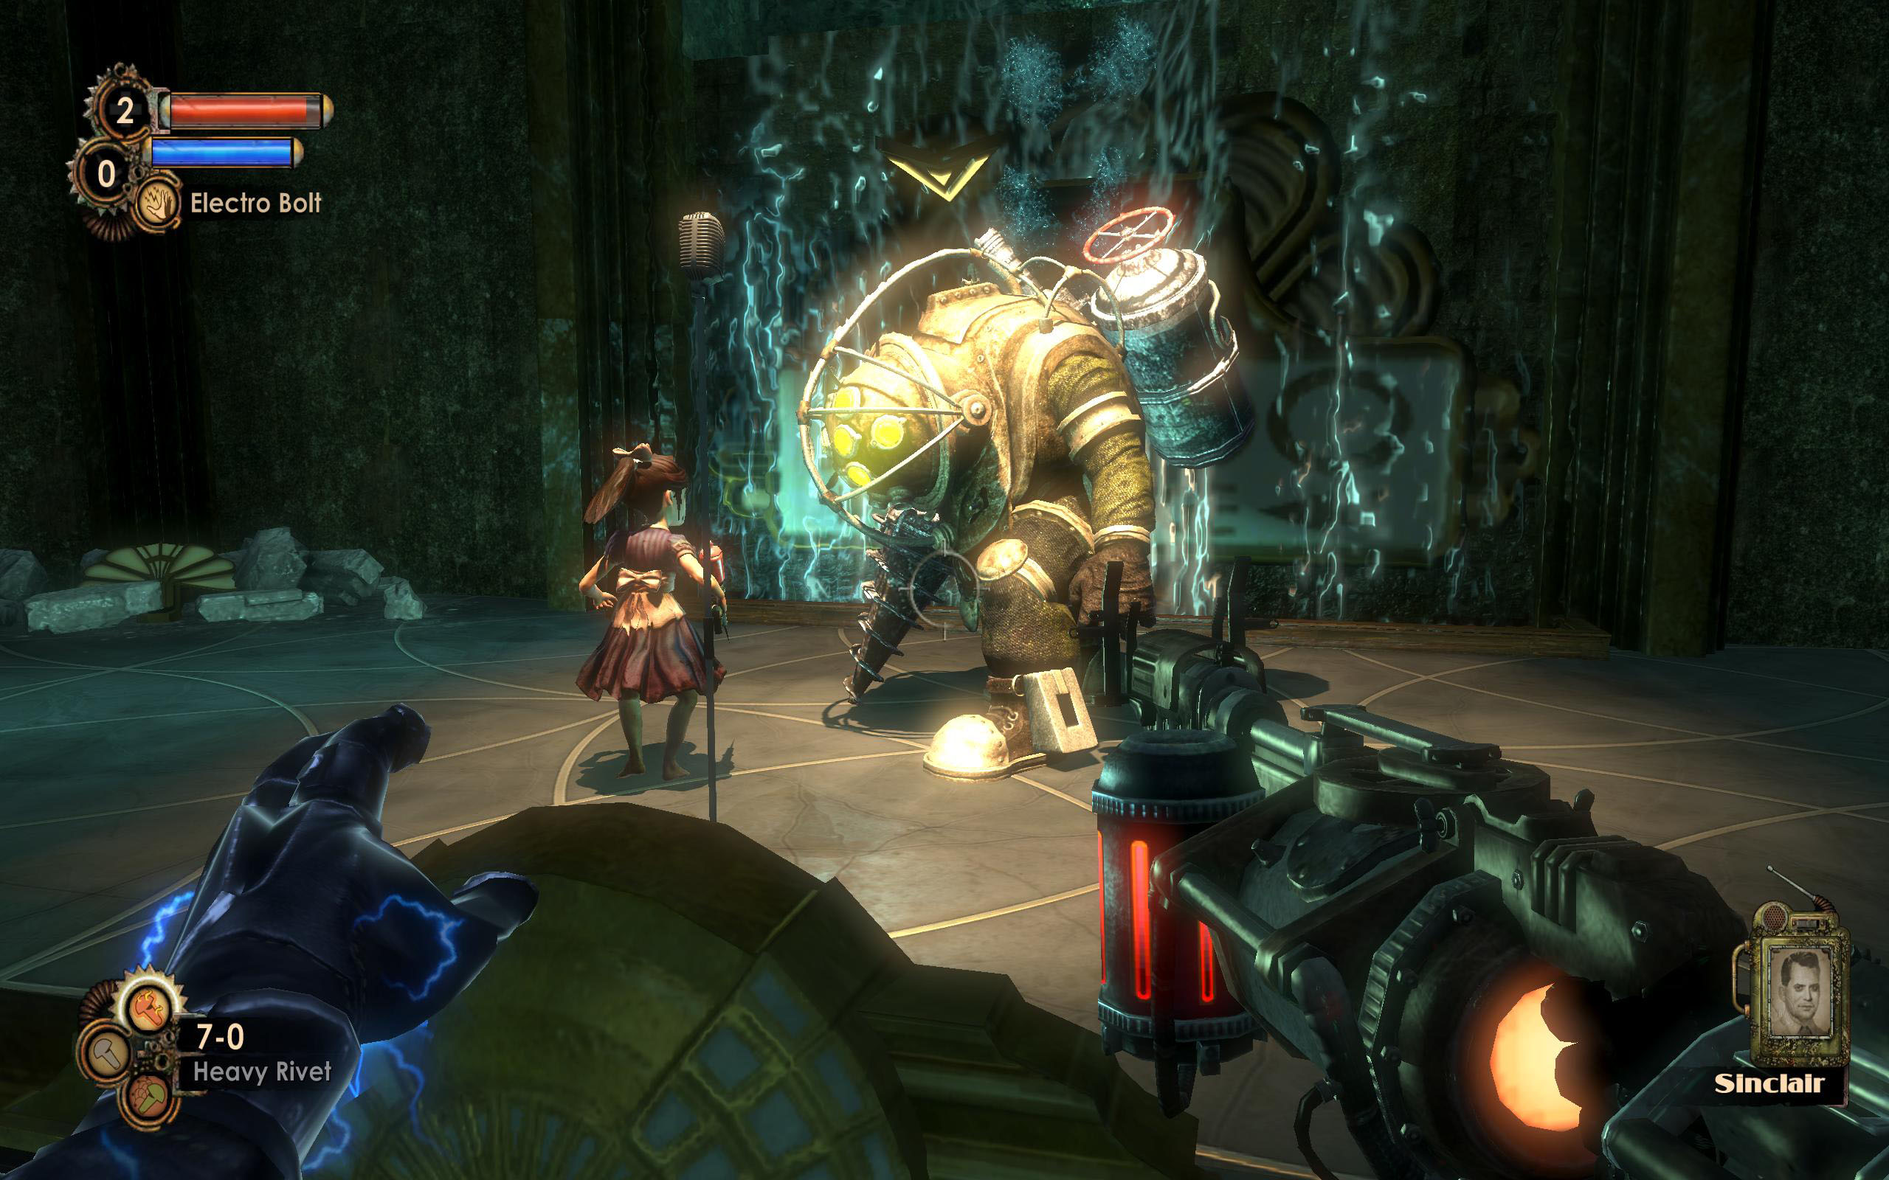
Difficult Example: Bioshock
“Bioshock is a game about the relationship between freedom and power… It says, rather explicitly, that the notion that rational self-interest is moral or good is a trap, and that the ‘power’ we derive from complete and unchecked freedom necessarily corrupts, and ultimately destroys us.” –Clint Hocking
Saving the innocent characters in this game and being altruistic hurts you throughout the game, with no positive outcome whatsoever.

Slide 20
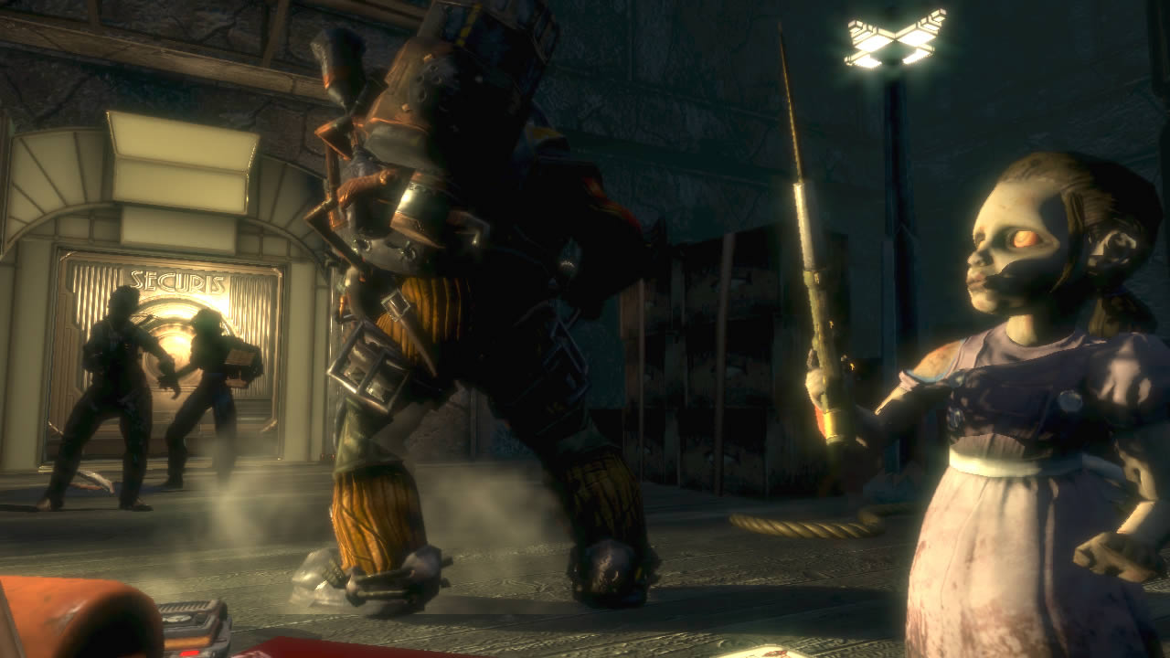
Why is this a difficult example?
It could be intentional, and up to the player to make the decision between making the game easier and being the better person. The narrative might be focused on self-reflection and not the protagonist.
When you have to nitpick to this depth, you’ve done a great job. Nothing’s going to be perfect.

Slide 21
Information Literacy Instruction
Narrative Contract
“[Information literacy] enables learners to master content and extend their investigations, become more self-directed, and assume greater control over their own learning.”
ACRL, “Information Literacy Standards for Higher Education,” http://www.ala.org/acrl/standards/informationliteracycompetency

Slide 22
Examining Ludic Planning in basic library instruction
Focus on the actions (our substitute for “play”) in a library instruction session plan, and you may find the following:

Slide 23
“Lecture” Library Instruction
Ludic Contract
Students must listen to and follow the librarian during the lecture. The objective is for the student to pass the minimum requirements for their current assignment. The reward is a good grade.
By the way, here’s a paper handout or Libguide link. You don’t need to remember anything! Wait, no no no, Facebook is forbidden!

Slide 24
Typical “Hands-on instruction”
Ludic Contract
Students must listen to and follow the librarian during the lecture. The objective is for the student to pass the minimum requirements for their current assignment. By the way, here’s a paper handout or Libguide link.
…Well, that was a shorter lecture than usual! Get some of your homework done. Feel free to ask your professor course-specific questions, because your knowledge of the assignment affects your grade more than knowing this content.

Slide 25
A typical argument…
Not enough time! We must integrate instruction into the curriculum!
Is time really the issue? Could you make the content more focused, shorten the scope, and address broader outcomes instead?
Students are lazy! It’s Twitter’s fault! (Kids these days!)
If I observe a session where students lose engagement after five minutes or less, I’ve lost my engagement too.

Slide 26
My qualitative goal:
How do I get to this in 50 minutes or less?
Narrative Contract
(Or “Learning Outcomes”)
Students will become masters of their own learning through library content and become self-directed researchers.

Slide 27
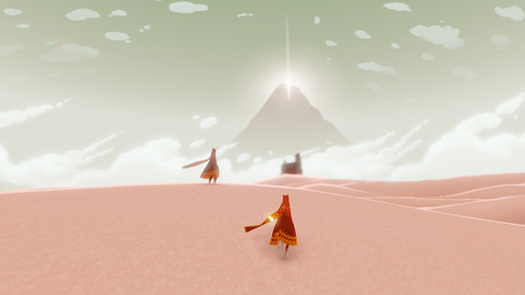
Look at great game design!
Encourage discovery over telling a player what to do.
Make your game simple and focused enough that discovery can happen quickly.
Achieve that simplicity and focus through a well-thought-out set of rules.
Journey, thatgamecompany

Slide 28
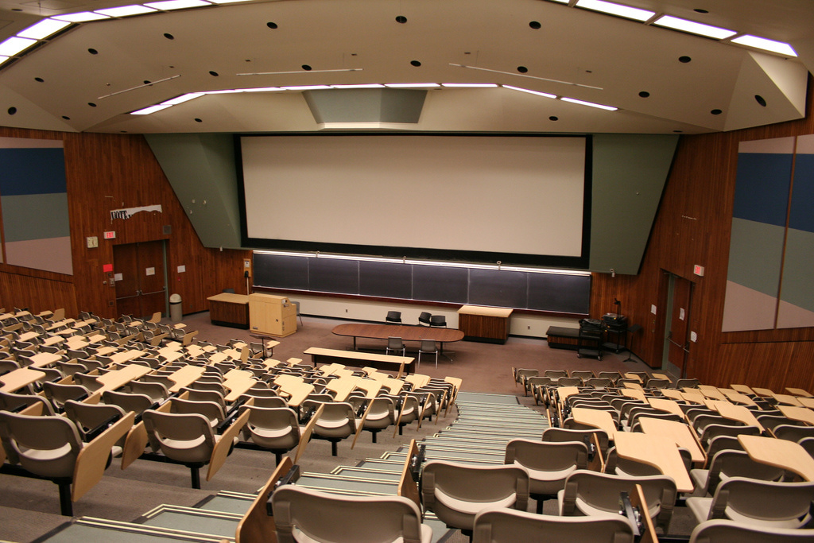
Example: First-year students need to have five library sources in a paper about a particular career.

Slide 29
Typical planning…
Teach and demonstrate how to find:
Monograph Books
Reference Books
Journal Articles
News Articles
Magazine Articles
Trade Publications
Once everything is covered, then it’s a block of hands-on instruction.

Slide 30
No, wait!
What if they’re off-campus? What if they need to know when the library is open? What if they need to create a library account? Add:
Webpage introduction
EZProxy/GALILEO instructions
Hours Pages
Catalog account creation
More! More! More! I can’t miss anything!

Slide 31
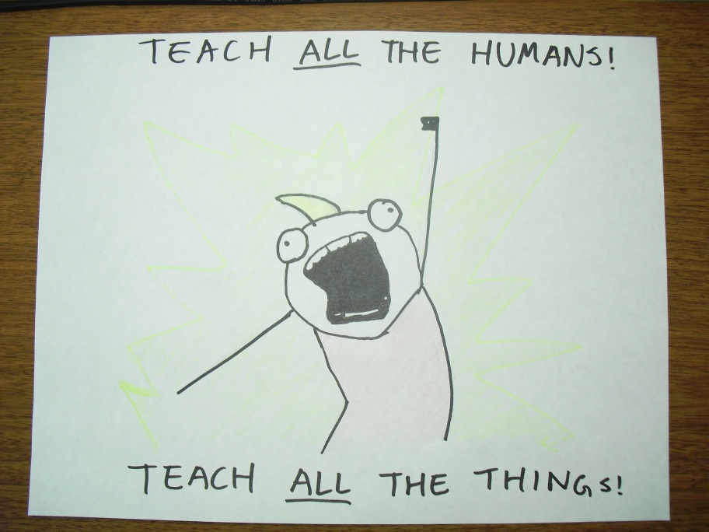

Slide 32
Ludic Planning
My current template: Alternate lecture, exploration, and discovery
Lecture: Direct, set the rules
Exploration: Introduce the content
Discovery: Let students “play” with the resources and learn how stuff works. Encourage this quickly to keep everyone engaged.

Slide 33
Sample Introduction (5 minutes max.)
Introduce yourself (1 minute max.)
Website, Live Chat, and EZProxy (Anywhere Access) (2 minutes max.)
Quick assignment introduction (2 minutes max.)

Slide 34
First source:
Occupational Outlook Handbook
Get everyone up, meet at the front of the room, talk about why they need it, display the handbook, pass it around.
Move everyone to a computer, have them access OOH online.
Instruct students to find their selected job in the handbook, give a 2 minute deadline
Make it clear that you will pick two people to share their findings.

Slide 35
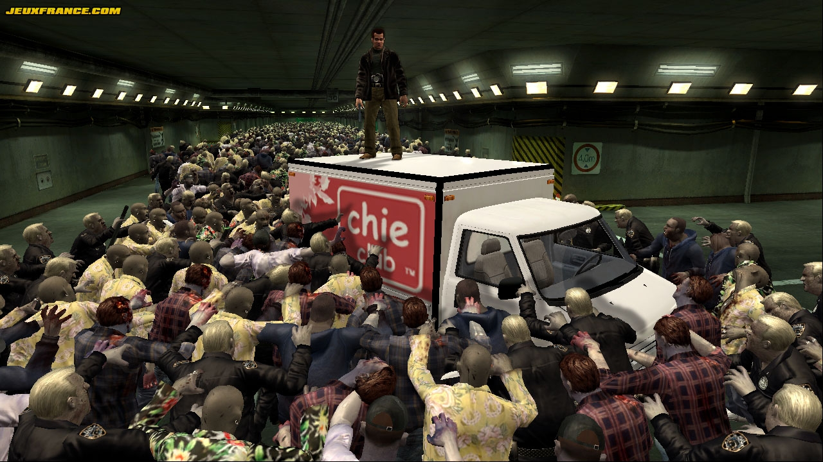
Isn’t this a little frantic?
Sure!
Is that worse than teaching 50 disengaged student zombies for almost an hour?
No!
Dead Rising, Capcom

Slide 36
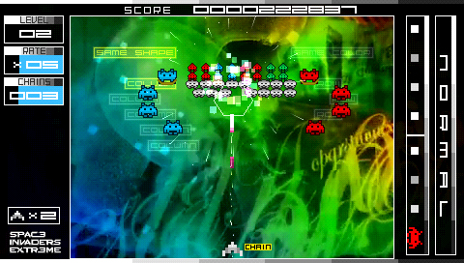
This is just one aspect…
Theming
Immersion
Extrinsic and Intrinsic Rewards
Inclusion
Learning Curve
On and on and on…
Space Invaders Extreme, Taito

Slide 37
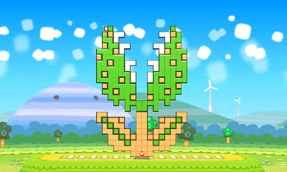
Could we do this without games?
Absolutely, but looking at why you plan they way you plan includes introducing connections to your interests, exploring. It’s reflective and personal.
Looking at the what involves surveying the scholarly research first (did someone already do this?) and measuring the effectiveness of my methods after.
Crashmo, Intelligent Systems

