Slide 1
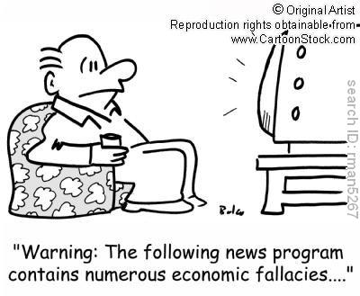
Fallacies

Slide 2
Definition of Weak Analogy
Definition: Many arguments rely on an analogy between two or more objects, ideas, or situations. If the two things that are being compared aren't really alike in the relevant respects, the analogy is a weak one, and the argument that relies on it commits the fallacy of weak analogy.

Slide 3
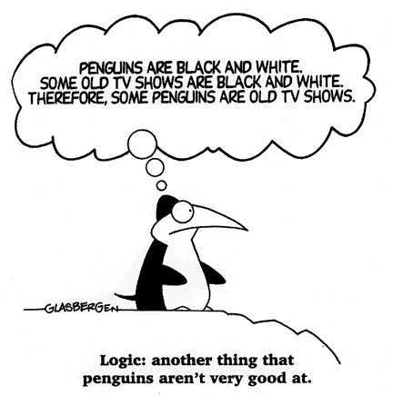
Weak Analogy Example

Slide 4
Ad Hominem
Latin translation to English: “against the man” or “against the person”
Attacking the person instead of attacking his argument. (It may be true of the person, but not valid reasoning).

Slide 5
Example
"Sarah Palin may be a lady, but she ain't no woman. I confess, it was pretty riveting when John McCain trotted out Sarah Palin for the first time. Like many people, I thought, "D*mn, a hyperconservative, f*ckable, Type A, antiabortion, Christian Stepford wife in a 'sexy librarian' costume -- as a vice president? That's a brilliant stroke of horrifyingly cynical pandering to the Christian right. Karl Rove must be behind it." -- Cintra Wilson, Salon

Slide 6
AD hominem
Examples:
  Clinton’s views on conducting domestic affairs can’t be right. After all, he can’t even conduct himself.
  “I think an overwhelming portion of the intensely demonstrated animosity toward President Barack Obama is based on the fact that he is a black man, that he’s African-American …I think it’s bubbled up to the surface because of a belief among many white people, not just in the South but around the country, that African-Americans are not qualified to lead this great country.”
              Jimmy Carter’s response to Ad Hominem fallacy towards President Obama

Slide 7
Further Explanation on Ad Hominem:
“If you call yourself a critical thinker, ad hominem attacks should not be the extent of your criticisms of those in whom you find fault. Show me one thing Sarah Palin has said or done that's "stupid", and I'll show you something that's perfectly rational for someone with her religious and political convictions. It may be that you simply disagree with her convictions, and you probably have very good reasons for doing so. But if that's the case, don't just say "Sarah Palin is stupid". That's kindergarten talk, and it makes you look bad, not her. Understand why she takes the position she does, then reveal the faults in that position.” –Brian Dunning
Therefore; during the McCain/Palin campaign, people who opposed her ideas simply criticized her on other levels than political beliefs. Some arguments tend to focus on the negative and irrelevant talk about a politician rather than their professional output they could provide to a nation.

Slide 8
Red Herring
Definition:
The arguer introduces an irrelevant point into an argument. He may think (or he may want us to think) it proves his side, but it really doesn’t.

Slide 9
Example:
Baseball player Mark McGwire just retired. Clearly, he deserves to be in the Hall of Fame. After all, he's such a nice guy, and he gives a lot of money to all sorts of charities.
Sesame Street: No Cookie is Safe http://www.youtube.com/watch?v=W1T_no7a-yM

Slide 10
Appeal To Pity
Also known as: Ad Misericordiam
Explanation:
When using appeal to pity, the arguer tries to get people to agree with their opinion by evoking pity and sympathy. Empathy can be a very strong emotion in people - it is important in any type of social groups, animal activist groups, etc. and is likely an important factor in our development of morals and ethics.

Slide 11
Example:
Children International-
  As a nonprofit humanitarian organization, we strive to help children around the world overcome the burdens of poverty to become healthy, educated, self-sustaining and contributing members of society.
EXAMPLE: from www.children.org
  Isabel E. Desperately Needs Your Help! Her family's monthly income is only $240. At 10 years of age, she has so much potential but
  needs your love and support.
  Your monthly sponsorship gift of $22 will provide Isabel E. with:
  Emergency Food
  Medical and Dental Care
  Educational Support
  Family Assistance
  Clothes, Shoes and More!
Please sponsor Isabel E. so she can escape poverty and achieve her dreams.
Explanation:
  We fall into pity, knowing that out of 22 $ maybe 10 of it will go to the child. Also we know that no matter which country the child lives in $10 or even $22 isn't enough to provide all of the things promised!

Slide 12
Appeal to Ignorance
Examples:
    “Since all who have tried to prove freedom of the will have failed, we are safe in assuming we are not free.”
    “Even the atheist Freud admitted that the existence of God can't be disproved. So we have good reason to continue to believe in him.”

Slide 13
Equivocation
Examples:
    : “The sign said "fine for parking here", and since it was fine, I parked there.”
    “Criminal actions are illegal, and all murder trials are criminal actions, thus all murder trials are illegal.”
    “A plane is a carpenter's tool, and the Boeing 737 is a plane, hence the Boeing 737 is a carpenter's tool.”

Slide 14
Appeal to popularity
Examples:
    “7 in 10 doctors say acupuncture works, therefore it must work”
    “Bill says that he likes the idea that people should work for their welfare when they can. His friends laugh at him, accuse him of fascist leanings, and threaten to ostracize him from their group. He decides to recant and abandon his position to avoid rejection.”

Slide 15
Hasty generalization
Marriah Hall
Examples:
      Fred, the Australian, stole my wallet. Therefore, all Australians are thieves.
      I’ve met three race drivers today and they all were aggressive. Clearly, all race drivers are aggressive.

Slide 16
Questionable Cause
It's Friday, the 13th. That's what caused me to fail the test.
We never had any trouble with the TV until George moved into the house. He must be the one who caused it to break.
https://www.youtube.com/watch?v=uuqfZB1WlWI Cat causes alarm clock problems and lateness/animated
https://www.youtube.com/watch?v=-gLle5PmSNQ#t=28 actual cat alarm clock

