Slide 1
Venn Diagrams and Categorical Syllogisms
Unit 5

Slide 2
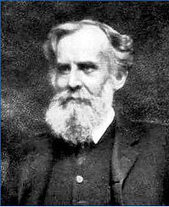
John Venn
1834 – 1923
English logician and philosopher noted for introducing the Venn diagram
Used in set theory, probability, logic, statistics, and computer science

Slide 3
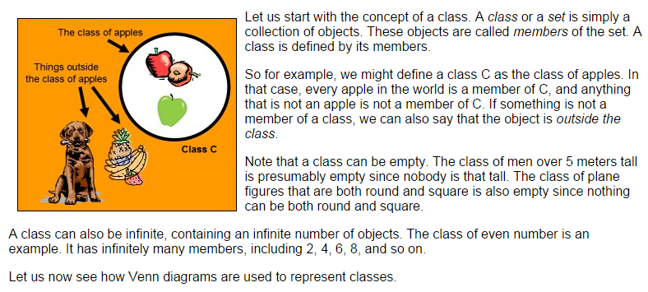
Classes of things represented in circles:

Slide 4
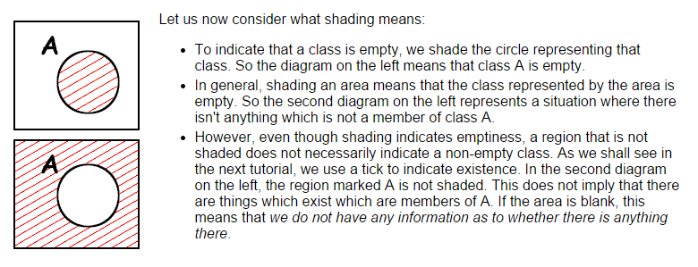
Shading means the class or set of items is empty – there are none that fit that description:

Slide 5
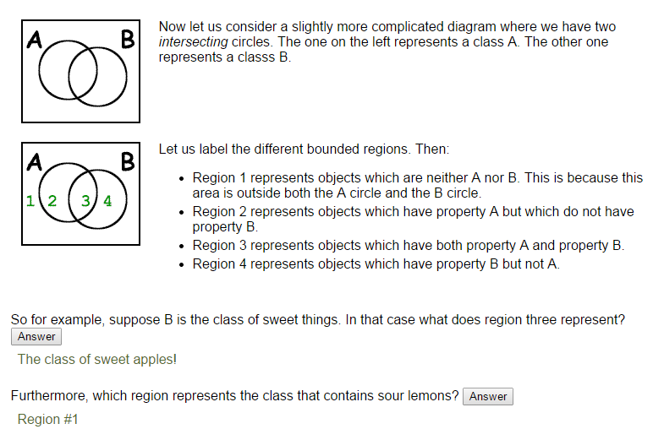
Comparing two different classes:

Slide 6
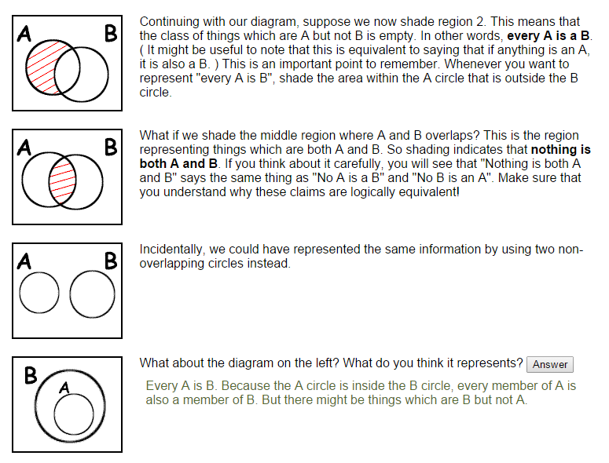
All are, “every” vs. No are, “none”, “nothing”

Slide 7
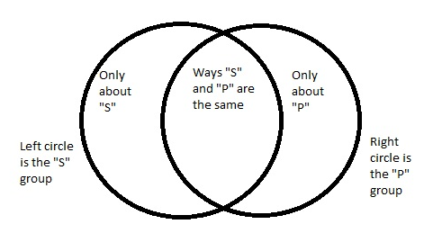
Representing subjects and predicates visually:

Slide 8
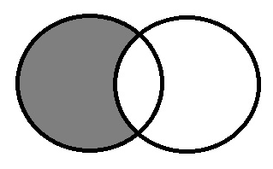
All S are P.
Universal Categorical Statement
All members of the subject class are also members of the predicate class.
All sharks are predators. (The circle on the left represents sharks, the circle on the left is predators.)
All apples are sweet.
We’ve shaded out the area where the non-predator sharks would have been, and where the non-sweet apples would have been.
This is known as an “A” statement.

Slide 9
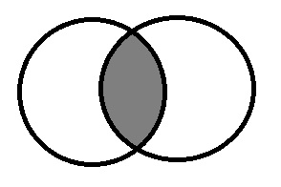
No S are P.
Universal Categorical Statement
No members of the subject class are also members of the predicate class.
No salmon are porpoises.
We shaded the area where a “salmon-porpoise” would have been, because there cannot be anything existing in that area.
This is known as an “E” statement.

Slide 10
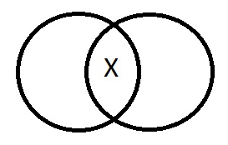
Some S are P.
Particular Categorical Statement
Some members of the subject class are also members of the predicate class.
Some sailors are privates.
The X is placed where the sailors who are also privates would exist.
This is known as the “I” statement.

Slide 11
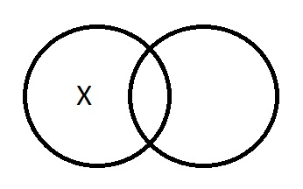
Some S are not P.
Particular Categorical Statement
Some members of the subject class are not members of the predicate class.
Some scholars are not philosophers.
This is known as the “O” form statement.

Slide 12
A, E, I, O
There are four basic categorical statement types, named A, E, I, and O.
The quantity of a categorical proposition is either universal, or particular.
The quality of a categorical proposition is either affirmative, or negative.

Slide 13
A, E, I, O and their quantity and quality
A is the universal affirmative statement.
E is the universal negative statement.
I is the particular affirmative statement.
O is the particular negative statement.

Slide 14
The meaning of “some”
In categorical logic “some” means “at least one”, which is considered its minimal meaning.
“Some” is the standard form particular quantifier.
So, for example, the I statement, “Some buses used by the city are roadworthy machines”, would mean there’s at least one bus used by the city (but not necessarily any more than that one) that is a roadworthy machine.

Slide 15
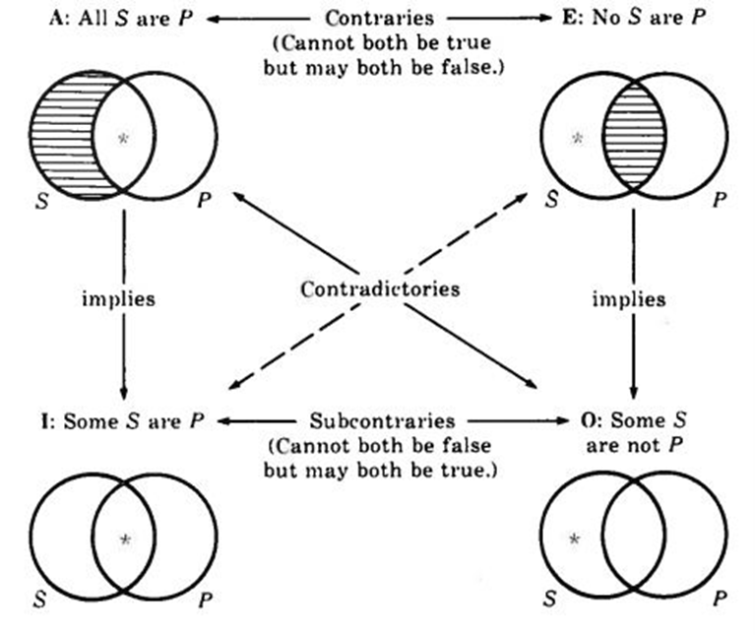
The Square of Opposition: How the four types of categorical statements relate to each other

Slide 16
Practice:
Which diagram goes with each of the following categorical propositions? Give the letter type, and draw the Venn diagram.
1. No Catholics are Protestants.
2. Some cats are Persians.
3. Some dogs are not hunters.
4. All Georgians are Americans.
5. No fish are bipeds.

Slide 17
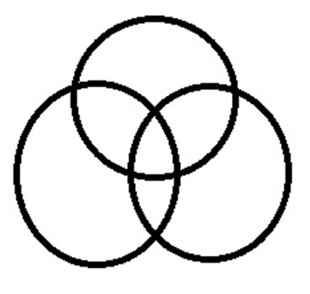
Categorical Syllogisms
Made up of three statements, giving three specific classes of things and how they relate
http://philosophy.hku.hk/think/venn/tute3.php
The webpage above is interactive, and shows how the three statements can be placed on a Venn Diagram made of three circles.

Slide 18
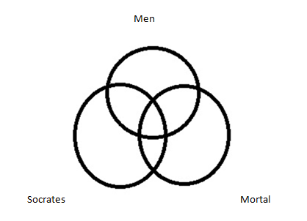
Imagine how to shade in:
All men are mortal.
Socrates is a man.
Therefore, Socrates is mortal.

Slide 19
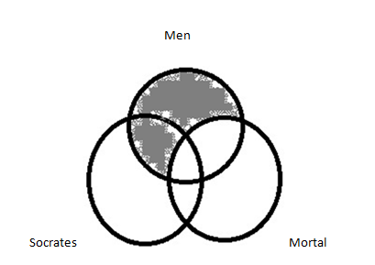
First shade in All men are mortal:

Slide 20
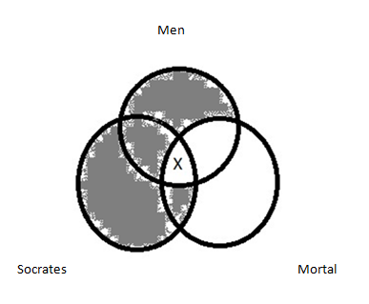
Now shade in:
Socrates is a Man
And check to see if there is a space where Socrates can be mortal as well – there is, where the X appears below:
This is considered “valid” because the Venn diagram shows that the conclusion is necessarily true: there is no space left for a Socrates who is non-mortal!

Slide 21
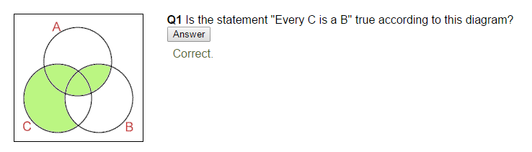
Checking what is true on a Venn diagram:

Slide 22
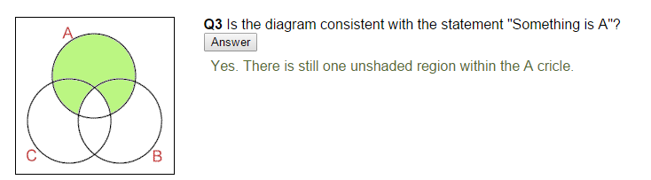
Checking what is true on a Venn diagram:

Slide 23
Venn Diagram checker
http://philosophy.hku.hk/think/venn/venn-program.php
Use this link to double check how you represent statements on Venn diagrams
The page immediately after it explains how to use “ticks” on a Venn diagram to check Categorical Syllogism arguments for validity

Slide 24
Mood (cont.)
Example:
All dictators are tyrants.
All czars are dictators.
Therefore, all czars are tyrants.
The mood of this example is AAA.

Slide 25
A Question For You
Selecting from the list below, what is the mood of this syllogism?
No candidates are witnesses.
Some lawyers are witnesses.
So, some lawyers are not candidates.
A. OIE
B. IOE
C. EIO
D. AOI

Slide 26
Answer
Selecting from the list below, what is the mood of this syllogism?
No candidates are witnesses.
Some lawyers are witnesses.
So, some lawyers are not candidates.
A. OIE
B. IOE
C. EIO (Correct)
D. AOI

Slide 27
Figure
The figure of a syllogism is determined by the position of the middle term.
Example:
All dictators are tyrants.
All czars are dictators.
Therefore, all czars are tyrants.
In this example the middle term is “dictators”.

Slide 28
Substituting the letters for the terms
(M) dictators- (P) tyrants
(S) czars- (M) dictators
(S) czars- (P) tyrants
This gives us:
M P
S M
S P
S refers to the subject term of the conclusion.
P refers to the predicate term of the conclusion.
M is the middle term, it only appears in the premises.

Slide 29
The 4 Figures:
M P P M M P P M
S M S M M S M S
S P S P S P S P
1STfigure 2NDfigure 3rd figure 4th figure

Slide 30
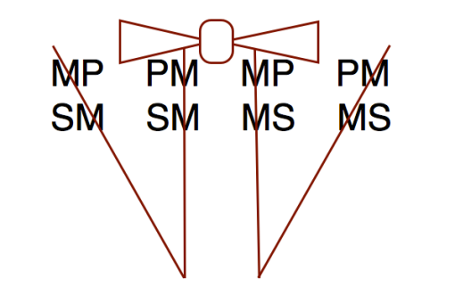
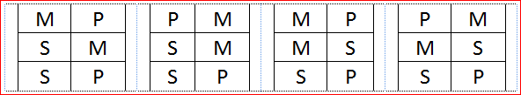
Figures represented as a bow tie and collar on the M (middle terms)
Figure: 1 2 3 4

