Slide 1
Chemical Energy 2
Objective: Learning about chemical reactions, bond energy and energy released in chemical reaction.
Key concepts:
Chemical Formula
Balancing Chemical Reactions
Bond Energy
Energy in Chemical Reactions
Acids and Bases
pH Scale

Slide 2
Chemical Formula Notation
The expression O₂ means there are 2 atoms of O
The expression H₂O means there are 2 atoms of H and one atom of O
The expression H₂ S O₄ means there are 2 atoms of H, one atom of S, and 4 atoms of O
Chemical Reaction - Elements can combine to make compounds and represented by Chemical Equations.
Example: Table Salt - Sodium Chloride - NaCl
Physical and chemical properties of NaCl is completely different from properties of individual Na and Cl elements
Reactants Products
Reacting substances
Newly formed substances

Slide 3
Balancing Chemical Equations
Chemical Equations are balanced in a similar way to nuclear equations: you just have to make sure that there is the same number of atoms of each element on both sides.
You balance each element separately but …
often we have molecules where one atom of one kind must be joined with more than one atom of the other kind. “Make odds even” is used to deal with this problem, which makes these problems more challenging than nuclear ones.
You must watch for subscripts and interpret them correctly to get your element count correct.
***Law of mass conservation in chemical reactions - Atoms are neither destroyed nor created during chemical reaction (reactants only rearrange to make new molecules)

Slide 4
Balancing Chemical Equations
Example:
H Cl + NaOH → NaCl + H₂O
Left side (Reactants): 2 H, 1 Cl, 1 Na, 1 O
Right side (Products): 2 H, 1 Cl, 1 Na, 1 O
This is a balanced chemical reaction equation!
Remember that the subscript 2 in H₂O means there are two H atoms in this molecule.
Reacting substances
Newly formed substances

Slide 5
Balancing Chemical Equations
Example:
H₂(g) + O₂(g) H₂O (g)
Not balanced
Reactants: 2 H and 2O atoms
Products: 2 H and 1 O atoms
2H₂(g) + 1O₂(g) 2H₂O (g)
Balanced
Reactants: 4 H and 2O atoms
Products: 4 H and 2 O atoms
NO(g) N₂O (g) + NO₂ (g)
Not balanced
Reactants: 1N and 1O atoms
Products: 3 N and 3 O atoms
3 NO(g) N₂O (g) + NO₂ (g)
Balanced
Reactants: 3N and 3O atoms
Products: 3 N and 3 O atoms

Slide 6
Balancing Chemical Equations
Practice:
a) ____C₂H₂ + ____O₂ ____CO₂ + ____H₂O
b) Balance this equation and determine how many molecules of H₂ are formed if 16 molecules of HCl are reacted.
____ Mg + ____ H Cl → ____ MgCl₂ + ____ H₂

Slide 7
Balancing Chemical Equations
Practice:
a) __5_C₂H₂ + _5__O₂ __4_CO₂ + __2_H₂O
Reactants: 10 H, 10 C and 10 O atoms
Products: 10 H, 10 C and 10O atoms
b) Balance this equation and determine how many molecules of H₂ are formed if 16 molecules of HCl are reacted.
__2_ Mg + __4_ HCl → __2_ MgCl₂ + __2_ H₂
4HCl: 2 H₂= 16 HCl: 8 H₂
Reactants: 2 Mg, 4 Cl and 4 H atoms
Products: 2 Mg, 4 Cl and 4 H atoms

Slide 8
Quantities in Chemical Reactions
The ratio of hydrogen atoms to oxygen atoms used to make water molecules is always 2:1, no matter how many water molecules are being made. It is impossible to organize atoms one at a time! (Need a new unit)
Chemists use a different unit for large number of atoms and molecules. A mole (mol) represents 6.022 × 10²³ things, called Avogadro’s number. (Just as a dozen implies 12 things)
The word mole can be used to represent atoms or molecules— if we have 6.022 × 10²³ O atoms, we say we have 1 mol of O atoms. While, 1 H₂ molecule contains 2 H atoms, therefore 1 mol of H₂ molecules (6.022 × 10²³ molecules) has 2 mol of H atoms or (2 × 6.022 × 10²³ atoms).
***Using formulas to indicate how many atoms of each element we have in a substance, we can relate the number of moles of molecules to the number of moles of atoms.

Slide 9
Quantities in Chemical Reactions
Example : If a sample consists of 2.5 mol of ethanol (C2H6O), how many moles of carbon atoms, hydrogen atoms, and oxygen atoms does it have?
Solution: We apply the appropriate conversion factor for each element:

Slide 10
Quantities in Chemical Reactions
It is useful to associate atomic mass with a mass in grams. It has been found that 1.01g H, 14g N, 16 g O, 23 g Na or 35.45 g Cl have 6.02x10²³ atoms (1 mole).
The mass of one mole is called “molar mass”. For example: 1 mol C = 12.01 g C (atomic mass of C is 12.01!). This can also be expressed as 12.01 g/mol.
Converting between grams and moles:
If we are given the # of grams of a compound we can determine the # of moles, & vise-versa.
In order to convert from one to the other you must first calculate molar mass
g = mol x g/mol
mol = g ÷g/mol
This can be represented in an “equation triangle”
g
mol
g/mol
Formula | g/ mol | g | mol
NaCl |  | 58.45
HCl |  |  | 0.5
HNO₃ |  | 53.15

Slide 11
Bond Energy
Energy is always required to break a bond. Energy is released when a bond is made.
When atoms combine to make a compound, energy is always given off, and the compound has a lower overall energy.
Bonds between certain specific elements usually have a characteristic energy, called the bond energy, that is needed to break the bond. The same amount of energy was liberated when the atoms made the chemical bond in the first place.
Chemical Reactions Can Be Either Exothermic or Endothermic.
Exothermic Reaction involves Net Release of Energy. Exothermic reactions give off energy, so energy is a product and written with the products
Endothermic Reaction involves Net Absorption of Energy. Endothermic reactions require energy, so energy is a reactant and written with the reactant.

Slide 12
Exothermic vs. Endothermic Reaction
(a) In an endothermic reaction, the energy of the system increases (i.e., moves higher on the vertical scale of energy). (b) In an exothermic reaction, the energy of the system decreases (i.e., moves lower on the vertical scale of energy).

Slide 13
Energy in Chemical Reactions
Example: Let’s examine the electrolysis of water. The general reaction is
2H₂O → 2H₂ + O₂ or H−O−H H−O−H → H−H H−H + O=O
The overall heat of reaction can be calculated as follows:
Thus, this is an Endothermic reaction (energy required) that absorbs 466 kJ. The thermochemical equation is 2H₂O + 466kJ → 2H₂ + O₂

Slide 14
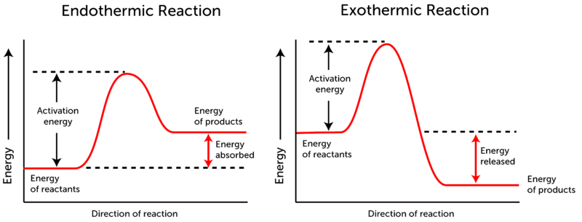
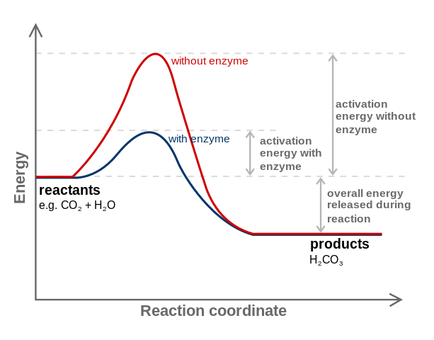
Activation Energy
Energy Needed for Reactants to React is termed the Activation Energy.
Catalysts Speed Up Reaction By Reducing Activation Energy.
If the activation energy is lower, reaction can occur at lower temperature.
Examples of catalysts:
Catalytic converter – car
Enzymes in body
Ozone breakdown by CFC’s in freon.

Slide 15
Acids and Bases
Acids are proton (H⁺) donors and bases are proton acceptors.
Example:
HCN + H₂O ⇔ H₃O⁺ + CN ‒
acid base →
← (acid) (base)
We say that HCN is an acid because an H⁺ ion leaves it to join H₂O to make H₃O⁺.

Slide 16
Acids and Bases
Acids are proton (H⁺) donors and bases are proton acceptors.
Example:
HCO₃– + H₂O ⇔ H₂CO₃ + OH–
base acid →
← (acid) (base)
Here the proton left H₂O to form H₂CO₃ , so water acts like an acid. Interesting!
**Water can be either an acid or a base depending on its function in the reaction!!

Slide 17
Acids and Bases
Acids are proton (H⁺) donors and bases are proton acceptors.
Practice: (Identify the acids and bases)
a) H₃PO₄ + H₂O ⇔ H₂PO₄– + H₃O⁺
→
←
b) NH₃ + H₂O ⇔ NH₄⁺ + OH–
→
←

Slide 18
Acids and Bases
Acids are proton (H⁺) donors and bases are proton acceptors.
Practice: (Identify the acids and bases)
a) H₃PO₄ + H₂O ⇔ H₂PO₄– + H₃O⁺
acid base →
← (base) (acid)
b) NH₃ + H₂O ⇔ NH₄⁺ + OH–
base acid →
← (acid) (base)

Slide 19
Acids and Bases
Did you notice a pattern?
Acids release H⁺ ions in aqueous solution.
H is written first in formula. (Example: HCl)
Bases release OH– ions in aqueous solution.
OH is written last, following metal ion. (NaOH)
Which are acids and which bases?
H₂SO₄ LiOH KOH HCHO₂

Slide 20
Acids and Bases
Neutralization Reactions
When acids and bases react and water is formed plus a salt.
(H⁺ + OH– → H₂O)
Example:
HCl + NaOH → H₂O + NaCl
acid + base → water + salt
Complete this reaction:
HBr + KOH →

Slide 21
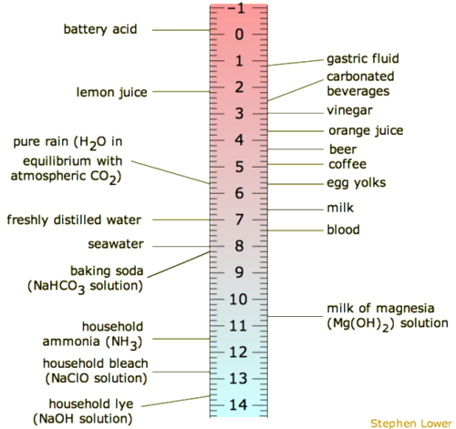
pH Scale
pH Scale: This scale is used to compare how strong an acid or base is.
Acid (<7)
Neutral (7)
Base (>7)

