Slide 1
PHIL 2020 Day 7 Week 4
Continuing types of arguments and evaluating arguments

Slide 2
Deductive and Inductive
Argument based on Mathematics
Argument from Definition
Categorical Syllogism
Hypothetical Syllogism
Disjunctive Syllogism
Prediction
Argument from Analogy
Generalization
Argument from Authority
Argument based on signs
Causal Inference

Slide 3
Evaluating Deductions
Question 1: If you hypothetically accept the premises, do you then have to accept the conclusion?
(Pretend you are living in the imaginary world the premises create, just for a minute.)
If yes, the argument is VALID.
If no, the argument is INVALID.
This is separate from
Question 2: Are the premises each really true?
If all premises are true as statements on their own, SOUND.
If there is even one false premise, UNSOUND.

Slide 4
Officially:
Once you see that an a deductive argument is unsound, it has to also be considered invalid.
However for the sake of our quiz on Unit 2, please do note the argument had a valid structure in which the premises would have made the conclusion true if the premises had been true.
In online quizzes, I will be sure to try and limit the choices so it is clear which is the best answer.
In written exams, you can write VALID and then strike through it as in VALID.

Slide 5
Evaluating Inductions
Question 1: If you hypothetically accept the premises, do you then find the conclusion has a strong likelihood of being true?
(Pretend you are living in the imaginary world the premises create, just for a minute.)
If yes, the argument is STRONG.
If no, or low likelihood, the argument is WEAK.
This is separate from
Question 2: Are the premises each really true?
If all premises are true as statements on their own, COGENT.
If there is even one false premise, UNCOGENT.

Slide 6
Remember:
The two questions are separate:
1. Do the premises give sufficient reason for the conclusion, if you pretend the premises are accurate for the sake of argument?
2. Are the premises actually true on their own?

Slide 7
Types
Deduction
Induction
Arguments based on Math
  Literally facts from math
Arguments based on Definitions
  Terms defined in the argument
Categorical Syllogism
  3 categories, 3 statements
Hypothetical Syllogism
  If—then conditions being met, usually 3 conditional if—then statements
Disjunctive Syllogism
  Either- or choice being made, usually 3 statements as well
Prediction
  Claims about future events
Arguments from Analogy
  Two things are compared and said to be alike in a new way too
Generalization
  Moving from group-individual claims or individual-group
Arguments from Authority
  Usually one individual is named who is well known, a claim about agreeing with them is made
Arguments based on Signs
  Literally a sign or a plaque is claimed to tell the truth
Causal Inference (inferring what caused an effect)
  Seeing some effect or evidence, and then inferring who did it or what did it as in Sherlock Holmes mysteries

Slide 8
What do you think?
1. Joe must own at least ten DVDs, because he’s been buying one a week since he got that DVD player in June.
2. All cats are mammals, and no mammals are fish, so no cats are fish.
3. Either we’ll get Chinese or Thai. But Thai Café is closed today, so we’ll have to get Chinese.
4. The Bobcats will probably come in last place this year because they are a terrible team.
5. Smith must have been smoking in the company front yard again, he’s the only person here who smokes Camels and these are all Camel cigarette butts in the yard.
6. The world is like a huge machine made up of smaller machines, and since machines have intelligent creators, the world must have one too.
7. Philosophers always write both fiction and non-fiction. After all, Sartre and Rousseau both wrote fiction and non-fiction.

Slide 9
At least 10 DVDs
1. Joe must own at least ten DVDs, because he’s been buying one a week since he got that DVD player in June.
Argument based on Math, Deductive
Relying on the math of “1 per week” with us counting the number of weeks since June
Valid and Sound
Premises would lead necessarily to that conclusion (at least 10) and the premises are the kind of imagined scenario we call true in Logic

Slide 10
Mammals, Cats, Fish
2. All cats are mammals, and no mammals are fish, so no cats are fish.
Categorical Syllogism, Deductive
Valid and Sound
If we imagine the premises are true, the conclusion follows necessarily with no alternative and no probability
Sound, all true premises: all cats really are mammals and no mammals are fish.

Slide 11
Either - Or
3. Either we’ll get Chinese or Thai. But Thai Café is closed today, so we’ll have to get Chinese.
This is actually a Disjunctive Syllogism, an example of disjunctive either-or argumentation.
There is a hidden premise/hidden assumption that Thai Café is the only Thai restaurant choice possible – if we assume that is true, then it is valid and the conclusion does follow from the premises. We would say sound as well, as we can assume these premises are indeed all true.

Slide 12
Bobcats a Bad Team
4. The Bobcats will probably come in last place this year because they are a terrible team.
Prediction, Induction
Strength depends on how bad of a team they are – if we accept that they are a terrible team then this is a strong prediction. Cogent.

Slide 13
Whose cigarette butts
5. Smith must have been smoking in the company front yard again, he’s the only person here who smokes Camels and these are all Camel cigarette butts in the yard.
Causal Inference, Induction (inferring from the cigarette butts who must have left them)
If we accept the premises, then the conclusion seems likely – strong, cogent

Slide 14
World like a Machine
6. The world is like a huge machine made up of smaller machines, and since machines have intelligent creators, the world must have one too.
Analogy, Induction (analogy comparing the world to a huge machine)
If we accept all the premises, strong. But many people would dispute these premises.
Some might argue that there is a different way to understand the world as indeterminate, so this is probably uncogent (the premises are not all true.)

Slide 15
Fiction and non-fiction
7. Philosophers always write both fiction and non-fiction. After all, Sartre and Rousseau both wrote fiction and non-fiction.
Generalization, Induction
If we accept the premise about Sartre and Rousseau, this argument might seem strong, but actually relatively few philosophers wrote fiction and philosophy.
The premise is true, so officially it is cogent, but it is weak (only two examples.)

Slide 16
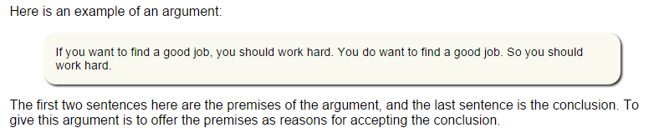
http://philosophy.hku.hk/think/arg/arg.php

Slide 17
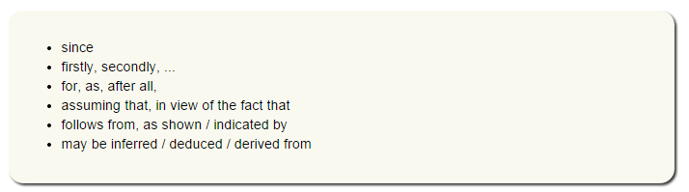
Premise Indicator Words

Slide 18
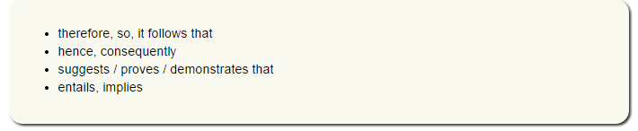
Conclusion Indicator Words

Slide 19
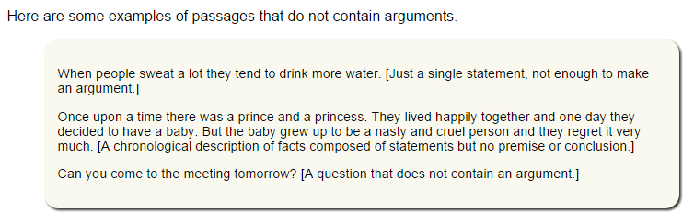
Passages that are not arguments
Explanations are also not counted as arguments. These passages explain why something happened, but do not prove (or try to prove) a particular fact.
Example: The jet crashed because of bad weather. (No attempt to prove this as a point of view, or to prove that the jet crashed -- just an explanation for why it happened.)

Slide 20
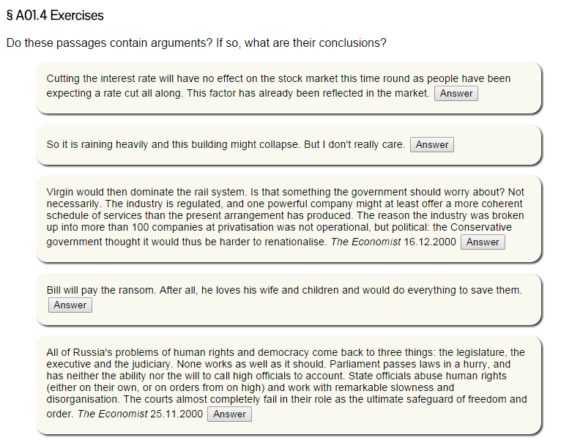

Slide 21
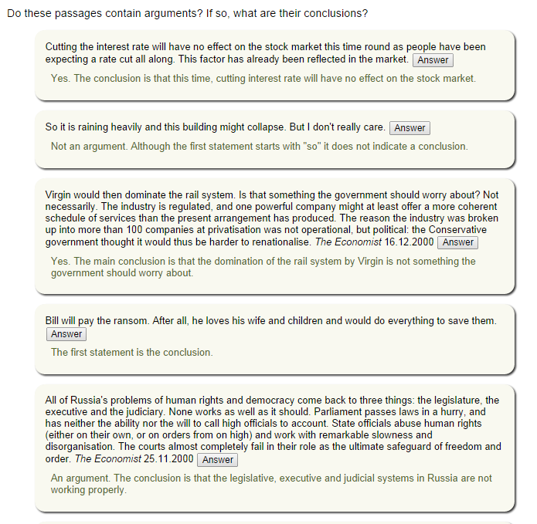

Slide 22
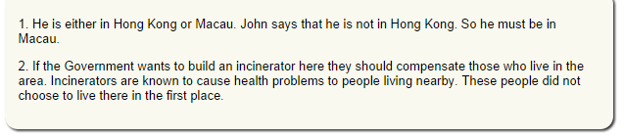
Finding Premises and Conclusions (Standard Form)

Slide 23
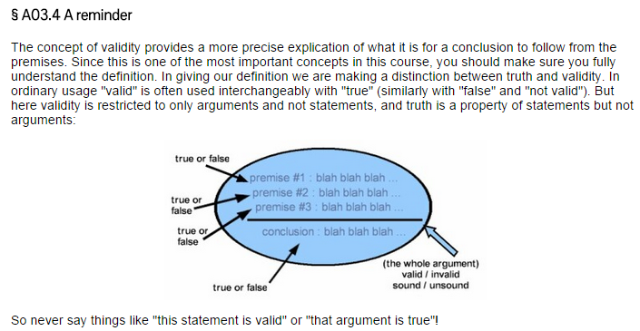
Validity compared to Truth:
Remember exercises on this page of the linked material too!

Slide 24
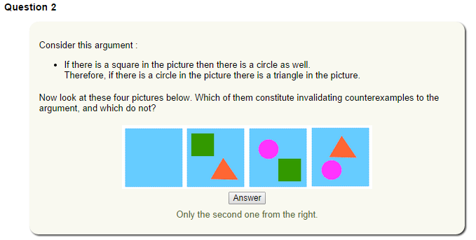
Counterexamples and attempting to invalidate your conclusion (reductio ad absurdum arguments)

Slide 25
“What we need to check further is of course whether the premises are true. If an argument is valid, and all the premises are true, then it is called a sound argument.”
An argument that is not sound is an unsound argument. If an argument is unsound, it might be that it is invalid, or maybe it has at least one false premise, or both.
Valid and Unsound: "Cows are insects. Insects are mammals. So cows are mammals.“
Invalid and Unsound: "Cows are mammals. So the sun is larger than the moon."

Slide 26
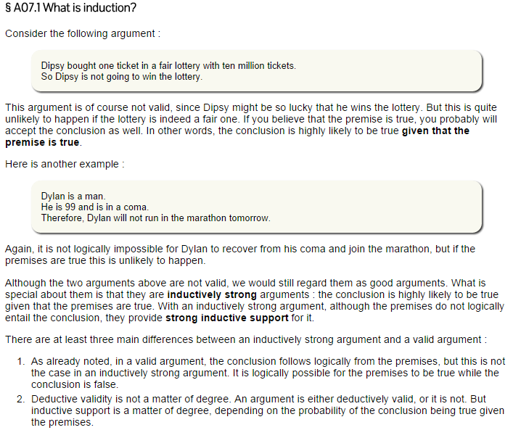

Slide 27
In each argument, note which parts are the premises and conclusion (Standard Form)
1. All humans are mammals. All mammals are warm-blooded. Therefore, all humans are warm-blooded.
2. Texans must all wear spurs because everyone on the streets of Dallas wears spurs, and everyone on the streets of Houston wears spurs.
3. There are footprints in the mud by the window. There are fingerprints on the windowsill. We must have either a peeping tom or a burglar.
4. Even numbers yield even numbers when they are squared. It follows that the square roots of odd perfect squares are odd.
5. Politicians never live perfect lives, and often the most imperfect people make excellent politicians. Therefore personal lives should not be brought into presidential debates.

Slide 28
Are the following passages arguments, or some type of non-argument? Hint: Try to be as specific as you can in naming the non-arguments.
6. Every swan ever observed thus far has been white. Therefore, the next swan observed will probably be white.
7. If the United States allows foreign workers to come in and do the jobs that legal citizens don't want to do, and if they will be able to collect SSI benefits and things of that nature that legal citizens have a hard time getting, then we’re going to have a serious problem taking care of our own citizens.
8. The Titanic sank on its maiden voyage in 1912 because it collided with an iceberg. Four of the ship’s 16 watertight compartments could have been flooded without the ship sinking. However, the iceberg tore several gashes in the hull, flooding 5 of these compartments.
9. High school health clinics across the country should be permitted to dispense the Ortho Evra patch, a birth control medication. The reason why is because teenage pregnancy today is at an all-time high, and the patch is 99 percent effective in preventing pregnancy. Furthermore, a single patch ensures protection for a full month.

Slide 29
Practice Identifying the Type of Argument, and Evaluate it using the right terms (valid/sound, strong/cogent, etc.)
10. A plaque on the Leaning Tower of Pisa says that Galileo performed experiments there with falling objects. It must be the case that Galileo did indeed perform those experiments there.
11. This is a standard deck of 52 playing cards. So if I draw a card at random from it, I predict that card will be a king.
12. 90% of humans are right-handed. Joe is a human. Therefore, the probability that Joe is right-handed is 90%.

