Slide 1
Tips for accessing the Logic App on the Web

Slide 2
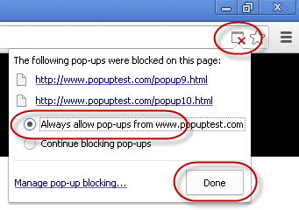
Pop-Up errors
The first kind of error you might see is a pop-up error. Be sure to use the clickable yellow “Pop-Up Blocker” you will see in the location bar of your browser, and allow popups from hatzicware.

Slide 3
Do you have Java on your computer?
Go to http://www.java.com for the free download.

Slide 4
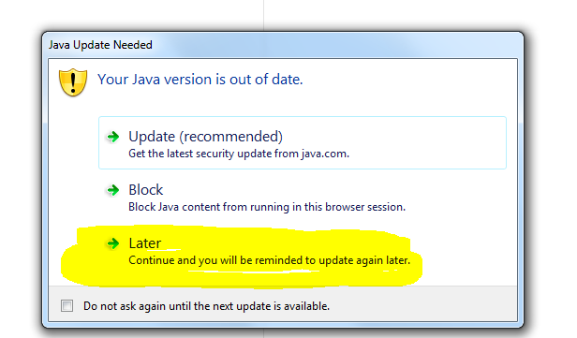
Java out of date error
Always choose “Later” if you see this, the web version of the Logic App is able to be used with older versions of Java.

Slide 5
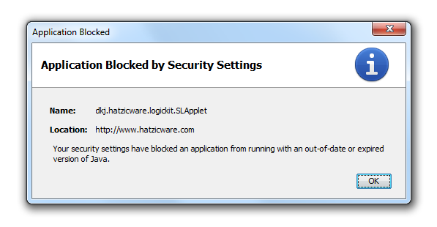
Java security settings error
You’ll just need to go into Java settings and add in this url exactly to the "exceptions" list: exactly this link to the 'exceptions' list, and then restarted the browsers:
http://www.hatzicware.com/jLogic/SLApplet.html
Instructions for Java exceptions from Java itself: http://java.com/en/download/help/jcp_security.xml

Slide 6
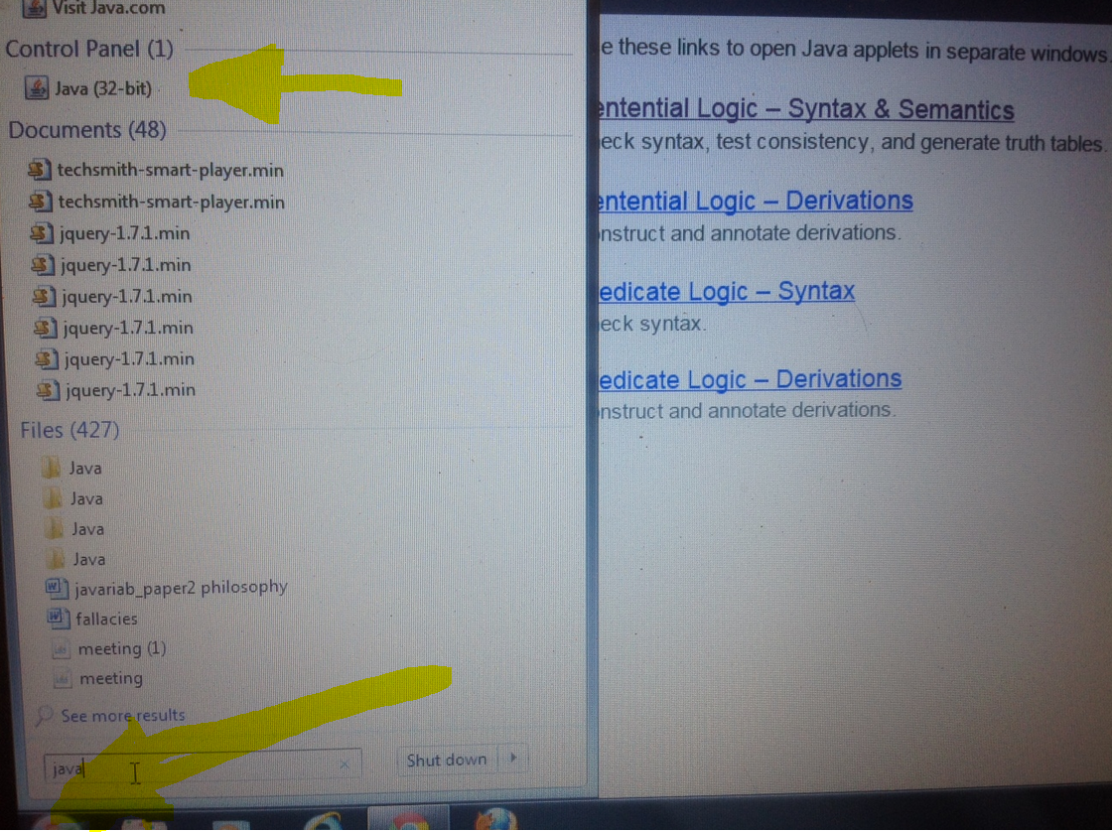
Find the Java Control Panel by clicking on the bottom left side Windows button, and searching for Java

Slide 7
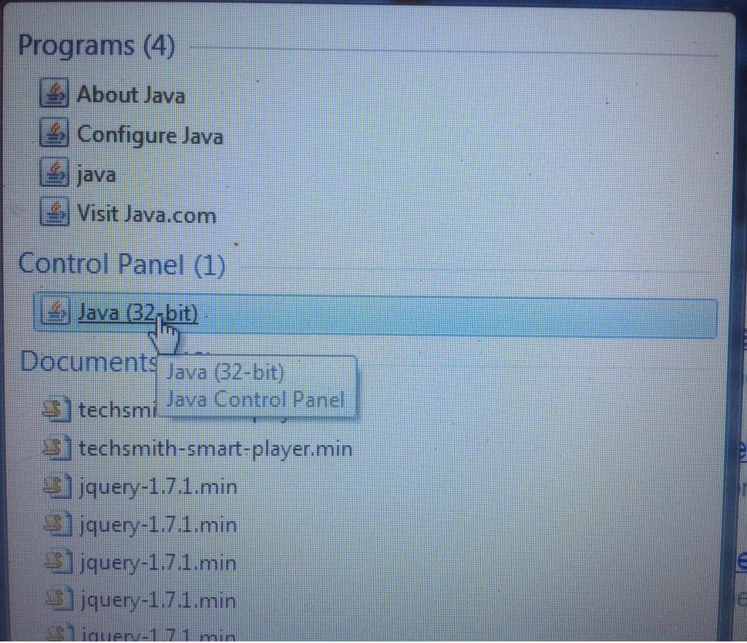
Click on
The Java
Control Panel, if you don’t see that choice, use Configure Java

Slide 8
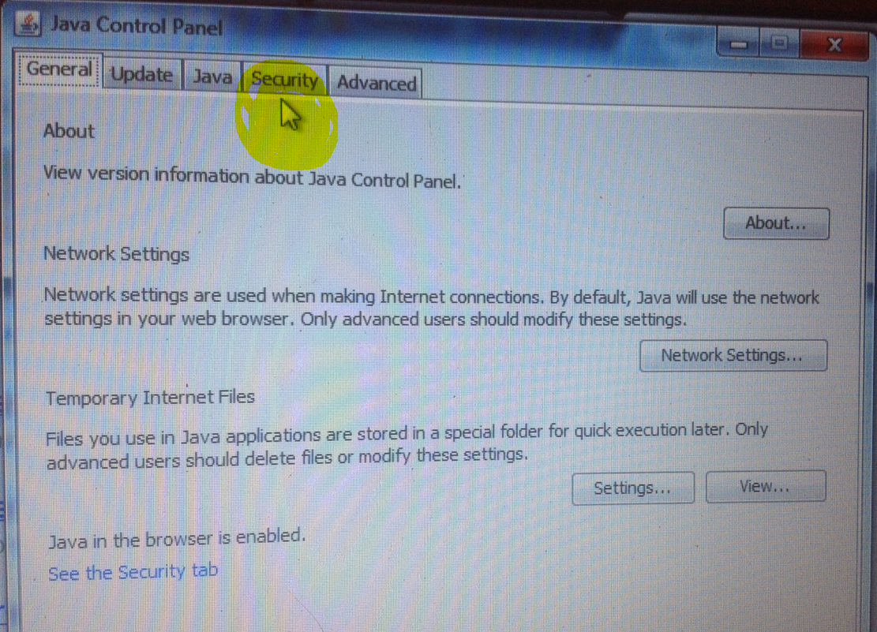
Click on the “Security” tab

Slide 9
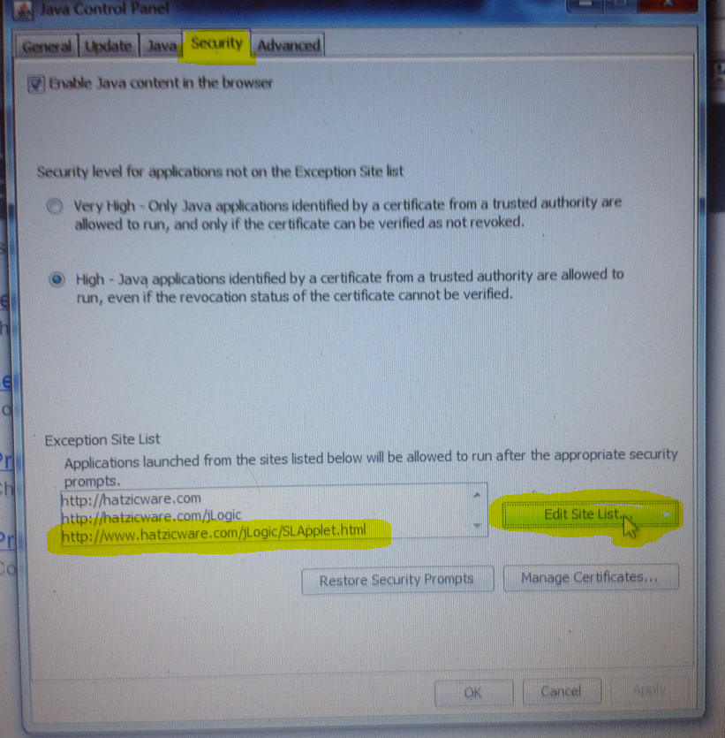
Add the full url to the Exceptions List
Click “Edit Site List”

Slide 10
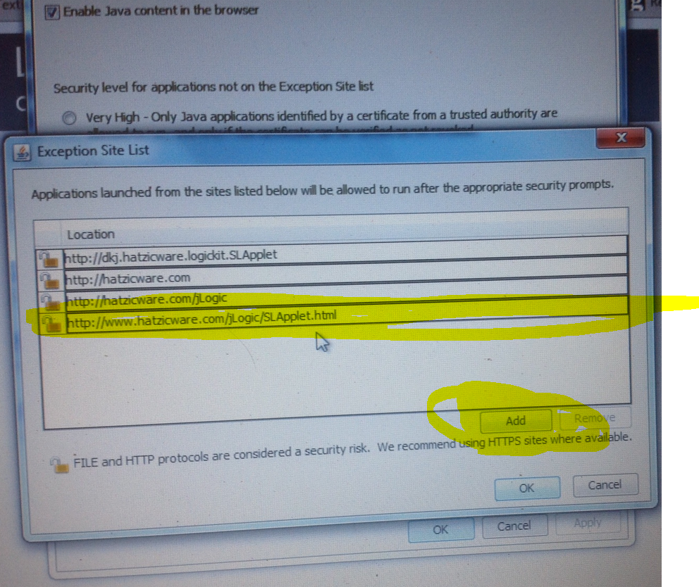
Click on Add, then type or copy in the whole url
http://www.hatzicware.com/jLogic/SLApplet.html

Slide 11
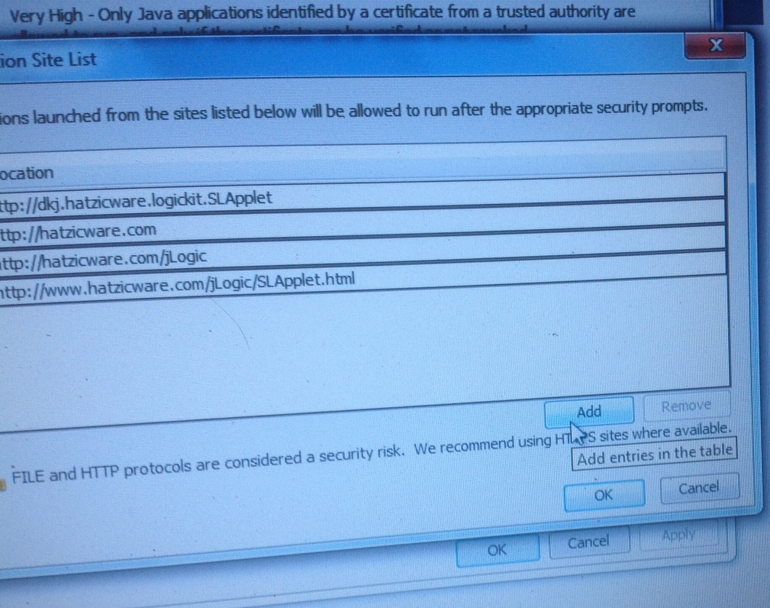

Slide 12
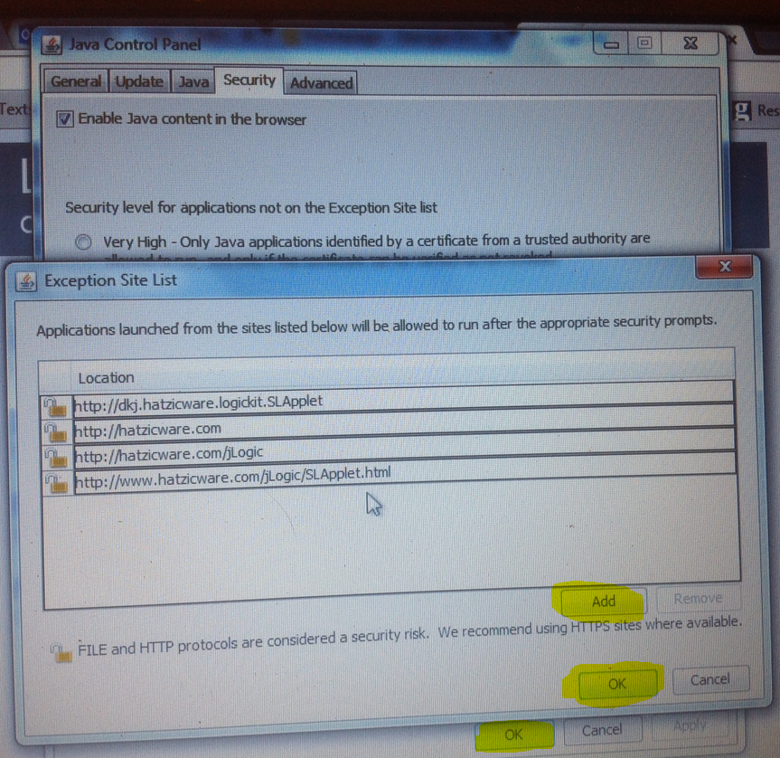
Once you see the url on its own line with the open lock, click Add, then both of the OKs

Slide 13
Also add the hatzicware urls to your Brower’s exceptions list as well, following the instructions on the next slides:
http://www.hatzicware.com/jLogic/SLApplet.html
Or
http://www.hatzicware.com

Slide 14
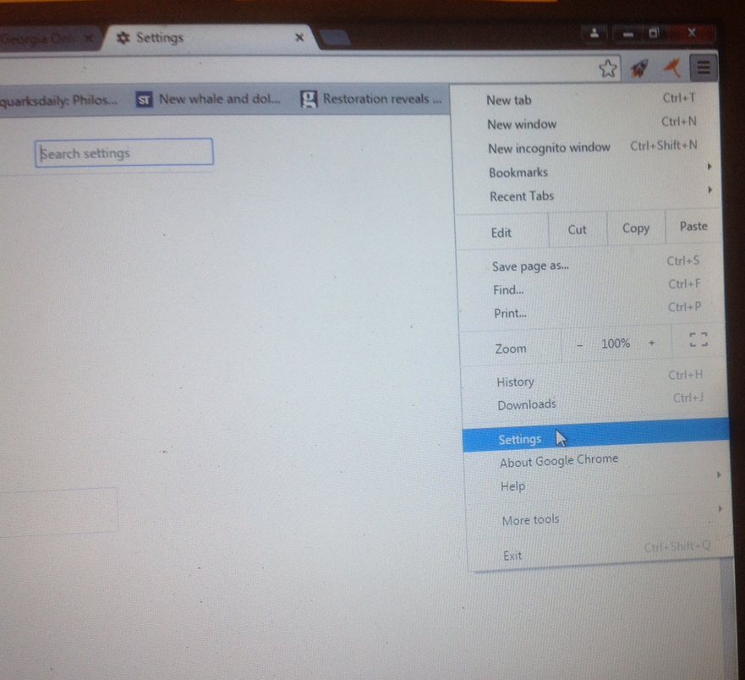
In Chrome:
Use the triple bar at the top right to get to “Settings”

Slide 15
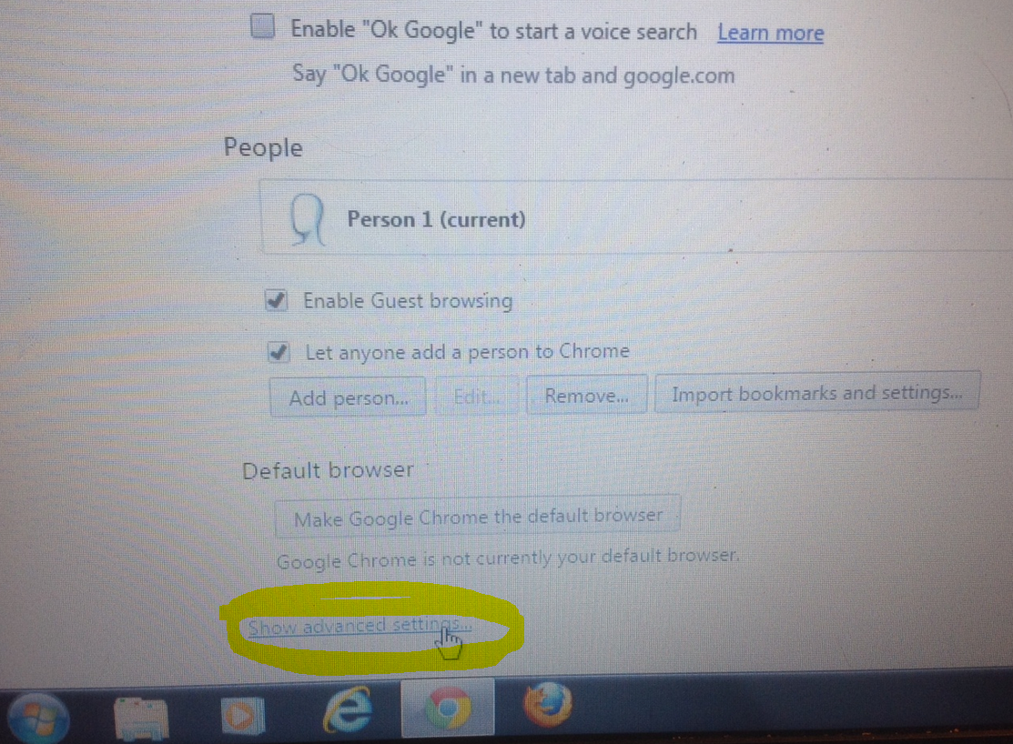
Scroll down to click on Show advanced settings

Slide 16
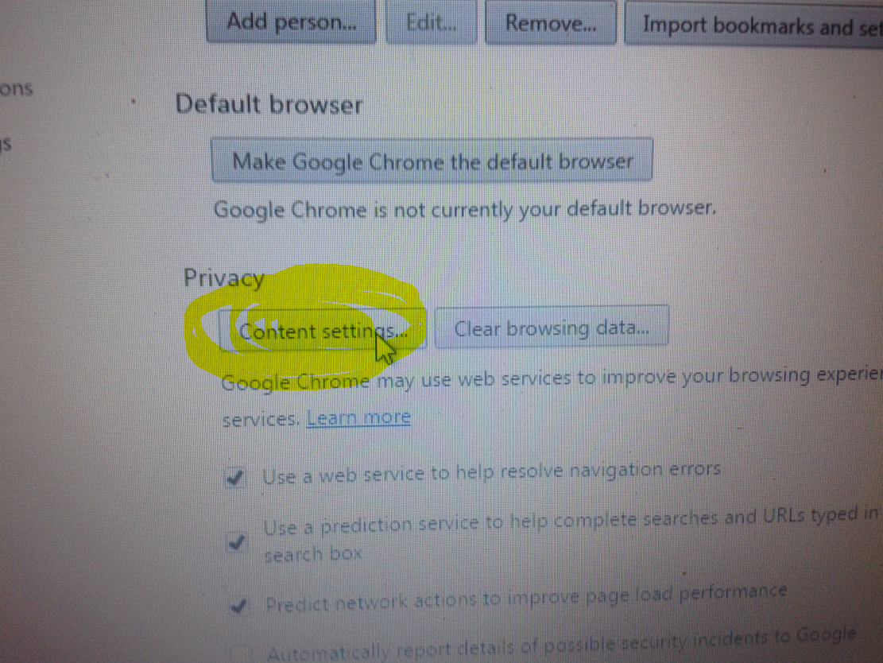
Click on the Privacy “Content Settings”

Slide 17
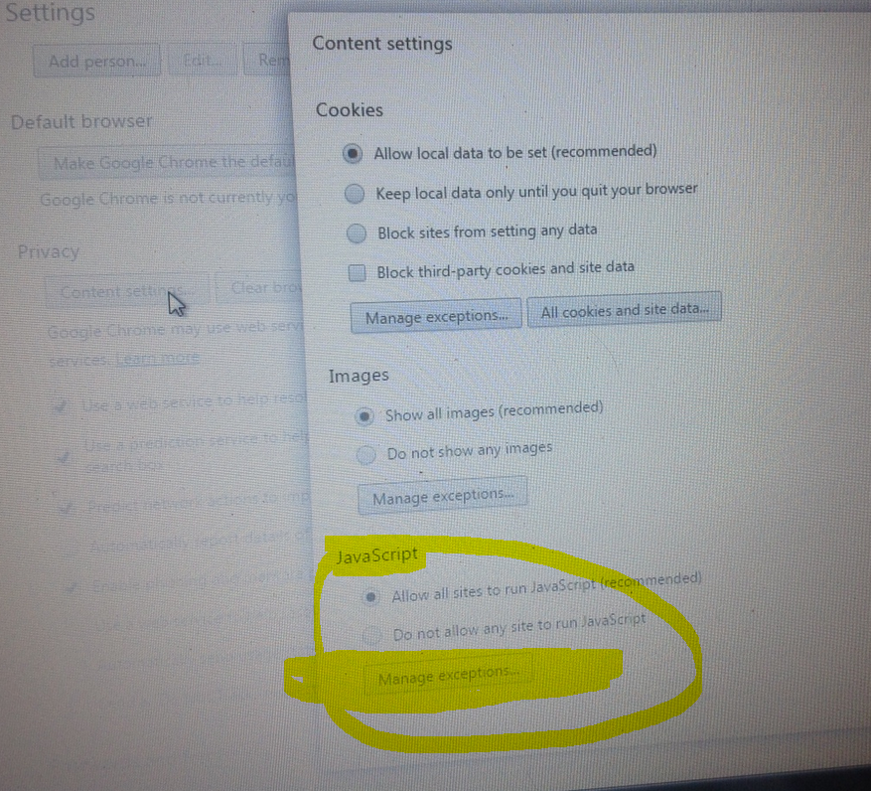
Then
Scroll down to Java Script and click “Manage Exceptions”

Slide 18
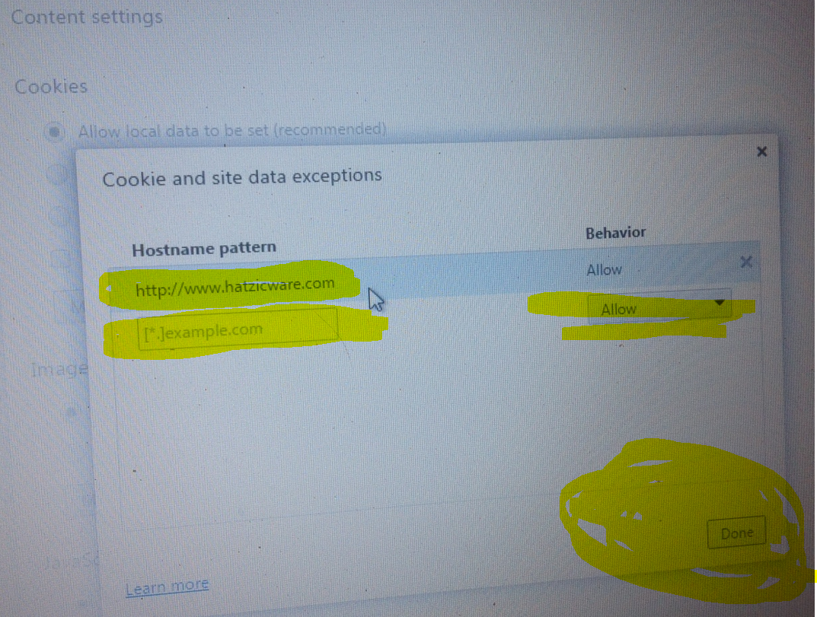
Add the hatzicware url into a box where it says “example.com” and Allow, then click Done

Slide 19
Close down all your browser windows and reopen the browser
So that the settings/options changes can take effect
Reopen the browser and go the url for hatzicware, and it should work.
http://www.hatzicware.com/jLogic/SLApplet.html
Post your screencaps in the Unit 4 discussion area in the class. Use “Communication” then “Discussion” in the pull down menu.

Slide 20
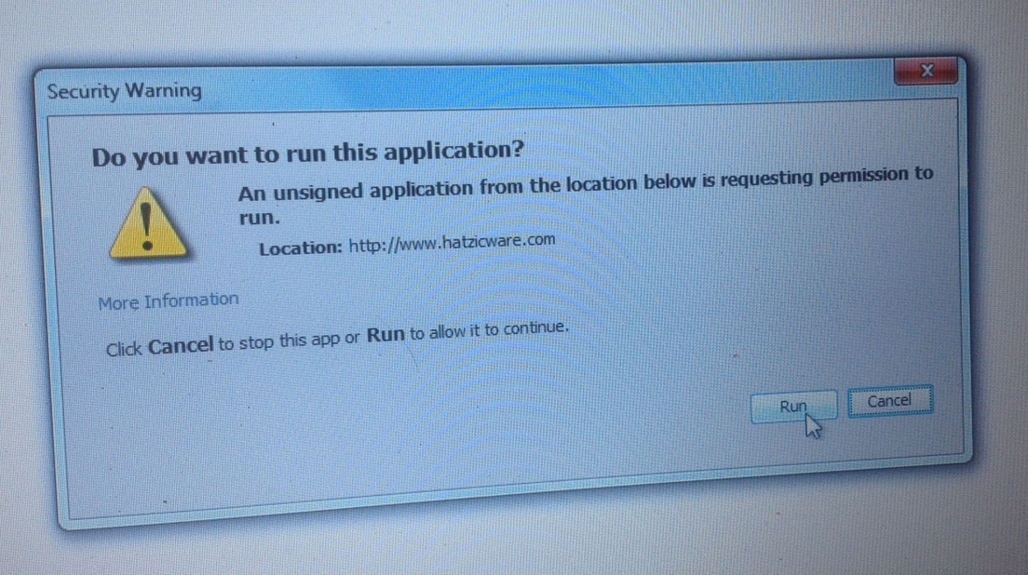
If you see this, simply click Run.

