Slide 1

Energy and Electricity and Magnetism

Slide 2
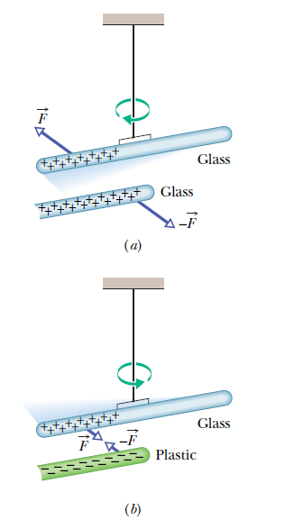
Electric Charge
Greeks
  Rubbing amber = attract straw
  Certain types of stone attract bits of iron
  Why?
Electric charge
  Intrinsic to everything in the world
  Two kinds of charges, positive (+) and negative (-), designated by Benjamin Franklin
  Electrically neutral - object with equal positive and negative charge

Slide 3
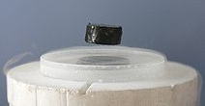
Conductors and Insulators
Conductors are materials through which charge can move freely; examples include metals (such as copper in common lamp wire), the human body, and tap water.
Nonconductors—also called insulators—are materials through which charge cannot move freely; examples include rubber, plastic, glass, and chemically pure water.
Semiconductors are materials that are intermediate between conductors and insulators; examples include silicon and germanium in computer chips.
Superconductors are materials that are perfect conductors, allowing charge to move without any hindrance.

Slide 4
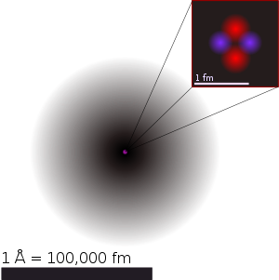
Conductors and Insulators
Properties of conductors and insulators are due to structure and electrical nature of atoms
Atoms
  positively charged protons
  negatively charged electrons
  electrically neutral neutrons
  The protons and neutrons are packed tightly together in a central nucleus
Conductor
  some of outermost (and so most loosely held) electrons become free to wander about within the solid
  leaving behind positively charged atoms (positive ions).
  We call the mobile electrons conduction, or free, electrons.
There are few (if any) free electrons in a insulator.

Slide 5


Coulomb’s Law
The equation giving the force for charged particles is called Coulomb’s law:
  particle 1 has charge q₁
  particle 2 has charge q₂
  F is the force on particle 1 by particle 2
  r is the distance between them
  k is the electrostatic constant
  The quantity ε₀ is called the permittivity of free space.
The SI unit of charge is the coulomb (C), named for Chris Coulomb.

Slide 6
Concept Question
Which one of the following statements concerning the electric force is true?
Two charged objects with identical charges will exert an attractive force on one another.
It is possible for a small negatively-charged particle to float above a negatively charged surface.
A positively-charged object is attracted toward another positively-charged object.
The electric force cannot alter the motion of an object.
Newton’s third law of motion does not apply to the electrostatic force
Notes:
Answer: B.

Slide 7
Example Problem
Imagine two conducting spheres separated by two meters. Each sphere carries an excess charge of 0.5 C. What is the magnitude of the electrostatic force that each sphere exerts on the other?
Notes:
Answer: D 9 x 10^9 N

Slide 8
Example Problem
Imagine two conducting spheres separated by two meters. Each sphere carries an excess charge of 0.5 C. What is the magnitude of the electrostatic force that each sphere exerts on the other?
Let’s start with the equation:
And now for the givens:
r = 2 m
q1 = 0.5 C
q2 = 0.5 C
F = 8.99 x 10⁹ * (0.5 C *0.5 C)/ (2m)²
F = 5.62 x 10⁸ N or 562,000,000 N
Notes:
Answer: D 9 x 10^9 N

Slide 9
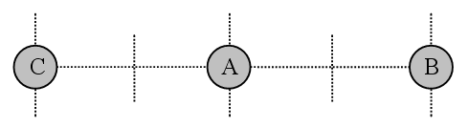
Concept Question
A charged particle, labeled A, is located at the midpoint between two other charged particles, labeled B and C, as shown. The sign of the charges on all three particles is the same. When particle A is released, it starts drifting toward B. What can be determined from this behavior?
The charge on A is larger than the charge on B.
The charge on A is larger than the charge on C.
The charge on C is larger than the charge on B.
The charge on B is larger than the charge on A.
The charge on B is larger than the charge on C.
Notes:
Answer: C

Slide 10
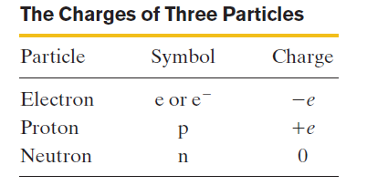
Charge is Quantized
The total charge for a system is always integer multiples of an elementary charge (e).
The magnitude of this elementary charges the same for both protons and electrons:
Elementary particles either carry no charge, or carry a single elementary charge.
When a physical quantity such as charge can have only discrete values, rather than any value, we say the quantity is quantized.
It is possible, For example, to find a particle that has no charge at all, or a charge of +10e, or -6e, but not a particle with a charge of, say, 3.57e.

Slide 11

Charge is Conserved
If one rubs a glass rod with silk, a positive charge appears on the rod. Measurement shows that a negative charge of equal magnitude appears on the silk. This suggests that rubbing does not create charge but only transfers it from one body to another, upsetting the electrical neutrality of each body during the process.
This hypothesis of conservation of charge has stood up under close examination, both for large-scale charged bodies and for atoms, nuclei, and elementary particles.
An example is in radioactive decay of nuclei, in which a nucleus transforms into (becomes) a different type of nucleus. A uranium-238 nucleus (²³⁸U) transforms into a thorium- 234 nucleus (²³⁴Th) by emitting an alpha particle. An alpha particle has the same makeup as a helium-4 nucleus, it has the symbol ⁴He. Here the net charge is 238.
Notes:
Answer: B

Slide 12
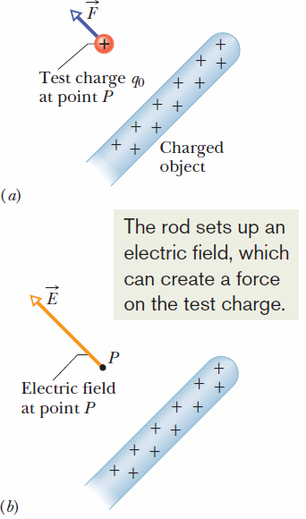

Electric Field due to a Point Charge
We can define the electric field at some point near the charged object, such as point P in figure (a), as follows:
  A positive test charge q₀, placed at the point will experience an electrostatic force, F.
  The electric field, E, at point P due to the charged object is defined as shown to the right.
  The SI unit for the electric field is the newton per coulomb (N/C) or volt per meter (V/m).
The direction of E is directly away from the point charge if q is positive, and directly toward the point charge if q is negative.

Slide 13
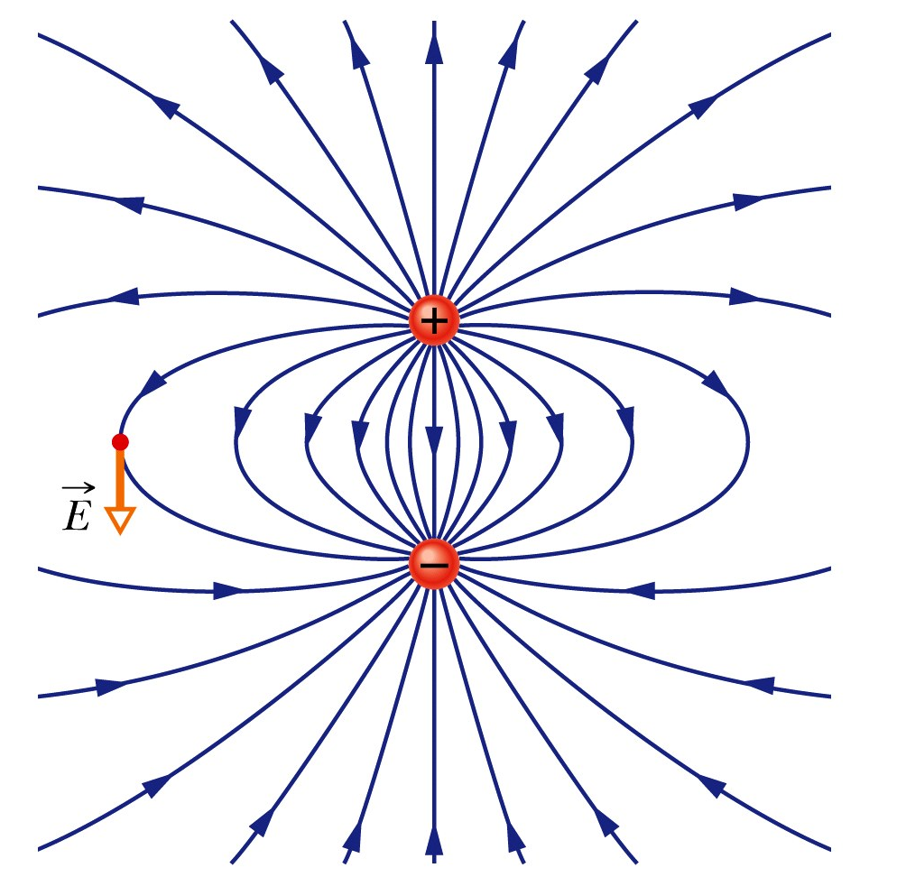
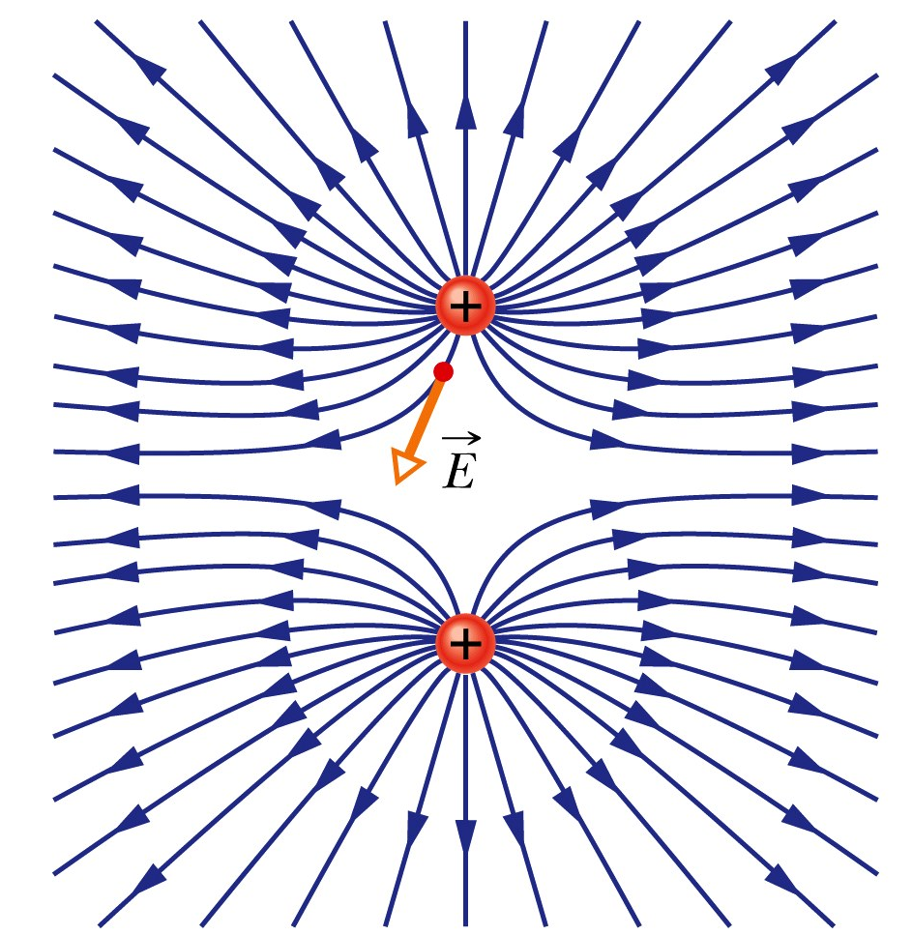
Electric Field
Field lines for an electric dipole, a positive and negative charged pair.
Field lines for two positive charges.

Slide 14
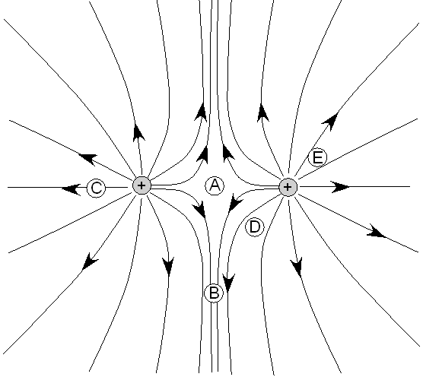
Concept Question
A positively charged object is located to the left of a positively charged object as shown. Electric field lines are shown connecting the two objects. The five points on the electric field lines are labeled A, B, C, D, and E. At which one of these points would a test charge experience the smallest force?
A
B
C
D
E
Notes:
Answer: A

Slide 15
Example Problem
An electric force of 30 N is applied to a charge of q = +15 mC. What is the magnitude of the electric field produced?
Let’s start with our givens:
F = 30 N
= +15 mC = 0.015 C
E = F/q = 30 N/ 0.015 C = 2,000 N/C
What is the electric field 15 m from the charge?
Remember the
and E = k q/r²
So, E = 8.99 x 10⁹ * 0.015 C/(15²) = 599,000 N/C
Notes:
Answer: D 9 x 10^9 N

Slide 16
Example Problem
An electric force of 30 N is applied to a charge of q = +15 mC. What is the magnitude of the electric field produced?
Let’s start with our givens:
F = 30 N
q = +15 mC = 0.015 C
E = F/q = 30 N/ 0.015 C = 2,000 N/C
What is the electric field 15 m from the charge?
Remember the
and E = k q/r²
So, E = 8.99 x 10⁹ * 0.015 C/(15²) = 599,000 N/C
Notes:
Answer: D 9 x 10^9 N

Slide 17
Example Problem
An electric force of 30 N is applied to a charge of q = +15 mC. What is the magnitude of the electric field produced?
Let’s start with our givens:
F = 30 N
q = +15 mC = 0.015 C
E = F/q = 30 N/ 0.015 C = 2,000 N/C
What is the electric field 15 m from the charge?
Remember the
and E = k q/r²
So, E = 8.99 x 10⁹ * 0.015 C/(15²) = 599,000 N/C
Notes:
Answer: D 9 x 10^9 N

Slide 18


Electric Potential
The potential energy per unit charge at a point in an electric field is called the electric potential V (or simply the potential) at that point. This is a scalar quantity.
The electric potential difference V between any two points i and f in an electric field is equal to the difference in potential energy per unit charge between the two points. Thus,
The potential difference between two points is thus the negative of the work done by the electrostatic force to move a unit charge from one point to the other.
The SI unit for potential is the joule per coulomb. This combination is called the volt (abbreviated V).

Slide 19
Concept Question
A uniform electric field is directed in the negative x direction. If you were to move a positive charge in the positive x direction, how would the total energy of the positive charge and the electric field system change, if at all?
The total energy of the system would increase.
The total energy of the system would decrease.
The total energy of the system would remain unchanged.
Notes:
Answer: A, there would now be a kinetic energy as well as potential

Slide 20
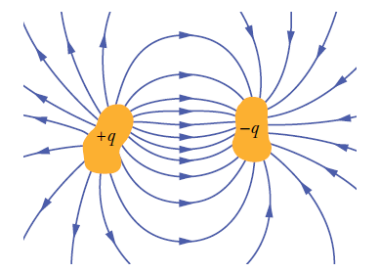

Capacitance
What is a capacitor?
  Two conductors electrically isolated from each other
  When charged, the charges on the conductors, or plates, have the same magnitude q but opposite sign, +q and –q
  However, we refer to the charge of a capacitor as being q, the absolute value of these charges on the plates.
The charge q and the potential difference V for a capacitor are proportional to each other:
The proportionality constant C is called the capacitance of the capacitor. Its value depends only on the geometry of the plates and not on their charge or potential difference.
The SI unit is called the farad (F): 1 farad (1 F)= 1 coulomb per volt =1 C/V.

Slide 21
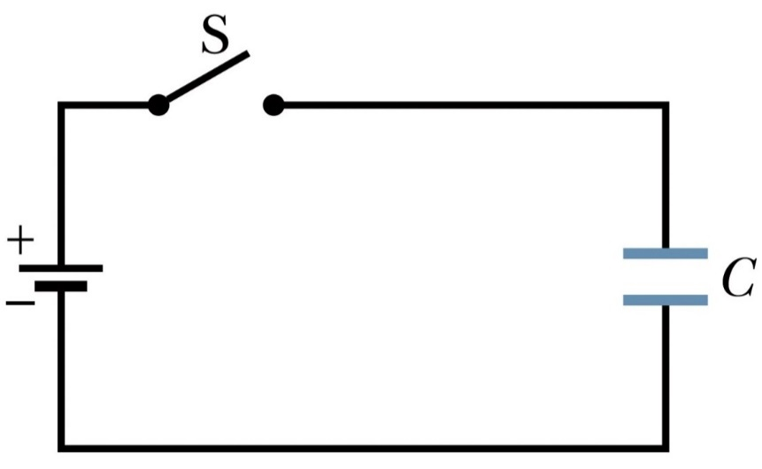
Example Problem
The capacitor in the schematic has a capacitance of 25 mF and is initially uncharged. The battery provides a potential difference of 120 V. After switch S is closed, how much charge will pass through it?
Let’s write down out givens
C = 25 mF = 0.025 F
V = 120 V
Q = CV
Q = 0.025 F* 120 V
Q = 3 C

Slide 22
Example Problem
The capacitor in the schematic has a capacitance of 25 mF and is initially uncharged. The battery provides a potential difference of 120 V. After switch S is closed, how much charge will pass through it?
Let’s write down out givens
C = 25 mF = 0.025 F
V = 120 V
Q = CV
Q = 0.025 F* 120 V
Q = 3 C

Slide 23
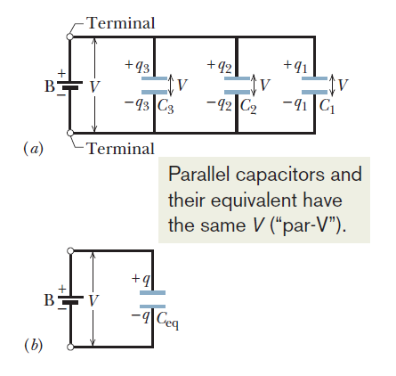

Capacitors in Parallel
When a potential difference V is applied across several capacitors connected in parallel, that potential difference V is applied across each capacitor.
The total charge q stored on the capacitors is the sum of the charges stored on all the capacitors
Capacitors connected in parallel can be replaced with an equivalent capacitor that has the same total charge q and the same potential difference V as the actual capacitors, figure (b)

Slide 24
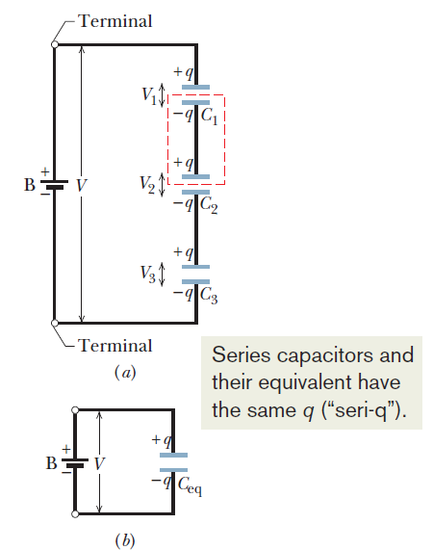

Capacitors in Series
When a potential difference V is applied across several capacitors connected in series, the capacitors have identical charge q
The sum of the potential differences across all the capacitors is equal to the applied potential difference V
Capacitors that are connected in series can be replaced with an equivalent capacitor that has the same charge q and the same total potential difference V as the actual series capacitors, figure (b)
C_{eq} will be less then the sum of the individual capacitors.

Slide 25
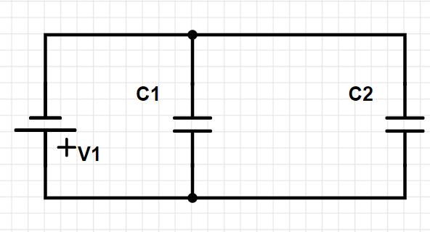
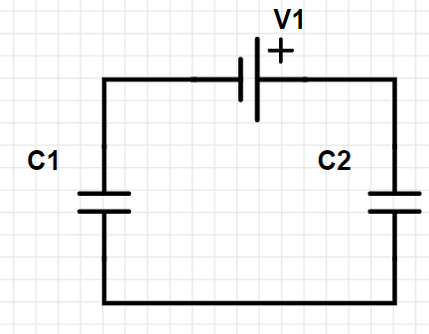
Example Problem
Find the equivalent capacitance for the combination of capacitors shown, across which potential difference V = 10 V is applied. Assume the C1 = 10 F and C2 = 25 F.
C_{eq} = C1 + C2 = 35 Ω 1/C_{eq} = 1/C1+1/C2
1/C_{eq} = 1/10 +1/25 = 0.10+0.04
1/C_{eq} = 0.14
C_{eq} = 7.14 F

Slide 26
Example Problem
Find the equivalent capacitance for the combination of capacitors shown, across which potential difference V = 10 V is applied. Assume the C1 = 10 F and C2 = 25 F.
C_{eq} = C1 + C2 = 35 Ω 1/C_{eq} = 1/C1+1/C2
1/C_{eq} = 1/10 +1/25 = 0.10+0.04
1/C_{eq} = 0.14
C_{eq} = 7.14 F

Slide 27
Example Problem
Find the equivalent capacitance for the combination of capacitors shown, across which potential difference V = 10 V is applied. Assume the C1 = 10 F and C2 = 25 F.
C_{eq} = C1 + C2 = 35 Ω 1/C_{eq} = 1/C1+1/C2
1/C_{eq} = 1/10 +1/25 = 0.10+0.04
1/C_{eq} = 0.14
C_{eq} = 7.14 F

Slide 28
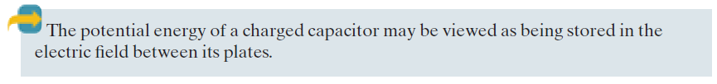


Energy Stored in an Electric Field

Slide 29
Example Problem
An isolate conducting sphere has a capacitance of 50 mF and a charge q = 1.25 C. How much potential energy is stored in the electric field of this charged conductor?

Slide 30
Example Problem
An isolate conducting sphere has a capacitance of 50 mF and a charge q = 1.25 C. How much potential energy is stored in the electric field of this charged conductor?
Remember that U = q²/(2*C) and 1000 mF = 1 F
So U = (0.050 F)² / (2*1.25 C) =0.001 J

Slide 31
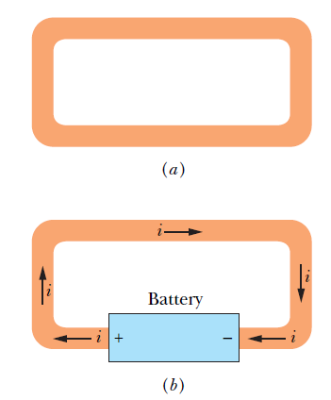

Electric Current
Although an electric current is a stream of moving charges, not all moving charges constitute an electric current.
If there is to be an electric current through a given surface, there must be a net flow of charge through that surface.
Example of free electrons (conduction electrons) in an isolated length of copper wire .
The unit of electric current is the Ampere or Amp (A).
The power associated with an electric current is

Slide 32
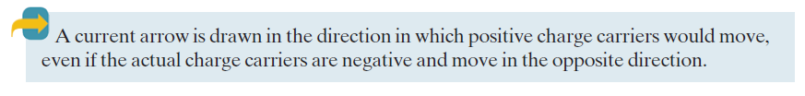
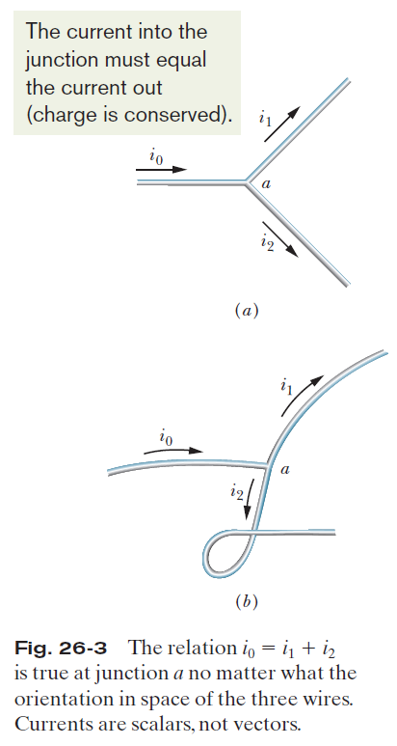
Electric Current

Slide 33


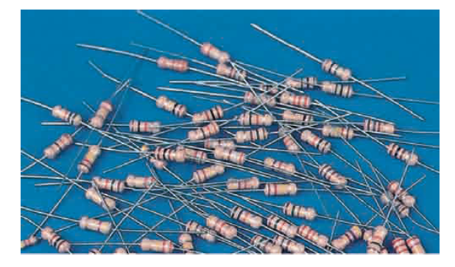
Resistance and Current
We determine the resistance between any two points of a conductor by applying a potential difference V between those points and measuring the current i that results. The resistance R is then
The SI unit for resistance is the volt per ampere. This has a special name, the ohm (symbol Ω):
In a circuit diagram, we represent a resistor and a resistance with the symbol

Slide 34
Concept Question
By which of the following methods could the current in a given circuit be doubled?
Either double the resistance or double the voltage.
Reduce either the voltage or the resistance to half of the initial value.
Either double the voltage or reduce the resistance to half of its initial value.
Either double the resistance or reduce the voltage to half of its initial value.
None of the above answers are correct.
Notes:
Answer: C

Slide 35
Example Problem
A circuit contains a battery and a resistor of resistance R. For which one of the following combinations of current and voltage does R have the smallest value?
Remember V = IR, which means R = V/I
V = 9 V and I = 0.002 A R = 9 V/0.002 A = 4500 Ω
V = 12 V and I = 0.5 A R = 12 V/0.5 A = 24 Ω
V = 1.5 V and I = 0.075 A R = 1.5 V/0.075 A = 20 Ω
V = 6 V and I = 0.1 A R = 6 V/0.1 A = 60 Ω
V = 4.5 V and I = 0.009 A R = 4.5 V/0.009 A = 500 Ω
Notes:
Answer: C

Slide 36
Example Problem
A circuit contains a battery and a resistor of resistance R. For which one of the following combinations of current and voltage does R have the smallest value?
Remember V = IR, which means R = V/I
V = 9 V and I = 0.002 A R = 9 V/0.002 A = 4500 Ω
V = 12 V and I = 0.5 A R = 12 V/0.5 A = 24 Ω
V = 1.5 V and I = 0.075 A R = 1.5 V/0.075 A = 20 Ω
V = 6 V and I = 0.1 A R = 6 V/0.1 A = 60 Ω
V = 4.5 V and I = 0.009 A R = 4.5 V/0.009 A = 500 Ω
Notes:
Answer: C

Slide 37
Example Problem
A circuit contains a battery and a resistor of resistance R. For which one of the following combinations of current and voltage does R have the smallest value?
Remember V = IR, which means R = V/I
V = 9 V and I = 0.002 A R = 9 V/0.002 A = 4500 Ω
V = 12 V and I = 0.5 A R = 12 V/0.5 A = 24 Ω
V = 1.5 V and I = 0.075 A R = 1.5 V/0.075 A = 20 Ω
V = 6 V and I = 0.1 A R = 6 V/0.1 A = 60 Ω
V = 4.5 V and I = 0.009 A R = 4.5 V/0.009 A = 500 Ω
Notes:
Answer: C

Slide 38
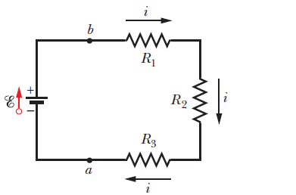
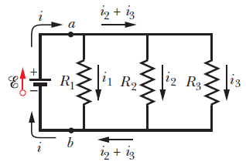


Resistors in Series and Parallel

Slide 39
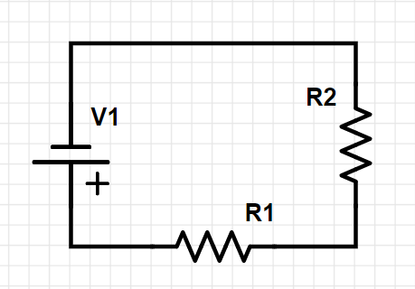
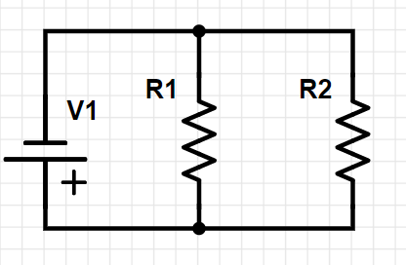
Example Problem
Find the equivalent resistance for the combination of resistors shown, across which potential difference V = 10 V is applied. Assume the R1 = 15 Ω and R2 = 35 Ω.
R_{eq} = R1 + R2 = 50 Ω 1/R_{eq} = 1/R1+1/R2
1/R_{eq} = 1/15 +1/35 = 0.0667+0.0286
1/R_{eq} = 0.0953
R_{eq} = 10.5 Ω

Slide 40
Example Problem
Find the equivalent capacitance for the combination of capacitances shown, across which potential difference V = 10 V is applied. Assume the R1 = 15 Ω and R2 = 35 Ω.
R_{eq} = R1 + R2 = 50 Ω 1/R_{eq} = 1/R1+1/R2
1/R_{eq} = 1/15 +1/35 = 0.0667+0.0286
1/R_{eq} = 0.0953
R_{eq} = 10.5 Ω

Slide 41
Example Problem
Find the equivalent capacitance for the combination of capacitances shown, across which potential difference V = 10 V is applied. Assume the R1 = 15 Ω and R2 = 35 Ω.
R_{eq} = R1 + R2 = 50 Ω 1/R_{eq} = 1/R1+1/R2
1/R_{eq} = 1/15 +1/35 = 0.0667+0.0286
1/R_{eq} = 0.0953
R_{eq} = 10.5 Ω

Slide 42
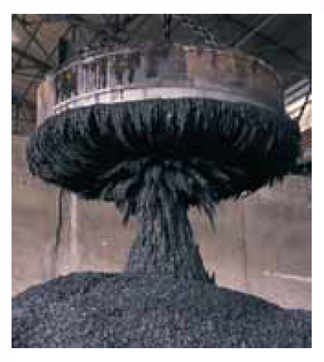
What Produces a Magnetic Field?
One way that magnetic fields are produced is to use moving electrically charged particles, such as a current in a wire, to make an electromagnet. The current produces a magnetic field that is utilizable.
The other way to produce a magnetic field is by means of elementary particles such as electrons, because these particles have an intrinsic magnetic field around them.
The magnetic fields of the electrons in certain materials add together to give a net magnetic field around the material. Such addition is the reason why a permanent magnet, has a permanent magnetic field.
In other materials, the magnetic fields of the electrons cancel out, giving no net magnetic field surrounding the material.

Slide 43

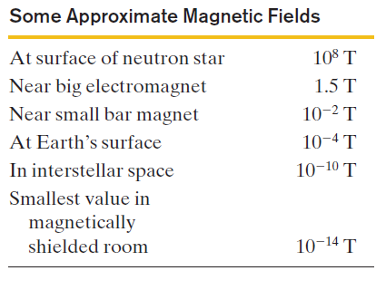

Definition of the Magnetic Field
We can define a magnetic field, B, by firing a charged particle through the point at which is to be defined, using various directions and speeds for the particle and determining the force that acts on the particle at that point.
B is then defined to be a vector quantity that is directed along the zero-force axis.
The magnetic force on the charged particle, F_{B}, is defined to be:
Here φ is the angle between vectors v and B.
The SI unit for B that follows is newton per coulomb-meter per second. For convenience, this is called the tesla (T), after Nikola Tesla
An earlier (non-SI) unit for B is the gauss (G), and

Slide 44
Concept Question
Complete the following sentence: When a positively-charged particle is released from rest in a region that has a magnetic field directed due east, the particle will
a) remain at rest.
b) be accelerated due east.
c) be accelerated due north.
d) be accelerated upward.
e) be accelerated downward.
Notes:
Answer: A

Slide 45
Example Problem
A charge of 13 mC is moving into a magnetic field of magnitude of 50 T. If the speed of the charge is 7.0 × 10³ m/s and the angle of entry is 90°, what is the magnetic force produced on the charge?
Let’s start by writing down what we are given:
q = 13 mC B = 50 T v = 7.0 × 10³ m/s φ = 90°
Remember that F = qvBsinφ and that 1000 mC = 1 C.
So, F = 0.013 C*7.0 × 10³ m/s *50 T *sin(90°) = 4,550 N
A second charge follows the first one into the same field at a speed of 2.5 × 10³ m/s. If the magnetic force on the second charge is 7,500 N, what is its charge?
Let’s write down our givens:
F = 7,500N B = 50 T v = 2.5 × 10³ m/s φ = 90°
Rearranging the force formula from before to solve for q, we get
q = F/(vBsin φ) = 7500 N/(50 T*2.5 × 10³ m/s * sin(90°) ) = 0.06 C or 60 mC

Slide 46
Example Problem
A charge of 13 mC is moving into a magnetic field of magnitude of 50 T. If the speed of the charge is 7.0 × 10³ m/s and the angle of entry is 90°, what is the magnetic force produced on the charge?
Let’s start by writing down what we are given:
q = 13 mC B = 50 T v = 7.0 × 10³ m/s φ = 90°
Remember that F = qvBsinφ and that 1000 mC = 1 C.
So, F = 0.013 C*7.0 × 10³ m/s *50 T *sin(90°) = 4,550 N
A second charge follows the first one into the same field at a speed of 2.5 × 10³ m/s. If the magnetic force on the second charge is 7,500 N, what is its charge?
Let’s write down our givens:
F = 7,500N B = 50 T v = 2.5 × 10³ m/s φ = 90°
Rearranging the force formula from before to solve for q, we get
q = F/(vBsin φ) = 7500 N/(50 T*2.5 × 10³ m/s * sin(90°) ) = 0.06 C or 60 mC

Slide 47
Example Problem
A charge of 13 mC is moving into a magnetic field of magnitude of 50 T. If the speed of the charge is 7.0 × 10³ m/s and the angle of entry is 90°, what is the magnetic force produced on the charge?
Let’s start by writing down what we are given:
q = 13 mC B = 50 T v = 7.0 × 10³ m/s φ = 90°
Remember that F = qvBsinφ and that 1000 mC = 1 C.
So, F = 0.013 C*7.0 × 10³ m/s *50 T *sin(90°) = 4,550 N
A second charge follows the first one into the same field at a speed of 2.5 × 10³ m/s. If the magnetic force on the second charge is 7,500 N, what is its charge?
Let’s write down our givens:
F = 7,500N B = 50 T v = 2.5 × 10³ m/s φ = 90°
Rearranging the force formula from before to solve for q, we get
q = F/(vBsin φ) = 7500 N/(50 T*2.5 × 10³ m/s * sin(90°) ) = 0.06 C or 60 mC

Slide 48
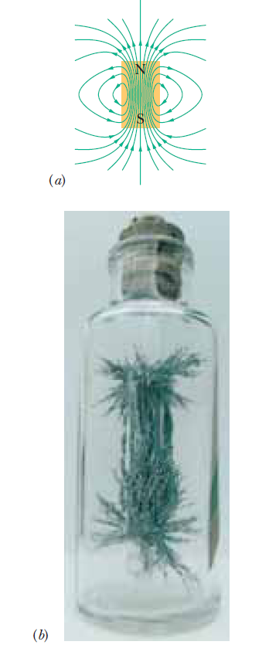
Magnetic Field Lines
The direction of the tangent to a magnetic field line at any point gives the direction of B at that point.
The spacing of the lines represents the magnitude of B —the magnetic field is stronger where the lines are closer together, and conversely.

Slide 49
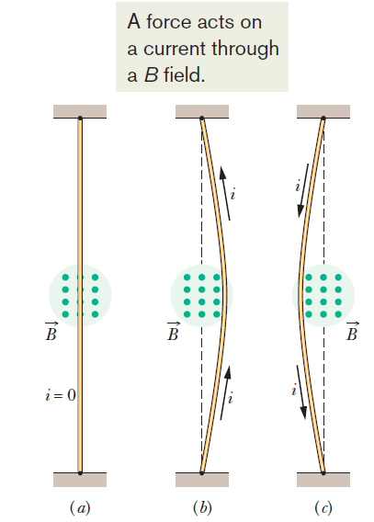

Magnetic Force on a Wire
A flexible wire passes between the pole faces of a magnet.
  Without current the wire is straight
  With upward current, the wire id deflected right-ward
  With downward current the wire is deflected leftward.
The force that causes this wire to bend is the magnetic force which is given by

Slide 50
Concept Question
Which one of the following parameters is not used to determine the magnetic force on a current-carrying wire in a magnetic field?
a) length of the wire
b) radius of the wire
c) the strength of the magnetic field
d) the magnitude of the electric current
Notes:
Answer: C

