Slide 1
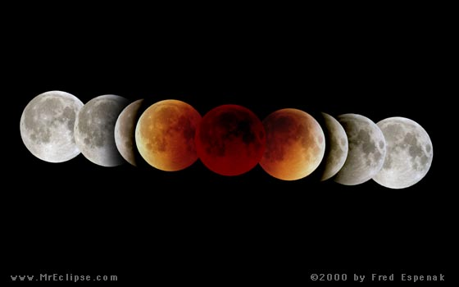
A LUNAR ECLIPSE takes place when the FULL Moon happens to move into Earth shadow.
LUNAR ECLIPSE = the Moon is Hidden

Slide 2
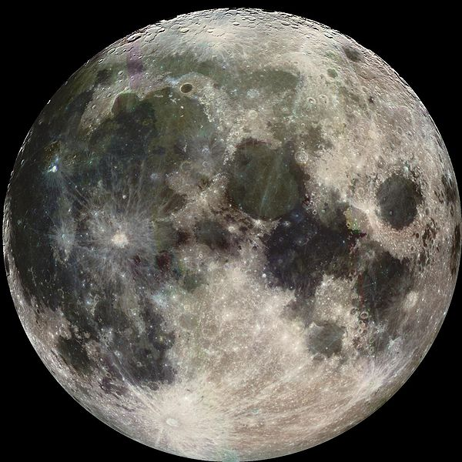
3,400 km about 1/3 the size of Earth’s shadow at the distance of the Moon

Slide 3
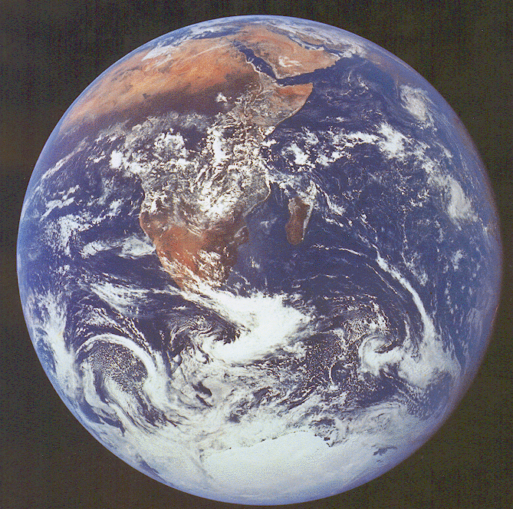

the Moon need NOT be exactly on the ecliptic in order to fall in Earth’s shadow …

Slide 4
ecliptic
… there’s quite a bit of leeway.

Slide 5
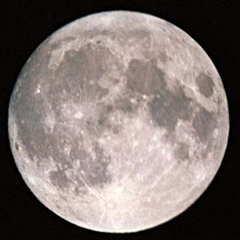
ecliptic
Usually, as viewed from Earth during a full Moon, the Moon passes above the Earth’s shadow or…

Slide 6
… below the Earth;s shadow.
ecliptic

Slide 7
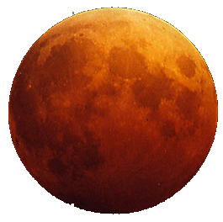
But every now and then, the moon crosses into Earth’s shadow, and we are treated to a LUNAR ECLIPSE
ecliptic

Slide 8
But why is the Moon reddish-brown? Why doesn’t it just wink out?
ecliptic

Slide 9
Sunlight gets refracted in Earth’s atmosphere and bends toward the Moon, lighting it up a bit.
ecliptic

Slide 10
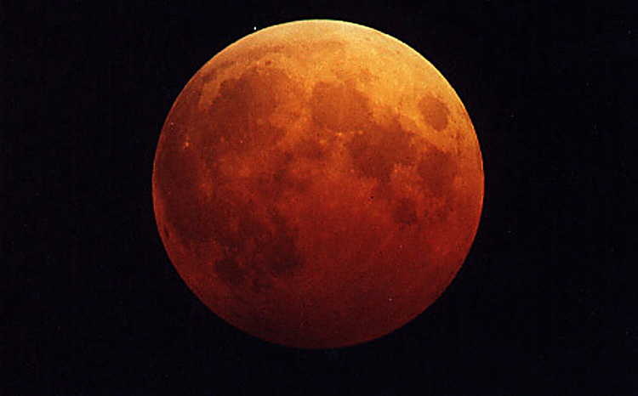

Slide 12
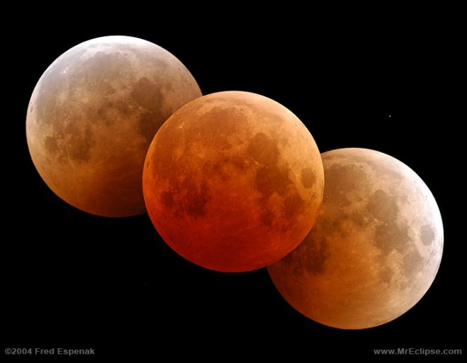

Slide 13
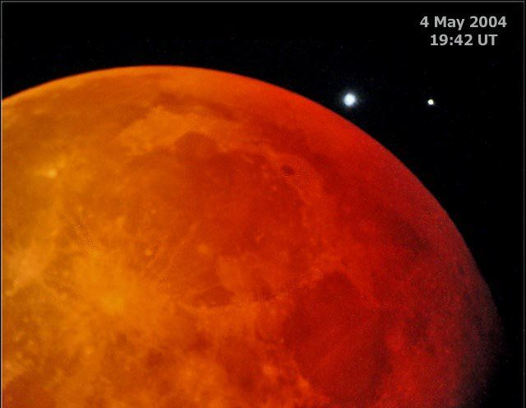

Slide 14
Review for Test 1
What is Science?
Scientific Notation and Significant Figures
Our Cosmic Address
Motion in the solar system
Ecliptic Planes
Our solar system
Phases of the moon
Solar Eclipse
Lunar Eclipse

