Slide 1
Fallacies continued
PHIL 2020
Week 6 Day 11

Slide 2
Relevance, Sufficiency, Acceptability
-Appeal to Force/Argumentum ad Baculum
-Appeal to Pity/Argumentum ad Misericordiam
-Appeal to the People/Improper Appeal to Popularity, Argumentum ad Populum
-Ad Hominem (argument against the person)
-Straw Person, Straw Man
-Missing the Point, Ignoratio Elenchi
Red Herring
-Improper Appeal to Authority, Unqualified Authority
-Appeal to Ignorance
-Hasty Generalization/Converse Accident
-False Cause/ Questionable Cause
-Slippery Slope
-Weak Analogy / Faulty Analogy
-Begging the Question/ Petitio Principii
-False Dichotomy, False Dilemma, or Either-Or Fallacy
Equivocation
-Inconsistency
-Improper Appeal to Tradition or Past Practice
-Ambiguity

Slide 3
Direct TV Slippery Slope Compilation
https://www.youtube.com/watch?v=NZ80SVOHKoo

Slide 4
Ad Hominem in the movie A Time To Kill
https://www.youtube.com/watch?v=Q5ktq5Cccac

Slide 5
Fallacies and Arguing on the Internet by PBS Idea Channel
https://www.youtube.com/watch?v=8qb-h0sXkH4
https://www.youtube.com/watch?v=ybOvddwpJAg

Slide 6
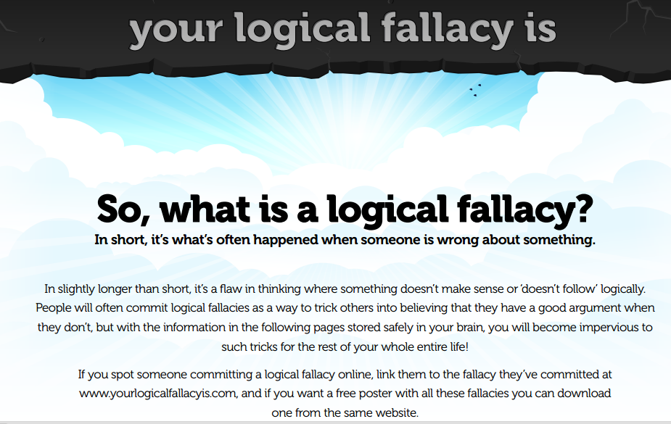
https://yourlogicalfallacyis.com/pdf/Logical_Fallacies_on_A4.pdf

Slide 7
Straw Man/Straw Person
Example: After Will said that we should put more money into health and education, Warren responded by saying that he was surprised that Will hates our country so much that he wants to leave it defenseless by cutting military spending.

Slide 8
Questionable Cause/False Cause
Example: Pointing to a fancy chart, Roger shows how temperatures have been rising over the past few centuries, whilst at the same time the numbers of pirates have been decreasing; thus pirates cool the world and global warming is a hoax.

Slide 9
Slippery Slope
Colin Closet asserts that if we allow same-sex couples to marry, then the next thing we know we’ll be allowing people to marry their parents, then their cars, and then Bonobo monkeys. So we cannot allow same-sex marriage in the first place.

Slide 10
Ad Hominem
Example: After Sally presents an eloquent and compelling case for a more equitable taxation system, Sam asks the audience whether we should believe anything from a woman who isn’t married, was once arrested, and smells a bit weird.

