Slide 1
Are We Ready for the New Realities in the 21st Century Ivory Tower?
ONLINE LIFELINE CONFERENCE
Valdosta State University
Bruce Chaloux
Student Access Programs & Services
Southern Regional Education Board

Slide 2


Our Crumbling Ivory Tower…
Is Online Learning Contributing to the Collapse or Will We Be Its Savior?

Slide 3
Remarks Today
Whimsical? Moving in a different direction
Our changing higher education environment…and you/we are part of it
  The U.S. Challenge
  Georgia’s Challenge
  Policy Challenges
  Is there a new Tower emerging?
  SREB degree completion focus
  A major (grave?) challenge at hand
Q & A…or your turn to express opinions

Slide 4
The Challenge in the U.S.
Over the last generation we’ve moved
from 1st in educational attainment to 12th
Overall education attainment is projected
to decrease for the first time
Billions of dollars (federal/state)are spent on activity that never leads to a credential
Worse: millions of students are trying,
but experiencing significant failures that
put their futures (and ours) at risk

Slide 5
The Challenge in Georgia
High marks on access
Well above regional and national averages on enrolling high school graduates
BUT
Below regional and national averages on six year graduation rates
On national and regional averages for adults with degrees (imports?)
Huge annual increases in degree awards needed

Slide 6
GA Postsecondary Certificates & Degrees
Estimated College Enrollment Rates of
Recent High School Graduates
Source: National Center for Education Statistics

Slide 7
GA Postsecondary Certificates & Degrees
Six-Year Graduation Rates in 2008
for First-Time, Full-Time Freshmen Who Entered
Public Four-Year Colleges and Universities
in Fall 2002
Source: SREB-State Data Exchange

Slide 8
GA Postsecondary Certificates & Degrees
Adults With Bachelor’s Degrees or Higher 2008
Source: U.S. Census Bureau

Slide 9
College-Going Rates—First-Time Freshmen Directly Out of High School as a Percent of Recent High School Graduates, 2006
Source: Tom Mortenson, Postsecondary Opportunity

Slide 10
Bachelor's Degrees Awarded per 100 FTE Students Public Four-Year (2006-07)
Sources: NCES, IPEDS 2006-07 Completions File; c2007_a Early Release Data File Downloaded 04-28-08; NCES, IPEDS 2006-07 Instructional Activity File; efia2007 Final Release Data File; NCES, IPEDS 2006-07 Unduplicated Headcount File; effy2007 Final Release Data File.; NCES, IPEDS Fall 2006 Enrollment File; ef2006a Final Release Data File.

Slide 11
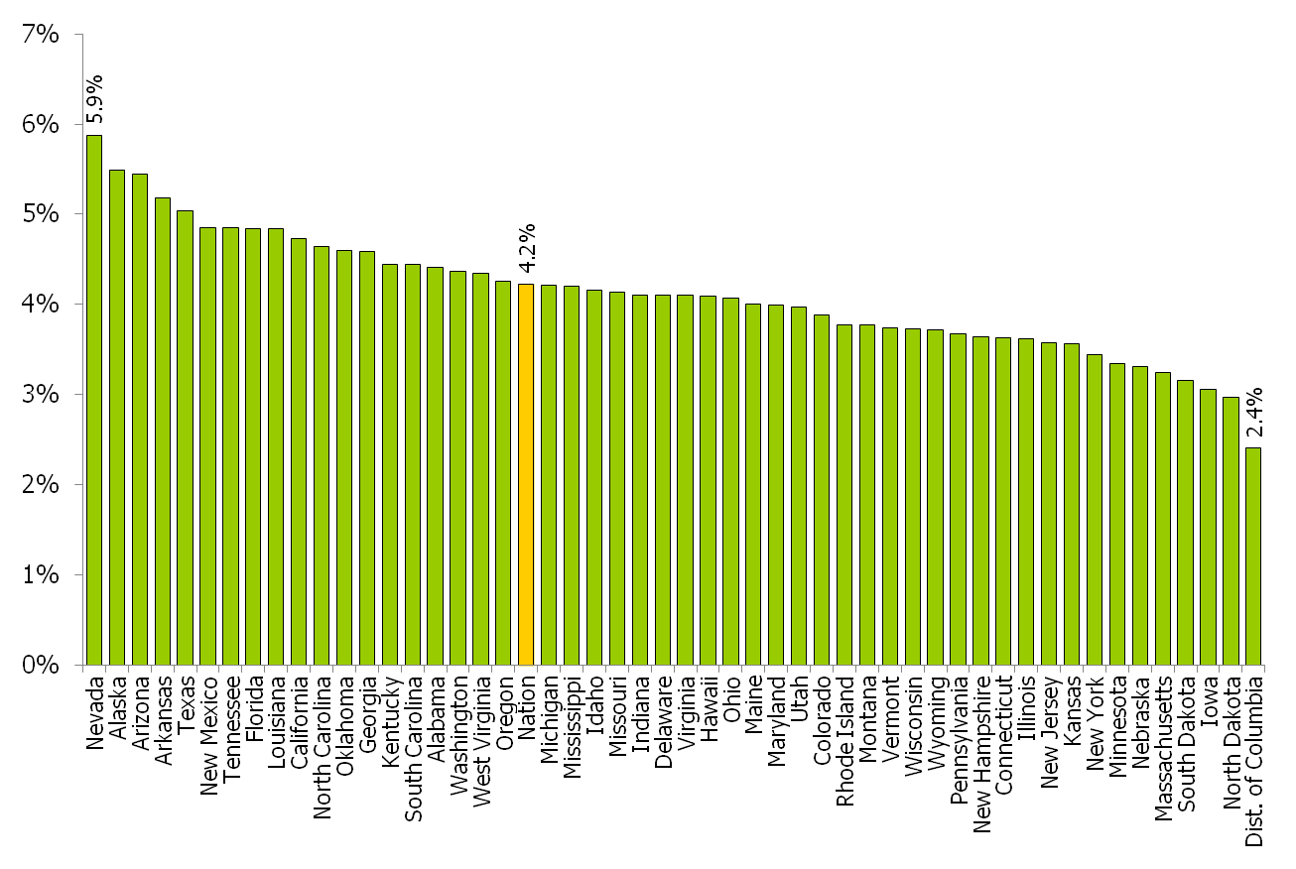
Contributing to the Goal: Average Annual % Increase in Degree Production Needed
Sources: NCES, IPEDS 2006-07 Completions File; c2007_a Early Release Data File Downloaded 04-28-08; NCES, IPEDS 2006-07 Instructional Activity File; efia2007 Final Release Data File; NCES, IPEDS 2006-07 Unduplicated Headcount File; effy2007 Final Release Data File.; NCES, IPEDS Fall 2006 Enrollment File; ef2006a Final Release Data File.

Slide 12
Degree Attainment Challenge
With this backdrop, new national goals, U.S. competitiveness and degree “gap” driving policy
Given the percentage increases each state needs to contribute to reaching our national goals….and
Given the time it will take to reach these percentage increases with traditional-aged students…and
Given the changing demographics in many states…
Opportunities for online learning

Slide 13
Accountability
Greater pressure to produce graduates (or completers)
  Our rates of completion are difficult to defend
  40 million working age adults with some college and no degree (adding nearly one million a year to that total)
Funding changes that focus on rewarding completion
Challenges for the for-profit sector likely to be applied to the non-profit sector
Online programming can reach and serve many in the degree completion market

Slide 14
Tuition and Fees
Every indication that tuition and fees will continue to rise (tax that is not considered a tax)
  Redefining “public” institutions
Seeing some interesting tuition strategies in online learning
Increasing rates and fees for technology and “convenience” fees for online learners
  Revenue replacement for fees paid by on-campus students
“Market pricing”
  Movement away from in-state/out-of-state tuition policy in the public sector?

Slide 15
Policy “Potpourri”
Outsourcing
  Straighter Line?
Requirements for traditional students to complete some portion of their program online
New competitors in the marketplace
Emergence (re-emergence) of state regulatory efforts for online programming across state lines
Prior Learning Assessment (CAEL’s new effort)
  Outcomes-based degrees?

Slide 16
The Emerging Ivory Tower
Greater reliance on adjunct faculty
Emerging cadre of professional online faculty teaching remotely for multiple institutions
The WGU Phenomena
  Competency-based degrees
  Reduced time to degree
  Break the “seat-in-a-seat” model
  WGU Indiana…is it coming to other states?
On campus learning driven by technology, mobile devices, virtual communities

Slide 17
The Emerging Ivory Tower (2)
E-books and e-course packs
More student ‘swirling’
Greater workforce focus
Self-paced learning
More a la carte approaches to pricing
Blended learning will become main strategy for traditional campuses
All things virtual…but fear not, we still enjoy football on Saturday’s (and Thursday’s and Friday’s…)

Slide 18
An SREB Focus on Degrees
Full Court Press on Degree Completion as Outlined in “No Time to Waste”
Get copy of report from SREB.org
Focus
  Better job of preparation for college
  One in college, get students to a credential
  If they drop out, get them back in at some point
Growing awareness of our poor degree completion results by state legislatures suggests new accountability on success (and not just access) tied to funding

Slide 19
The Broader Challenge…
Even if we achieve success getting traditional-aged students to degree completion at the highest levels in top states, we will not achieve national goals…

Slide 20
First, if what we are doing was working, we wouldn’t have millions of young adults without degrees—our approaches need to be different.
SREB’s “Guiding Principles”
Online or blended delivery
Accelerated (compressed) terms
Institutions become “adult friendly”
Supportive credit transfer/PLA

Slide 21
Programs Built on These Principles Provide…
More Flexible Programs that Meet Adult Needs
  Time, Location, Length, Delivery Formats
Pathways to Degrees that Give Some Hope of Completion
Services Designed to Meet the Needs of Adult Learners (re-designed or new)
More Adult-Friendly Policies
  Credit Transfer/Acceptance
  Prior Learning Assessment Opportunities
  Financial Aid/Assistance for “non-traditional learners

Slide 22
Coming Soon…
TheAdultLearner.org
Four-year grant from Lumina Foundation for Education (part of a $14m initiative)
Establish a regional and then national portal focusing on adult degree completion
  Programs (initially focusing on SREB states efforts
  Services
    Advising
    Career Services
    Prior Learning Assessment
  Policy (state and institutional)

Slide 23
Here Come the Feds…
New federal requirements going into effect July 1, 2011 (600.9)
Institutions serving students outside their home state must meet all state requirements
  No consideration for “physical presence”
  Can’t be exempted from state approval by accreditation
  Failure to have evidence of approval will make institution ineligible for Title IV funding

Slide 24
Impact/Implications
State approval/licensure requirements are uneven (at best) and problematic
Most public institutions have operated in an unfettered way in states, in particular those with a few students and no other presence
Time-consuming and costly
  One institution in North Dakota
    600+ online students in 40+ states
    Estimated cost of $160,000 for approval
    8 student in MA--$28,000
    5 students in TN--$29,000

Slide 25
SREB’s Stance and Actions
Since inception of Electronic Campus, we have operated in a “free trade zone”
  Home state “sign-off” of programs recognized by other SREB states
Consortial or reciprocity agreements allowable under the new regs
  Seeking clarification from feds as to our continuing use to meet new regs
Broader campaign to repeal, amend or delay implementation
At this point, some action by July 1… YOU NEED TO TAKE ACTION

Slide 26
What Should Institutions Do?
Assuming we do not get clarification/clearance to continue “free trade zone” (and if you are offering programming outside the region…
Send a letter to every state
  Inform them you offer online programs and may have now or in the future students enrolling in programs
    What is there regulatory requirements?
    What do you need to do?
    What is there process?
    How long does it take?
    How much does it cost?
    Request response by July 1 to meet new federal regulations
DOCUMENT EVERYTHING.

Slide 27
Some Available Resources
SREB
Applicable federal regs (600.9)
http://edocket.access.gop.gov/2010/pdf/2010-26531.pdf
State Approval “Starter List”
http://wcet.wiche.edu/wcet/advance/state-approval
Blog (by Russ Poulin, WCET-WICHE
http://wcetblog.wordpress.com/2011/01/26/629/
Your national membership organizations (e.g. AASCU, APLU, AACC)

Slide 28
Thank You… sreb.org electroniccampus.org soon…
TheAdultLearner.org
Bruce Chaloux bruce.chaloux@sreb.org

