Slide 1
Toolkit Bonus: A Voicethread Demo
of a Voicethread
Go to link for a demonstration of the features of VoiceThread:
http://voicethread.com/?#q.b409.i848804
Notes:
The proceeding slides you may share with your students to cut down training time. Yey!

Slide 2
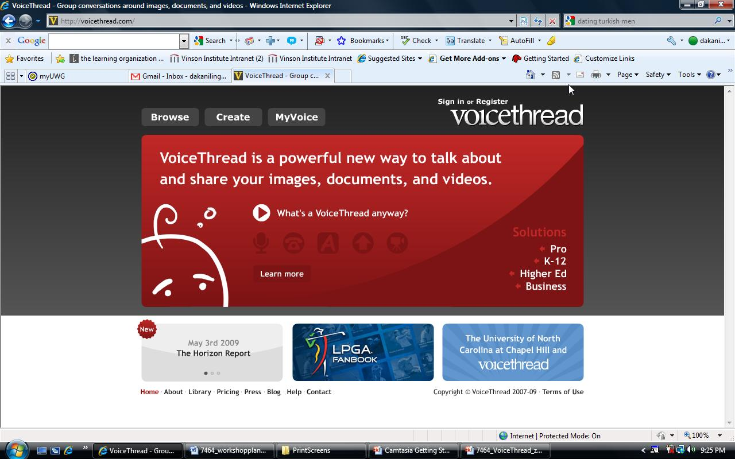
Step 1: Google: Voicethread or go to voicethread.com
Go to the VoiceThread website and click “create”.

Slide 3
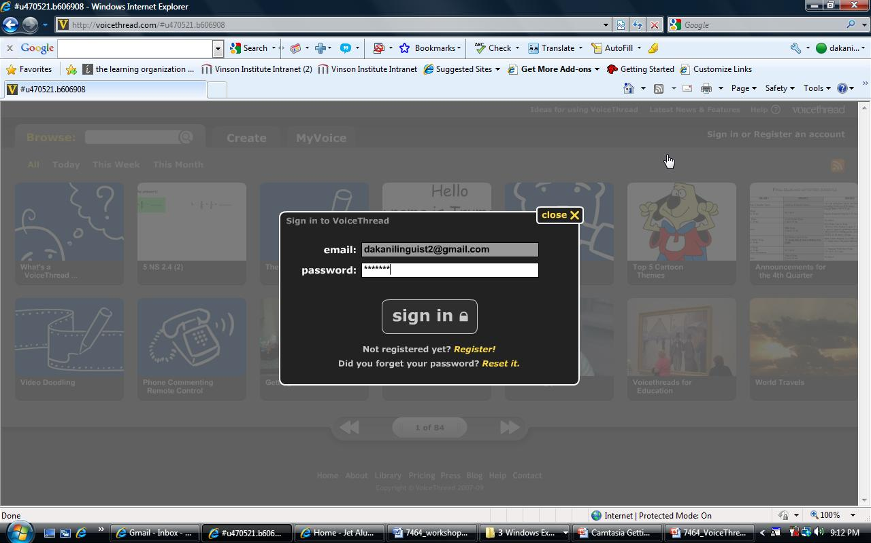
Step 2: Sign in at the prompt. First time users: To use this website you must register with an email address. This is a mostly free, “shareware” website.

Slide 4
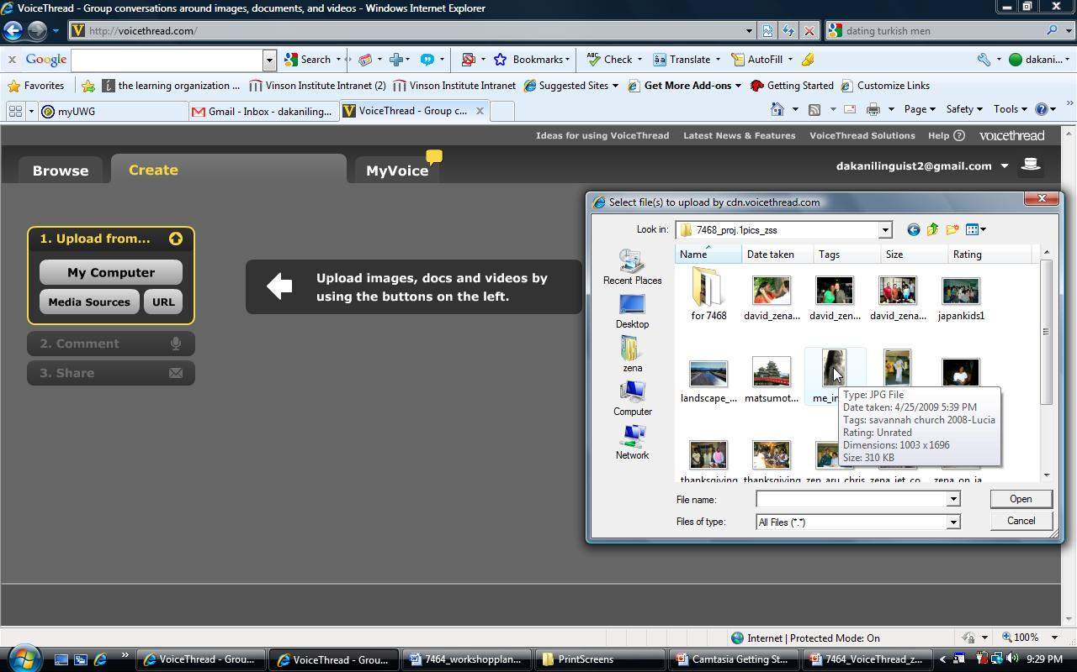
Step 3: From the “Create” tab, click “upload” to insert an image/picture from your computer files, media sources or URL. PowerPoints/Excel must be in .jpeg format.

Slide 5
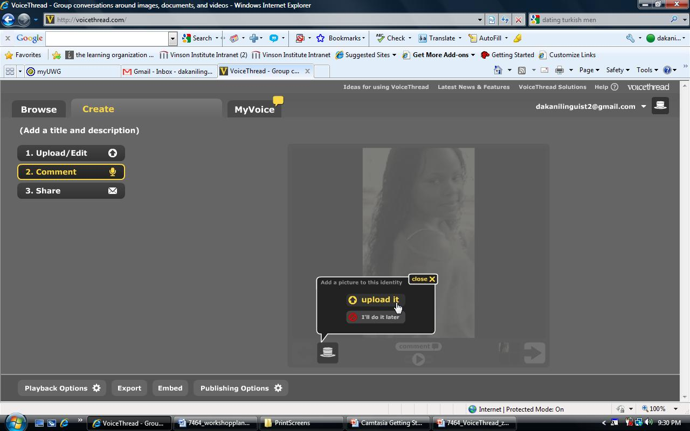
Step 4-A: There are many ways to add audio/or video:
You may upload a file from your computer…

Slide 6
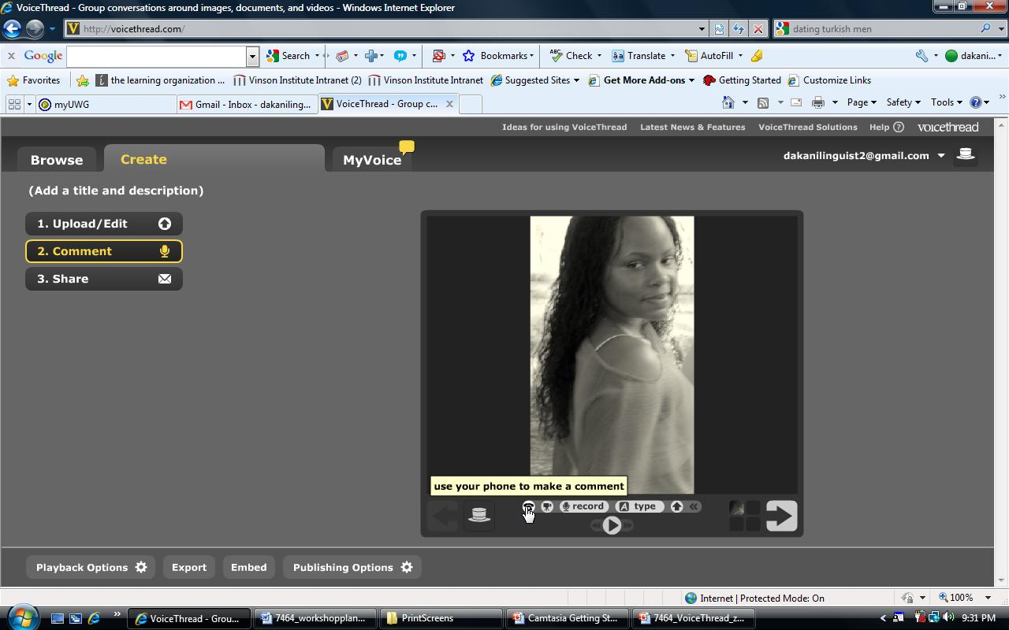
Step 4-B: You can insert a comment by phone as long as it’s a phone number with the U.S. and Canada.

Slide 7
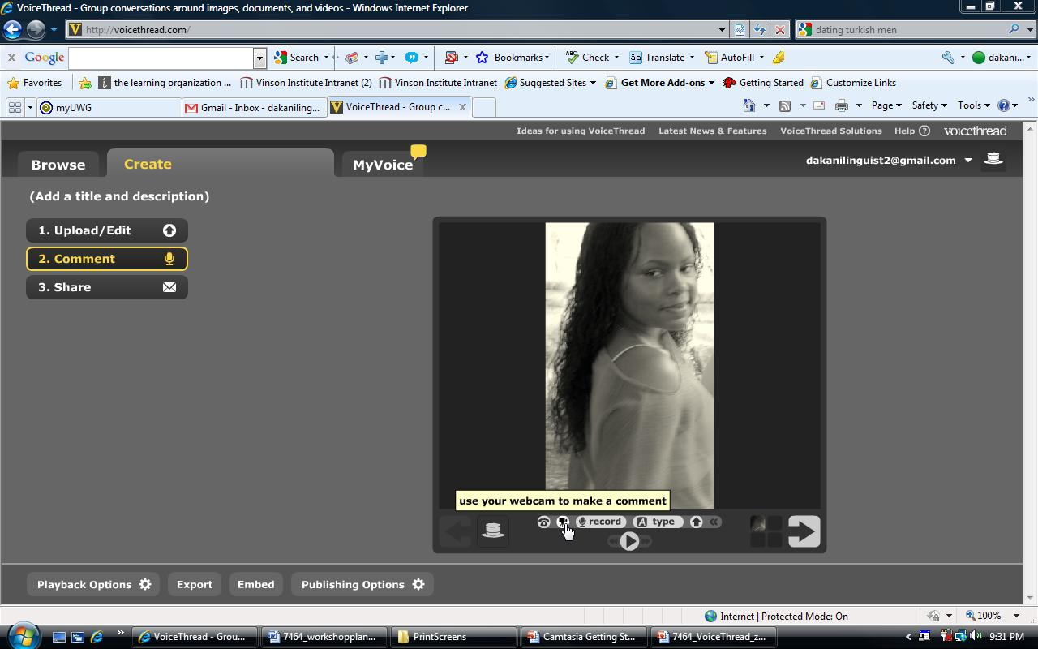
Step 4-C: You may upload your comment via webcam by clicking the webcam icon below your image.

Slide 8
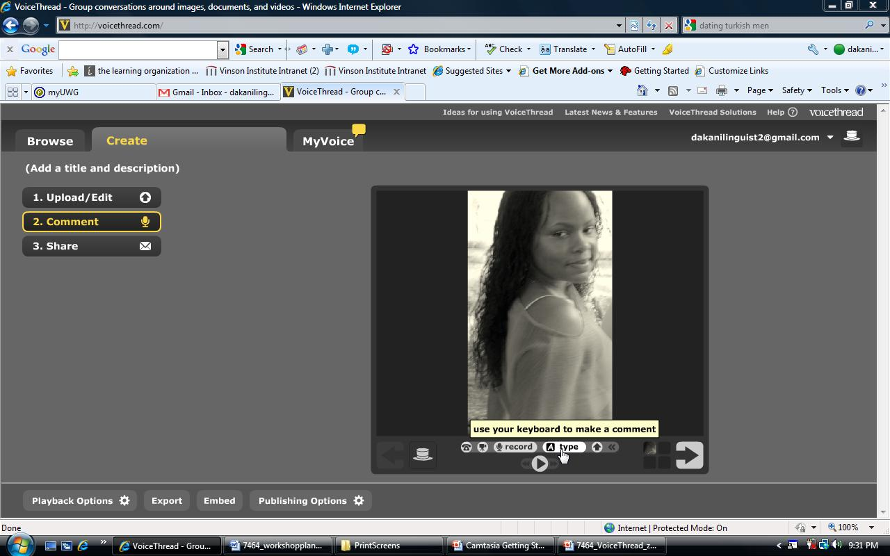
Step 4-D: Finally, you may simply type your comment
so that its written for all to read.

Slide 9
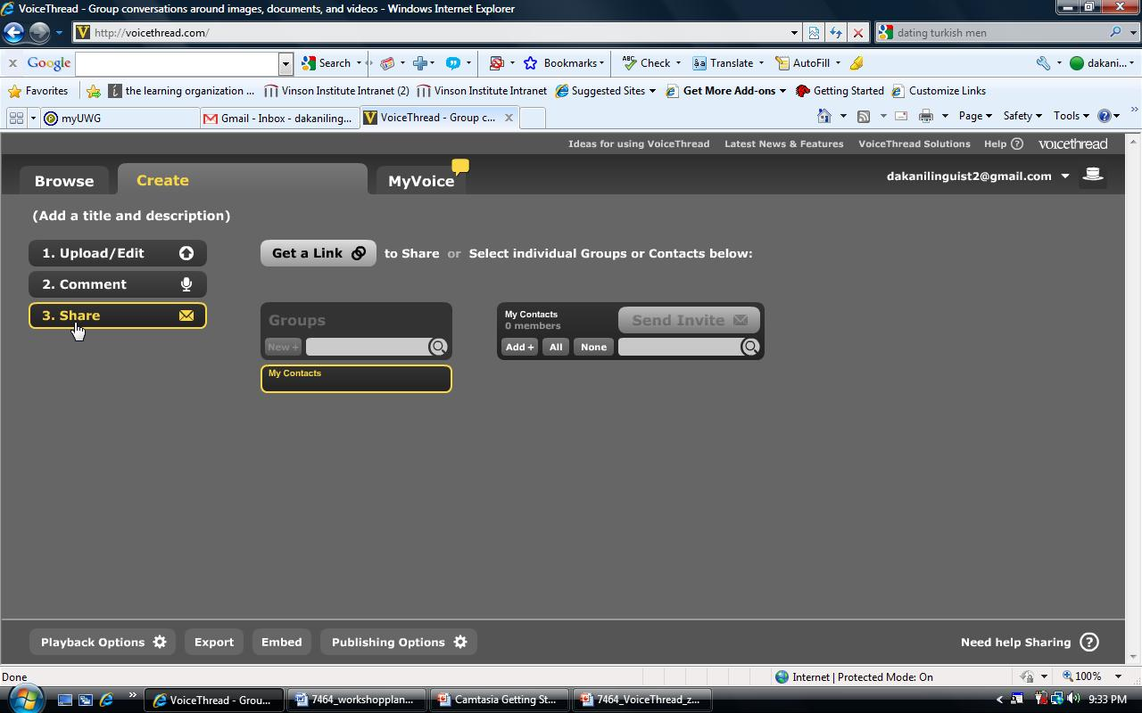
Step 5-A: Next, click the share tab for sharing options such as
obtaining a link or emailing your VoiceThread to your contacts.

Slide 10
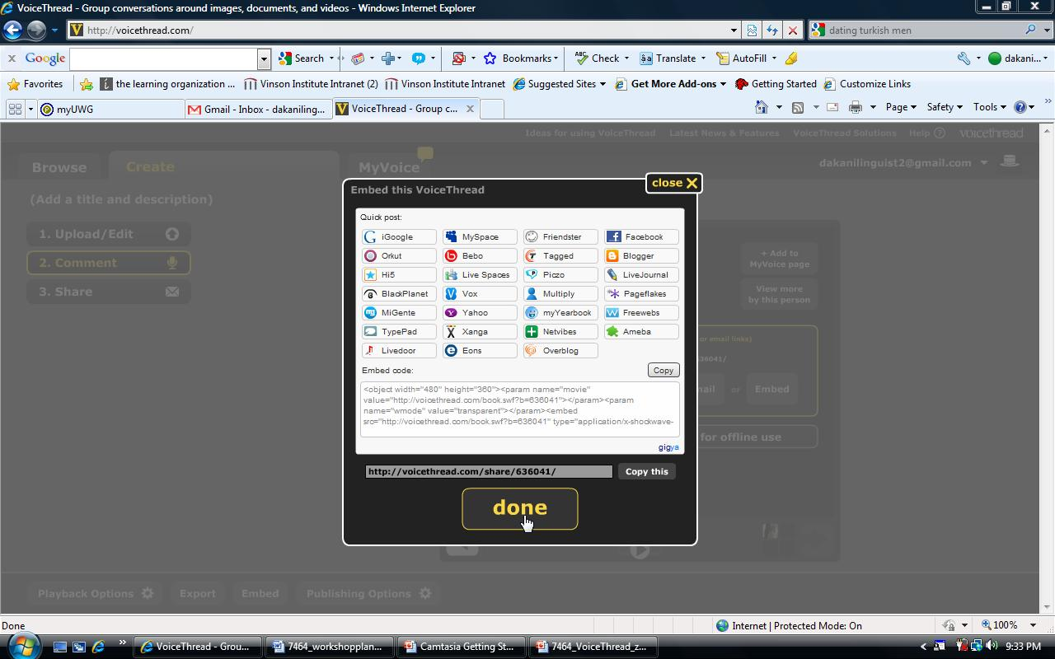
Step 5-B: You can also embed your VoiceThread anywhere
that accepts embed code: Vista 8, D2L and Facebook!

Slide 11
Guided Practice
Instructions:
Create a VT account: http://voicethread.com/
Browse to find the sample VT.
Once you located the VT for this workshop, select it.
Upload a comment via microphone, text, or by phone describing how you would use VT or any other Web 2.0 to “flip” your classroom.

