Slide 1
More About Light

Slide 2
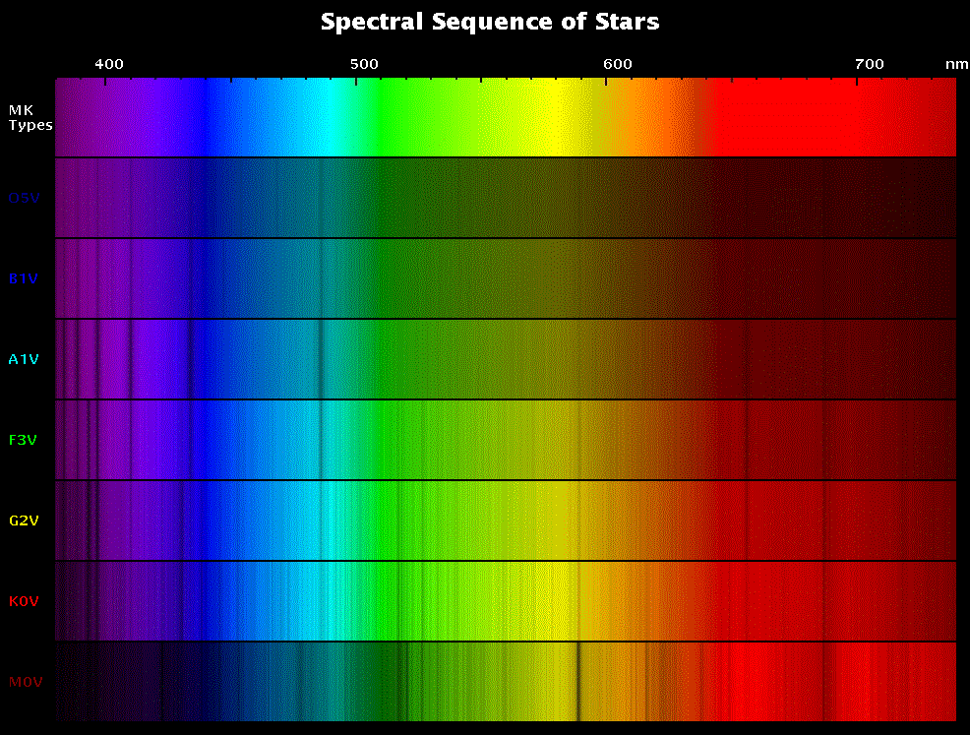

The sun emits a rainbow — a spectrum
How much light at each wavelength (color) depends on one thing:
the TEMPERATURE of the Sun
0.4µ 0.7µ

Slide 3




How much light at each wavelength?
0.4µm 0.7µm
amount of light
This light source emits more light of wavelength $λ_{2}$ than any other wavelength.
i.e. the peak wavelength is $λ_{2}$
It also emits more of $λ_{1}$ compared to $λ_{3}$
2
1
3
$$λ_{1}$$
$$λ_{2}$$
$$λ_{3}$$
wavelength

Slide 4

COOL stars emit more light at longer wavelengths
0.4µm 0.7µm
amount of light
At a lower temperature, the same light source emits more light of longer wavelengths, such that the peak wavelength is longer than $λ_{2}$
2
3
1
$$λ_{1}$$
$$λ_{2}$$
$$λ_{3}$$
wavelength

Slide 5

HOT stars emit more light at shorter wavelengths
0.4µm 0.7µm
amount of light
At a higher temperature, the same light source emits more light of shorter wavelengths, such that the peak wavelength is shorter than $λ_{2}$
2
1
3
$$λ_{1}$$
$$λ_{2}$$
$$λ_{3}$$
wavelength

Slide 6
0.4µ 0.7µ
All objects in the universe made out of charged particles emit light
How much light at each wavelength (color) depends on one thing:
the TEMPERATURE of the object.

Slide 7
0.4µ 0.7µ
The color you see for the star is the color at which it puts out the most light.
The relation between color and peak wavelength is simple:
T =
2900
λ_{peak}

Slide 8
0.4µ 0.7µ
This means that the hotter the object,
the bluer it appears, and the colder the
object, the redder it appears
T =
2900
λ_{peak}

Slide 9


So our Sun has a temperature of 5800 K
0.4µm 0.7µm
amount of light
Peak Wavelength:
$$λ_{peak}=\frac{2900}{T}$$
$$=\frac{2900}{5800} μm$$
$$=0.5 μm$$
$$λ_{peak}$$
wavelength

Slide 10
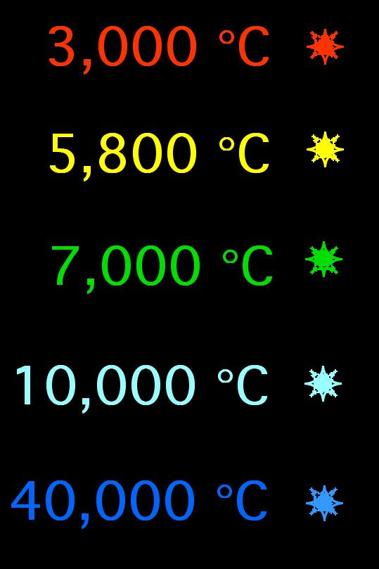
K
K
K
K
K

Slide 11
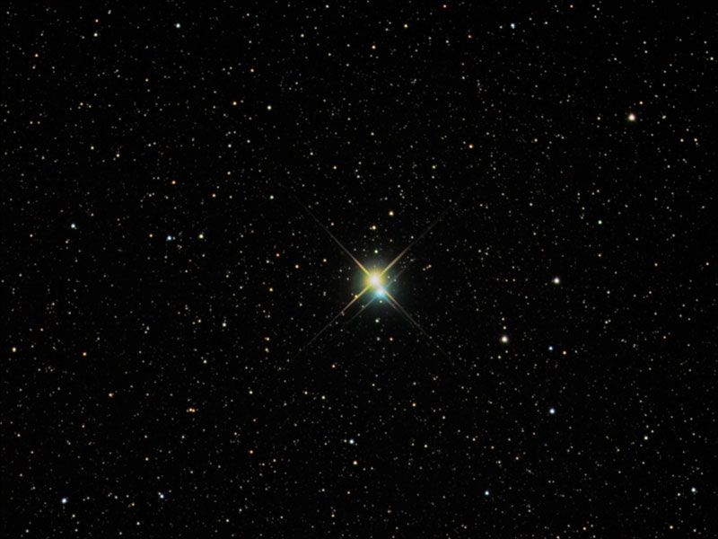

Slide 12
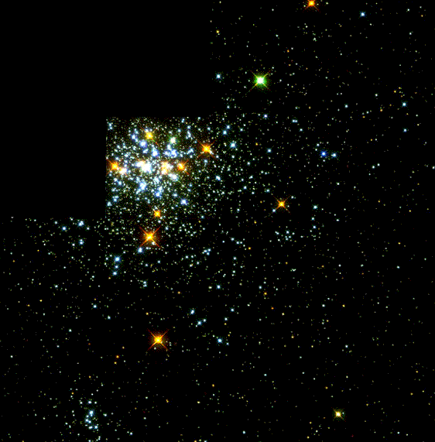
Notes:
Not all stars are the same.

Slide 13
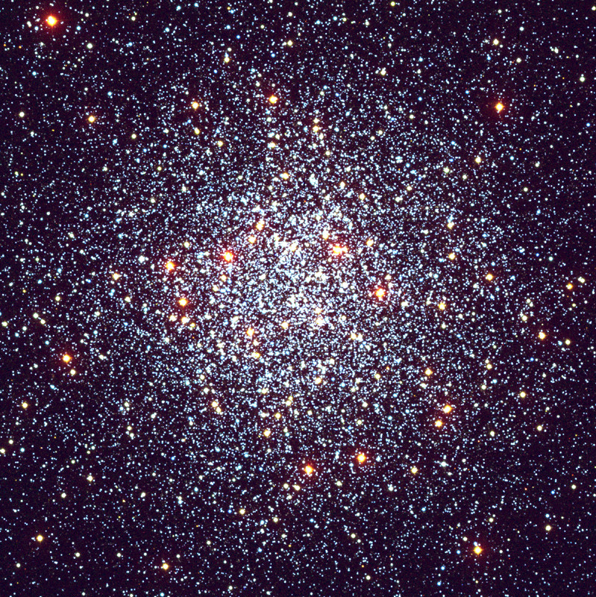

Slide 14
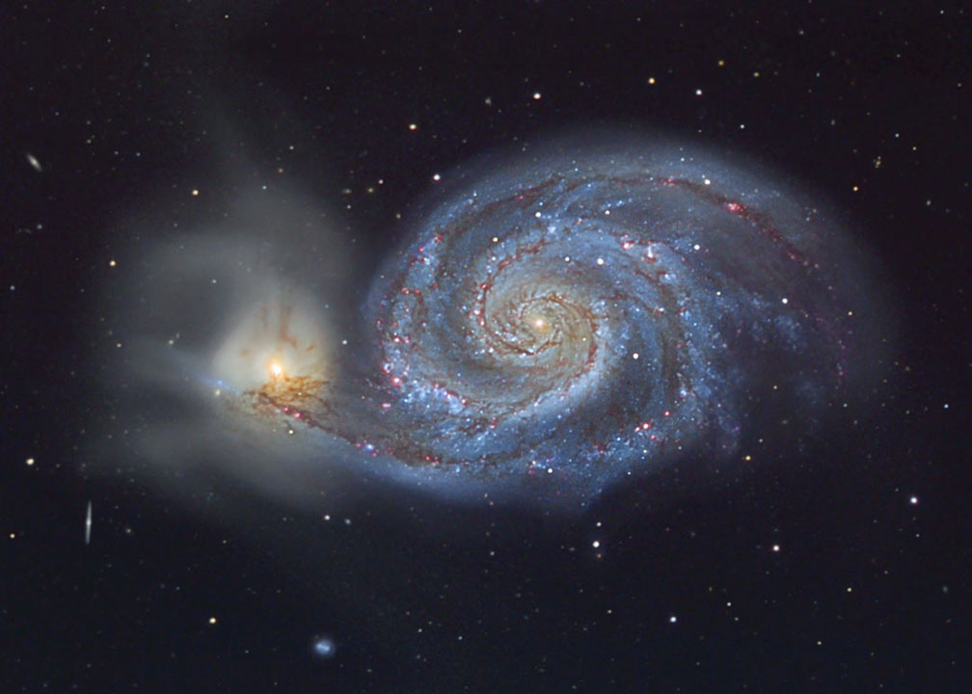
Notes:
m51

Slide 15
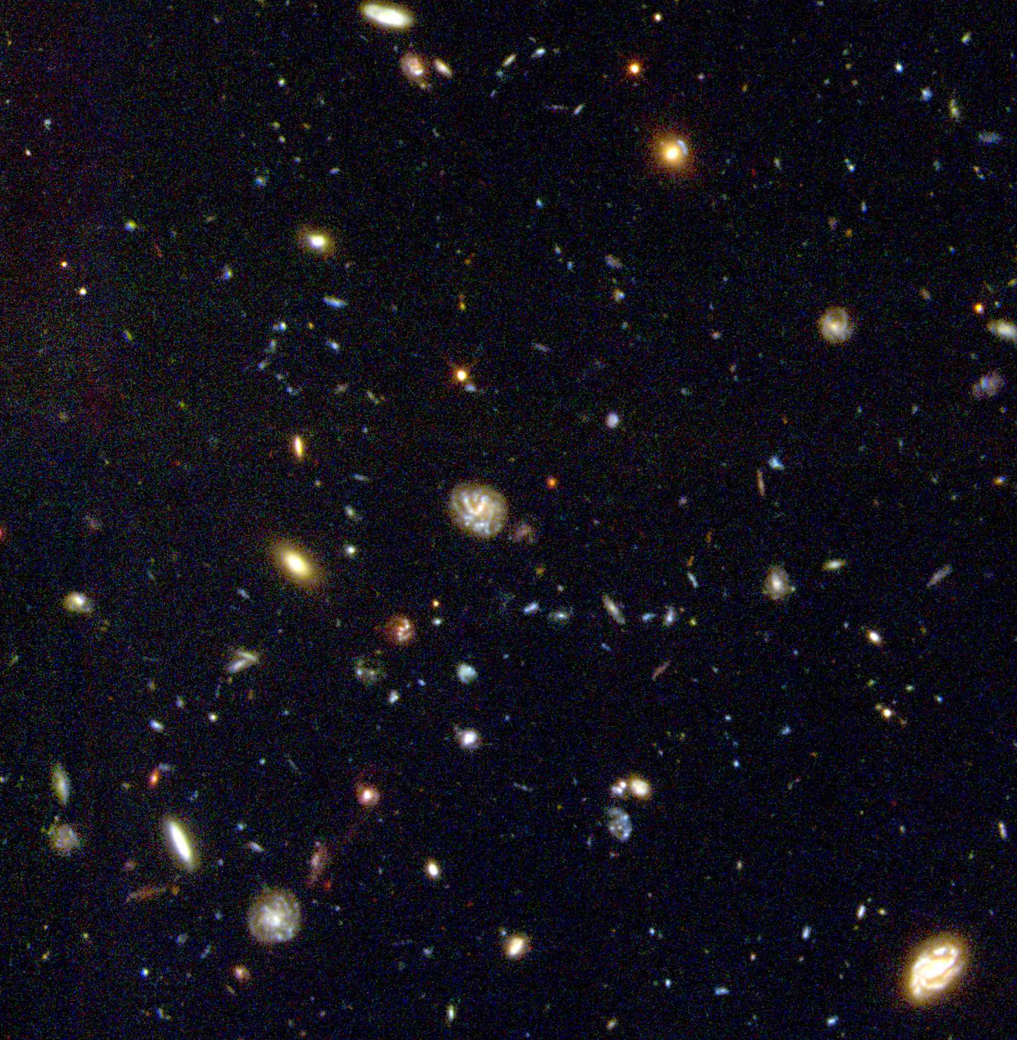
Notes:
Hdf field south

Slide 16
IMAGES FROM TELESCOPES
Effects of Atmosphere
Resolution
Magnification
TELESCOPES in general:
Refracting
Reflecting
RESEARCH TELESCOPES (reflecting):
Optical (visible light) Telescopes
Radio Telescopes

Slide 17
When light bends around (DIFFRACTS) the edges of the
lens or mirror

Slide 18
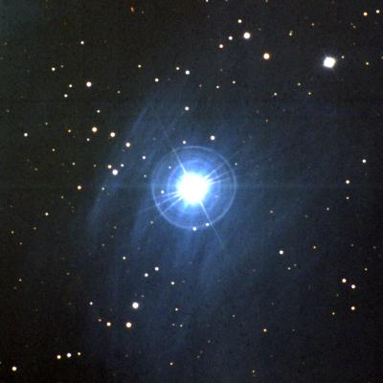
Causing a diffraction pattern

Slide 19
.
star as a point source

Slide 20

.
image from space telescope with diffraction
star as a point source
Diffraction due to light passing through the telescope smears the light out a little bit.

Slide 21
This is why we put telescope in Space
.
image from ground
image from space with diffraction
star as a point source
But refraction due to our atmosphere and the turbulent conditions of our atmosphere blur and distort the image.

Slide 22
RESOLUTION
Resolution is a measure of how much detail we can see in an image
Whether you can distinguish one blob or two — you see more detail on the right
better RESOLUTION means more information

Slide 23
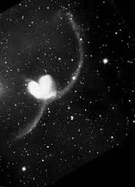
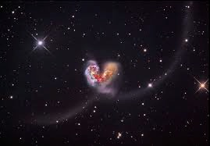
poor resolution good resolution

Slide 24
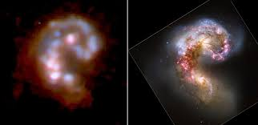
poor resolution good resolution

Slide 25
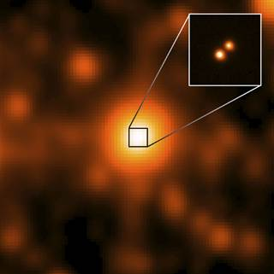
good resolution — can see more detail
(different telescope!)
poor resolution

Slide 26
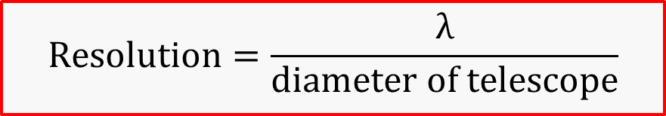
RESOLUTION
Resolution depends on the diameter of the telescope and the size of the wavelength observed
$$Resolution=\frac{λ}{diameter of telescope}$$

Slide 27
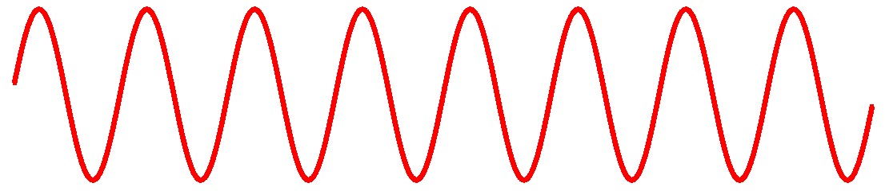
diameter of the telescope because the larger the surface, the more photons get captured.
smaller diameter
large diameter
The more photons, the more information, and so the better the resolution.

Slide 28
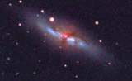
M82 — Cigar Galaxy
12 million l-y distant
small telescope
Notes:
M81 and m82

Slide 29
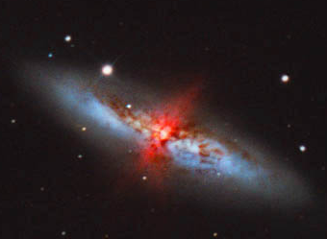
M82 — Cigar Galaxy
12 million l-y distant
medium telescope

Slide 30
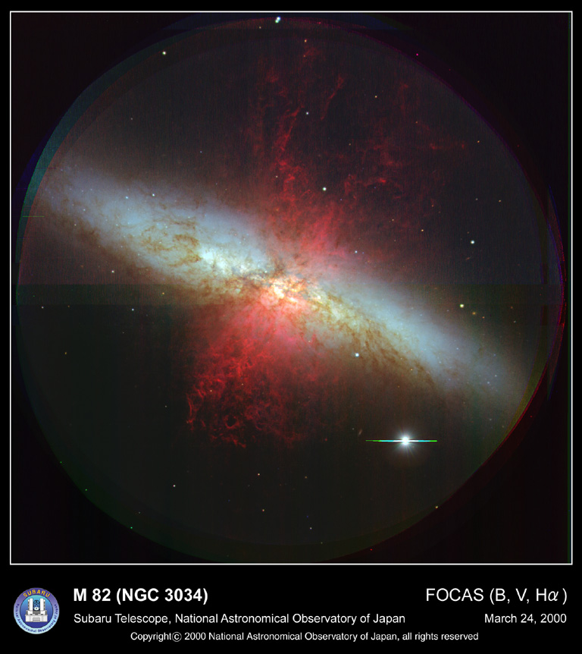
M82 — Cigar Galaxy
12 million l-y distant
large telescope
Notes:
M82
A Superwind from the Cigar Galaxy
Credit: FOCAS, Subaru 8.3-m Telescope, NAOJ
Explanation: What's lighting up the Cigar Galaxy? M82, as this irregular galaxy is also known, was stirred up by a recent pass near large spiral galaxy M81. This doesn't fully explain the source of the red-glowing outwardly expanding gas, however. Recent evidence indicates that this gas is being driven out by the combined emerging particle winds of many stars, together creating a galactic "superwind." The above recently released photograph from the new Subaru Telescope highlights the specific color of red light strongly emitted by ionized hydrogen gas, showing detailed filaments of this gas. The filaments extend for over 10,000 light years. The 12-million light-year distant Cigar Galaxy is

Slide 31
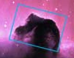
Horsehead Nebula, small telescope

Slide 32
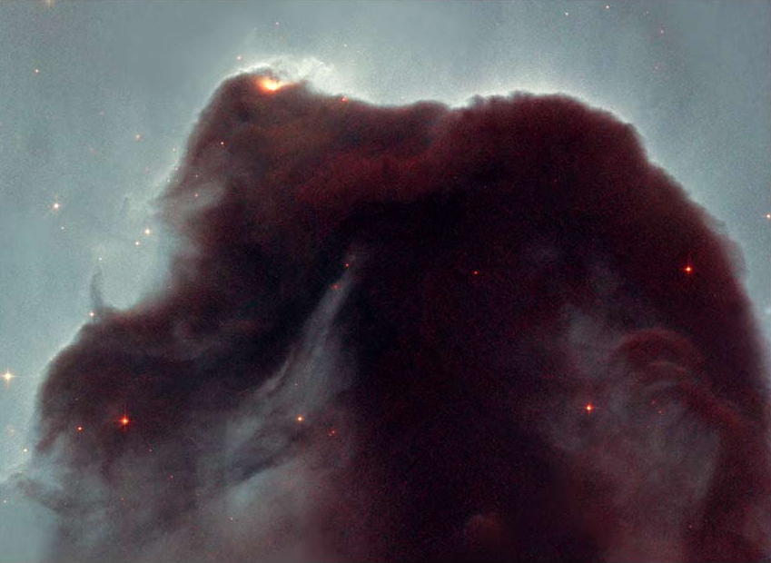
Horsehead Nebula, medium telescope

Slide 33
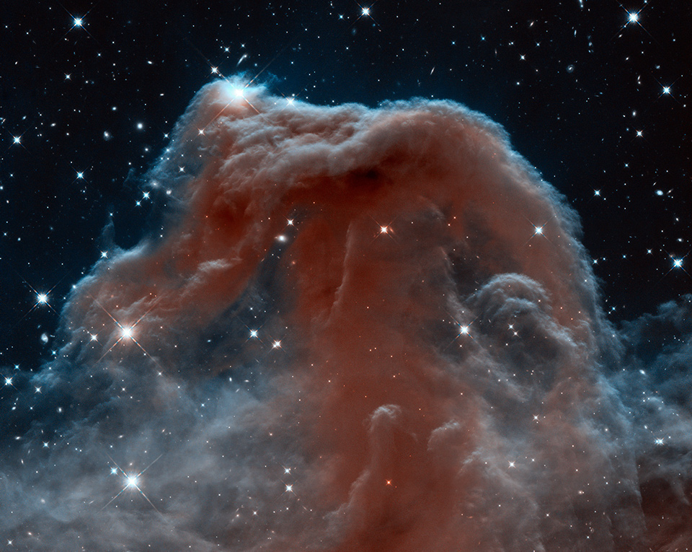
Horsehead Nebula, HST

Slide 34
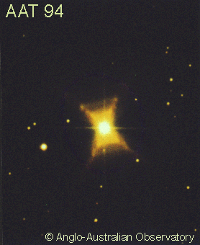
RESOLUTION and MAGNIFICATION
Ground based, small telescope, Red Rectangle

Slide 35
RESOLUTION and MAGNIFICATION
if the RESOLUTION is poor, MAGNIFICATION will not make it better

Slide 36
RESOLUTION and MAGNIFICATION
increase in MAGNIFICATION does not increase information

Slide 37
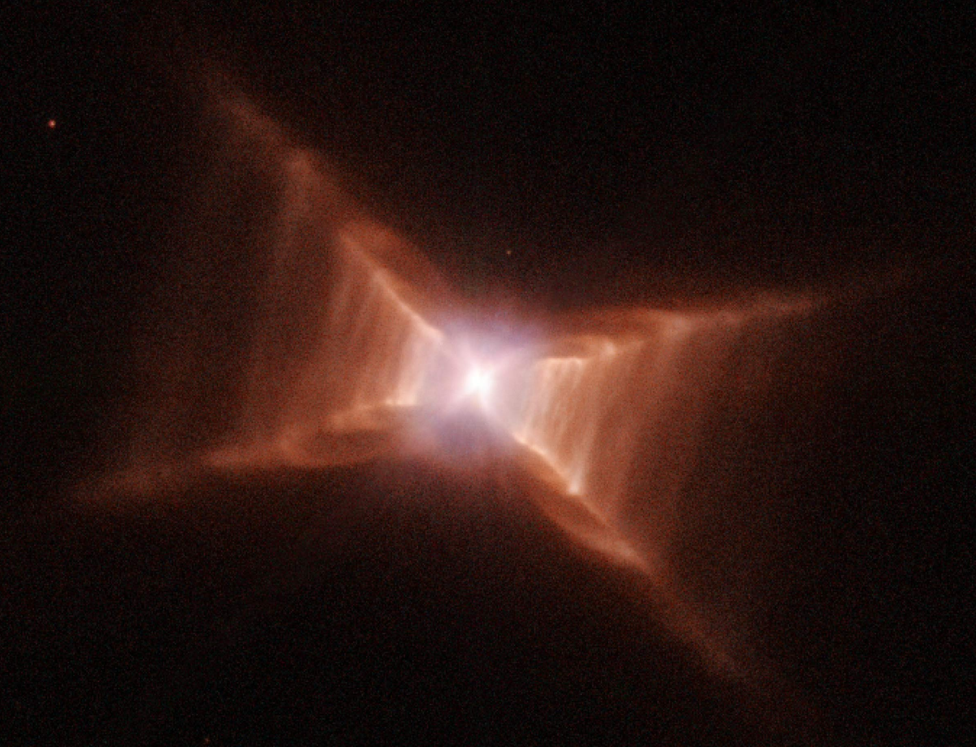
HST, medium telescope, Red Rectangle

Slide 38
Same Image Magnified
HST, medium telescope, Red Rectangle

Slide 39
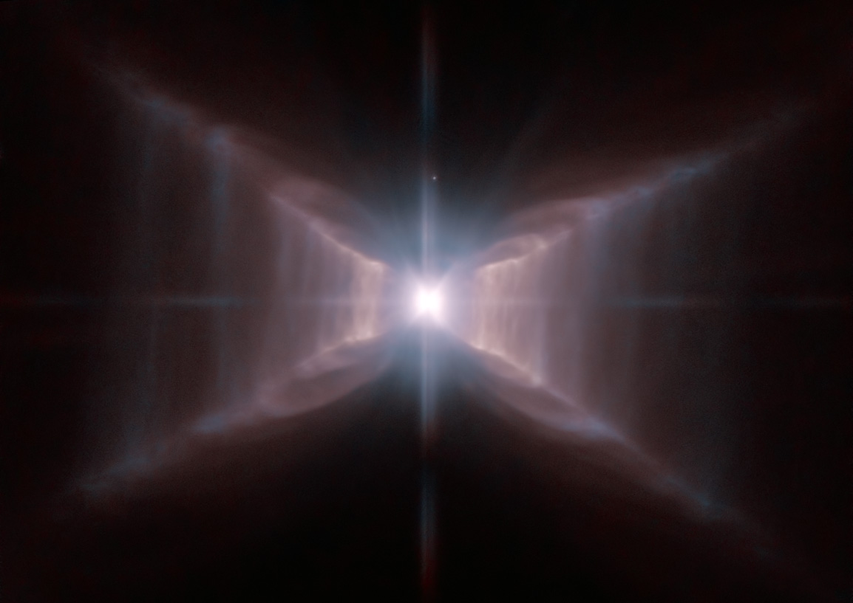
HST, medium telescope, better camera, Red Rectangle

Slide 40
Same Image Magnified
HST, medium telescope, better camera, Red Rectangle

Slide 41
If the image has good RESOLUTION then you can MAGNIFY it and still see lots of detail
HST, medium telescope, better camera, Red Rectangle

Slide 42
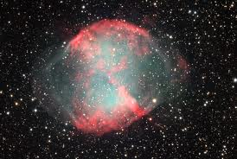
Dumbbell Nebula, ground based, medium telescope
Notes:
dumbell neb, full color, 1000 ly dist.

Slide 43
Same Image Magnified
Dumbbell Nebula, ground based, medium telescope, magnified view — yuck — poor resolution
Notes:
dumbell neb, full color, 1000 ly dist.

Slide 44
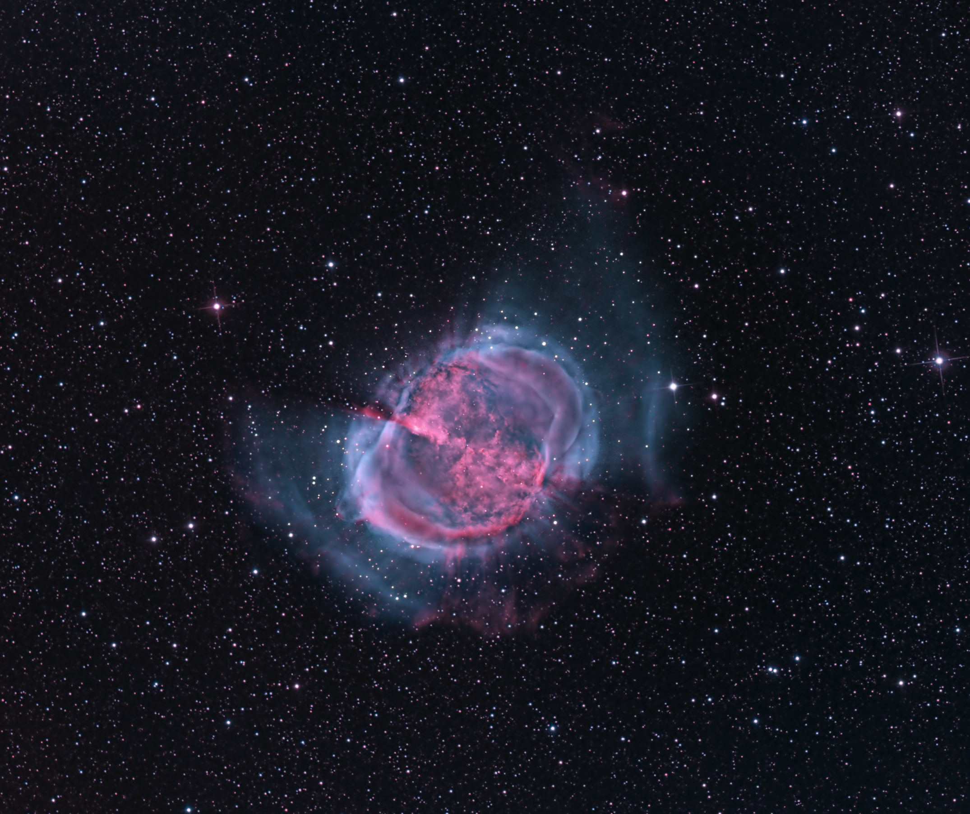
Dumbell Nebula, larger telescope

Slide 45
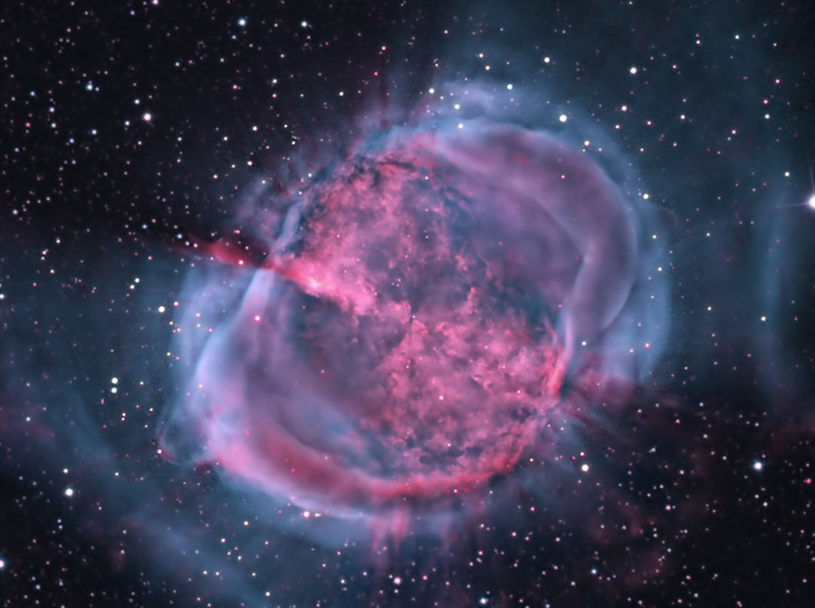
Same Image Magnified
Dumbbell Nebula,

Slide 46
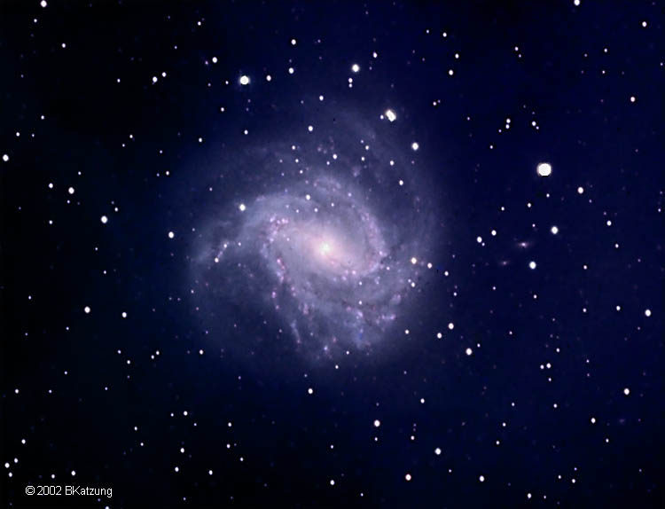
M83 galaxy, small telescope

Slide 47
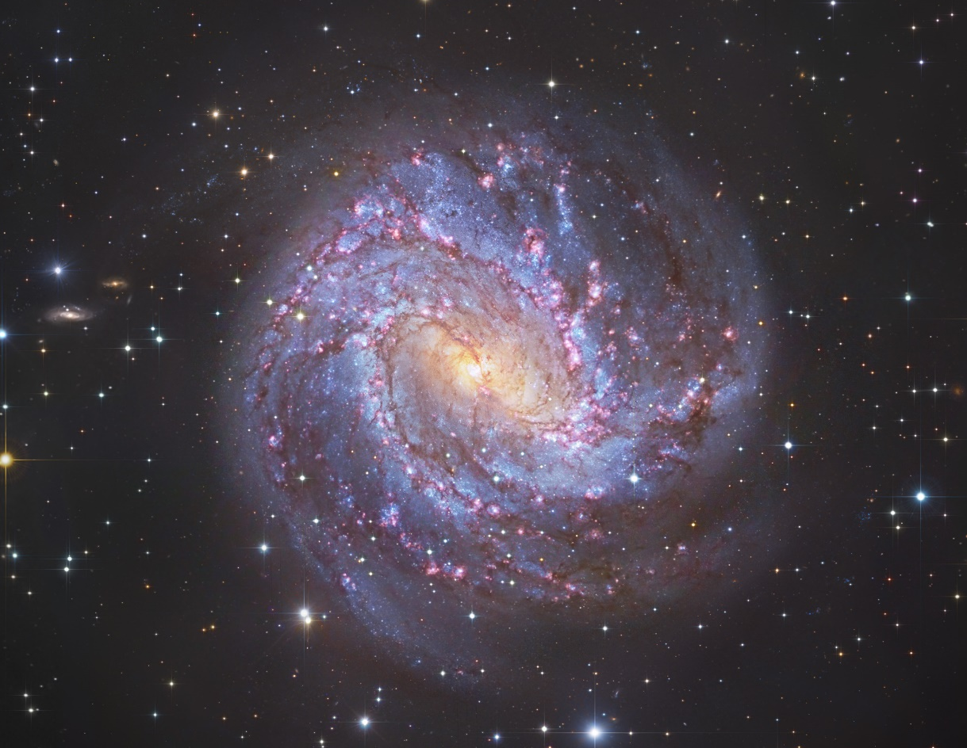
Same Image Magnified
M83 galaxy, larger telescope
M83 galaxy, small telescope

Slide 48
M83 galaxy, small telescope

Slide 49

M83 galaxy, larger telescope

Slide 50
Same Image Magnified
M83 galaxy, larger telescope

Slide 52
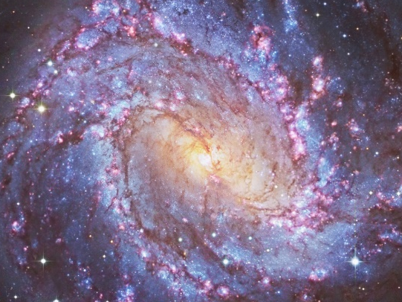

Slide 53
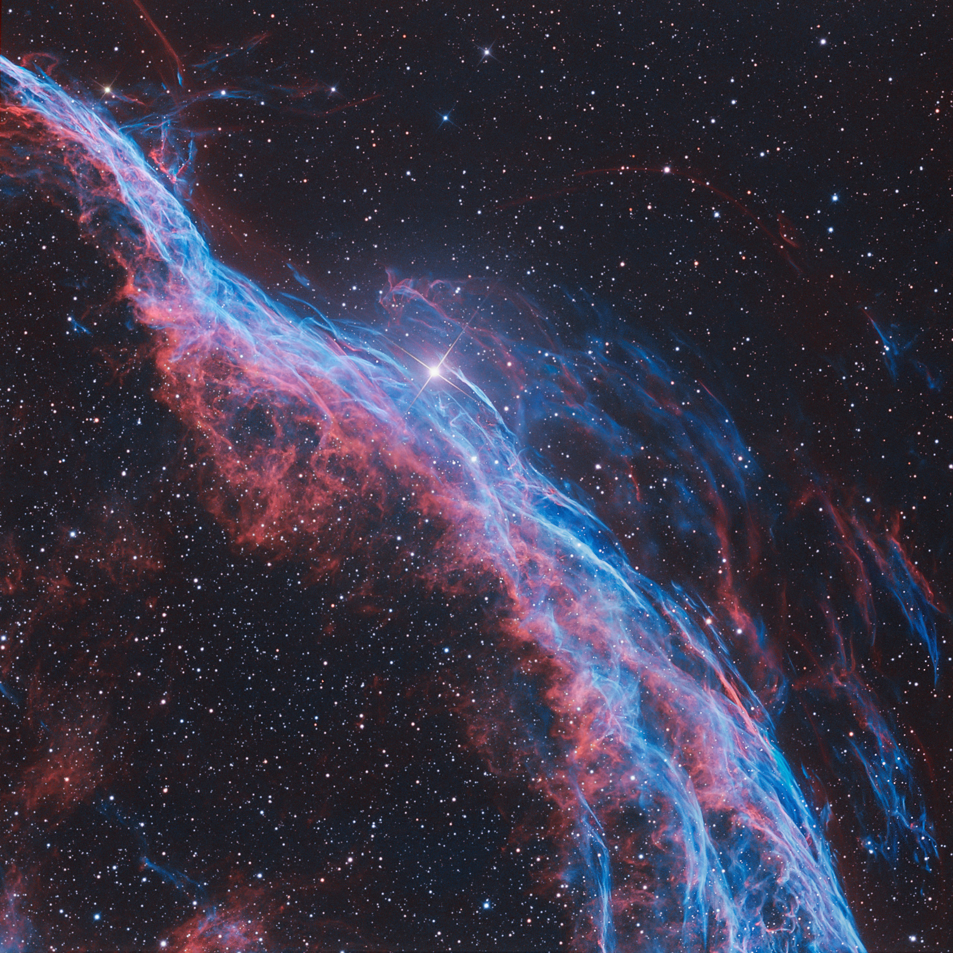
good resolution image of Veil Nebula

Slide 55
Same Image Magnified

Slide 57
Same Image Magnified

Slide 58
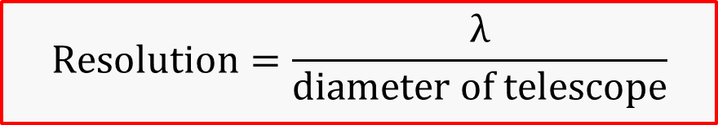
IMPROVING RESOLUTION:
$$Resolution=\frac{λ}{diameter of telescope}$$
Since resolution depends on wavelength, using shorter wavelengths for detection will improve resolution

Slide 59
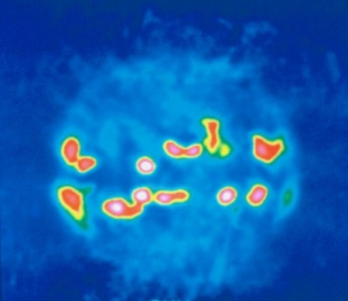
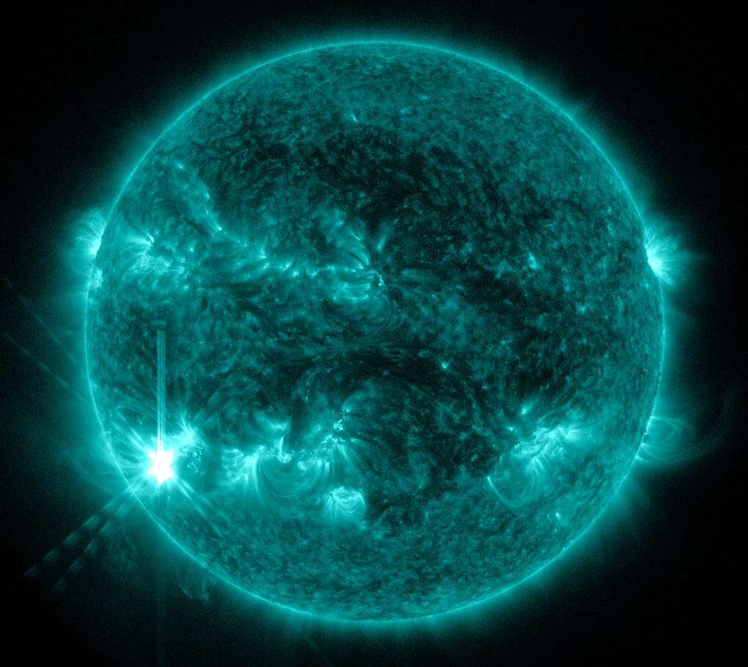
Sun in short x-ray wavelength
better resolution
Sun in long radio wavelength
poorer resolution
The more photons, the more information, and so the better the resolution.

Slide 60
There is another way to get better resolution with the same telescope observing the same wavelength
short time observtion
long time observation
INCREASE THE OBSERVING TIME
to get more photons

Slide 61
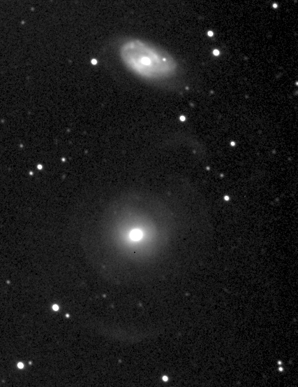
short time exposure

Slide 62
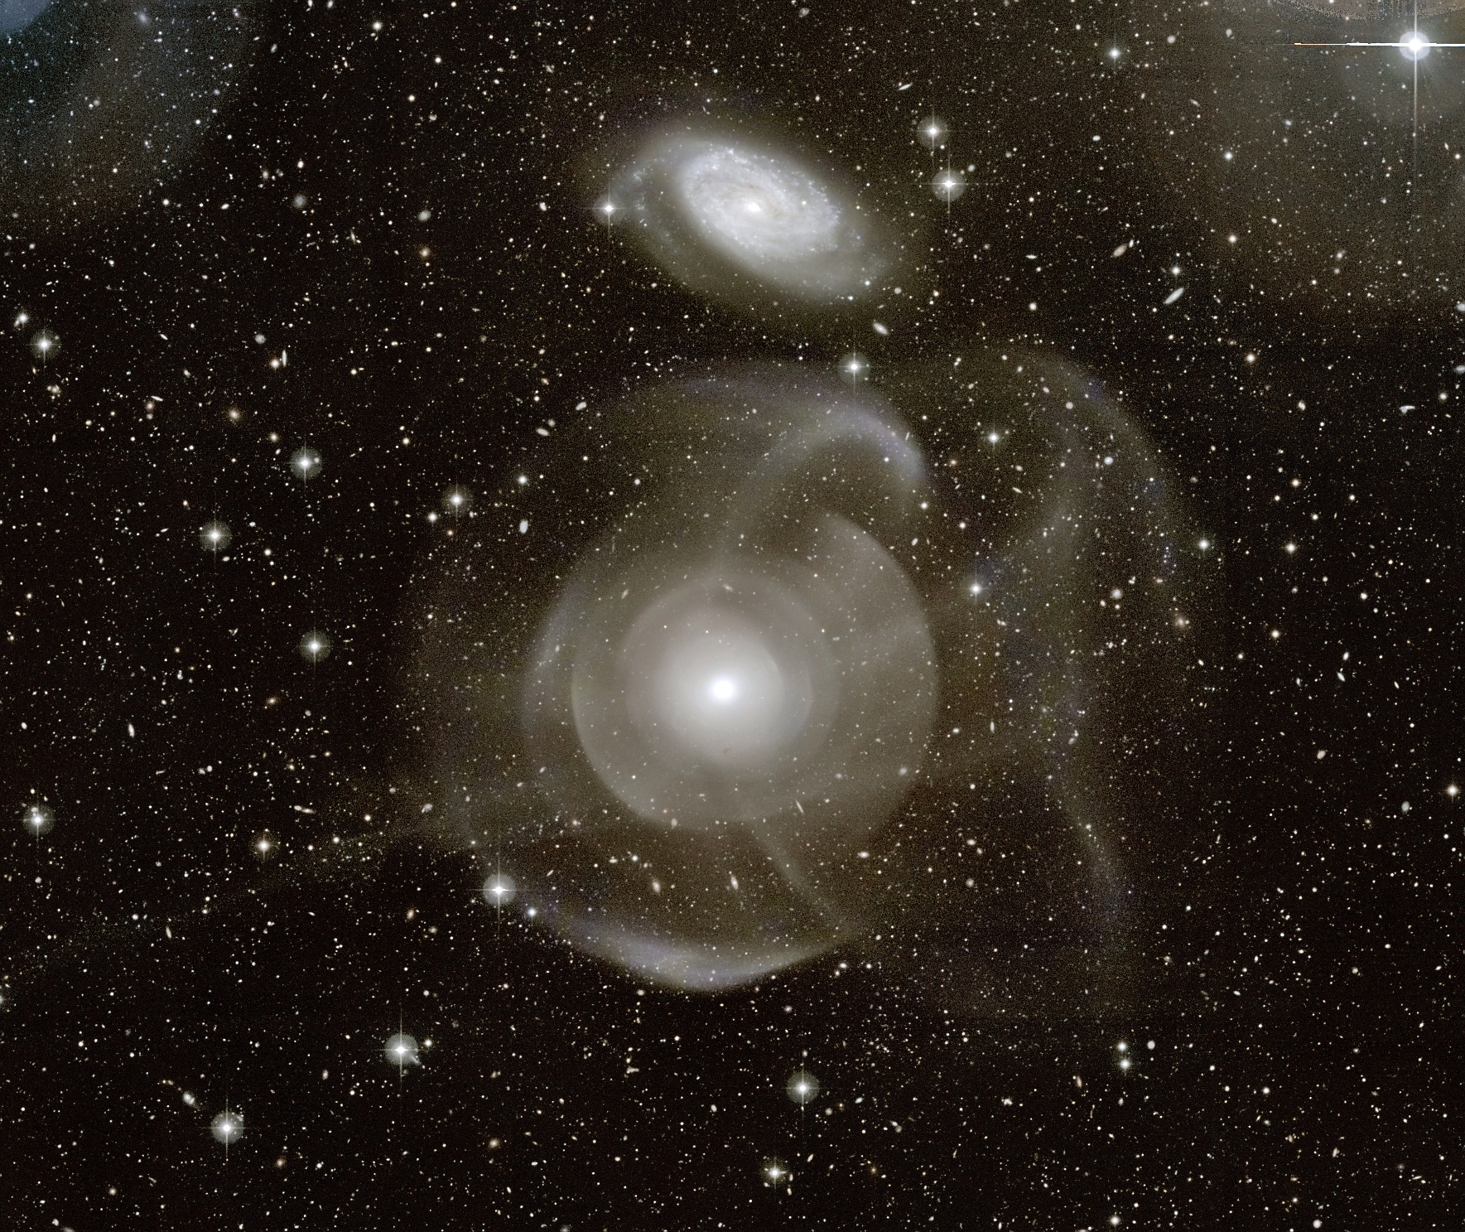
long time exposure

Slide 63
In SUMMARY:
Resolution depends on:
diameter of telescpe
λ observed
Resolution can be affected by
atmosphere
exposure time
Better RESOLUTION means more INFORMATION
Higher Magnification does NOT increase INFORMATION

Slide 64
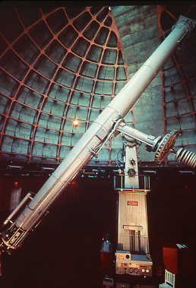
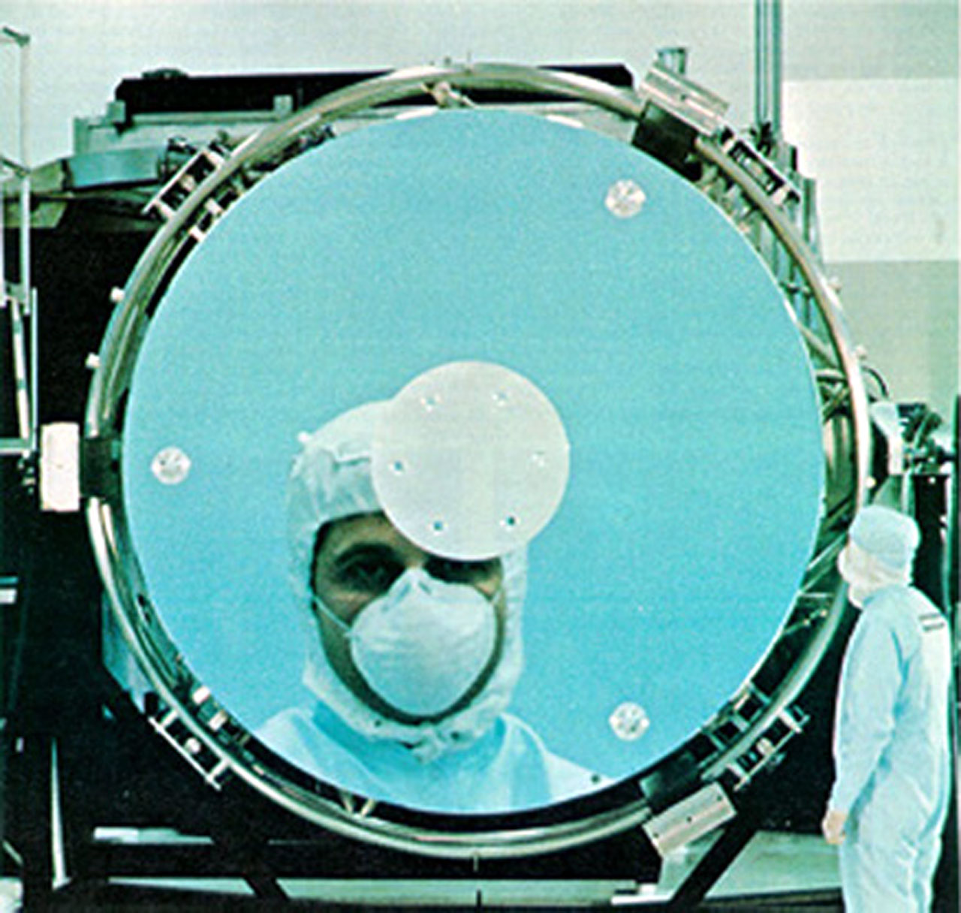
2 Basic kinds of Telescopes: Refractor and Reflector
lens
mirror

Slide 65
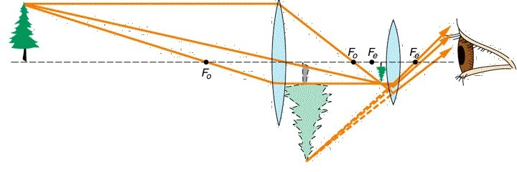
A lens from a REFRACTING telescope
(note: not to scale)

Slide 66
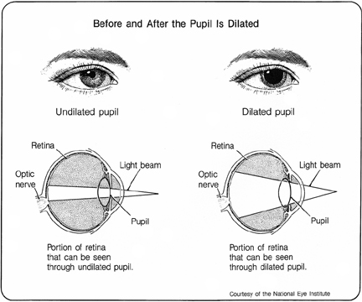
retina
light
refracting
LENS

Slide 67
Lick Observatory 36” Refractor
lens
astronomer

Slide 68
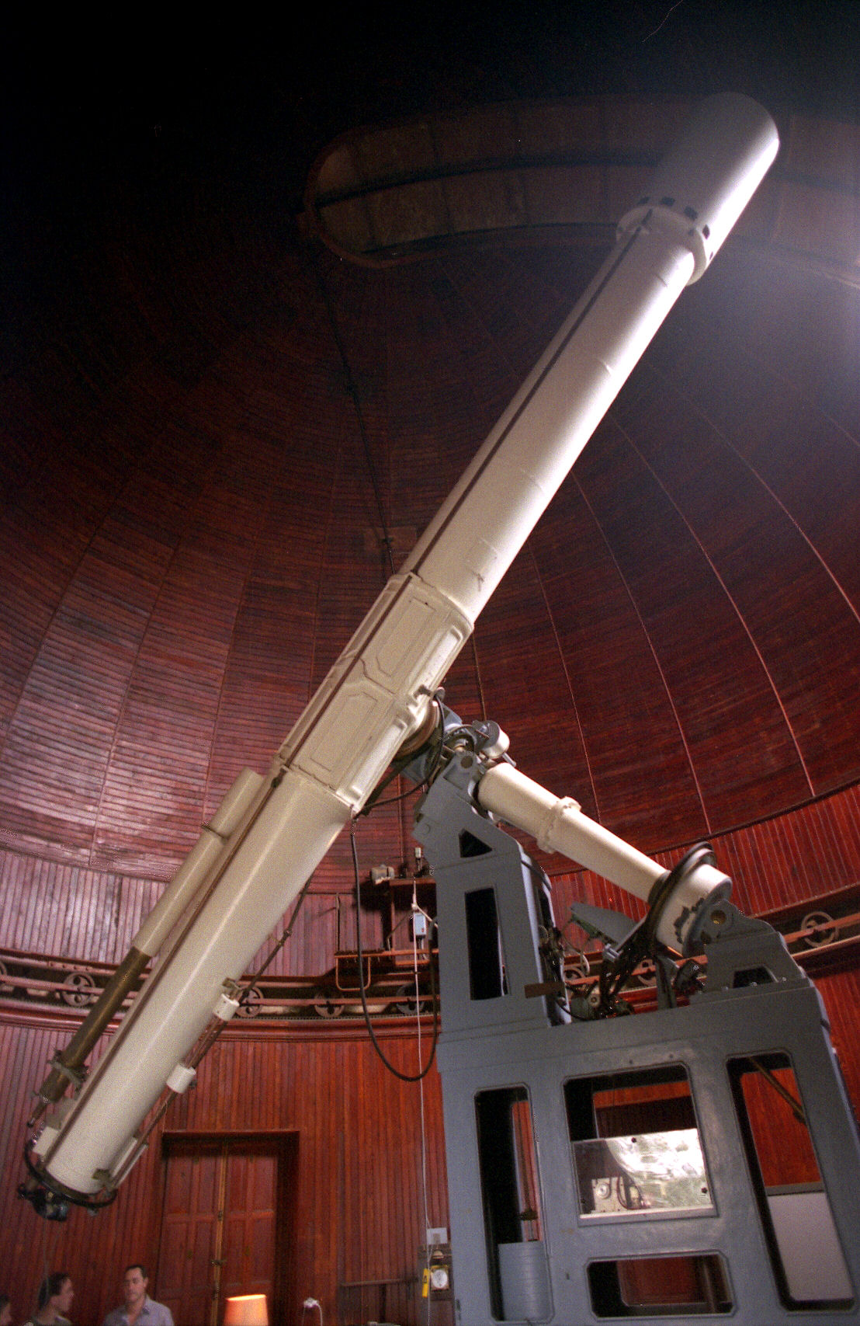
lens
Problems with Refracting Telescopes:
image distortion
large lens warps
bigger lens, longer tube
(Why do we want a large lens?)

Slide 69
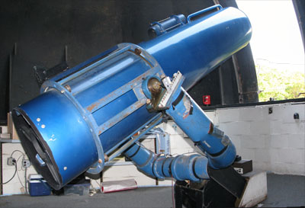
Advantages of Reflecting Telescopes:
no distortion
can make large mirror
tube short
mirror

Slide 70
REFLECTING telescopes

Slide 71
All modern research telescopes use MIRRORS —
These are REFLECTING telescopes

Slide 72
The parabolic shape of the mirror reflects light to one point.

Slide 73
…no matter where on the dish the light strikes.

Slide 74
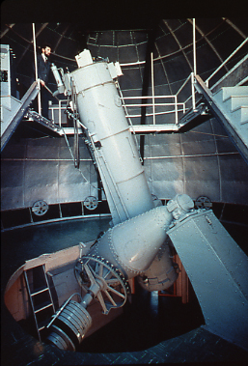
astronomer
mirror
Lick Observatory — The Death Trap Telescope,
The 40” Crossley Reflecting Telescope

Slide 75
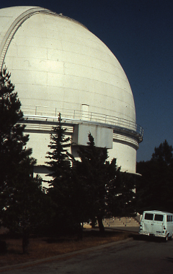
Lick Observatory — The Shane 120” Reflecting Telescope Dome

Slide 76
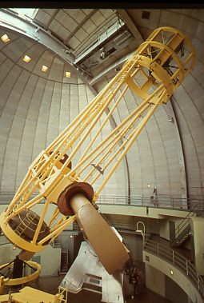
Lick Observatory — 120 inch Reflecting Telescope
mirror
control room door
person

Slide 77
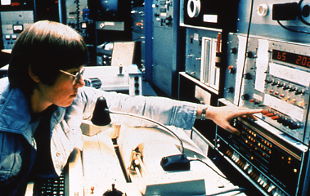
Lick Observatory — The Shane 120” Reflecting Telescope Control room from the early 1980’s

Slide 78
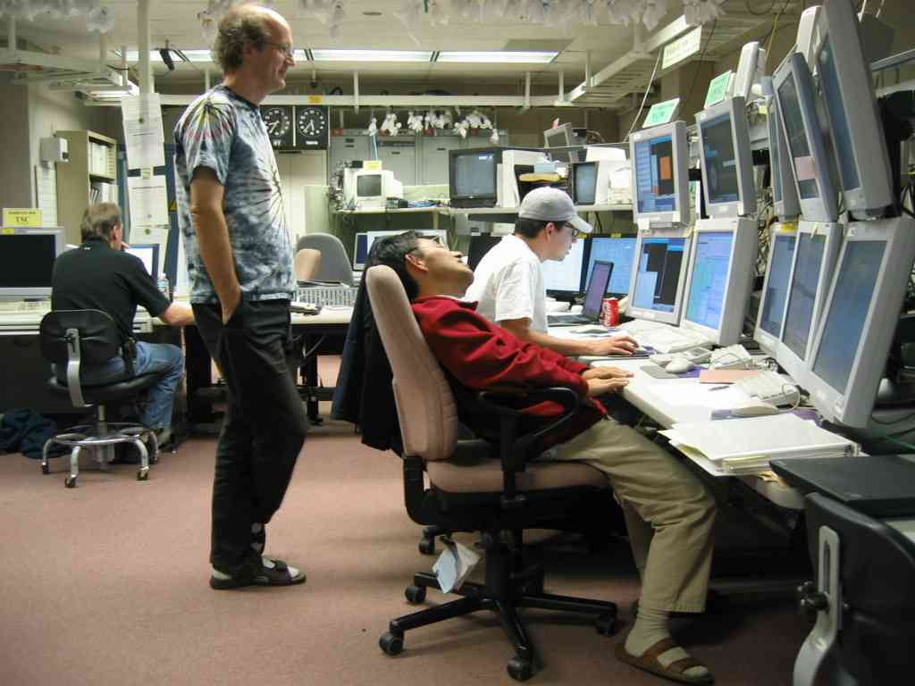
More modern Control Room

Slide 79

Kitt Peak Observatory — 4 meter telescope

Slide 80
We want to observe at other than visible wavelengths to see different physical processes

Slide 81

visible light image
Notes:
Carina pillar 9 microns

Slide 82

infrared image
Notes:
Carina pillar hst

Slide 83

visible light

Slide 84

near-IR light, 0.9 µ

Slide 85

0.44 µ
0.55 µ
0.90 µ
2.16 µ
1.65 µ
1.25 µ
images at different wavelengths in this cloud tell us about dust grain size in the cloud

Slide 86
Radio Telescopes are mirrors
receiver
mirror (dish)

Slide 87
Radio light reflects off
the mirror and comes to
a focus at the receiver
receiver
mirror (dish)

Slide 88
Optical and Radio Telescopes are alike in that they are both mirrors.
So what makes a good mirror?
Why can’t you see yourself in a radio telescope?

Slide 89
Optical and Radio Telescopes are alike in that they are both mirrors.
So what makes a good mirror?
— Parabolic
— Metal
— A smooth surface for the wavelength of light you want to observe

Slide 90

Untitled-40.jpg
Radio Telescopes are Mirrors

Slide 91
The parabolic shape of the mirror reflects light to one point.

Slide 92
Optical and Radio Telescopes are alike in that they are both mirrors.
So what makes a good mirror?
Smooth means having no bump on the mirror more than
a tenth of the wavelength of the light you observe

Slide 93
Optical and Radio Telescopes are alike in that they are both mirrors.
So what makes a good mirror?
Smooth means having no bump on the mirror more than
a tenth of the wavelength (0.1 x λ)

Slide 94

Optical and Radio Telescopes are alike in that they are both mirrors.
So what makes a good mirror?
For an optical telescope mirror: no bump > 0.05 µ (1/600 the width of a human hair)

Slide 95

Optical and Radio Telescopes are alike in that they are both mirrors.
So what makes a good mirror?
For a radio telescope mirror: no bump > 1 mm (for an observation at a wavelength of 1 cm)

Slide 96
Optical and Radio Telescopes are placed in different locations….

Slide 97

Kitt Peak Observatory
Optical telescopes are housed in domes on the top of high mountains…
Kitt Peak Observatory

Slide 98

Mauna Kea Observatory — Optical Telescopes on Mountain Tops
14,000 ft elevation

Slide 99

European Southern Observatory in Chile — Optical Telescopes on Mountain Tops

Slide 100

SOFIA — Airborne Observatory — INFRARED Telescopes High in the Air

Slide 101


Slide 102

Hubble Space Telescope — Size of a School Bus

Slide 103

Hubble Space Telescope — Size of a School Bus

Slide 104

HST being repaired by the Space Shuttle

Slide 105

Green Bank Observatory
Radio telescopes are built in low valleys surrounded by mountains which protects against ground radio transmissions

Slide 106

Optical and Radio Telescopes are different in that they use completely different systems to record the light.
Optical telescopes use a Charge Coupled Device (CCD)
It is an array of pixels that respond to the particle nature of light

Slide 107
pixel
light

Slide 108
1

Slide 109
1
1
1
2
1
2
1
2
3
3
3
2
1
3
4
4
3
2
1
2
3
4
3
1
2
3
2
1
2
1
1
1

Slide 110
1
1
1
2
1
2
1
2
3
3
3
2
1
3
4
4
3
2
1
2
3
4
3
1
2
3
2
1
2
1
1

Slide 113


Slide 114

Optical and Radio Telescopes are different in that they use completely different systems to record the light.
Radio telescopes use a Receiver
It measures the whole wave and exploits the wave nature of light

Slide 115

receiver
mirror (dish)

Slide 116
Receiver
antenna
electron

Slide 118

Remember the next time you see a satellite dish that it
is just a small radio telescope!
chirp
Receiver
mirror

Slide 119

140 ft radio telescope at Green Bank

Slide 120

Untitled-37.jpg

Slide 121

Max Planck Institute in Effelsberg, Germany — 300 ft Radio Telescope

Slide 122

1000 ft telescope at Arecibo, Puerto Rico

Slide 123

Betelgeuse

Slide 124

Orion Nebula

Slide 125

NRAO Very Large Array in Socorro, NM
Interferometry

Slide 126


300,000 l-yr at distance of central galaxy

Slide 127
300,000 l-yr at distance of central galaxy

