Slide 1
Energy in Waves - 1
Objective: Learning about different physical properties of waves and wave propagation.
Key concepts:
Wavelength
Time period and frequency
Wave speed
Longitudinal and Transverse waves
Interference and Beats
Doppler effect

Slide 2
Waves
When discussing waves, whether they are waves of water, sound, light or matter, the same terms are used – namely, wavelength, frequency, and wave speed.
Vibrations make waves, for example both sound and light are vibrations that move as waves.
Sound – vibration of matter Needs a medium to travel cannot travel in vacuum
Light – vibration of Energy Does not require a medium to travel - can travel in vacuum

Slide 3
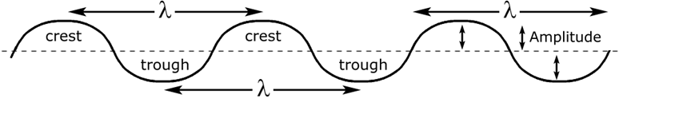
Wavelength
Wavelength:
The __________________, designated by the Greek letter λ, is the distance between a point on one wave and the corresponding point on the next wave.
λ is pronounced lambda and is the Greek “L” for length
The same wavelength would be measured from crest to crest or from trough to trough. The unit is usually given in meters, centimeters, millimeters, nanometers, depending upon the wavelength size.
The wave amplitude is half of the “wave height” measured on the ocean. Amplitude is measured from the middle.

Slide 4
Frequency and Period
Frequency:
The __________________, designated by the f, is the number of cycles completes per second by a wave.
The frequency of a wave refers to how often the particles of the medium vibrate when a wave passes through the medium. Frequency would have units of cycles/second, or vibrations/second. SI unit for frequency is the Hertz (abbreviated Hz), where 1 Hz is equivalent to 1 cycle/second.
Frequency =
Period – time taken for one cycle
Two cycle per second
time(sec)
Period = ½ s
f = 2 Hz
1
2
3

Slide 5
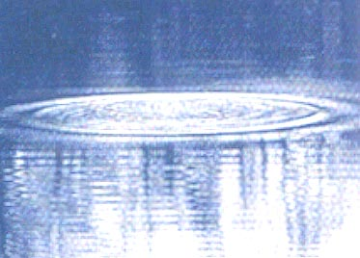
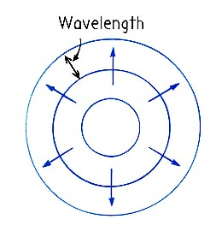
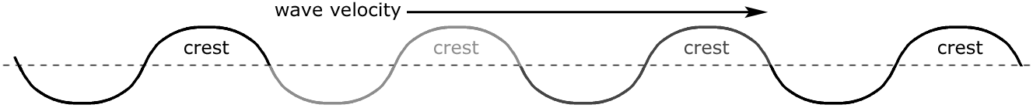
Wave Speed
The _________________, designated by the letter v, is the speed measured for any point on the wave, such as the crest of a water wave.
The SI units are m/s, and v = λ × f .
This is true for all waves; sound waves, water waves
and light waves.
Wave Motion- Transporting Energy
Top view of water waves

Slide 6
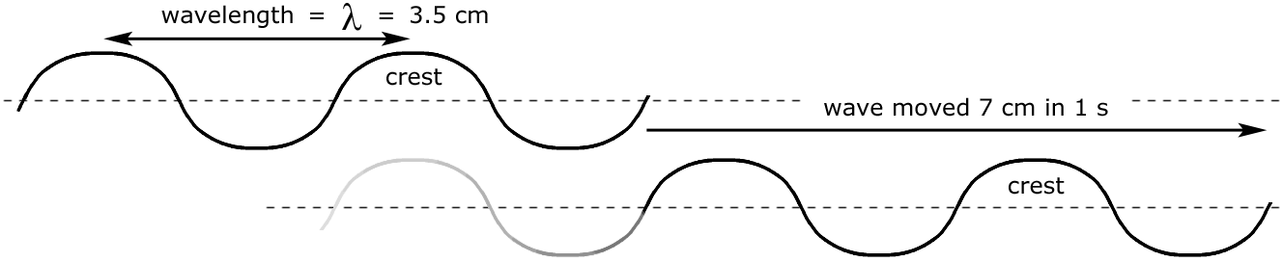
Example
1. You can use a ruler to measure the wavelength to be about 3.5 in cm or 0.035 in m.
Number of waves that passed the observer in 1 second: _____
Wave frequency in Hz: _______ Velocity of wave: _________
Observer

Slide 7

Example
2. Closely related to frequency is period.
The Period of a wave is the time (in units of seconds) it takes for one full wave to pass a point.
The period is the inverse of the frequency.
If waves hit the shore every 4 seconds,
what is the period? Period = ____________
What is the frequency? Frequency = ___________
What is the period of a 500 Hz sound wave? _________

Slide 8
Example
3. The wavelength and frequency are related by the wave speed:
v = λ × f so λ = v / f and f = v / λ
Thus, wavelength and frequency are ____________ related.
4. Higher frequencies correspond to _______ wavelengths
while lower frequencies correspond to ______ wavelengths.
Practice: The graph shows the displacement x of a tuning fork as a function of time t as it is playing a single note. What are the amplitude, period and frequency.

Slide 9
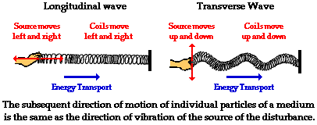
Types of waves
Sound – Longitudinal wave
Vibrations are along the direction of the wave
Light – Transverse wave
Vibrations are perpendicular to the direction of the wave
Click on the Sound and Light waves to explore animations of those waves!

Slide 10
Sound and Light waves
There are some similarities between SOUND and LIGHT:
The same terms – namely, wavelength, frequency, and wave speed are used for all waves, including both sound and light.
Also, both sound and light produce the effects of interference, diffraction, reflection, refraction, and the doppler effect.
Some differences:
(a) SOUND does not travel through a vacuum, and travels much faster in dense materials, such as water or steel, than it does in air.
(b) LIGHT travels fastest in a vacuum and travels slower in materials such as water or glass.
2. (a) SOUND travels slowly, at about 340 m/s in air or about 1500 m/s in water.
(b) . LIGHT travels extremely fast, at 3 x 10⁸ m/s in a vacuum.

Slide 11
Sound and Light waves
Other differences:
3. (a) Our range of hearing is from 20 Hz to 20,000 Hz when we are young.
  We lose the ability to hear high frequency sounds as we age (damaged by loud sounds). Most adults cannot hear above 15,000 Hz and many have additional hearing loss in particular frequency ranges.
  (b) Visible light frequency ~ 4 x 10¹⁴ to 8 x 10¹⁴ Hz is perceived as color by our eyes. Other kinds of “electromagnetic waves” include microwaves, radio waves and X rays cannot be seen.
0 Hz
20 Hz
20,000 Hz
Human Ear can hear
infrasonic
ultrasonic

Slide 12
Interference
When two or more waves arrive at the same point, they superimpose themselves on one another. More specifically, the disturbances of waves are superimposed when they come together—a phenomenon called superposition.
Constructive Interference: two identical waves that arrive at the same point exactly in phase.
Destructive Interference: two identical waves that arrive exactly out of phase

Slide 13
Beats
Beats: When two tones of slightly different frequencies are sounded together a fluctuation of loudness occurs.
The wave resulting from the superposition of two similar-frequency waves has a frequency that is the average of the two. This wave fluctuates in amplitude, or beats, with a frequency called the beat frequency, f_{B.} = ∣ f₁ − f₂ ∣

Slide 14
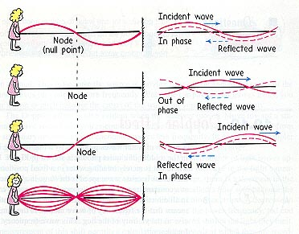
Standing waves
Standing wave: If the incident and the reflected waves have the same amplitude and wavelength, then they alternate between constructive and destructive interference. The resultant looks like a wave standing in place and, thus, is called a standing wave.
Standing waves are commonly found on the strings of musical instruments

Slide 15
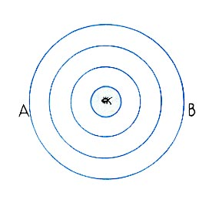
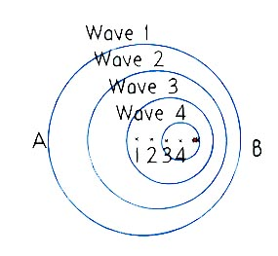
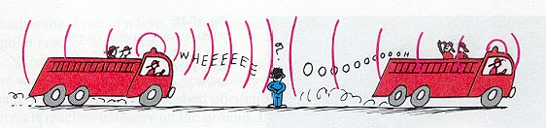
Doppler Effect
Doppler Effect happens due to changes in frequency due to motion

