Slide 1

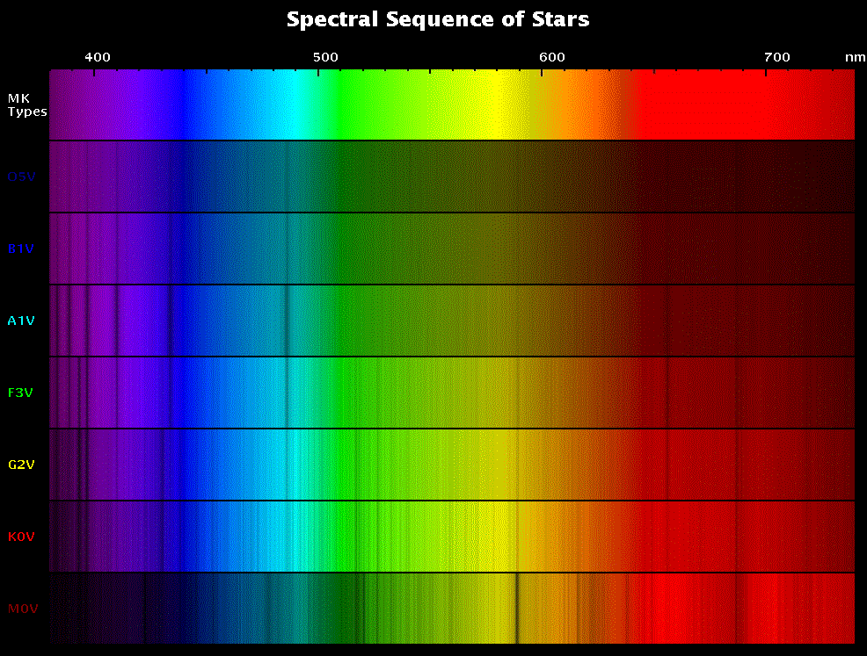
From a spectrum we can measure:
Temperature
Composition
Abundance
Radial Velocity
Brightness

Slide 2
How much light at each wavelength?
amount of light
wavelength

Slide 3
How much light at each wavelength?
2900
T
=
amount of light
0.45 µm
0.45 µm wavelength

Slide 4
Wavelengths where the light is dimmer or absent
Absorption lines

Slide 5
Wavelengths where the light is dimmer or absent
Absorption lines
amount of light
wavelength

Slide 6
From a spectrum we can measure:
Temperature
Composition
Abundance
Radial Velocity
Brightness
what elements the object is made of
how much of each element is there

Slide 7
Composition:
Missing wavelengths of light
correspond to electron energies of atoms
Hydrogen:

Slide 8
Composition:
Missing wavelengths of light
correspond to electron energies of atoms
Sodium:

Slide 9
Elements put their signature in light

Slide 10
Closer look at BB curve

Slide 11
Wavelength gives COMPOSITION
amount of light
wavelength

Slide 12
Wavelength gives composition
Depth gives ABUNDANCE
amount of light
wavelength

Slide 13
Zoom in on one “line” (absorption feature)
amount of light
wavelength

Slide 14
Zoom in on one “line” (absorption feature)
amount of light
Depth gives abundance
Wavelength of bottom gives composition
0.6 µm
wavelength

Slide 15
Absorption: electrons of elements grabbing light of specific λ ’s...
Energy
H
n = 5
n = 4
n = 3
n = 2
n = 1

Slide 16
Absorption: … and jumping UP to HIGHER energy levels
Energy
H
n = 5
n = 4
n = 3
n = 2
n = 1

Slide 17
Absorption spectrum in detail

Slide 18
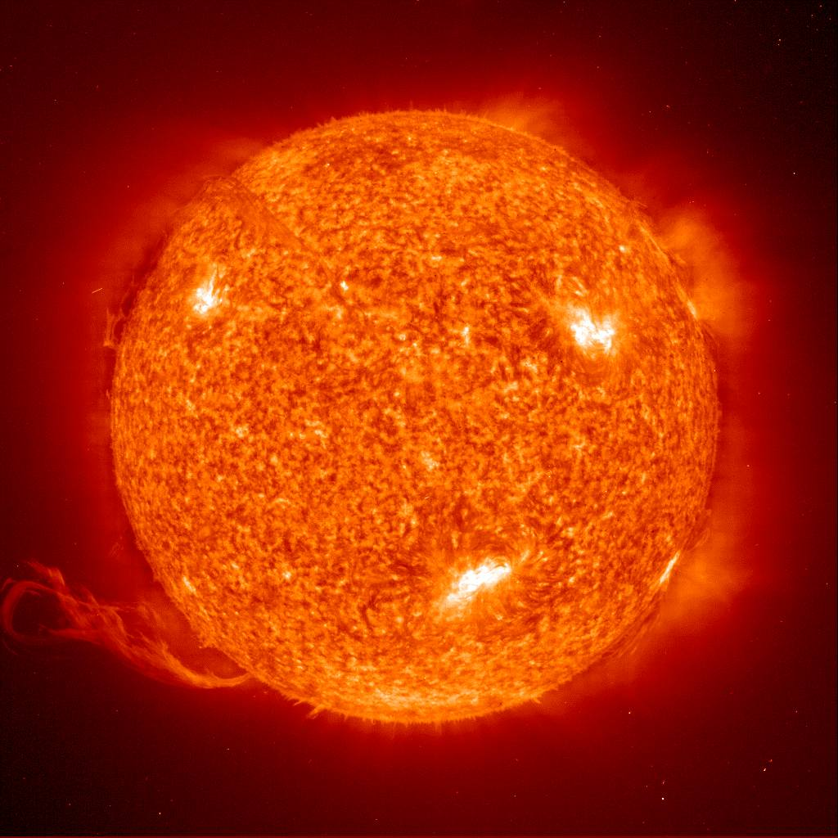
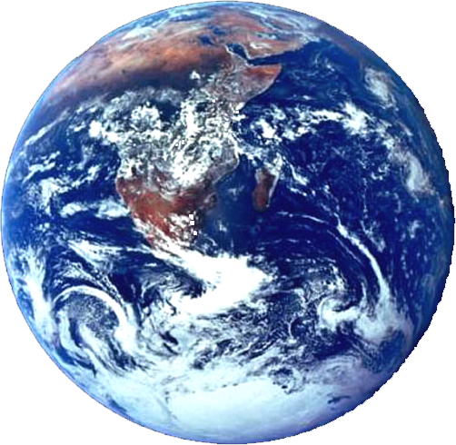
For Absorption You Need a light source behind a cloud.
That cloud can be the atmosphere of the Sun or a Star or an Interstellar cloud. The light source is the surface of the Sun or Star.
star
earth
All wavelengths present
# of
photons
λ

Slide 19
absorption
star
absorption
# of
photons
earth
0.6 µ
Composition: the wavelength used by the electron

Slide 20
absorption
star
absorption
# of
photons
earth
0.6 µ
Abundance: how deep the line is

Slide 21
Absorption spectrum in the SUN

Slide 22
Absorption: … and jumping UP to HIGHER energy levels
Emission: letting go of specific λ ‘s…..
emission absorption
Energy
H
Energy
H
n = 5
n = 4
n = 3
n = 2
n = 1
n = 5
n = 4
n = 3
n = 2
n = 1

Slide 23
Absorption: … and jumping UP to HIGHER energy levels
Emission: … and moving DOWN to LOWER energy levels
emission absorption
Energy
H
Energy
H
n = 5
n = 4
n = 3
n = 2
n = 1
n = 5
n = 4
n = 3
n = 2
n = 1

Slide 24
For EMISSION lines, all you need is a cloud of gas WITHOUT a light source behind it.
interstellar cloud
earth

Slide 25
Emission spectrum

Slide 26
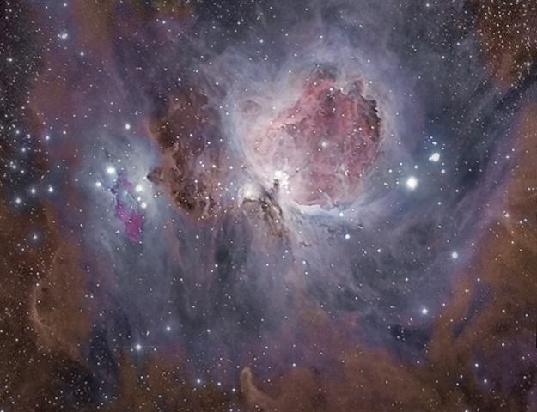
Orion Star cloud emitting at many wavelengths

Slide 27
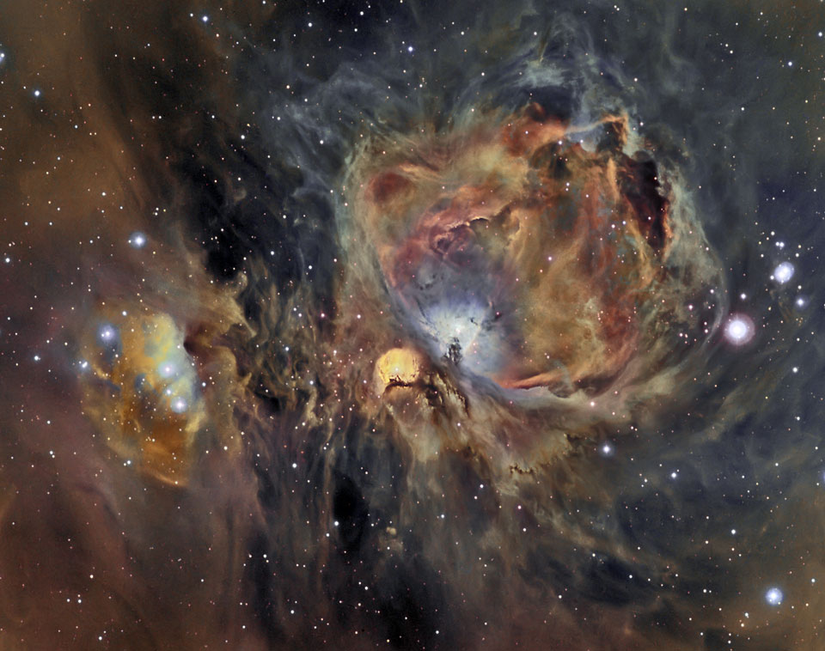
Orion Star cloud emitting at H, O, S

Slide 28
Question: what kind of spectrum will each see?
interstellar cloud
absorption
star
earth
emission
alien planet

Slide 29
From a spectrum we can measure:
Temperature
Composition
Abundance
Radial Velocity Doppler effect
Brightness

Slide 30
absorption
star
Sun or Laboratory wavelength:
earth
0.6 µ

Slide 31
absorption
star
if Star is Moving TOWARD you
the absorption line is shifted to BLUER (shorter) wavelengths
earth
0.5 µ
0.6 µ

Slide 32
absorption
star
if Star is Moving AWAY FROM you
the absorption line is shifted to REDDER (longer) wavelengths
earth
0.5 µ
0.6 µ
0.7 µ

Slide 33
Velocity

Slide 34
From a spectrum we can measure:
Temperature
Composition
Abundance
Radial Velocity
Brightness

Slide 35
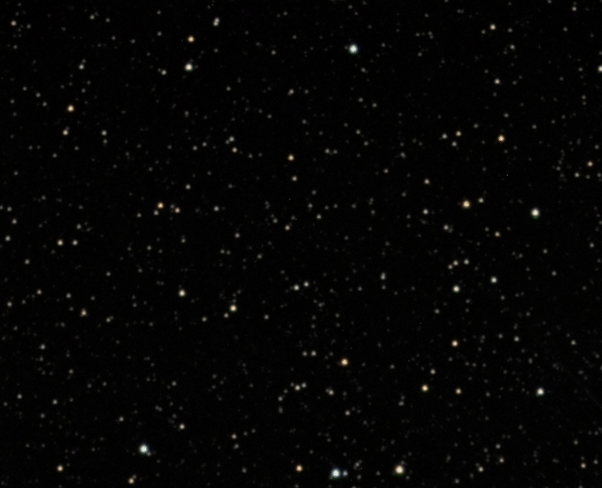

Slide 36
