Slide 1
PHYS 1111K
Lectures 11-12
OpenStax Chapter 6
Youtube: https://youtu.be/1T5978spBTM

Slide 2
Circular Motion
Watch these videos from PBS Learning Media
http://www.pbslearningmedia.org/asset/lsps07_int_circmotion/
In each case, what was the force that kept the object moving in a circle?
Sketch this particular force on the object at different points on the circular trajectory. Pay attention to the direction of the force.
In each case, would you say that the object was accelerating?

Slide 3
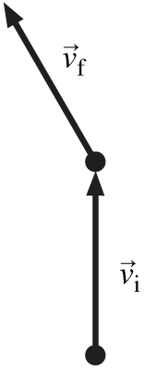
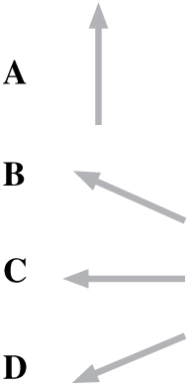

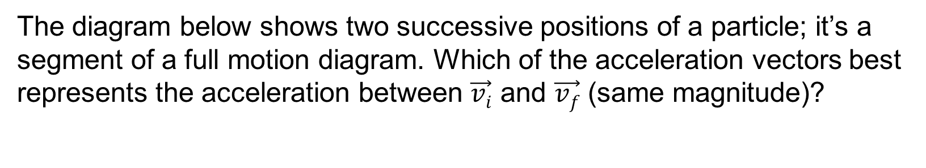
Check your understanding [1]
The diagram below shows two successive positions of a particle; it’s a segment of a full motion diagram. Which of the acceleration vectors best represents the acceleration between $\vec{vi}$ and $\vec{vf}$ (same magnitude)?
Reminder :
Notes:
Answer: D

Slide 4

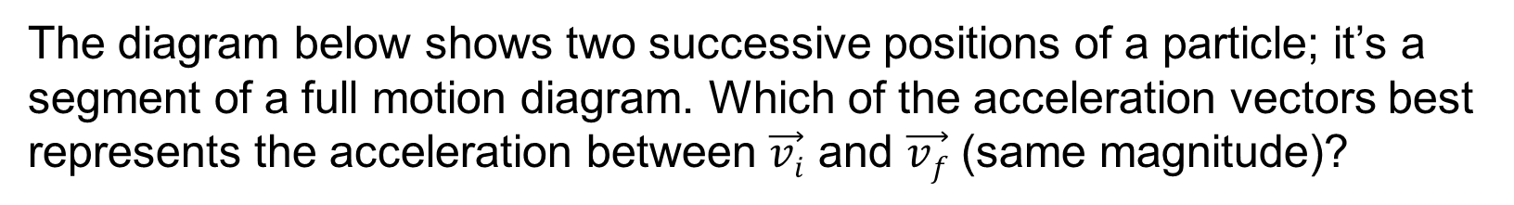



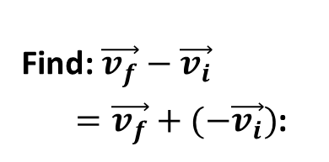
Check your understanding [2]
The diagram below shows two successive positions of a particle; it’s a segment of a full motion diagram. Which of the acceleration vectors best represents the acceleration between $\vec{vi}$ and $\vec{vf}$ (same magnitude)?
Find: $\vec{v_{f}}−\vec{v_{i}}$
$=\vec{v_{f}}+(−\vec{v_{i}})$:
$$v_{f}$$
$${−v}_{i}$$
$$a$$
$$a$$
Notes:
Answer: D

Slide 5





Check your understanding [3]
The diagram below shows two successive positions of a particle; it’s a segment of a full motion diagram. Which of the acceleration vectors best represents the acceleration between $\vec{vi}$ and $\vec{vf}$ (same magnitude)?
$$v_{f}$$
$${−v}_{i}$$
$$a$$
$$a$$
$$center$$
Notes:
Answer: D

Slide 6
Answer
The diagram below shows two successive positions of a particle; it’s a segment of a full motion diagram. Which of the acceleration vectors best represents the acceleration between $\vec{vi}$ and $\vec{vf}$ (same magnitude)?
Notes:
Answer: D

Slide 7
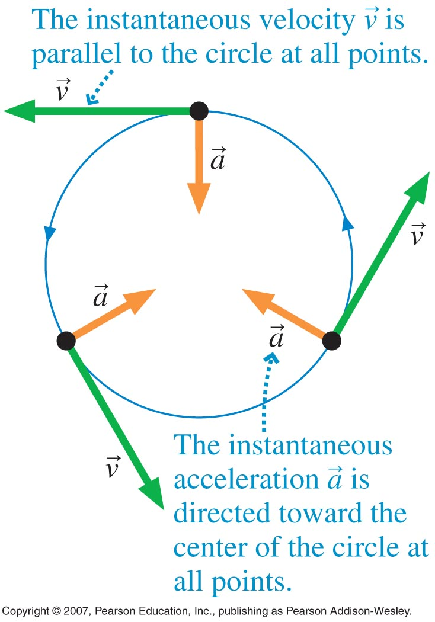
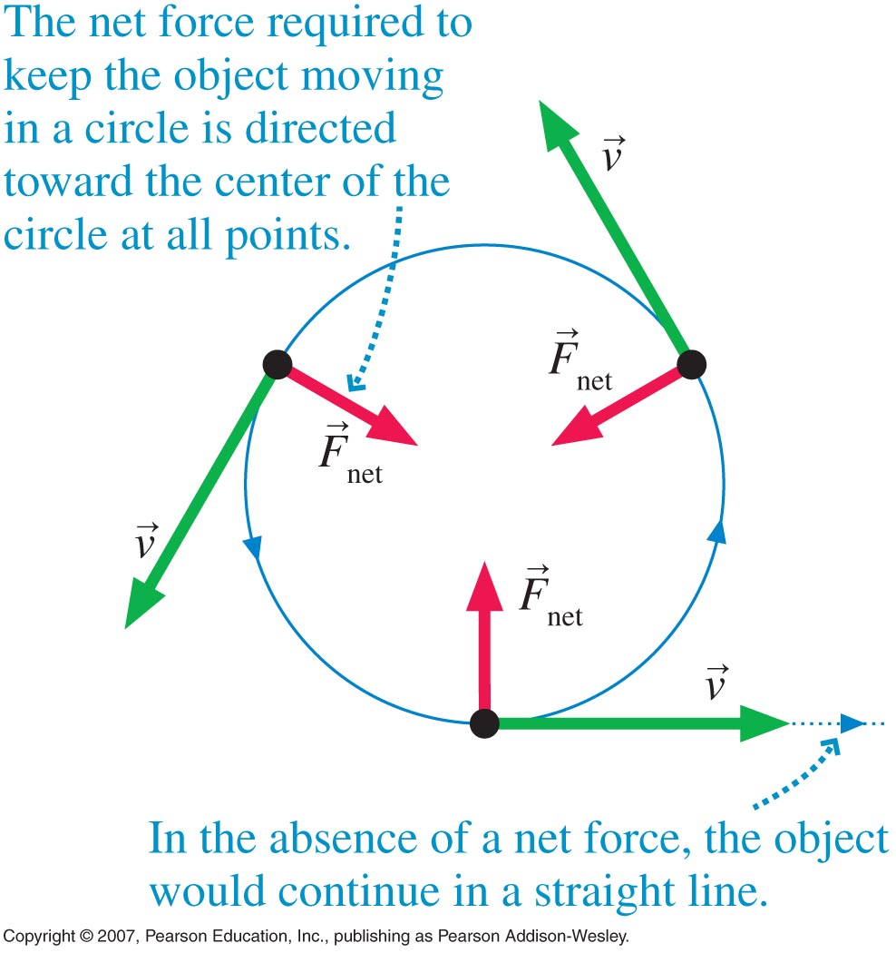
Uniform Circular Motion (motion at constant speed along a circular path)

Slide 8
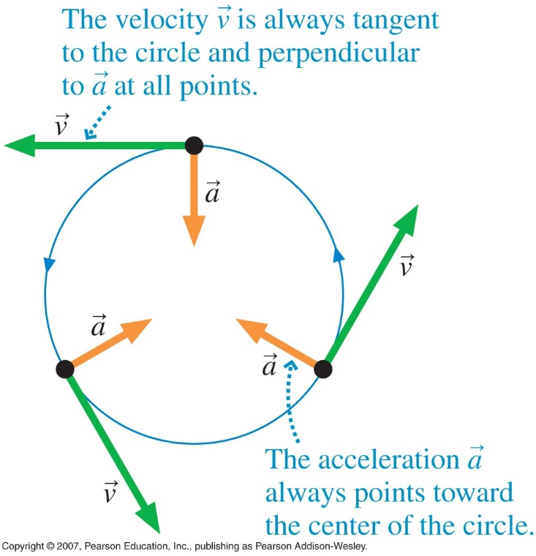

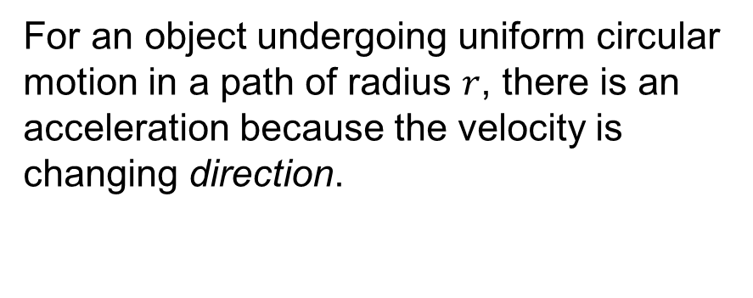
Circular Motion
For an object undergoing uniform circular motion in a path of radius $r$, there is an acceleration because the velocity is changing direction.
magnitude
direction
This is called centripetal acceleration
Therefore, $F_{net}$ also points to center of circle, and is called centripetal force

Slide 9
Checking Understanding
When a ball on the end of a string is swung in a vertical circle:
We know that the ball is accelerating because
  the speed is changing.
  the direction is changing.
  the speed and the direction are changing.
Notes:
Answer: B

Slide 10
Answer
When a ball on the end of a string is swung in a vertical circle:
We know that the ball is accelerating because
  the speed is changing.
  the direction is changing.
  the speed and the direction are changing.
Notes:
Answer: B

Slide 11
Checking Understanding
When a ball on the end of a string is swung in a vertical circle:
What is the direction of the acceleration of the ball?
  Tangent to the circle, in the direction of the ball’s motion
  Toward the center of the circle
Notes:
Answer: B

Slide 12
Answer
When a ball on the end of a string is swung in a vertical circle:
What is the direction of the acceleration of the ball?
  Tangent to the circle, in the direction of the ball’s motion
  Toward the center of the circle
Notes:
Answer: B

Slide 13
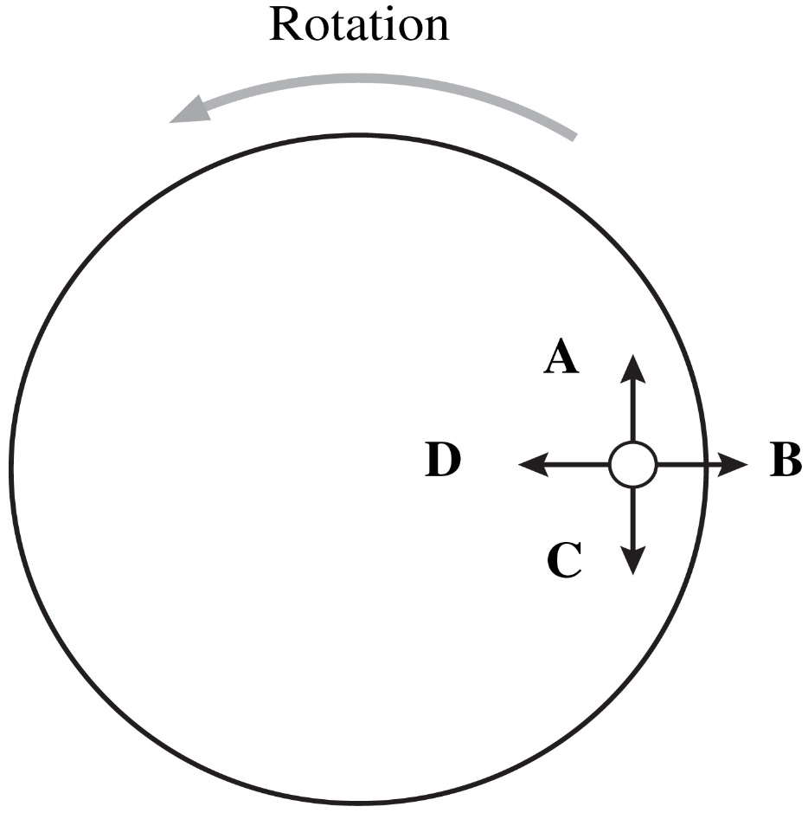
Checking Understanding
A coin sits on a rotating turntable.
  At the time shown in the figure, which arrow gives the direction of the frictional force on the coin?
Notes:
Answer: D

Slide 14
Answer
A coin sits on a rotating turntable.
  At the time shown in the figure, which arrow gives the direction of the frictional force on the coin?
Notes:
Answer: D

Slide 15
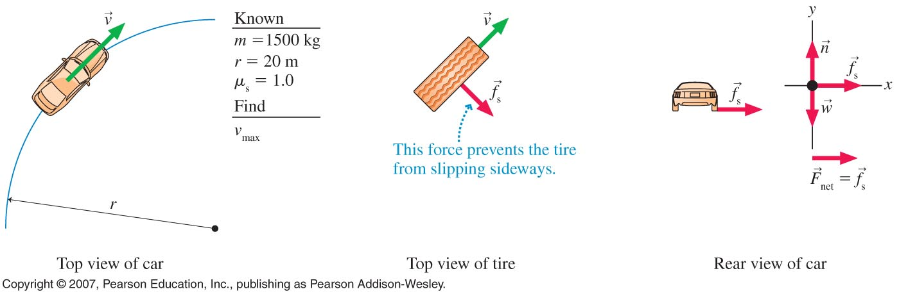
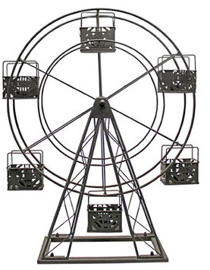


Free Body Diagrams and Circular Motion
Example 1 : A car negotiating a level curve on a country road
Example 2 : A person in a Ferris wheel car at the top of the ride
top
$$\vec{n}$$
Draw the free body diagram with the circle viewed edge-on, the x-axis pointing towards the center of the circle, and the y-axis perpendicular to the plane of the circle.
$$\vec{w}$$

Slide 16

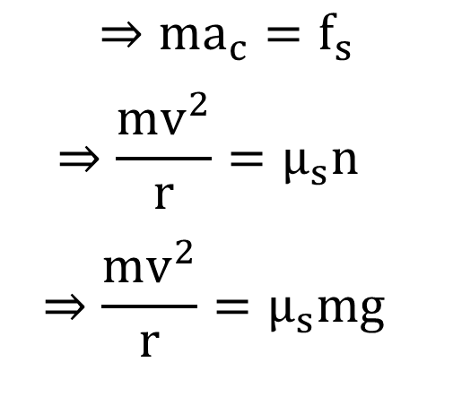



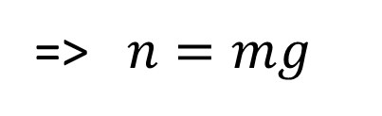
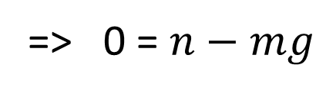
Problem-solving [1]
A level curve on a country road has a radius of 150 m. What is the maximum speed at which this curve can be safely negotiated on a rainy day when the coefficient of static friction between the tires on a car and the road is 0.40?
$$Fnet,y=n−mg$$
$$Fnet,x=fs$$
=> 0 = $n−mg$
$$⇒ma_{c}=f_{s}$$
$$⇒\frac{mv^{2}}{r}=μ_{s}n$$
$$⇒\frac{mv^{2}}{r}=μ_{s}mg$$
$ac$ - centripetal acceleration
=> $n=mg$
$$⇒ v=\sqrt{μsgr}$$

Slide 17
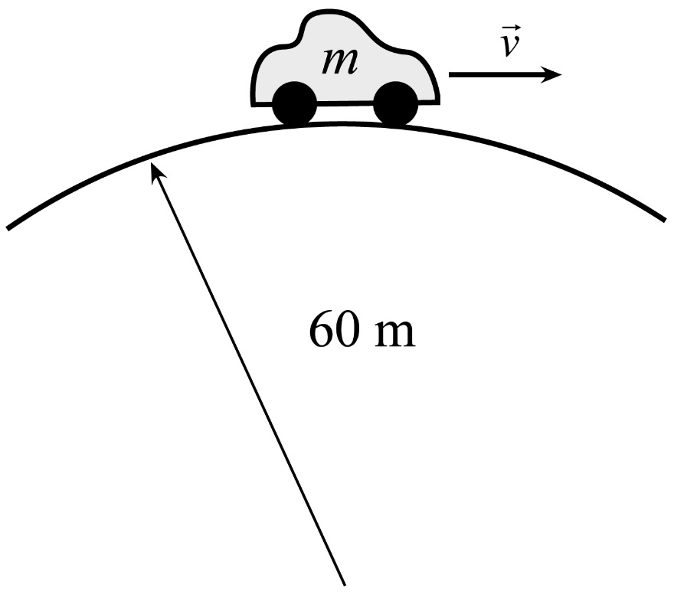

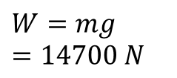
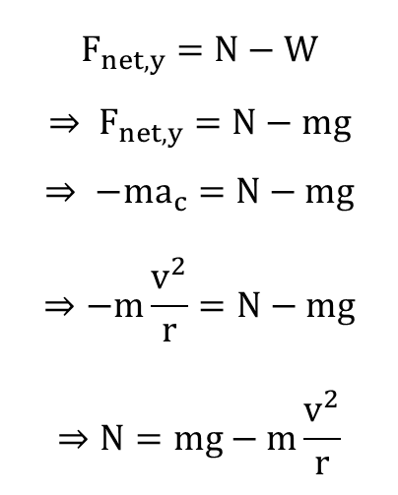
Problem-solving [2]
A car of mass 1500 kg goes over a hill at a speed of 20 m/s. The shape of the hill is approximately circular, with a radius of 60 m, as in the figure at right. When the car is at the highest point of the hill, what is the normal force of the road on the car?
$$N$$
$$F_{net,y}=N−W$$
$$⇒ F_{net,y}=N−mg$$
$$⇒ −ma_{c}=N−mg$$
$$⇒−m\frac{v^{2}}{r}=N−mg$$
$$⇒N=mg−m\frac{v^{2}}{r}$$
$$W=mg=14700 N$$

Slide 18

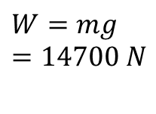
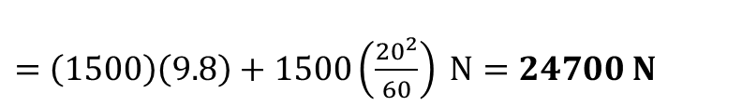
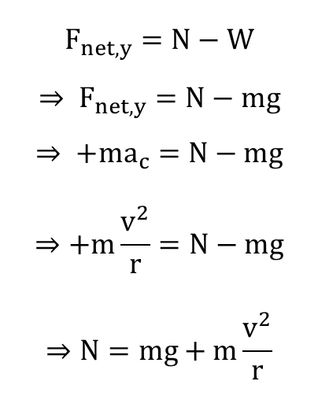

Problem-solving [3]
A car of mass 1500 kg goes over a valley at a speed of 20 m/s. The shape of the valley is approximately circular, with a radius of 60 m, as in the figure at right. When the car is at the lowest point of the valley, what is the normal force of the road on the car?
CAR
$$N$$
$$F_{net,y}=N−W$$
$$⇒ F_{net,y}=N−mg$$
$$⇒ +ma_{c}=N−mg$$
$$⇒+m\frac{v^{2}}{r}=N−mg$$
$$⇒N=mg+m\frac{v^{2}}{r}$$
$$W=mg=14700 N$$
$=$ $\left(1500\right)\left(9.8\right)+1500\left(\frac{{20}^{2}}{60}\right) N=24700 N$

Slide 19
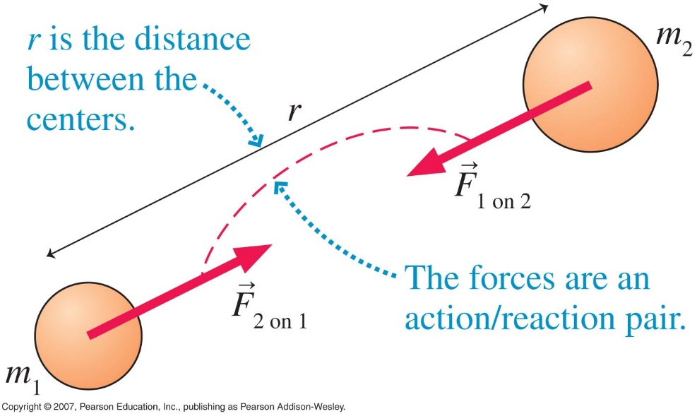
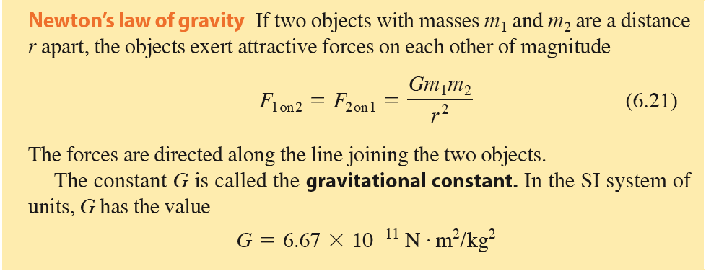
Newton’s law of gravitation

Slide 20



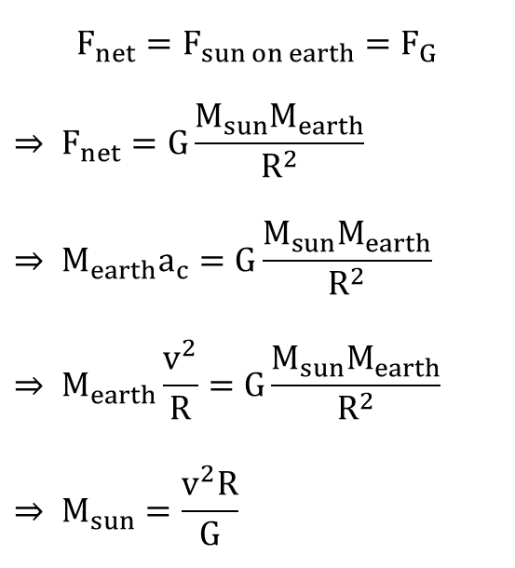
Gravity and Circular orbits
The distance from the earth to the sun is R = 149 x 10⁶ km. Assuming that the earth's orbit around the sun is circular, calculate the mass of the sun.
Earth:
$$F_{net}=F_{sun on earth}=F_{G}$$
$$⇒ F_{net}=G\frac{M_{sun}M_{earth}}{R^{2}}$$
$$⇒ M_{earth}a_{c}=G\frac{M_{sun}M_{earth}}{R^{2}}$$
$$⇒ M_{earth}\frac{v^{2}}{R}=G\frac{M_{sun}M_{earth}}{R^{2}}⇒ M_{sun}=\frac{v^{2}R}{G}$$
$$FG$$
We know $R$ and $G$. How do we find the velocity of the earth (v) around the sun?

Slide 21

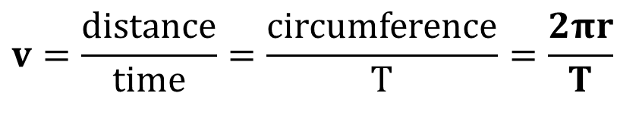
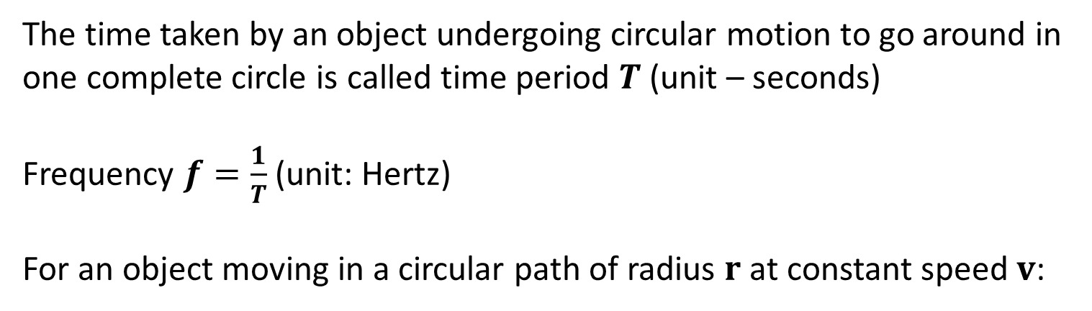
Circular orbits – Time period, Frequency
The time taken by an object undergoing circular motion to go around in one complete circle is called time period $T$ (unit – seconds)
Frequency $f=\frac{1}{T}$ (unit: Hertz)
For an object moving in a circular path of radius $r$ at constant speed $v$:
$$r$$
$$v=\frac{distance}{time}=\frac{circumference}{T}=\frac{2πr}{T}$$

Slide 22



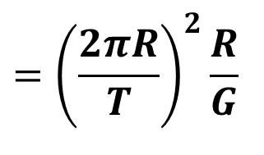

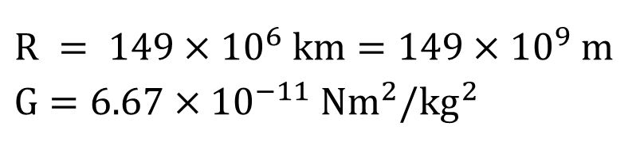
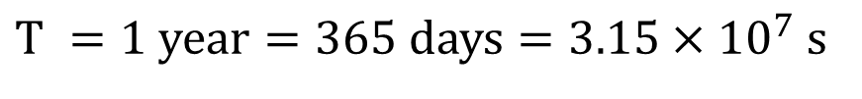
Gravity and Circular orbits [continued from slide 20]
The distance from the earth to the sun is R = 149 x 10⁶ km. Assuming that the earth's orbit around the sun is circular, calculate the mass of the sun.
$$={\left(\frac{2πR}{T}\right)}^{2}\frac{R}{G}$$
$$FG$$
$$R = 149×{10}^{6} km=149×{10}^{9} m$$
$$G=6.67×{10}^{−11} Nm^{2}/kg^{2}$$
What is $T$ for the motion of the earth around the sun? [convert 1 year to seconds]
$$T =1 year=365 days=3.15×{10}^{7} s$$

Slide 23
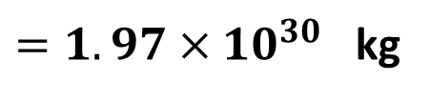
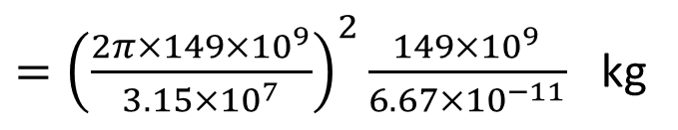
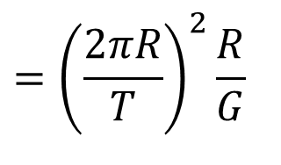
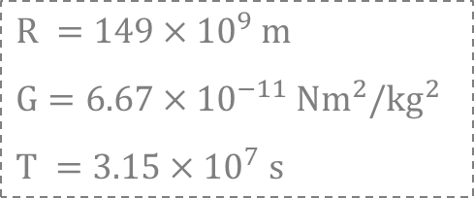
Gravity and Circular orbits [continued from slide 22]
The distance from the earth to the sun is R = 149 x 10⁶ km. Assuming that the earth's orbit around the sun is circular, calculate the mass of the sun.
$$={\left(\frac{2πR}{T}\right)}^{2}\frac{R}{G}$$
$$R =149×{10}^{9} m$$
$$G=6.67×{10}^{−11} Nm^{2}/kg^{2}$$
$$T =3.15×{10}^{7} s$$
$$FG$$
$={\left(\frac{2π×149×{10}^{9}}{3.15×{10}^{7}}\right)}^{2}\frac{149×{10}^{9}}{6.67×{10}^{−11}}$ kg
$=1.97×10^{30}$ kg

Slide 24

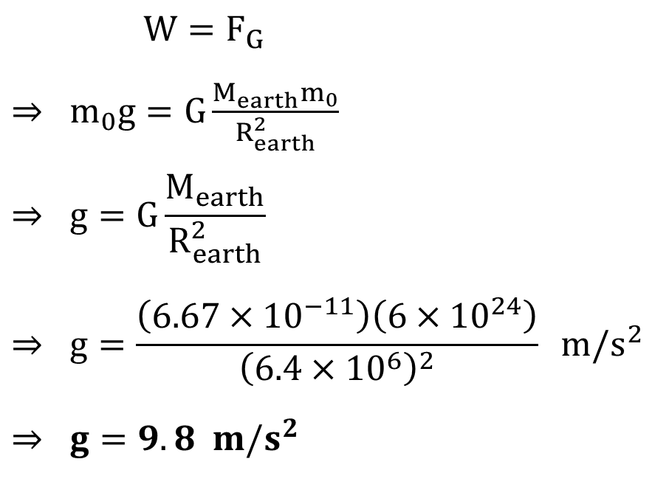
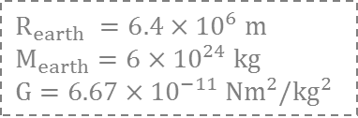
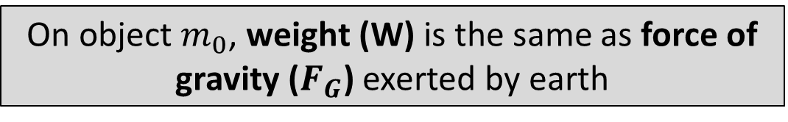


Weight and Acceleration of Free-fall (g)
On object $m_{0}$, weight (W) is the same as force of gravity ($F_{G}$) exerted by earth
$$m_{0}$$
$$W=F_{G}$$
$⇒ m_{0}g=G\frac{M_{earth}m_{0}}{R_{earth}^{2}}$
$$⇒ g=G\frac{M_{earth}}{R_{earth}^{2}}$$
$$⇒ g=\frac{\left(6.67×{10}^{−11}\right)\left(6×{10}^{24}\right)}{{\left(6.4×{10}^{6}\right)}^{2}} m/s^{2}$$
$$⇒ g=9.8 m/s^{2}$$
$$W=FG$$
$$R_{earth}=6400 km$$
$$M_{earth}=6×{10}^{24} kg$$
$$R_{earth} =6.4×{10}^{6} m$$
$$M_{earth}=6×{10}^{24} kg$$
$$G=6.67×{10}^{−11} Nm^{2}/kg^{2}$$

Slide 25
Check your understanding
Is it possible for an object moving with a constant speed to accelerate?
An object moves in a circular path at a constant speed. Compare the direction of the object's velocity and acceleration vectors.
What type of acceleration does an object moving with constant speed in a circular path experience?
When an object experiences uniform circular motion, what is the direction of the net force?

Slide 26
Check your understanding
Is it possible for an object moving with a constant speed to accelerate? Yes, although the speed is constant, the direction of the velocity can be changing
An object moves in a circular path at a constant speed. Compare the direction of the object's velocity and acceleration vectors.
What type of acceleration does an object moving with constant speed in a circular path experience?
When an object experiences uniform circular motion, what is the direction of the net force?

Slide 27
Check your understanding
Is it possible for an object moving with a constant speed to accelerate? Yes, although the speed is constant, the direction of the velocity can be changing
An object moves in a circular path at a constant speed. Compare the direction of the object's velocity and acceleration vectors. The vectors are perpendicular
What type of acceleration does an object moving with constant speed in a circular path experience?
When an object experiences uniform circular motion, what is the direction of the net force?

Slide 28
Check your understanding
Is it possible for an object moving with a constant speed to accelerate? Yes, although the speed is constant, the direction of the velocity can be changing
An object moves in a circular path at a constant speed. Compare the direction of the object's velocity and acceleration vectors. The vectors are perpendicular
What type of acceleration does an object moving with constant speed in a circular path experience? Centripetal acceleration
When an object experiences uniform circular motion, what is the direction of the net force?

Slide 29
Check your understanding
Is it possible for an object moving with a constant speed to accelerate? Yes, although the speed is constant, the direction of the velocity can be changing
An object moves in a circular path at a constant speed. Compare the direction of the object's velocity and acceleration vectors. The vectors are perpendicular
What type of acceleration does an object moving with constant speed in a circular path experience? Centripetal acceleration
When an object experiences uniform circular motion, what is the direction of the net force? Directed toward the center of the circular path

Slide 30
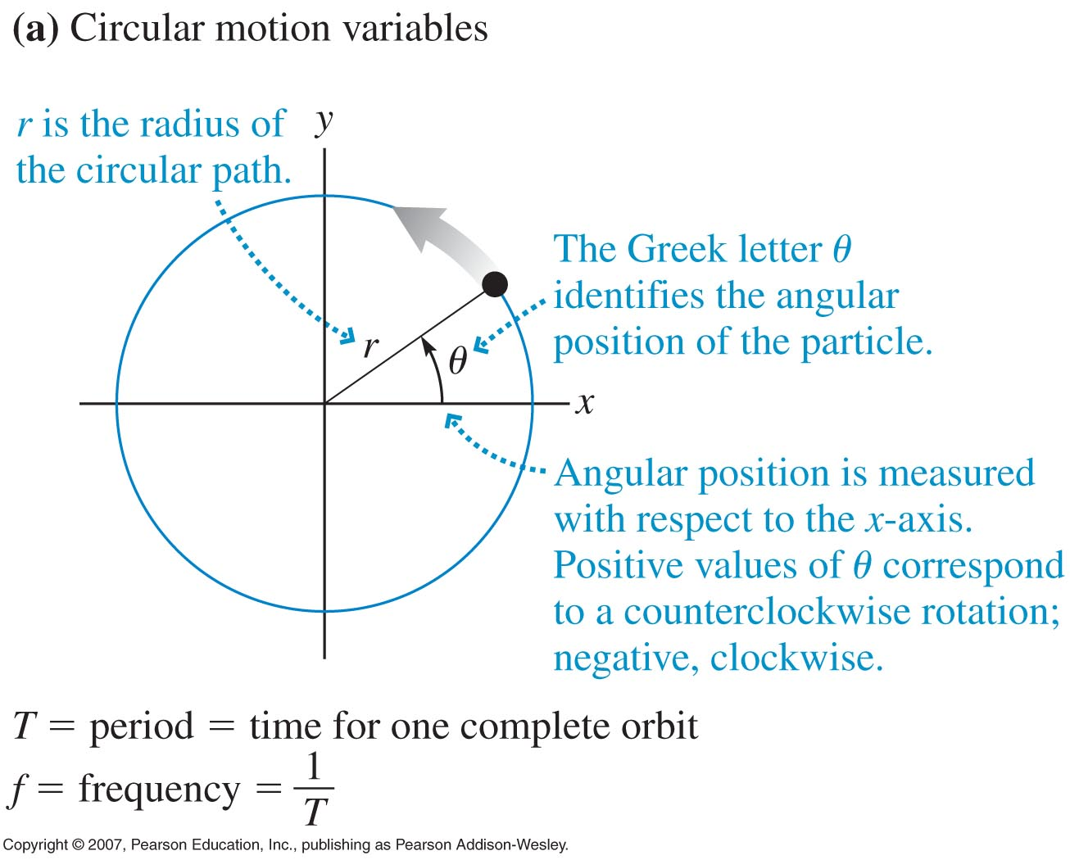
Circular motion – variables involved

Slide 31
Circular motion – variables involved

Slide 32
Circular motion – variables involved

Slide 33
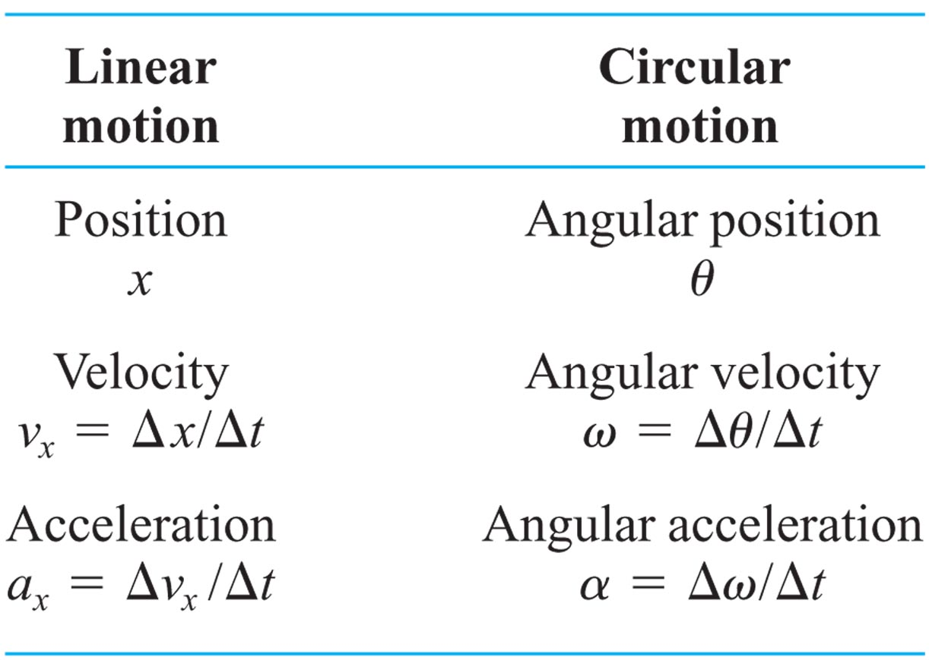
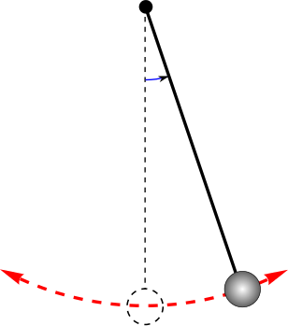
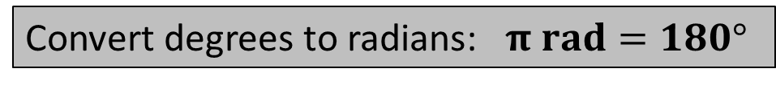
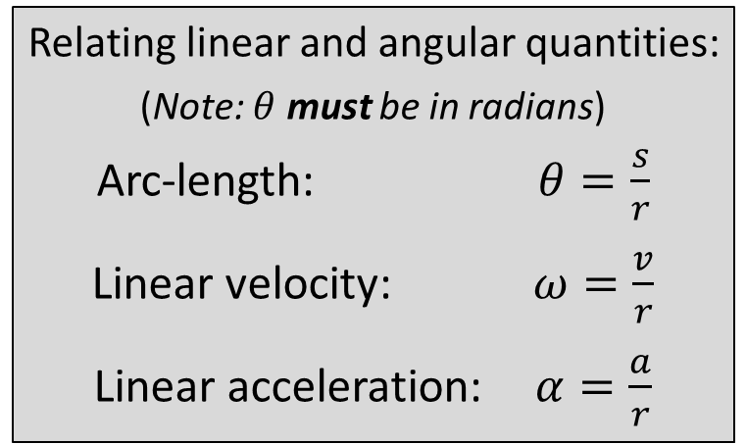



Linear and Circular Motion Compared
Relating linear and angular quantities:
(Note: $θ$ must be in radians)
Arc-length: $θ=\frac{s}{r}$
Linear velocity: $ω=\frac{v}{r}$
Linear acceleration: $α=\frac{a}{r}$
(uniform motion)
$$θ$$
$$r$$
(non-uniform motion)
Convert degrees to radians: $π rad=180°$
$$s$$

Slide 34
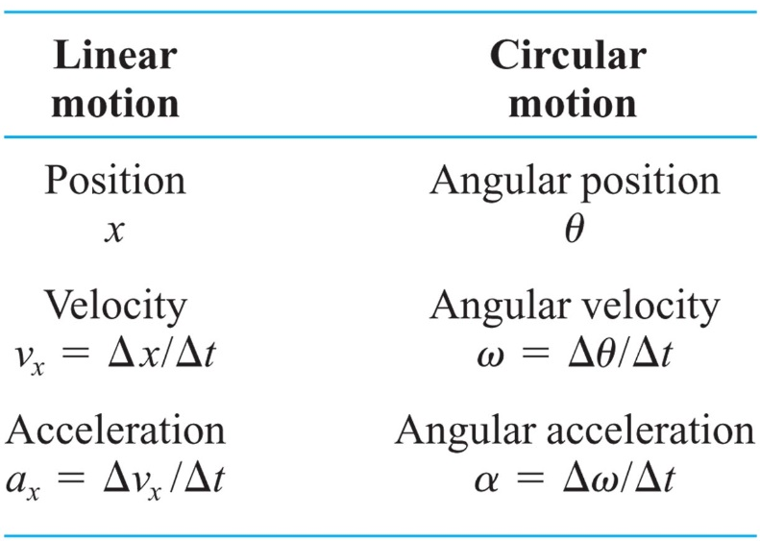
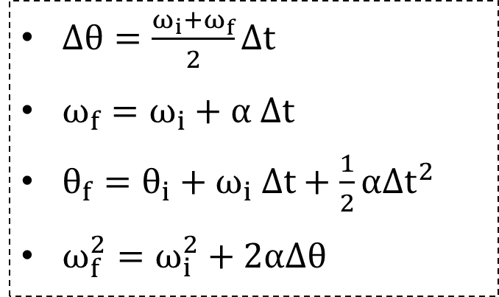
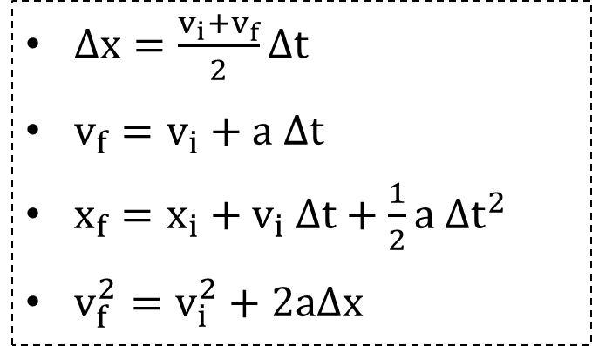
Linear and Circular Kinematics Compared
Linear kinematics
Circular kinematics
$Δx=\frac{v_{i}+v_{f}}{2}Δt$
$v_{f}=v_{i}+a Δt$
$x_{f}=x_{i}+v_{i} Δt+\frac{1}{2}a Δt^{2}$
$v_{f}^{2}=v_{i}^{2}+2aΔx$
$Δθ=\frac{ω_{i}+ω_{f}}{2}Δt$
$ω_{f}=ω_{i}+α Δt$
$θ_{f}=θ_{i}+ω_{i} Δt+\frac{1}{2}αΔt^{2}$
$ω_{f}^{2}=ω_{i}^{2}+2αΔθ$

Slide 35
Uniform and Non-uniform Circular Motion
Uniform Circular Motion

Slide 36
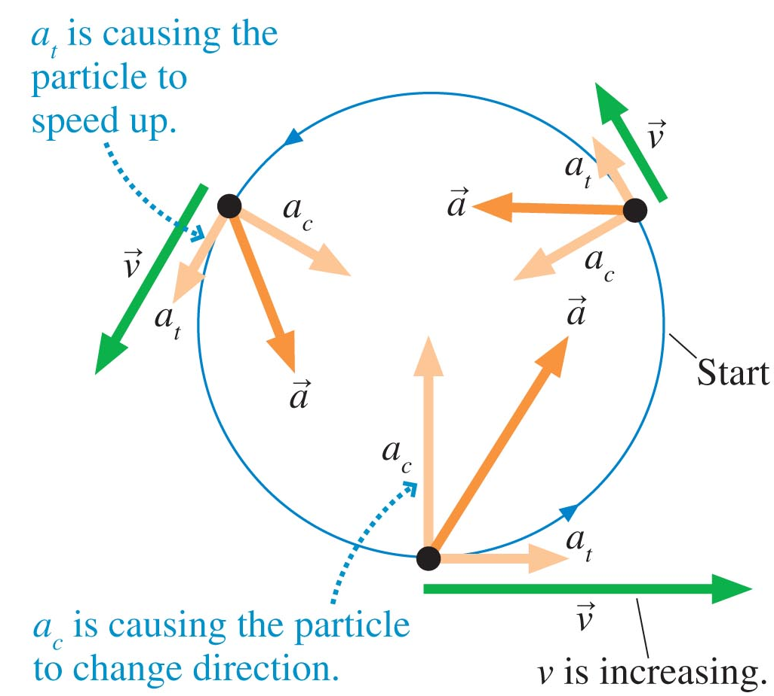

Uniform and Non-uniform Circular Motion
Uniform Circular Motion
Non-uniform Circular Motion
Tangential acceleration

Slide 37




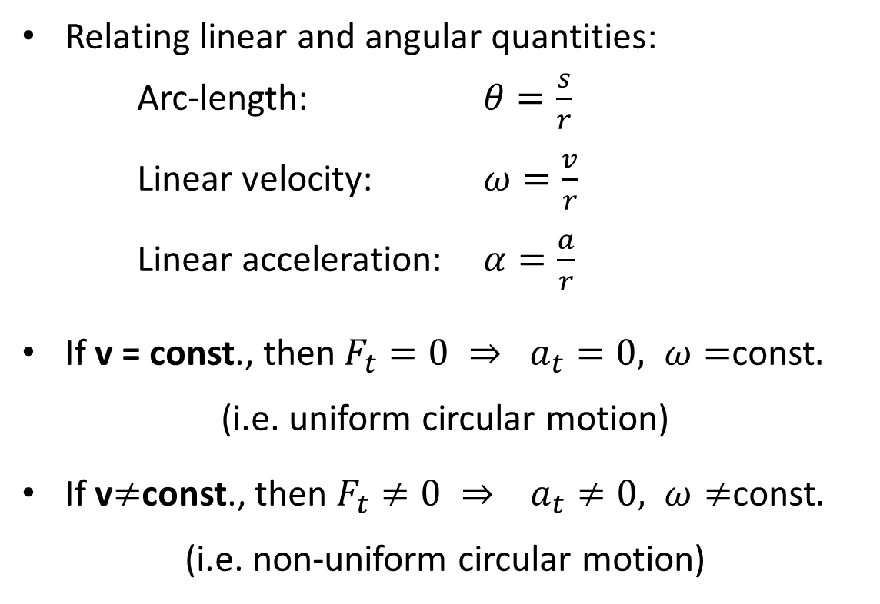

Example: Pendulum
Relating linear and angular quantities:
Arc-length: $θ=\frac{s}{r}$
Linear velocity: $ω=\frac{v}{r}$
Linear acceleration: $α=\frac{a}{r}$
If v = const., then $F_{t}=0 ⇒ a_{t}=0, ω=$const$.$
(i.e. uniform circular motion)
If v$≠$const., then $F_{t}≠0 ⇒ a_{t}≠0, ω≠$const$.$
(i.e. non-uniform circular motion)
$$θ$$
$$r$$
$$r$$
$$F_{c}$$
m
$$F_{t}$$

Slide 38
Motion of Rigid Bodies : moving beyond the particle model

Slide 39
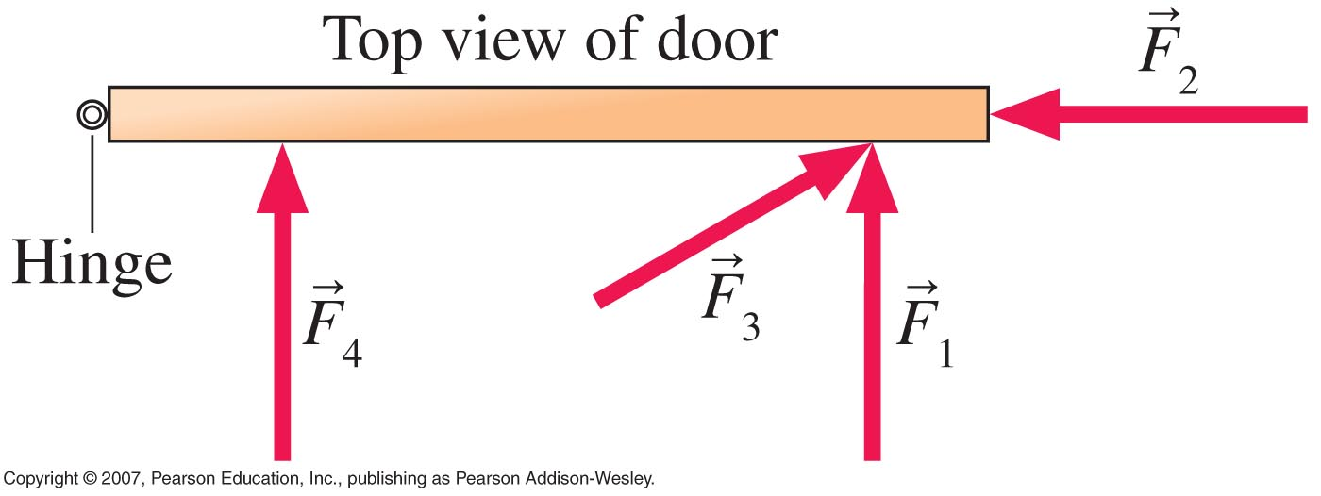
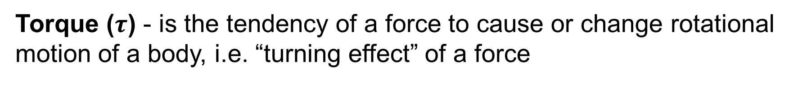
Torque ($τ$) - is the tendency of a force to cause or change rotational motion of a body, i.e. “turning effect” of a force
Which force would be most effective in opening the door?

Slide 40


Torque ($τ$) - is the tendency of a force to cause or change rotational motion of a body, i.e. “turning effect” of a force
Which force would be most effective in opening the door?
Reference point is called the pivot
Direction of $τ$: clockwise (CW) or counter-clockwise (CCW) around pivot

Slide 41

Interpreting Torque
Torque is due to the component of the force perpendicular to the radial line.

Slide 42

A Second Interpretation of Torque
Torque is due to the force acting perpendicular to the moment arm.

Slide 43

Center of Gravity (a.k.a center of mass)
It is the average location of the weight of the object, i.e. the location where the entire mass appears to be concentrated
=

Slide 44
Center of mass of some shapes

Slide 45


Slide 46


Slide 47

Check your understanding
Which point could be the center of gravity of this L-shaped piece?
Notes:
Answer: A

Slide 48

Answer
Which point could be the center of gravity of this L-shaped piece?
Notes:
Answer: A

Slide 49

Calculating the Center-of-Gravity Position

Slide 50





Problem-solving
An object consists of the three balls shown, connected by massless rods. Find the x- and y-positions of the object’s center of gravity.
$$y$$
Mass | (x,y) (m)
1 kg | (0,0)
1 kg | (0,1)
2 kg | (1,0)
$$x_{COM}=\frac{\left(1\right)\left(0\right)+\left(1\right)\left(0\right)+\left(2\right)\left(1\right)}{1+1+2}$$
$$⇒ x_{COM}=0.5 m$$
$$y_{COM}=\frac{\left(1\right)\left(0\right)+\left(1\right)\left(1\right)+\left(2\right)\left(0\right)}{1+1+2}$$
$$⇒ y_{COM}=0.25 m$$
(0.5, 0.25) m
$$x$$

Slide 51

Moment of Inertia ($I$ ; unit: $kg m^{2}$)
Resistance to rotation
Depends on:
- mass of object
- mass distribution around axis of rotation
Axis of rotation
Axis of rotation
Axis of rotation

Slide 52








Examples: Moment of Inertia of Point Masses
m3
m1
$$r_{3}$$
$$r_{1}$$
m3
$$r_{3}=0$$
m1
axis of rotation
$$r_{1}$$
$$r_{2}$$
m2
m2
$$r_{2}$$
axis of rotation
$$I=∑mr^{2}=m_{1}r_{1}^{2}+m_{2}r_{2}^{2}+m_{3}r_{3}^{2}$$
$$I=∑mr^{2}=m_{1}r_{1}^{2}+m_{2}r_{2}^{2}+m_{3}(0)$$

Slide 53

Moments of Inertia of Common Shapes (i.e. non-point masses)

