Slide 1
PHYS 1111K
Lectures 1 – 2
OpenStax Chapter 2
Youtube link: https://youtu.be/62yjCS26Rp8

Slide 2

Cartesian coordinate system
(named after Rene Descartes, French philosopher, mathematician and scientist, 1596 – 1650)
How do you tell somebody where exactly the fly is?
Specify the coordinates of the fly’s position with respect to some fixed point (e.g. Descartes’ head)
e.g.
I am standing 7 feet from the front wall and 20 feet from the left wall
I am sitting on the 3rd row from the front and 5th column from the right
A Fly on the Ceiling
René Descartes and the fly
Richard Walz (illustrator)

Slide 3
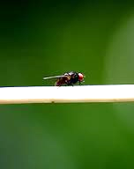
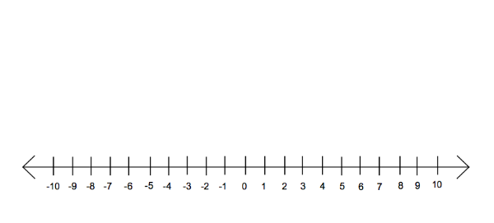
Cartesian coordinate system
One dimensional (1D) coordinate system: object can move only along a straight line
Fly on a tightrope
Current position x = 2 cm
x = 2 cm means:
Reference point is at x = 0
Fly is at 2 cm from x = 0 on the tight rope (i.e. along x-direction)
Position x (cm)
We choose locations to the right of zero to be positive

Slide 4
Cartesian coordinate system
One dimensional (1D) coordinate system
Fly on a tightrope
Current position x = - 5 cm
Position x (cm)
We choose locations to the left of zero to be negative

Slide 5
Always specify the coordinate system you are using
Specify the origin of the coordinate system (i.e. zero)
Specify positive and negative directions
x = - 5 cm
x = 2 cm
Origin
To the right is positive
Position x (cm)

Slide 6
Upward is positive
Does it matter if the fly travels along a vertical line?
No, we can still specify the location of the fly once we pick a 1D coordinate system and
Specify the origin
Specify the positive direction
y = 5 cm
Origin
Position y (cm)
y = - 7 cm

Slide 7
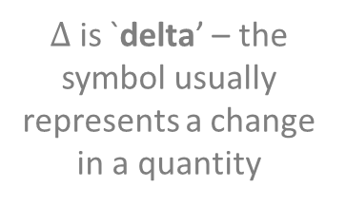
One dimensional (1D) motion – Displacement (change in position)
Previous position x = - 5 cm
Current position x = 2 cm
Position x (cm)
Displacement : change in position
Δx = x_{final} - x_{initial}
Question : What is the fly’s displacement?
$Δ$ is `delta’ – the symbol usually represents a change in a quantity

Slide 8
One dimensional (1D) motion - Displacement
Previous position x = - 5 cm
Current position x = 2 cm
Position x (cm)
Displacement : change in position
Δx = x_{final} - x_{initial}
Answer : Δx = (2 cm) - (-5 cm) = +7 cm
In words, the fly moved 7 cm to the right

Slide 9
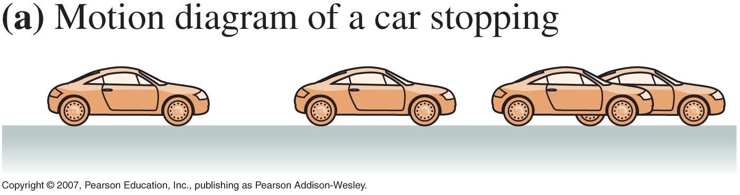
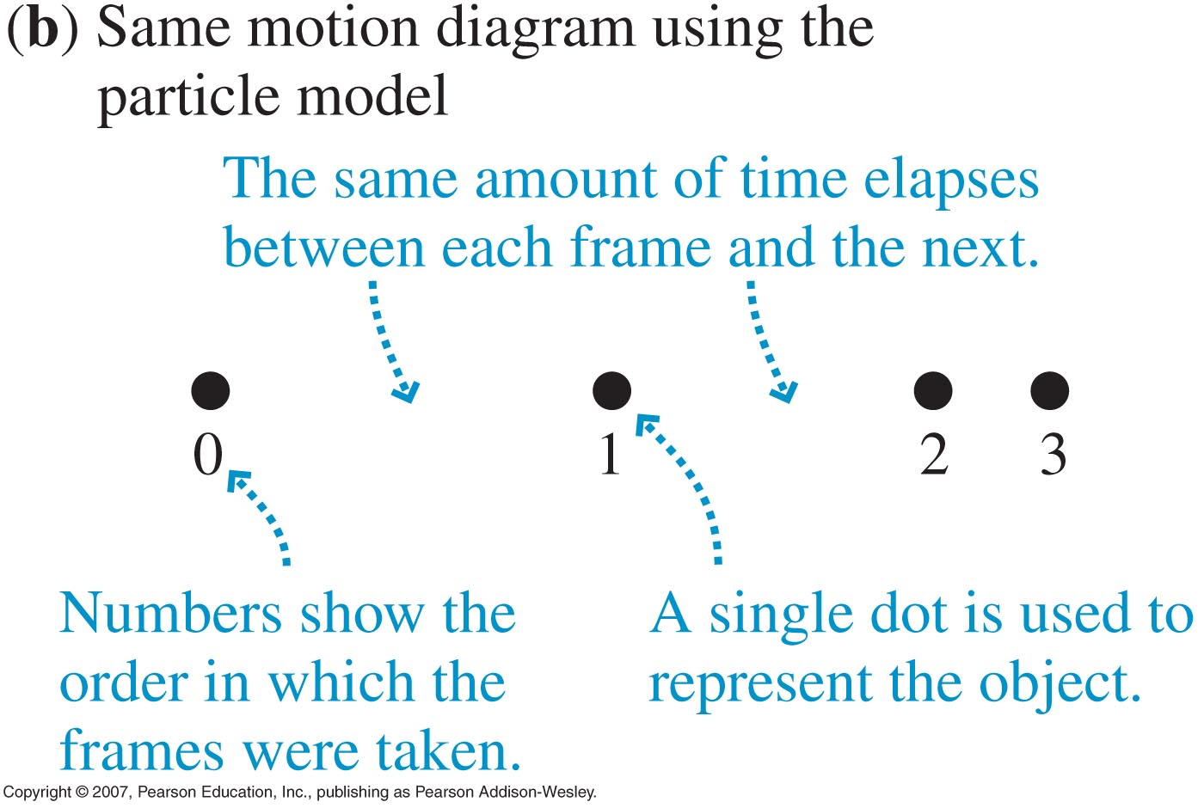
One dimensional (1D) motion - Particle model
Motion diagram of a car stopping (snapshots taken every 1 s)
Same motion diagram using the particle model

Slide 10
Particle model

Slide 11
Particle model

Slide 12
Particle model

Slide 13

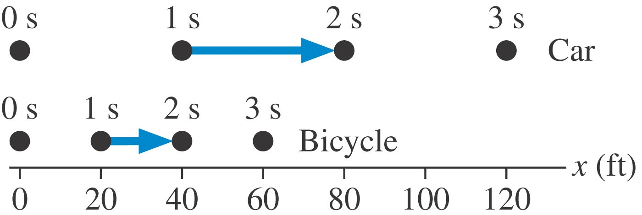

One dimensional (1D) motion - Speed
m
40 m
m
The car moves 40 m in 1 s. Its speed is
= 40
1 s
s
20 m
= 20
m
The bike moves 20 m in 1 s. Its speed is
1 s
s

Slide 14

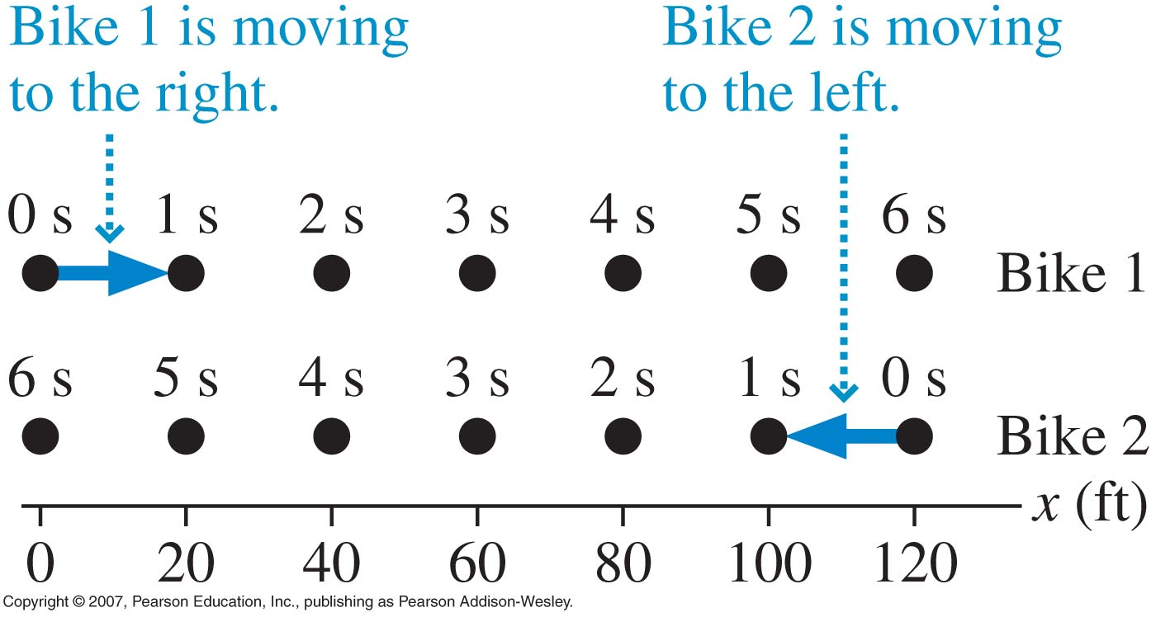
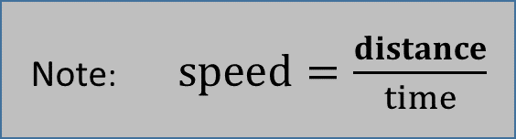
One dimensional (1D) motion - Velocity
Note: $speed=\frac{distance}{time}$
m
m
Bike 1 moves 20 m towards the right in 1 s. Its velocity is + 20
s
m
Bike 2 moves 20 m towards the left in 1 s. Its velocity is - 20
s

Slide 15
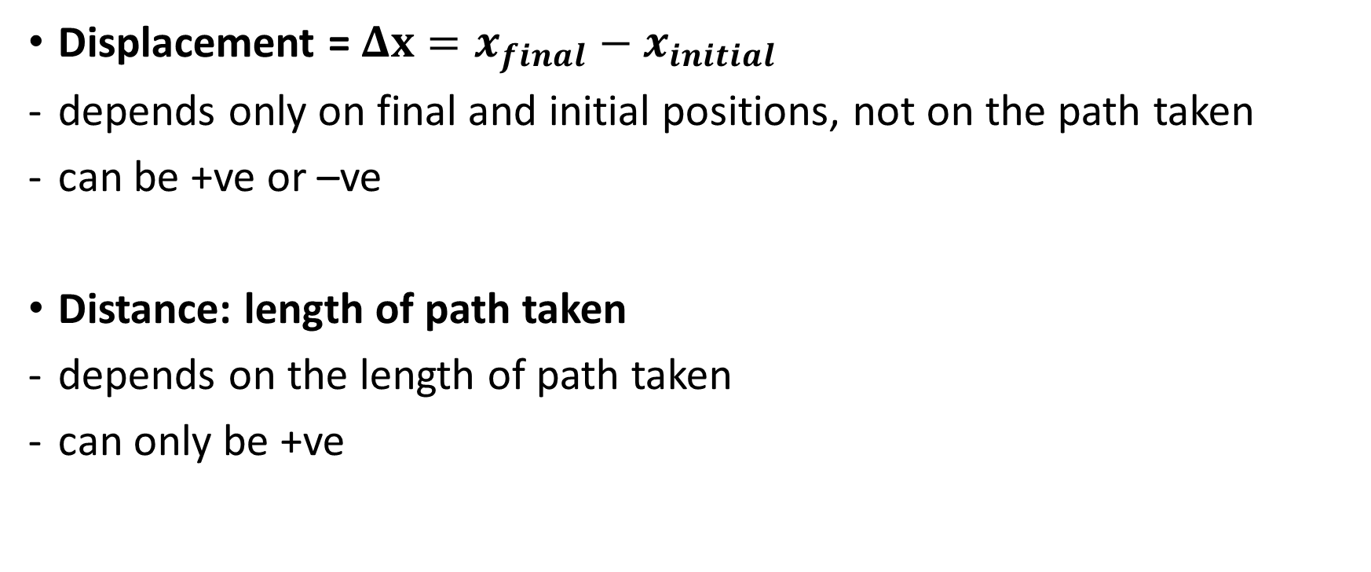
Displacement vs Distance
Displacement = $Δx=x_{final}−x_{initial}$
depends only on final and initial positions, not on the path taken
can be +ve or –ve
Distance: length of path taken
depends on the length of path taken
can only be +ve

Slide 16
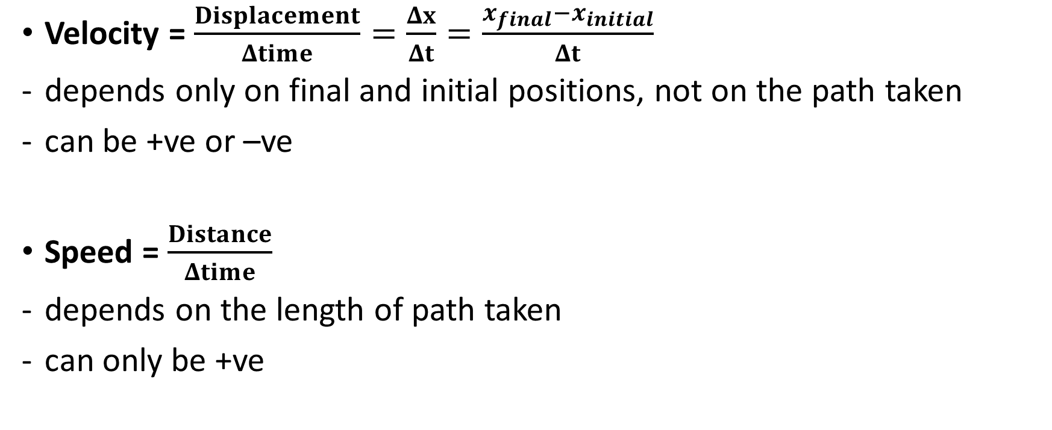
Velocity vs Speed
Velocity = $\frac{Displacement}{Δtime}=\frac{Δx}{Δt}=\frac{x_{final}−x_{initial}}{Δt}$
depends only on final and initial positions, not on the path taken
can be +ve or –ve
Speed = $\frac{Distance}{Δtime}$
depends on the length of path taken
can only be +ve

Slide 17
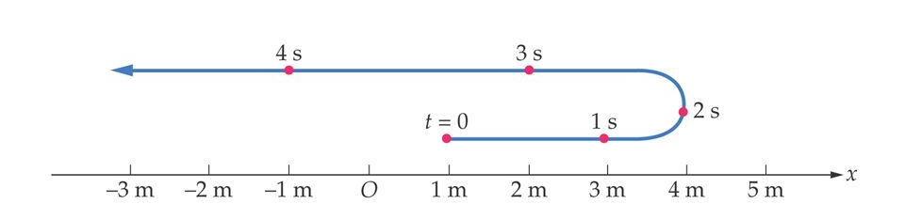
One dimensional (1D) motion – Average speed & Average velocity
Turning point – velocity changes from positive to negative through zero
Total distance covered
8 m
Average speed between t=0 and t=4s = = = 2 ms⁻¹
Time taken
4 s
x _{final} - x_{initial}
(-1 m) – (1 m)
Average velocity between t=0 and t=4s = = Δx = = = - 0.5 ms⁻¹
Total displacement
Time taken
Δt
t_{final} - t_{initial}
4 s – 0 s

Slide 18
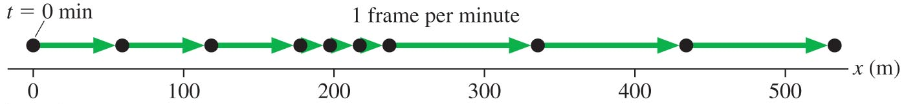
Various representations
Motion diagram (student walking to school)

Slide 19
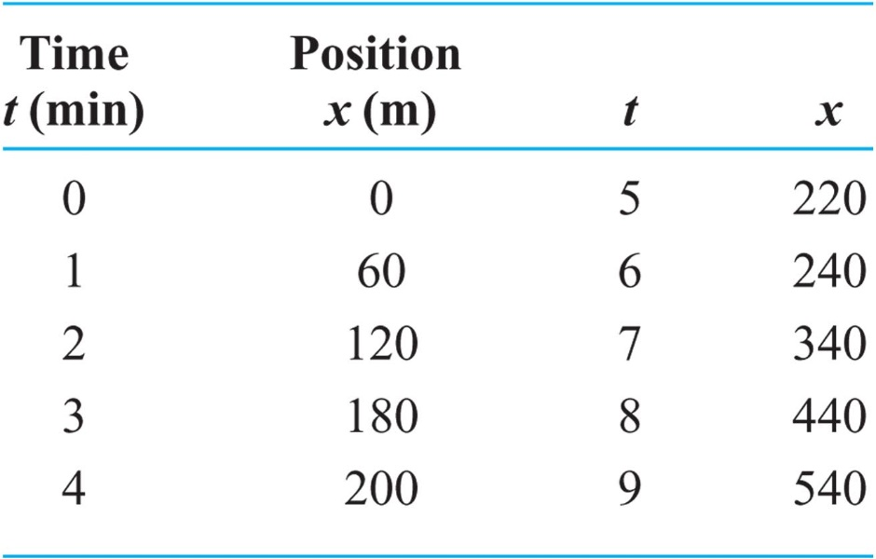
Various representations
Motion diagram (student walking to school)
Table of data

Slide 20
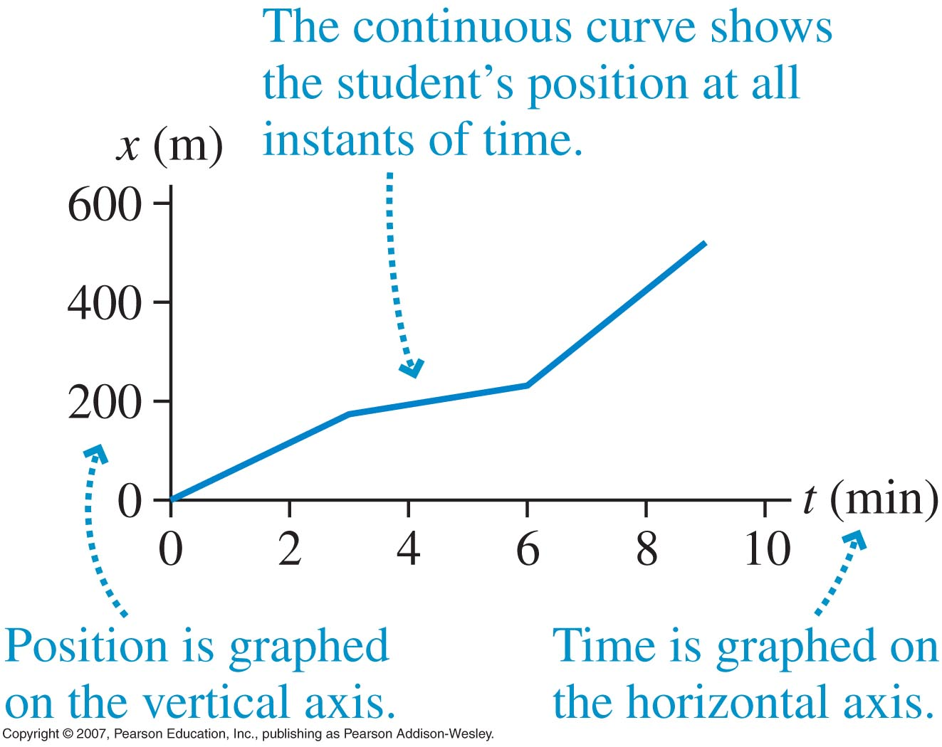
Various representations
Motion diagram (student walking to school)
Table of data
Graph

Slide 21
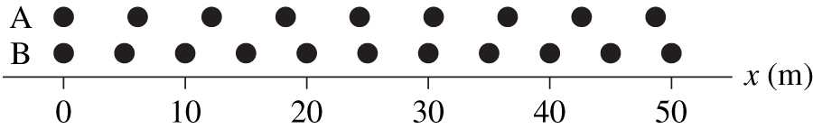
Checking Understanding
Two runners jog along a track. The positions are shown at 1 s time intervals. Which runner is moving faster?
(i.e. who has greater speed?)
Notes:
Answer: A

Slide 22
Answer
Two runners jog along a track. The positions are shown at 1 s time intervals. Which runner is moving faster?
Notes:
Answer: A

Slide 23
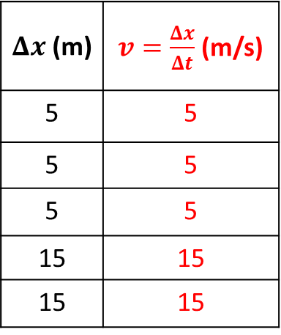
Position-Time and Velocity-Time Graphs
x (m)
t (s) | x (m)
0 | 0
1 | 5
2 | 10
3 | 15
4 | 30
5 | 45
$Δx$ (m) | $v=\frac{Δx}{Δt}$ (m/s)
5 | 5
5 | 5
5 | 5
15 | 15
15 | 15
t (s)
v (m/s)
t (s)

Slide 24
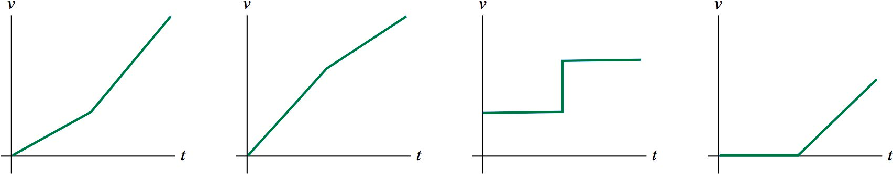
Checking Understanding
Here is a motion diagram of a car moving along a straight stretch of road:
Which of the following velocity-versus-time graphs matches this motion diagram?
A.
B.
C.
D.
Notes:
Answer: C

Slide 25
Checking Understanding
Here is a motion diagram of a car moving along a straight stretch of road:
Which of the following velocity-versus-time graphs matches this motion diagram?
C.
Notes:
Answer: C

Slide 26




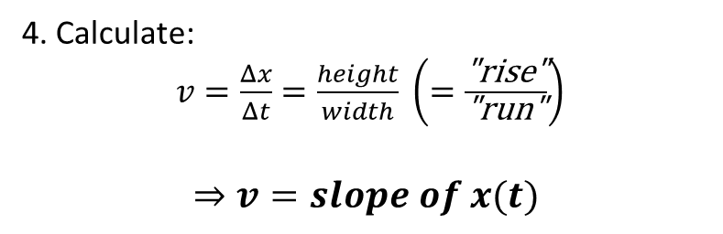

Finding v(t) from x(t)
$$v=\frac{Δx}{Δt}$$
Find v between two points:
x (m)
1. Select the two points
2. Find $Δx$ (i.e. height between the points)
$$Δx$$
3. Find $Δ$t (i.e. width between the points)
4. Calculate:
$v=\frac{Δx}{Δt}=\frac{height}{width} \left(=\frac{\text{"}\text{rise}\text{"}}{\text{"}\text{run}\text{"}}\right)$
$$⇒v=slope of x(t)$$
$$Δt$$
t (s)

Slide 27
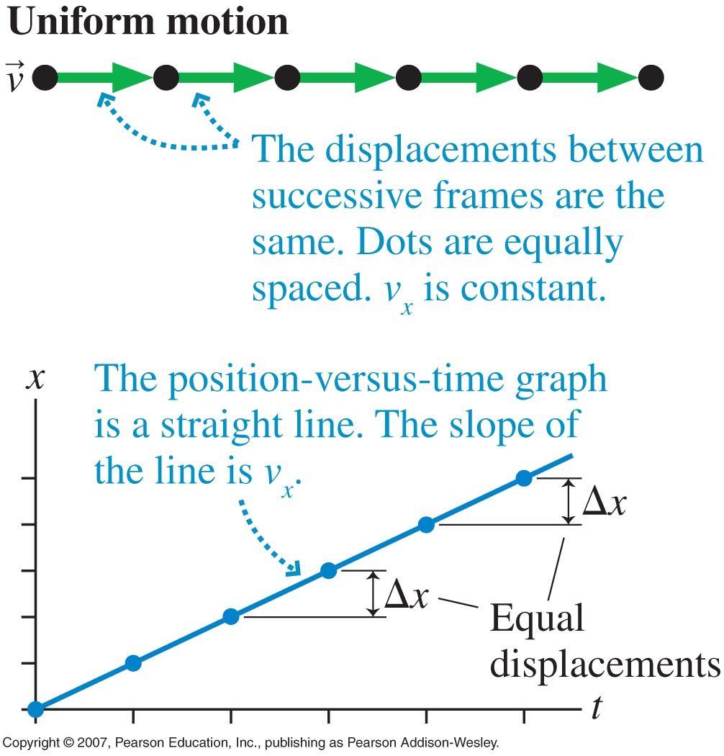
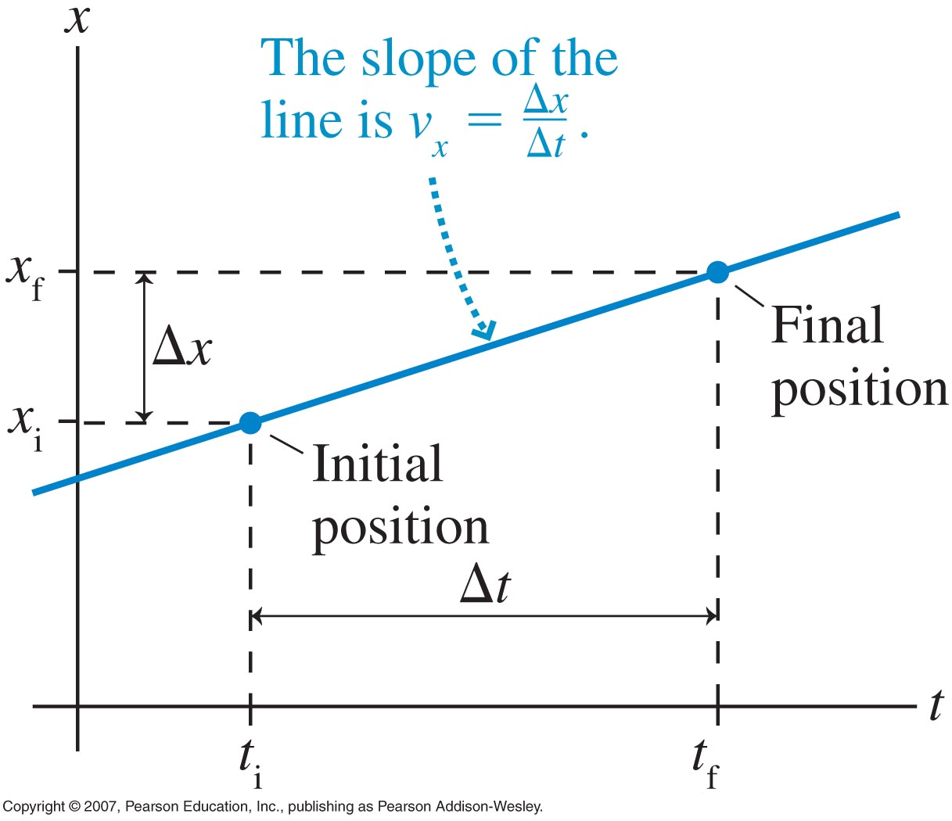
Slope of the position vs time graph gives velocity

Slide 28
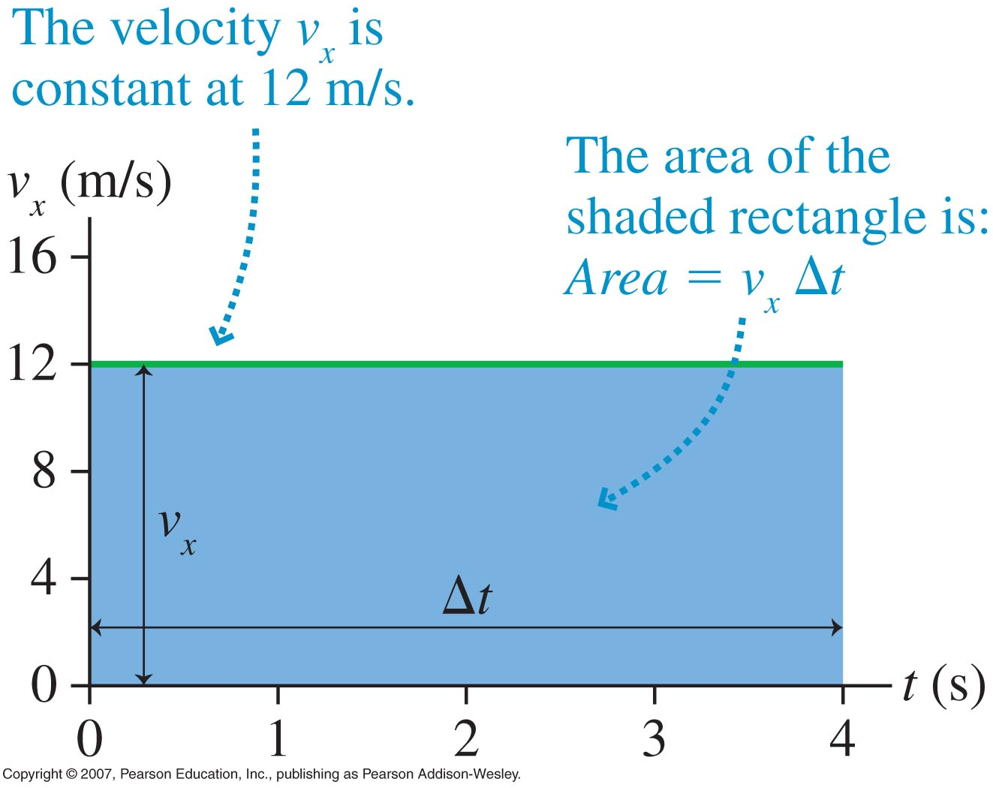

Area under the velocity vs time graph gives displacement
[i.e. $Δx=area of v(t)]$

Slide 29
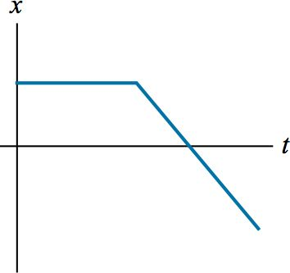
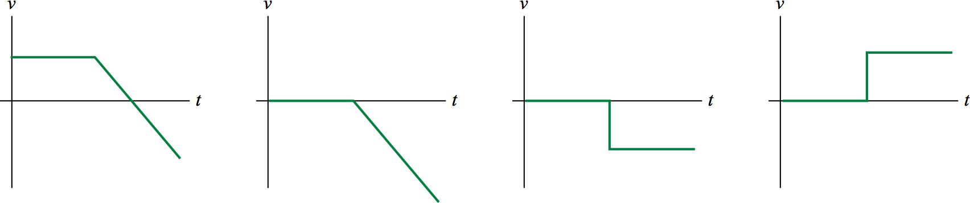
Checking Understanding
A graph of position versus time for a basketball player moving down the court appears like so:
Which of the following velocity graphs matches the above position graph?
A.
B.
C.
D.
Notes:
Answer: C

Slide 30
Answer
A graph of position versus time for a basketball player moving down the court appears like so:
Which of the following velocity graphs matches the above position graph?
C.
Notes:
Answer: C

Slide 31
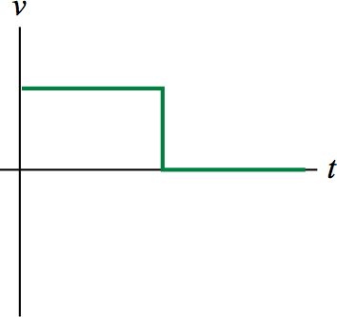
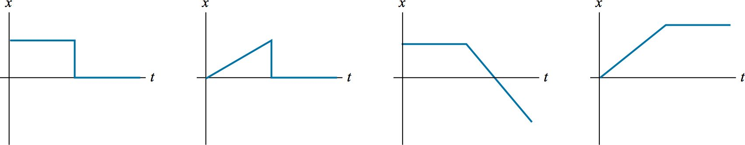
Checking Understanding
A graph of velocity versus time for a hockey puck shot into a goal appears like so:
Which of the following position graphs matches the above velocity graph?
A.
B.
C.
D.
Notes:
Answer: D

Slide 32
Answer
A graph of velocity versus time for a hockey puck shot into a goal appears like so:
Which of the following position graphs matches the above velocity graph?
D.
Notes:
Answer: D

Slide 33
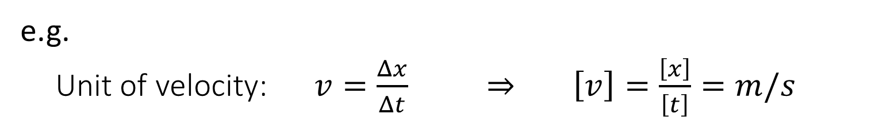
Units
Standard Units (SI units):
  Distance: meter (m)
  Time: second (s)
  Mass: kilogram (kg)
Base Units
There are seven base units (three of them are listed above).
Units of all quantities can be derived in terms of base units.
e.g.
Unit of velocity: $v=\frac{Δx}{Δt}$ $⇒$ $\left[v\right]=\frac{\left[x\right]}{\left[t\right]}=m/s$

Slide 34
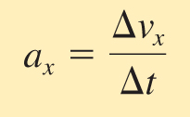
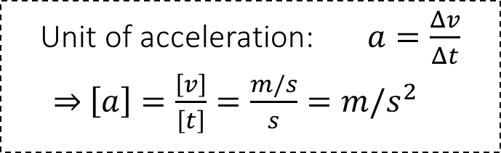
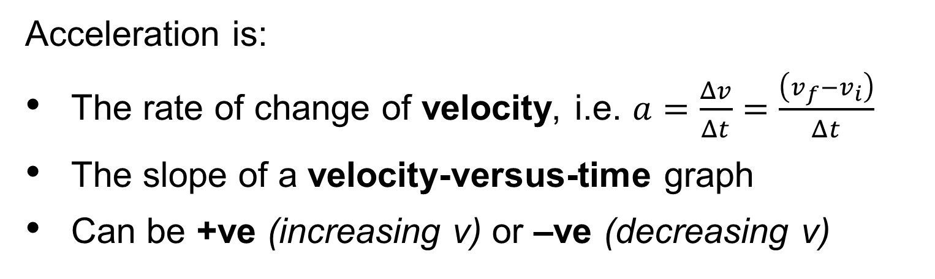
Non-uniform motion – Constant Acceleration
Unit of acceleration: $a=\frac{Δv}{Δt}$
$⇒$ $\left[a\right]=\frac{\left[v\right]}{\left[t\right]}=\frac{m/s}{s}=m/s^{2}$
When the velocity of an object changes (e.g. when speeding up or slowing down), the object is said to accelerate
Acceleration is:
The rate of change of velocity, i.e. $a=\frac{Δv}{Δt}=\frac{\left(v_{f}−v_{i}\right)}{Δt}$
The slope of a velocity-versus-time graph
Can be +ve (increasing v) or –ve (decreasing v)

Slide 35
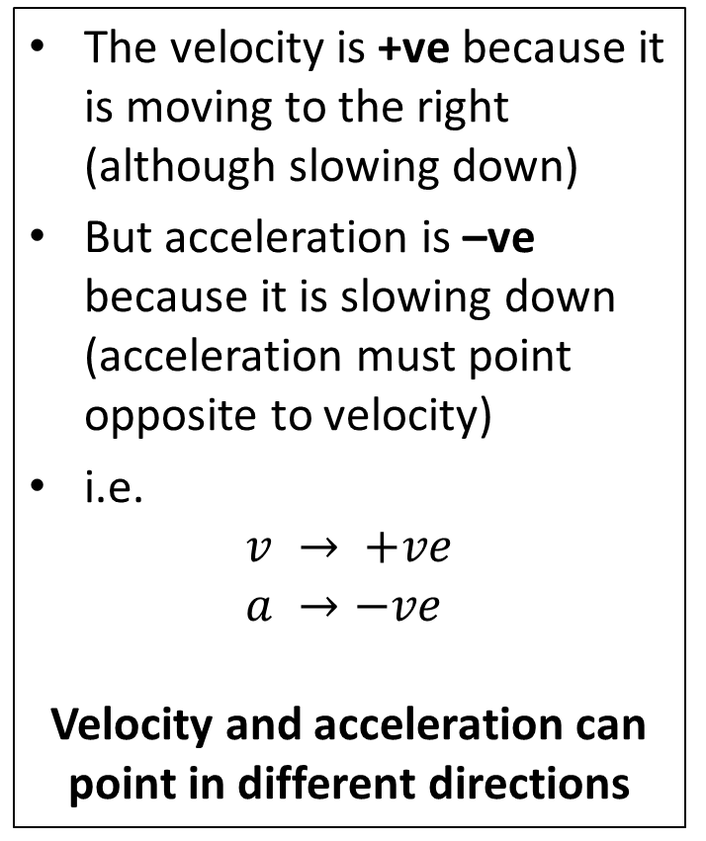


Constant Acceleration
The velocity is +ve because it is moving to the right (although slowing down)
But acceleration is –ve because it is slowing down (acceleration must point opposite to velocity)
i.e.
$$v → +ve$$
$$a →−ve$$
Velocity and acceleration can point in different directions
$$a$$
$$v$$

Slide 36
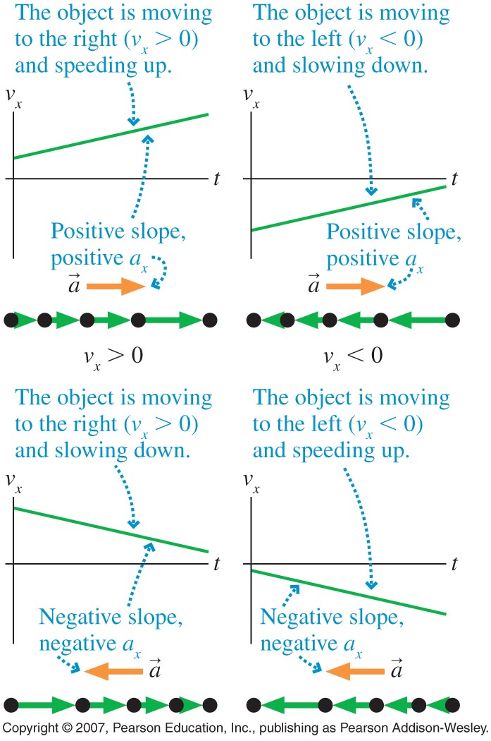
Non-uniform motion – Constant Acceleration
Velocity and acceleration can point in different directions (and have different signs)
i.e. an object can be moving in one direction, but accelerating in a different direction (and, therefore, changing its velocity)

Slide 37
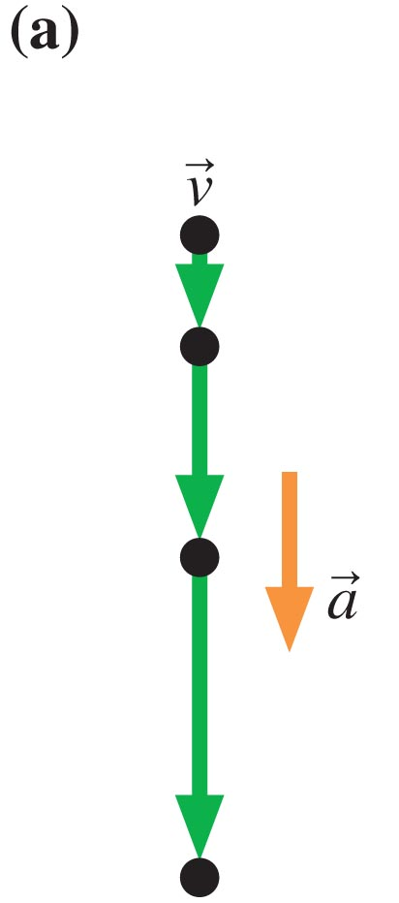
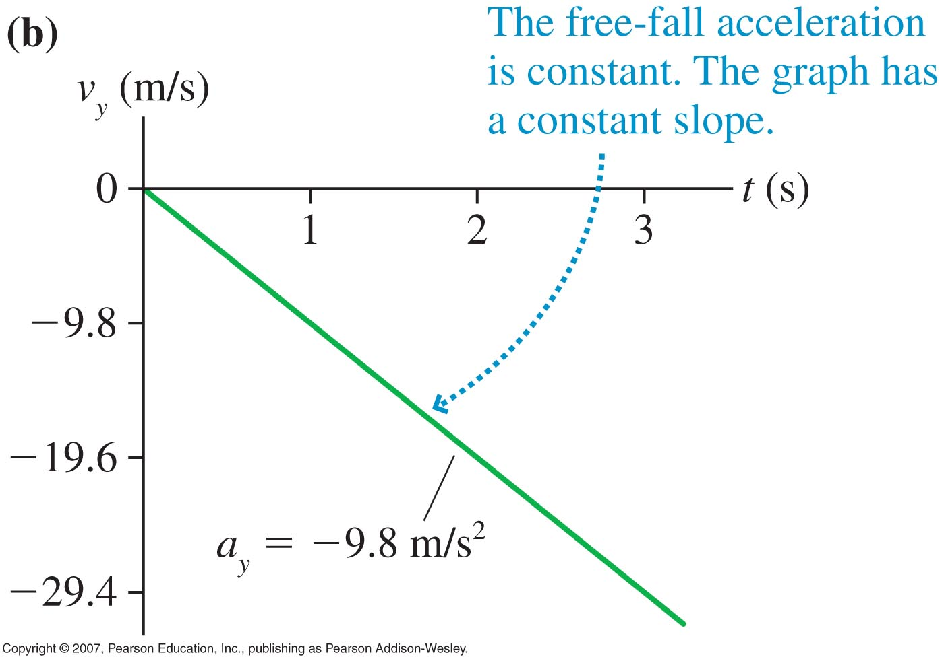
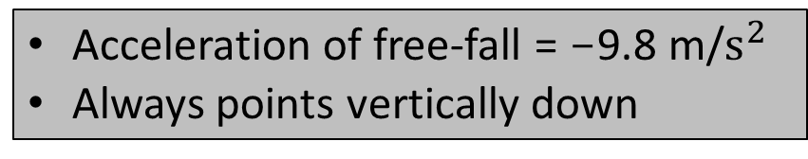
Example of Constant Acceleration: Free-fall
Acceleration of free-fall = -9.8 m/$s^{2}$
Always points vertically down

Slide 38




v(t) and a(t) graphs:
x
v
v = slope of x(t)
$$v=\frac{Δx}{Δt}$$
$Δx$ = area under v(t)
t
t
v
a
a = slope of v(t)
$$a=\frac{Δv}{Δt}$$
$Δv$ = area under a(t)
t
t

Slide 39




x(t), v(t) and a(t) graphs:
$$v=\frac{Δx}{Δt}$$
$$a=\frac{Δv}{Δt}$$
x
v
a
v = slope of x(t)
a = slope of v(t)
$Δx$ = area under v(t)
$Δv$ = area under a(t)
t
t
t

Slide 40









x(t), v(t) and a(t) graphs:
a
v
x
a = slope of v(t)
$v$ = slope of x(t)
$$a=0$$
$Δ$v = area of a(t)
$Δx$ = area of v(t)
t
t
t
a
v
x
a = slope of v(t)
$v$ = slope of x(t)
$$a=const.$$
$$?$$
$Δ$v = area of a(t)
$Δx$ = area of v(t)
t
t
t

Slide 41



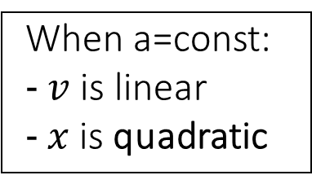

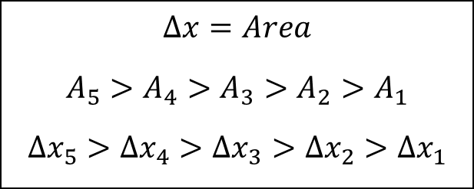







a=const., v linear, x=?
Particle model motion diagram:
v
0 1 2 3
x
$${Δx}_{5}$$
$$A_{4}$$
$$A_{5}$$
$$A_{2}$$
$$A_{3}$$
$$A_{1}$$
t
$${Δx}_{4}$$
When a=const:
$v$ is linear
$x$is quadratic
$$Δx=Area$$
$$A_{5}>A_{4}>A_{3}>A_{2}>A_{1}$$
$${Δx}_{5}>{Δx}_{4}>{Δx}_{3}>{Δx}_{2}>{Δx}_{1}$$
$${Δx}_{3}$$
$${Δx}_{2}$$
$${Δx}_{1}$$
t

Slide 42


a=const., v linear, x quadratic
v
x
v = slope of x(t)
$Δx$ = area under v(t)
t
t
v
x
t
v = slope of x(t)
t
$Δx$ = area under v(t)

Slide 43
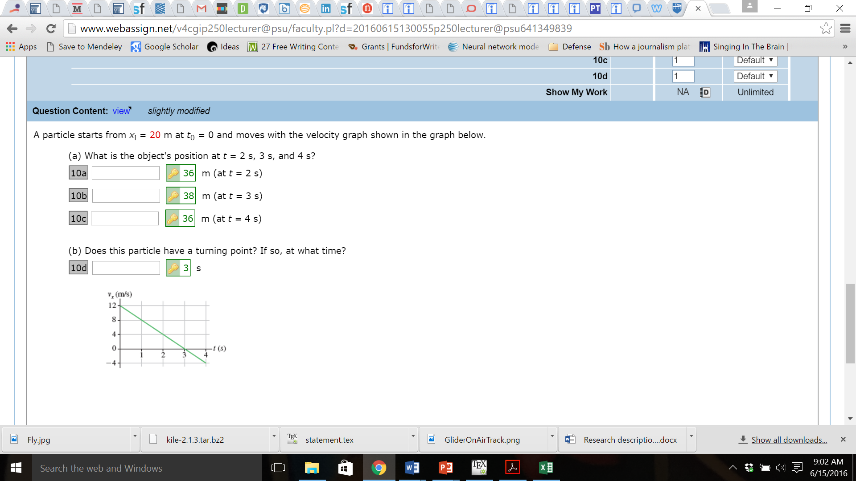
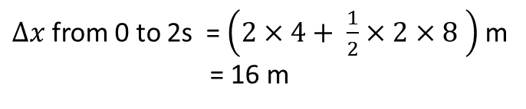
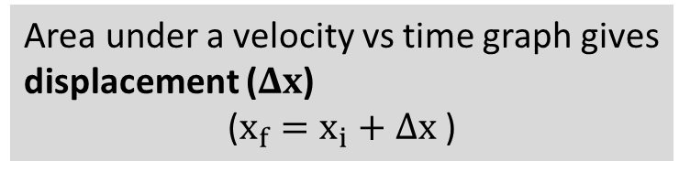
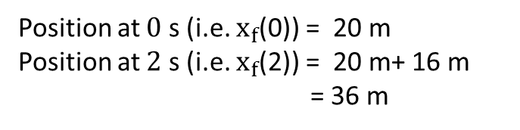
36
Reminder :
38
36
Area under a velocity vs time graph gives displacement ($Δx$)
($x_{f}=x_{i}+Δx$ )
3
$∆x$from 0 to 2s = $\left(2×4+ \frac{1}{2}×2×8 \right)$ m
= 16 m
Position at $0$ s (i.e. $x_{f}$(0)) = 20 m
Position at $2$ s (i.e. $x_{f}$(2)) = 20 m+ 16 m
= 36 m

Slide 44
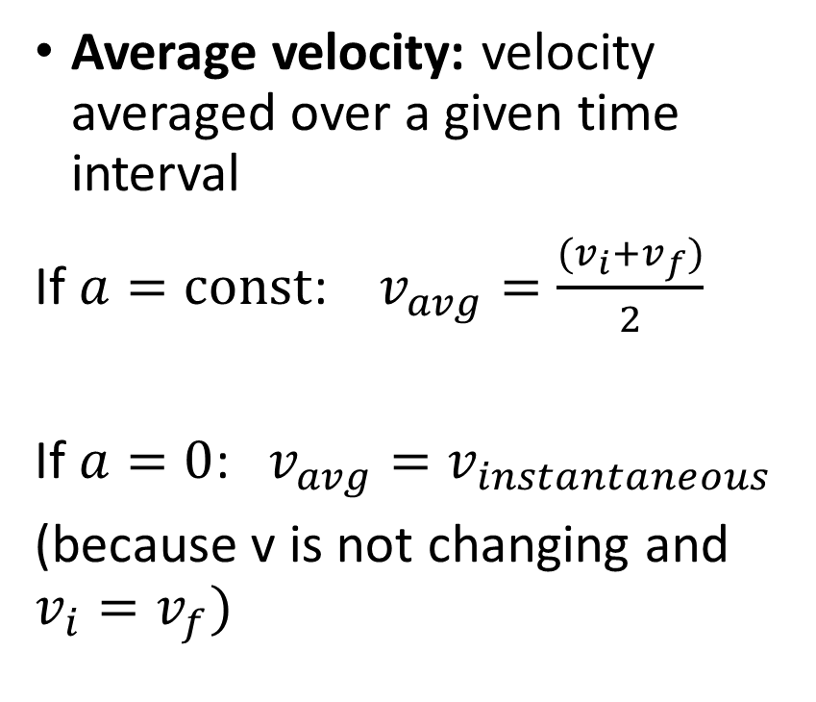



Instantaneous vs Average Velocity
Instantaneous velocity: velocity at one instant of time
Average velocity: velocity averaged over a given time interval
If $a=const$: $v_{avg}=\frac{{(v}_{i}+v_{f})}{2}$
If $a=0$: $v_{avg}=v_{instantaneous}$
(because v is not changing and $v_{i}=v_{f})$
v
$$v_{3}$$
$$v_{2}$$
$$v_{1}$$
t

