Slide 1
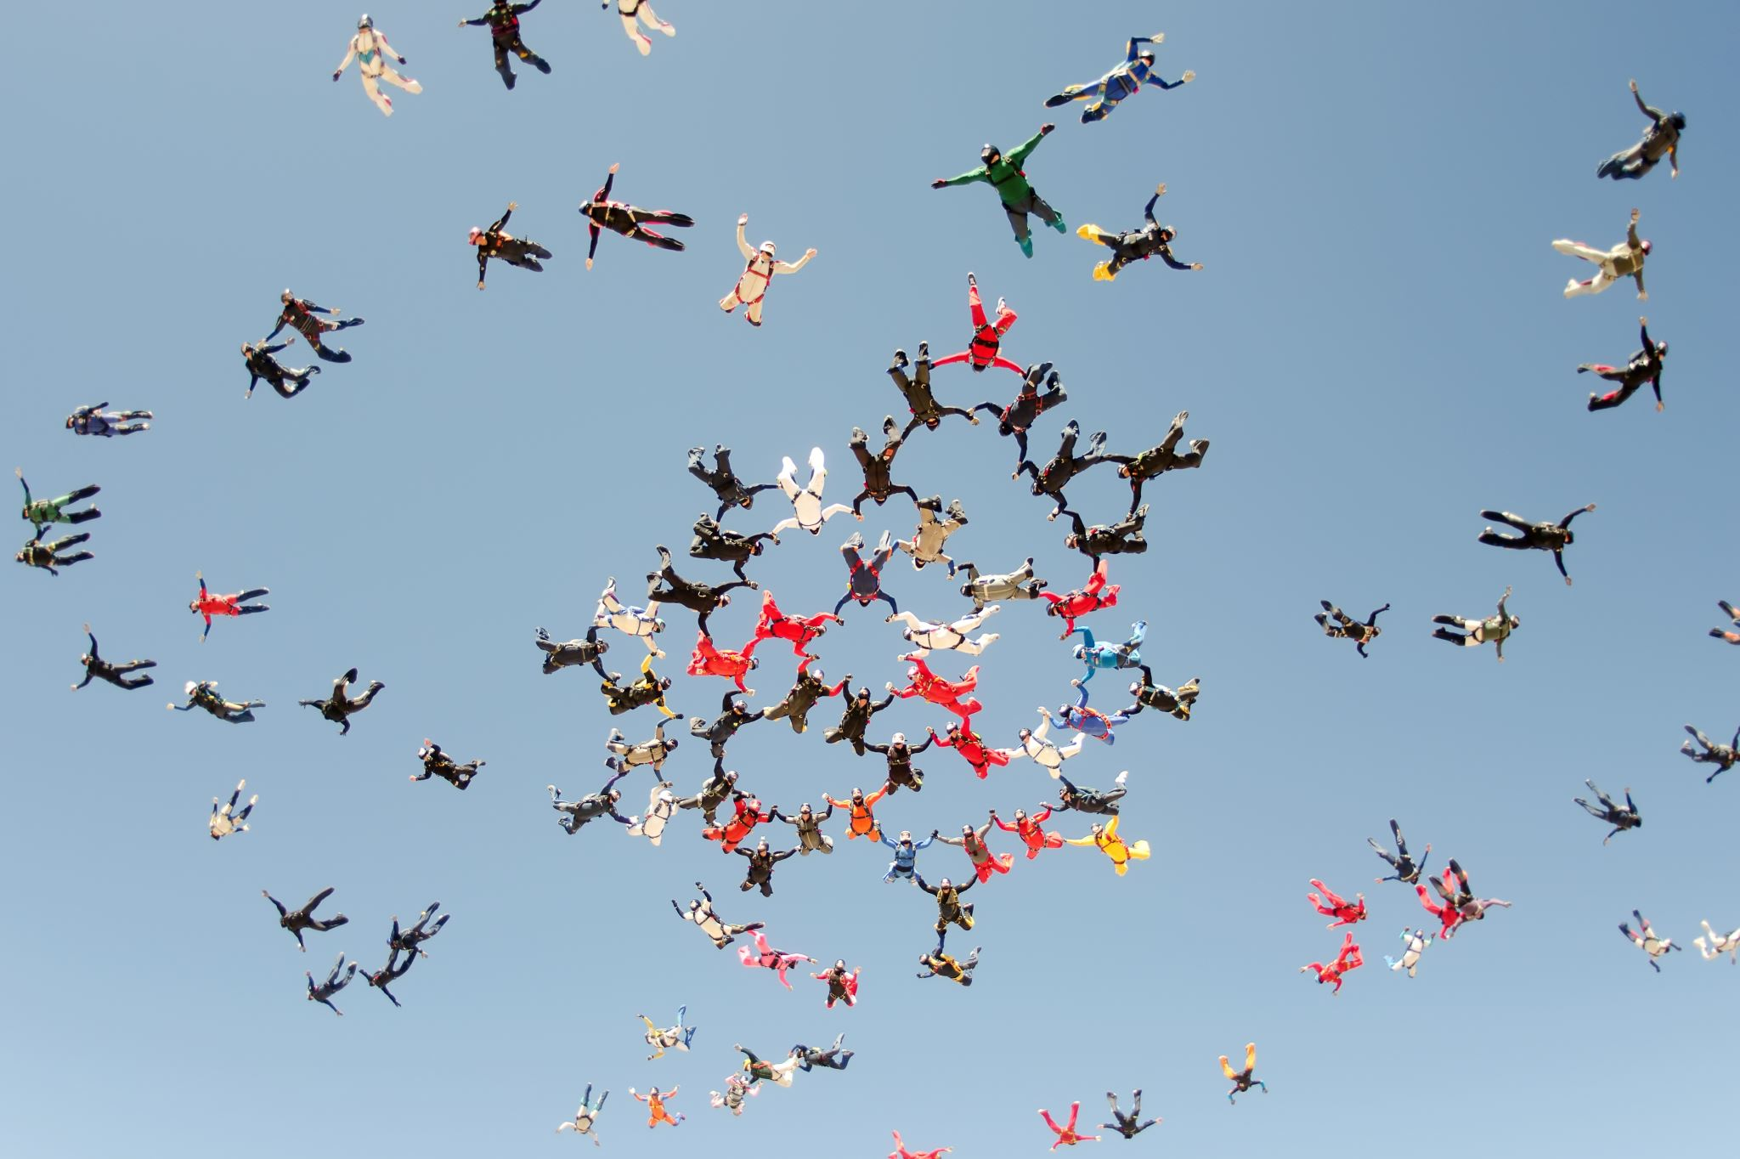
Why things move

Slide 2
How things move

Slide 3
The study of motion is called kinematics.
Examples:
The Earth orbits around the Sun
A roadway moves with Earth’s rotation

Slide 4
Position and Displacement
The location of an object is usually given in terms of a standard reference point, called the origin.
positive direction is taken to be the direction where the coordinates are increasing
negative direction as that where the coordinates are decreasing.
A change in the coordinates of the position of the body describes the displacement of the body.
For example, if the x-coordinate of a body changes from x₁ to x₂, then the displacement, Δx = (x₂-x₁).
Displacement is a vector quantity. That is, a quantity that has both magnitude and direction information.
An object’s displacement is x = -4 m means that the object has moved towards decreasing x-axis by 4 m. The direction of motion, here, is toward decreasing x.

Slide 5
Position and Displacement
Concept Question
You drive in your car due north for 30 miles. Then you turn east and drive for 50 miles. Finally, you turn south and drive for 30 more miles. What is your total displacement and distance traveled from for this journey?
Displacement and distance traveled is 50 miles.
Displacement and distance traveled is 110 miles.
Displacement is 50 miles and distance traveled is 110 miles.
Displacement is 110 miles and distance traveled is 50 miles.
Notes:
Answer: C

Slide 6
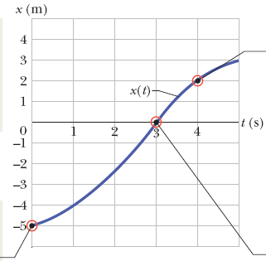
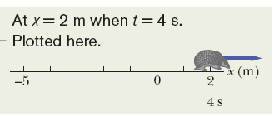
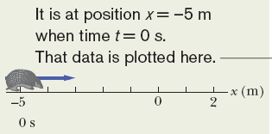
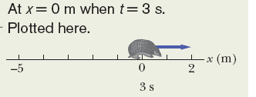

Average Velocity and Speed
A common way to describe the motion of an object is to show a graph of the position as a function of time.
Average velocity, or v_{avg}, is defined as the displacement over the time duration.
The average velocity has the same sign as the displacement.

Slide 7
Example Problem
At what average velocity are you traveling if you cover 6.5 meters in 5 seconds?

Slide 8
Example Problem
At what average velocity are you traveling if you cover 6.5 meters in 5 seconds?
Let’s write down what we are given
Δx = 6.5 meters
Δt = 5 seconds.
Remember that average velocity is given by
Plugging in our numbers:
v_{avg} = 6.5 meters/5 seconds = 1.3 m/s

Slide 9
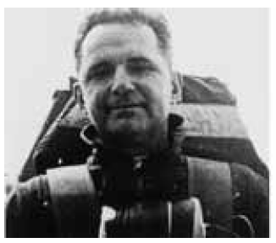

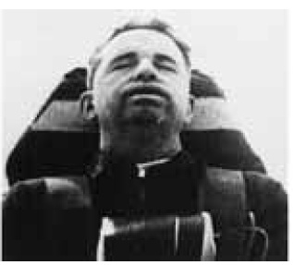
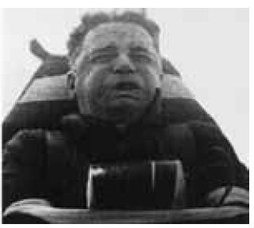
Average Acceleration
Average acceleration is the change of velocity over the change of time.
Here the velocity is v₁ at time t₁, and the velocity is v₂ at time t₂.
The SI units for acceleration are m/s².
Our bodies often react to accelerations but not to velocities.
  fast car often does not bother the rider, but a sudden brake is felt strongly by the rider
  Amusement car rides, where the rides change velocities quickly to thrill the riders.
  Colonel J. P. Stapp in a rocket sled, which undergoes sudden change in velocities.
The magnitude of acceleration falling near the Earth’s surface is 9.8 m/s², and is often referred to as g.

Slide 10
Average velocity and acceleration can tell you what direction something is moving
If an object has opposite signs for velocity and acceleration, then it is slowing down.
If an object has same sign for velocity and acceleration, then it is speeding up.

Slide 11
Velocity and Acceleration
Concept Question
At one particular moment, a subway train is moving with a positive velocity and negative acceleration. Which of the following phrases best describes the motion of this train? Assume the front of the train is pointing in the positive x direction.
a) The train is moving forward as it slows down.
b) The train is moving in reverse as it slows down.
c) The train is moving faster as it moves forward.
d) The train is moving faster as it moves in reverse.
e) There is no way to determine whether the train is moving forward or in reverse.
Notes:
Answer: A

Slide 12
Example Problem
You enter a speed zone, so you apply your breaks to go from 80 km/hr to 50 km/hr in 10 seconds. What is your acceleration?
(Remember to convert the units!)

Slide 13
Example Problem
You enter a speed zone, so you apply your breaks to go from 80 km/hr to 50 km/hr in 10 seconds. What is your acceleration?
(Remember to convert the units!)
Let’s start with writing down what we are given
v1 = 80 km/hr
v2 = 50 km/hr
Δt = 10 s
Now convert units to SI, km/hr → m/s:
80 km/hr *1000 m/1 km * 1 hr/3600 s = 22.22 m/s
50 km/hr *1000 m/1 km * 1 hr/3600 s = 13.89 m/s
Remember that to find the acceleration:
Plugging in our numbers:
a_{avg} = (13.89 m/s – 22.22 m/s)/10 s = -0.833 m/s²

Slide 14
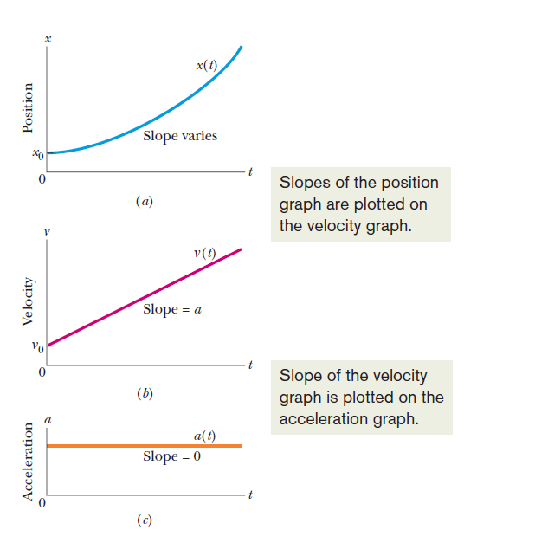
Constant Acceleration
Integrating constant acceleration graph for a fixed time duration yields values for velocity graph during that time.
Similarly, integrating velocity graph will yield values for position graph.

Slide 15
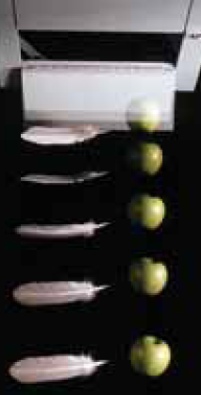
In this case objects close to the Earth’s surface fall towards the Earth’s surface with no external forces acting on them except for their weight.
Use the constant acceleration model with “a” replaced by “-g”, where g = 9.8 m/s² for motion close to the Earth’s surface.
In vacuum, a feather and an apple will fall at the same rate.
Free-Fall Acceleration

Slide 16
Example Problem
If an object is in free-fall, what is its average velocity 1s after starting to fall if its initial velocity is 0 m/s? What about 2s after starting to fall?

Slide 17
Example Problem
If an object is in free-fall, what is its average velocity 1s after starting to fall if it’s initial velocity is 0 m/s? What about 2s after starting to fall?
Let’s write down what we are given for the first question:
t₂ = 1s
v₁ = 0 m/s
I’m in free fall so I know that a = g = 9.81 m/s²
And we can assume that t₁ = 0s
Remember that acceleration is found from:
Rearranging this equation to solve for v₂ we get:
v₂ = a_{avg}(t₂ – t₁) + v₁
Plugging in our numbers we get:
v₂ = 9.81(1-0)+0 = 9.81 m/s
Repeating for t₂ = 2s, we get v₂ = 19.62 m/s.

Slide 18
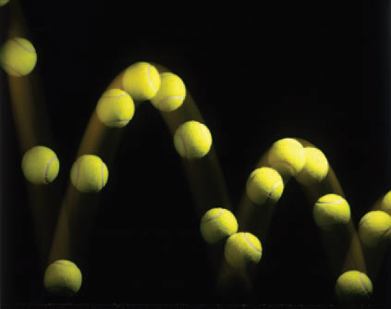
A particle moves in a vertical plane, with the only acceleration equal to the free fall acceleration, g.
Examples in sports:
Tennis
Baseball
Football
Lacrosse
Racquetball
Soccer
Projectile Motion

Slide 19
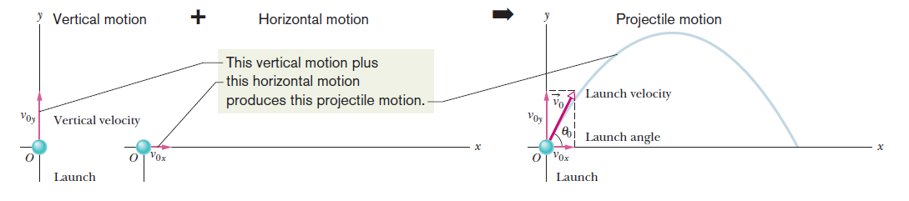
Projectile Motion

Slide 20
Projectile Motion
Concept Question
Complete the following statement: In two-dimensional motion in the x-y plane, the x part of the motion and the y part of the motion are independent
a) only if there is no acceleration in either direction.
b) only if there is no acceleration in one of the directions.
c) only if there is an acceleration in both directions.
d) whether or not there is an acceleration in any direction.
e) whenever the acceleration is in the y direction only.
Notes:
Answer: D

Slide 21
Why things move

Slide 22
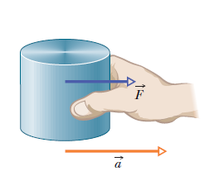
Force
Forces are what causes motion!
The force that is exerted on a standard mass of 1 kg to produce an acceleration of 1 m/s² has a magnitude of 1 Newton.

Slide 23

Study of the relationship between force and motion of a body is defined as Newtonian Mechanics.

Slide 24
Newton’s First Law
Newton’s First Law: If no force acts on a body, the body’s velocity cannot change; that is, the body cannot accelerate.
If the body is at rest, it stays at rest. If it is moving, it continues to move with the same velocity (same magnitude and same direction).
A force is measured by the acceleration it produces.
Forces have both magnitudes and directions.
When two or more forces act on a body, we can find their net, or resultant force, by adding the individual forces.
The SI unit of force is newton (N).

Slide 25
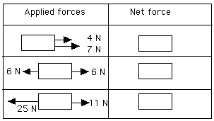
Example Problem
What is the net Force?

Slide 26
Example Problem
What is the net Force?
For the first one, F_{net} = 7 N + 4 N = 11 N

Slide 27
Example Problem
What is the net Force?
For the first one, F_{net} = 7 N + 4 N = 11 N
For the second one, F_{net} = 6 N – 6 N = 0 N

Slide 28
Example Problem
What is the net Force?
For the first one, F_{net} = 7 N + 4 N = 11 N
For the second one, F_{net} = 6 N – 6 N = 0 N
For the third one, F_{net} = 11N – 25 N = -14 N

Slide 29

Newton’s Second Law
Newton’s 2nd Law states that the net force on a body is equal to the product of the body’s mass and its acceleration.
The acceleration component along a given axis is caused only by the sum of the force components along that same axis, and not by force components along any other axis.

Slide 30
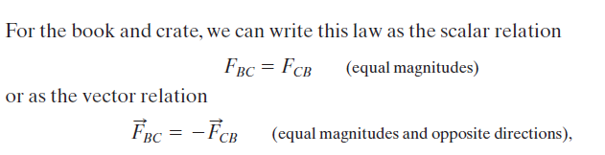
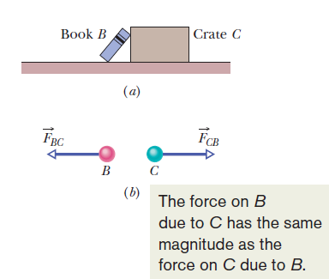
Newton’s Third Law
Newton’s 3rd law of motion states that when two bodies interact, the forces on the bodies from each other are always equal in magnitude and opposite in direction.
The minus sign means that these two forces are in opposite directions
The forces between two interacting bodies are called a third-law force pair.

Slide 31
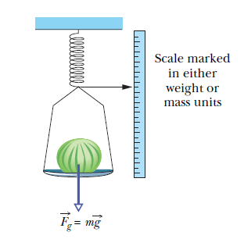
Some Particular Forces: Gravitational
A gravitational force on a body is a certain type of pull that is directed toward a second body.
Suppose a body of mass m is in free fall with the free-fall acceleration of magnitude g. The force that the body feels as a result is: F_{g} = mg.
The weight, W, of a body is equal to the magnitude F_{g} of the gravitational force on the body: W = mg

Slide 32
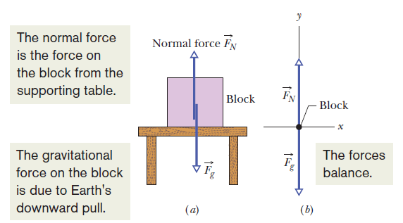
Some Particular Forces: Normal
When a body presses against a surface, the surface (even a seemingly rigid one) deforms and pushes on the body with a normal force, F_{N}, that is perpendicular to the surface.
Forces F_{g} and F_{N} and are the only two forces on the block

Slide 33
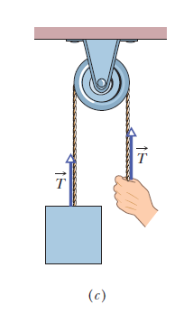
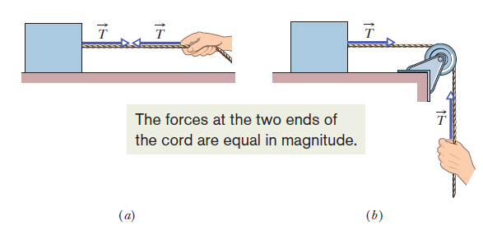
Some Particular Forces: Tension
When a cord is attached to a body and pulled taut, the cord pulls on the body with a force T directed away from the body and along the cord.

Slide 34
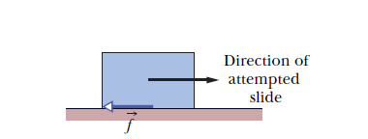
Some Particular Forces: Friction
If we either slide or attempt to slide a body over a surface, the motion is resisted by a bonding between the body and the surface.
The resistance is considered to be single force called the frictional force, f. This force is directed along the surface, opposite the direction of the intended motion.
Frictional forces are very common in our everyday lives.
If you send a book sliding down a horizontal surface, the book will finally slow down and stop.
If you push a heavy crate and the crate does not move, then the applied force must be counteracted by frictional forces.

Slide 35
Friction
Static frictional force acts when there is no relative motion between the body and the contact surface
The magnitude of the static frictional force increases as the applied force to the body is increased.
Finally when the there is relative motion between the body and the contact surface, kinetic friction starts to act.
Usually, the magnitude of the kinetic frictional force, which acts when there is motion, is less than the maximum magnitude of the static frictional force, which acts when there is no motion.
Often, the sliding motion of one surface over another is “jerky” because the two surfaces alternately stick together and then slip.
  Tires skid on dry pavement
  Fingernails scratch on a chalkboard
  A rusty hinge is forced to open
  A bow is drawn on a violin string

Slide 36


Properties Friction
Property 1. If the body does not move, then the static frictional force and the component of F that is parallel to the surface balance each other. They are equal in magnitude, and is f_{s} directed opposite that component of F.
Property 2. The magnitude of has a maximum value f_{s,max} that is given by
where μ_{s} is the coefficient of static friction and F_{N} is the magnitude of the normal force on the body from the surface. If the magnitude of the component of F that is parallel to the surface exceeds f_{s,max}, then the body begins to slide along the surface.
Property 3. If the body begins to slide along the surface, the magnitude of the frictional force rapidly decreases to a value f_{k} given by
where μ_{k} is the coefficient of kinetic friction. Thereafter, during the sliding, a kinetic frictional force f_{k} opposes the motion.

Slide 37
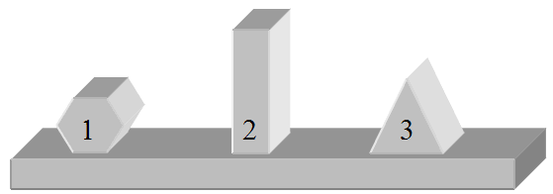
Friction
Concept Question
Three pine blocks, each with identical mass, are sitting on a rough surface. If the same horizontal force is applied to each block, which one of the following statements is false?
  The coefficient of kinetic friction is the same for all three blocks.
  The magnitude of the force of kinetic friction is greater for block 3.
  The normal force exerted by the surface is the same for all three blocks.
  Block 3 has the greatest apparent area in contact with the surface.
  If the horizontal force is the minimum to start block 1 moving, then that same force could be used to start block 2 or block 3 moving.
Notes:
Answer: B

Slide 38
Example Problem
Fill in the missing information in the table below if the mass is 5 kg:
FORCE | FRICTIONAL FORCE | NET FORCE | ACCELERATION
50 N | 0 N
 | 0 N |  | 8 m/s²
45 N | 30 N
30 N | 30 N

Slide 39
Example Problem
Fill in the missing information in the table below if the mass is 5 kg:
For the first one:
F_{net} = 50 N – 0 N = 50 N
a = F_{net} /m = 50 N/5 kg = 10 m/s²
FORCE | FRICTIONAL FORCE | NET FORCE | ACCELERATION
50 N | 0 N
 | 0 N |  | 8 m/s²
45 N | 30 N
30 N | 30 N

Slide 40
Example Problem
Fill in the missing information in the table below if the mass is 5 kg:
For the second one:
F_{net} = m*a = 5kg * 8 m/s² = 40 N
F = F_{net} – F_{f} = 40 N – 0 N = 40 N
FORCE | FRICTIONAL FORCE | NET FORCE | ACCELERATION
50 N | 0 N
 | 0 N |  | 8 m/s²
45 N | 30 N
30 N | 30 N

Slide 41
Example Problem
Fill in the missing information in the table below if the mass is 5 kg:
For the third one:
F_{net} = 45 N – 30 N = 10 N
a = F_{net} /m = 10 N/5 kg = 2 m/s²
FORCE | FRICTIONAL FORCE | NET FORCE | ACCELERATION
50 N | 0 N
 | 0 N |  | 8 m/s²
45 N | 30 N
30 N | 30 N

Slide 42
Example Problem
Fill in the missing information in the table below if the mass is 5 kg:
For the fourth one:
F_{net} = 30 N – 30 N = 0 N
a = F_{net} /m = 0 N/5 kg = 0 m/s²
FORCE | FRICTIONAL FORCE | NET FORCE | ACCELERATION
50 N | 0 N
 | 0 N |  | 8 m/s²
45 N | 30 N
30 N | 30 N

Slide 43
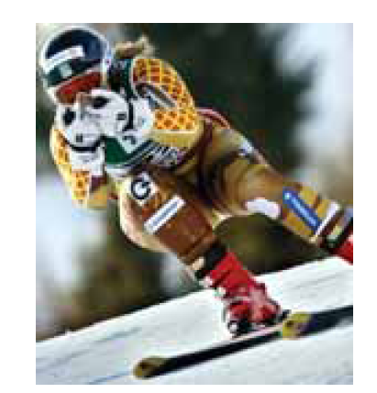
Drag Force & Terminal Speed
When there is a relative velocity between a fluid and a body, the body experiences a drag force, D, that opposes the relative motion and points in the direction opposite of the motion of the object.

Slide 44


Drag Force & Terminal Speed
For cases in which air is the fluid, and the body is blunt (like a baseball) rather than slender (like a javelin), and the relative motion is fast enough so that the air becomes turbulent (breaks up into swirls) behind the body,
When a blunt body falls from rest through air, the drag force is directed upward; its magnitude gradually increases from zero as the speed of the body increases. Eventually, a = 0, and the body then falls at a constant speed, called the terminal speed v_{t} .

Slide 45
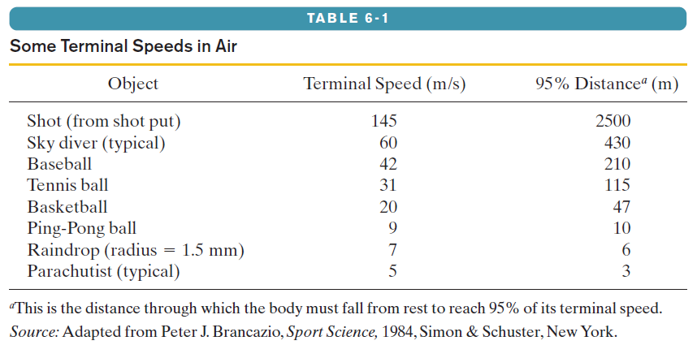
Drag Force & Terminal Speed

