Slide 1
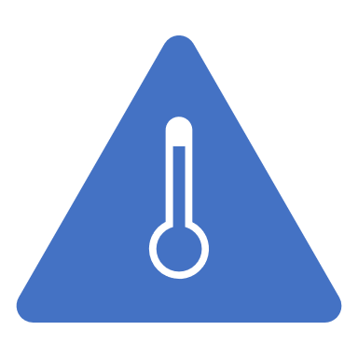
Thermal Energy

Slide 2
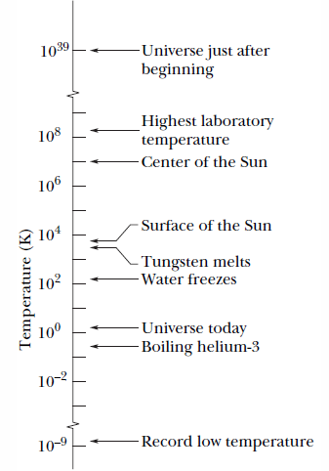

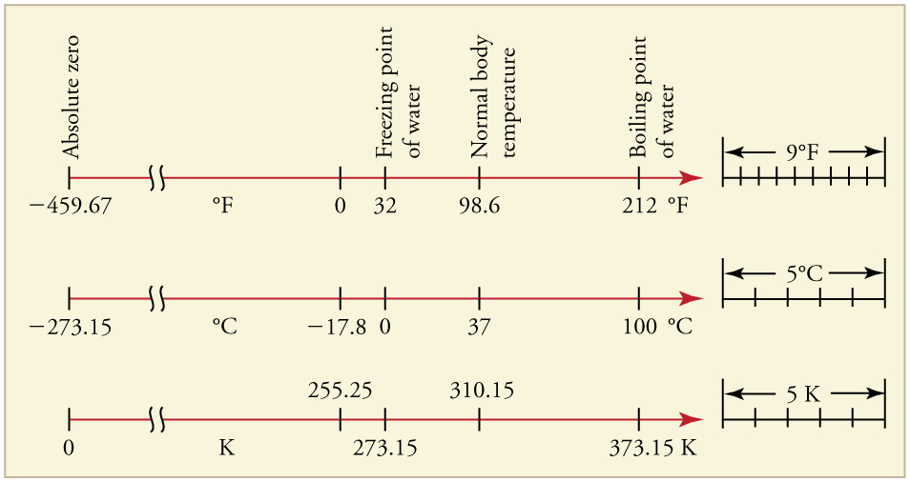
Temperature
In the Celsius scale (or the centigrade scale), temperatures are measured in degrees. The Celsius degree has the same size as the kelvin. The zero of the Celsius scale is shifted to a more convenient value than absolute zero.

Slide 3
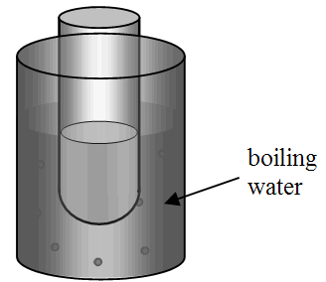
Temperature
Concept Question
Consider the system shown in the drawing. A test tube containing water is inserted into boiling water. Will the water in the test tube eventually boil?
a) Yes, heat is continually transferred to the water
inside the test tube and eventually it will boil?
b) Yes, the pressure above the water in the test tube
will be reduced to less than atmospheric pressure
and cause the water to boil.
c) No, heat will only be transferred until the water
in the test tube is 100 °C.
d) No, the temperature of the water in the test tube will never reach 100 °C.
Notes:
Answer: C

Slide 4
Example Problem
Convert each of the following into the indicated unit:
134 °F = _______ °C
Remember that T_{F} = 9/5*T_{C} +32.
Rearranging this we get T_{C} = 5/9(T_{F} – 32) = 56.67 °C
250 °C = _________ K
Looking at the chart we see that 0 K = -273.15 °C.
That means that T_{K} = T_{C} – 273.15 = -23.15 K
450 K = _________ °F
To get Fahrenheit, I need to first convert K to °C.
T_{C} = 450 K + 273.15 = 723.15 °C
Now convert from Celsius to Fahrenheit
T_{F} = 9/5*(723.15 °C)+32 = 1324 °F

Slide 5
Example Problem
Convert each of the following into the indicated unit:
134 °F = _______ °C
Remember that T_{F} = 9/5*T_{C} +32.
Rearranging this we get T_{C} = 5/9(T_{F} – 32) = 56.67 °C
250 °C = _________ K
Looking at the chart we see that 0 K = -273.15 °C.
That means that T_{K} = T_{C} – 273.15 = -23.15 K
450 K = _________ °F
To get Fahrenheit, I need to first convert K to °C.
T_{C} = 450 K + 273.15 = 723.15 °C
Now convert from Celsius to Fahrenheit
T_{F} = 9/5*(723.15 °C)+32 = 1324 °F

Slide 6
Example Problem
Convert each of the following into the indicated unit:
134 °F = _______ °C
Remember that T_{F} = 9/5*T_{C} +32.
Rearranging this we get T_{C} = 5/9(T_{F} – 32) = 56.67 °C
250 °C = _________ K
Looking at the chart we see that 0 K = -273.15 °C.
That means that T_{K} = T_{C} – 273.15 = -23.15 K
450 K = _________ °F
To get Fahrenheit, I need to first convert K to °C.
T_{C} = 450 K + 273.15 = 723.15 °C
Now convert from Celsius to Fahrenheit
T_{F} = 9/5*(723.15 °C)+32 = 1324 °F

Slide 7
Example Problem
Convert each of the following into the indicated unit:
134 °F = _______ °C
Remember that T_{F} = 9/5*T_{C} +32.
Rearranging this we get T_{C} = 5/9(T_{F} – 32) = 56.67 °C
250 °C = _________ K
Looking at the chart we see that 0 K = -273.15 °C.
That means that T_{K} = T_{C} – 273.15 = -23.15 K
450 K = _________ °F
To get Fahrenheit, I need to first convert K to °C.
T_{C} = 450 K + 273.15 = 723.15 °C
Now convert from Celsius to Fahrenheit
T_{F} = 9/5*(723.15 °C)+32 = 1324 °F

Slide 8
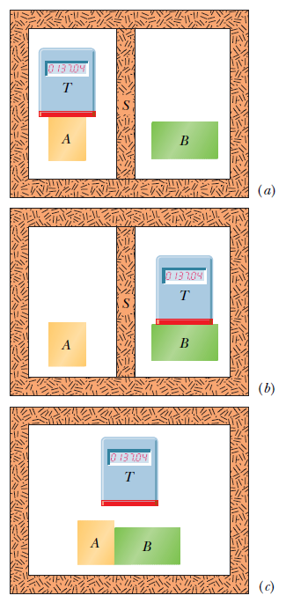
The Zeroth aw of Thermodynamics
If bodies A and B are each in thermal equilibrium with a third body T, then A and B are in thermal equilibrium with each other.

Slide 9
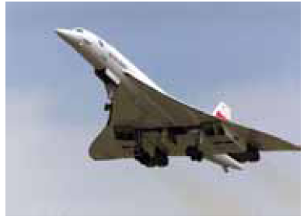
Thermal Expansion
When the temperature of an object is raised, the body usually exhibit “thermal expansion”. With the added thermal energy, the atoms can move a bit farther from one another than usual, against the spring-like interatomic forces that hold every solid together.)
The atoms in the metal move farther apart than those in the glass, which makes a metal object expand more than a glass object.

Slide 10
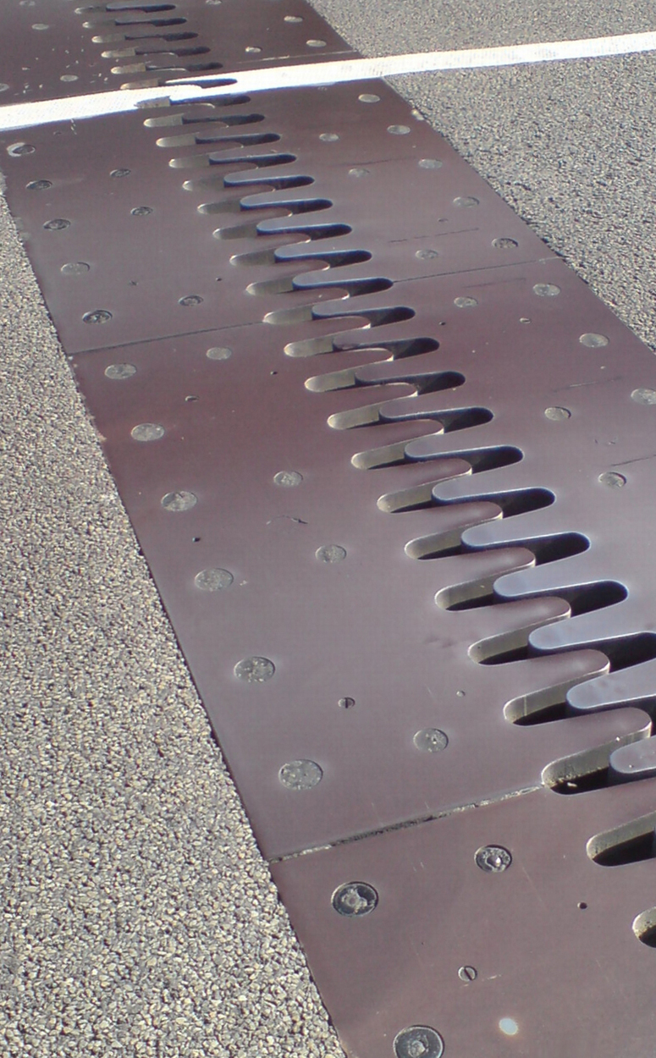
Thermal Expansion
Thermal expansion joints like these in the Auckland Harbour Bridge in New Zealand allow bridges to change length without buckling. (credit: Ingolfson, Wikimedia Commons)

Slide 11

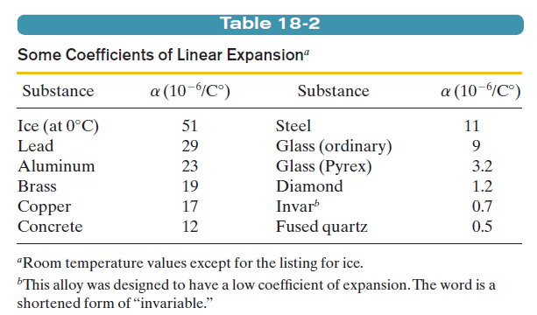
18.6: Thermal Expansion, Linear Expansion
If the temperature of a metal rod of length L is raised by an amount T, its length
is found to increase by an amount
in which α is a constant called the coefficient of linear expansion.

Slide 12
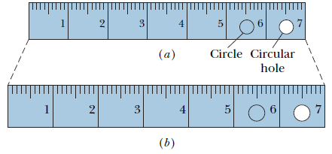


Thermal Expansion, Volume Expansion
If all dimensions of a solid expand with temperature, the volume of that solid must also expand. For liquids, volume expansion is the only meaningful expansion parameter.
If the temperature of a solid or liquid whose volume is V is increased by an amount DT, the increase in volume is found to be
where b is the coefficient of volume expansion of the solid or liquid. The coefficients of volume expansion and linear expansion for a solid are related by

Slide 13
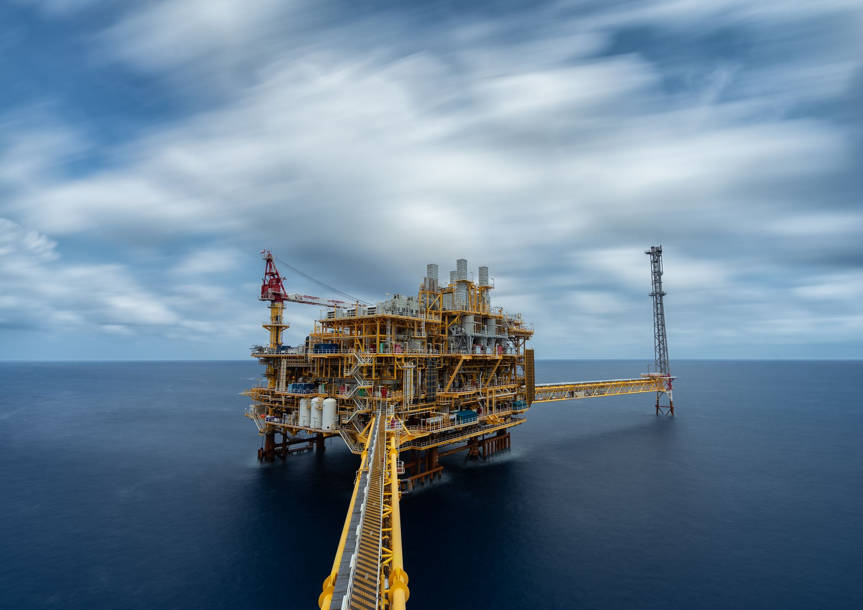
Thermal Expansion, Anomalous Expansion of Water
The most common liquid, water, does not behave like other liquids. Above about 4°C, water expands as the temperature rises, as we would expect.
Between 0 and about 4°C, however, water contracts with increasing temperature. Thus, at about 4°C, the density of water passes through a maximum.
At all other temperatures, the density of water is less than this maximum value.
Thus the surface of a pond freezes while the lower water is still liquid.

Slide 14
Thermal Expansion
Concept Question
Which one of the following statements is the best explanation for the fact that metal pipes that carry water often burst during cold winter months?
a) Both the metal and the water expand, but the water expands to a greater extent.
b) Water contracts upon freezing while the metal expands at lower temperatures.
c) The metal contracts to a greater extent than the water.
d) The interior of the pipe contracts less than the outside of the pipe.
e) Water expands upon freezing while the metal contracts at lower temperatures.
Notes:
Answer: E

Slide 15
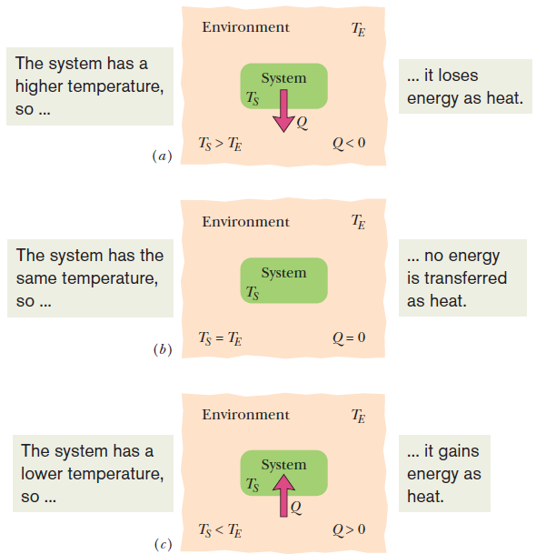
Temperature and Heat
Heat is the thermal energy transferred between a system and its environment because of a temperature difference that exists between them.

Slide 16
Temperature and Heat
Units
The calorie (cal) was defined as the amount of heat that would raise the temperature of 1 g of water from 14.5°C to 15.5°C.
In the British system, the corresponding unit of heat was the British thermal unit (Btu), defined as the amount of heat that would raise the temperature of 1 lb of water from 63°F to 64°F.
Presently, the SI unit for heat is the joule.
The calorie is now defined to be 4.1868 J.
1 cal =3.968 x10⁻³ Btu = 4.1868 J.

Slide 17

  The heat capacity C of an object is the proportionality constant between the heat Q that the object absorbs or loses and the resulting temperature change T of the object
  in which T_{i} and T_{f} are the initial and final temperatures of the object.
  Heat capacity C has the unit of energy per degree or energy per kelvin.
The Absorption of Heat by Solids and Liquids

Slide 18
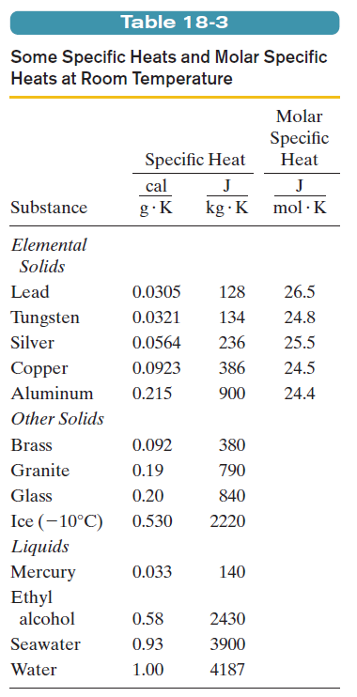


The Absorption of Heat by Solids and Liquids:
Specific Heat
The specific heat, c, is the heat capacity per unit mass. It refers not to an object but to a unit mass of the material of which the object is made.
When quantities are expressed in moles, specific heats must also involve moles (rather than a mass unit); they are then called molar specific heats.

Slide 19
Absorption of Heat by Liquids
Concept Question
What is the final temperature when 2.50 × 10⁵ J are added to 0.950 kg of ice at 0.0 °C?
a) 0.0 °C
b) 4.2 °C
c) 15.7 °C
d) 36.3 °C
e) 62.8 °C
Notes:
Answer: A

Slide 20

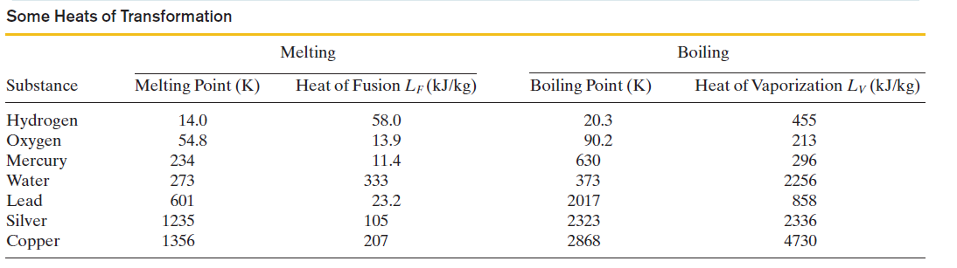
The Absorption of Heat by Solids and Liquids:
Heat of Transformation
The amount of energy per unit mass that must be transferred as heat when a sample completely undergoes a phase change is called the heat of transformation L. When a sample of mass m completely undergoes a phase change, the total energy transferred is:
When the phase change is between liquid to gas, the heat of transformation is called the heat of vaporization L_{V}.
When the phase change is between solid to liquid, the heat of transformation is called the heat of fusion L_{F.}

Slide 21

The First Law of Thermodynamics
$$∆E= ∆Q − ∆W$$
Q is the heat and W is the work done by the system.
The quantity (Q –W) is the same for all processes. It depends only on the initial and final states of the system and does not depend at all on how the system gets from one to the other.

Slide 22
First Law of Thermodynamics
Concept Question
Which one of the following statements is not consistent with the first law of thermodynamics?
a) The internal energy of a finite system must be finite.
b) An engine may be constructed such that the work done by the machine exceeds the energy input to the engine.
c) An isolated system that is thermally insulated cannot do work on its surroundings nor can work be done on the system.
d) The internal energy of a system decreases when it does work on its surroundings and there is no flow of heat.
e) An engine may be constructed that gains energy while heat is transferred to it and work is done on it.
Notes:
Answer: B

Slide 23
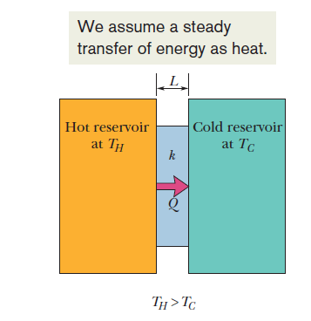


Heat Transfer Mechanisms: Conduction
A slab of face area A and thickness L, have faces maintained at temperatures T_{H} and T_{C} by a hot reservoir and a cold reservoir. If Q be the energy that is transferred as heat through the slab, from its hot face to its cold face, in time t, then the conduction rate P_{cond} (the amount of energy transferred per unit time) is shown in the bottom equation
k, called the thermal conductivity, is a constant that depends on the material of which the slab is made. It has units of W/Km
The thermal resistance R, or the R-value of a slab of thickness L, is shown in the formula to the right has units of K/W.

Slide 24

Heat Transfer Mechanisms: Convection
In convection, energy transfer occurs when a fluid, such as air or water, comes in contact with an object whose temperature is higher than that of the fluid.
The temperature of the part of the fluid that is in contact with the hot object increases, and (in most cases) that fluid expands and thus becomes less dense.
The expanded fluid is now lighter than the surrounding cooler fluid, and the buoyant forces cause it to rise.
Some of the surrounding cooler fluid then flows so as to take the place of the rising warmer fluid, and the process can then continue.

Slide 25
Heat Transfer Mechanisms
Concept Question
During the summer, sunlight warms the land beside a cool lake. This warming is followed by a breeze blowing from the direction of the lake toward the land. Which of the following provides the best explanation for this summer breeze?
a) Air naturally flows from cooler locations to warmer locations.
b) The lake must be west of the land because winds typically blow from the west.
c) The land is usually cooler near a lake, so this is a case of temperature inversion which causes air to blow from the direction of the lake.
d) Warm air rises above the land and cooler air moves downward, appearing to come from the direction of the lake, but it is really from above the land.
e) Warm air rises from above the land and is replaced by the air blowing in from the lake.
Notes:
Answer: E

Slide 26
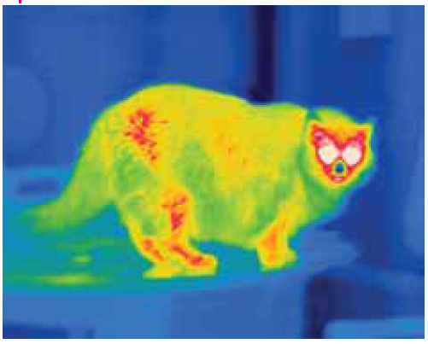


Heat Transfer Mechanisms: Radiation
In radiation, an object and its environment can exchange energy as heat via electromagnetic waves. Energy transferred in this way is called thermal radiation.
The rate P_{rad} at which an object emits energy via electromagnetic radiation depends on the object’s surface area A and the temperature T of that area in K, and is given by the top equation.
Here σ =5.6704 x10⁻⁸ W/m² K⁴ is called the Stefan–Boltzmann constant, and ε is the emissivity.
If the rate at which an object absorbs energy via thermal radiation from its environment is P_{abs}, then the object’s net rate P_{net} of energy exchange due to thermal radiation is shown in the bottom equation.

Slide 27
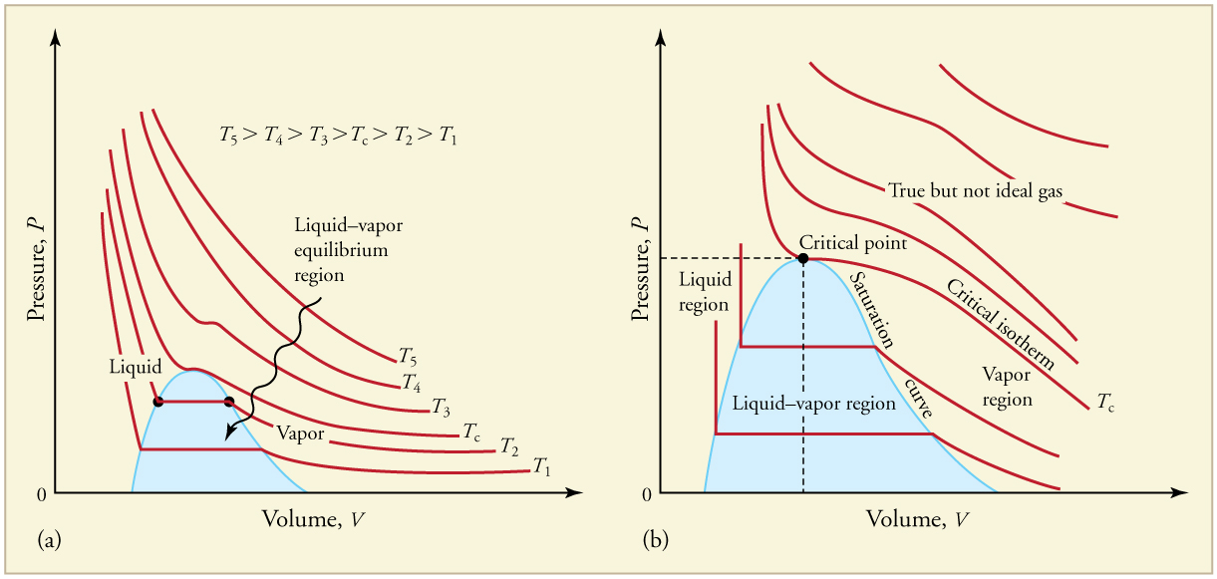
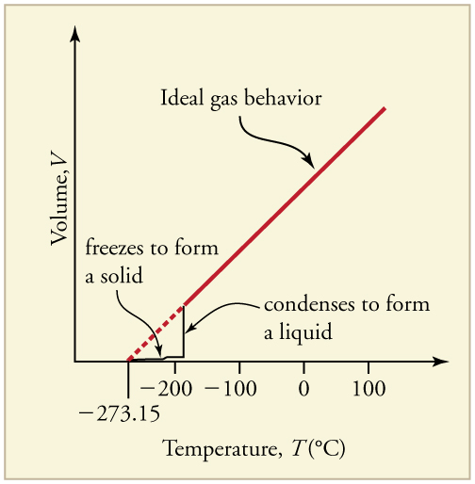
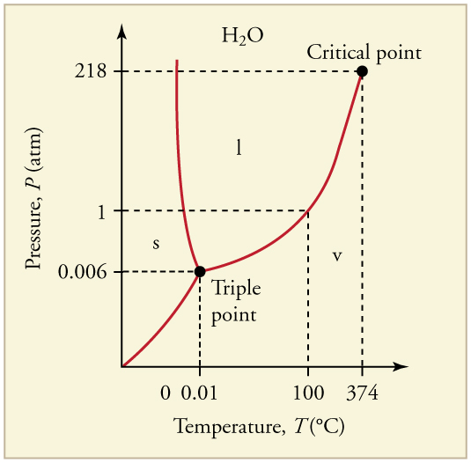
State Diagrams
Several different types: PV diagrams, VT diagrams, PT diagrams, and PVT diagrams.

Slide 28
State Diagrams:
PV Diagrams
Each curve (isotherm) represents the relationship between P and V at a fixed temperature; the upper curves are at higher temperatures. The lower curves are not hyperbolas, because the gas is no longer an ideal gas.
An expanded portion of the PV diagram for low temperatures, where the phase can change from a gas to a liquid. The term “vapor” refers to the gas phase when it exists at a temperature below the boiling temperature.

Slide 29
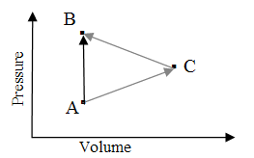
Heat Transfer Mechanisms
Concept Question
Consider the pressure-volume graph shown for an ideal gas that may be taken along one of two paths from state A to state B. Path “1” is directly from A to B via a constant volume path. Path “2” follows the path A−C−B. How does the amount of work done along each path compare?
a) W₁ = W₂ and the value is not equal to zero
b) W₁ = W₂ = 0
c) W₁ > W₂
d) W₁ < W₂
e) It is not possible to compare the work done along each path without knowing the values of the temperature, pressure, and volume for each state.
Notes:
Answer: B

Slide 30
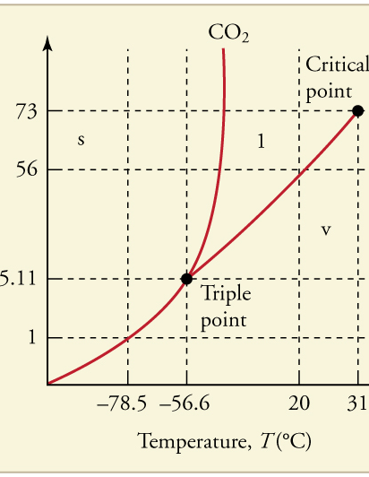
PT Diagram
The phase diagram for carbon dioxide. The axes are nonlinear, and the graph is not to scale. Dry ice is solid carbon dioxide and has a sublimation temperature of – 78.5ºC.

Slide 31
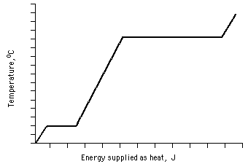
Example Problem
Use the graph below to do the following:
Identify the melting point (MP) and the boiling point (BP). Use 40º increments for y-axis starting with –120 ºC. Label these on the diagram.
Label each region of the heating curve with appropriate terms: solid phase (S), liquid phase (L), gas phase (G), solid-liquid transition (S-L), liquid-gas transition (L-G).

Slide 32
Example Problem
Use the graph below to do the following:
Identify the melting point (MP) and the boiling point (BP). Use 40º increments for y-axis starting with –120 ºC. Label these on the diagram.
Label each region of the heating curve with appropriate terms: solid phase (S), liquid phase (L), gas phase (G), solid-liquid transition (S-L), liquid-gas transition (L-G).
BP = 360 °C
MP = -40 °C

Slide 33
Example Problem
Use the graph below to do the following:
Identify the melting point (MP) and the boiling point (BP). Use 40º increments for y-axis starting with –120 ºC. Label these on the diagram.
Label each region of the heating curve with appropriate terms: solid phase (S), liquid phase (L), gas phase (G), solid-liquid transition (S-L), liquid-gas transition (L-G).
BP = 360 °C
L-G
G
L
MP = -40 °C
S-L
S

Slide 34
Entropy Postulate: If an irreversible process occurs in a closed system, the entropy S of the system always increases; it never decreases.
Changes in energy within a closed system do not set the direction of irreversible processes.
For example, if you were to wrap your hands around a cup of hot coffee, you would be astonished if your hands got cooler and the cup got warmer. That is obviously the wrong way for the energy transfer, but the total energy of the closed system (hands +cup of coffee) would be the same as the total energy if the process had run in the right way.
Irreversible Processes and Entropy:

Slide 35

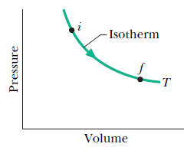
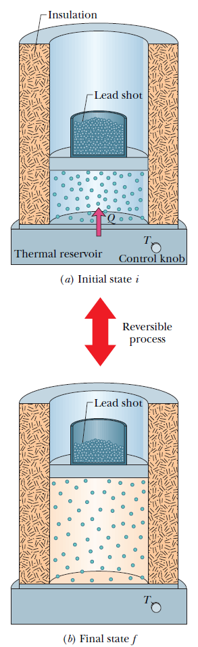

Change in Entropy:
Reversible Process
To find the entropy change for an irreversible process occurring in a closed system, replace that process with any reversible process that connects the same initial and final states, and calculate the entropy change for this reversible process.

Slide 36

The Second Law of Thermodynamics
If a process occurs in a closed system, the entropy of the system increases for irreversible processes and remains constant for reversible processes. It never decreases.
Here the greater-than sign applies to irreversible processes and the equals sign to reversible processes. This relation applies only to closed systems.

Slide 37
Entropy
Concept Question
A leaf is growing on a tree. Does this growth process violate the second law of thermodynamics when it is stated in terms of entropy?
a) Yes, but the law does not apply to living things. It only applies to inanimate objects.
b) Yes, because this law is not applicable in situations involving radiant energy from the Sun.
c) No, because the entropy of the Sun has decreased while the entropy of the leaf increases as it grows.
d) No, because while the entropy of the leaf is decreasing as it grows, there is a net increase in entropy because of the light emitted from the leaf.
e) No, because there is no net increase in the energy of the leaf.
Notes:
Answer: D

Slide 38
Entropy
Concept Question
A tray of water is placed into a freezer. As the water cools, its entropy decreases and eventually it turns to ice. Why doesn’t this process violate the second law of thermodynamics?
a) When the ice is later taken out and melted, the entropy will increase back to what it was before the tray was put into the freezer.
b) The overall entropy increases due to the refrigerator chilling and eventually freezing the water.
c) The entropy of the tray increases to offset the decrease in the entropy of the water.
d) The entropy of the water decreases, but upon freezing it increases to its previous value.
e) The process as described does violate the second law of thermodynamics.
Notes:
Answer: B

