Slide 1
Using Truth Tables for Sentences
PHIL 2020 Day 15 Week 8

Slide 2
Truth Tables
Remember the Order of Operations for Truth Tables
Set up the table by the number of different letters, and lines
The number of lines will be 2^{n}, n is the number of different letters

Slide 3
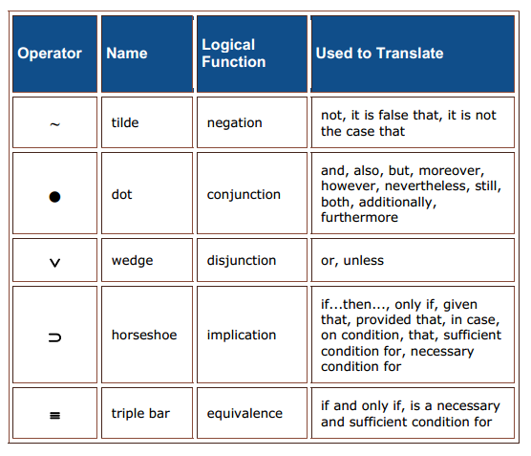
Operators (Both Sets)
Same as:
Hook ¬
Ampersand &
Wedge v
Arrow →
Double Arrow ⇔

Slide 4
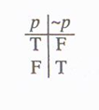
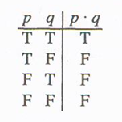
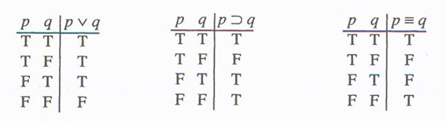
~ • v ⊃ ≡
Truth Functions

Slide 5
Truth Functions written out in English:
~ changes the truth value of whatever it has “scope” over from T to F and from F to T; note that some ~ are on letters and some are on brackets or parentheses.
• is only True if both sides are True, T•T.
v is only False if both sides are False, FvF. If there is even one T on one side, or T on both sides, the v is true.
⊃ is only false in a line where T⊃F, because that’s like a cause happening without the effect. Any other combination of T⊃T, F⊃T, or F⊃F is T for the ⊃.
≡ is T as long as the sides match, T≡T or F≡F is True for the ≡.

Slide 6
Order of Operations when Truth Tabling
~ • v ⊃ ≡
1) Tilde ~ on single letters should be done after the letters themselves are already done.
2) Connectors inside parentheses should be done next, after each side in the parentheses is done.
3) Tilde ~ outside of parentheses should be done next. Make sure you are changing the truth value of the connector column, not a side column.
4) Connectors that are in between two sets of parentheses should be done next.
5) Tilde ~ on big brackets, larger brackets [] and {}

Slide 7
~ • v ⊃ ≡
Truth Functions (how the operators are true or false)

Slide 8
Constructing a Truth Table
The number of lines in the truth table relates to the number of different letters in your sentence.
2 to the n power 2^{n} where n is the number of different letters
2 different letters = 2x2 = 4 lines
3 different letters = 2x2x2 = 8 lines
The first letter has half the lines true, and half the lines false.
The next letter divides those in half again, so if you have an 8 line table with a first letter with four true lines, the second letter will be two true lines, two false lines, and so on.

Slide 9
What are the values of the column for the “dot”?
C | S |  | C | • | S
T | T |  | T |  | T
F | T |  | F |  | T
T | F |  | T |  | F
F | F |  | F |  | F

Slide 10
The complete table for our example:
C | S |  | C | • | S
T | T |  | T | T | T
F | T |  | F | F | T
T | F |  | T | F | F
F | F |  | F | F | F

Slide 11
The basic truth table for conjunction:
p | q |  | p | • | q
T | T |  | T | T | T
F | T |  | F | F | T
T | F |  | T | F | F
F | F |  | F | F | F

Slide 12
What are the values in the column for the “v”?
C | S |  | C | v | S
T | T |  | T |  | T
F | T |  | F |  | T
T | F |  | T |  | F
F | F |  | F |  | F

Slide 13
The complete truth table for our example:
C | S |  | C | v | S
T | T |  | T | T | T
F | T |  | F | T | T
T | F |  | T | T | F
F | F |  | F | F | F

Slide 14
The basic truth table for disjunction:
p | q |  | p | v | q
T | T |  | T | T | T
F | T |  | F | T | T
T | F |  | T | T | F
F | F |  | F | F | F

Slide 15
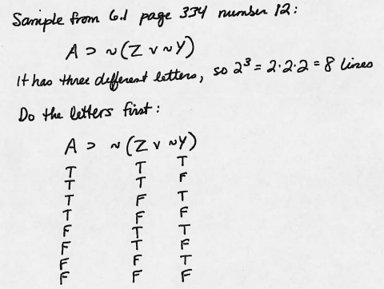

Slide 16
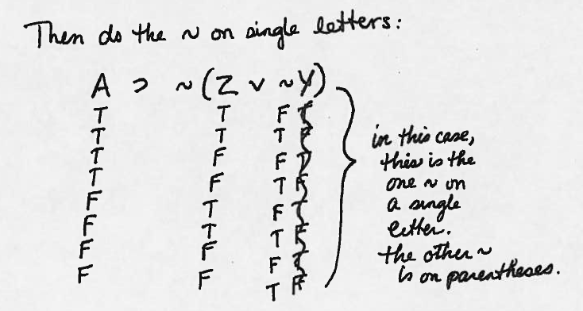

Slide 17
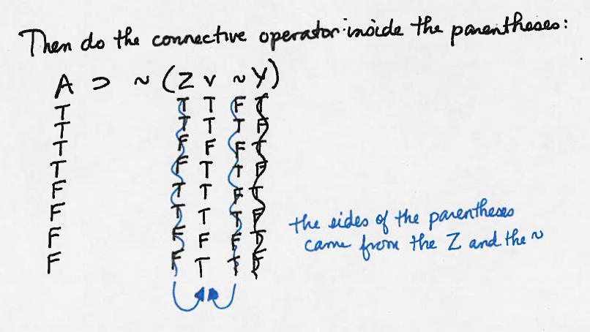

Slide 18
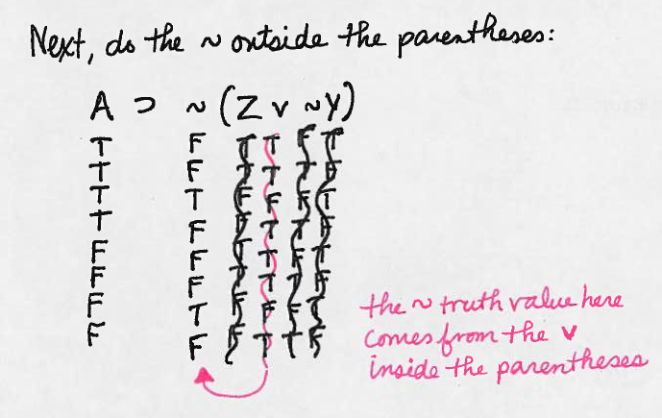

Slide 19
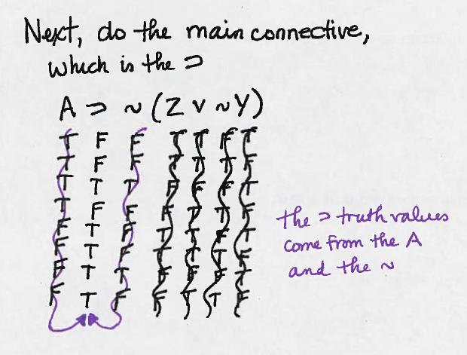

Slide 20
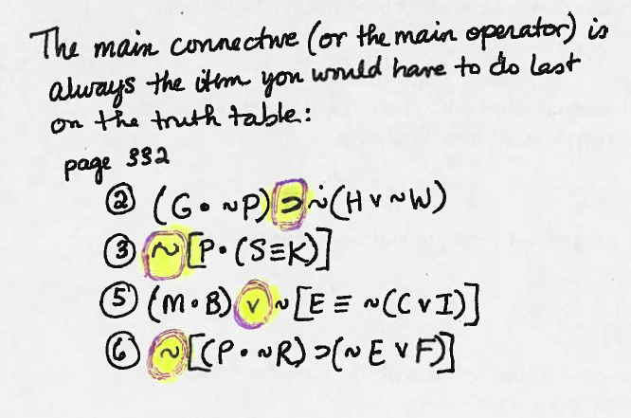

Slide 21
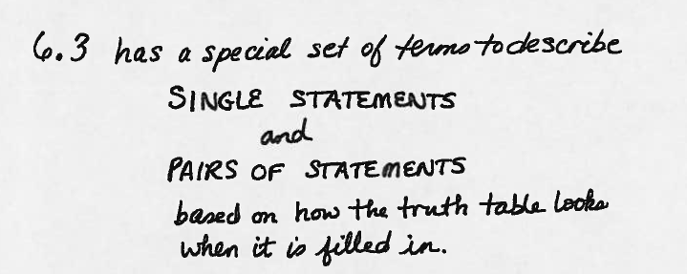

Slide 22
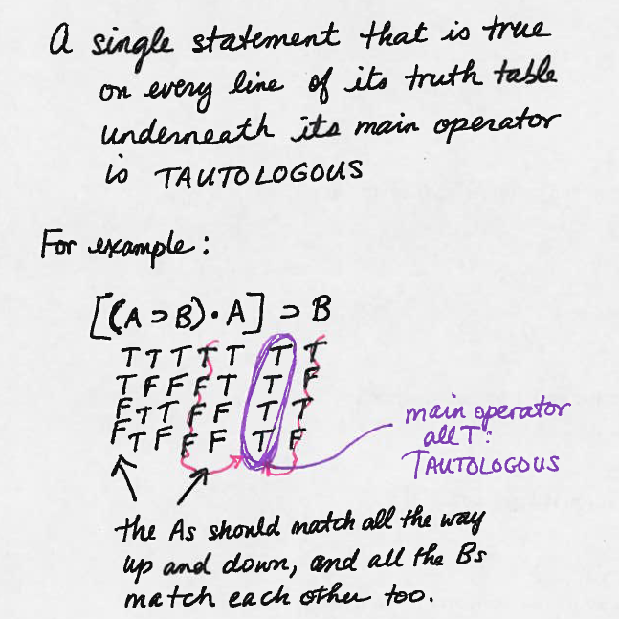

Slide 23
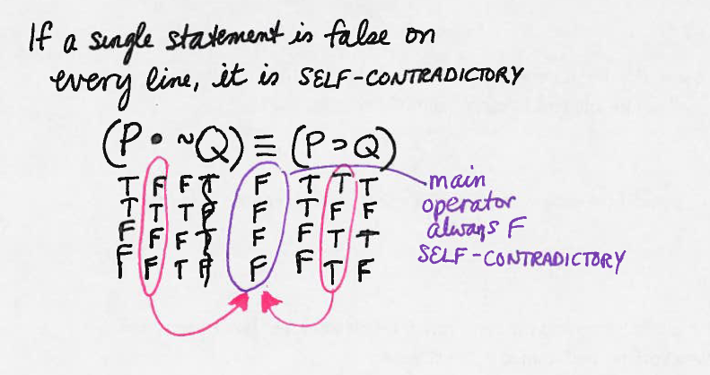

Slide 24
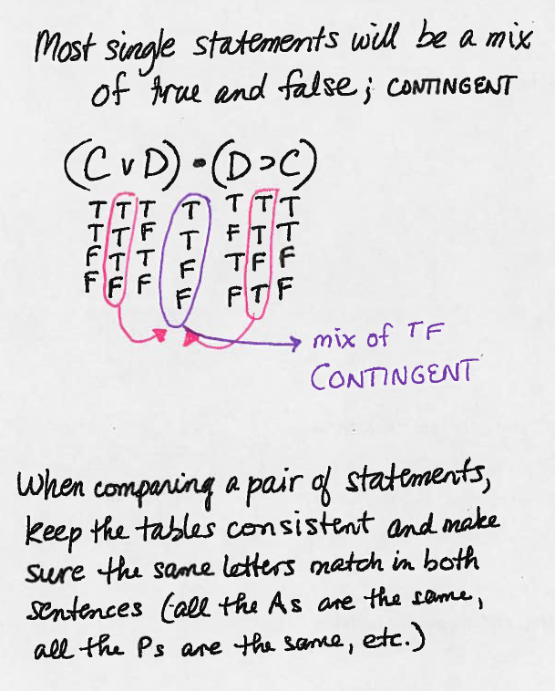

Slide 25
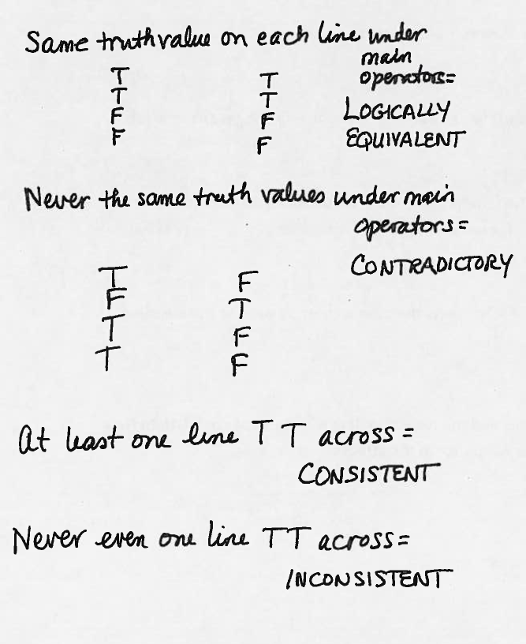

Slide 26
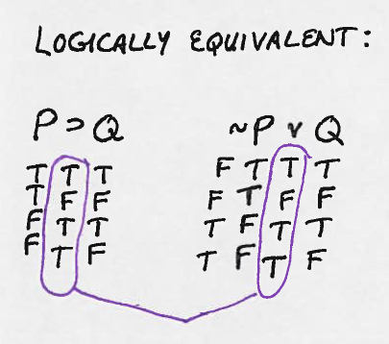

Slide 27
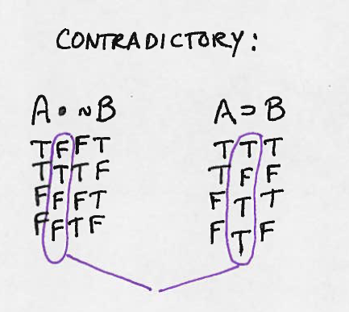

Slide 28
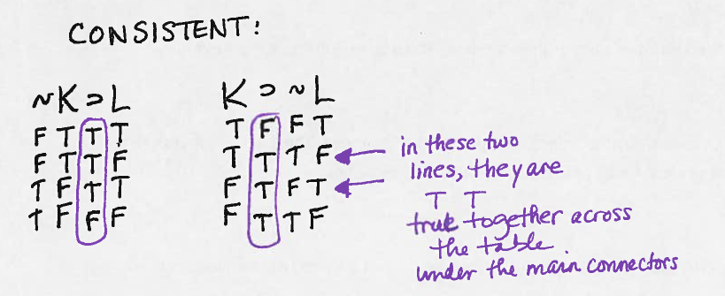

Slide 29
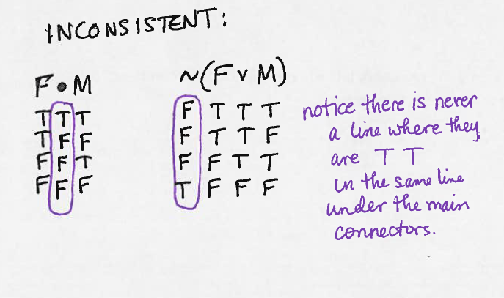

Slide 30
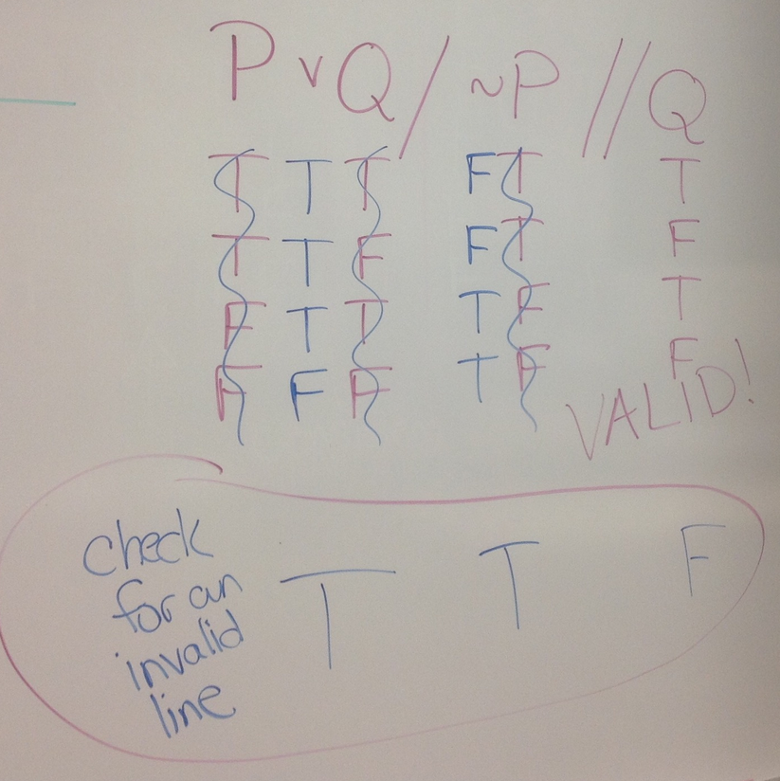
Validity tests for arguments using truth tables
This argument is valid, there is no TT->F line with all true premises and a false conclusion

Slide 31
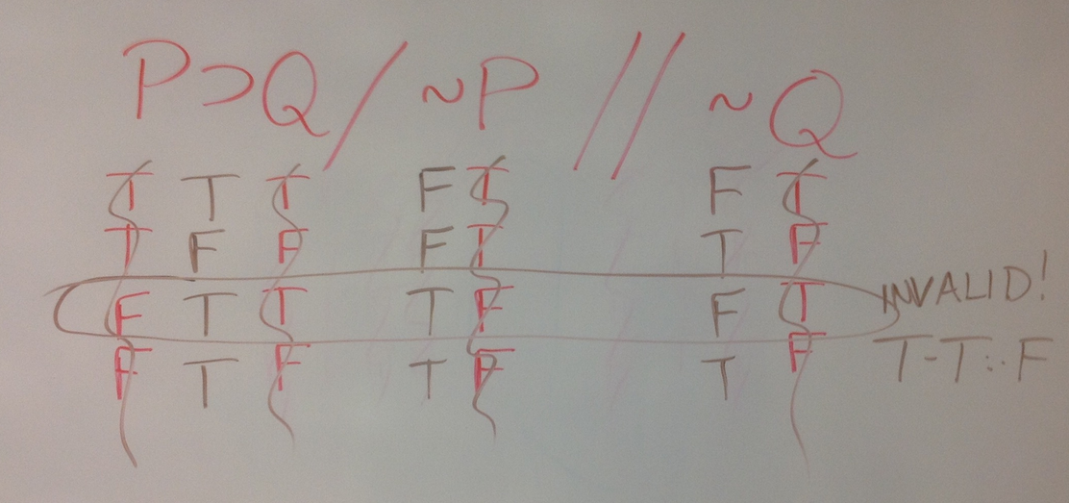
This argument is invalid; there is a line with all true premises and a false conclusion

