Slide 1
Fallacies
Adapted from PowerPoint slides written by Raymond Peace
Instructor, Valdosta State University
Department of Philosophy and Religious Studies

Slide 2
What are Fallacies?
Fallacies are mistakes in reasoning.
There are formal and informal fallacies.
This PowerPoint focuses on the informal fallacies.

Slide 3
As you examine fallacies, keep these points in mind:
To decide which fallacy is committed, it is often helpful to analyze the fallacy example as an argument (i.e., to be clear what the premise(s) and conclusion are).
However, some examples labeled as fallacies are statements, rather than arguments with a premise/conclusion relationship.
There are many, many fallacies; be sure to consider the three main ideas of Sufficiency, Relevance, and Acceptability.

Slide 4
More points to keep in mind regarding fallacies:
Some fallacies have more than one name (for example, false dichotomy is also called the either/or fallacy, the black-and-white fallacy, etc.)
Many fallacies have Latin names, and sometimes the Latin name is still used (for example, Ad Hominem)

Slide 5
Some fallacies can be described as the arguer being too subjective instead of objective
The cardinal virtue in reasoning is objectivity, which is to say a commitment to thinking in accordance with the facts and interpreting them logically, without bias or prejudice.
When someone rejects objectivity, in one way or another, they commit a subjectivist fallacy.
Examples of subjectivist fallacies are appeal to popularity, appeal to pity, and appeal to force.

Slide 6
Appeal to Popularity
Using the fact that large numbers of people believe a proposition to be true as evidence of its truth.
It concludes that a proposition is true because many or all people believe it—its form is: many believe it, therefore, it is so.

Slide 7
Appeal to Popularity (cont.)
This type of argument has many names, including appeal to the majority, appeal to the people (argumentum ad populum, in Latin), and the bandwagon fallacy.
Example:
Most citizens hold that the War was morally right. Therefore, the War was morally right.

Slide 8
Appeal to Pity
Trying to get someone to accept a proposition on the basis of an emotion, instead of on a rational basis.
Instead of evidence and rational argument, this fallacy involves expressive language along with rhetorical devices used to generate emotions such as anger, sympathy, pity, etc.

Slide 9
Appeal to pity (example)
“Yes, persons of the jury, its true that the defendant committed a terrible deed when he embezzled the money, but as you consider the sentence, remember the defendant’s family will suffer greatly if his punishment forces him to be away from them.”

Slide 10
Appeal to Force (argumentum ad baculum)
Trying to get someone to accept a proposition on the basis of a threat.
Example:
Child to parent: “I don’t want to study right now; there’s something good on cable.”
Parent to child: “If you don’t study and make an A on the test, then I’ll cut off your allowance.”

Slide 11
Fallacies Involving Credibility:
Another problem of being subjective instead of objective, when arguers give credit to the wrong person or claim
We rely on information passed on by other people for much of what we know. The value of such evidence depends on the credibility of the source. When we accept a conclusion on the basis of someone's testimony, our reasoning can be diagrammed as follows:
X says p. Therefore, p is true.

Slide 12
Fallacies Involving Credibility (cont.)
If such an argument is to have any logical strength, two assumptions must be true.
First, X must be competent to speak on the subject.
If p is a statement in some technical area, then X must have some expertise in that area.
If it is a statement about some event, X must be someone who was in a position to know what happened.

Slide 13
Fallacies Involving Credibility (cont.)
Second, X must be reporting what he or she knows objectively, without bias, distortion, or deceit. In other words, X must be someone who not only knows the truth, but who also tells the truth.

Slide 14
Appeal to Authority
(argumentum ad verecundiam)
Using testimonial evidence for a proposition when the conditions for credibility are not satisfied, or the use of such evidence is inappropriate.

Slide 15
Appeal to Authority (example)
Curt: “Clearly the government needs to impose more regulation on the banking industry.
Gert: “Why do you think that is so?”
Curt: “The noted novelist, Stephen Z. Koontz, said so in an interview I heard the other day.”

Slide 16
Ad hominem
(verbally attacking the other person)
Using a negative trait of a speaker as evidence that his statement is false or his argument is weak.
Example:
Commentator: “We should ignore what the senator is suggesting about energy conservation, because after all he is a known member of a weird religious group.”

Slide 17
Arguments with a Sufficiency Problem: Fallacies of Context
Fallacies in this category include arguments that "jump to conclusions."
There is a logical gap in these arguments because they fail to consider a wide enough context of information; hence, the name, fallacies of context.

Slide 18
Fallacies of Context
(cont).
The problem is not the premises per se; the premises are relevant to the conclusion; they do provide genuine evidence. But the evidence is simply inadequate or incomplete.
We examine the following fallacies of context: false dichotomy, questionable cause/false cause, hasty generalization, slippery slope.

Slide 19
False Dichotomy
Excluding relevant possibilities without justification, assuming there are only two extreme alternatives.
Example:
“You’re either part of the solution or you’re part of the problem, so we want your vote in our column come election day.”

Slide 20
(False Cause)
Post hoc
Using the fact that one event preceded another as sufficient evidence for the conclusion that the first caused the second.
Example:
“Our team lost the game but the leading scorer forget to wear his old pink socks for good luck, so no wonder we lost.”

Slide 21
Hasty generalization
Inferring a general proposition from an inadequate sample of particular cases.
Example:
“This chicken wing from Wingies I am eating is excellent, so Wingies restaurant has the best chicken wings.”

Slide 22
Slippery Slope
Claiming without sufficient evidence that a proposed action or policy will lead to a series of increasingly bad consequences.
Example:
Voter: “If we vote yes for the 7% tax now, then in two years they’ll be asking for 9%, then in two more 11%. So I’m voting against it.”

Slide 23
Acceptability: Fallacies of Logical Structure
In the previous sections, we examined arguments that are fallacious because they introduce irrelevant considerations into the reasoning process--emotions, threats, personal traits, etc..
In this section, we'll examine fallacies that involve errors within the reasoning process itself.

Slide 24
Acceptability:
Fallacies of Logical Structure
(cont.)
The problem in these arguments is not the premises they use, but the relation between the premises and the conclusion.
We examine these fallacies of logical structure on the following slides: Begging the question; equivocation; appeal to ignorance; and diversion.

Slide 25
Begging the question (circular argument)
Trying to support a proposition with an argument in which that proposition is a premise.
In the fallacy of begging the question, the premise is repeated, either explicitly or implicitly, in the conclusion.
(Currently the phrase “begs the question” is used in everday contexts in which the meaning is essentially “calls for the question” or “brings up the issue” —this usage is different than its association with the fallacy.)

Slide 26
Begging the Question (example)
Bert: “The future will be like the past.”
Curt: “How so?”
Bert: “Because it has always been like the past.”

Slide 27
Equivocation
Using a word in two different meanings in the premises and/or conclusion.
Example:
That hippopotamus is a rather small one, so it is a small animal.

Slide 28
Appeal to ignorance (argumentum ad ignorantiam)
Using the absence of proof for a proposition as evidence for the truth of the opposing proposition.
Example:
Phlogiston must exist, since no one has entirely conclusively demonstrated that it doesn’t exist.

Slide 29
Red Herring
Trying to support one proposition, by arguing for another proposition; instead of addressing the issue, one addresses a different issue.
Often diversion occurs when one is asked a question and instead of answering it, one talks about something else.

Slide 30
Red Herring (example)
Moe: “You should be more careful about your diet with all that junk food you consume.
Jo: “Well, you got to have a little fun sometimes, and not worry about every single calorie.”

Slide 31
Ambiguity: Punny Examples
1. Reportedly, the worker who fell into the upholstery machine is fully recovered ...
2. Sad to say, the origami store in town folded.
3. The two men arrested for drinking battery acid will soon be charged.
4. A friend told me I was average, but he was just being mean . . .
5. Quite appropriately, the cannibal who showed up late to the luncheon was given the cold shoulder.
6. A crossed-eyed teacher may have a very difficult time controlling his pupils . . .
7. Curious as to why the capacitor kissed the diode? Well, he just couldn't resistor...
8. The pint-sized fortune-teller who escaped from prison was, obviously, a small medium at large .....
9. I'm offering up my dead battery ---- free of charge...
10. When the invisible, homely man married the invisible, homely woman, it was apparently inevitable that their children wouldn't be anything to look at either...
11. If a thousand hares escaped from a zoo, would the police comb the area to find them?
12. It is said that babies are delivered by a stork. Of course, the heavier ones must be delivered by a crane.....
13. Hmmm, if a parsley farmer is sued, could they garnish his wages?

Slide 32
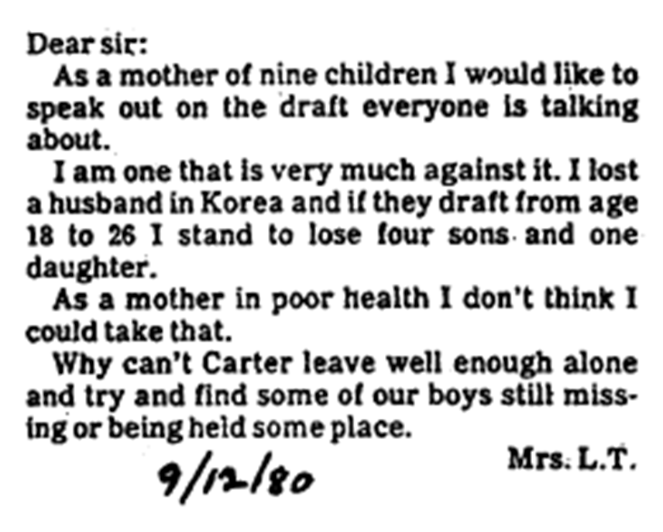
What fallacy is this?

Slide 33

What fallacy is this?

Slide 34
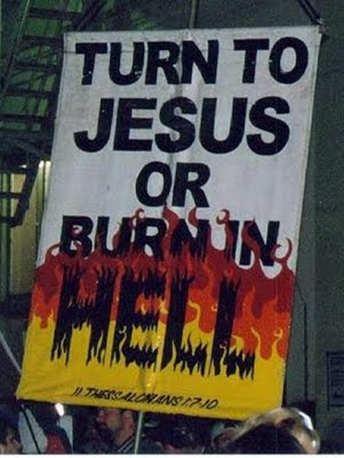
What fallacy is this?

Slide 35
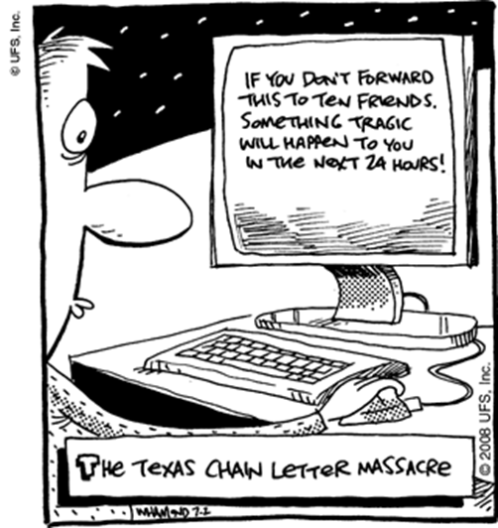
What fallacy is this?

Slide 36
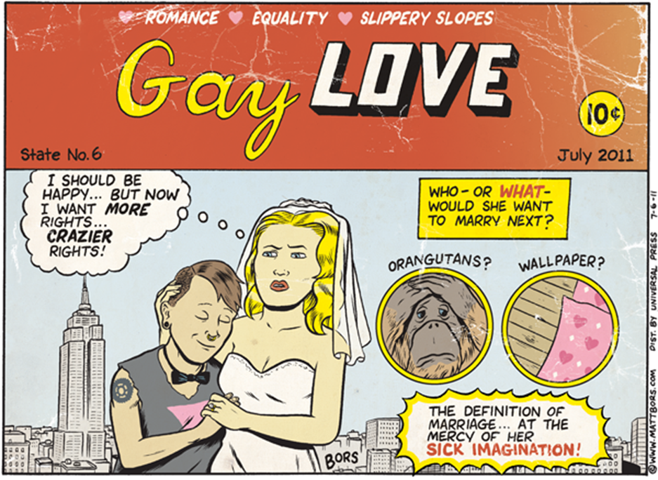
What fallacy is this?

Slide 37
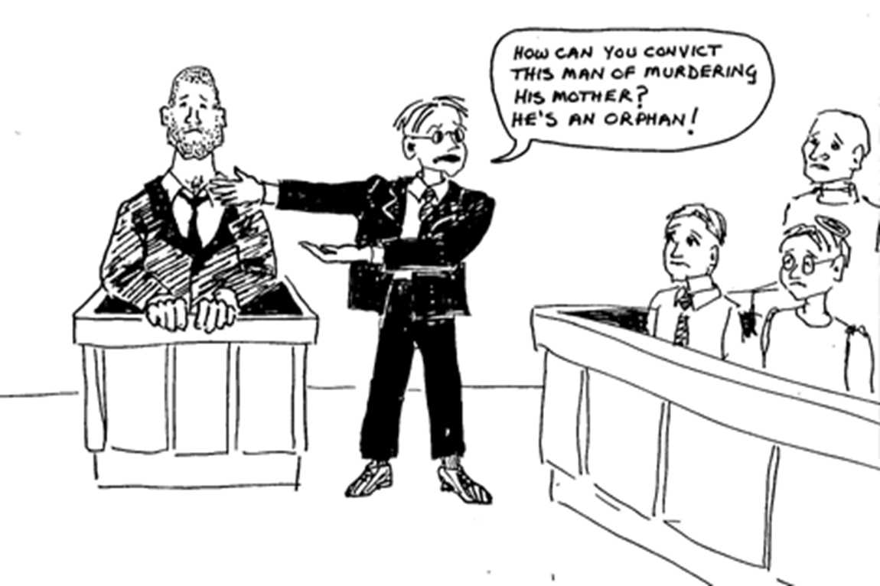
What fallacy is this?

Slide 38
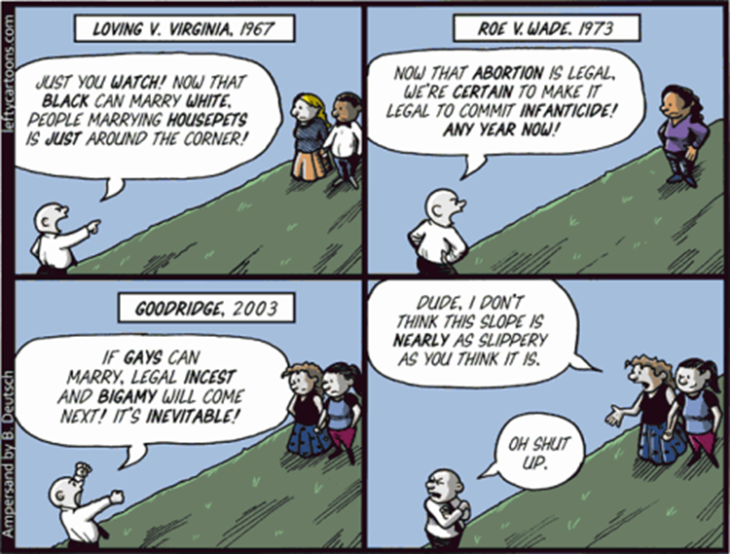
What fallacy is this?

