Slide 1
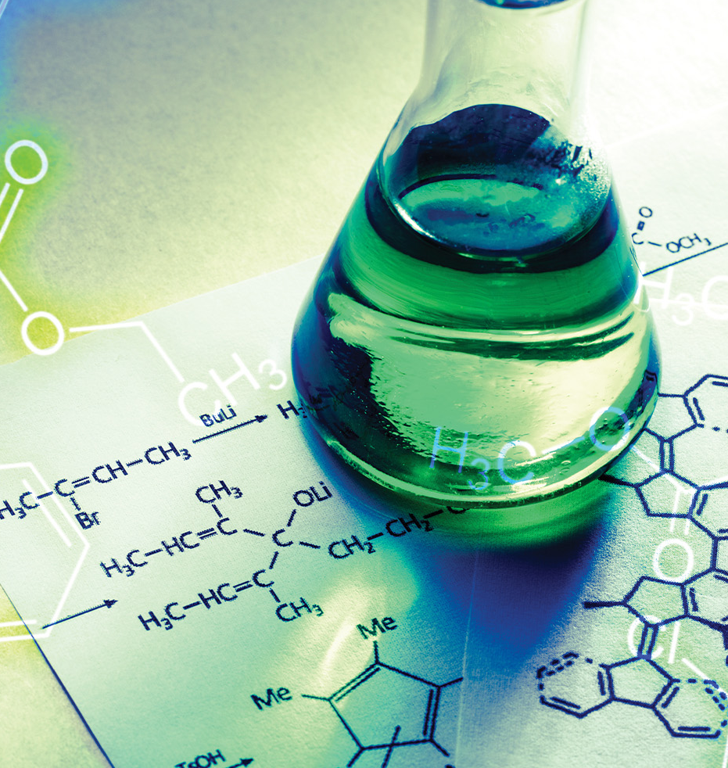
Chemical Energy

Slide 2
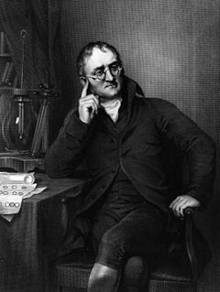
John Dalton
(1766 - 1844)
Stoichiometry – math of how elements combined to form other elements
Dalton found that oxygen & carbon combined to make 2 compounds (1803)
  Each had its own particular weight ratio of oxygen to carbon (1.33:1 and 2.66:1)
  Same amount of carbon, one had exactly twice as much oxygen as the other
Law of simple multiple proportions

Slide 3
Dalton’s Elementary Atomic Theory
  Elements are made of extremely small particles called atoms
  Atoms of a given element are identical in size, mass, and other properties
  Atoms of different elements differ in size, mass, and other properties
  Atoms cannot be subdivided, created, or destroyed
  Atoms of different elements combine in simple whole-number ratios to form chemical compounds
  In chemical reactions, atoms are combined, separated, or rearranged.

Slide 4
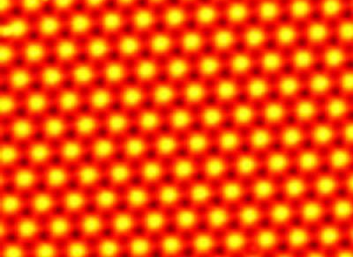
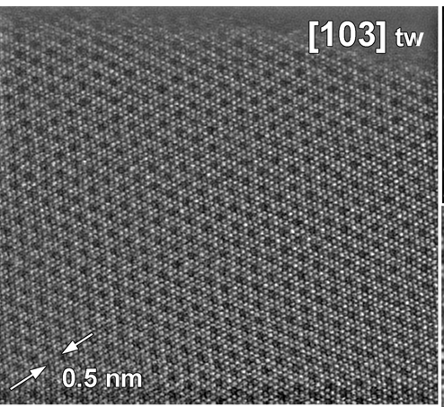
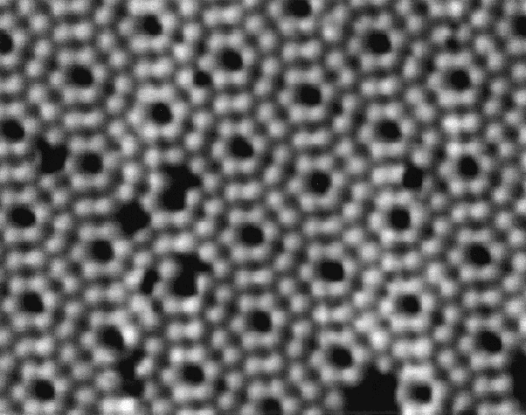
Dalton’s Elementary Atomic Theory
  Elements are made of extremely small particles called atoms.

Slide 5
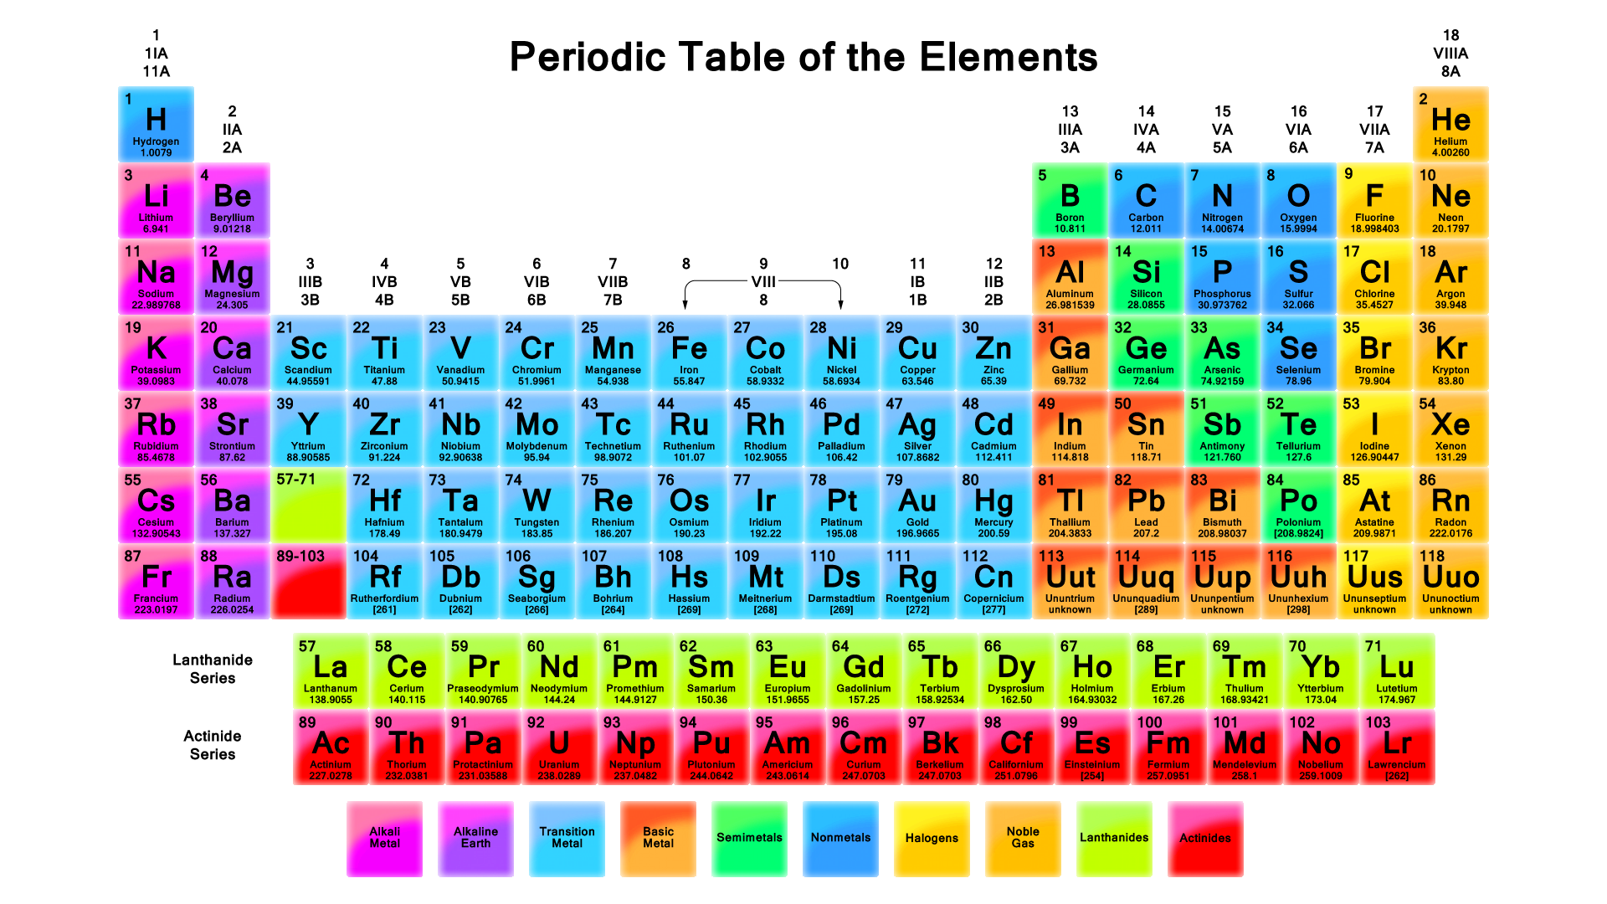
Dalton’s Elementary Atomic Theory
  Atoms of a given element are identical in size, mass, and other properties.
  Atoms of different elements differ in size, mass, and other properties.

Slide 6
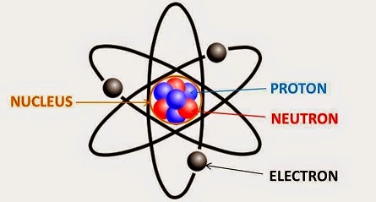
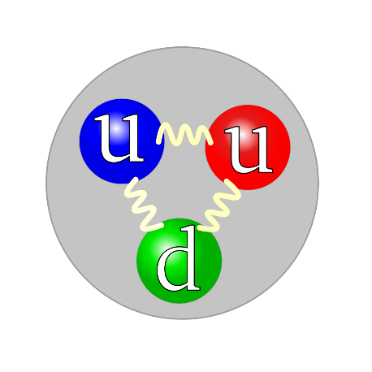
Dalton’s Elementary Atomic Theory
  Atoms cannot be subdivided, created, or destroyed.
  As we saw with the talks on Atomic and Nuclear energy, this assertion is false.
    Atoms are made of protons, neutrons, and electrons
    Protons and neutrons are made of quarks

Slide 7
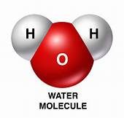
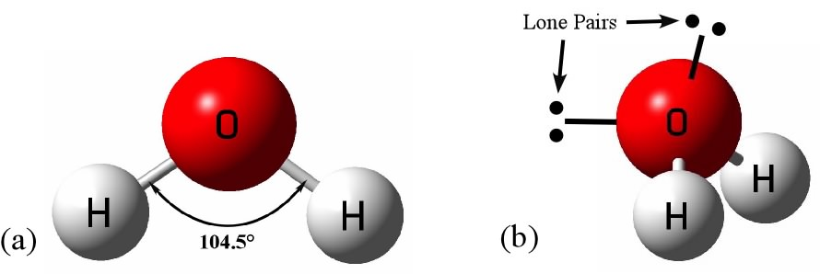
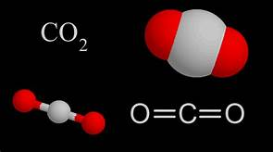
Dalton’s Elementary Atomic Theory
  Atoms of different elements combine in simple whole-number ratios to form chemical compounds.
  Let’s look at two common molecules:
    Water
    Carbon Dioxide

Slide 8
Dalton’s Elementary Atomic Theory
  A chemical reaction is one in which various chemicals, elements, or species react to one another in one of three ways.
  The reactants are the species that start the reaction and the products are the result of the chemical reaction.
  Three common types of reactions:
    Precipitation
      Dissolved substances react to form one or more solid products
    Acid-base
      Hydrogen ion is transferred rom one chemical species to another
    Oxidation-reduction
      A reaction involving the transfer of O₂ molecules

Slide 9
Dalton’s Elementary Atomic Theory
  A balanced chemical equation provides a great deal if information about the interaction of various species.
  Chemical formulas provide the identities of each reactant and product in a chemical reaction.
  Coefficients provide the relative numbers of each species allowing for quantitative assessment of the relationships.
  Stoichiometry is the quantitative part of the relationships.

Slide 10
Concept Question
What does it mean to say an equation is balanced?
An equation is balanced when the same number of each element is represented on the reactant and product sides.
An equation is balanced when the same number of each molecules are represented on the reactant and product sides.
An equation is balanced when the same number of reactants are represented on the product sides.
An equation is balanced when the same number of molecule and atom is represented on the reactant and product sides.
Notes:
Answer: A

Slide 11
Dalton’s Elementary Atomic Theory
  In chemical reactions, atoms are combined, separated, or rearranged.
  An example of chemical reaction using stoichiometry:
    P₄ + O₂ → P₄O₁₀
    I need to get the same number of Phosphorus (P) and Oxygen (O) atoms on both side.
    There are four P on both side, which is good.
    But there are 2 O on one side and 10 on the other. To balance them I need to get 10 on both sides. To do that I need to add a 5.
    P₄ + O₂ → 5P₄O₁₀

Slide 12
Dalton’s Elementary Atomic Theory
  In chemical reactions, atoms are combined, separated, or rearranged.
  An example of chemical reaction using stoichiometry:
    P₄ + O₂ → P₄O₁₀
    I need to get the same number of Phosphorus (P) and Oxygen (O) atoms on both side.
    There are four P on both side, which is good.
    But there are 2 O on one side and 10 on the other. To balance them I need to get 10 on both sides. To do that I need to add a 5.
    P₄ + O₂ → 5P₄O₁₀

Slide 13
Dalton’s Elementary Atomic Theory
  In chemical reactions, atoms are combined, separated, or rearranged.
  An example of chemical reaction using stoichiometry:
    P₄ + O₂ → P₄O₁₀
    I need to get the same number of Phosphorus (P) and Oxygen (O) atoms on both side.
    There are four P on both side, which is good.
    But there are 2 O on one side and 10 on the other. To balance them I need to get 10 on both sides. To do that I need to add a 5.
    P₄ + 5O₂ → P₄O₁₀

Slide 14
Example Problem
Balance the chemical reactions shown below:
H₂ + I₂ → HI
Notice that on the left there are two hydrogens and two iodine atoms. So on the right there have to be two of each. In order for this to happen, and still maintain the outcome of an HI molecule:
H₂ + I₂ → 2HI
Fe + H₂O → Fe₃O₄ + H₂
We need the same number of each element without changing the reaction. I need 4 oxygen molecules:
Fe + 4H₂O → Fe₃O₄ + H₂
Now we need to get 3 iron on each side
3Fe +4H₂O → Fe₃O₄ + H₂
And finally we need to get 8 hydrogens on both sides
3Fe +4H₂O → Fe₃O₄ + 4H₂

Slide 15
Example Problem
Balance the chemical reactions shown below:
H₂ + I₂ → HI
Notice that on the left there are two hydrogens and two iodine atoms. So on the right there have to be two of each. In order for this to happen, and still maintain the outcome of an HI molecule:
H₂ + I₂ → 2HI
Fe + H₂O → Fe₃O₄ + H₂
We need the same number of each element without changing the reaction. I need 4 oxygen molecules:
Fe + 4H₂O → Fe₃O₄ + H₂
Now we need to get 3 iron on each side
3Fe +4H₂O → Fe₃O₄ + H₂
And finally we need to get 8 hydrogens on both sides
3Fe +4H₂O → Fe₃O₄ + 4H₂

Slide 16
Example Problem
Balance the chemical reactions shown below:
H₂ + I₂ → HI
Notice that on the left there are two hydrogens and two iodine atoms. So on the right there have to be two of each. In order for this to happen, and still maintain the outcome of an HI molecule:
H₂ + I₂ → 2HI
Fe + H₂O → Fe₃O₄ + H₂
We need the same number of each element without changing the reaction. I need 4 oxygen molecules:
Fe + 4H₂O → Fe₃O₄ + H₂
Now we need to get 3 iron on each side
3Fe +4H₂O → Fe₃O₄ + H₂
And finally we need to get 8 hydrogens on both sides
3Fe +4H₂O → Fe₃O₄ + 4H₂

Slide 17
Example Problem
Balance the chemical reactions shown below:
H₂ + I₂ → HI
Notice that on the left there are two hydrogens and two iodine atoms. So on the right there have to be two of each. In order for this to happen, and still maintain the outcome of an HI molecule:
H₂ + I₂ → 2HI
Fe + H₂O → Fe₃O₄ + H₂
We need the same number of each element without changing the reaction. I need 4 oxygen molecules:
Fe + 4H₂O → Fe₃O₄ + H₂
Now we need to get 3 iron on each side
3Fe +4H₂O → Fe₃O₄ + H₂
And finally we need to get 8 hydrogens on both sides
3Fe +4H₂O → Fe₃O₄ + 4H₂

Slide 18
Example Problem
Balance the chemical reactions shown below:
H₂ + I₂ → HI
Notice that on the left there are two hydrogens and two iodine atoms. So on the right there have to be two of each. In order for this to happen, and still maintain the outcome of an HI molecule:
H₂ + I₂ → 2HI
Fe + H₂O → Fe₃O₄ + H₂
We need the same number of each element without changing the reaction. I need 4 oxygen molecules:
Fe + 4H₂O → Fe₃O₄ + H₂
Now we need to get 3 iron on each side
3Fe +4H₂O → Fe₃O₄ + H₂
And finally we need to get 8 hydrogens on both sides
3Fe +4H₂O → Fe₃O₄ + 4H₂

Slide 19
What is chemical energy and where is it stored?
Chemical energy - the potential of a substance to undergo a chemical reaction
Chemical energy is stored in the bonds between different atoms within molecules
Breaking or making chemical bonds involves the use of energy which may either be absorbed or emitted during the reaction

Slide 20

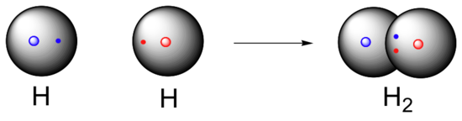
What are the different types of chemical bonds?
Covalent bonds
A bond that forms due to a mutual attraction of atoms for a shared pair of electrons.
Both atoms must have tendency to attract electrons to themselves.
An example is molecular hydrogen (H₂)

Slide 21
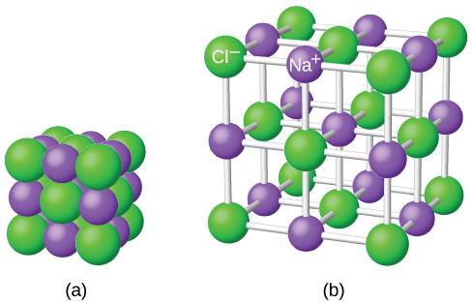
What are the different types of chemical bonds?
Ionic bonds
The bonds between ions in compounds typically known as ionic compounds or salts.
Electrostatic attraction of oppositely charged ions by transfer of electrons
An example of one is Sodium Chloride (NaCl) or common table salt

Slide 22
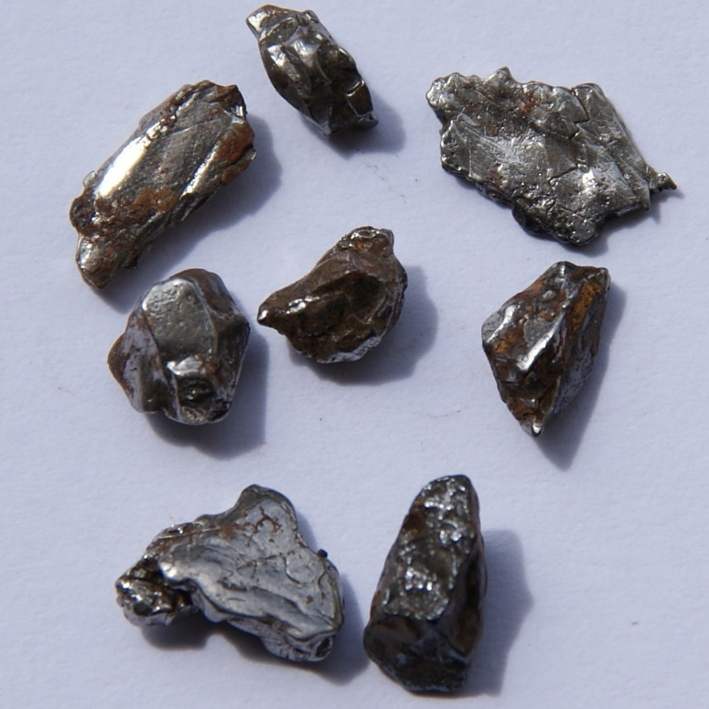
What are the different types of chemical bonds?
Metallic bonds
A bond that form from the electrostatic attractive force between conduction electrons and positively charged metal ions
Accounts for many of the physical properties of metals
An example are ion alloys

Slide 23

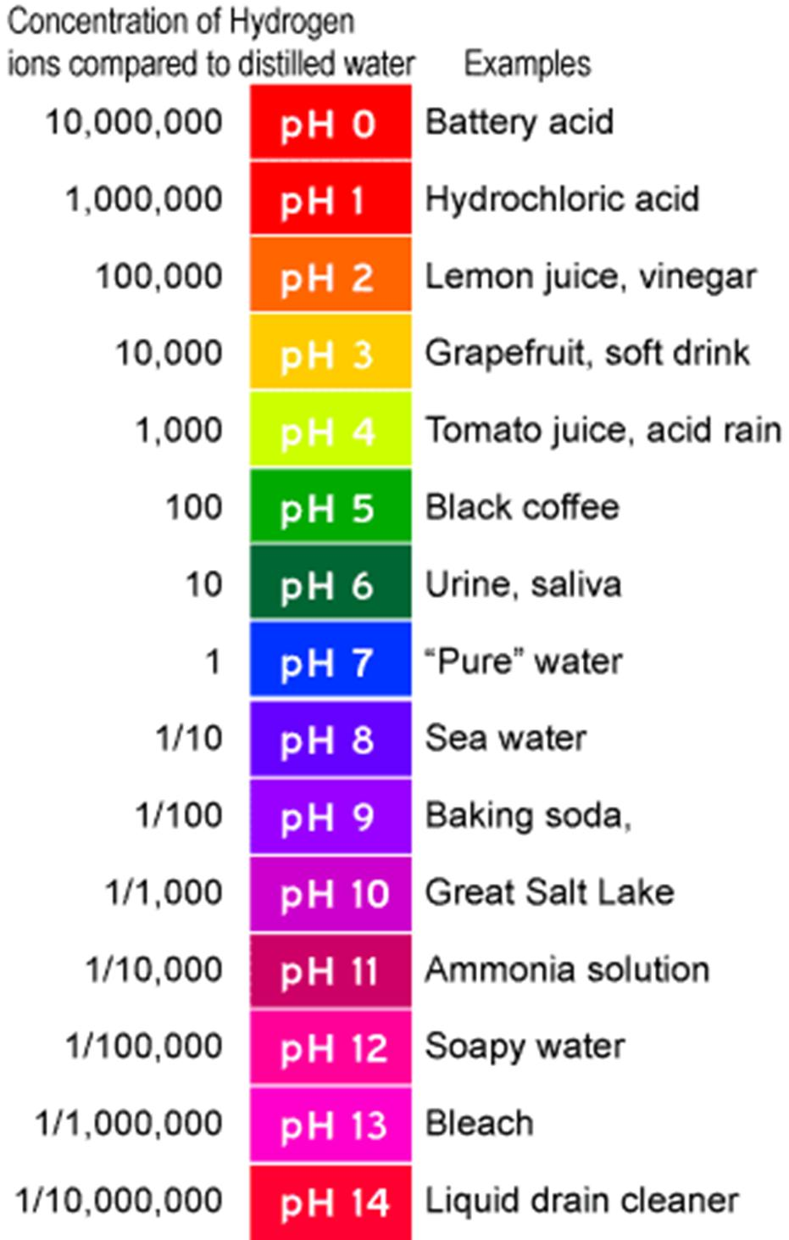
More on Chemical Reactions
pH Scale
Every aqueous solution contains both hydroxide (OH⁻) and hydronium (H₃O⁺).
The amount of hydronium in a system determines where a substance exists on the pH scale.
Defined as pH = -log[H₃O⁺]

Slide 24
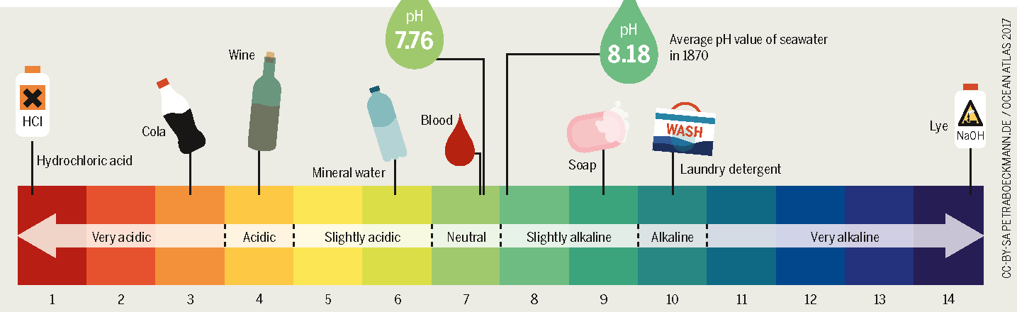
More on Chemical Reactions
When a substance has more hydronium it is called an acid.
When a substance has more hydroxide is called a base
When a substance has equal amounts of hydronium and hydroxide is neutral.

Slide 25
Concept Question
What is the difference between acids and bases?
An acid donates a hydrogen atom and a base will receive a hydrogen atom.
A base donates a hydrogen atom and an acid will receive a hydrogen atom.
An acid donates a hydrogen ion and a base will receive a hydrogen ion.
A base donates a hydrogen ion and an acid will receive a hydrogen ion.
Notes:
Answer: C

Slide 26
Example Problem
Using the table below identify if the substance is slightly acidic, acidic, strongly acidic, slightly basic, basic, strongly basic, or neutral.
Substance | pH Scale | Acid, base or neutral
Hand Soap | 9.5
Coca Cola | 2.5
Water | 7
Red Bull | 3.4
Evian water | 8.1
Bleach | 12.5
Milk | 6.8

Slide 27
Example Problem
Using the table below identify if the substance is slightly acidic, acidic, strongly acidic, slightly basic, basic, strongly basic, or neutral.
Substance | pH Scale | Acid, base or neutral
Hand Soap | 9.5 | Basic
Coca Cola | 2.5 | Strongly Acidic
Water | 7
Red Bull | 3.4
Evian water | 8.1
Bleach | 12.5
Milk | 6.8

Slide 28
Example Problem
Using the table below identify if the substance is slightly acidic, acidic, strongly acidic, slightly basic, basic, strongly basic, or neutral.
Substance | pH Scale | Acid, base or neutral
Hand Soap | 9.5 | Basic
Coca Cola | 2.5 | Strongly Acidic
Water | 7 | Neutral
Red Bull | 3.4 | Acidic
Evian water | 8.1 | Slightly Basic
Bleach | 12.5 | Strongly Basic
Milk | 6.8 | Slightly Acidic

