Slide 1
Propostions, Arguments, Premises, Conclusions, Deduction, Induction, etc.

Slide 2
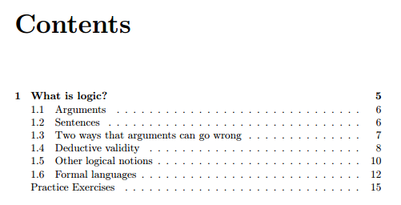
ForAllx (the open source linked pdf)
This PowerPoint is meant to go along with the linked reading in Unit 2, ForAllx Chapter 1
http://www.fecundity.com/codex/forallx.pdf

Slide 3
Remember the parts of arguments
Statements, propositions that can be found to be true or false
Propositions have to be declarative descriptive statements, not questions or commands
Premises (evidence for a claim)
Conclusion (the major claim itself)

Slide 4
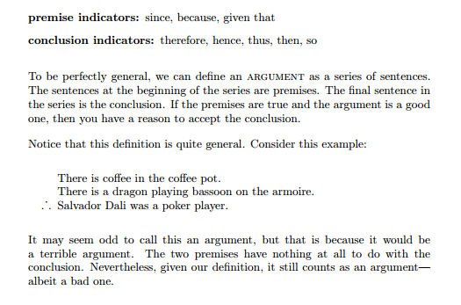

Slide 5
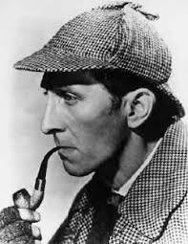
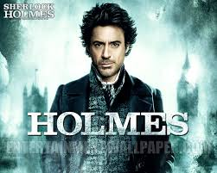
Elementary deduction, my dear Watson… (Sherlock Holmes)
Just be careful, because sometimes when Holmes mentions deduction, he’s actually been doing an inductive causal inference. That’s how college makes you think!
Notes:
Make sure the sound is turned off before beginning this PP.

Slide 6
Deduction:
the type of argument in which the premises are meant to be providing such solid support that the conclusion should be inescapable, necessary, no other choice.
The rare earths appear in a particular row near the bottom of the periodic table, and Cerium appears in that particular row near the bottom of the periodic table. Cerium is a rare earth.

Slide 7
Induction:
the type of argument in which
the conclusion is supposed to follow from
the premise(s) with probability or likelihood.
John is a Republican, and many Republicans voted for Romney, so he probably voted for Romney.

Slide 8
Evaluating Arguments
A key goal of logic is to provide standards for measuring the degree to which the premises support the conclusion.
Assessing the degrees of support of the premises for the conclusion involves a variety of techniques that we shall be encountering.

Slide 9
Evaluating Arguments (cont.)
To have a good argument, the premises must sufficiently support the conclusion, and the premises must actually be true.
Determining whether the premises are actually true, we must appeal either to facts that we know directly through our experiences and observations, or to facts we know through credible sources and expert opinion.

Slide 10
Induction and Deduction
Assessing the support for the conclusion depends upon whether we have an inductive or a deductive argument.
Good deductive arguments have conclusions that follow necessarily or that must follow.
Inductive arguments have conclusions that are probable or likely to some degree.

Slide 11
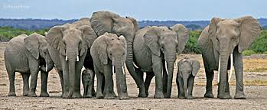
Inductive arguments
Here’s an example of an inductive argument:
  The elephants in the zoo are gray.
  The elephants in the pictures in National Geographic magazine are gray.
  The elephants in the movie “African Queen” are gray.
  Therefore, all elephants are gray.
The conclusion “All elephants are gray” is likely to some degree based on the premises, but the premises do not guarantee that every elephant is gray, which is to say that the argument is inductive.
Notice that in an inductive argument more supporting evidence can strengthen the conclusion—for instance if we have the additional premises that “All the elephants in Barnum’s Circus are gray”.

Slide 12
Deductive Arguments
Deductive arguments can be assessed as either valid or invalid.
The basis of validity is the form of the argument.

Slide 13
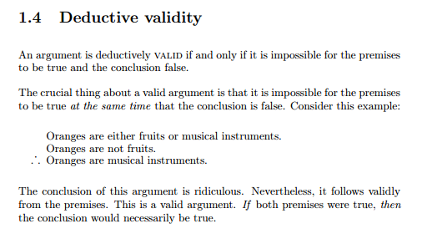

Slide 14
A Question for You:
What conclusion would you draw from these premises?
All ducks are birds, and
all mallards are ducks;
therefore, ________________.

Slide 15
Some possibilities----
All birds are ducks?
All ducks are mallards?
All mallards are mallards?
All birds are mallards?
All mallards are birds?
All birds have feathers?

Slide 16
The best answer----
All ducks are birds, and
All mallards are ducks,
Therefore, all mallards are birds.
Why does this work better than the other choices? Discuss.

Slide 17
Types of Deductive Arguments
Arguments based on Definitions
Arguments based on Math
Syllogisms
  Categorical Syllogism
  Hypothetical Syllogism
  Disjunctive Syllogism

Slide 18
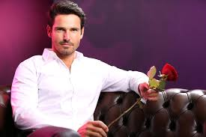
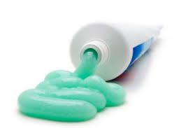
Arguments based on Definitions
A bachelor is an unmarried man. Bob is a man, and Bob is unmarried, so Bob is a bachelor.
A toothpaste is a dentifrice. Crest is a toothpaste, therefore Crest is a dentifrice.

Slide 19
Arguments based on Math
Mark has twice as many cats as Susan. Susan has 3 cats; therefore, Mark has 6 cats.
The area of a circle is π × r². This circle has a r (radius) of 3. Therefore the area of the circle is π × 3².
  Remember that these arguments should come from facts in math knowledge, not percentages or odds or likelihood of some event.

Slide 20
Categorical Syllogism
All students are rich, and students are rich people, and some students do volunteer work. Therefore, some rich people do volunteer work.
Some philosophers were from Athens, and all people from Athens enjoy olives. Therefore, some philosophers enjoy olives.

Slide 21
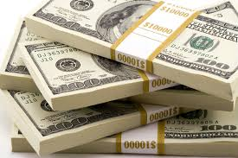
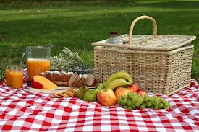
Hypothetical Syllogism (if..then..)
If I do not wake up, then I cannot go to work. If I cannot go to work, then I will not get paid. Therefore, if I do not wake up, then I will not get paid.
If it rains, we will not have a picnic. If we don't have a picnic, we won't need a picnic basket. Therefore, if it rains, we won't need a picnic basket.

Slide 22
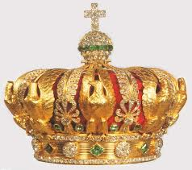
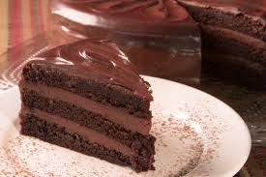
Disjunctive Syllogism (either…or)
Either Logic is the most important course you will take in college or I am the queen of England. I am not the queen of England; therefore, Logic is the most important course you will take in college.
The cake has either chocolate or vanilla frosting. The cake does not have vanilla frosting. Therefore, the cake has chocolate frosting.

Slide 23
Inductive Arguments
Words like “necessary” or “it must be the case that” usually indicate a deductive argument.
Words like “probably” or “likely” most often indicate that the argument is inductive.

Slide 24
Types of Inductive Arguments
Prediction
Arguments from Analogy
Generalization
Arguments from Authority
Arguments based on Signs
Causal Inference (inferring what caused an effect)

Slide 25
Prediction
In the past when we have had unusually warm winters we have had problems with fire ants in the summer. Since we are having an unusually warm winter this year, next summer we will have problems with fire ants.
The summer in Death Valley always includes at least ten days above 100 degrees. This summer in Death Valley there will be at least ten days above 100 degrees.

Slide 26
Argument from Analogy
Katie and Elizabeth are both from California,
taking Sociology and wearing flip-flops. I know Katie is a vegetarian, so Elizabeth is probably a vegetarian too.
Coleridge is a poet from England, and Blake is a poet from England. Their poems are surely very similar.

Slide 27
Generalization
Every class I have taken in the English department has been a piece of cake, so all English classes are probably easy.
All the people I know who are members of the Democratic party are in favor of campaign finance reform. All members of the Democratic party are likely to be in favor of campaign finance reform.

Slide 28
Argument from Authority
Bush says that the war in Iraq was justified, so it is justified.
The Pope says that the best flavor of ice cream is vanilla, so I believe that vanilla is the best flavor of ice cream.

Slide 29
Argument based on Signs
(Literally, a sign or a plaque that says something.)
This sign says this is room 104. This must be room 104.
This historical marker says a famous civil war battle happened here. It must have happened here.
This sign says George Washington slept here. George Washington must have slept here!

Slide 30
Causal Inference
It is raining, so the shoes I left in the yard are probably wet.
There is honey in the beehive, so the bees likely made the honey.
There is police tape across the entrance to that building. Perhaps there was a police investigation happening here today.

Slide 31
Deductive and Inductive
Argument based on Mathematics
Argument from Definition
Categorical Syllogism
Hypothetical Syllogism
Disjunctive Syllogism
Prediction
Argument from Analogy
Generalization
Argument from Authority
Argument based on signs
Causal Inference

Slide 32
Evaluating Deductions
Question 1: If you hypothetically accept the premises, do you then have to accept the conclusion?
(Pretend you are living in the imaginary world the premises create, just for a minute.)
If yes, the argument is VALID.
If no, the argument is INVALID.
This is separate from
Question 2: Are the premises each really true?
If all premises are true as statements on their own, SOUND.
If there is even one false premise, UNSOUND.

Slide 33
Example:
Spiders are reptiles, and All reptiles are democrats, so some Spiders are democrats.
Categorical Syllogism, Deductive
If we accept the premises (Spiders are reptiles, and reptiles are democrats in this world) then we do have to accept the conclusion: VALID.
But, the premises are not all true (spiders are not reptiles, and reptiles don’t appear to have a political party affiliation) so UNSOUND.

Slide 34
Officially:
Once you see that an a deductive argument is unsound, it has to also be considered invalid.
However for the sake of our exam on Unit 1, please do note the argument had a valid structure in which the premises would have made the conclusion true if the premises had been true.
You can write VALID and then strike through it as in VALID

Slide 35
More examples for you to do:
Jones is a citizen because she can vote, and only citizens can vote.
If Ronald Reagan was assassinated, then he’s dead. So he must have been assassinated, since he’s dead.
All tooth fillings are made of metal amalgam, and Mary has tooth fillings. Therefore Mary has metal amalgam tooth fillings.

Slide 36
Evaluating Inductions
Question 1: If you hypothetically accept the premises, do you then find the conclusion has a strong likelihood of being true?
(Pretend you are living in the imaginary world the premises create, just for a minute.)
If yes, the argument is STRONG.
If no, or low likelihood, the argument is WEAK.
This is separate from
Question 2: Are the premises each really true?
If all premises are true as statements on their own, COGENT.
If there is even one false premise, UNCOGENT.

Slide 37
Example:
The next President is probably going to be male, since all Presidents so far have been male.
Inductive, Prediction
If we accept the premise, that all Presidents so far have been male, then it does seem to be quite strong that the next one will be male.
The premise is actually true, all Presidents so far have been male, so it is cogent as well.

Slide 38
Another Example:
Turner is an orthodontist, so he’s probably homeless.
Inductive: Generalization
Weak (being an orthodontist does not give strong evidence for being homeless also)
Cogent (we can say it is cogent, we can assume the premise is true that there actually is some orthodontist named Turner)

Slide 39
Remember:
The two questions are separate:
1. Do the premises give sufficient reason for the conclusion, if you pretend the premises are accurate for the sake of argument?
2. Are the premises actually true on their own?

Slide 40
Types
Deduction
Induction
Arguments based on Math
  Literally facts from math
Arguments based on Definitions
  Terms defined in the argument
Categorical Syllogism
  3 categories, 3 statements
Hypothetical Syllogism
  If—then conditions being met, usually 3 conditional if—then statements
Disjunctive Syllogism
  Either- or choice being made, usually 3 statements as well
Prediction
  Claims about future events
Arguments from Analogy
  Two things are compared and said to be alike in a new way too
Generalization
  Moving from group-individual claims or individual-group
Arguments from Authority
  Usually one individual is named who is well known, a claim about agreeing with them is made
Arguments based on Signs
  Literally a sign or a plaque is claimed to tell the truth
Causal Inference (inferring what caused an effect)
  Seeing some effect or evidence, and then inferring who did it or what did it as in Sherlock Holmes mysteries

Slide 41
What do you think?
1. Joe must own at least ten DVD’s, because he’s been buying one a week since he got that DVD player in June.
2. All cats are mammals, and no mammals are fish, so no cats are fish.
3. Either we’ll get Chinese or Thai. But Thai Café is closed today, so we’ll have to get Chinese.
4. The Bobcats will probably come in last place this year because they are a terrible team.
5. Smith must have been smoking in the company front yard again, he’s the only person here who smokes Camels and these are all Camel cigarette butts in the yard.
6. The world is like a huge machine made up of smaller machines, and since machines have intelligent creators, the world must have one too.
7. Philosophers always write both fiction and non-fiction. After all, Sartre and Rousseau both wrote fiction and non-fiction.

