Slide 1
What is Energy?

Slide 2

What is Energy
Definition: Energy is a scalar quantity associated with the state (or condition) of one or more objects.
Some characteristics:
Energy can be transformed from one type to another and transferred from one object to another.
The total amount of energy is always the same (energy is conserved).
In this lecture, we are going to look at mechanical energy which comes in two parts: Kinetic Energy and Potential Energy

Slide 3

Kinetic Energy
Kinetic energy K is energy associated with the state of motion of an object. The faster the object moves, the greater is its kinetic energy.
For an object of mass m whose speed v is well below the speed of light,
The SI unit of kinetic energy (and every other type of energy) is the joule (J),
1 joule = 1 J = 1 kg·m²/s².

Slide 4
Kinetic Energy
Concept Question
Two balls of equal size are dropped from the same height from the roof of a building. One ball has twice the mass of the other. When the balls reach the ground, how do the kinetic energies of the two balls compare?
The lighter one has one fourth as much kinetic energy as the other does.
The lighter one has one half as much kinetic energy as the other does.
The lighter one has the same kinetic energy as the other does.
The lighter one has twice as much kinetic energy as the other does.
The lighter one has four times as much kinetic energy as the other does
Notes:
Answer: B

Slide 5
Example Problem
A car is traveling at 15 m/s and has a KE of 200 kJ. What is the KE of the car have as the velocity is changed to 30 m/s and 45 m/s?

Slide 6
Example Problem
A car is traveling at 15 m/s and has a KE of 200 kJ. What is the KE of the car have as the velocity is changed to 30 m/s and 45 m/s?
Remember KE is defined as
So, if the velocity increases by a factor of C, the kinetic energy will increase by a factor of C². Notice that 30 m/s is twice the initial speed of 15 m/s. So, C = 2 in this case (30/15 = 2).
Thus,
KE₂ = C²*KE₁ = 2²* 200 kJ = 4* 200 kJ = 800 kJ

Slide 7
Example Problem
A car is traveling at 15 m/s and has a KE of 200 kJ. What is the KE of the car have as the velocity is changed to 30 m/s and 45 m/s?
Remember KE is defined as
So, if the velocity increases by a factor of C, the kinetic energy will increase by a factor of C². Notice that 30 m/s is twice the initial speed of 15 m/s. So, C = 2 in this case (30/15 = 2).
Thus,
KE₂ = C²*KE₁ = 2²* 200 kJ = 4* 200 kJ = 800 kJ
If the velocity is now 45 m/s, that’s 3 times the original speed of 15 m/s. This means KE₃ = C²*KE₁ = 3²* 200 kJ = 9* 200 kJ = 1800 kJ

Slide 8

Work
Work, W, is energy transferred to or from an object by means of a force acting on the object.
Energy transferred to the object is positive work, and energy transferred from the object is negative work.

Slide 9
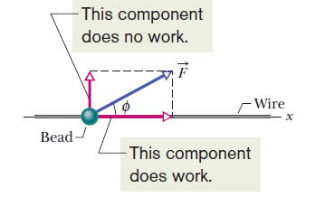


Work
To calculate the work a force F does on an object as the object moves through some displacement d, or Δx, we use only the force component along the object’s displacement. The force component perpendicular to the displacement direction does zero work.
For a constant force F, the work done W is:
A constant force directed at angle φ to the displacement (in the x-direction) of a bead does work on the bead. The only component of force taken into account here is the x-component.
When two or more forces act on an object, the net work done on the object is the sum of the works done by the individual forces.

Slide 10
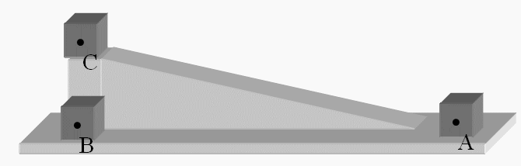
Work
Concept Question
Consider the box in the drawing. We can slide the box up the frictionless incline from point A and to point C or we can slide it along the frictionless horizontal surface from point A to point B and then lift it to point C. How does the work done on the box along path A-C,W_{AC}, compare to the work done on the box along the two step path A-B-C, W_{ABC}?
W_{ABC} is much greater than W_{AC}.
W_{ABC} is slightly greater than W_{AC}.
W_{ABC} is much less than W_{AC}.
W_{ABC} is slight less than W_{AC}.
The work done in both cases is the same.
Notes:
Answer: E

Slide 11



Power
The time rate at which work is done by a force is said to be the power due to the force. If a force does an amount of work W in an amount of time t, the average power due to the force during that time interval is
or
The SI unit of power is the Watt (W).
In the British system, the unit of power is the footpound per second. Often the horsepower is used.

Slide 12
Example Problem
How much work is done if an applied force of 500 N moves an object 7.25 m?
What is power output of an engine performing 4000J of work in 5 s?
How much work is done to lift an object weighing 400 N to a height of 3 m?
How much power is required to lift the 300 N object 2m in 3 s?

Slide 13
Example Problem
How much work is done if an applied force of 500 N moves an object 7.25 m?
  W = F * d = 500 N * 7.25 m = 3,625 J
What is power output of an engine performing 4000J of work in 5 s?
How much work is done to lift an object weighing 400 N to a height of 3 m?
How much power is required to lift the 300 N object 2m in 3 s?

Slide 14
Example Problem
How much work is done if an applied force of 500 N moves an object 7.25 m?
  W = F * d = 500 N * 7.25 m = 3,625 J
What is power output of an engine performing 4000J of work in 5 s?
  P = W/Δt = 4000 J/5s = 800 W
How much work is done to lift an object weighing 400 N to a height of 3 m?
How much power is required to lift the 300 N object 2m in 3 s?

Slide 15
Example Problem
How much work is done if an applied force of 500 N moves an object 7.25 m?
  W = F * d = 500 N * 7.25 m = 3,625 J
What is power output of an engine performing 4000J of work in 5 s?
  P = W/Δt = 4000 J/5s = 800 W
How much work is done to lift an object weighing 400 N to a height of 3 m?
  W = F* d =400 N * 3 m = 1200 J
How much power is required to lift the 300 N object 2m in 3 s?

Slide 16
Example Problem
How much work is done if an applied force of 500 N moves an object 7.25 m?
  W = F * d = 500 N * 7.25 m = 3,625 J
What is power output of an engine performing 4000J of work in 5 s?
  P = W/Δt = 4000 J/5s = 800 W
How much work is done to lift an object weighing 400 N to a height of 3 m?
  W = F* d =400 N * 3 m = 1200 J
How much power is required to lift the 300 N object 2m in 3 s?
  W = F * d = 300 N * 2 m = 600 J
  P = W/Δt = 600 J /3 s = 200 W

Slide 17

Potential Energy
Technically, potential energy is energy that can be associated with the configuration (arrangement) of a system of objects that exert forces on one another.
Some forms of potential energy:
Gravitational Potential Energy,
Elastic Potential Energy
The change ΔU in potential energy is defined as being equal to the negative of the work done on the object by the force:

Slide 18
Conservative and Non-conservative Forces
Suppose:
A system consists of two or more objects.
A force acts between a particle-like object in the system and the rest of the system.
When the system configuration changes, the force does work (call it W₁) on the object, transferring energy between the kinetic energy of the object, K, and some other type of energy of the system.
When the configuration change is reversed, the force reverses the energy transfer, doing work W₂ in the process
In a situation in which W₁=-W₂ is always true, the other type of energy is a potential energy and the force is said to be a conservative force.
A force that is not conservative is called a non-conservative force. The kinetic frictional force and drag force are non-conservative.

Slide 19

Determining Potential Energy
Gravitational
A particle with mass m moving vertically along a y axis (the positive direction is upward). As the particle moves from point y_{i} to point y_{f}, the gravitational force does work on it.
The gravitational potential energy associated with a particle–Earth system depends only on the vertical position y (or height) of the particle relative to the reference position y =0, not on the horizontal position.

Slide 20

Determining Potential Energy
Elastic
In a block–spring system, the block is moving on the end of a spring of spring constant k. As the block moves from point x_{i} to point x_{f} , the spring force F_{x} =- kx does work on the block. The corresponding change in the elastic potential energy of the block–spring system is

Slide 21
Potential Energy
Concept Question
A donkey pulls a crate up a rough, inclined plane at constant speed. Which one of the following statements concerning this situation is false?
The gravitational potential energy of the crate is increasing.
The net work done by all the forces acting on the crate is zero joules.
The work done on the crate by the normal force of the plane is zero joules.
The donkey does "positive" work in pulling the crate up the incline.
The work done on the object by gravity is zero joules.
Notes:
Answer: E

Slide 22
Example Problem
What is the gravitational PE of 10 N object at 1 m, 2 m, 3 m above the floor?
Remember the U = m*g*h.
Notice I’m not given the mass, but I know that
W = m*g
This means that
U = W * h
So for h = 1 m,
U = 10 N * 1 m = 10 J
For h = 2 m,
U = 10 N * 2 m = 20 J
For h = 3 m,
U = 10 N * 3 m = 30 J

Slide 23
Example Problem
What is the gravitational PE of 10 N object at 1 m, 2 m, 3 m above the floor?
Remember the U = m*g*h.
Notice I’m not given the mass, but I know that
W = m*g
This means that
U = W * h
So for h = 1 m,
U = 10 N * 1 m = 10 J
For h = 2 m,
U = 10 N * 2 m = 20 J
For h = 3 m,
U = 10 N * 3 m = 30 J

Slide 24
Example Problem
What is the gravitational PE of 10 N object at 1 m, 2 m, 3 m above the floor?
Remember the U = m*g*h.
Notice I’m not given the mass, but I know that
W = m*g
This means that
U = W * h
So for h = 1 m,
U = 10 N * 1 m = 10 J
For h = 2 m,
U = 10 N * 2 m = 20 J
For h = 3 m,
U = 10 N * 3 m = 30 J

Slide 25
Example Problem
What is the gravitational PE of 10 N object at 1 m, 2 m, 3 m above the floor?
Remember the U = m*g*h.
Notice I’m not given the mass, but I know that
W = m*g
This means that
U = W * h
So for h = 1 m,
U = 10 N * 1 m = 10 J
For h = 2 m,
U = 10 N * 2 m = 20 J
For h = 3 m,
U = 10 N * 3 m = 30 J

Slide 26






Conservative of Mechanical Energy
Principle of conservation of energy:
In an isolated system where only conservative forces cause energy changes, the kinetic energy and potential energy can change, but their sum, the mechanical energy E_{mec} of the system, cannot change.
The mechanical energy E_{mec} of a system is the sum of its potential energy U and the kinetic energy K of the objects within it:
With and
We have:

Slide 27
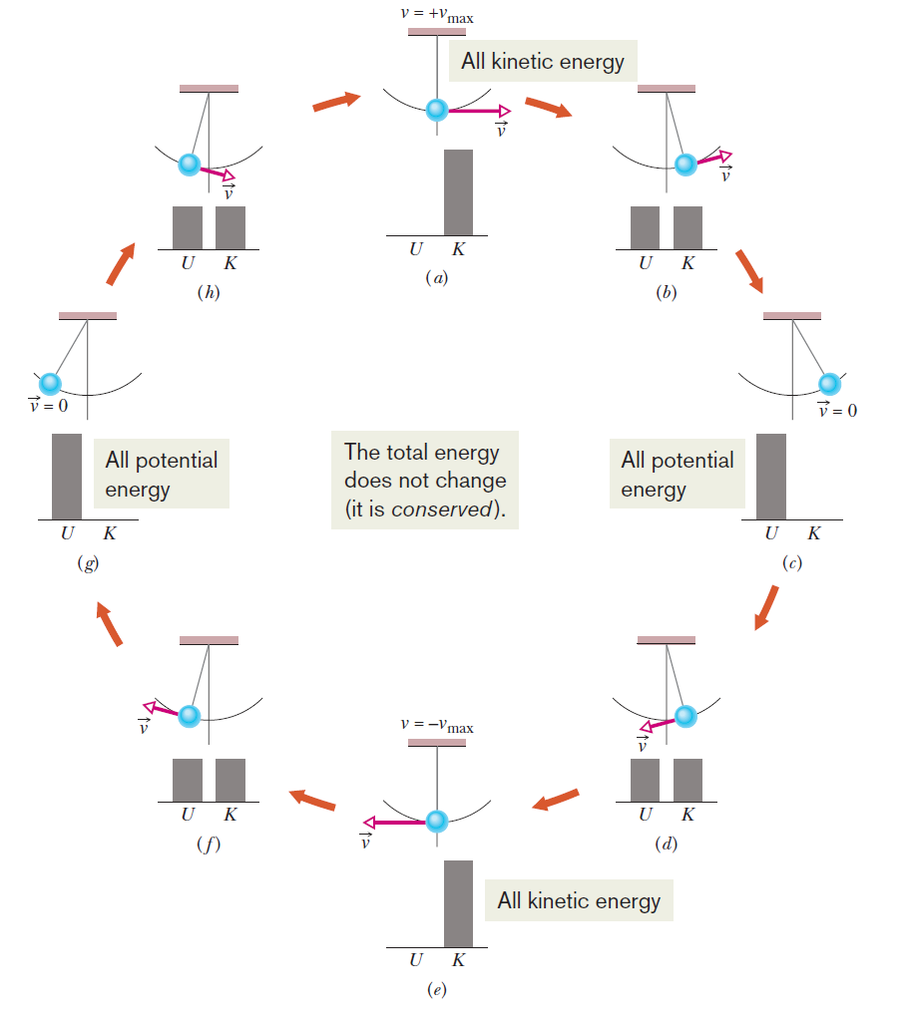
Conservative of Mechanical Energy
A pendulum swings back and forth. During one full cycle the values of the potential and kinetic energies of the pendulum– Earth system vary as the bob rises and falls, but the mechanical energy E_{mec} of the system remains constant. The energy E_{mec} can be described as continuously shifting between the kinetic and potential forms.
In stages (a) and (e), all the energy is kinetic energy. In stages (c) and (g), all the energy is potential energy. In stages (b), (d), ( f ), and (h), half the energy is kinetic energy and half is potential energy.
If the swinging involved a frictional force then E_{mec} would not be conserved, and eventually the pendulum would stop.

Slide 28
Conservation of Mechanical Energy
Concept Question
A rubber ball is dropped from rest from a height h. The ball bounces off the floor and reaches a height of 2h/3. How can we use the principle of the conservation of mechanical energy to interpret this observation?
During the collision with the floor, the floor did not push hard enough on the ball for it to reach its original height.
Some of the ball’s potential energy was lost in accelerating it toward the floor.
The force of the earth’s gravity on the ball prevented it from returning to its original height.
Work was done on the ball by the gravitational force that reduced the ball’s kinetic energy.
Work was done on the ball by non-conservative forces that resulted in the ball having less total mechanical energy after the bounce.
Notes:
Answer: E

Slide 29
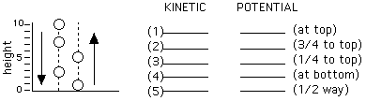
Example Problem
Fill in the KE and PE energy at each point. Assume PE = 200 J and KE = 0 J for position (1) at top.
At top all the energy is potential so
KE = 0 J
PE = 200 J
At ¾ to the top, it’s mostly potential but a little kinetic:
KE = ¼ * 200 J = 50 J
PE = ¾ * 200 J = 150 J
At ¼ to the top, it’s still mostly kinetic and a little potential:
KE = ¾ * 200 J = 150 J
PE = ¼ * 200 J = 50 J
At the bottom, it’s all kinetic:
KE = 200 J
PE = 0 J
At the halfway point, it’s both kinetic and potential:
PE = ½ * 200 J = 100 J
KE = ½ * 200 J = 100 J

Slide 30
Example Problem
Fill in the KE and PE energy at each point. Assume PE = 200 J and KE = 0 J for position (1) at top.
At top all the energy is potential so
KE = 0 J
PE = 200 J
At ¾ to the top, it’s mostly potential but a little kinetic:
KE = ¼ * 200 J = 50 J
PE = ¾ * 200 J = 150 J
At ¼ to the top, it’s still mostly kinetic and a little potential:
KE = ¾ * 200 J = 150 J
PE = ¼ * 200 J = 50 J
At the bottom, it’s all kinetic:
KE = 200 J
PE = 0 J
At the halfway point, it’s both kinetic and potential:
PE = ½ * 200 J = 100 J
KE = ½ * 200 J = 100 J

Slide 31
Example Problem
Fill in the KE and PE energy at each point. Assume PE = 200 J and KE = 0 J for position (1) at top.
At top all the energy is potential so
KE = 0 J
PE = 200 J
At ¾ to the top, it’s mostly potential but a little kinetic:
KE = ¼ * 200 J = 50 J
PE = ¾ * 200 J = 150 J
At ¼ to the top, it’s still mostly kinetic and a little potential:
KE = ¾ * 200 J = 150 J
PE = ¼ * 200 J = 50 J
At the bottom, it’s all kinetic:
KE = 200 J
PE = 0 J
At the halfway point, it’s both kinetic and potential:
PE = ½ * 200 J = 100 J
KE = ½ * 200 J = 100 J

Slide 32
Example Problem
Fill in the KE and PE energy at each point. Assume PE = 200 J and KE = 0 J for position (1) at top.
At top all the energy is potential so
KE = 0 J
PE = 200 J
At ¾ to the top, it’s mostly potential but a little kinetic:
KE = ¼ * 200 J = 50 J
PE = ¾ * 200 J = 150 J
At ¼ to the top, it’s still mostly kinetic and a little potential:
KE = ¾ * 200 J = 150 J
PE = ¼ * 200 J = 50 J
At the bottom, it’s all kinetic:
KE = 200 J
PE = 0 J
At the halfway point, it’s both kinetic and potential:
PE = ½ * 200 J = 100 J
KE = ½ * 200 J = 100 J

Slide 33
Example Problem
Fill in the KE and PE energy at each point. Assume PE = 200 J and KE = 0 J for position (1) at top.
At top all the energy is potential so
KE = 0 J
PE = 200 J
At ¾ to the top, it’s mostly potential but a little kinetic:
KE = ¼ * 200 J = 50 J
PE = ¾ * 200 J = 150 J
At ¼ to the top, it’s still mostly kinetic and a little potential:
KE = ¾ * 200 J = 150 J
PE = ¼ * 200 J = 50 J
At the bottom, it’s all kinetic:
KE = 200 J
PE = 0 J
At the halfway point, it’s both kinetic and potential:
PE = ½ * 200 J = 100 J
KE = ½ * 200 J = 100 J

Slide 34
Example Problem
Fill in the KE and PE energy at each point. Assume PE = 200 J and KE = 0 J for position (1) at top.
At top all the energy is potential so
KE = 0 J
PE = 200 J
At ¾ to the top, it’s mostly potential but a little kinetic:
KE = ¼ * 200 J = 50 J
PE = ¾ * 200 J = 150 J
At ¼ to the top, it’s still mostly kinetic and a little potential:
KE = ¾ * 200 J = 150 J
PE = ¼ * 200 J = 50 J
At the bottom, it’s all kinetic:
KE = 200 J
PE = 0 J
At the halfway point, it’s both kinetic and potential:
PE = ½ * 200 J = 100 J
KE = ½ * 200 J = 100 J

Slide 35

Conservation of Energy
Law of Conservation of Energy
The total energy E of a system can change only by amounts of energy that are transferred to or from the system.
where E_{mec} is any change in the mechanical energy of the system, E_{th} is any change in the thermal energy of the system, and E_{int} is any change in any other type of internal energy of the system.
The total energy E of an isolated system cannot change.

Slide 36
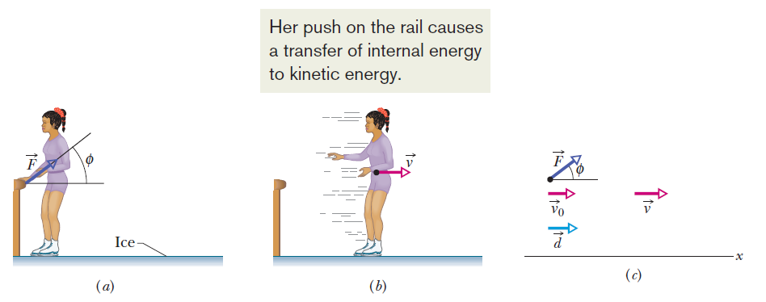
Conservation of Energy
An external force can change the kinetic energy or potential energy of an object without doing work on the object—that is, without transferring energy to the object. Instead, the force is responsible for transfers of energy from one type to another inside the object.

