Slide 1
Stars
Temperatures of Stars
Grouping in the Galaxy
free stars
open clusters
globular clusters
Luminosity vs Brightness
Stellar Classification: Temperature and Luminosity

Slide 2
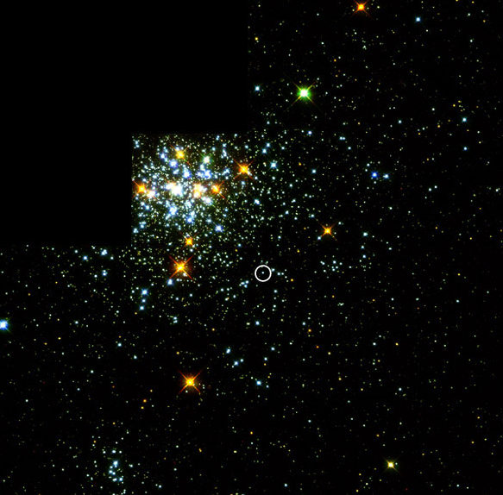
Open cluster

Slide 3
Stars are classified by their TEMPERATURE (color)
SPECTRAL TYPE
O 30,000 — 60,000 K hottest
B 10,000 — 30,000 K
A 7,500 — 10,000 K
F 6,000 — 7,500 K
G 5,000 — 6,000 K
K 3,000 — 5,000 K
M 1,800 — 3,000 K coolest

Slide 4
Stars are classified by their TEMPERATURE (color)
with sub-classification from 0 to 9
A0 is 10,000 K hotter
A9 is 7,500 K cooler
G2 5,800 K our Sun

Slide 5
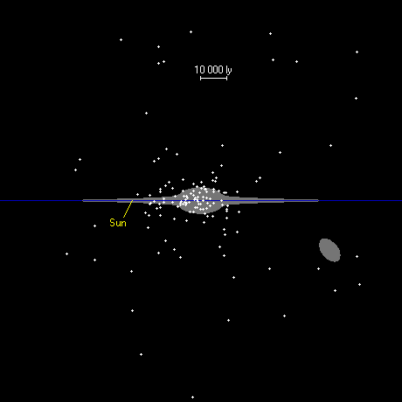
globular clusters
open clusters
open clusters
Open clusters are in the disk of Galaxy and continue to form to this day. Globular clusters formed when the MW was young

Slide 6
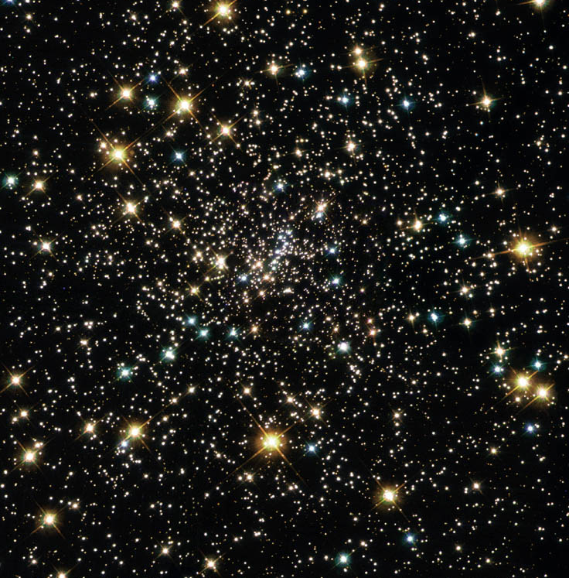
Open cluster

Slide 7
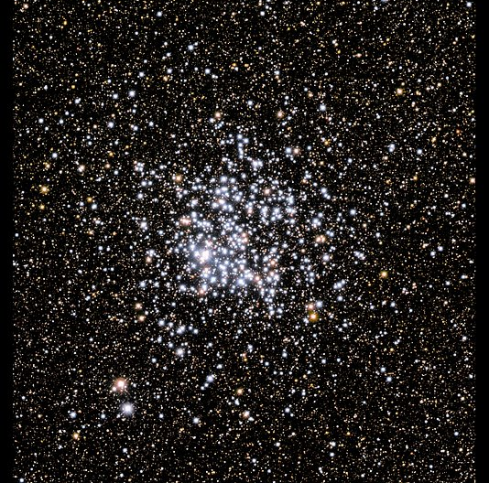
Open cluster

Slide 8
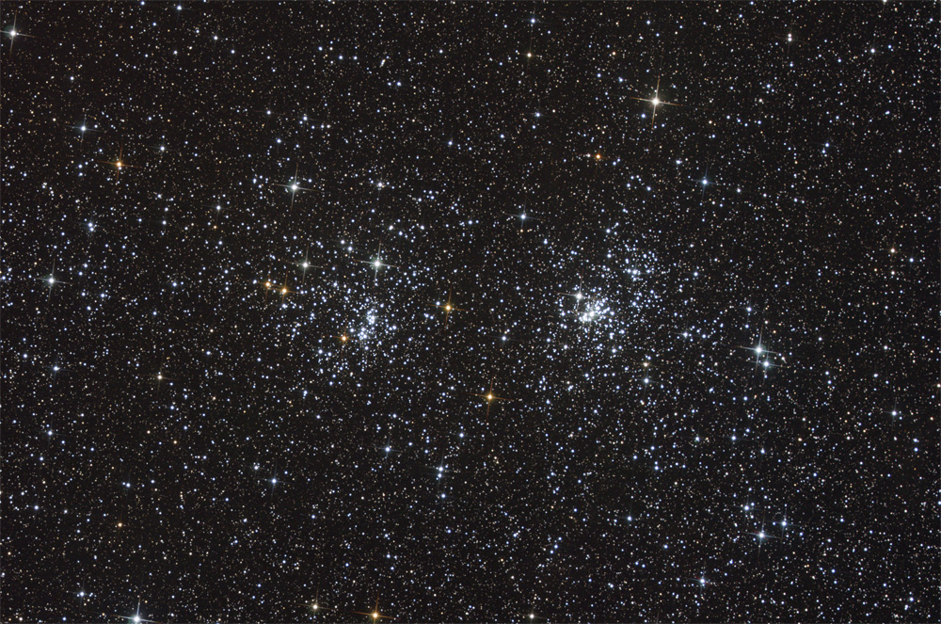
Double Open Cluster — 7,000 l-yrs from Earth but only a few hundred l-yrs apart!
Notes:
869 & NGC 884: A Double Open Cluster
Credit & Copyright: Thomas V. Davis (tvdavisastropix.com)
Explanation: Most star clusters are singularly impressive. Open clusters NGC 869 and NGC 884, however, are doubly impressive. Also known as "h and chi Persei", this unusual double cluster, shown above, is bright enough to be seen from a dark location without even binoculars. Although their discovery surely predates written history, the Greek astronomer Hipparchus notably cataloged the "double cluster". The clusters are over 7,000 light years distant toward the constellation of Perseus, but are separated by only hundreds of l-yrs.

Slide 9
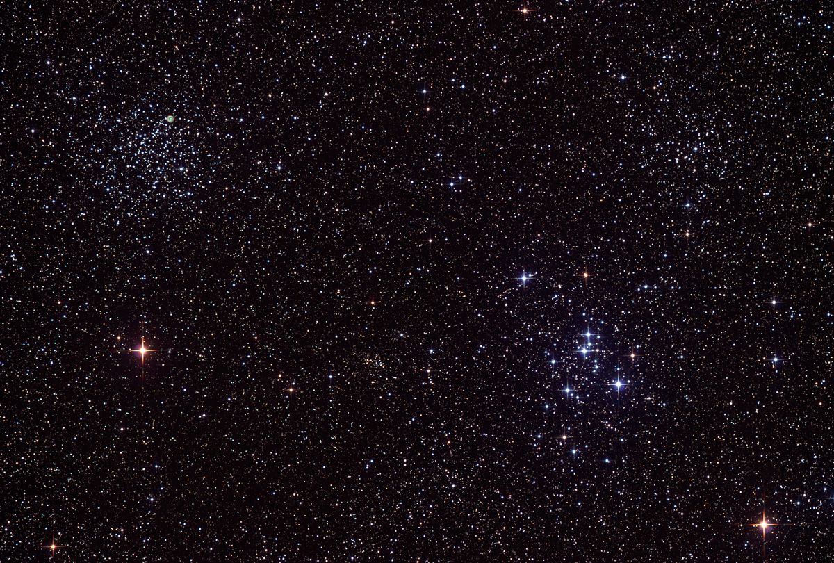
Two Open Clusters near each other on the sky
Notes:
Explanation: Galactic or open star clusters are relatively young swarms of bright stars born together near the plane of our Milky Way Galaxy. Separated by about a degree on the sky, two nice examples are M46 (upper left) 5,400 light-years in the distance and M47 (lower right) only 1,600 light-years away toward the nautical constellation Puppis. Around 300 million years young M46 contains a few hundred stars in a region about 30 light-years across. Aged 80 million years, M47 is a smaller but looser cluster of about 50 stars spanning 10 light-years. But thisportrait of stellar youth also contains an ancient interloper. The small, colorful patch of glowing gas in M46 is actually the planetary nebula NGC 2438 - the final phase in the life of a sun-like star billions of years old. NGC 2438 is estimated to be only 3,000 light-years distant and likely represents a foreground object, only by chance appearing along our line of sight to youthful M46.

Slide 10
5,400 l-yrs from Earth — has about 300 stars and formed about 300 million years ago
1,600 l-yrs from Earth — has only 50 stars and formed 80 million years ago
Two Open Clusters near each other on the sky
Notes:
Explanation: Galactic or open star clusters are relatively young swarms of bright stars born together near the plane of our Milky Way Galaxy. Separated by about a degree on the sky, two nice examples are M46 (upper left) 5,400 light-years in the distance and M47 (lower right) only 1,600 light-years away toward the nautical constellation Puppis. Around 300 million years young M46 contains a few hundred stars in a region about 30 light-years across. Aged 80 million years, M47 is a smaller but looser cluster of about 50 stars spanning 10 light-years. But thisportrait of stellar youth also contains an ancient interloper. The small, colorful patch of glowing gas in M46 is actually the planetary nebula NGC 2438 - the final phase in the life of a sun-like star billions of years old. NGC 2438 is estimated to be only 3,000 light-years distant and likely represents a foreground object, only by chance appearing along our line of sight to youthful M46.

Slide 11
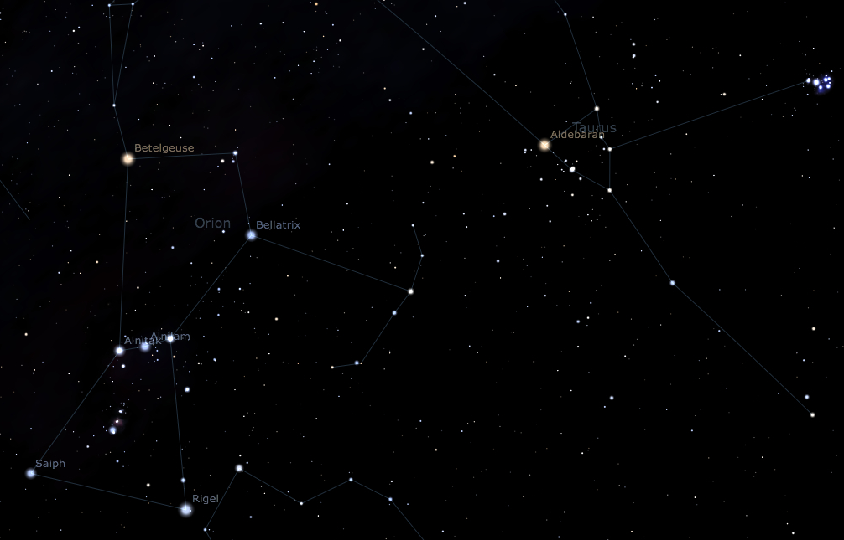
Pleiades
Betelgeuse
Aldebaran
Hyades
Orion
Taurus
Two Open Clusters relatively near Earth — Pleiades and Hyades

Slide 12
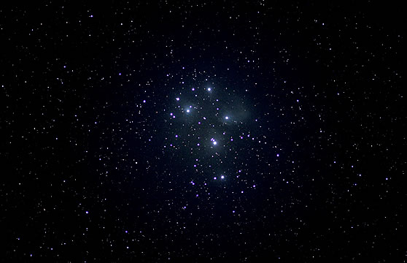
8 l-yrs
Pleiades Open Cluster — The 7 Sisters
390 l-yr away
To be accepted in the ancient Spartan army, all 7 stars had to be seen

Slide 13
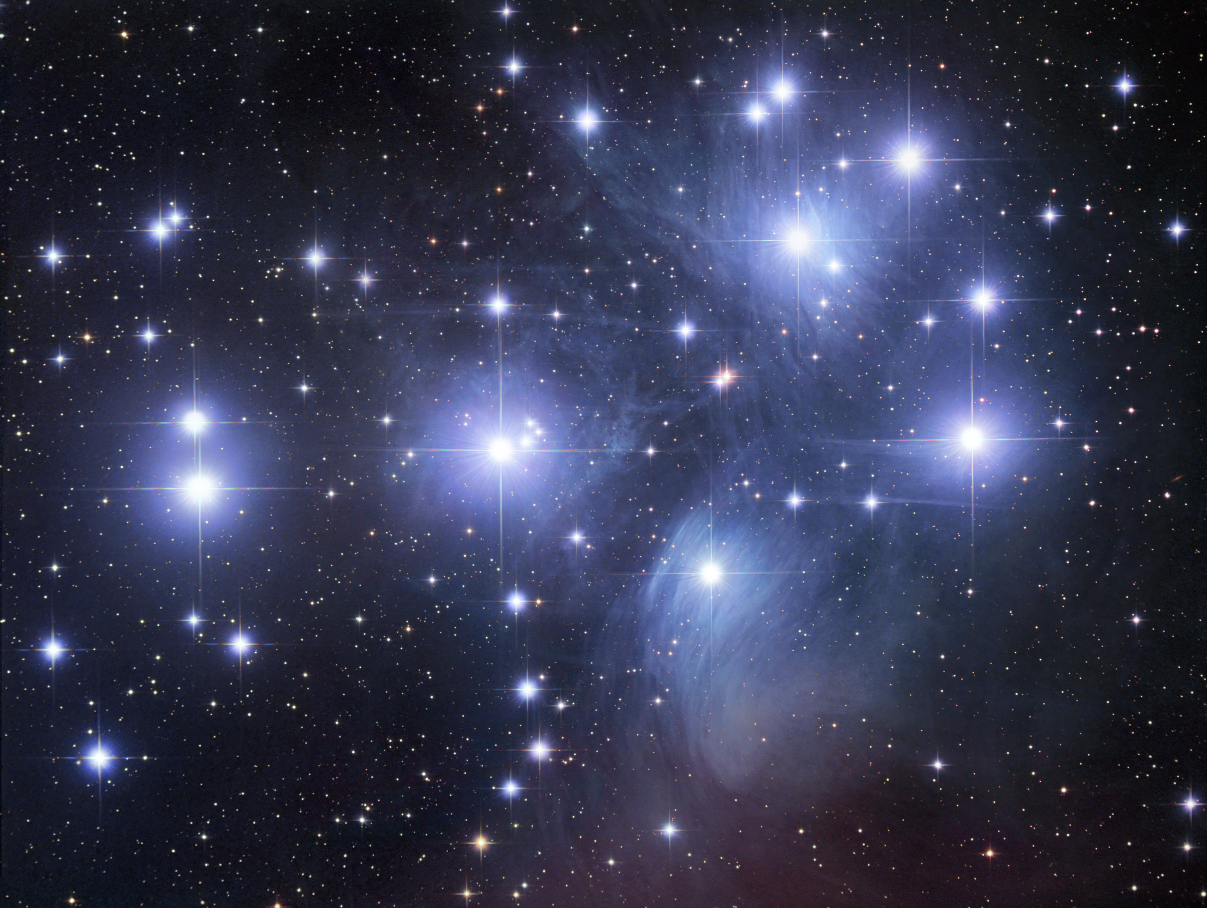
longer exposure shows dust reflecting the light of the stars

Slide 14
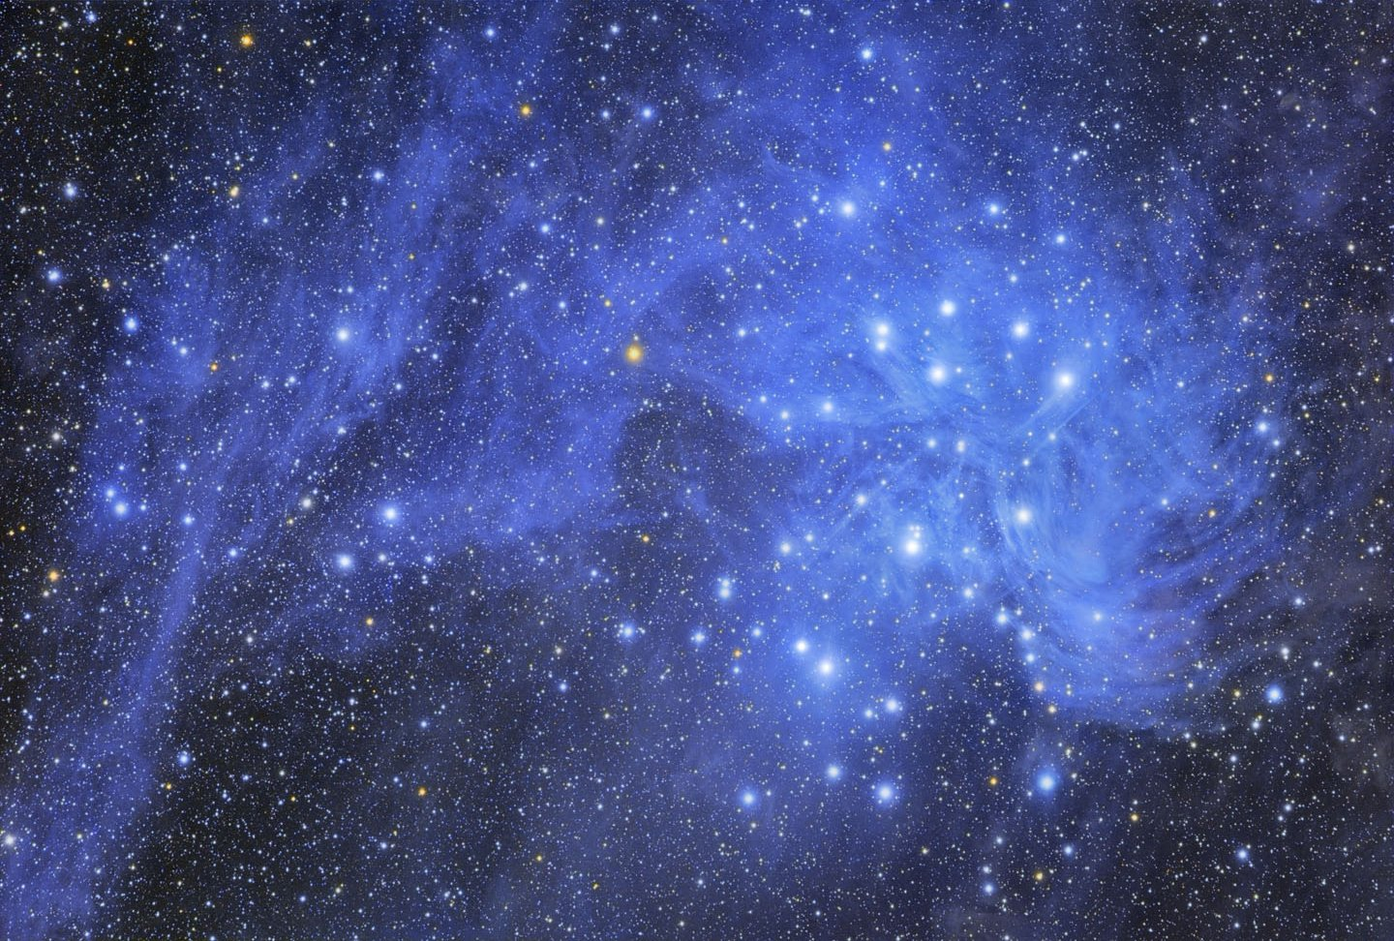
43 l-yrs
even wider view and longer exposure

Slide 15
43 l-yrs
even wider view and longer exposure

Slide 16
Pleiades
Betelgeuse
Aldebaran
Hyades
Orion
Taurus
Two Open Clusters relatively near Earth — Pleiades and Hyades

Slide 17
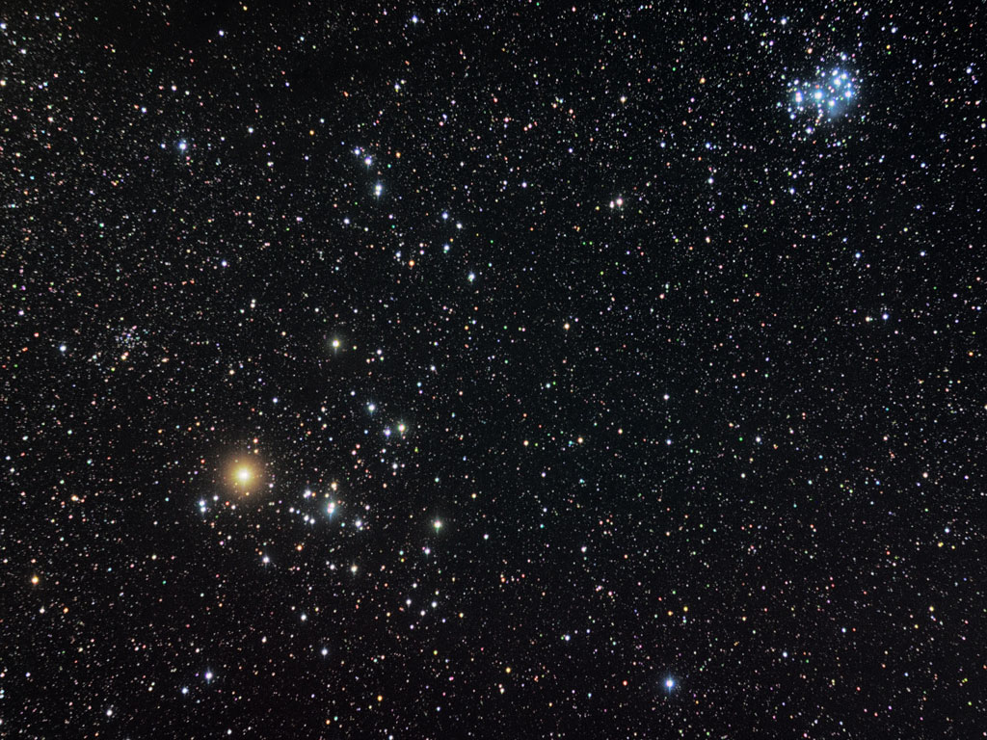
Aldebaran
is a foreground star, not part of the Hyades
Hyades Cluster

Slide 18
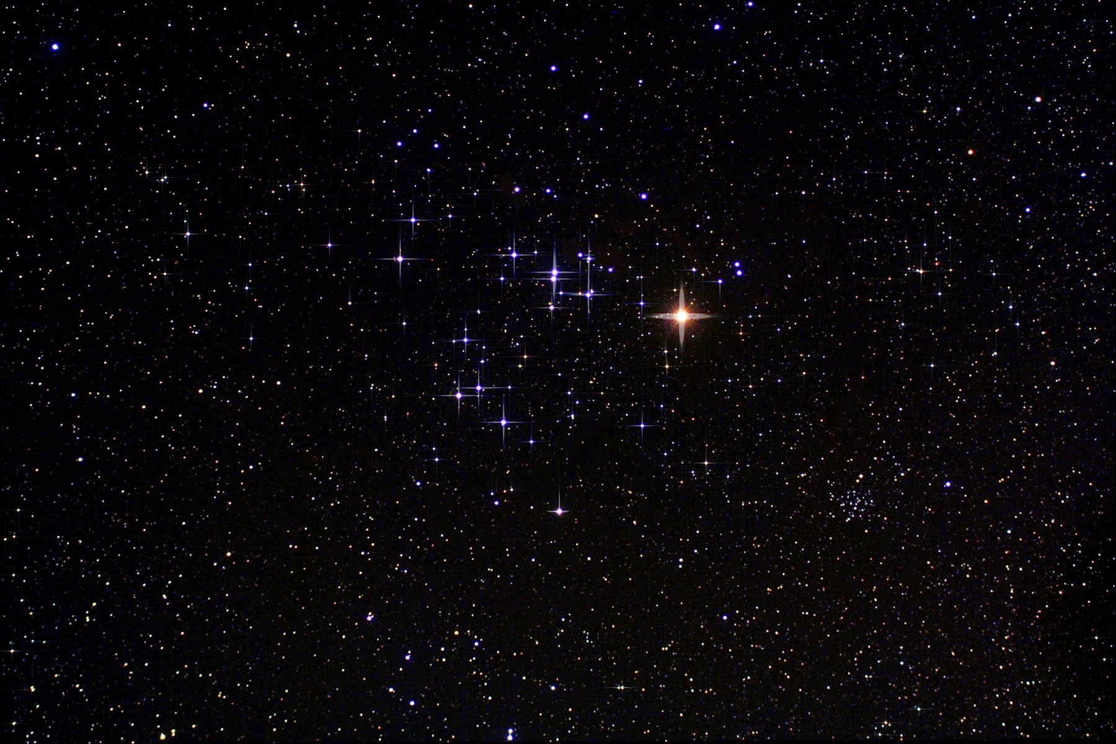
Hyades cluster — closest cluster to Earth 153 l-yrs away

Slide 19
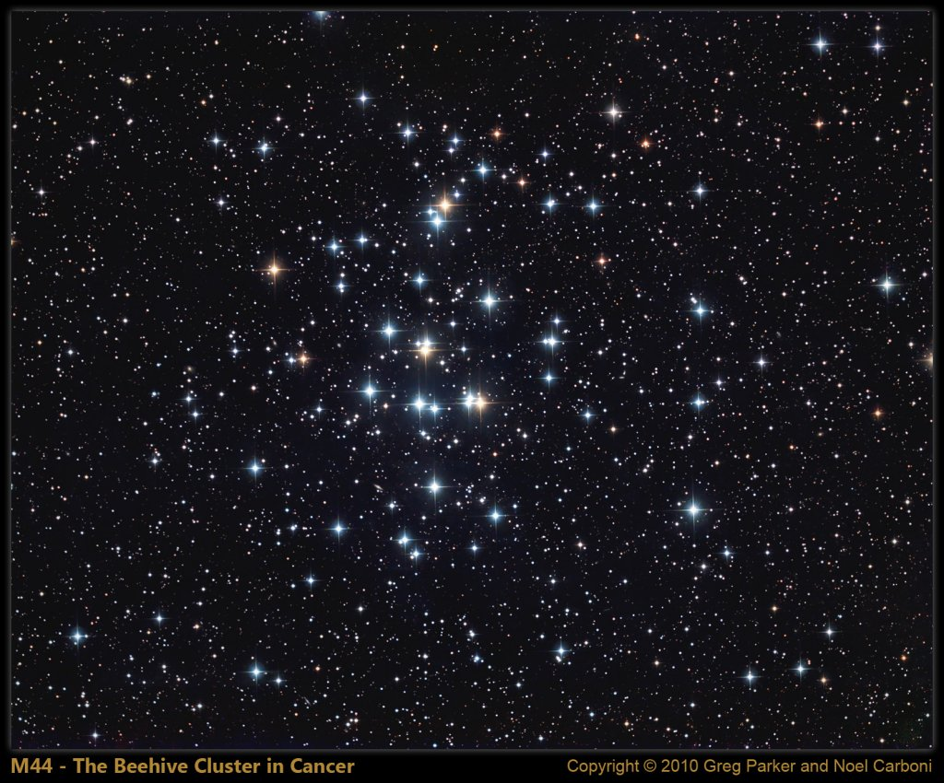
Beehive cluster — only 600 million yrs old
Notes:
A mere 600 light-years away, M44 is one of the closest star clusters to our solar system. Also known as the Praesepe or the Beehive cluster its stars are young though, about 600 million years old compared to our Sun's 4.5 billion years. Based on similar ages and motion through space, M44 and the even closer Hyades star cluster in Taurus are thought to have been born together in the same large molecular cloud. An open cluster spanning some 15 light-years, M44 holds 1,000 stars or so and covers about 3 full moons (1.5 degrees) on the sky in the constellation Cancer. Visible to the unaided eye, M44 has been recognized since antiquity. Described as a faint cloud or celestial mist long before being included as the 44th entry in Charles Messier's 18th century catalog, the cluster was not resolved into its individual stars until telescopes were available. A popular target for modern, binocular-equiped sky gazers, the cluster's few yellowish tinted, cool, red giants are scattered through the field of its brighter hot blue main sequence stars in this colorful stellar group snapshot.

Slide 20
Beehive cluster — only 600 million yrs old
Notes:
A mere 600 light-years away, M44 is one of the closest star clusters to our solar system. Also known as the Praesepe or the Beehive cluster its stars are young though, about 600 million years old compared to our Sun's 4.5 billion years. Based on similar ages and motion through space, M44 and the even closer Hyades star cluster in Taurus are thought to have been born together in the same large molecular cloud. An open cluster spanning some 15 light-years, M44 holds 1,000 stars or so and covers about 3 full moons (1.5 degrees) on the sky in the constellation Cancer. Visible to the unaided eye, M44 has been recognized since antiquity. Described as a faint cloud or celestial mist long before being included as the 44th entry in Charles Messier's 18th century catalog, the cluster was not resolved into its individual stars until telescopes were available. A popular target for modern, binocular-equiped sky gazers, the cluster's few yellowish tinted, cool, red giants are scattered through the field of its brighter hot blue main sequence stars in this colorful stellar group snapshot.

Slide 21
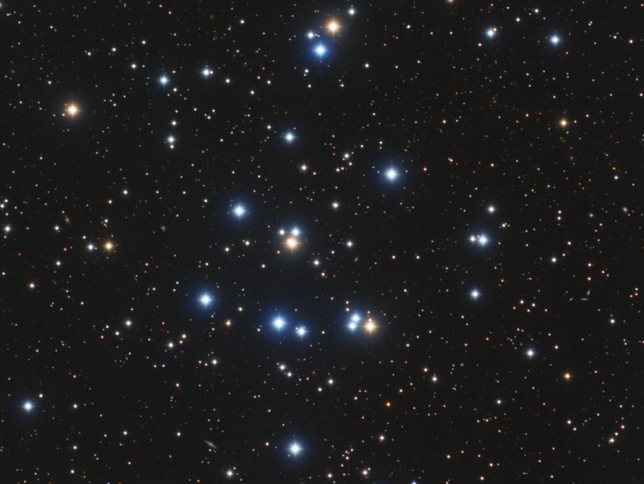
Beehive cluster — only 600 million yrs old
Notes:
A mere 600 light-years away, M44 is one of the closest star clusters to our solar system. Also known as the Praesepe or the Beehive cluster its stars are young though, about 600 million years old compared to our Sun's 4.5 billion years. Based on similar ages and motion through space, M44 and the even closer Hyades star cluster in Taurus are thought to have been born together in the same large molecular cloud. An open cluster spanning some 15 light-years, M44 holds 1,000 stars or so and covers about 3 full moons (1.5 degrees) on the sky in the constellation Cancer. Visible to the unaided eye, M44 has been recognized since antiquity. Described as a faint cloud or celestial mist long before being included as the 44th entry in Charles Messier's 18th century catalog, the cluster was not resolved into its individual stars until telescopes were available. A popular target for modern, binocular-equiped sky gazers, the cluster's few yellowish tinted, cool, red giants are scattered through the field of its brighter hot blue main sequence stars in this colorful stellar group snapshot.

Slide 22
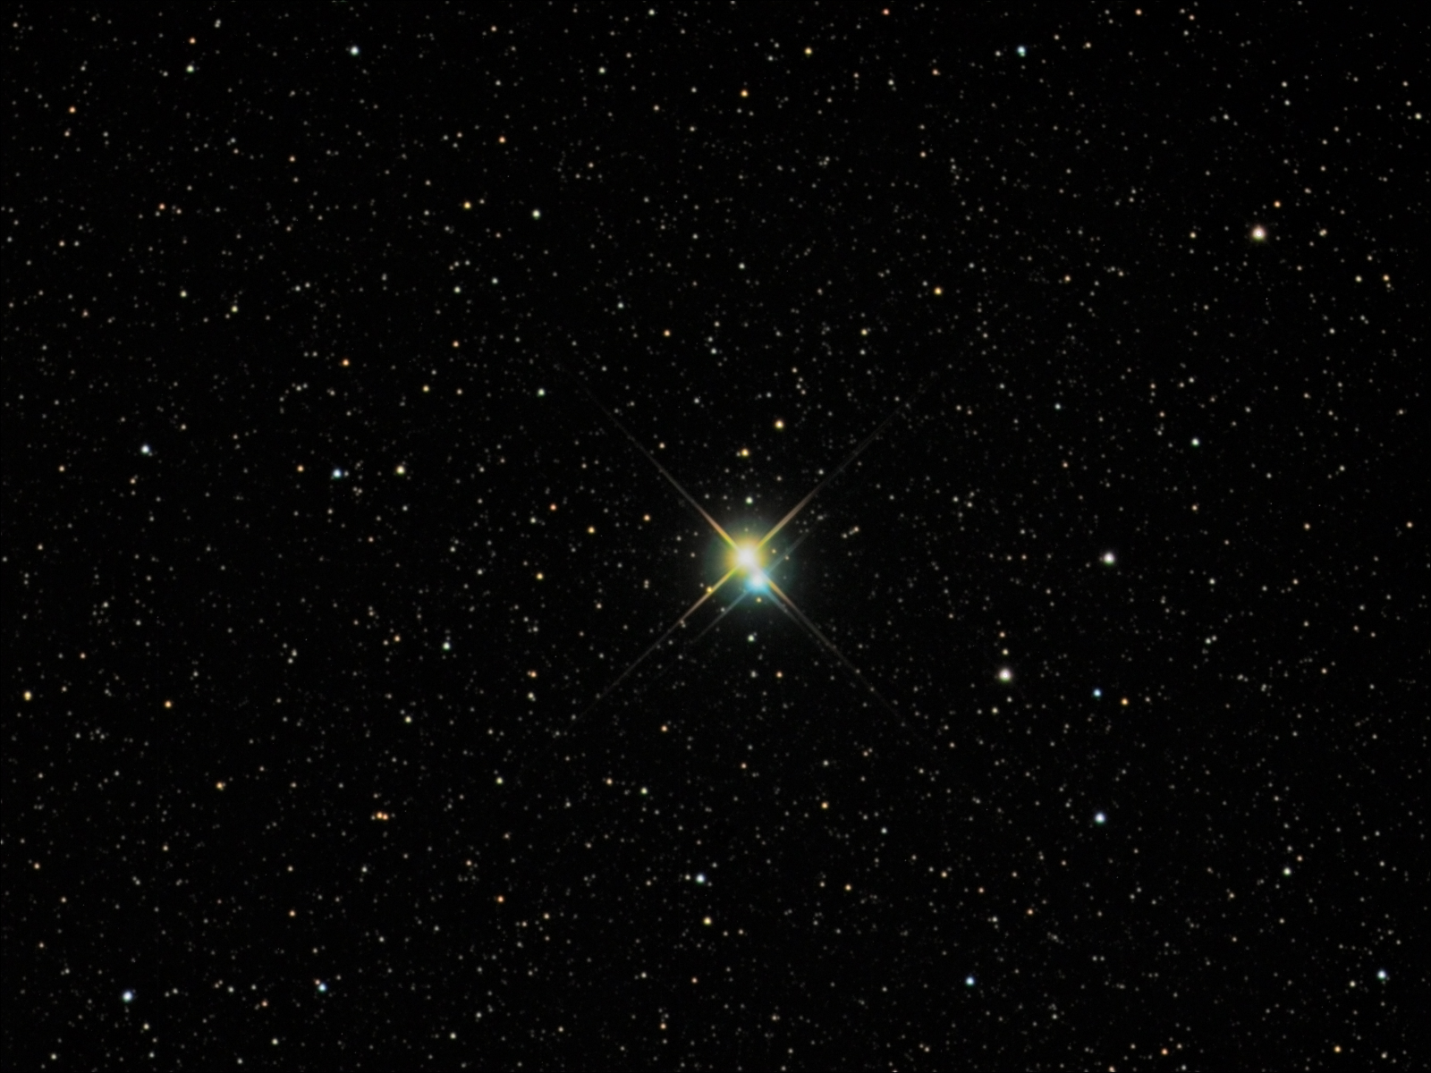
380 l-yr from earth — Triple star system Albireo — 5 M_{sun}.
75,000 yrs to orbit once around each other puts them at more than 1 ly-ry apart, and the yellow star is also a binary!
Notes:
Albireo: A Bright and Beautiful Double
Credit & Copyright: Richard Yandrick (Cosmicimage.com)
Explanation: Sometimes, even a small telescope can help unlock a hidden beauty of the heavens. Such is the case of the bright double star Albireo. Seen at even slight magnification, Albireo unfolds from a bright single point into a beautiful double star of strikingly different colors. At 380 light years distant, the two bright stars of Albireo are comparatively far from each other and take about 75,000 years to complete a single orbit. The brighter yellow star is itself a binary star system, but too close together to be resolved even with a telescope. Albireo, pictured above, is the fifth brightest star system toward the constellation of the Swan (Cygnus) and easily visible to the unaided eye.

Slide 23
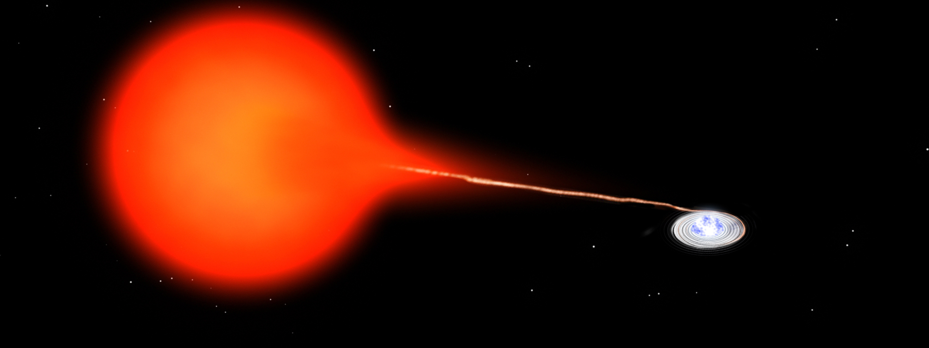
SS Cygni—Some double stars are so close, that mass is transferred — causing a NOVA flare up. These orbit each other every 49 days! 200,000 times closer than is Mercury from the Sun (0.01 l-min) and 370 l-yr from us.

Slide 24
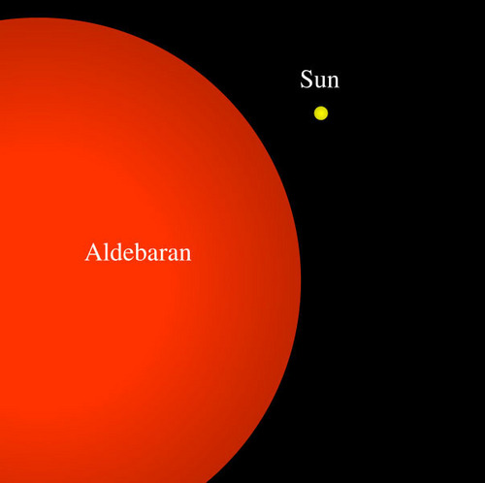

Slide 25
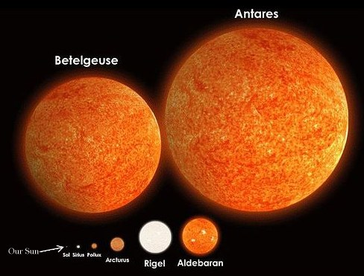
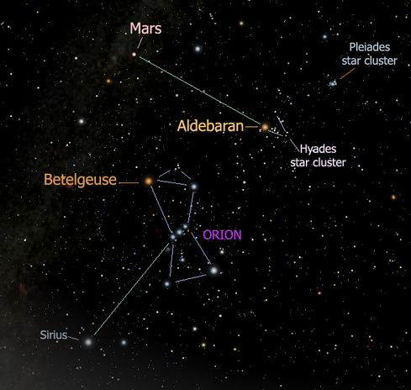
Aldebaran

Slide 26
Betelgeuse
Aldeberan

Slide 27
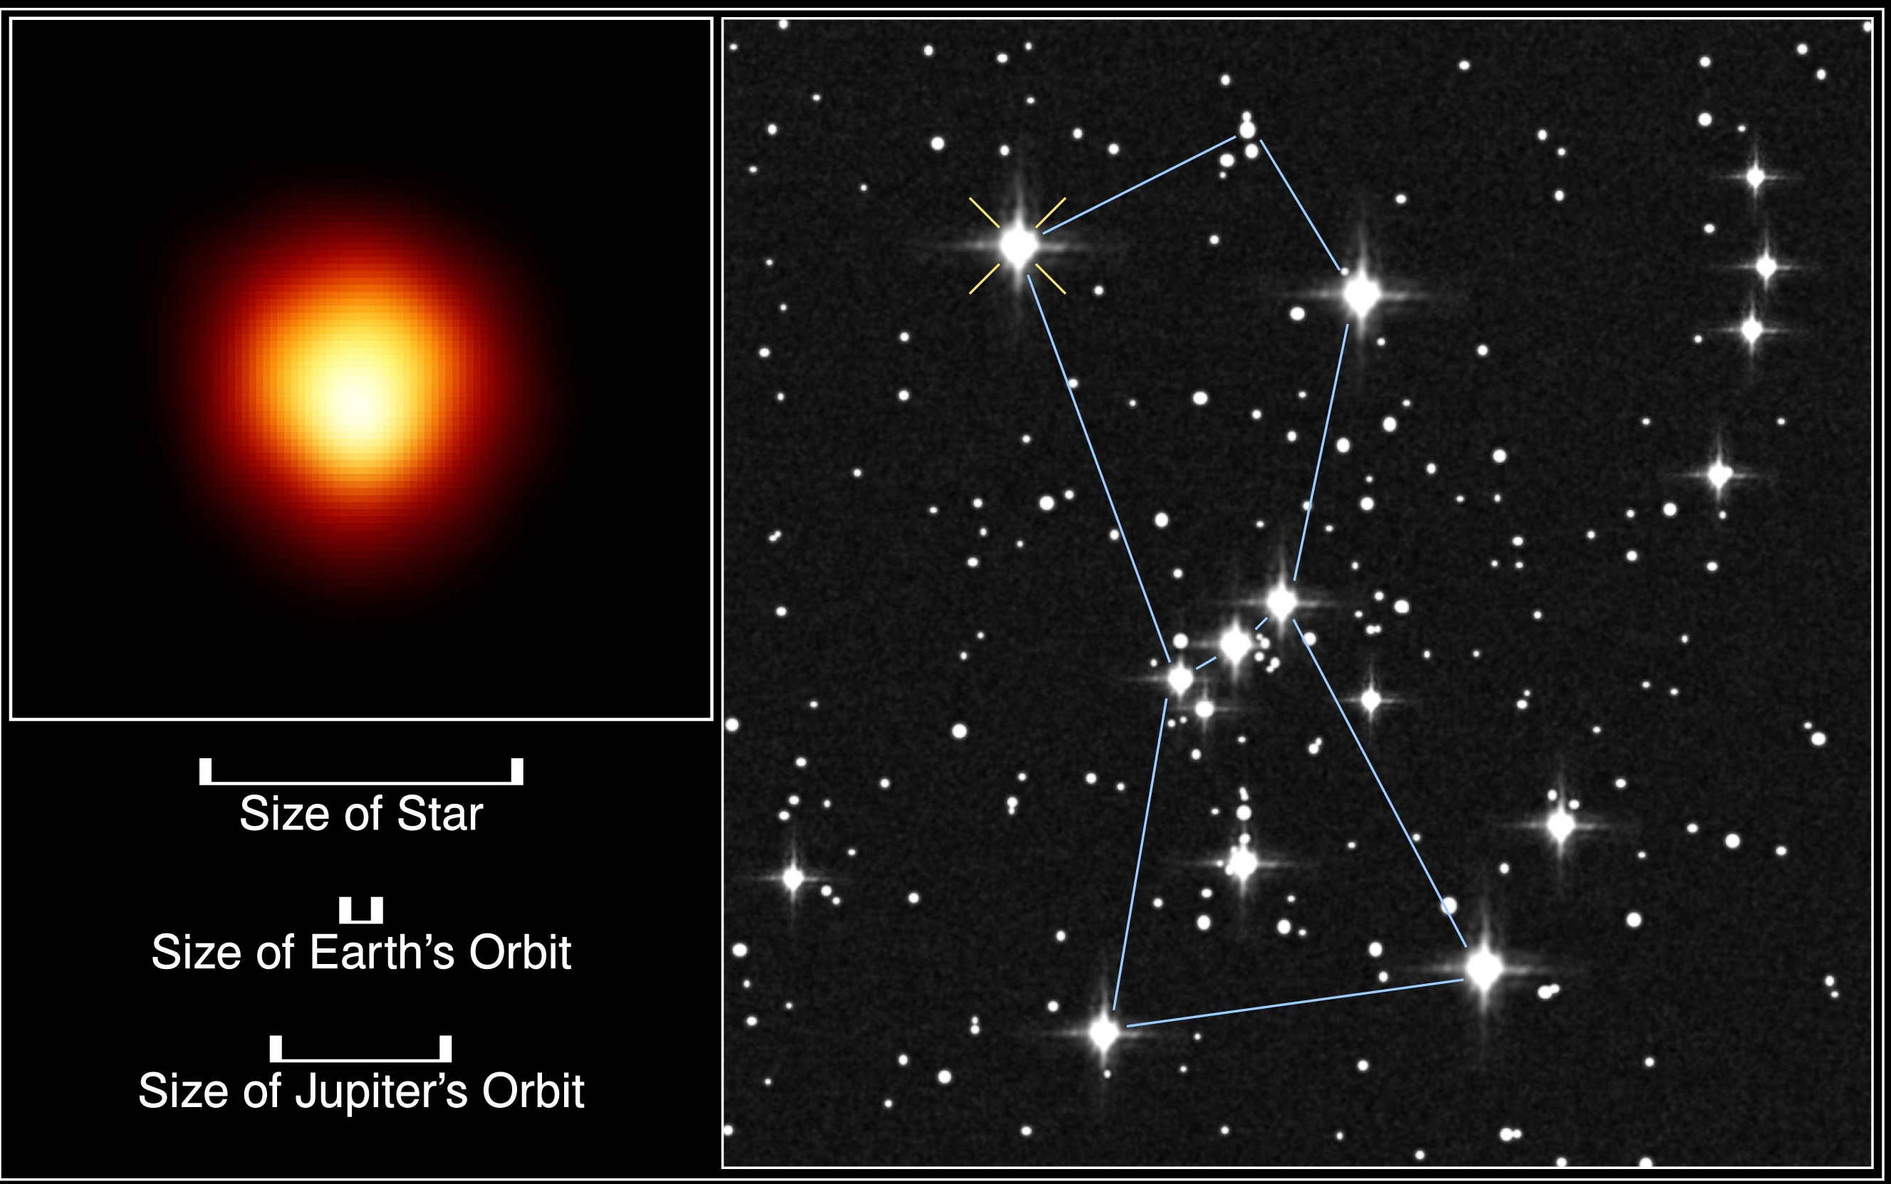
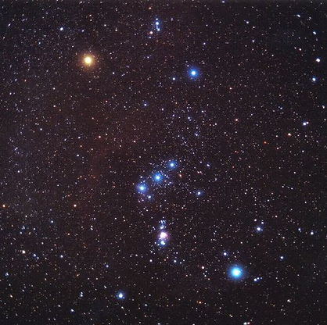
Betelgeuse
Orion Constellation

Slide 28
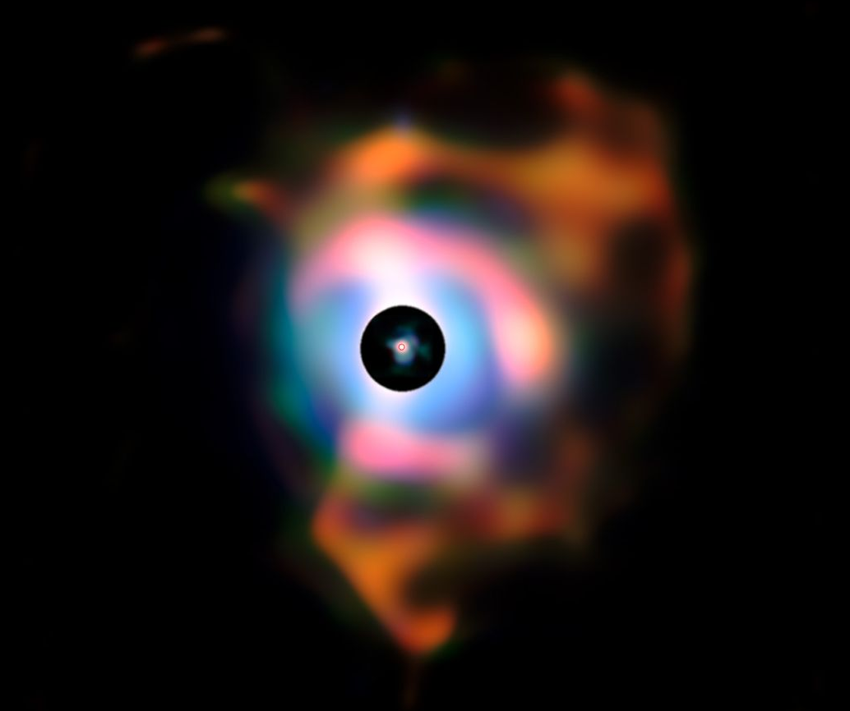
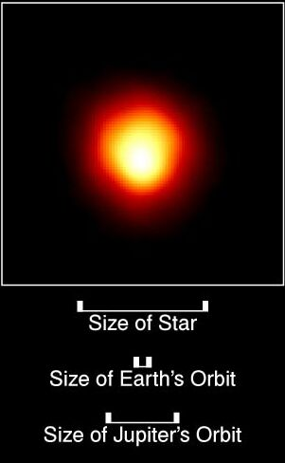
= 5 AU
400 AU
Cloud of Gas and Dust
Betelgeuse is ready to go Supernova!

Slide 29
globular clusters
open clusters
open clusters
Open clusters are in the disk of Galaxy and continue to form to this day.

Slide 30
globular clusters
Globular clusters are distributed spherically in the Galaxy and were made in the early days of galaxy formation.

Slide 31
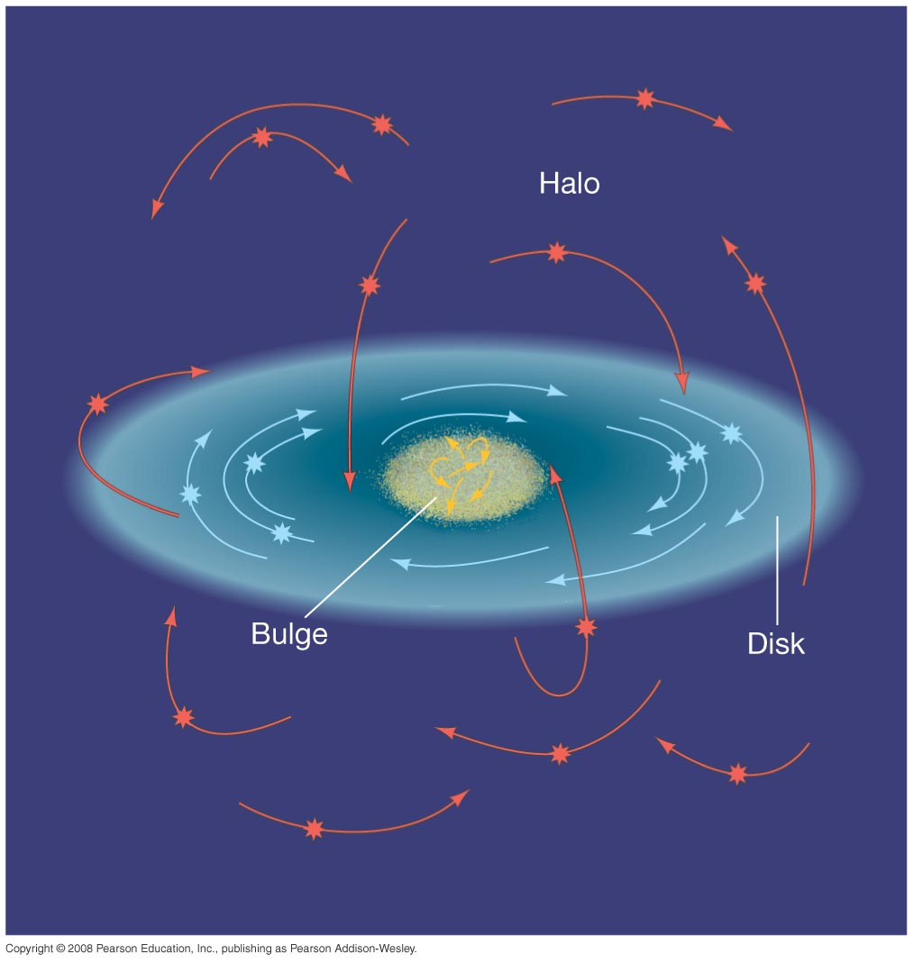
globular clusters swarm in all directions and are found above, below and within the disk
open clusters form in the flat disk and move around the Galaxy in the same direction

Slide 32
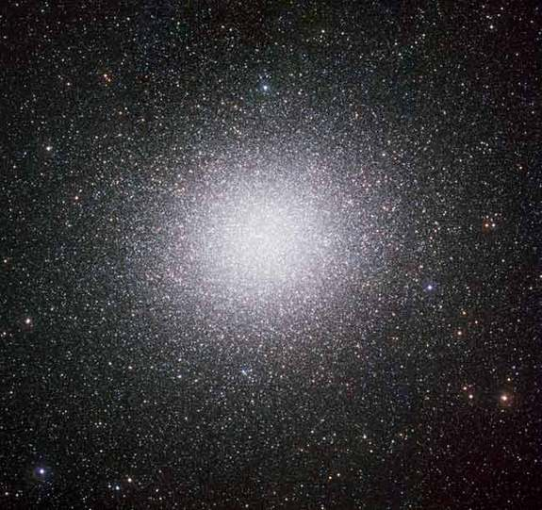
Globular Cluster Omega Centauri
containing several million stars and is 15,800 l-yr from Earth

Slide 33
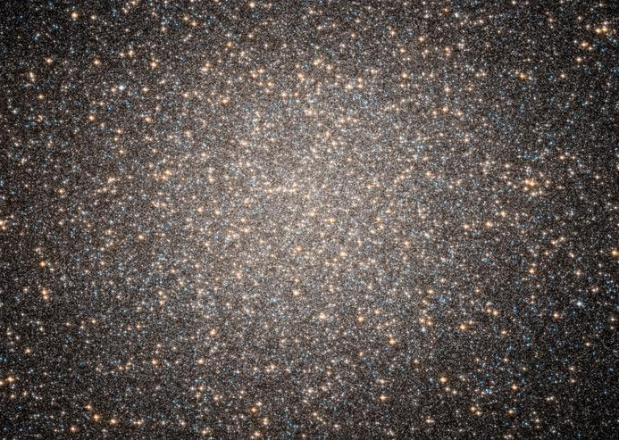
Globular Cluster Omega Centauri — central region

Slide 34
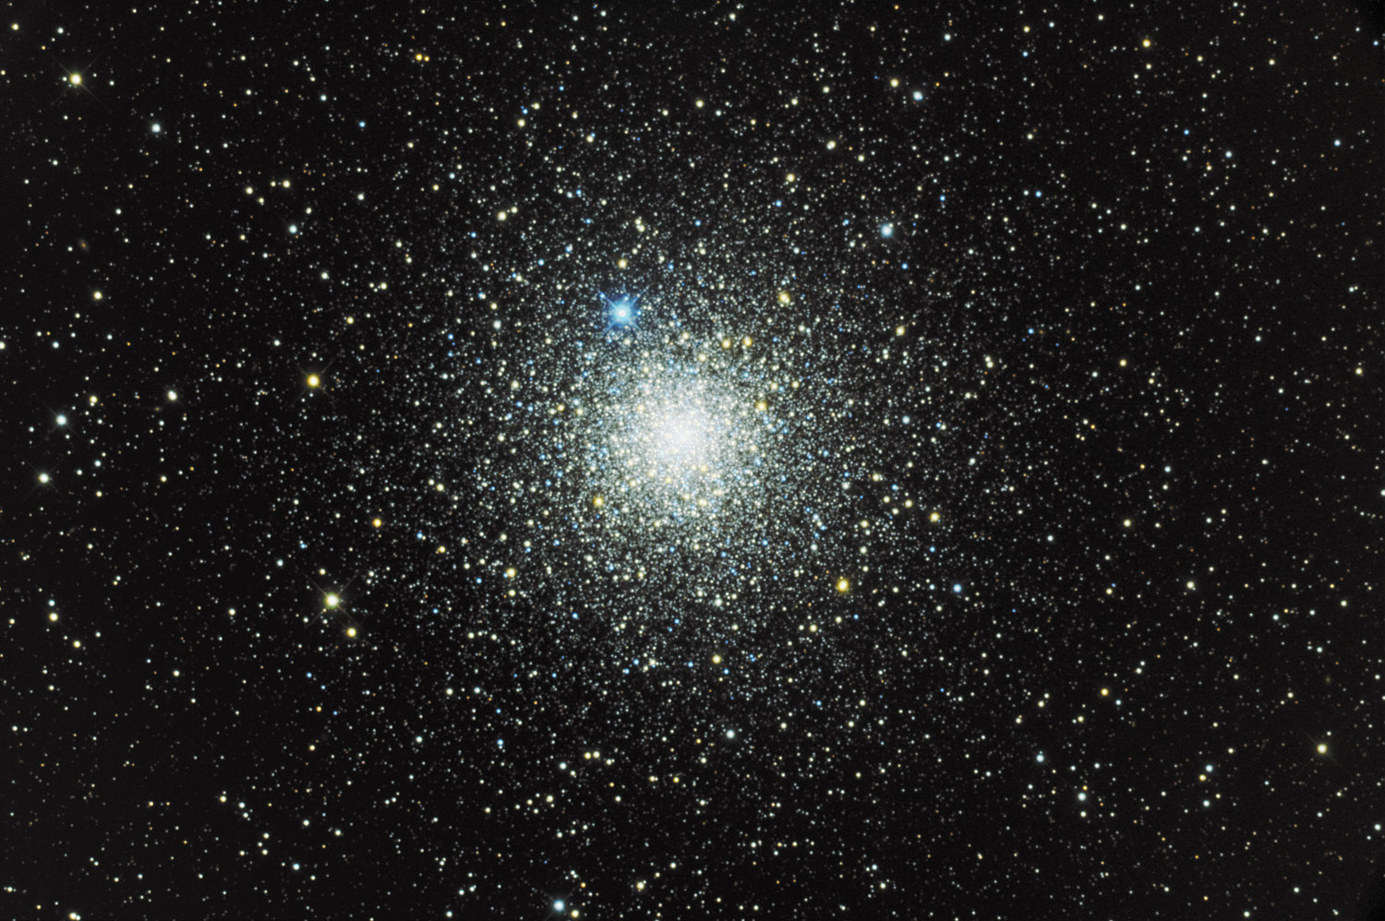
Globular Cluster NGC 6752
containing several thousand stars and is 13,000 l-yr from Earth

Slide 35
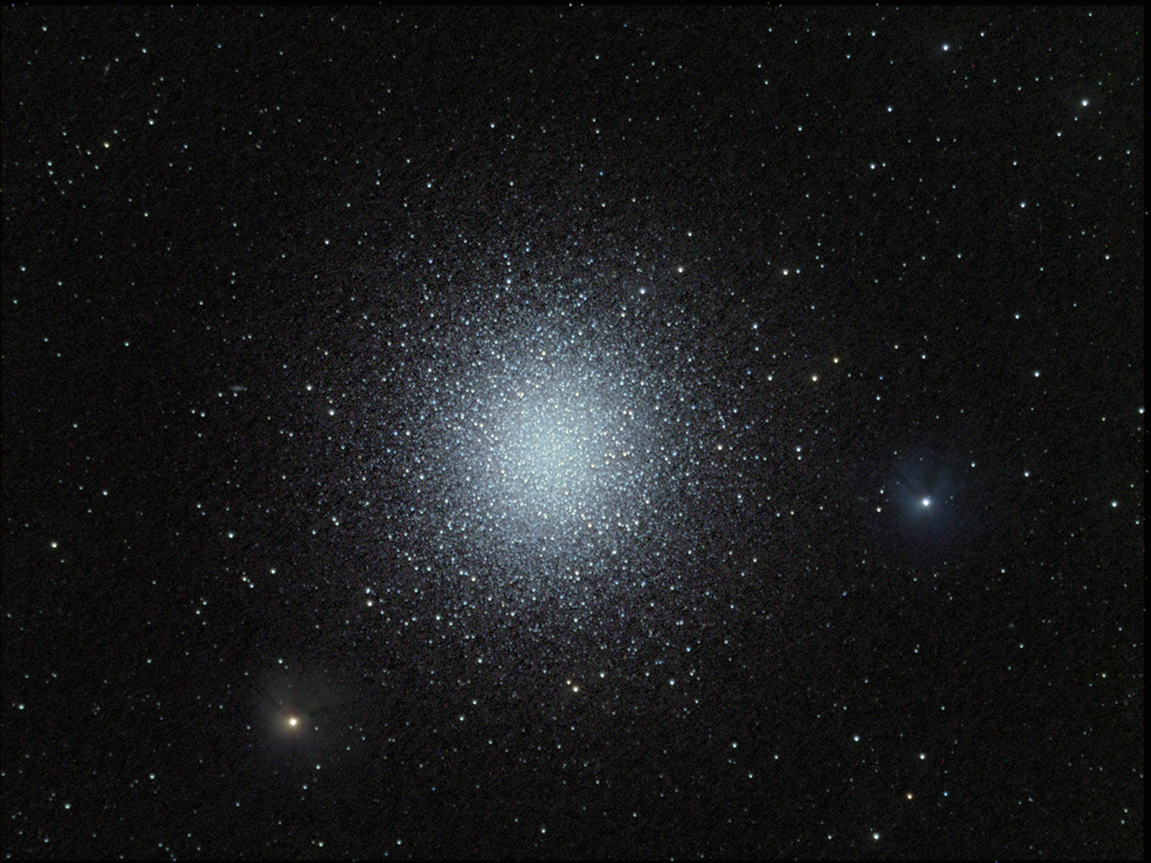
Globular Cluster in Hercules
containing 300,000 stars and is 25,000 l-yr from Earth

Slide 36
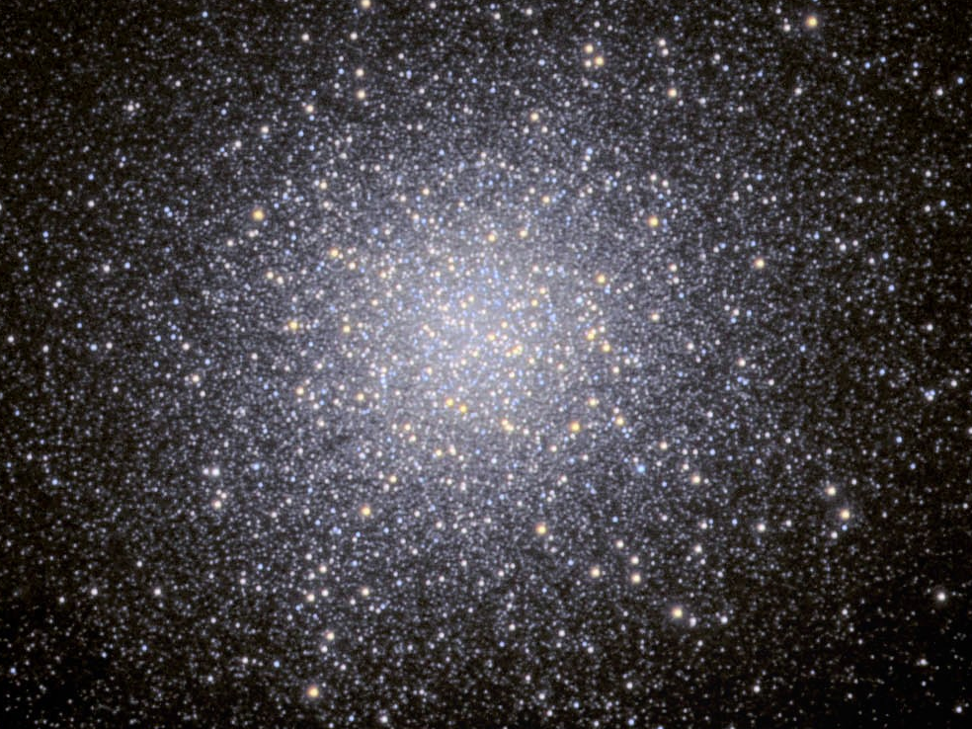
Globular Cluster in Hercules — central region

Slide 37
There are two ways to classify stars:
Temperature Type (O, B, A, F, G, K, M)
they put out (POWER) = LUMINOSITY
Power = Energy / Time

Slide 38
Temperature Type (O, B, A, F, G, K, M)
Is the Temperature of a star's
SURFACE

Slide 39
Luminosity Classification
Luminosity is due to the T's in the
CORE
Energy
sec

Slide 40
Temperature on surface
5800 K
Temperature in core:
15 million K
Energy
sec

Slide 41
Energy
sec
LUMINOSITY = Power =
Notice that LUMINOSITY does not have
a DISTANCE unit. LUMINOSITY is
INTRINSIC to the star, just as is its mass.

Slide 42
Luminosity
Distance²
BRIGHTNESS ∞
BRIGHTNESS relies on distance.

Slide 43
what you see is BRIGHTNESS
L=100 W
1 meters

Slide 44
How bright would the bulb appear now?
what you see is BRIGHTNESS
L=100 W
2 meters

Slide 45
Since Brightness goes as 1 over the distance squared, it would appear 4 times dimmer.
what you see is APPARENT BRIGHTNESS
L=100 W
2 meters

Slide 46
To know how REALLY (ABSOLUTELY) BRIGHT a star is, you MUST
know its DISTANCE

Slide 47
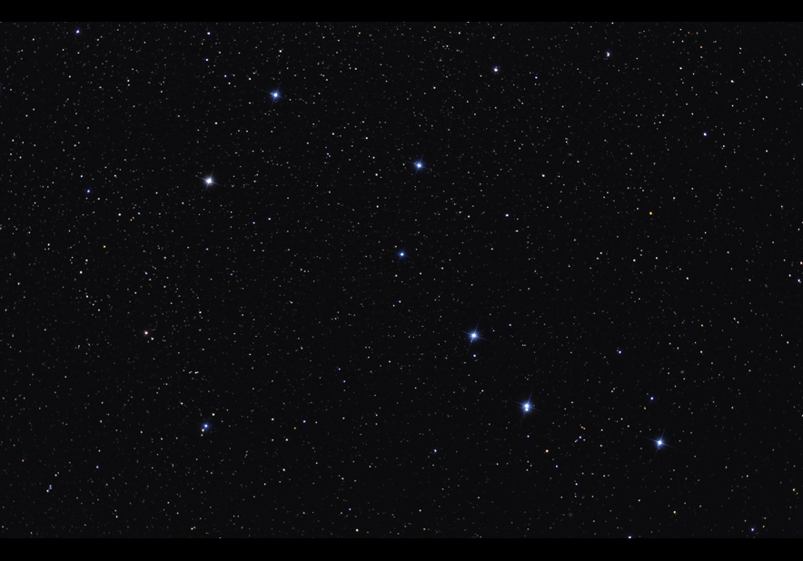
Stars appear to be the same distance, but they are not

Slide 48
For ex., if they are luminous but far, they will appear bright...

Slide 49
but if they are not very luminous but close, they will appear to be bright

Slide 50
If you had two light bulbs whose luminosity was unknown, how would you tell which bulb was the more luminous?
The brightness of stars you measure is called their APPARENT BRIGHTNESS.
what you see is BRIGHTNESS

Slide 51
You would put them at the same distance from you and see which APPEARED brighter
The brightness of stars at a STANDARD DISTANCE is called their ABSOLUTE BRIGHTNESS.
what you see is BRIGHTNESS
2 meters

Slide 52
There are 2 "kinds" of BRIGHTNESS:
APPARENT brightness
and
ABSOLUTE brightness

Slide 53
APPARENT brightness
ABSOLUTE brightness
how bright it APPEARS to you at its distance from you
how it WOULD appear at a STANDARD DISTANCE

Slide 54
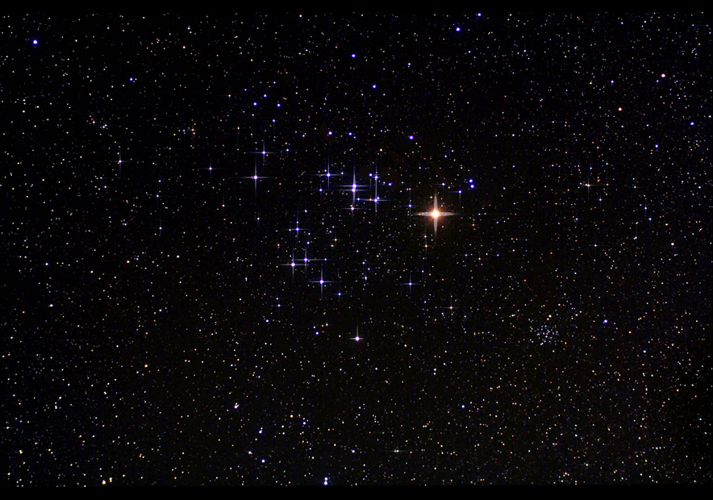
Once you know the distance to the stars, you can calculate their their ABSOLUTE BRIGHTNESS.

Slide 55
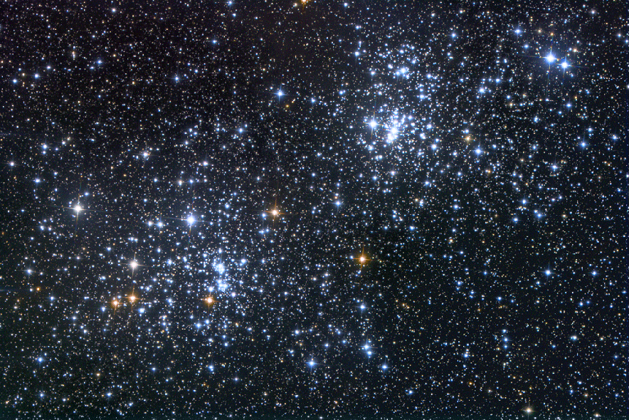
The standard distance is 10 parsecs. A parsec is 3.26 l-yrs.

Slide 56
Why in the heck would anyone use a weird unit like
10 parsecs (32.6 l-yr) for the standard distance?
It goes back to parallax as the first distance measurement to the stars.

Slide 57
Why in the heck would anyone use a weird unit like
10 parsecs (32.6 l-yr) for the standard distance?
It goes back to parallax as the first distance measurement to the stars.
The shift of a star is measured in angles,
and one degree is split up into 3,600 arcseconds,
that is,
1 degree = 3600 ”

Slide 58
Why in the heck would anyone use a weird unit like
10 parsecs (32.6 l-yr) for the standard distance?
It goes back to parallax as the first distance measurement to the stars.
The shift of a star is measured in angles,
and one degree is split up into 3,600 arcseconds,
that is,
1 degree = 3600 ”
If a star’s parallactic shift is 1 arcsecond, the star is 1 parsec distant.

Slide 59
There are other ways to find the distances to stars which we will discuss in the next session.

Slide 60
Stellar Classification: TEMPERATURE
Hot Star: 10,000 K
number of photons
0.3 µ
wavelength

Slide 61
Cool Star: 3,000 K
number of photons
wavelength
0.6 µ

Slide 62
Notice the SHAPE of the distribution is the same
Hot Star: 10,000 K
Cool Star: 3,000 K
number of photons
0.3 µ
wavelength
0.6 µ

Slide 63
Energy per second
0.3 µ
0.6 µ
wavelength

Slide 64
Bluer means MORE energy per photon
Energy per second
10,000 K
Redder means LESS energy per photon
3,000 K
0.3 µ
0.6 µ
wavelength

Slide 65
If you plot the energy per sec versus λ
Energy per second
0.3 µ
0.6 µ
wavelength

Slide 66
You would expect a straight line — the hotter the star, the more luminous
Energy per second
0.3 µ
0.6 µ
wavelength

Slide 67
Energy
sec
LUMINOSITY = Power =
The hotter the star, the more short wavelengths it emits.
Then we would expect luminosity plotted against temperature to make a straight line…

Slide 68
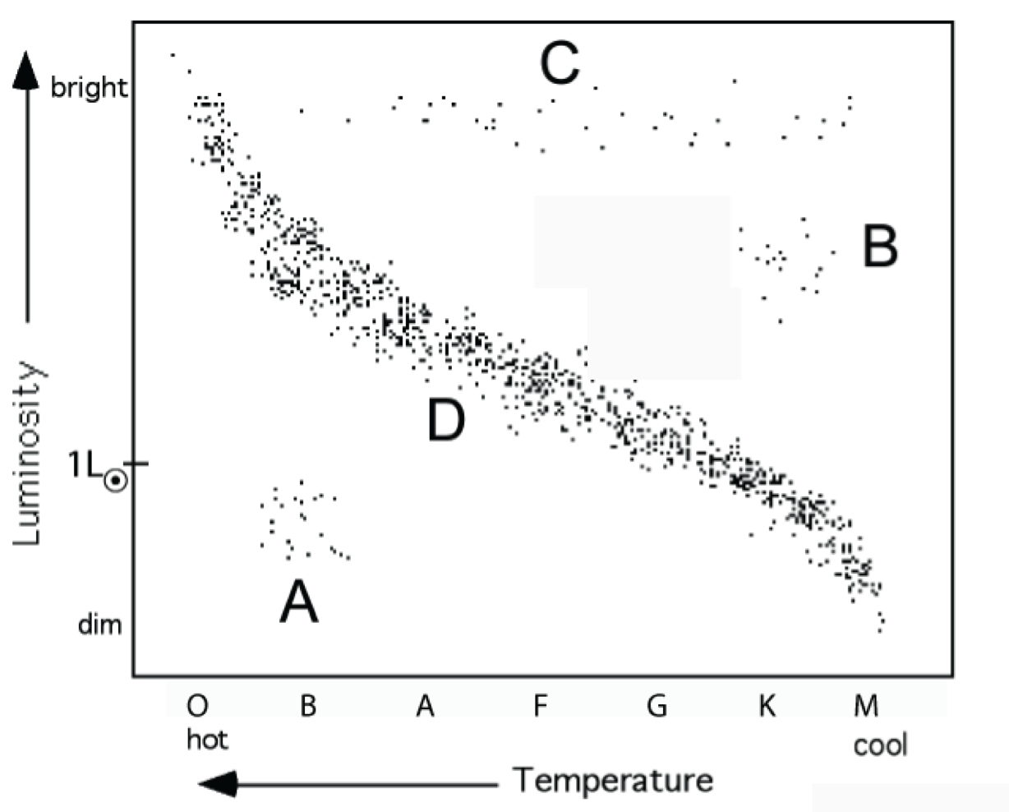
The HOTTER the Star, the Greater its ABSOLUTE BRIGHTNESS
There should be a one-to-one correlation between luminosity and temperature

Slide 69
This is what Hertzsprung and Russell the absolute brightness and plotted the luminosity of 3,000 stars versus temperature.
It is a similar procedure to putting a box of light bulbs all at the same distance to be able to compare them directly.

Slide 70
If you plot temperature against luminosity
Stars are classified on basis of TEMPERATURE and LUMINOSITY
exceptions
mostly a straight line
exceptions

Slide 71
The exceptions mean: Stars change with time.
➔ Stars evolve.
exceptions
mostly a straight line
exceptions

Slide 72
This is the Hertzsprung-Russell (HR) Diagram
Luminosity Classifications
Supergiants
Red Giants
(He fusion)
Main Sequence
(H fusion)
White
Dwarfs

Slide 73
SO! Every Star has a first name: Temperature Type
and a last name: Luminosity Class
Temperature Type Luminosity Class
O 0 – 9 hottest I Supergiant
B 0 – 9 III Red Giant
A 0 – 9 IV White Dwarf
F 0 – 9 V Main Sequence
G 0 – 9
K 0 – 9
M 0 – 9 coolest
for ex., our Sun is a G2 V star

Slide 74
Our Sun is a G2 Main Sequence star
Our Sun

Slide 75
QUESTION: Which is more luminous, a K0 main sequence star or a K0 red giant?

Slide 76
QUESTION: Which is more luminous, a K0 main sequence star or a K0 red giant?

Slide 77
QUESTION: Which is more luminous, a K0 main sequence star or a K0 red giant?

Slide 78
QUESTION: Which is more luminous, a K0 main sequence star or a K0 red giant?

Slide 79
ANSWER: the K0 red giant is more luminous.

Slide 80
Knowing distance lets us calculate the LUMINOSITY and the ABSOLUTE BRIGHTNESS
With LUMINOSITY we can calculate how bright a star would be if it were 10 parsecs from us
Why not stick with LUMINOSITY?

Slide 81
Knowing distance lets us calculate the LUMINOSITY and the ABSOLUTE BRIGHTNESS
Why not stick with LUMINOSITY?
Because we want to compare
ABSOLUTE BRIGHTNESS
with
APPARENT BRIGHTNESS
to get the distance from Earth to the star.

Slide 82
Knowing DISTANCE is key in astronomy.
Distance to stars tells us the structure and size of
our Milky Way Galaxy
and
our Local Group of galaxies,
and ultimately, the structure of the Universe.

Slide 83
Parallax was the first distance measurement
method observations range
Parallax 2 pictures 200 l-yrs

Slide 84
Using spectra with the HR diagram came next
method observations range
Parallax 2 pictures 200 l-yrs
spectrum 30,000 l-yrs
Spectroscopy
with HR diag.

Slide 85
Spectroscopy with HR diagram
use the spectrum to get the TEMPERATURE and the LUMINOSITY CLASS …..
absolute brightness

Slide 86
Spectroscopy with HR diagram
absolute brightness
and use the HR diagram to get the absolute brightness. Compare the absolute and apparent brightness, and then you can calculate the distance.

Slide 87
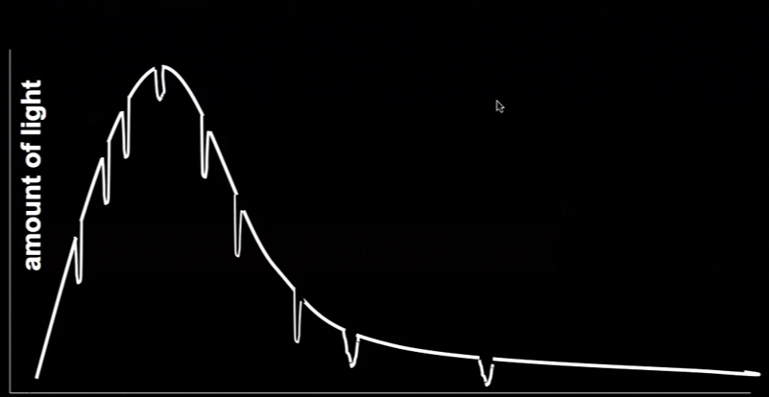
Spectroscopy with HR diagram
For example, consider this spectrum. You figure out that it tells you it is from an F3 supergiant star and you also measure its apparent brightness. Take the spectral information to the HR diagram….

Slide 88
Spectroscopy with HR diagram
absolute brightness
and use the HR diagram to get the absolute brightness. From this diagram and your measurement of the apparent brightness, you are ready to calculate the distance.

Slide 89
so your calculation would look like this:
distance = 10 pc x
from the HR diag
absolute brightness
apparent brightness
from what you measured

Slide 90
so your calculation would look like this:
distance = 10 pc x
absolute brightness
apparent brightness
if you calculate that the ratio of absolute to apparent brightness is 400, then the star is 200 parsecs away!
10 pc x 400 = 10 pc x 20 = 200 pc

Slide 91
Method of Cepheid Variables expanded our reach
method observations range
Parallax 2 pictures 200 l-yrs
spectrum 30,000 l-yrs
100,000,000 l-yrs
Spectroscopy
with HR diag.
Cepheid light curve

Slide 92
Cepheid Variables
— a type of pulsating Red Giant star
— their rate of pulsating is directly related to their absolute brightness
measure their pulsation rate, know their absolute brightness!

Slide 93
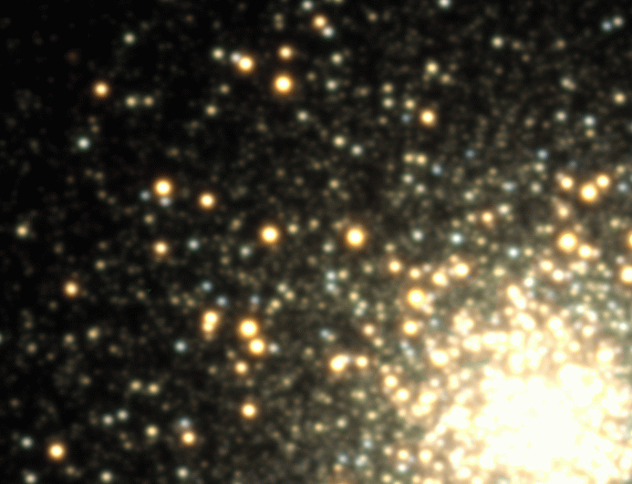
Cepheid Variables

Slide 94
Cepheid Variables
How do you measure their pulsation rate?
You measure how bright they are over time. This is called a LIGHT CURVE
apparent brightness
time (days)

Slide 95
Cepheid Variables
How do you measure their pulsation rate?
You measure how bright they are over time. This is called a LIGHT CURVE
apparent brightness
time (days)

Slide 96
Cepheid Variables
How do you measure their pulsation rate?
You measure how bright they are over time. This is called a LIGHT CURVE
apparent brightness
time (days)

Slide 97
Cepheid Variables
How do you measure their pulsation rate?
You measure how bright they are over time. This is called a LIGHT CURVE
apparent brightness
time (days)

Slide 98
Cepheid Variables
How do you measure their pulsation rate?
You measure how bright they are over time. This is called a LIGHT CURVE
apparent brightness
time (days)

Slide 99
Cepheid Variables
How do you measure their pulsation rate?
You measure how bright they are over time. This is called a LIGHT CURVE
apparent brightness
time (days)

Slide 100
Cepheid Variables
How do you measure their pulsation rate?
You measure how bright they are over time. This is called a LIGHT CURVE
apparent brightness
time (days)

Slide 101
Cepheid Variables
How do you measure their pulsation rate?
You measure how bright they are over time. This is called a LIGHT CURVE
apparent brightness
time (days)

Slide 102
Cepheid Variables
How do you measure their pulsation rate?
You measure how bright they are over time. This is called a LIGHT CURVE
apparent brightness
time (days)

Slide 103
Cepheid Variables
How do you measure their pulsation rate?
You measure how bright they are over time. This is called a LIGHT CURVE
apparent brightness
time (days)

Slide 104
Cepheid Variables
How do you measure their pulsation rate?
You measure how bright they are over time. This is called a LIGHT CURVE
apparent brightness
time (days)

Slide 105
Cepheid Variables
How do you measure their pulsation rate?
You measure how bright they are over time. This is called a LIGHT CURVE
apparent brightness
time (days)

Slide 106
Cepheid Variables
How do you measure their pulsation rate?
You measure how bright they are over time. This is called a LIGHT CURVE
apparent brightness
time (days)

Slide 107
Cepheid Variables
How do you measure their pulsation rate?
You measure how bright they are over time. This is called a LIGHT CURVE
apparent brightness
time (days)

Slide 108
Cepheid Variables
How do you measure their pulsation rate?
You measure how bright they are over time. This is called a LIGHT CURVE
apparent brightness
time (days)

Slide 109
Cepheid Variables
How do you measure their pulsation rate?
You measure how bright they are over time. This is called a LIGHT CURVE
apparent brightness
time (days)

Slide 110
Cepheid Variables
How do you measure their pulsation rate?
You measure how bright they are over time. This is called a LIGHT CURVE
apparent brightness
time (days)

Slide 111
Cepheid Variables
How do you measure their pulsation rate?
You measure how bright they are over time. This is called a LIGHT CURVE
apparent brightness
time (days)

Slide 112
Cepheid Variables
How do you measure their pulsation rate?
You measure how bright they are over time. This is called a LIGHT CURVE
apparent brightness
time (days)
40 140

Slide 113
Cepheid Variables
How do you measure their pulsation rate?
From the light curve, you measure the PERIOD
Period
apparent brightness
time (days)
40 140

Slide 114
Cepheid Variables
You take the measured period to the standard
Period–Luminosity Diagram and read off the ABSOLUTE BRIGHTNESS.
From the light curve, you measure the PERIOD
absolute brightness
Period (days)
40 60 80 100 120 140 160

Slide 115
Cepheid Variables
You take the measured period to the standard
Period–Luminosity Diagram and read off the ABSOLUTE BRIGHTNESS.
From the light curve, you measure the PERIOD
absolute brightness
Period (days)
40 60 80 100 120 140 160

Slide 116
so your calculation would look like this:
distance = 10 pc x
from the P-L diag
absolute brightness
apparent brightness
from what you measured

Slide 117
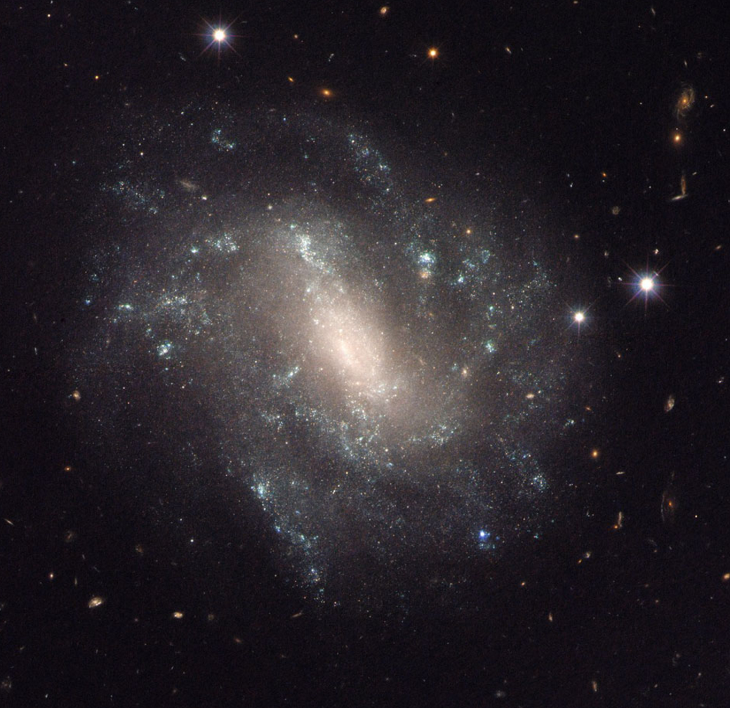
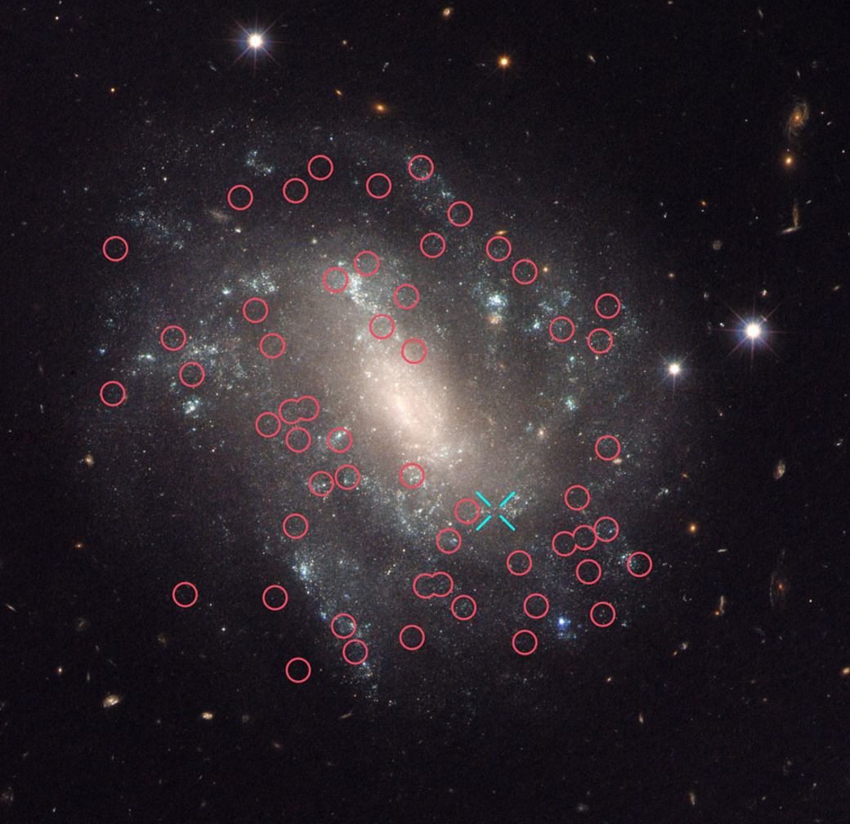
Cepheid Variables
Notes:
UGC 9391 is 130 million ly

