Slide 1

Nuclear Energy

Slide 2
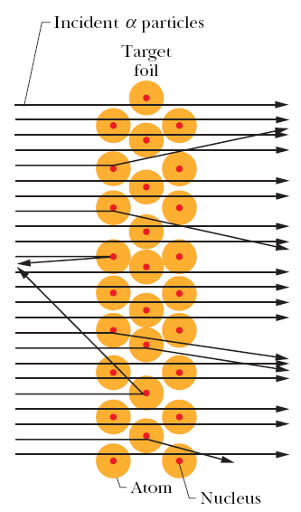
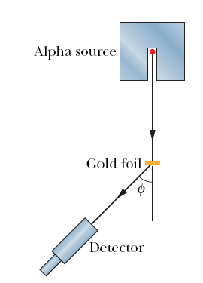
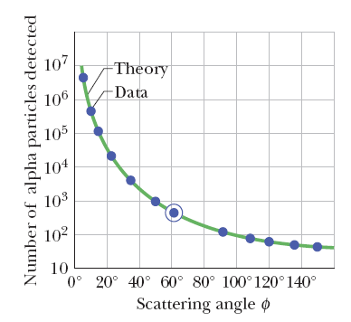
Discovery of the Nucleus
In 1911 Ernest Rutherford proposed that the positive charge of the atom is densely concentrated at the center of the atom, forming its nucleus, and that, furthermore, the nucleus is responsible for most of the mass of the atom.
Notes:
We see that most of the particles are scattered through rather small angles, but a very small fraction of them are scattered through very large angles, approaching 180°.
In Rutherford’s words: “It was quite the most incredible event that ever happened to me in my life. It was almost as incredible as if you had fired a 15-inch shell at a piece of tissue paper and it [the shell] came back and hit you.”
Rutherford saw that, to deflect the alpha particle backward, there must be a large force; this force could be provided if the positive charge, instead of being spread throughout the atom, were concentrated tightly at its center. Then the incoming alpha particle could get very close to the positive charge without penetrating it; such a close encounter would result in a large deflecting force.

Slide 3
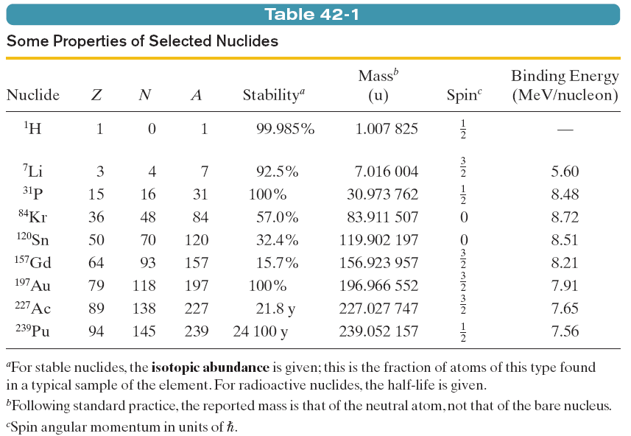
Some Nuclear Properties
Nuclei are made up of protons and neutrons. The number of protons in a nucleus is called the atomic number of the nucleus, and is represented by the symbol Z; the number of neutrons is the neutron number, and is represented by the symbol N.
The total number of neutrons and protons in a nucleus is called its mass number A. Neutrons and protons, when considered collectively, are called nucleons.

Slide 4
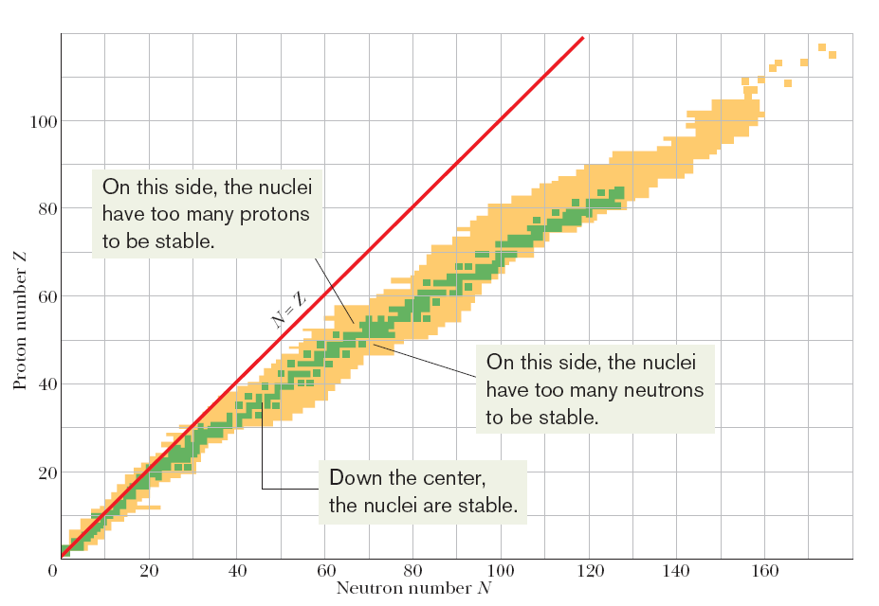
Some Nuclear Properties
Notes:
Nuclides with the same atomic number Z but different neutron numbers N are called isotopes of one another. The element gold has 32 isotopes, ranging from ¹⁷³Au to ²⁰⁴Au. Only one of them (¹⁹⁷Au) is stable; the remaining 31 are radioactive. Such radionuclides undergo decay (or disintegration) by emitting a particle and thereby transforming to a different nuclide.

Slide 5

Some Nuclear Properties
The nucleus, like the atom, is not a solid object with a well-defined surface.
Although most nuclides are spherical, some are notably ellipsoidal.
Electron-scattering experiments (as well as experiments of other kinds) allow us to assign to each nuclide an effective radius given by the equation to the right, where A is the mass number and r₀ =1.2 fm.
Notes:
The above equation does not apply to halo nuclides, which are neutron-rich. Nuclides, first produced in laboratories in the 1980s. These nuclides are larger than predicted by this equation, because some of the neutrons form a halo around a spherical core of the protons and the rest of the neutrons. Lithium isotopes are examples of this.

Slide 6

Some Nuclear Properties
Atomic masses are often reported in atomic mass units, a system in which the atomic mass of neutral ¹²C is defined to be exactly 12 u, where 1 u =1.660 538 86 × 10⁻²⁷ kg.
The mass number A of a nuclide gives such an approximate mass in atomic mass units. For example, the approximate mass of both the nucleus and the neutral atom for ¹⁹⁷Au is 197 u, which is close to the actual atomic mass of 196.966 552 u.
If the total mass of the participants in a nuclear reaction changes by an amount Δm, there is an energy release or absorption given by Q=mc².
The atom’s mass excess, Δ, is defined by the equation on the right.
Here, M is the actual mass of the atom in atomic units, and A is the mass number for that atom’s nucleus.

Slide 7
Example Problem
Using the table below determine the effective radius and mass excess for hydrogen (H), krypton (Kr), and silver (Au).
Remember that
For hydrogen:
r = (1.2 x 10⁻¹⁵)*(1)^{1/3} = 1.2 x 10⁻¹⁵
Δ = 1.007825-1 = 0.007825
For krypton:
r = (1.2 x 10⁻¹⁵)*(84)^{1/3} = 5.26 x 10⁻¹⁵
Δ = 83.911507-84 = -0.088493
For silver:
r = (1.2 x 10⁻¹⁵)*(197)^{1/3} = 6.98 x 10⁻¹⁵
Δ = 196.966552-197 = -0.033448

Slide 8
Example Problem
Using the table below determine the effective radius and mass excess for hydrogen (H), krypton (Kr), and silver (Au).
Remember that
For hydrogen:
r = (1.2 x 10⁻¹⁵)*(1)^{1/3} = 1.2 x 10⁻¹⁵
Δ = 1.007825-1 = 0.007825
For krypton:
r = (1.2 x 10⁻¹⁵)*(84)^{1/3} = 5.26 x 10⁻¹⁵
Δ = 83.911507-84 = -0.088493
For silver:
r = (1.2 x 10⁻¹⁵)*(197)^{1/3} = 6.98 x 10⁻¹⁵
Δ = 196.966552-197 = -0.033448

Slide 9
Example Problem
Using the table below determine the effective radius and mass excess for hydrogen (H), krypton (Kr), and gold (Au).
Remember that
For hydrogen:
r = (1.2 x 10⁻¹⁵)*(1)^{1/3} = 1.2 x 10⁻¹⁵
Δ = 1.007825-1 = 0.007825
For krypton:
r = (1.2 x 10⁻¹⁵)*(84)^{1/3} = 5.26 x 10⁻¹⁵
Δ = 83.911507-84 = -0.088493
For gold:
r = (1.2 x 10⁻¹⁵)*(197)^{1/3} = 6.98 x 10⁻¹⁵
Δ = 196.966552-197 = -0.033448

Slide 10

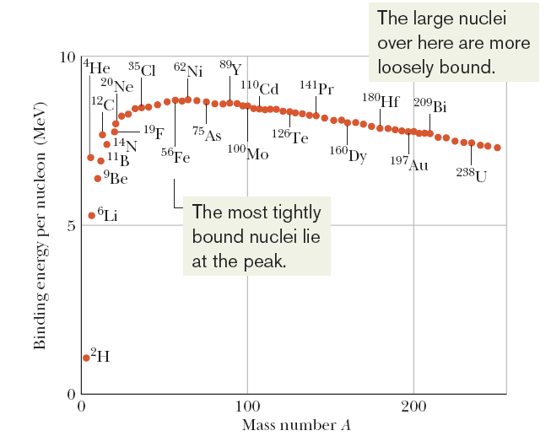
Nuclear Binding Energy
If the nucleus splits into two nuclei, the process is called fission, and occurs naturally with large high mass number nuclei.
If a pair of nuclei were to combine to form a single nucleus, the process is called fusion, and occurs naturally in stars.

Slide 11
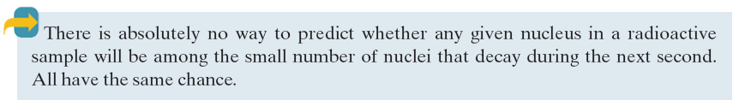


Radioactive Decay
The decay rate is defined as,
The half life-time (T_{1/2}) is the time at which both N and R have been reduced to one-half their initial values and λ is the decay energy.
Here τ is the mean life-time, which is the time at which both N and R have been reduced to e⁻¹ of their initial values.

Slide 12
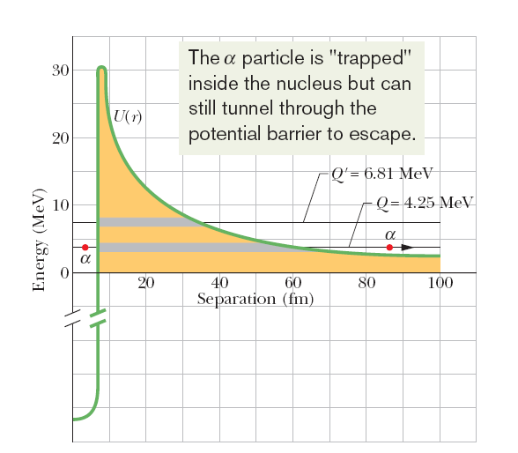

Alpha Decay
When a nucleus undergoes alpha decay, it transforms to a different nuclide by emitting an alpha particle (a helium nucleus, ⁴He). For example, when uranium ²³⁸U undergoes alpha decay, it transforms to thorium ²³⁴Th:
The disintegration energy, Q, for the decay above is 4.25.
The potential energy shown in the figure below is a combination of the potential energy associated with the (attractive) strong nuclear force that acts in the nuclear interior and a Coulomb potential associated with the (repulsive) electric force that acts between the two particles (²³⁴Th and ⁴He) before and after the decay has occurred.
Notes:
A potential energy function for the emission of an alpha particle by ²³⁸U. The horizontal black line marked Q =4.25 MeV shows the disintegration energy for the process. The thick gray portion of this line represents separations r that are classically forbidden to the alpha particle. The alpha particle is represented by a dot, both inside this potential energy barrier (at the left) and outside it (at the right), after the particle has tunneled through. The horizontal black line marked Q =6.81 MeV shows the disintegration energy for the alpha decay of ²²⁸U. (Both isotopes have the same potential energy function because they have the same nuclear charge.)

Slide 13
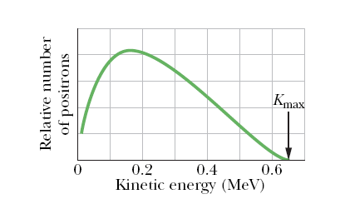
Beta Decay
A nucleus that decays spontaneously by emitting an electron or a positron (a positively charged particle with the mass of an electron) is said to undergo beta decay. Like alpha decay, this is a spontaneous process, with a definite disintegration energy and half-life.
Examples: (b⁻ decay)
(b⁺ decay)
Here, n is a neutrino, a neutral particle which has a very small mass, that is emitted from the nucleus along with the electron or positron during the decay process.
In a beta decay the energy of the emitted electrons or positrons may range from zero up to a certain maximum K_{max}, since, unlike the alpha decay, the Q energy is shared by two components.

Slide 14
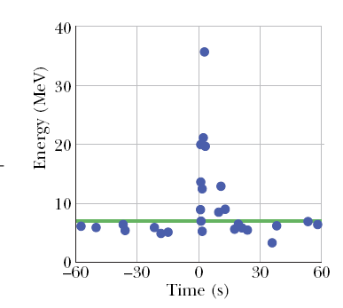
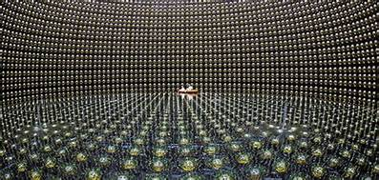
Beta Decay and the Neutrino
Wolfgang Pauli first suggested the existence of neutrinos in 1930.
Billions of them pass through our bodies every second, leaving no trace.
Despite their elusive character, neutrinos have been detected in the laboratory.

Slide 15
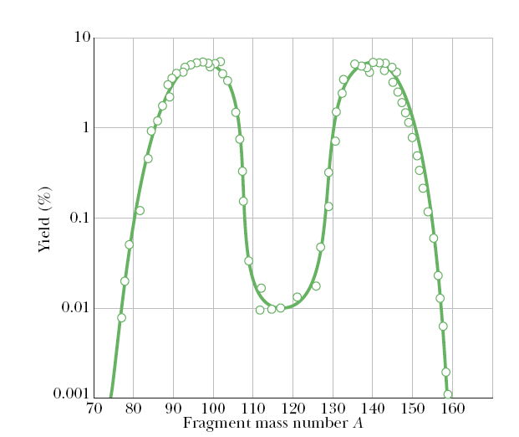
Nuclear Fission
The most probable mass numbers, occurring in about 7% of the fission events, are centered around A ~95 and A~140.

Slide 16


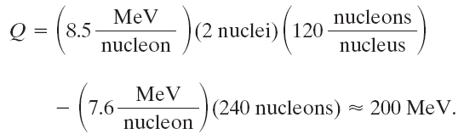
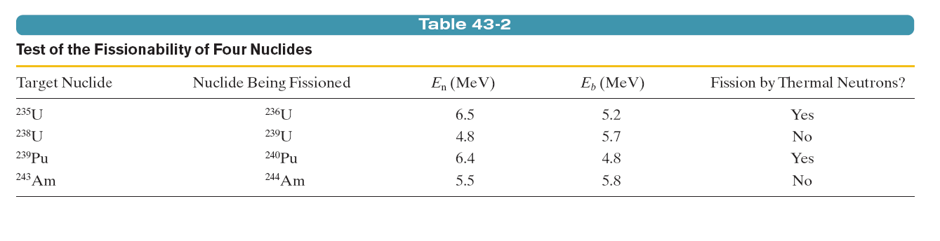
Nuclear Fission
The energy released by the fission, Q, is:
For a high-mass nuclide (A ~240), the binding energy per nucleon is about 7.6 MeV/nucleon. For middle-mass nuclides (A~120), it is about 8.5 MeV/nucleon. Thus, the energy released by fission of a high-mass nuclide to two middle-mass nuclides is
Notes:
For four high-mass nuclides, this test of whether capture of a thermal neutron can cause fissioning. For each nuclide, the table shows both the barrier height E_{b} of the nucleus that is formed by the neutron capture and the excitation energy E_{n} due to the capture.

Slide 17
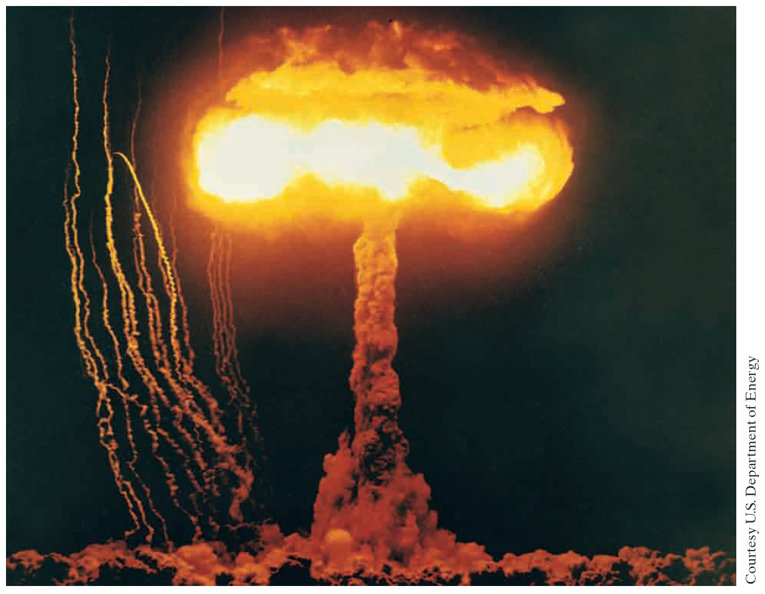
Notes:
This image has transfixed the world since World War II. When Robert Oppenheimer, the head of the scientific team that developed the atomic bomb, witnessed the first atomic explosion, he quoted from a sacred Hindu text: “Now I am become Death, the destroyer of worlds.”

Slide 18
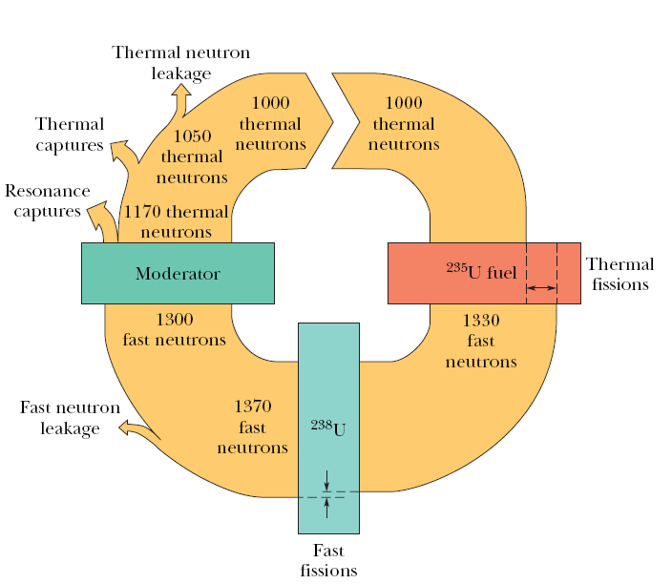
Nuclear Reactors
Three main difficulties stand in the way of a working reactor:
The Neutron Leakage Problem: Some neutrons produced by fission leak out from the reactor.
The Neutron Energy Problem: Fast neutrons are not as effective in producing fission as slower thermal neutrons.
The Neutron Capture Problem: Non-fission capture of neutrons

Slide 19
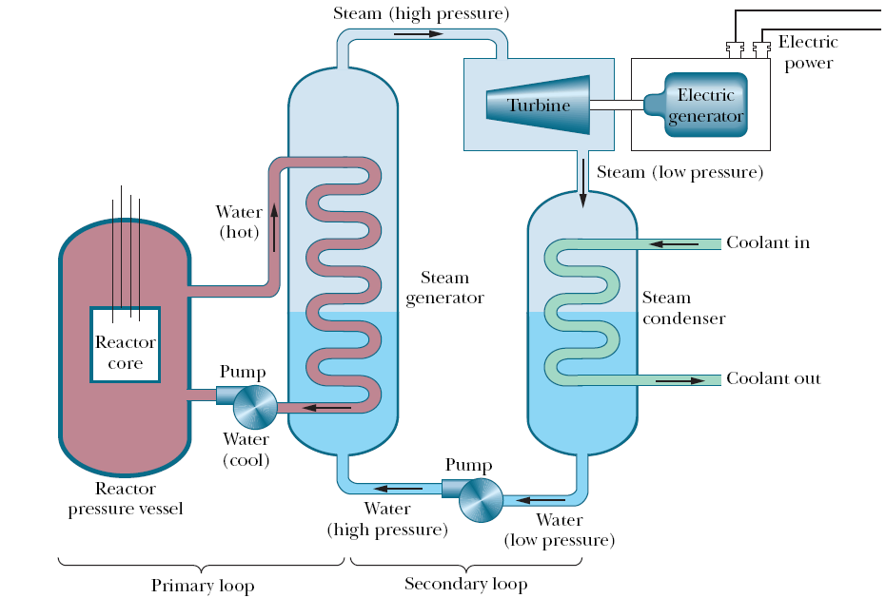
Nuclear Reactors
Notes:
Some two billion years ago, in a uranium deposit recently mined in Gabon, West Africa, a natural fission reactor apparently went into operation and ran for perhaps several hundred thousand years before shutting down.
Both ²³⁵U and ²³⁸U are radioactive, with half-lives of 7.04 x10⁸ y and 44.7 x10⁸ y, respectively. Thus, the half-life of the readily fissionable ²³⁵U is about 6.4 times shorter than that of ²³⁸U. Because ²³⁵U decays faster, there was more of it, relative to ²³⁸U, in the past.
Two billion years ago, in fact, this abundance of ²³⁵U was not 0.72%, as it is now, but 3.8%. This abundance happens to be just about the abundance to which natural uranium is artificially enriched to serve as fuel in modern power reactors.
Of the 30 or so elements whose stable isotopes are produced in a reactor, some must still remain. Study of their isotopic abundances could provide the evidence we need. Of the several elements investigated, the case of neodymium is spectacularly convincing. The next figure explains this fact.

Slide 20
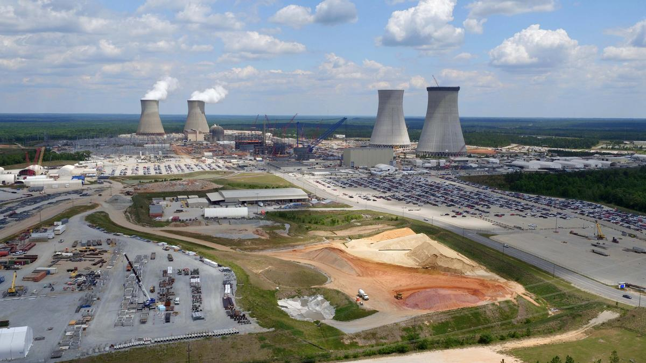
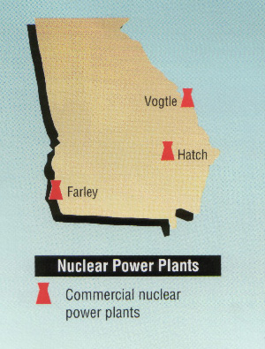
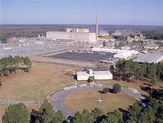
Nuclear Reactors

Slide 21


Nuclear Fusion
For controlled terrestrial use one could consider two deuteron–deuteron (d-d), and one deuteron-tritium reactions:
Three requirements for a successful thermonuclear reactor can be considered:
High Particle Density
High Plasma Temperature
Long Confinement Time
For the successful operation of a thermonuclear reactor using the d-t reaction, it is necessary to have Lawson’s Criterion:

Slide 22
Nuclear Fusion
Magnetic Confinement
  A suitably shaped magnetic field is used to confine the hot plasma in an evacuated doughnut-shaped chamber called a tokomak. The magnetic forces acting on the charged particles that make up the hot plasma keep the plasma from touching the walls of the chamber.
  The plasma is heated by inducing a current in it and by bombarding it with an externally accelerated beam of particles. The first goal of this approach is to achieve breakeven, which occurs when the Lawson criterion is met or exceeded.
  The ultimate goal is ignition, which corresponds to a self-sustaining thermonuclear reaction and a net generation of energy.
Inertial Confinement
  A second approach, involves “zapping” a solid fuel pellet from all sides with intense laser beams, evaporating some material from the surface of the pellet. This boiled-off material causes an inward-moving shock wave that compresses the core of the pellet, increasing both its particle density and its temperature. The fuel is confined to the pellet and the particles do not escape from the heated pellet during the very short zapping interval because of their inertia .
  Laser fusion, using the inertial confinement approach, is being investigated in many laboratories in the United States and elsewhere.

Slide 23
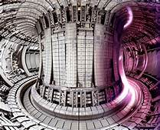
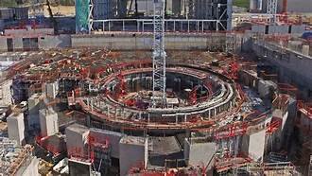
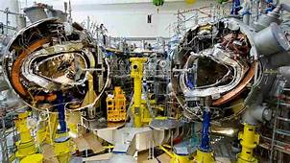
Tokomaks
Notes:
Top left JET in Japan
Top right ITER in Europe
Bottom Fusion reactor in Germany

