Slide 1
Subliminal teaching:
An interactive workshop for classroom activities
Dr. Henry Jordan and Ms. Kiiva Copeland
DeVry University and Valdosta State University
TIES Conference - Valdosta States University
Valdosta, Georgia
February 18, 2016

Slide 2
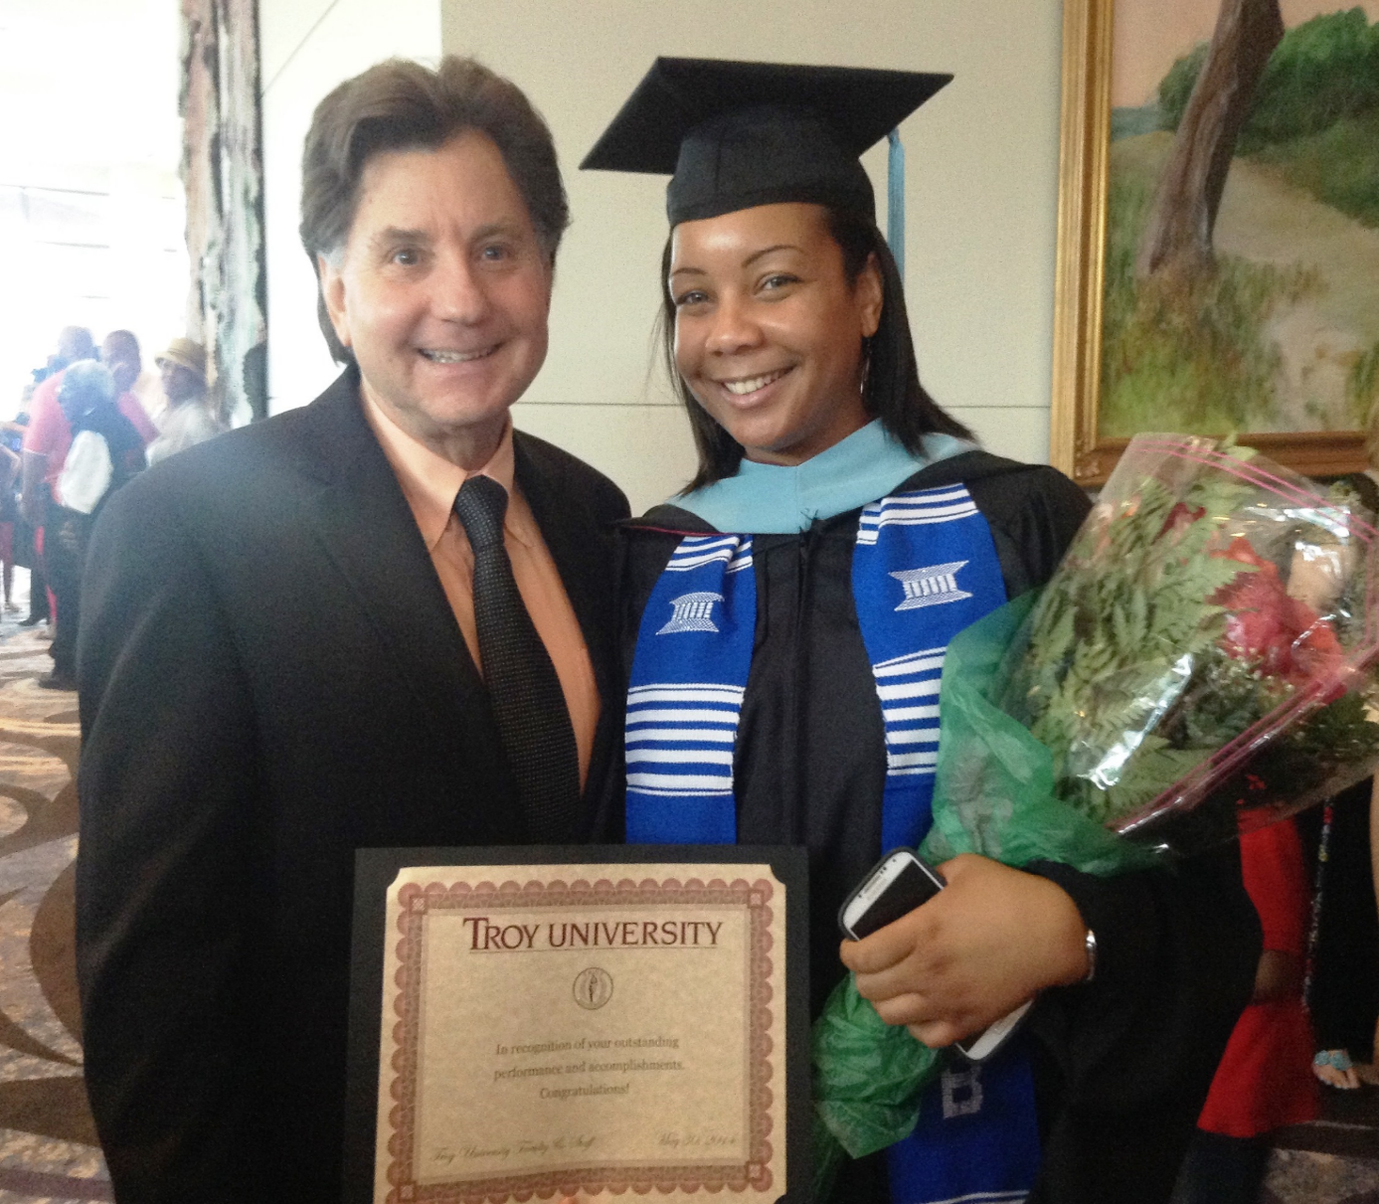
Dr. Henry Jordan and Ms. Kiiva Copeland

Slide 3
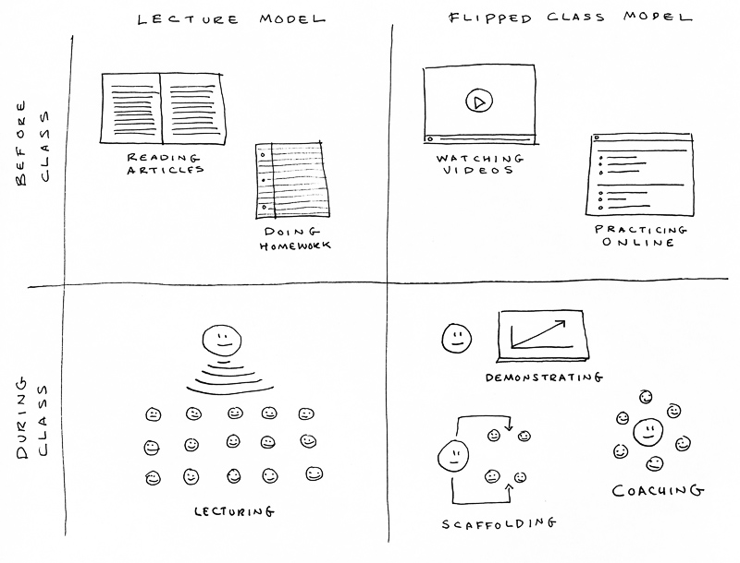
Traditional Lecture Model vs the Flipped Classroom
http://blogs.stern.nyu.edu/learnED/?p=102

Slide 4
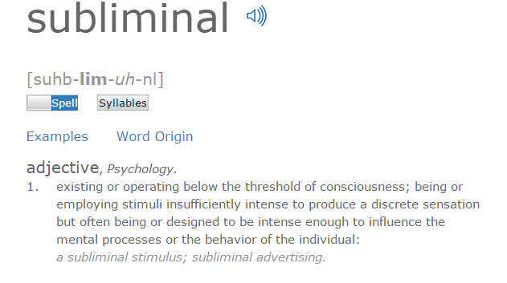

Slide 5
Exploring the Meaning of Cancer
in the Lives of Higher Education Teachers
Colorado State University
  “Higher education teachers who have survived cancer through that experience consciously or unconsciously alter their philosophy of teaching and its implementation.”

Slide 6
Our Experiential Learning Model
Apply
Reflect
Do
Adapted from David Kolb’s “Experiential Learning”, 1984.

Slide 7
“Making the material you are teaching stimulating and interesting is a priority of good teaching” (Fry, Ketteridge, & Marshall, 1999, p.33).
“We have to understand the significance of what we see, hear, and touch. This significance consists of the consequences that will result when what is seen is acted upon” (Dewey, 1938, p. 68).
“Novelty kicks us out of our regular routine and into a new awareness of details” (Baker & White-McMahon, 2013, p. 62).
“If there is one common aim for most college teaching, it is to get students to think” (Eble, 1988, p. 28).

Slide 8
“Novelty is the brain’s friend” – Dr. Henry Jordan
Meet Jamie, the tuxedo C.A.T.
Make a list of skills employers want from their employees.
Use the word CAT as your acronym.

Slide 9
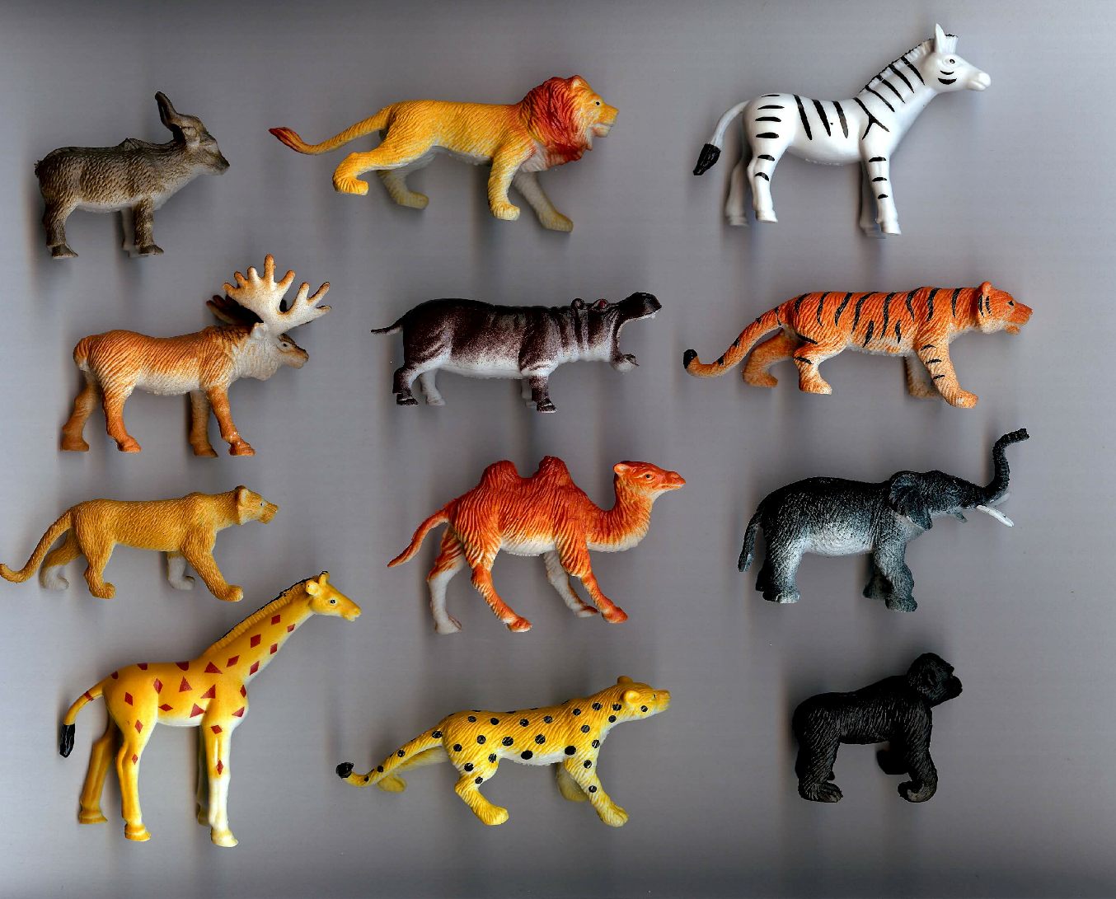
Subliminal Activities
“Animals at Work”

Slide 10
What did you learn?
“I see and I forget. I hear and I remember. I do and I understand.”
~Confucius

Slide 11
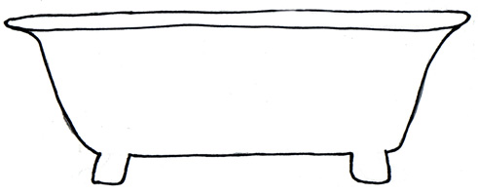
Subliminal Activities
“Bathtub Financials”
<a href="http://cliparts.co">Image source</a>

Slide 12
What did you learn?
“I see and I forget. I hear and I remember. I do and I understand.”
~Confucius

Slide 13
Our Experiential Learning Model
Apply
Reflect
Do
Adapted from David Kolb’s “Experiential Learning”, 1984.

Slide 14
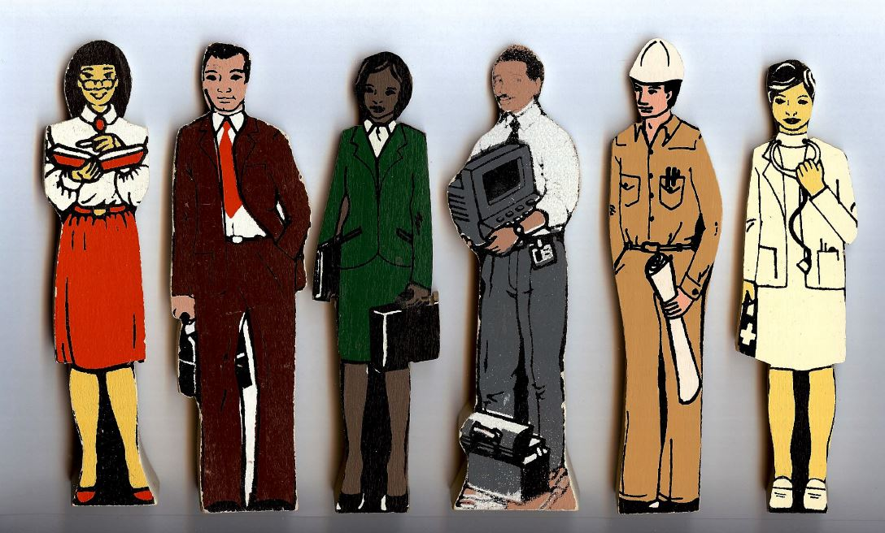
Your turn!
Meet the “Career People”!

Slide 15
What did you learn?
“I see and I forget. I hear and I remember. I do and I understand.”
~Confucius

Slide 16
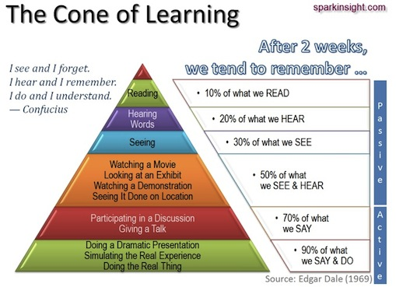

Slide 17
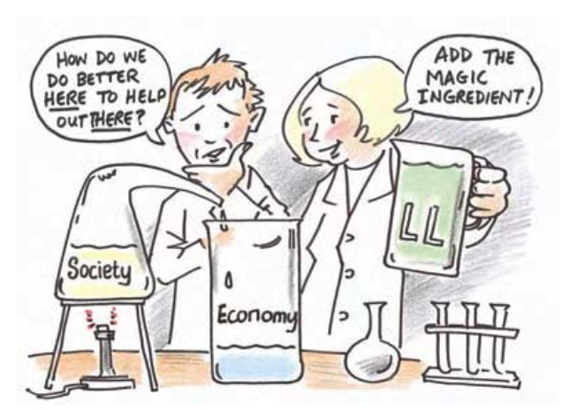
Henry Jordan, HJordan@devry.edu & Kiiva Copeland, KCopeland@Valdosta.edu

Slide 18
References
Baker, P. W., and White-McMahon, M. (2013). The hopeful brain: NeuroRelational repair for disconnected children and youth. Lulu Publishing.
Dewey, J. (1938). Experience and education. New York, Collier Books.
Eble, K. E. (1988). The craft of teaching: A guide to mastering the professor’s art. San Francisco, CA., Jossey-Bass.
Fry, H., Ketteridge, S., and Marshall, S. (1999). A handbook for teaching and learning in higher education. London, Kogan Page Limited.
Kolb, D. (1984). Experiential learning. Englewoods Cliff, NJ., Prentice-Hall.
Subliminal. (n.d.). Dictionary.com Unabridged. Retrieved January 26, 2016 from Dictionary.com websitehttp://dictionary.reference.com/browse/subliminal

Slide 19
